Slide 1


ADS1299
Fully low power integrated analog front end for ECG applications
Chen Jian
2019.4.24

Slide 2

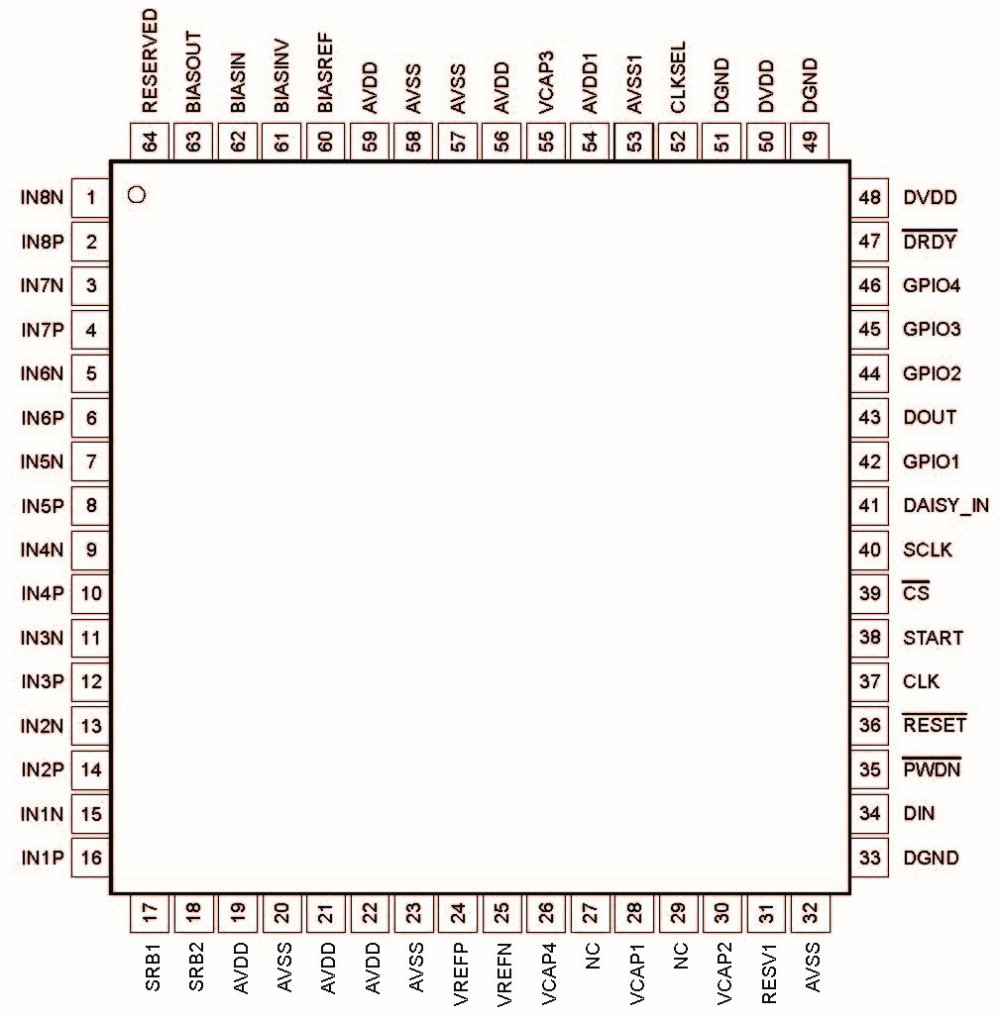
The main content
01
02
Functional Block Diagram
Feature Description
03
04
Device Functional Modes
Register

Slide 3

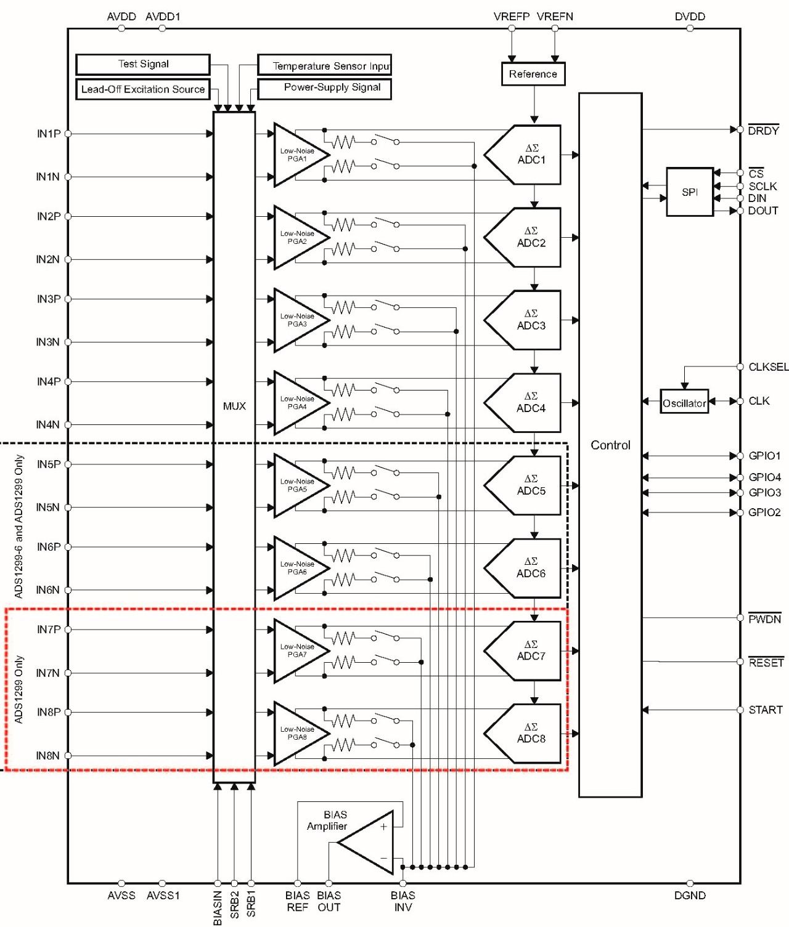
Functional Block Diagram

Slide 4

Feature Description
01
Analog Functionality
Input Multiplex
Analog Input
PGA Settings
02
Digital Functionality
Digital Decimation Filter
Clock
GPIO
03
ECG and EEG Specific Features
Input Multiplexer
Lead-Off Detection
Bias Lead-Off
Bias Drive(DC Bias Circuit)

Slide 5


Device Functional Modes
1
4
Start
Data Retrieval
2
Reset
5
Continuous Conversion Mode
3
Power-Down
6
Single-Shot Mode

Slide 6
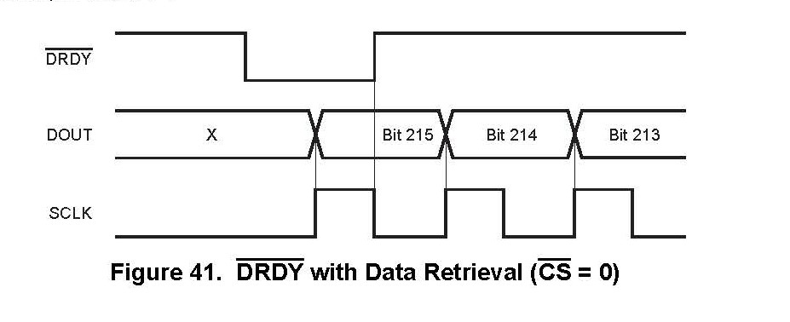
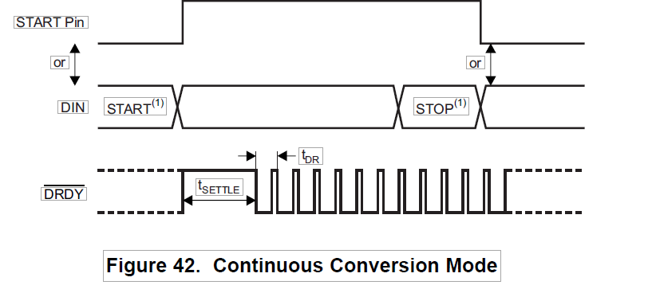
Sequence diagram
Data Ready
Continuous Conversion Mode

Slide 7
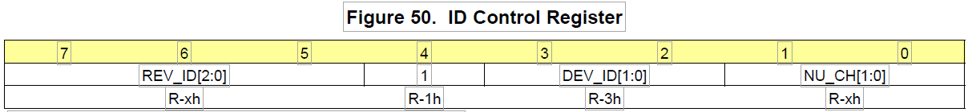
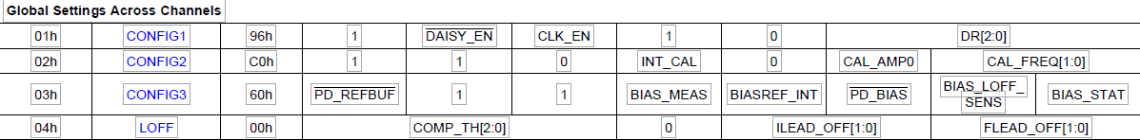
Register
Read Only ID Registers
添加文本
添加文本
Global Settings Across Channels

Slide 8
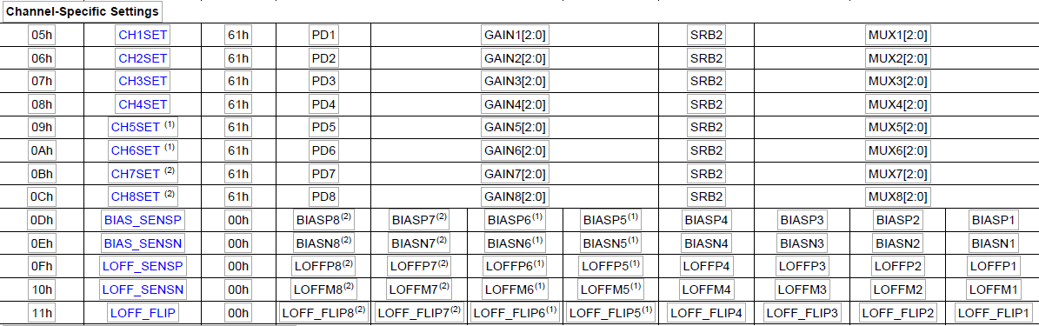
Register
Channel-Specific Settings

Slide 9
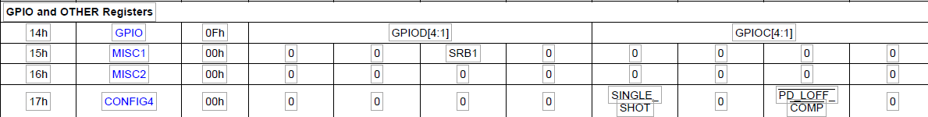
Register
Lead-Off Status Registers (Read-Only Registers)
GPIO and OTHER Registers

Slide 10
Thanks

