Slide 1
Extinction Archive: Umwelt Hypothesis Dossiers
A biodigital memorial where extinction is experienced as rhythm, multisensory reminiscence, and consequence — with cognitive limits and uncertainty kept visible.
AI memorial for lost species · Sensory time capsule
circadian · migration · synchrony · multisensory memory
Biodesign Challenge 2026 · Convergent Life
Digital Art & AI Technology — MDes
Literature-grounded memorial · biodigital experience · memory reshaping Macau University · Mentor: Atticus SIMS · GUO XIAO YUE (MC569254) · LIU JIA QUN (MC569293)
Extinction Archive: Umwelt Hypothesis Dossiers · Biodigital chronobiology · BDC 2026 1 / 12

Slide 2
WHY THIS PROJECT NOW
Extinction removes more than bodies.
It erases migration pulses, social synchrony, and seasonal fit to landscape.
Public memory often normalizes ecological absence after enough time passes.
This project asks how constrained computation can make loss legible without pretending we fully know another species' Umwelt.
FRAMING QUESTION
How can an archive make extinction felt as both biological disappearance and cultural amnesia?
Extinction Archive · Biodigital chronobiology · BDC 2026 2 / 12

Slide 3
DESIGN PROPOSITION
Umwelt as memory technology
Primary frame: bounded sensory-temporal hypothesis space.
Secondary frame: collective memory fracture and ethical remembrance.
Visitors move through Memory Sites, Species Dossier, Polyphony Mixer, and Ethics Console.
The archive is not resurrection; uncertainty remains visible at every stage.
TONE
Museum sobriety overall. Awe appears briefly, mainly inside the mixer.
Extinction Archive · Biodigital chronobiology · BDC 2026 3 / 12

Slide 4
CORE ARCHITECTURE
Memory reshaping (foreground): multisensory reminiscence retrains attention on extinct Umwelten; guardrails address collective cognitive impairment, flattening, and misremembering. Three load-bearing modules
Species Dossier
Polyphony Mixer
Ethics Console
Evidence cards · epistemic tiers
Temporal niche · diel / seasonal anchors
Sensory proxies · multisensory reminiscence paths
Extinction mechanism · colonial + ecological chronologies
360° constrained scene
Seasonal layers
Diel rhythm
Density and synchrony
Audible coexistence
Collapse as retuning
Evidence sorting
Forced tradeoffs
Rule-based outcomes
Sonic finale shifts
Action over nostalgia Mixer + Console: reminiscence without false certainty
Extinction Archive · Biodigital chronobiology · BDC 2026 4 / 12

Slide 5
HERO SPECIES
Memory reshaping through paired hero dossiers Mammoth + thylacine dossiers (two deep case studies)
Woolly mammoth — seasonal Umwelt for slow, somatic reminiscence
Thylacine (Tasmanian tiger)
Memory sites MVP
Tusk isotope trails
Arctic photoperiod
Comparative genomics
Ground-level pacing
Slow seasonal time
Orbit / diel activity (Pozniak 2018)
POV metaphor via RGC models (Mass & Supin 2020, Interpolated)
Colonial extinction history (Paddle; Sleightholme & Campbell)
Palawa / Country framing (Rimmer; Lehman; Clements; Schlunke)
Ethics Console + reflection log — cognition-friendly branching
2-5 curated pins
Last ranges and dates
Single-species deep links
No global atlas in MVP
Extinction Archive · Biodigital chronobiology · BDC 2026 5 / 12

Slide 6
BIOLOGICAL LAYER
Only traceable evidence enters the archive
Migration isotopes, morphology as sensory proxy, comparative genomics, historical range data, and acoustic ecology of relatives.
Smell cues remain metaphorical or synesthetic only and are always labeled Speculative.
Every strong line in the UI is tagged: Cited, Modeled, or Speculative.
RULE
If the biology can be removed and the piece still works, the project has failed its biodigital test.
Extinction Archive · Biodigital chronobiology · BDC 2026 6 / 12

Slide 7
DIGITAL LAYER
Expressive, but never unconstrained
Primary image strategy: diffusion plus structural conditioning.
Support layer: procedural shaders for light, fog, atmosphere, and temporal credibility.
A-Frame-first WebXR with desktop fallback and mobile WebAR entry points.
Web Audio DSP ties season, density, and time-of-day to the sonic field.
R and ggplot provide auditable scientific visuals for dossiers and appendix slides.
TOOLING
A-Frame first, Three.js as needed inside the same XR ecosystem.
Extinction Archive · Biodigital chronobiology · BDC 2026 7 / 12

Slide 8
PHYSICAL CONTRAST
Minimal physical anchor + WebXR entry (Summit build)
3D-printed focal object anchors the body of the extinct species in gallery space.
Mobile WebAR opens dossier content from the physical object.
Safe tactile materials symbolize tundra and steppe without claiming literal reconstruction.
Plants plus soil moisture, light, and temperature sensors drive one live audio bus.
INSTALLATION LABEL
Not a simulation of extinct habitat — an index of evidence, uncertainty, and responsibility.
Extinction Archive · Biodigital chronobiology · BDC 2026 8 / 12

Slide 9
ETHICS AND REFLECTION
Reflection is part of the interface
Digital resurrection is kept distinct from laboratory de-extinction discourse.
Visitors face choices around conservation resources, land-use pressure, and moral hazard.
AI-generated confidence is actively countered through tier labels, provenance, and rule-based consequences.
The project avoids speaking for communities it has not collaborated with.
DESIRED EFFECT
Move from grief to responsibility, not from grief to spectacle.
Extinction Archive · Biodigital chronobiology · BDC 2026 9 / 12

Slide 10
BDC ALIGNMENT
Why this fits Biodesign Challenge 2026
Narrative: a clear emotional and spatial journey supported by physical and digital prototypes.
Concept: Umwelt plus temporal niche plus collective memory creates a distinct biodigital proposition.
Context: biodiversity loss, de-extinction ethics, misinformation risk, and sustainable installation logic.
Reflection: transparent iteration, limits, evidence tiers, and expert-reviewable claims.
PRIZE TARGET
Primary target: BDC Prize for Biodigital Excellence.
Extinction Archive · Biodigital chronobiology · BDC 2026 10 / 12

Slide 11
1-MONTH VERTICAL SLICE
Build the hero demo first — memory reshaping in the loop
Lock evidence cards, dossier fields, multisensory reminiscence beats, memory sites, ethics branches, plain-language / cognitive-access patterns, consultant outreach.
PARALLEL RULE
Week 1
The film track starts after Week 2 and must not block the core interaction milestone. Parallel rule (memory): remix and polyphony remain legible under fatigue — no sentimental erasure of uncertainty.
Week 2
Ship a mammoth vertical slice: dossier, polyphonic mixer reminiscence layers, WebXR scene, film-track kickoff.
Week 3
Integrate thylacine dossier, Indigenous context UI, ethics fork (Sherkow & Greely), reflection log, WebXR polish — rehearse multisensory pacing + confusion testing.
Week 4
Polish, rehearse, finish trailer, finalize appendix citations, harden demo fallback, validate reminiscence overload safeguards.
Extinction Archive · Biodigital chronobiology · BDC 2026 11 / 12

Slide 12
DELIVERABLES MAP
What the final package includes
English planning document ready for the repo.
Editable PowerPoint deck in project theme.
GitHub slide README with Office preview link and PDF preview link.
A methods appendix culture: citations and limits developed in parallel, not at the end.
CLOSING QUESTION
What should responsibility sound like after a species has already disappeared?
Extinction Archive · Biodigital chronobiology · BDC 2026 12 / 12

Slide 13
Part II — Summit appendix (English)
Selected slides from BDC_Summit_Extinction_Archive_2026: citations, scene IDs, rubric, methods.
Part I (previous slides) follows the BDC_Extinction_Archive_EN layout and narrative spine.

Slide 14
Extinction Archive: Umwelt Hypothesis Dossiers
AI memorial for lost species · sensory time capsule
Biodesign Challenge 2026 · “Convergent Life”
Macau University

Slide 15
Team & institution
Institution: Macau University
Mentor: Atticus SIMS
Team: GUO XIAO YUE — ID MC569254
Team: LIU JIA QUN — ID MC569293
Program: MDes — Digital Art & AI Technology.

Slide 16
Why this title?
“Umwelt Hypothesis Dossiers” = each species as a **folder of testable claims** (genes, orbits, climate), not a fantasy safari.
“AI memorial” = generative media **constrained** by literature — grief and wonder without faking science.
“Sensory time capsule” = we reconstruct **when** they lived (phase, season), not only **what** they looked like.

Slide 17
Core design question
“If we use **generative AI + WebXR** to **reconstruct** a **temporal phenotype**, can we repair the human gap in **sensing extinction**?”
Palaeo-chronobiology + morphology (orbit, clock pathways, TRPV3…) = evidence ladder.
Umwelt = sensory world as **hypothesis**, disclosed layer-by-layer.

Slide 18
Bio × digital quadrants (our mapping)
**SENSE / VISUALIZE:** photoperiod sliders, orbit-informed POV filters, habitat maps from Zimov et al.
**OPTIMIZE:** prompt + data rules so generative landscapes respect paleo proxies.
**SIMULATE:** phase / sonification of “a species day” — rhythmic, not decorative.
Red-flag: if biology OR code is removed and the piece still “works,” we failed the biodigital brief.

Slide 19
Creative concept — two dossiers only
**Woolly mammoth:** Arctic circadian genomics (Lynch 2015), reindeer analogy (Lu 2010), mammoth steppe (Zimov 2012), TRPV3 cold (Lynch; Kim preprint optional).
**Thylacine:** skull / diel activity (Pozniak 2018), RGC metaphor (Mass & Supin 2020), history (Paddle; Sleightholme), sovereignty (Clements + Palawa-led Rimmer, Lehman; Schlunke).
Journey: discover rhythm → epistemic layers → ethics sliders → reflection log (HTML template in repo).

Slide 20
Scene IDs → citations
Mammoth path
Scene_Bio_01 — Lynch (circadian-related genes)
Scene_Environment_02 — Lu [Interpolated]
Scene_Landscape_01 — Zimov
Scene_Sensory_01 — TRPV3 / cold
Thylacine path
Scene_Bio_02 — Pozniak / orbit
Scene_POV_01 — Mass & Supin [Interpolated]
Scene_Context_01 — Paddle + Sleightholme
UI_Indigenous_Context → UI_Ethics_Fork → UI_Reflection_Log

Slide 21
Design techniques & stack
**WebXR:** A-Frame / Three.js; browser-based Summit demo.
**Generative AI:** 360° / environment art **bounded** by citation-backed parameters (no silent photoreal “truth”).
**Epistemic UI:** toggles for Cited / Interpolated / Speculative; on-screen (Author, year) tags.
**Sonification (optional):** tie audio to phase / season from literature.
**Reflection:** `templates/reflection-log-webxr.html` — keyword → ethics cards (Sherkow & Greely themes).

Slide 22
Ideation method (8 steps)
1 Map interests & skills · 2 Intersection statements (“code × bio × problem”)
3 Stress-test vs BDC rubric (Narrative, Concept, Context, Reflection)
4 Biology sprint per species (30–45 min lit passes)
5 Bio / digital split + red-flag test
6 200-word narrative (Problem → Insight → Solution → Impact)
7 Prototype + deliverable owners · 8 Build sprint: Discovery → Prototype → Integration → Polish
Guided by `biodesign_cursor_agent.md` + course workbook.

Slide 23
Four-week production spine
W1 Discovery — literature grid, storyboard ↔ DOI table, WebXR shell.
W2 Prototype — time scrubber, generative constraint doc, epistemic toggles.
W3 Integration — sonification, Indigenous + ethics UI, reflection panel.
W4 Polish — 10′ talk, 5′ Q&A drill, 1–5′ video, deploy, judge cheat sheet.

Slide 24
Context — colonial violence & Country
Thylacine loss tied to colonial harm to Palawa peoples and lutruwita (Tasmania).
Sources: Clements (2025); Schlunke (2025) poetry / Palawa names; **Palawa-led** Rimmer (2020), Lehman (2013).
UI protocol: author positionality; no tourism copy as TEK.

Slide 25
Ethics layer — Sherkow & Greely (2013)
Sliders: lab de-extinction vs **in situ** conservation funding.
Legal novelty of revived lineages → liability / ecosystem risk.
Grounded in Science DOI 10.1126/science.1236946 — not generic sci-fi branches.

Slide 26
Key literature — Mammoth (DOIs)
M1 Lynch et al., 2015 — 10.1016/j.celrep.2015.06.027
M2 Lu et al., 2010 — 10.1016/j.cub.2010.01.042
M3 Zimov et al., 2012 — 10.1016/j.quascirev.2012.08.004
M4 Kim bioRxiv — 10.1101/151746 (TRPV3 structure; phenotype cite Lynch 2015)
M5 Sherkow & Greely — 10.1126/science.1236946

Slide 27
Key literature — Thylacine & sovereignty
T1 Pozniak 2018 — 10.1002/ar.23910
T2 Mass & Supin 2020 — 10.31857/S0002332920060107
T3 Paddle 2000 — ISBN 9780521782196
T4 Sleightholme & Campbell 2016 — 10.1080/00222933.2016.1217037
T5 Clements 2025 — 10.1177/13534858251272203
Schlunke 2025 — 10.1017/ext.2025.10008 · Rimmer 2020 Artlink · Lehman 2013 Griffith Review

Slide 28
Rubric self-check
Narrative: rhythm → loss → fork.
Concept: **time** as spine; one proxy per scene.
Context: trade-offs + sovereignty sources.
Reflection: epistemic UI + user reflection + AI limits.

Slide 29
Repository pointers
Canonical plan: BDC_2026_Extinction_Archive_Planning_Document.md
Executive: PROJECT_PLAN.md · Reflection template: templates/reflection-log-webxr.html
GitHub preview this talk: slides/SUMMIT_DECK_GITHUB_PREVIEW.md (this file is auto-generated).

Slide 30
Part III — Visual deck (BDC_Deck_EN)
Full-bleed slide graphics from BDC_Deck_EN.pptx (image export pipeline).

Slide 31
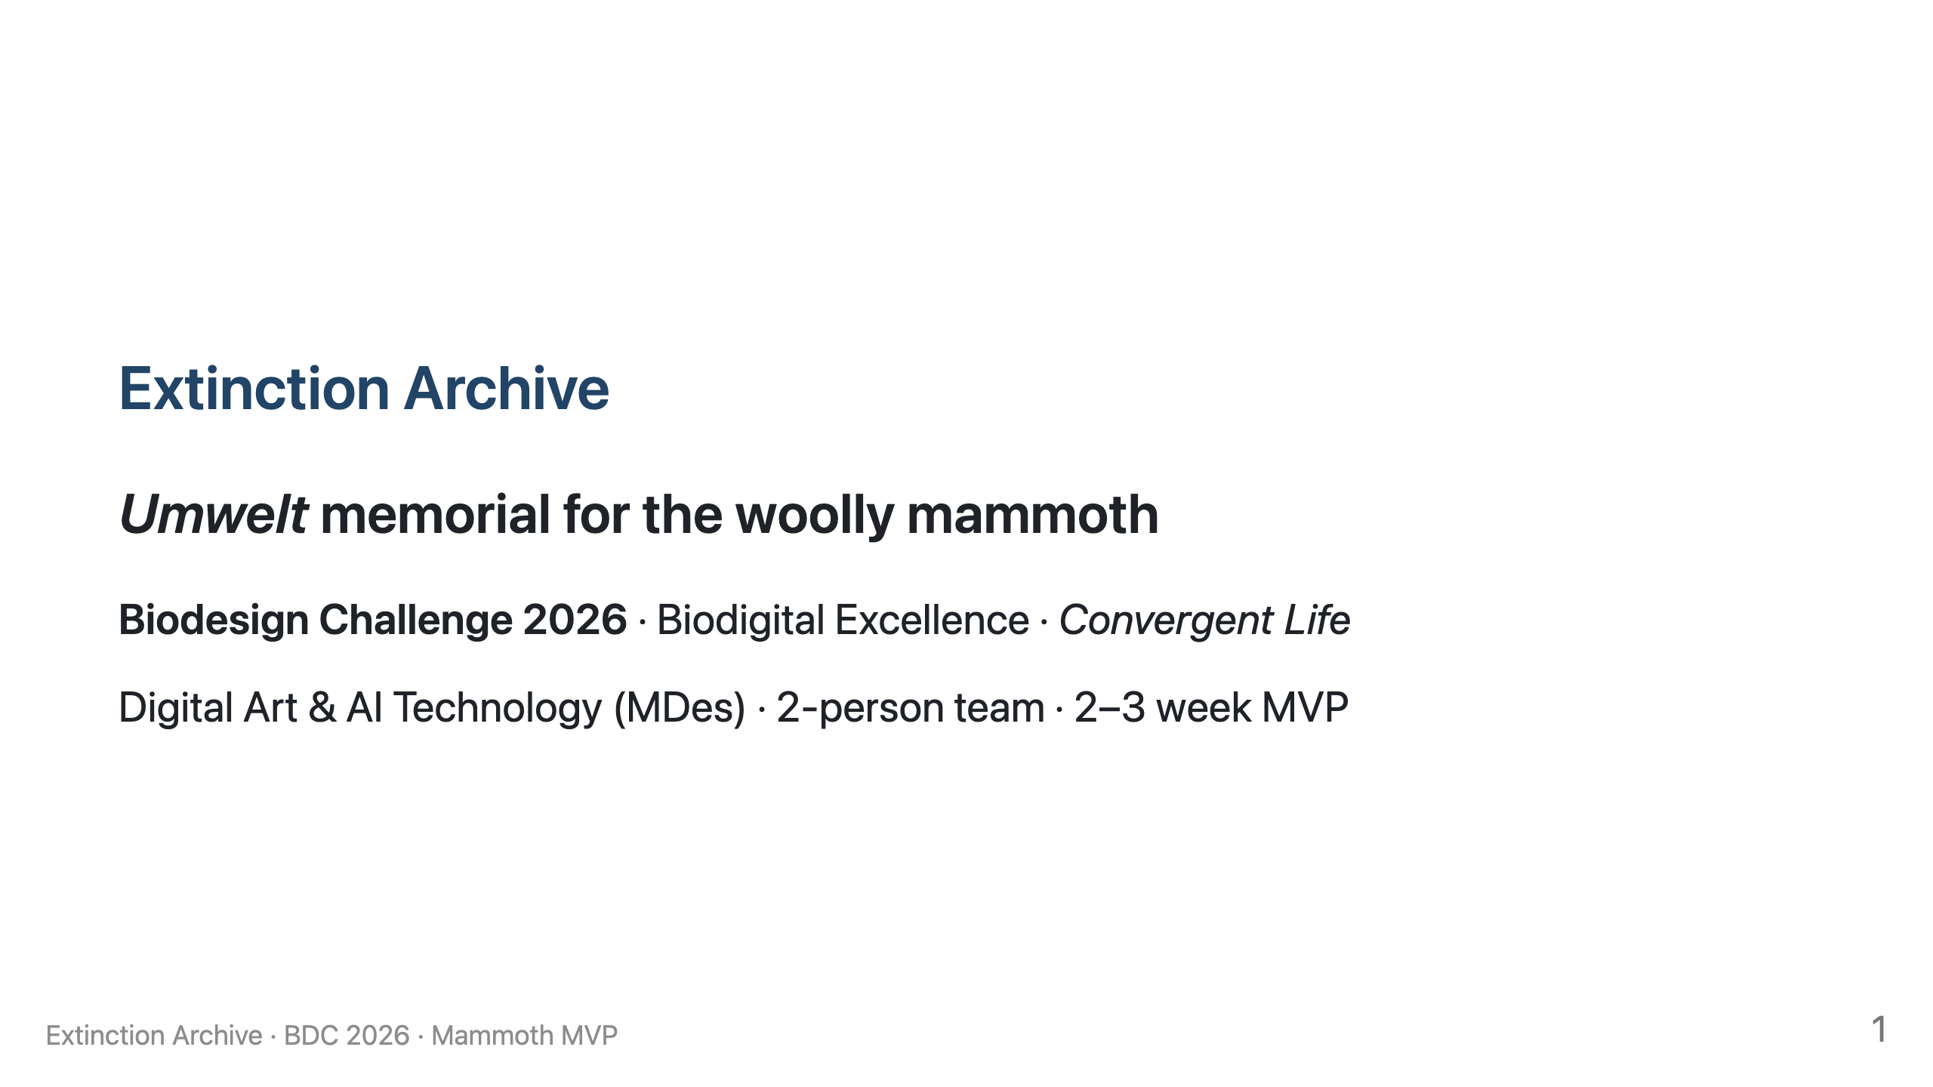

Slide 32
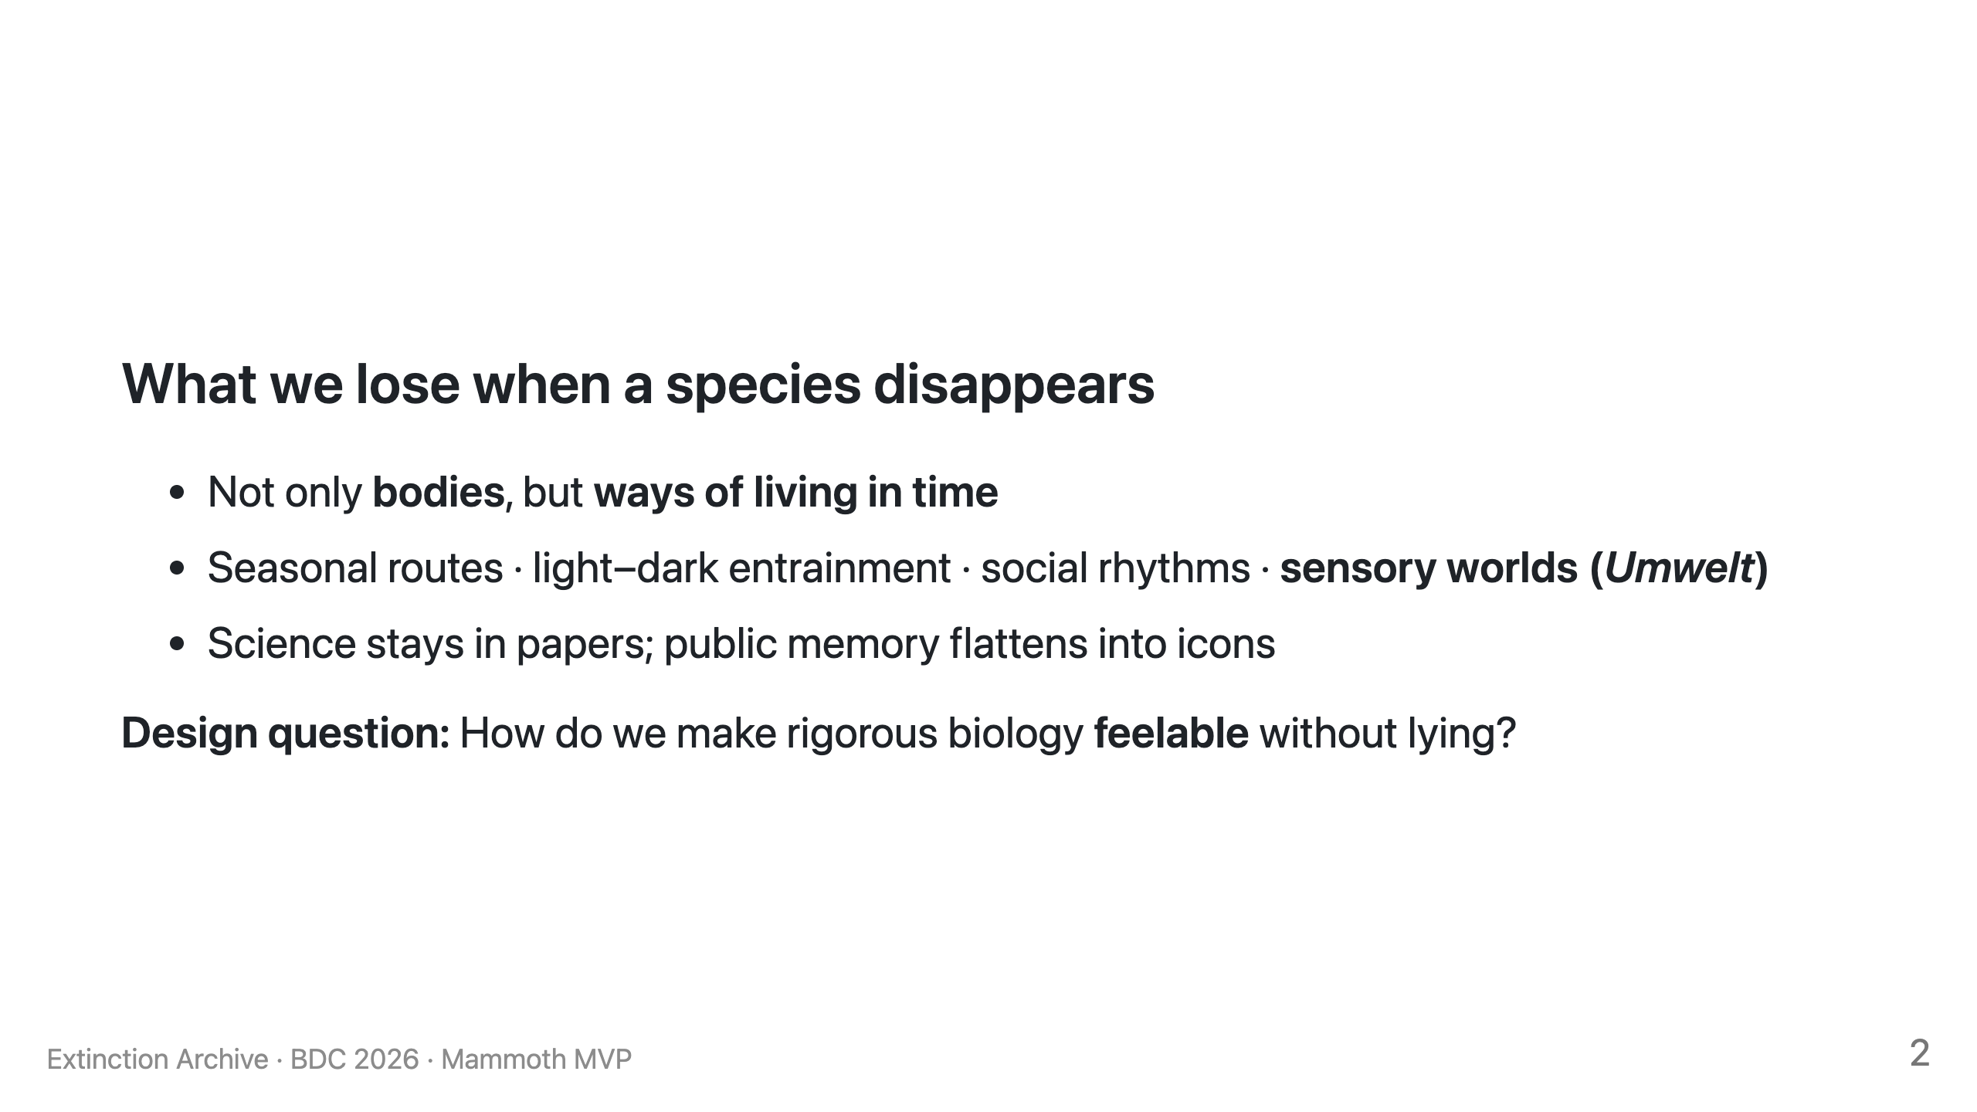

Slide 33
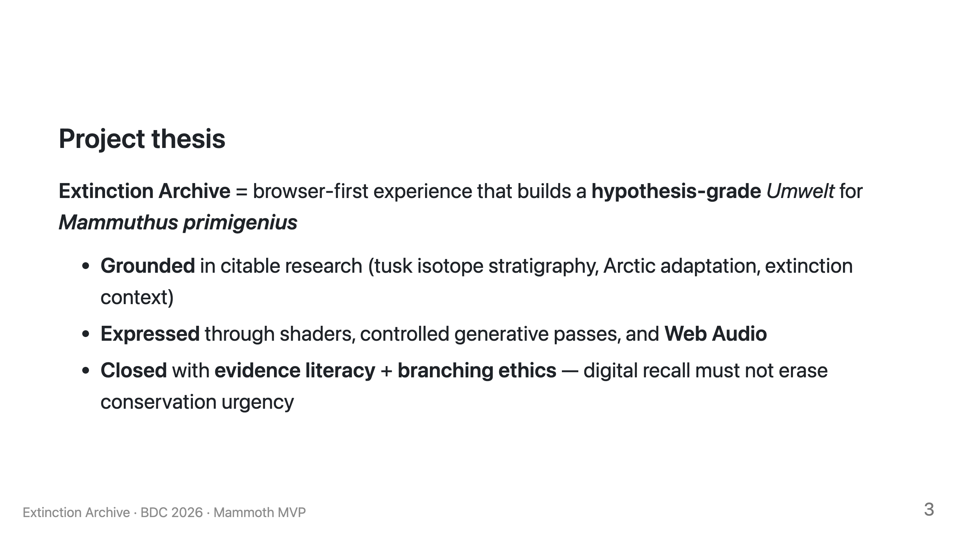

Slide 34
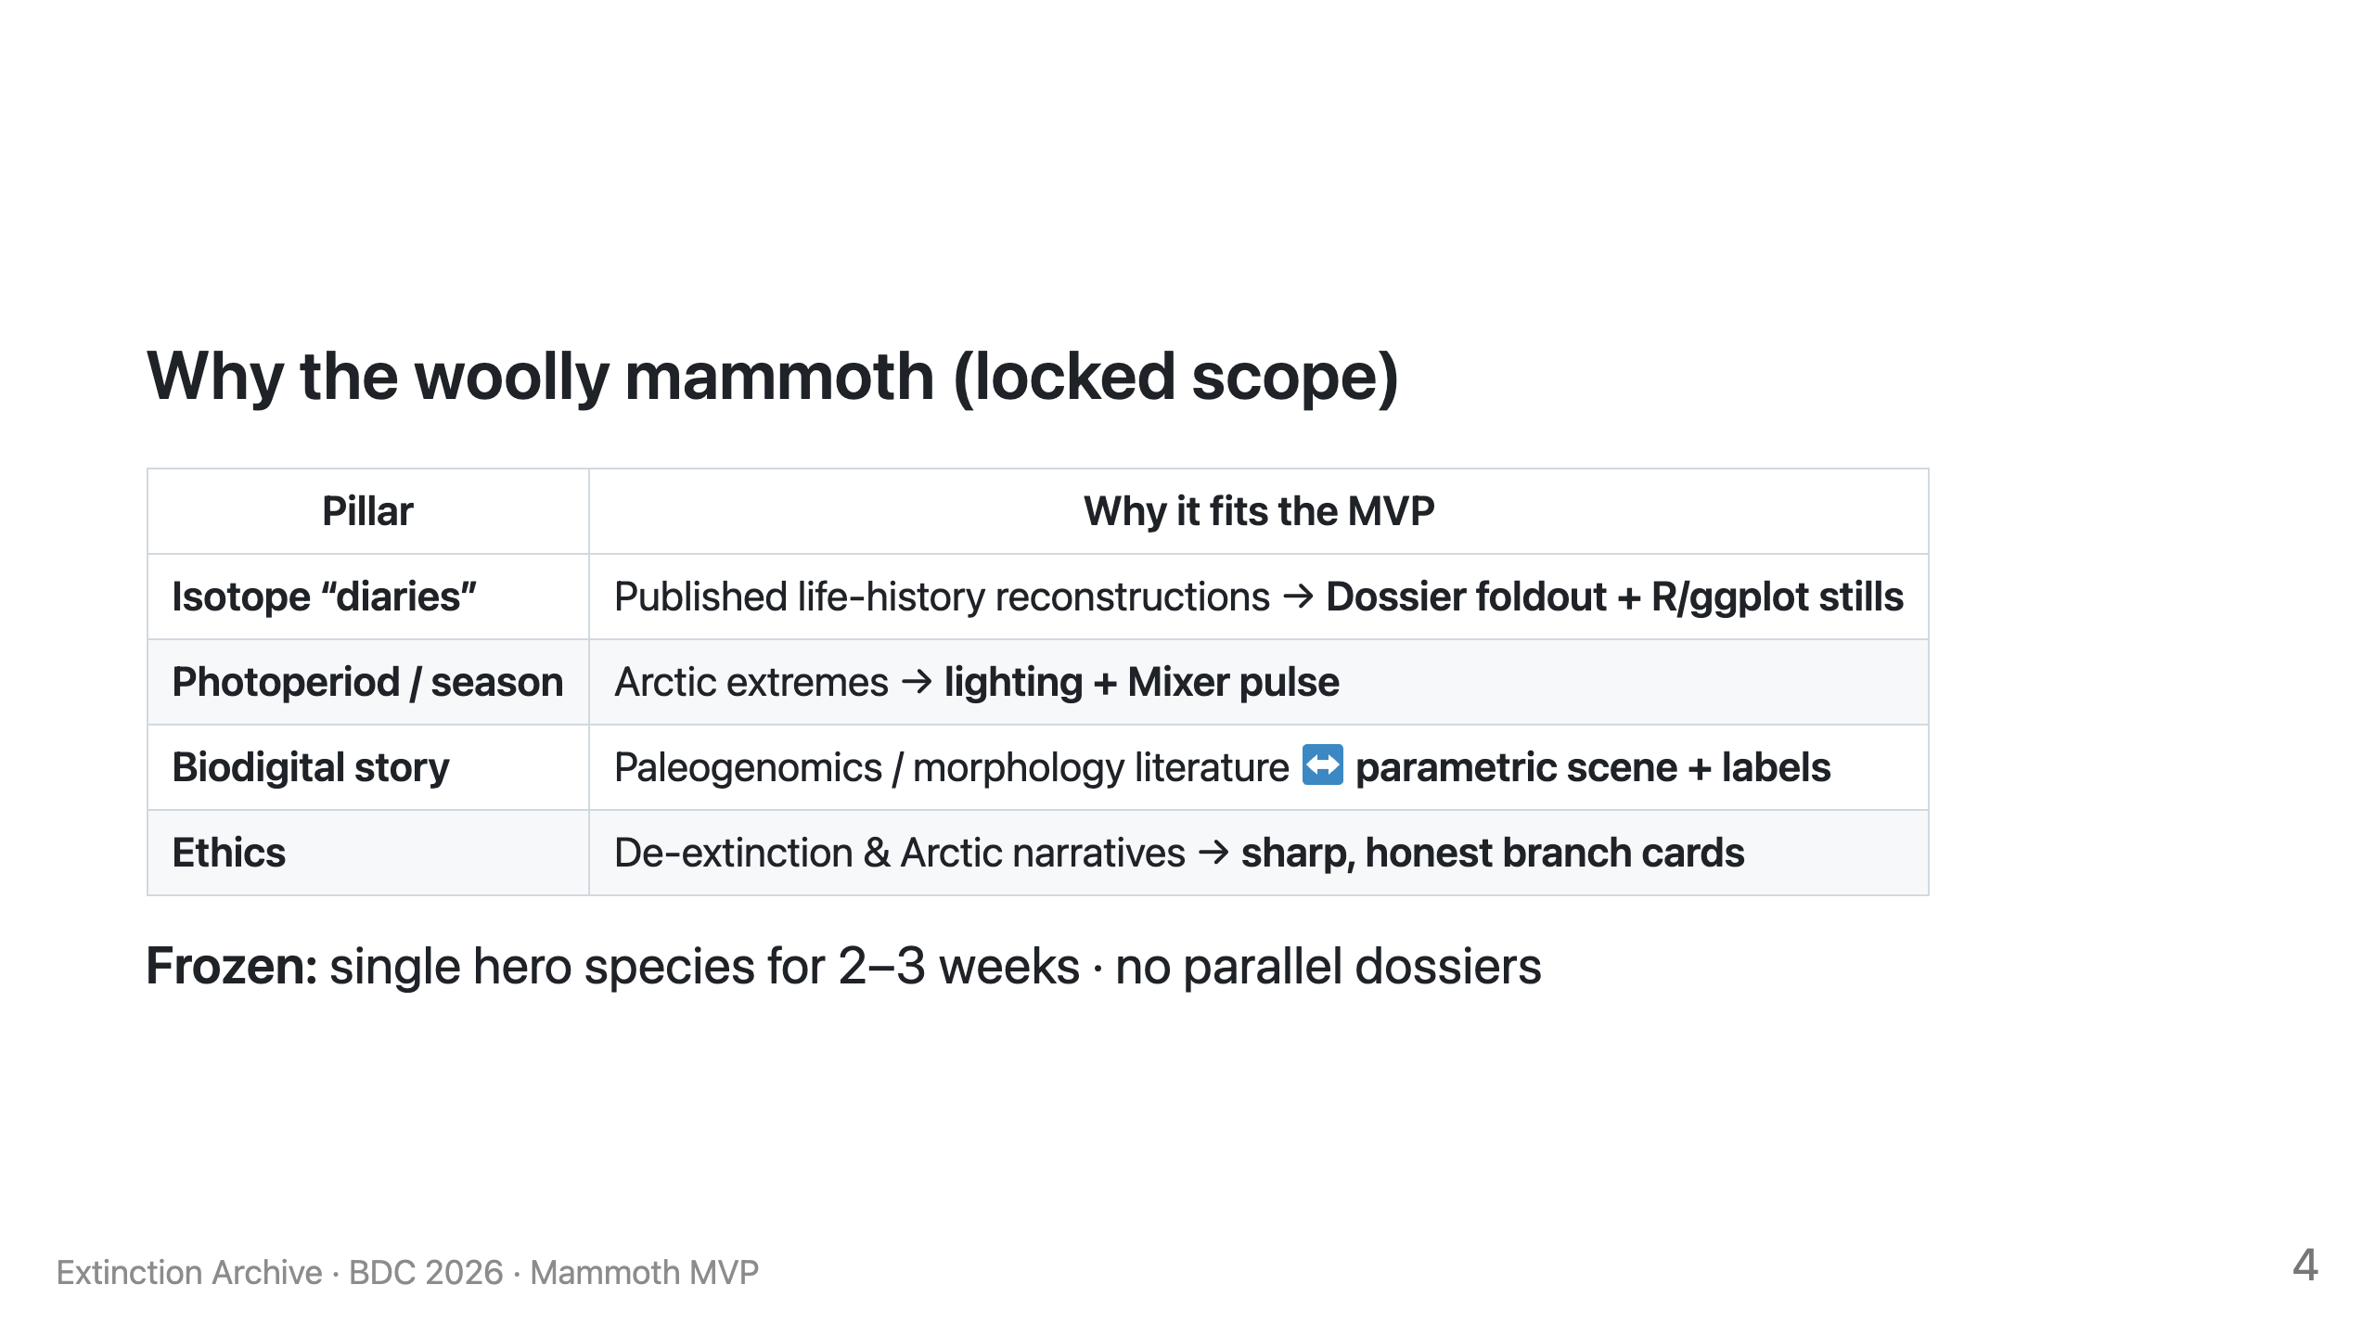

Slide 35
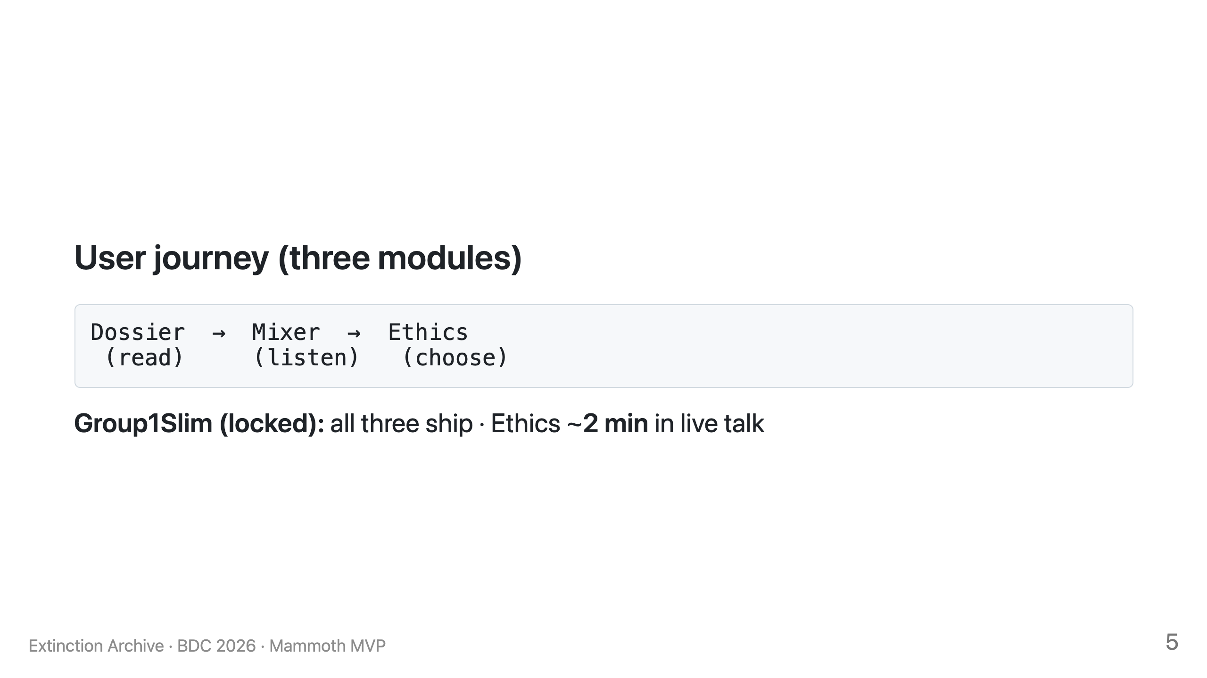

Slide 36
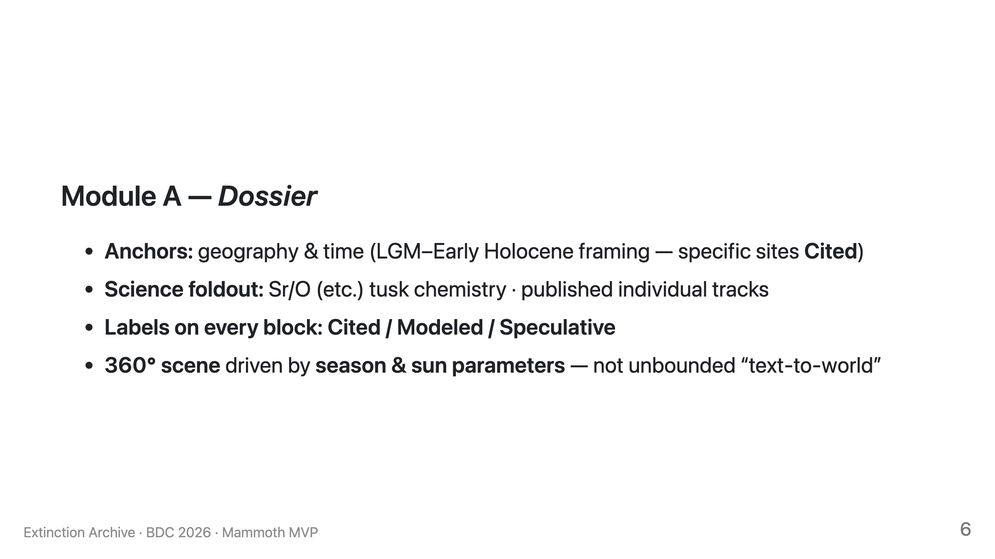

Slide 37
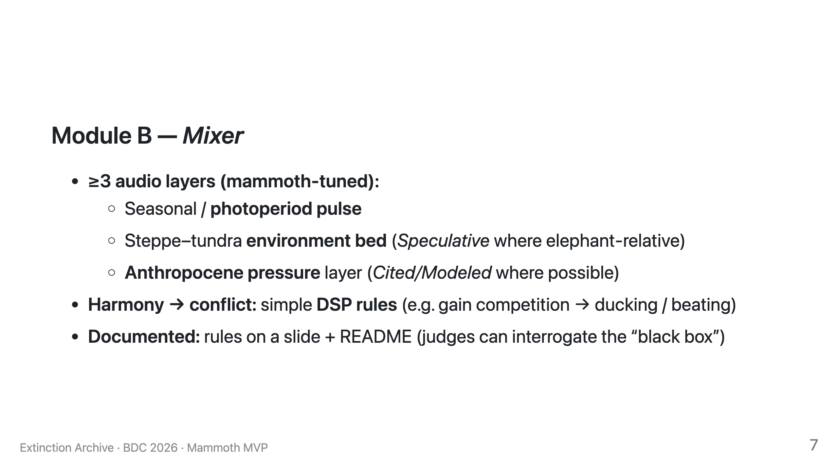

Slide 38
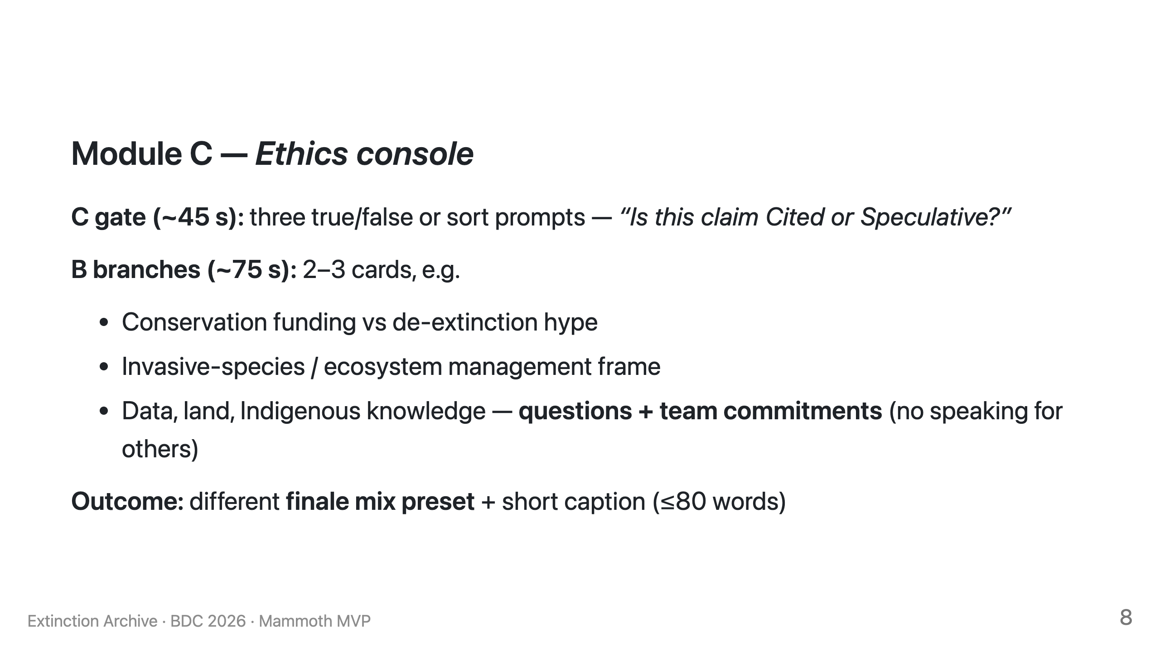

Slide 39
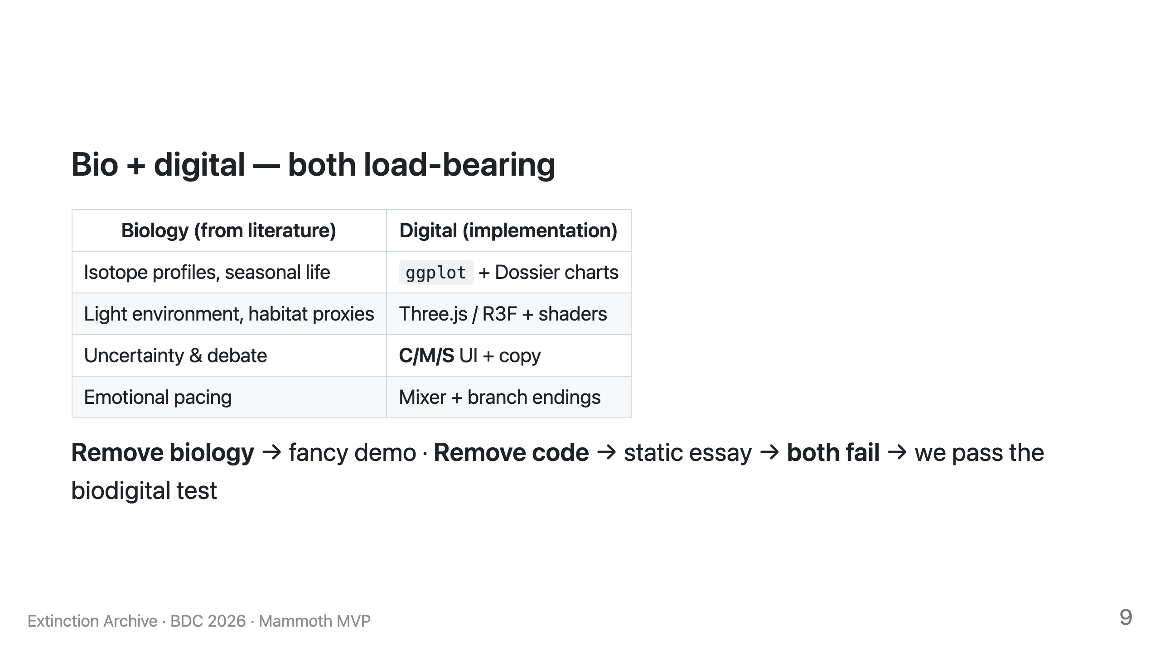

Slide 40
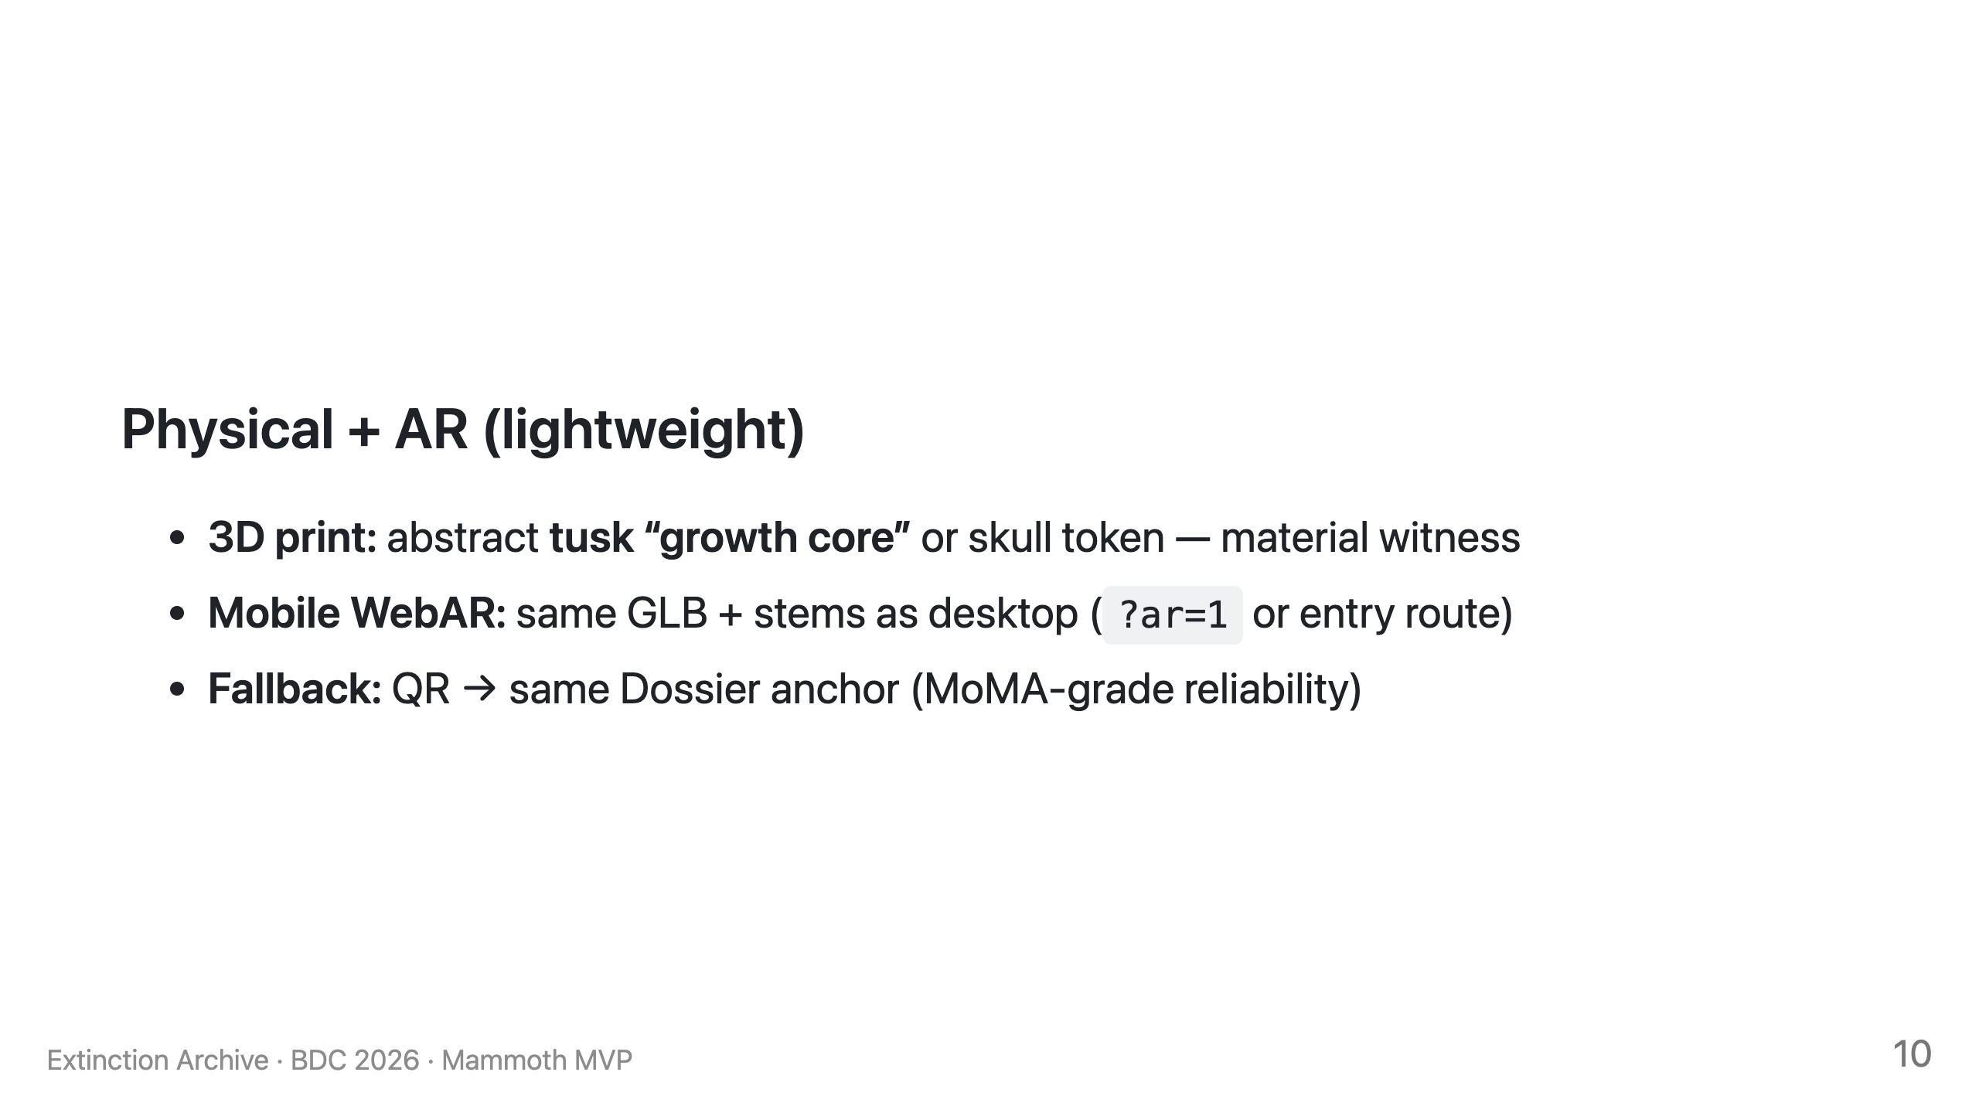

Slide 41
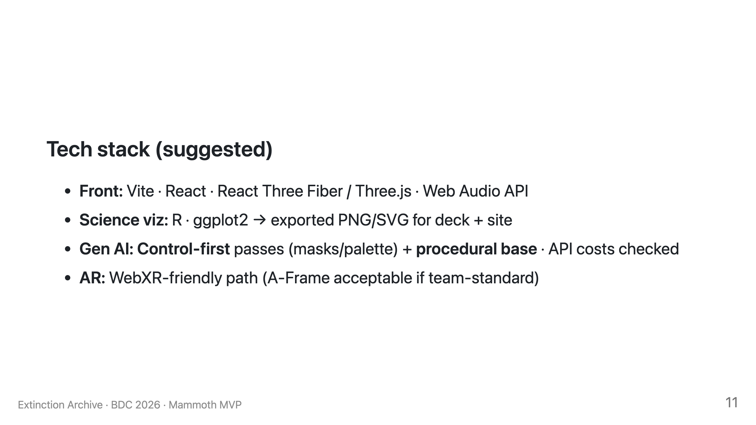

Slide 42
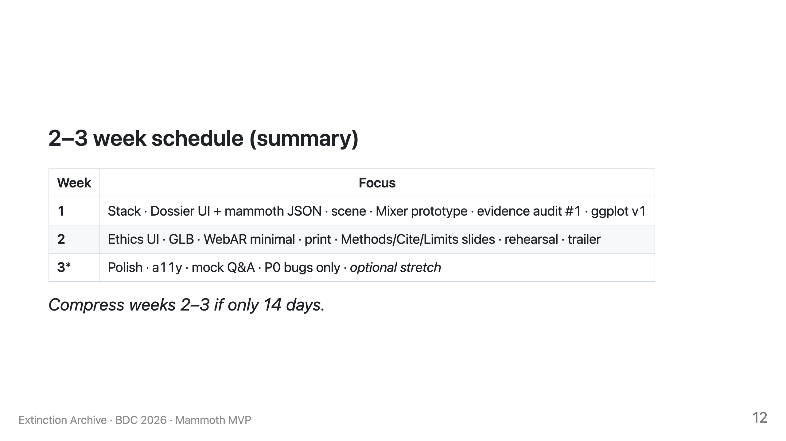

Slide 43
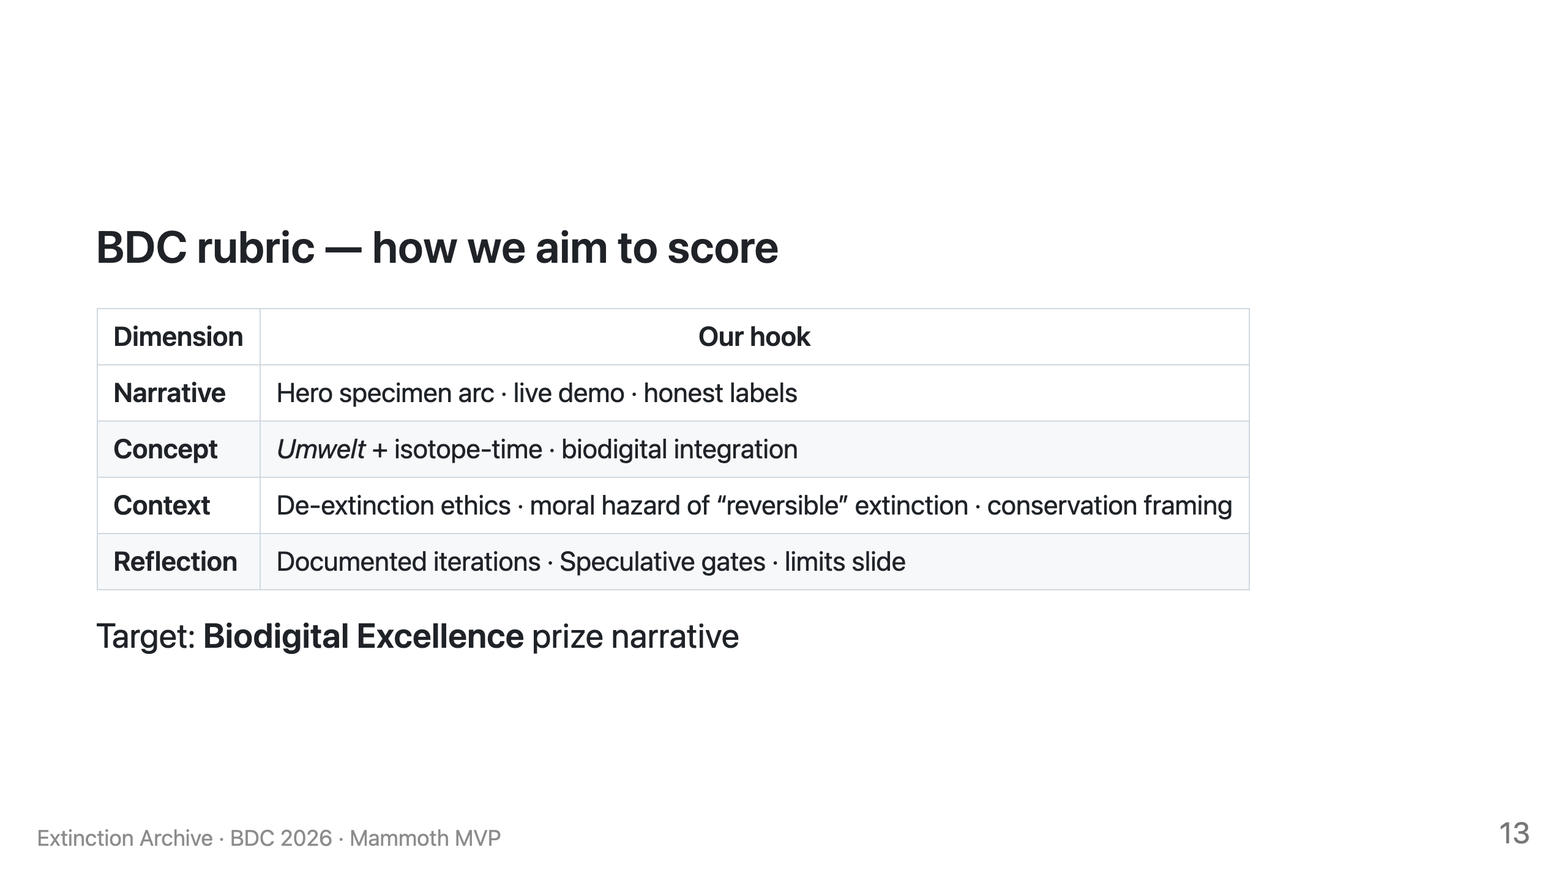

Slide 44
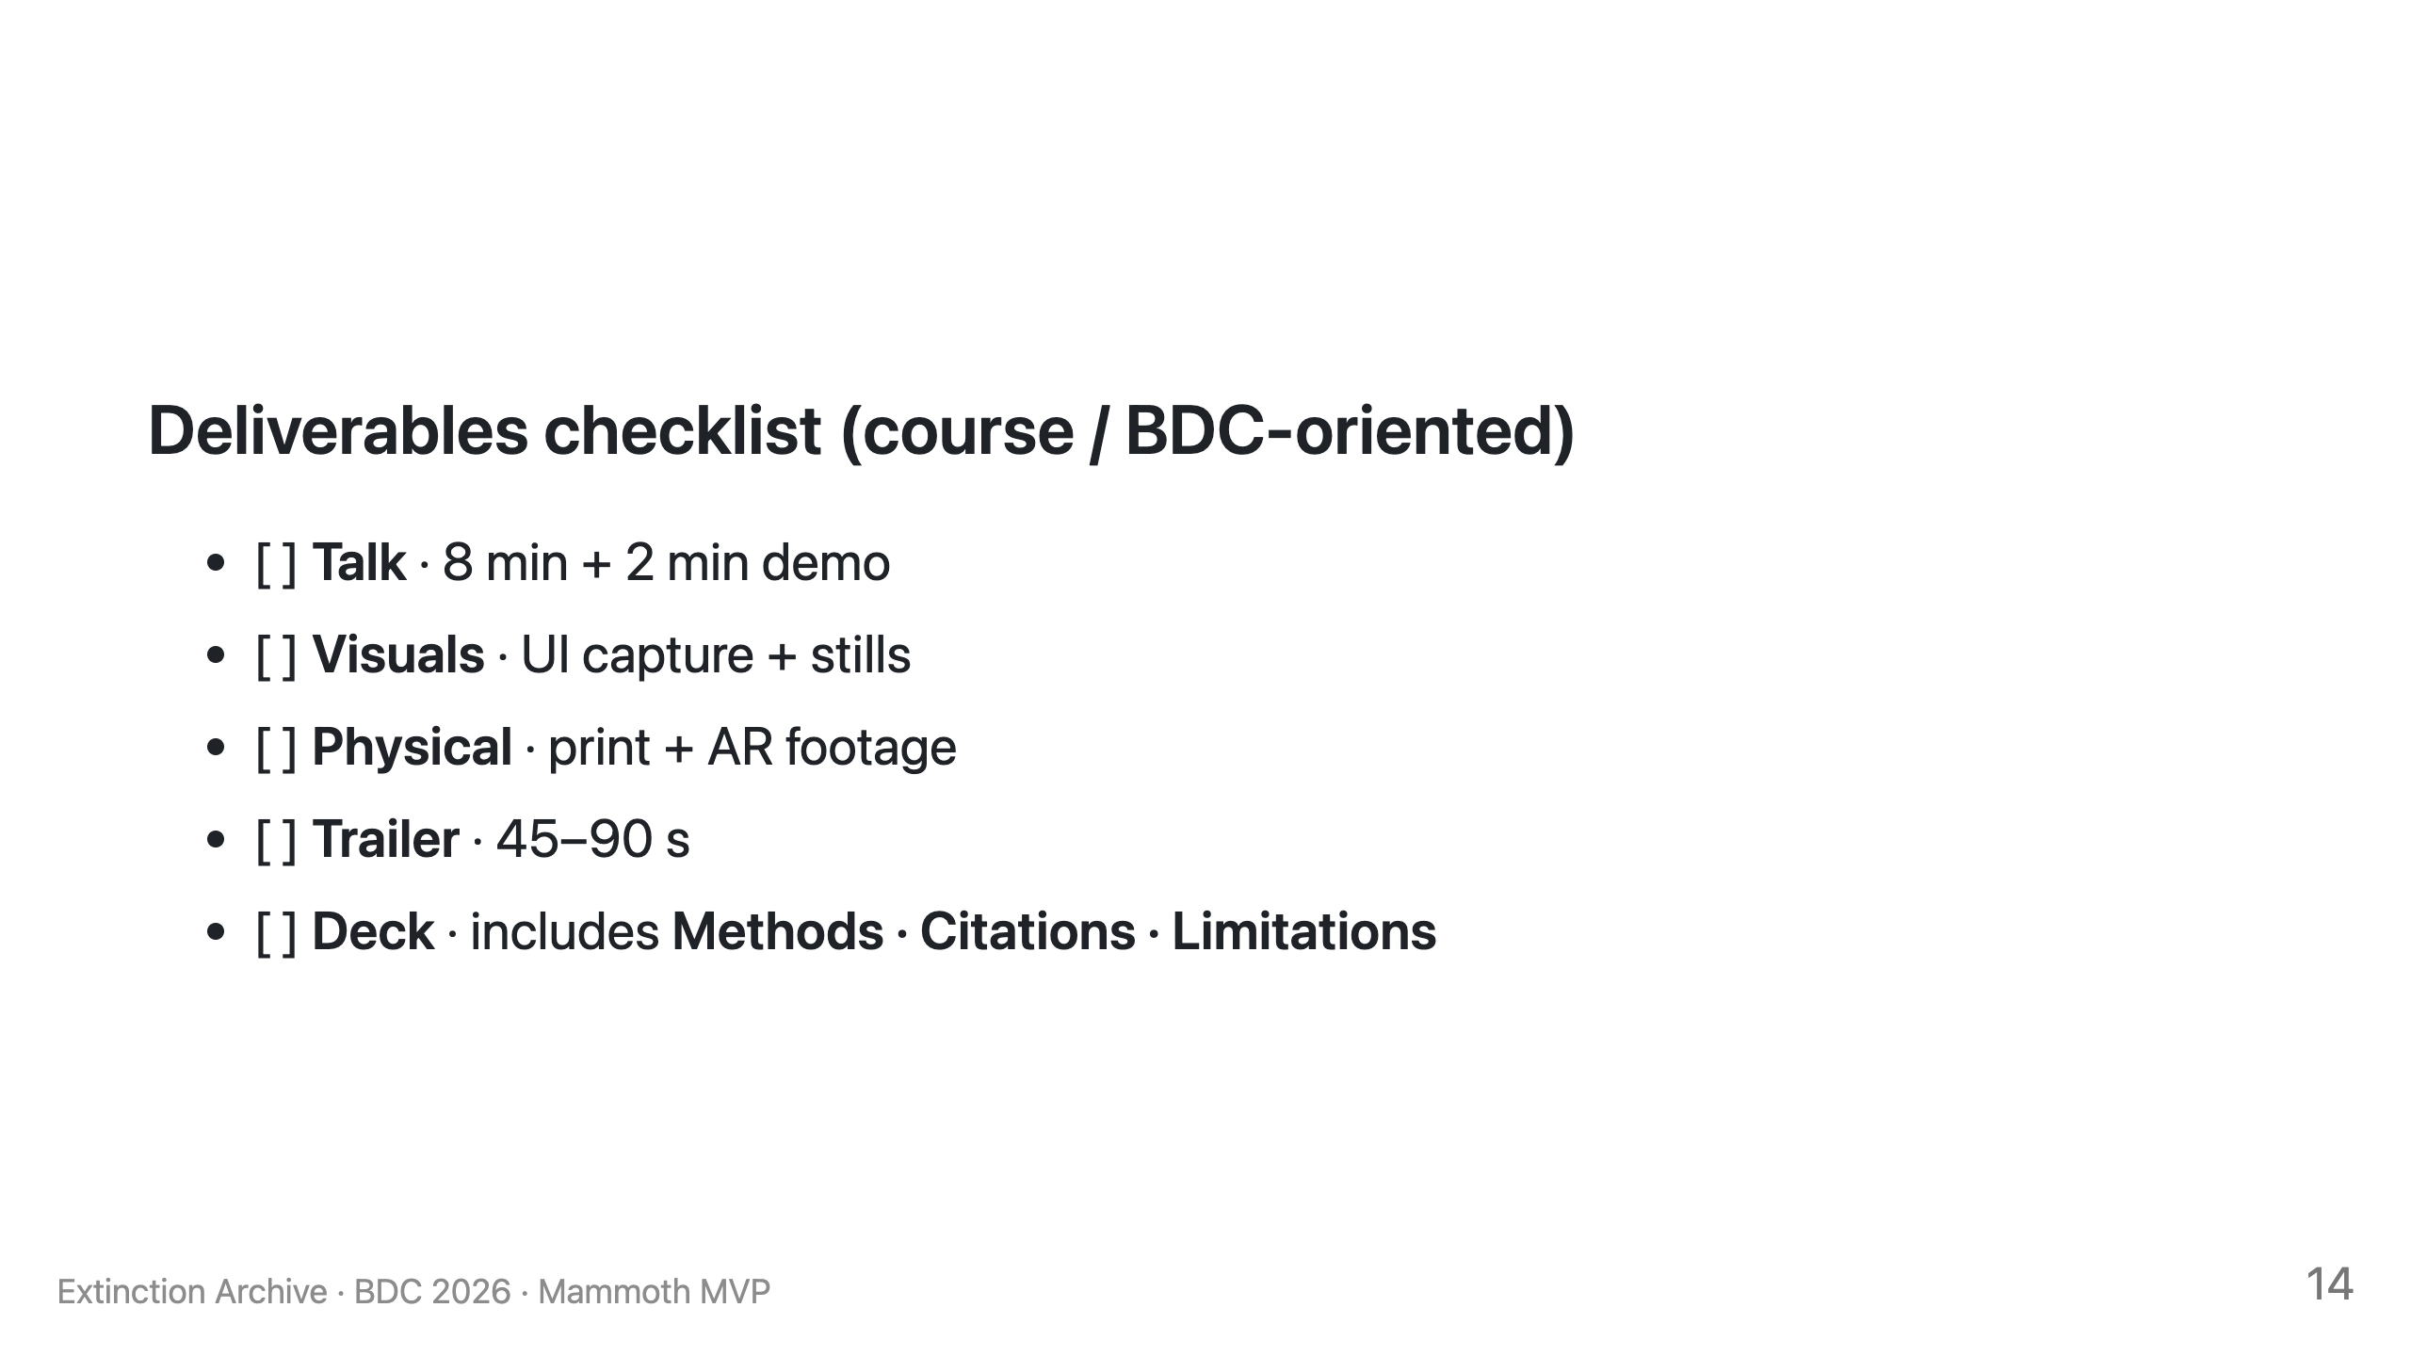

Slide 45
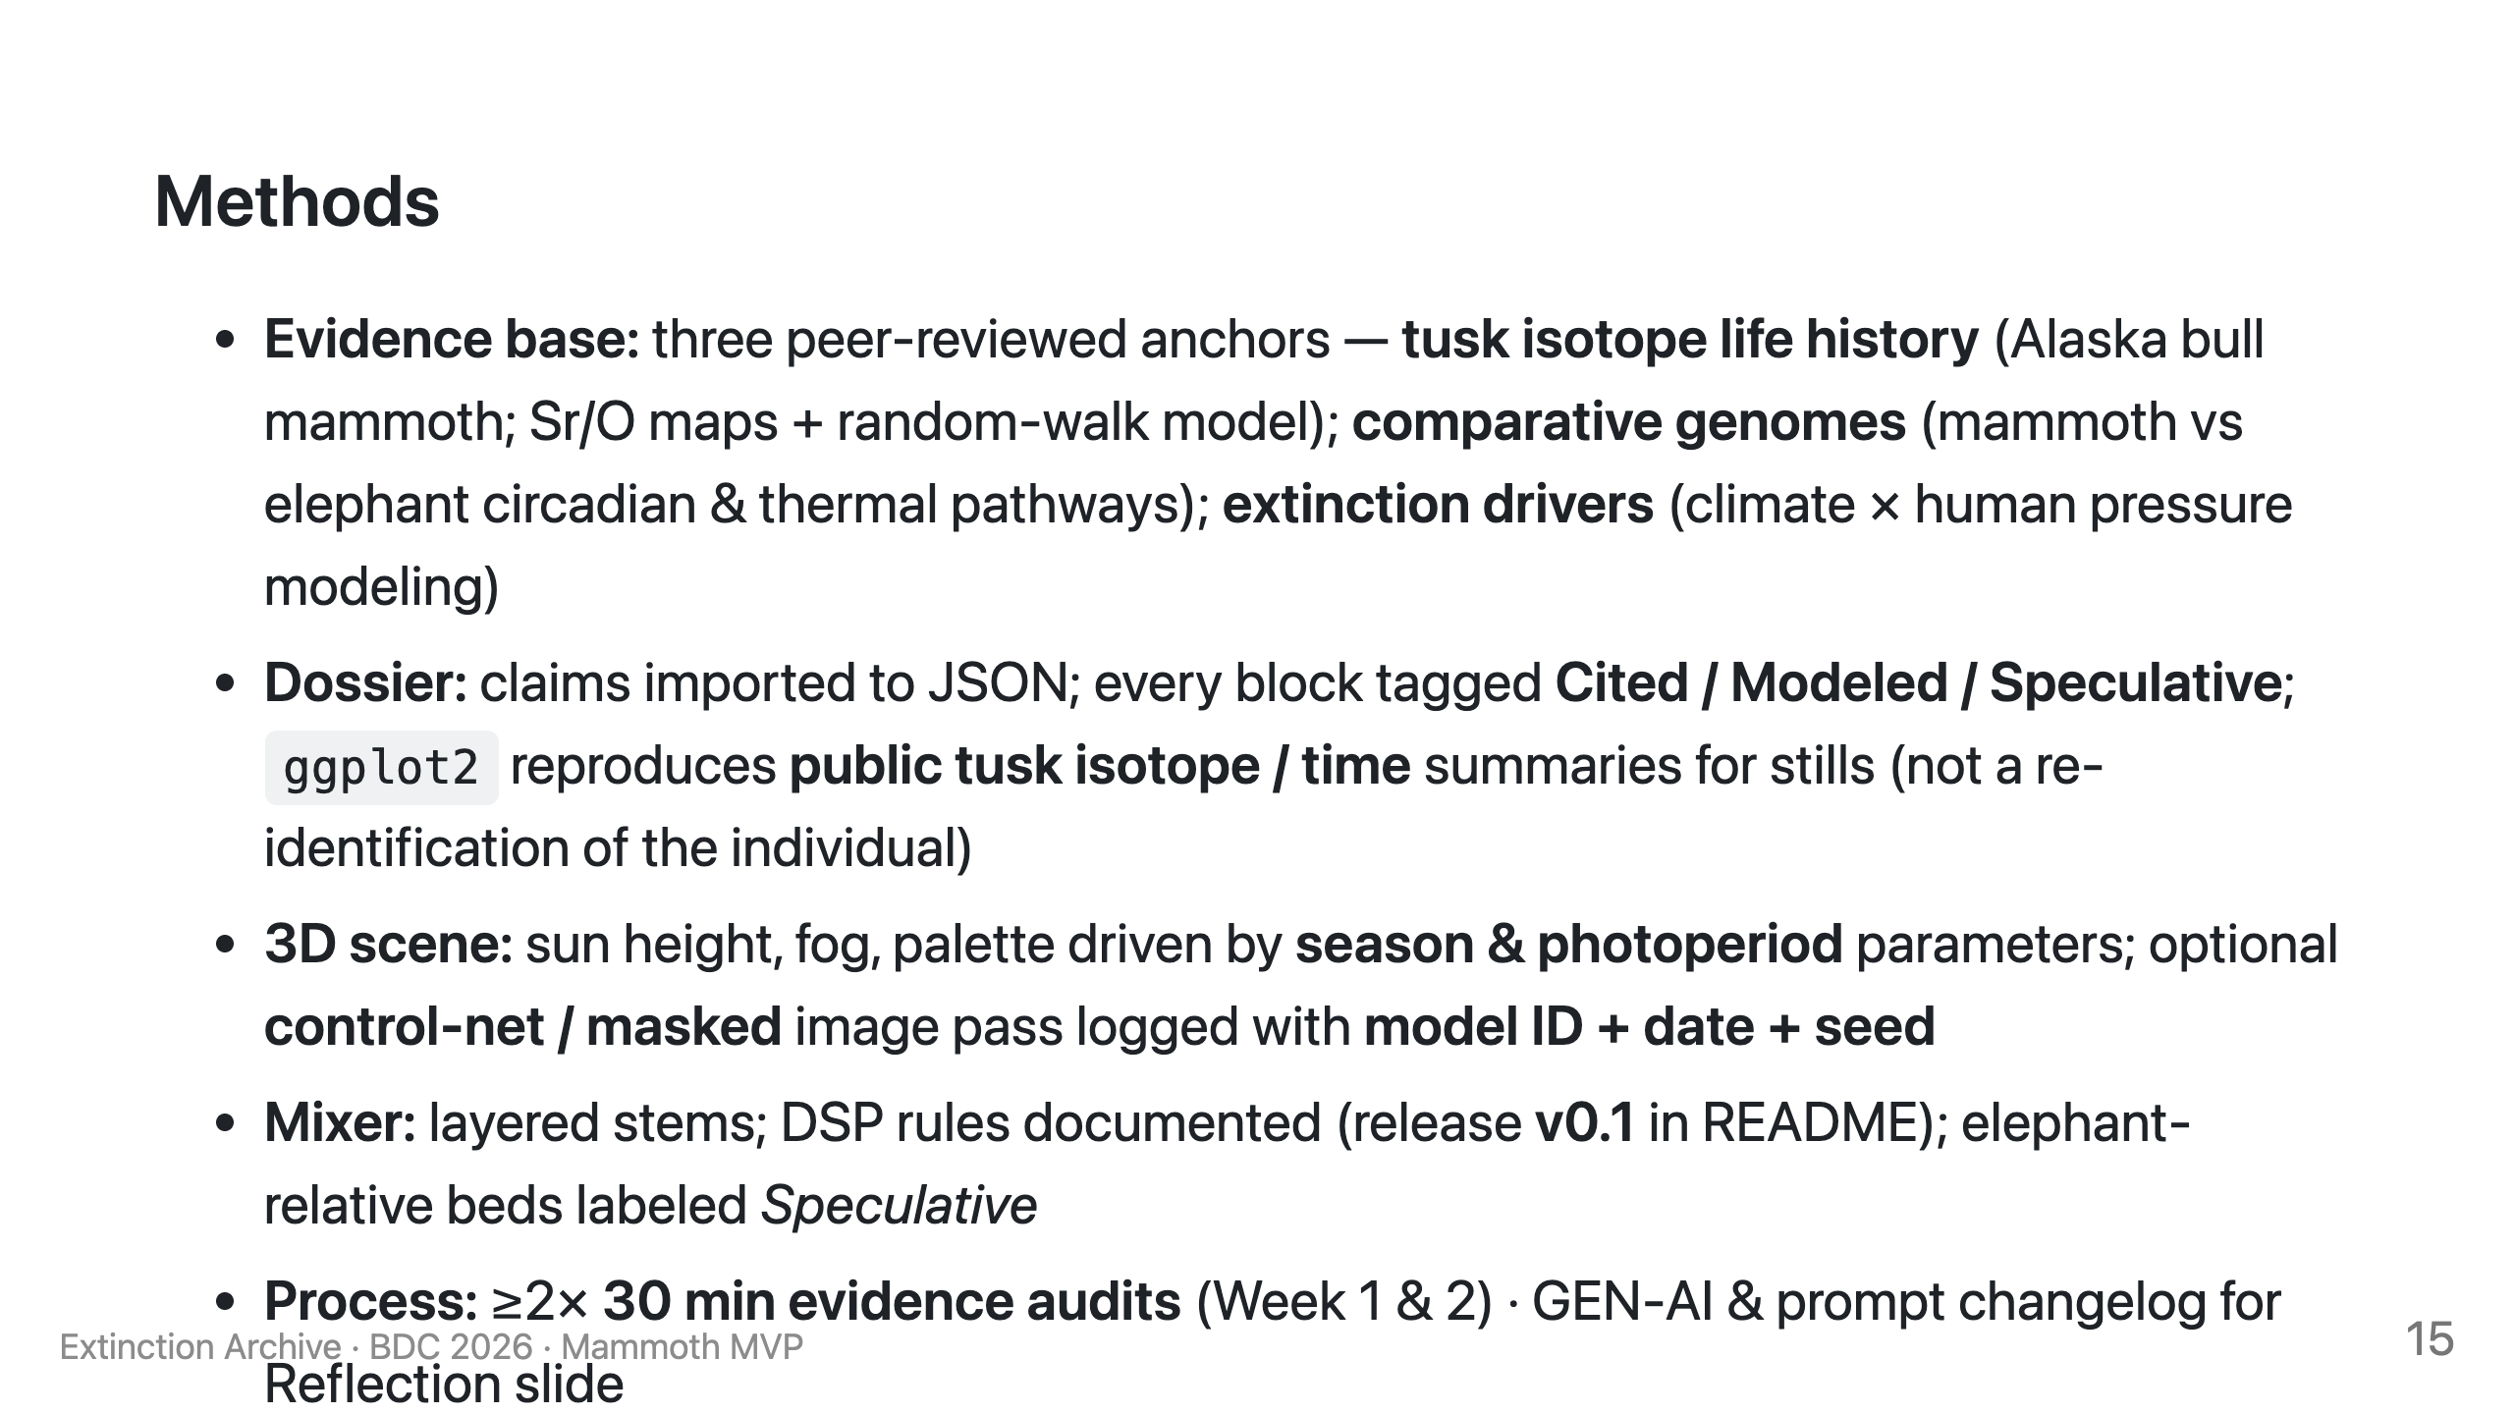

Slide 46
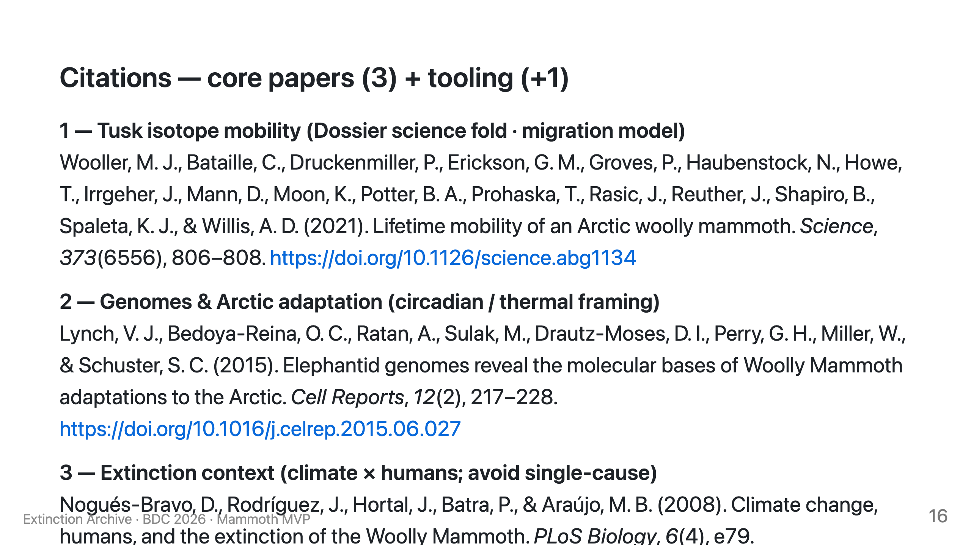

Slide 47
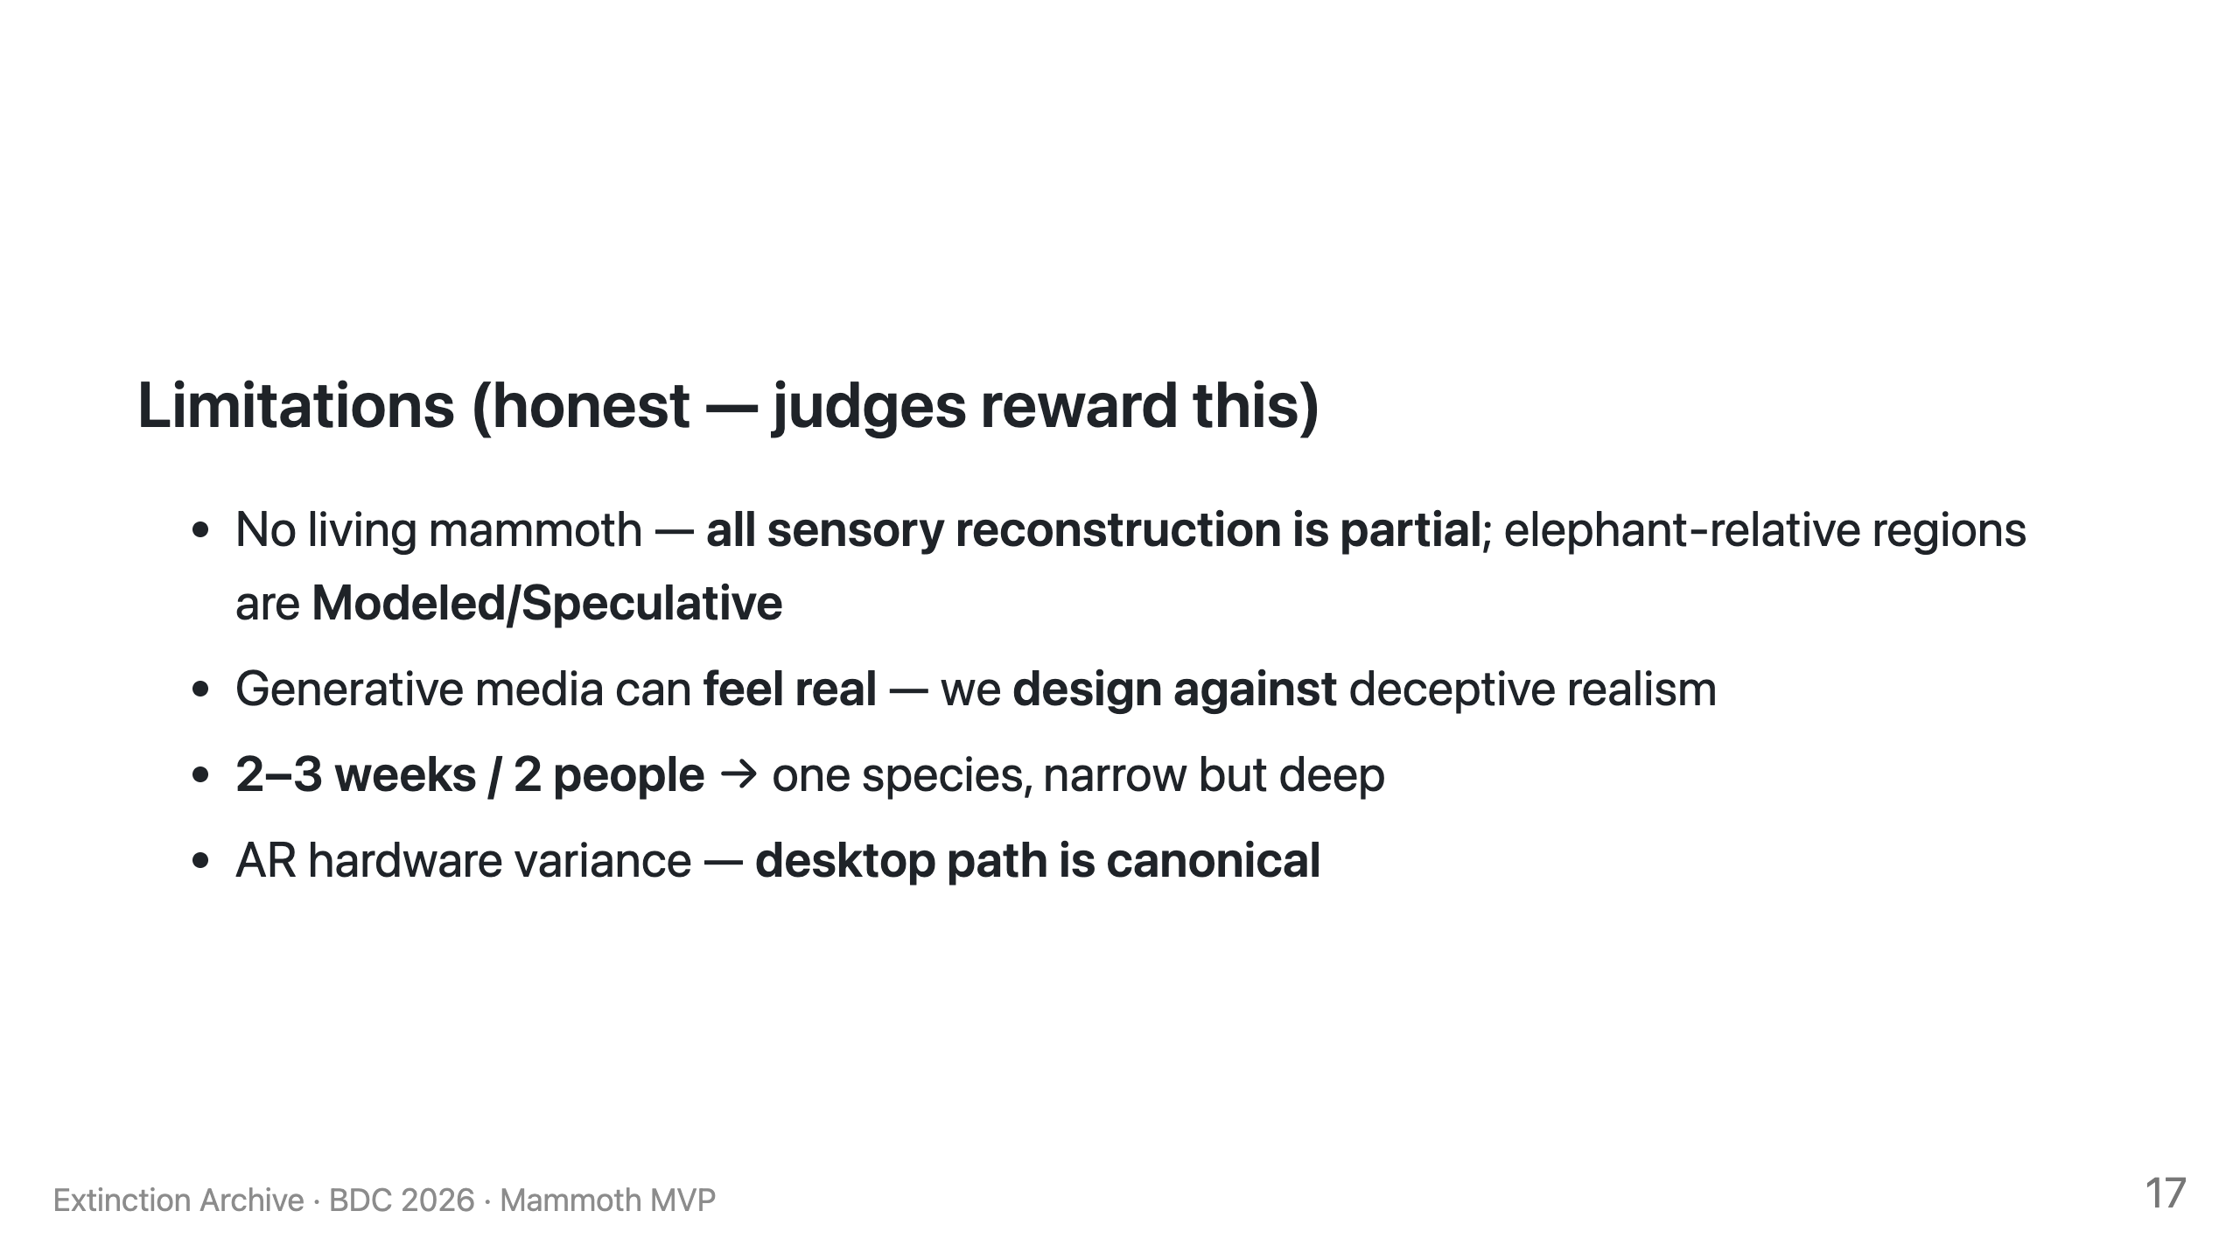

Slide 48
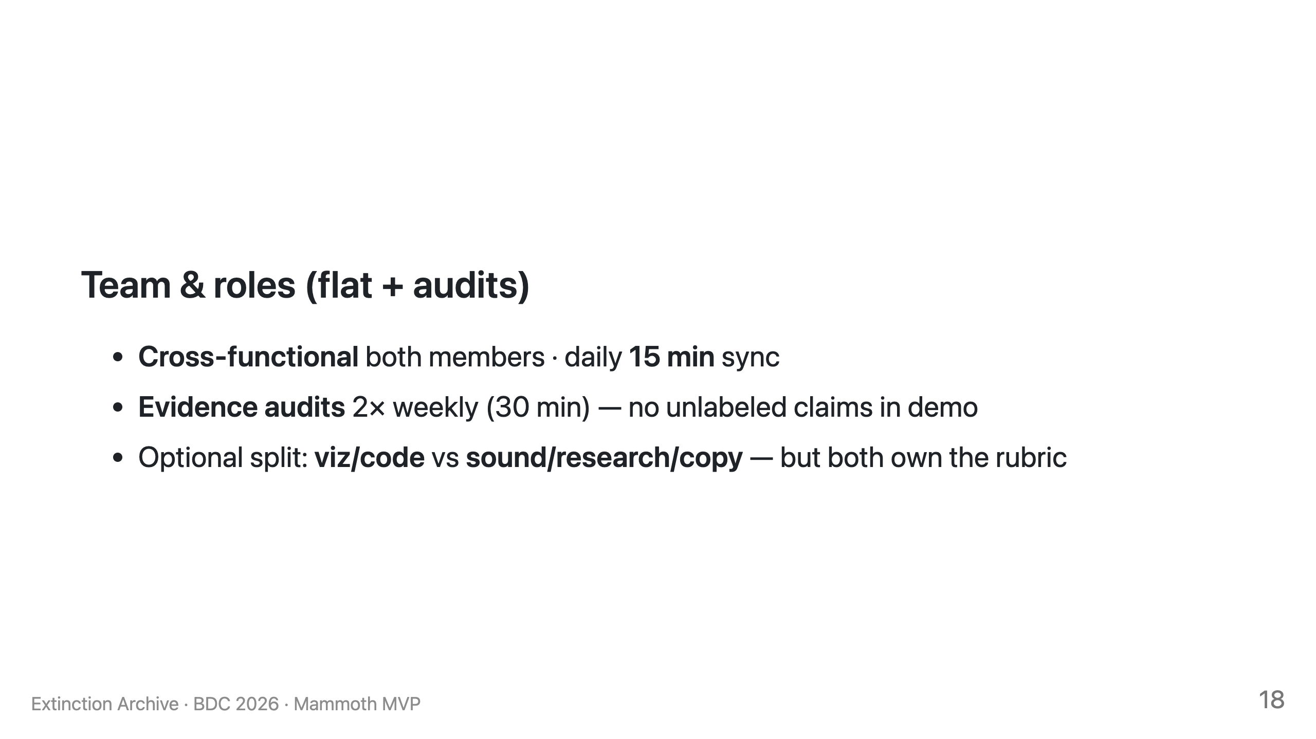

Slide 49
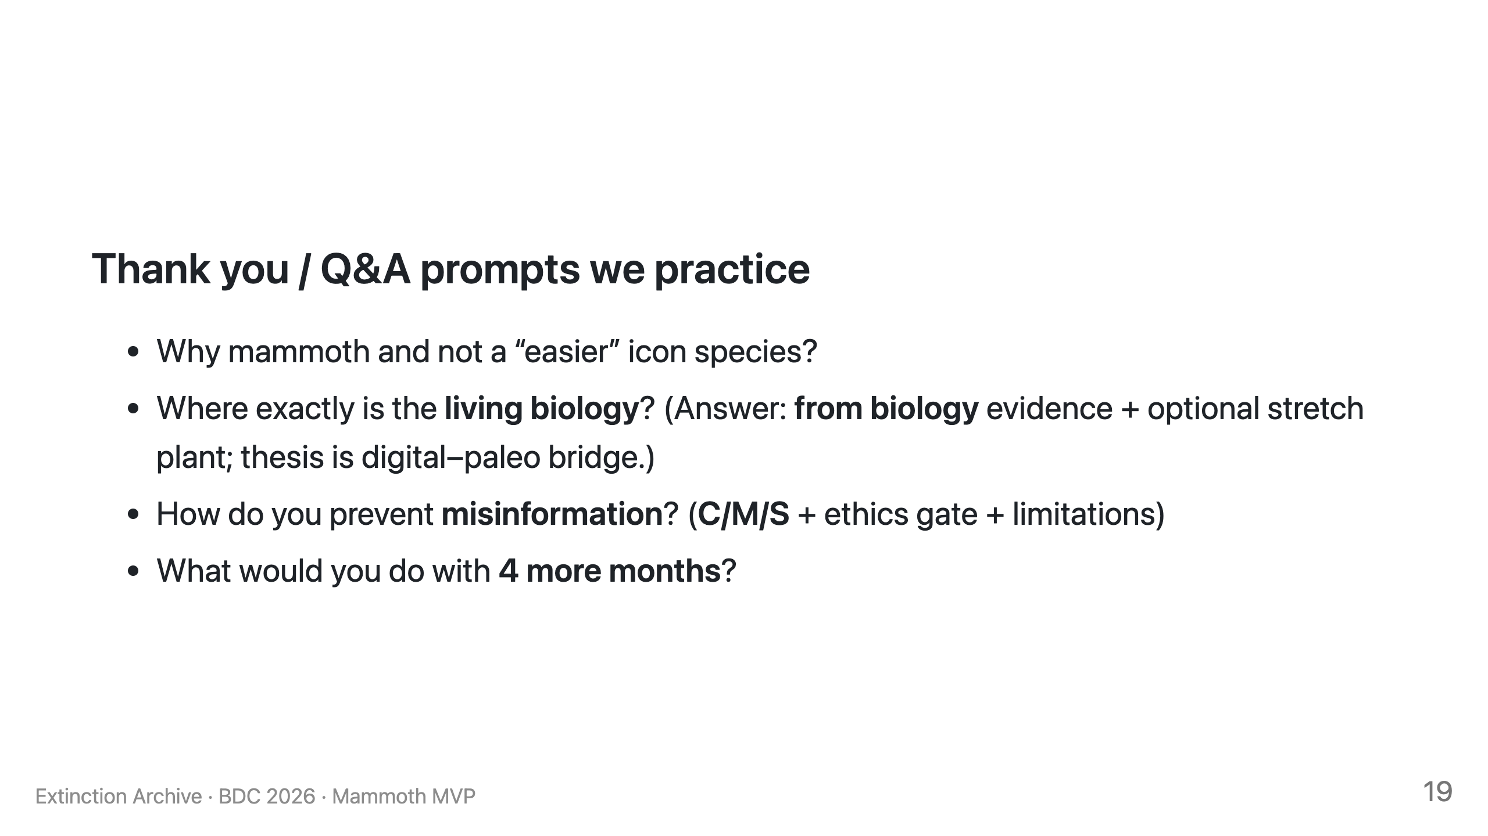

Slide 50
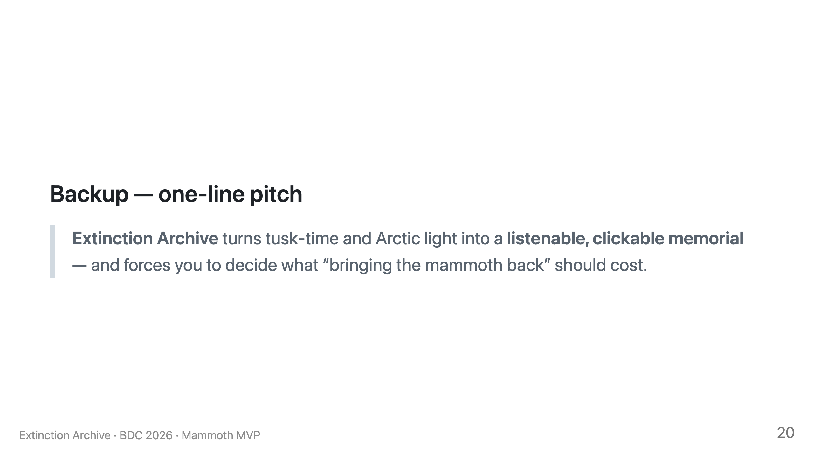

Slide 51
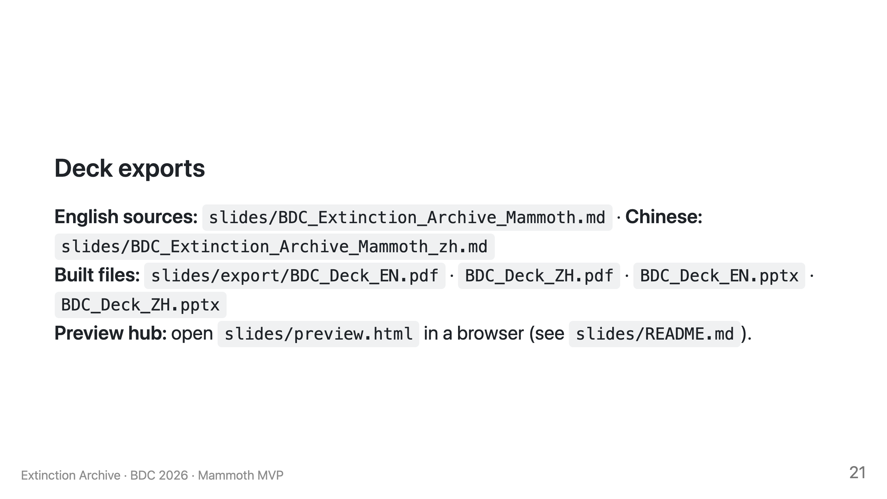

Slide 52
Thank you
Extinction Archive: Umwelt Hypothesis Dossiers
AI memorial for lost species · Sensory time capsule
Macau University · Biodesign Challenge 2026 · Biodigital Excellence
GUO XIAO YUE (MC569254) · LIU JIA QUN (MC569293) · Mentor: Atticus SIMS

