Slide 1

Analyze and Forecast Electricity Market in Germany using Neural Network IBM ADVANCED DATA SCIENCE CAPSTONE PROJECT
Siavash Saki

Slide 2
Electricity Market
Why Electricity Market?
Data Source: SMARD website
Datasets:
Electricity Consumption in Germany
Electricity Generation in Germany
Installed Generation Capacity in Germany
Day Ahead Price
Why Analyzing Data?
Why Forecasting?

Slide 3
Extract – Transform - LOAD
Data Sources
Download SMARD Data
Read CSV data into pandas Dataframes
Transform
Handle duplicates
…
Data Warehouse
Create a connection to database
Querying Database
Handle missing data
Looking at ranges
Matching data types
Merging Data
Append Dataframes to tables

Slide 4
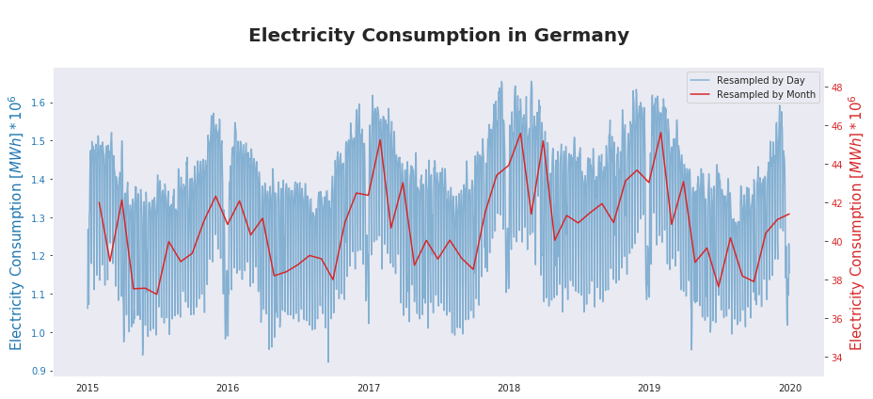

Slide 5
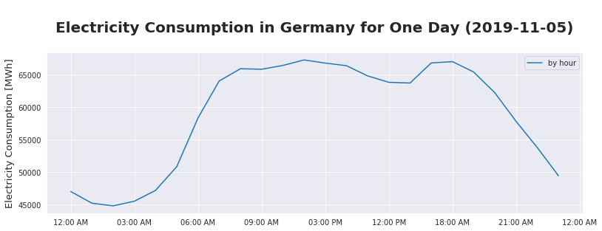

Slide 6
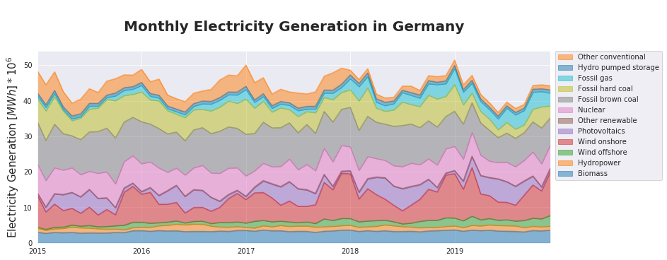

Slide 7
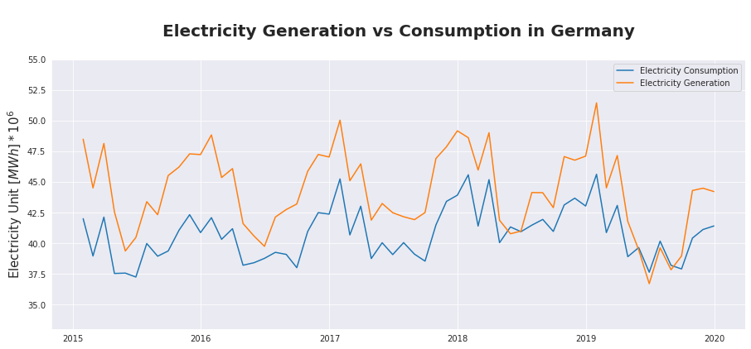

Slide 8
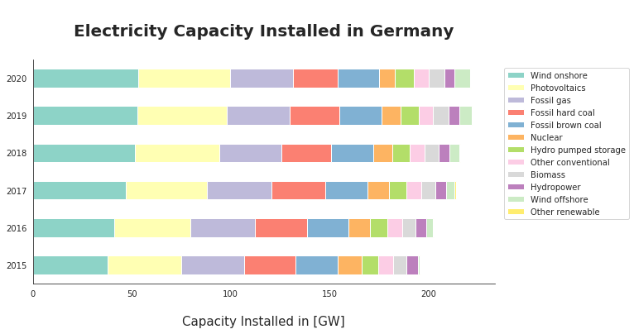

Slide 9
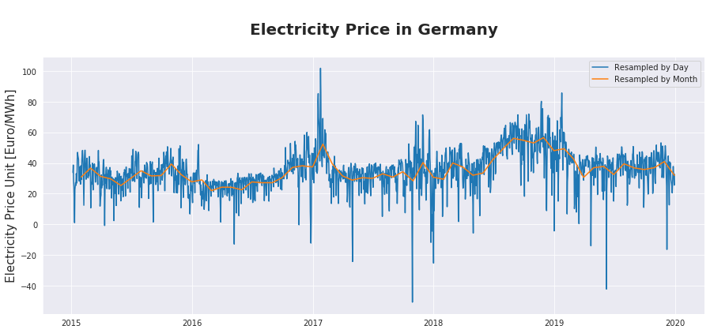

Slide 10
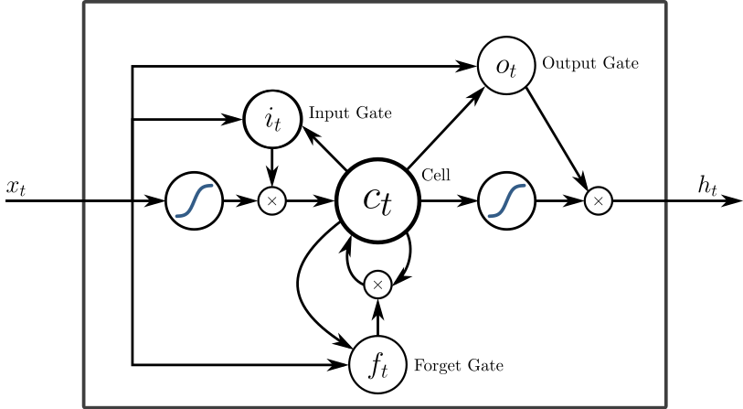
LSTM (Long short-term memory)

Slide 11
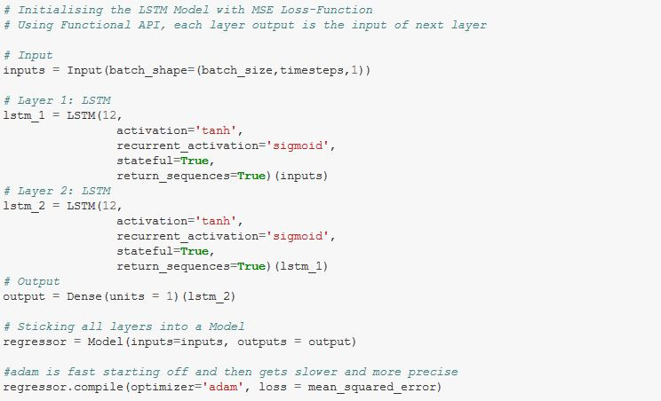
LSTM (Long short-term memory)

Slide 12
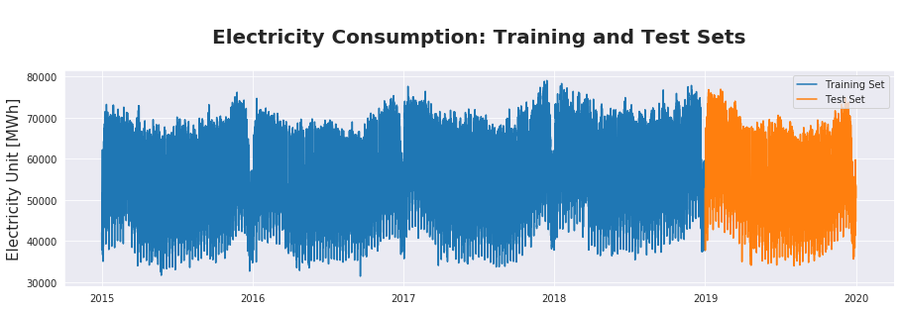
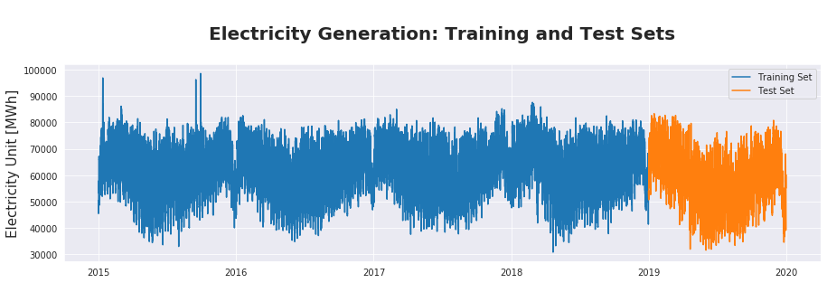
Train Test Split

Slide 13
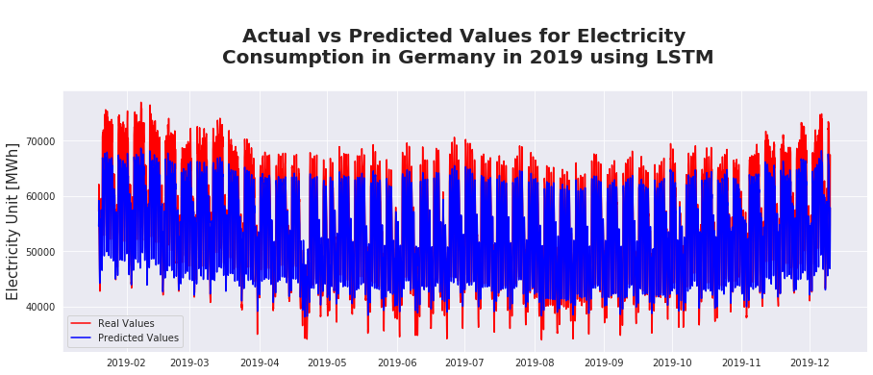
EVALUATION: RMSE=3651

Slide 14
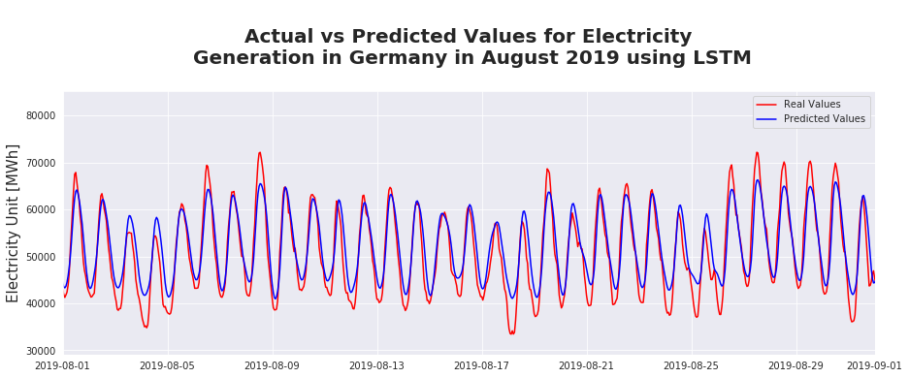
EVALUATION: RMSE=5803

Slide 15
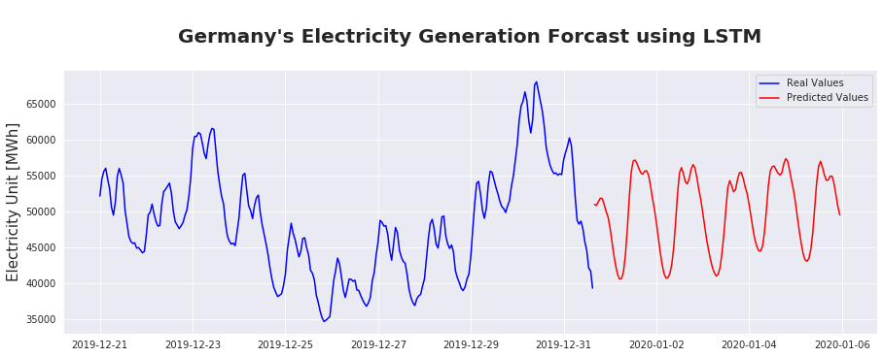
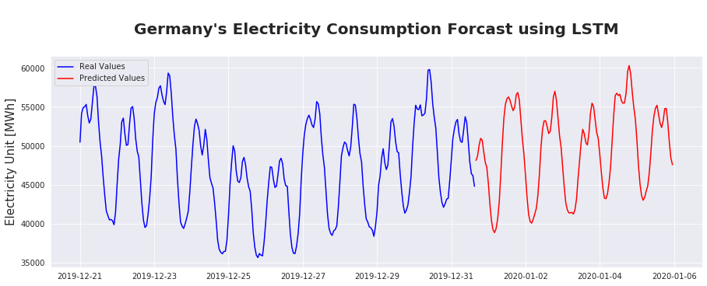

Slide 16
Summary
LSTM Model working
Further tasks: Tuning parameters to get better predictions
Activation Function
Loss Function
Number of layers
Number of hidden units in each layer
Optimizer
Links below

