Slide 1
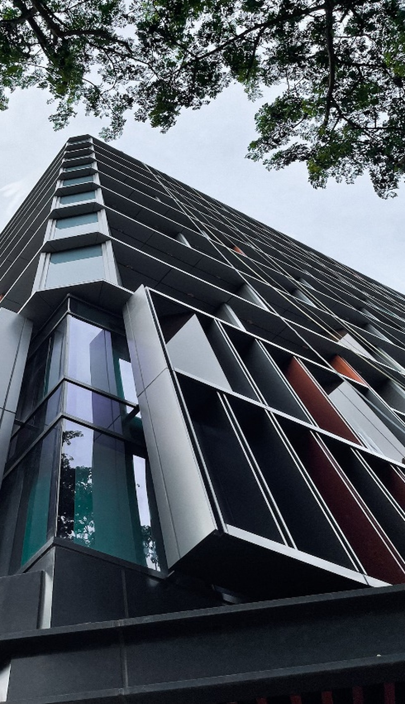

Board Strategy Meeting · September 2026
Aravest’s Next Phase
From integration to institution-building: establishing the post-SMFL track record, defining the near-term investment focus and developing the pathways for sustainable long-term growth.
Aravest Fund Management Pte. Ltd. Private and Confidential

Slide 2
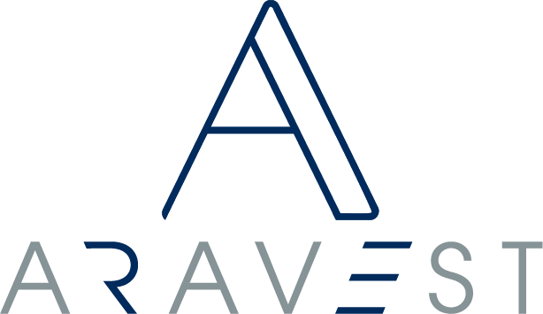
Agenda
01
Purpose and development pathway
From integration to institution-building
02
The Aravest Way
Values-led. Value-focused.
03
The post-SMFL track record
Two parallel pathways and warehousing
04
Capital, AUM and current pipeline
Conrad Seoul illustration
05
2027 investment focus and value creation
Playbooks and capability coverage
06
Institutional standards and decisions
Structuring standard; matters for the Board
Private and Confidential
1

Slide 3
01 · Purpose
Aravest is moving from integration into institution-building.
The initial integration into SMFL has been substantially completed. Aravest has maintained continuity across the platform, strengthened governance and begun building a visible record of execution under the new sponsor. The next phase is to develop the institutional foundations and investment record required for sustainable long-term growth.
Private and Confidential
2

Slide 4
02 · Development pathway
The proof-building process has begun and becomes the principal focus from 2027 to 2029.
2025
Integrate and begin proving
Complete the initial integration, maintain platform continuity and begin demonstrating execution under SMFL ownership.
2026
Establish institutional identity
Introduce The Aravest Way, deepen governance and investment discipline, and continue building visible post-SMFL evidence.
2027–2029
Build and compound the record
Execute selected opportunities, demonstrate outcomes, establish repeatable strategies and deepen investor relationships.
AROUND 2030 ONWARD
Convert proof into scale
Use the accumulated track record to pursue larger and increasingly repeatable institutional capital.
→
→
→
Around 2030 is a realistic point at which broader institutional capital may become more achievable, subject to execution and market conditions.
Private and Confidential
3

Slide 5
01
The Aravest Way
The institutional foundation for how Aravest conducts its business and invests.
Private and Confidential

Slide 6
The Aravest Way provides the foundation for how Aravest conducts its business and invests.
Our values are equal and inseparable. Strategies will evolve and markets will change; the values should remain constant.
EXCELLENCE
The quality of our thinking
Excellence guides how Aravest analyses, prepares, executes, communicates and continuously raises its standards.
TRUST
The way we behave
Trust guides how Aravest deals with investors, shareholders, partners, lenders and colleagues, particularly when circumstances are difficult.
ACCOUNTABILITY
How we take ownership
Accountability requires Aravest to own its decisions and outcomes, act when circumstances change and remain responsible through the full investment lifecycle.
Our first principle. Investment management is a responsibility before it is a business.
Every investment, partnership and decision is tested against the responsibility Aravest accepts when capital and trust are entrusted to the platform.
Private and Confidential
4

Slide 7
04 · Values-led. Value-focused.
The Aravest Way defines how we invest; value creation determines where we deploy.
VALUES-LED
The standards remain constant
Excellence: disciplined thinking, underwriting and execution.
Trust: alignment, transparency and institutional governance.
Accountability: ownership of decisions, risks and investment outcomes.
VALUE-FOCUSED
Deployment follows identifiable value
A genuine value gap, mispricing or market dislocation.
A clear and executable value-creation plan.
Complete capabilities, internally or through secured partners.
A credible route to stabilisation, capital recycling or exit.
Sector-flexible, but not strategy-neutral. Every investment must have an identifiable value opportunity, a credible plan and the capabilities to execute it.
Private and Confidential
5

Slide 8
05 · Building the post-SMFL track record
A credible track record is built through the full investment lifecycle, not through acquisitions alone.
01
Recognise and underwrite value
02
Secure and execute
03
Manage and create value
04
Deliver and realise outcomes
05
Repeat across a strategy
→
→
→
→
Investors will first seek evidence that Aravest can source, execute, manage and complete investments successfully under SMFL ownership — judgement, execution, stewardship, performance, realisation and repeatability.
The objective: move investor confidence from the individual opportunity, to the repeat relationship, and ultimately to the Aravest strategy.
At Aravest's current stage, third-party capital is likely to be opportunity-led before it becomes strategy-led or discretionary.
Private and Confidential
6

Slide 9
02
Two parallel pathways
The principal programme for the record, and the possibility of acceleration — case by case.
Private and Confidential

Slide 10
06 · Strategy
Aravest will build the platform through two complementary pathways.
Pathway 1 — Diversified Track Record Building
BUILDS THE RECORD
Pathway 2 — Institutional-Scale Opportunities
CAN ACCELERATE SCALE
PRIMARY PURPOSE
Build multiple proof points and a repeatable post-SMFL investment record.
PRIMARY PURPOSE
Accelerate AUM, institutional relevance and market visibility.
TYPICAL OPPORTUNITY
Selected small and medium transactions across repeatable themes.
TYPICAL OPPORTUNITY
Selected large transactions capable of creating meaningful scale.
CAPITAL PROFILE
The existing US$300 million support, diversified across several investments.
CAPITAL PROFILE
May require materially greater transaction-specific capital.
RISK PROFILE
More diversified, with lower single-asset concentration.
RISK PROFILE
Higher single-asset concentration and greater liquidity exposure.
EXPECTED AUM EFFECT
Gradual and potentially uneven growth.
EXPECTED AUM EFFECT
Potential step-change growth.
RUN IN PARALLEL Pathway 1 builds the record; Pathway 2 can accelerate scale.
Private and Confidential
7

Slide 11
07 · Pathway 1 · Capital recycling
Two routes to capital recycling: asset-level speed, or portfolio-level institutional scale.
ASSET-LEVEL RECYCLING
PORTFOLIO-LEVEL RECYCLING THROUGH AGGREGATION
APPROACH
Sell, recapitalise or introduce third-party capital into an individual asset.
Combine related assets into a coherent portfolio before introducing third-party capital.
TIMING
Potentially earlier where there is sufficient demand for the individual asset.
Usually requires more time to assemble sufficient scale.
INVESTOR RELEVANCE
The individual ticket may be too small for larger institutions.
The portfolio can provide a more meaningful ticket and greater diversification.
STRATEGIC BENEFIT
Releases capital earlier and creates a realised proof point.
Creates a scalable strategy or platform, rather than a single investment.
AUM IMPLICATION
A full disposal may reduce AUM; a partial sell-down may retain it.
Can create larger and more durable portfolio-level AUM.
Capital recycling remains important because sponsor capital is finite; the immediate priority is the investment record from which longer-term capital efficiency can develop.
Private and Confidential
8

Slide 12
09 · Warehousing as an execution enabler
Warehousing bridges the timing gap between securing a transaction and forming third-party capital.
WITHOUT WAREHOUSING
The record cannot form
Limited advance third-party commitments → fewer secured transactions → insufficient post-SMFL proof → continued difficulty attracting third-party capital.
WITH WAREHOUSING
Execution builds the record
Secure and execute transactions → demonstrate the full investment lifecycle → establish investor confidence → introduce or raise third-party capital → repeat.
Institutional investors generally require a specific and sufficiently secured opportunity, while sellers require certainty and speed — the two timetables often do not align. Without the ability to bridge this gap, Aravest may be unable to secure opportunities at the point they are available.
The chain: warehousing enables execution; execution builds the track record; the track record supports long-term third-party capital formation.
Private and Confidential
9

Slide 13
10 · Capital & AUM
The two pathways are expected to produce different AUM profiles.
Closing AUM = Opening AUM + New investments − Realisations ± Valuation and FX movements
SPONSOR CAPITAL SUPPORT
US$300m
Existing support, diversified across several Pathway 1 investments.
Warehousing bridges execution and third-party capital formation.
Pathway 1 — gradual and uneven
Pathway 2 — potential step-change
AUM may grow gradually, remain flat where investments replace realisations, or decline temporarily after disposals or sell-downs.
Illustrative profile only — not a forecast.
A single institutional-scale transaction can create a material or step-change increase in AUM and more meaningful ticket sizes.
Illustrative profile only — not a forecast.
BASIS Financial figures to be populated by Finance and refreshed by transaction teams before Board circulation. Source: Locked Board Strategy Narrative v8.
Private and Confidential
10

Slide 14

11 · Conrad Seoul illustration
Conrad Seoul illustrates the sequencing of warehousing, execution and institutional capital formation.
THE SEQUENCE
01 Sponsor-supported capital enabled the transaction to be secured and completed.
02 Execution became visible and established confidence in the platform.
03 Institutional investors — including GIC and M&G — were subsequently introduced.
04 Capital was recycled while Aravest retained the management relationship and strengthened its post-SMFL record.
HOW THE EXAMPLE SHOULD BE UNDERSTOOD
The sequence demonstrates an available model, not an assured timetable; the sponsor may need to retain the investment for longer if external capital takes time to form.
Private and Confidential
11

Slide 15
12 · Investment case · Current pipeline
Current opportunities illustrate how the two pathways may develop in practice.
STRATEGIC ROLE
ILLUSTRATIVE OPPORTUNITIES
CONNECTION TO THE PATHWAY
Institutional-scale opportunity
PATHWAY 2
Marina One and other selected large opportunities.
Potential to create a material increase in AUM, institutional relevance and market visibility.
Portfolio building block
PATHWAY 1
Project Guardian / PBSA and subsequent PBSA opportunities.
Build a repeatable strategy through aggregation into a portfolio of institutional scale.
Track-record proof point
PATHWAY 1
Courtyard by Marriott Suwon, ARA-NH Fund 2, Aberdeen / Shinyoung recapitalisation and other relevant transactions.
Deepen post-SMFL execution evidence and create additional realisation or recycling pathways.
Private credit is excluded as a core Aravest growth strategy (an agreed SMDAM strategy, with Aravest providing support where relevant). Transaction names, figures and status to be refreshed by the relevant transaction teams before Board circulation.
Private and Confidential
12

Slide 16
03
2027 focus and value creation
Where we will look, and why we would invest.
Private and Confidential

Slide 17
13 · 2027 investment focus
Near-term focus combines established capabilities with selected areas of current market opportunity.
FOCUS
2027 STRATEGIC ROLE
HOW WE WILL APPROACH THEM
ESTABLISHED SECTORS
Office, logistics and selective retail or mixed-use
Remain the principal investment base, supported by existing experience, local market knowledge and asset-management capabilities.
Prioritise opportunities where repositioning, lease-up, AEI, redevelopment or market dislocation can create a clear and defensible value proposition.
CURRENT TARGET PRIORITIES
Hospitality and living
Focus origination and capability development where current demand, market conditions and developing experience provide attractive opportunities.
Pursue repeatable strategies with strong operating partners, clear demand drivers and a credible path from individual opportunities to institutional portfolios.
OPPORTUNISTIC ADJACENCIES
Data centres and other emerging real asset sectors
Consider selectively rather than as a standing capital allocation or broad commitment to build every capability internally.
Proceed only where there is differentiated access, a compelling value thesis and the required technical, development and operating capabilities have been secured.
These priorities guide origination and capability development for 2027. They are not fixed capital allocations and may evolve with market conditions, investor demand and demonstrated investment outcomes.
Private and Confidential
13

Slide 18
14 · How Aravest creates value
Sector selection identifies where we invest; the value-creation plan determines why.
VALUE-CREATION PLAYBOOK
TYPICAL APPLICATION
Repositioning and lease-up
Improve occupancy, tenant mix, rental performance and market positioning.
Asset enhancement and conversion
Undertake refurbishment, AEI, change of use or physical repositioning.
Development and redevelopment
Create value through ground-up development or material redevelopment where the capability and risk controls are established.
Operational improvement
Improve performance through stronger management, branding, service delivery or specialist operating partners.
Market or capital dislocation
Invest where pricing, ownership constraints, refinancing pressure or capital scarcity create an attractive entry point.
Aggregation and portfolio formation
Combine related investments into portfolios or repeatable strategies capable of attracting institutional capital.
CAPABILITY COVERAGE IS AN INVESTMENT GATE
Aravest will proceed only where all capabilities required for origination, underwriting, financing, development, operations, asset management and realisation are covered internally or through secured partners.
Private and Confidential
14

Slide 19
15 · Institutional structuring standard
Every fund and investment must be structured to standards acceptable to institutional investors.
Institutional investors and approved co-investors
Fund vehicle
Investment SPV / borrower
Underlying asset
→
→
→
RISK AND LIABILITIES ARE GENERALLY RING-FENCED
Risk and liabilities are generally contained within the relevant fund and asset-level structure; financing should generally have recourse only to the relevant borrower, secured assets and expressly agreed credit support.
Committed capital is exposed to investment performance
Wider fund and asset liabilities are ring-fenced
Manager or shareholder recourse is not automatic
Exceptions must be explicit and separately approved. Any guarantee, keepwell, completion support, cost-overrun undertaking, indemnity or other manager- or shareholder-level obligation must be specifically identified, assessed, quantified and expressly approved through the applicable governance process.
Private and Confidential
15

Slide 20
For decision
The Board is asked to endorse the two-pathway strategy and the basis on which capital is committed.
01 ENDORSE
the two parallel pathways as the basis for building the Aravest platform — diversified track-record building alongside selective institutional-scale opportunities.
02 SUPPORT
deployment of the existing US$300 million across Pathway 1 to build multiple proof points and diversify risk.
03 ENDORSE
warehousing as an execution enabler, bridging the timing gap between securing a transaction and forming third-party capital.
04 AGREE
that each Institutional-Scale Opportunity is brought to the Board separately — with its investment merits, capital requirement and risk profile — for decision case-by-case.
GOVERNING PRINCIPLE
Committed equity is exposed to investment performance; wider fund and asset liabilities are generally ring-fenced, with no automatic recourse to Aravest as manager or SMFL as shareholder. Any exception must be explicit and separately approved.
Formal resolutions to be confirmed by management and the company secretary; this slide reflects the locked Board Strategy Narrative v8 and does not itself constitute a resolution.
Private and Confidential
16

Slide 21
16 · The v8 proposition
One coherent proposition for Aravest's next phase.
Aravest is values-led in how it invests and value-focused in where it deploys. It will remain sector-flexible within a defined 2027 investment focus, pursue opportunities only where there is a clear value-creation plan and complete capability coverage, and structure every fund and investment to institutional standards.
Committed equity is exposed to investment performance, but wider liabilities are generally ring-fenced, with no automatic recourse to Aravest as manager or SMFL as shareholder.
Pathway 1 builds the record · Pathway 2 can accelerate scale
Private and Confidential
17

Slide 22
Appendix
Important notice and registered office.
Private and Confidential

Slide 23
Important notice · Singapore
© Copyright 2024, Aravest. The concepts and information contained in this paper are the property of Aravest. You acknowledge Aravest is the owner of the intellectual or industrial property owned or used in connection with any business of Aravest and which is set out in this paper.
This paper has been prepared by or on behalf of Aravest Fund Management Pte. Ltd. (“Aravest”) solely for preliminary general information purposes and without considering your individual objectives, financial situation or needs. Aravest is licensed by the Monetary Authority of Singapore to provide fund management services only to (i) accredited investors, (ii) institutional investors, (iii) collective investment schemes or closed-end funds, the units of which are the subject of an offer or invitation for subscription or purchase made only to accredited investors, or investors in an equivalent class under the laws of the country or territory in which the offer or invitation is made, or institutional investors, or both, and (iv) limited partnerships, where the limited partners comprise solely of accredited investors or investors in an equivalent class under the laws of the country or territory in which the partnership is formed, or institutional investors, or both.
This paper is strictly confidential and is solely for your own use and that of your necessary professional advisers. It must not be provided to any other party without the prior written consent of Aravest, which may be withheld in the absolute discretion of Aravest. No part of this paper may be copied, reproduced, transmitted or re-distributed without Aravest’ prior written consent.
The content in this paper does not constitute financial product advice (nor investment, tax or legal advice) by Aravest or its officers, employees, affiliates, holding companies, subsidiaries or controlling persons, directors, officers, partners, agents, representatives or advisers (collectively with Aravest, the “Aravest Representatives”). The information in this paper is general information only and has been prepared without considering your objectives, financial situation or needs. Before acting on any information in this paper, you should consider its appropriateness to your circumstances and obtain appropriate professional advice. Under no circumstances should shareholders, customers, suppliers or transaction counterparties of Aravest be contacted directly concerning this information or a possible transaction.
Statements in this paper are made only as of the date of this paper unless otherwise stated and solely for the purposes for which they are expressed to be prepared (or for general information purposes only if no purpose is specified). Nothing shall create an implication that the information contained herein is correct as of any other time subsequent to such date(s).
No Aravest Representative is responsible for providing updated information to you. Any forecasts, targets, projections, estimates or other forward-looking statements contained in this paper may involve significant elements of subjective judgement and assumptions as to future events which may or may not be correct. There are usually differences between forecast, projected and actual results because events and actual circumstances frequently do not occur as forecast or projected and these differences may be material. Representative examples of these factors include but are not limited to general market and economic conditions, interest rate trends, competition from other investors, changes in operating expenses including employee wages and benefits, changes in government policies, and the continued availability of financing in the amounts and terms necessary to support future business. Any forecast or projected return rates shown in this paper are neither promised nor guaranteed – they are each based on a number of assumptions and subject to the impact of risk factors.
No Aravest Representative makes any representation or warranty as to, or takes responsibility for, the accuracy, reliability or completeness of the information contained in this paper. Nothing contained in this paper, nor any other related information made available you is, or shall be relied upon as, a promise, representation, warranty or guarantee, whether as to the past, present or the future. Information in this paper from external sources has not been independently verified by any Aravest Representative and the Aravest Representatives do not assume any responsibility for the accuracy of such information.
To the maximum extent permitted by law, each Aravest Representative disclaims all liability and you expressly release each Aravest Representative from, any liability, that may otherwise arise from reliance upon this paper or due to any information contained in this paper being inaccurate or due to information being omitted from this paper, whether by way of negligence or otherwise. Each recipient of this paper should conduct its own independent review, investigations, verification and analysis of the information contained or referred to in this paper. Each recipient of this paper represents and warrants that it is and at all times will be a wholesale client, an accredited investor or an institutional investor.
All rights are reserved by Aravest.
Private and Confidential
18

Slide 24
23 Church Street #09-05
Capital Square
Singapore 049481
Aravest Pte Ltd
Private and Confidential

