Slide 1

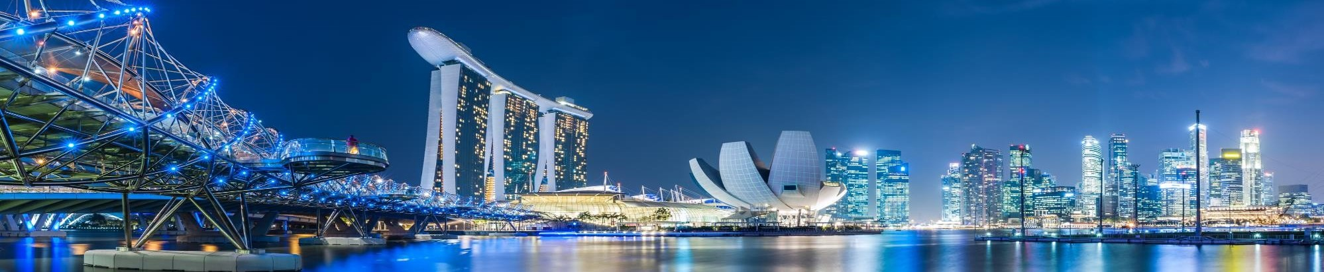
Private & Confidential · Board Strategy Meeting · September 2026
Aravest’s Next Phase
From integration to institution-building: establishing the post-SMFL track record, defining the near-term investment focus and developing the pathways for sustainable long-term growth.
Aravest Fund Management Pte. Ltd. Private and Confidential

Slide 2
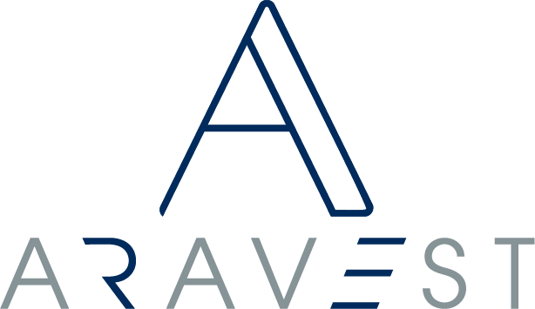
Executive summary
Aravest is moving from integration into institution-building.
The initial integration into SMFL has been substantially completed. The next phase is to develop the institutional foundations and investment record required for sustainable long-term growth.
01 Values-led. Value-focused.
Aravest is values-led in how it invests and value-focused in where it deploys — sector-flexible, but not strategy-neutral.
02 A track record through the full lifecycle
Built not through acquisitions alone, but through judgement, execution, stewardship, performance, realisation and repeatability.
03 Two parallel pathways
Diversified Track Record Building, supported by the existing US$300 million; and Institutional-Scale Opportunities, brought to the Board case-by-case.
04 Structured to institutional standards
Committed equity is exposed to performance; wider liabilities are ring-fenced, with no automatic recourse to Aravest or SMFL.
Private and Confidential
2

Slide 3
Strategy · Two parallel pathways
Aravest will build the platform through two complementary pathways.
PATHWAY 1
Diversified Track Record Building
PATHWAY 2
Institutional-Scale Opportunities
PRIMARY PURPOSE
Build multiple proof points and a repeatable post-SMFL investment record.
PRIMARY PURPOSE
Accelerate AUM, institutional relevance and market visibility.
TYPICAL OPPORTUNITY
Selected small and medium transactions across repeatable themes.
TYPICAL OPPORTUNITY
Selected large transactions capable of creating meaningful scale.
CAPITAL PROFILE
Existing US$300 million support, diversified across several investments.
CAPITAL PROFILE
May require materially greater transaction-specific capital.
RISK PROFILE
More diversified, with lower single-asset concentration.
RISK PROFILE
Higher single-asset concentration and liquidity exposure.
EXPECTED AUM EFFECT
Gradual and potentially uneven.
EXPECTED AUM EFFECT
Potential step-change growth.
The two pathways run in parallel — the first builds the record; the second can accelerate scale.
Private and Confidential
3

Slide 4
Capital & AUM · Dashboard
The two pathways are expected to produce different AUM profiles.
SPONSOR CAPITAL SUPPORT
US$300m
Existing support available to diversify across Pathway 1
OPENING AUM
—
To be populated by Finance
NET INVESTMENT / (REALISATIONS)
—
To be populated by Finance
CLOSING AUM
—
To be populated by Finance
Closing AUM = Opening AUM + New investments − Realisations ± Valuation and FX movements
Diversified Track Record Building
AUM growth is likely to be gradual and uneven — it may remain flat where new investments replace realisations, or decline temporarily following successful disposals or sell-downs.
Institutional-Scale Opportunities
Provide the potential for a material or step-change increase in AUM and more meaningful institutional ticket sizes, strengthening visibility and fundraising credibility.
PROOF POINT — CONRAD SEOUL
Sponsor-supported acquisition; institutional capital subsequently introduced (GIC, M&G), recycling capital while retaining the management relationship.
Source: Locked Board Strategy Narrative v8. Financial figures to be populated by Finance and refreshed by the relevant transaction teams before Board circulation.
Private and Confidential
4

Slide 5
Board decision required
The Board is asked to endorse the two-pathway strategy and the basis on which capital is committed.
1
Endorse the two parallel pathways as the basis for building the Aravest platform — diversified track-record building alongside selective institutional-scale opportunities.
2
Support deployment of the existing US$300 million across Pathway 1 to build multiple proof points and diversify risk.
3
Endorse warehousing as an execution enabler bridging the timing gap between securing a transaction and forming third-party capital.
4
Agree each Institutional-Scale Opportunity is brought to the Board separately with its investment merits, capital requirement and risk profile, for decision case-by-case.
BASIS OF CAPITAL COMMITMENT
Committed equity is exposed to investment performance; wider fund and asset liabilities are generally ring-fenced, with no automatic recourse to Aravest as manager or SMFL as shareholder. Any exception must be explicit and separately approved.
Formal resolutions to be confirmed by management and the company secretary. This slide reflects the locked Board Strategy Narrative v8 and does not itself constitute a resolution.
Private and Confidential
5

Slide 6
Investment case · Current pipeline
Current opportunities illustrate how the two pathways may develop in practice.
Strategic role | Illustrative opportunities | Connection to the pathway
Institutional-scale opportunity | Marina One and other selected large opportunities. | Potential to create a material increase in AUM, institutional relevance and market visibility.
Portfolio building block | Project Guardian / PBSA and subsequent PBSA opportunities. | Build a repeatable strategy through aggregation into a portfolio of institutional scale.
Track-record proof point | Courtyard by Marriott Suwon, ARA-NH Fund 2, Aberdeen / Shinyoung recapitalisation and other relevant transactions. | Deepen post-SMFL execution evidence and create additional realisation or recycling pathways.
Private credit is excluded as a core Aravest growth strategy (an agreed SMDAM strategy, with Aravest providing support where relevant). Transaction names, figures and status to be refreshed by the relevant transaction teams before Board circulation.
Private and Confidential
6

