Slide 1


Board Strategy Meeting · September 2026
Aravest’s Next Phase
From integration to institution-building: establishing the post-SMFL track record, defining the near-term investment focus and developing the pathways for sustainable long-term growth.
Aravest Fund Management Pte. Ltd. Private and Confidential

Slide 2
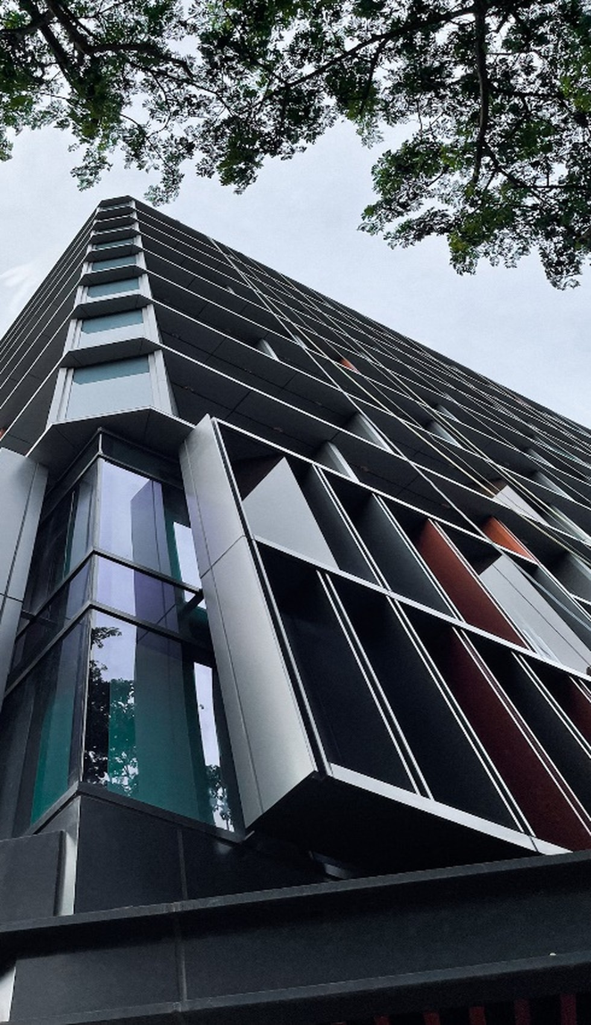
Board Strategy Meeting · September 2026
Aravest’s Next Phase
From integration to institution-building: establishing the post-SMFL track record, defining the near-term investment focus and developing the pathways for sustainable long-term growth.
Aravest Fund Management Pte. Ltd. Private and Confidential

Slide 3
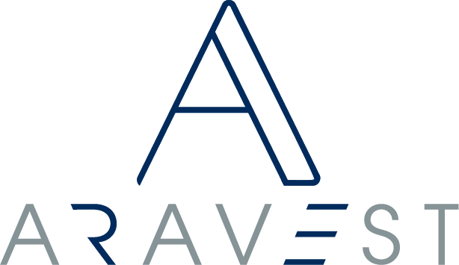
Aravest is moving from integration
into institution-building.
The initial integration into SMFL has been substantially completed. The next phase is to develop the institutional foundations and investment record required for sustainable long-term growth.
01
The Aravest Way
Values-led in how it invests; value-focused in where it deploys.
Investment management is a responsibility before it is a business — sector-flexible, but not strategy-neutral.
02
The post-SMFL record
Judgement, execution, stewardship, performance, realisation and repeatability.
Confidence moves from the individual opportunity, to the repeat relationship, to the Aravest strategy.
03
Two parallel pathways
Diversified track-record building on the existing US$300 million.
Institutional-scale opportunities, case-by-case, can accelerate AUM, relevance and visibility.
04
Institutional standards
Committed equity bears performance; wider liabilities are ring-fenced.
No automatic recourse to Aravest or SMFL; every fund structured to institutional standards.
One strategy. The standards stay constant while the record, the pathways and the structure compound into an institution.
Private and Confidential
2

Slide 4
Strategy · Two parallel pathways
Aravest will build the platform through two complementary pathways.
Pathway 1 — Diversified Track Record Building
BUILDS THE RECORD
Pathway 2 — Institutional-Scale Opportunities
CAN ACCELERATE SCALE
PRIMARY PURPOSE
Build multiple proof points and a repeatable post-SMFL investment record.
PRIMARY PURPOSE
Accelerate AUM, institutional relevance and market visibility.
TYPICAL OPPORTUNITY
Selected small and medium transactions across repeatable themes.
TYPICAL OPPORTUNITY
Selected large transactions capable of creating meaningful scale.
CAPITAL PROFILE
The existing US$300 million support, diversified across several investments.
CAPITAL PROFILE
May require materially greater transaction-specific capital.
RISK PROFILE
More diversified, with lower single-asset concentration.
RISK PROFILE
Higher single-asset concentration and greater liquidity exposure.
EXPECTED AUM EFFECT
Gradual and potentially uneven growth.
EXPECTED AUM EFFECT
Potential step-change growth.
RUN IN PARALLEL Pathway 1 builds the record; Pathway 2 can accelerate scale.
Private and Confidential
3

Slide 5
Capital & AUM
The two pathways are expected to produce different AUM profiles.
Closing AUM = Opening AUM + New investments − Realisations ± Valuation and FX movements
SPONSOR CAPITAL SUPPORT
US$300m
Existing support, diversified across several Pathway 1 investments.
Warehousing bridges transaction execution and third-party capital formation.
Pathway 1 — gradual and uneven
Pathway 2 — potential step-change
AUM may grow gradually, remain flat where new investments replace realisations, or decline temporarily after disposals or sell-downs.
Illustrative profile only — not a forecast.
A single institutional-scale transaction can create a material or step-change increase in AUM and more meaningful ticket sizes.
Illustrative profile only — not a forecast.
PROOF POINT — CONRAD SEOUL Sponsor-supported acquisition; institutional capital subsequently introduced (GIC, M&G), recycling capital while retaining the management relationship.
Source: Locked Board Strategy Narrative v8. Financial figures to be populated by Finance before Board circulation.
Private and Confidential
4

Slide 6
For decision
The Board is asked to endorse the two-pathway strategy and the basis on which capital is committed.
01 ENDORSE
the two parallel pathways as the basis for building the Aravest platform — diversified track-record building alongside selective institutional-scale opportunities.
02 SUPPORT
deployment of the existing US$300 million across Pathway 1 to build multiple proof points and diversify risk.
03 ENDORSE
warehousing as an execution enabler, bridging the timing gap between securing a transaction and forming third-party capital.
04 AGREE
that each Institutional-Scale Opportunity is brought to the Board separately — with its investment merits, capital requirement and risk profile — for decision case-by-case.
GOVERNING PRINCIPLE
Committed equity is exposed to investment performance; wider fund and asset liabilities are generally ring-fenced, with no automatic recourse to Aravest as manager or SMFL as shareholder. Any exception must be explicit and separately approved.
Formal resolutions to be confirmed by management and the company secretary; this slide reflects the locked Board Strategy Narrative v8 and does not itself constitute a resolution.
Private and Confidential
5

Slide 7
For decision — alternative treatment
The Board is asked to endorse the two-pathway strategy and the basis on which capital is committed.
01 ENDORSE
the two parallel pathways as the basis for building the Aravest platform — diversified track-record building alongside selective institutional-scale opportunities.
02 SUPPORT
deployment of the existing US$300 million across Pathway 1 to build multiple proof points and diversify risk.
03 ENDORSE
warehousing as an execution enabler, bridging the timing gap between securing a transaction and forming third-party capital.
04 AGREE
that each Institutional-Scale Opportunity is brought to the Board separately — with its investment merits, capital requirement and risk profile — for decision case-by-case.
GOVERNING PRINCIPLE
Committed equity is exposed to investment performance; wider fund and asset liabilities are generally ring-fenced, with no automatic recourse to Aravest as manager or SMFL as shareholder. Any exception must be explicit and separately approved.
Formal resolutions to be confirmed by management and the company secretary; this slide reflects the locked Board Strategy Narrative v8 and does not itself constitute a resolution.
Private and Confidential
5A

Slide 8
Investment case · Current pipeline
Current opportunities illustrate how the two pathways may develop in practice.
STRATEGIC ROLE
ILLUSTRATIVE OPPORTUNITIES
CONNECTION TO THE PATHWAY
Institutional-scale opportunity
PATHWAY 2
Marina One and other selected large opportunities.
Potential to create a material increase in AUM, institutional relevance and market visibility.
Portfolio building block
PATHWAY 1
Project Guardian / PBSA and subsequent PBSA opportunities.
Build a repeatable strategy through aggregation into a portfolio of institutional scale.
Track-record proof point
PATHWAY 1
Courtyard by Marriott Suwon, ARA-NH Fund 2, Aberdeen / Shinyoung recapitalisation and other relevant transactions.
Deepen post-SMFL execution evidence and create additional realisation or recycling pathways.
Private credit is excluded as a core Aravest growth strategy (an agreed SMDAM strategy, with Aravest providing support where relevant). Transaction names, figures and status to be refreshed by the relevant transaction teams before Board circulation.
Private and Confidential
6

