Slide 1
Status Report:
IST 687
Sinem Aytac • Emmanuel Victor Kamya • Abhijith Vamadev

Slide 2
Overview
Data Structure
Data Preparatory Work
EDA
Maps
Machine Learning - Logistic Regression
Final Recommendation /Conclusion

Slide 3
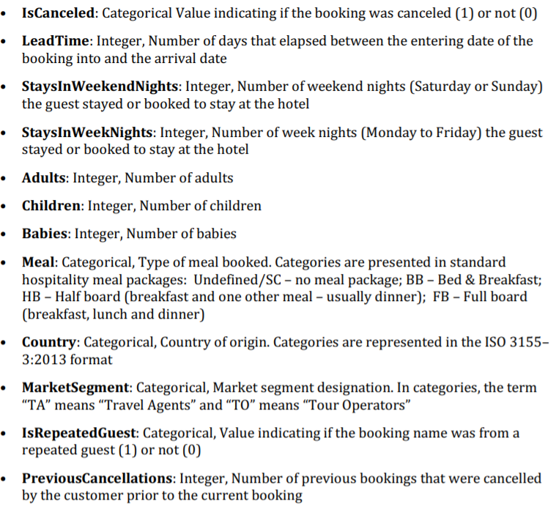
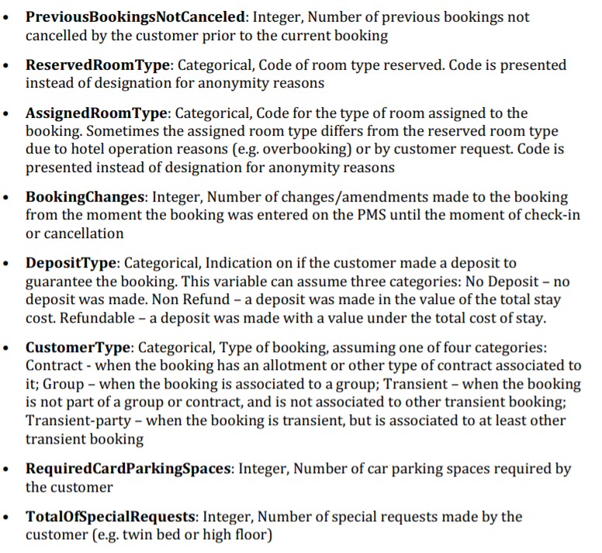
Data (40,600,20)
Notes:
So this is the list of variables that we will be covering for our analysis. And our dependent variable being the IsCancelled variable which is a binary variable that indicates if the booking was cancelled or not. There are overall 40, 600 rows of data with 20 variables.

Slide 4
Data Preparatory Work
Checked for null values - No null values present
Checked for negative values - No negative values present
Notes:
Before starting the EDA process, we started by preparing the data for viewing. Initially we started by checking for null values, and then negative values, none of which were found in any of the columns.

Slide 5
Data Preparatory Work
Checked for null values - No null values present
Checked for negative values - No negative values present
Created a new variable - StayInNights = StayInWeekendNights + StayInWeekNights
Notes:
Then we created a new variable called StayInNights which is the combination of Weekend and Week Nights, we created this to see the overall number of days that they would be booking for.

Slide 6
Data Preparatory Work
Checked for null values - No null values present
Checked for negative values - No negative values present
Created a new variable - StayInNights = StayInWeekendNights + StayInWeekNights
Separated variables into numeric and categorical:
Numeric: LeadTime, StaysInWeekendNights, StaysInWeekNights, StayInNights, Adults, Children, Babies, PreviousCancellations, PreviousBookingsNotCanceled, BookingChanges, RequiredCarParkingSpaces, TotalOfSpecialRequests
Categorical: IsCanceled, Meal, Country, MarketSegment, IsRepeatedGuest, ReservedRoomType , AssignedRoomType, DepositType, CustomerType
Notes:
After that we separated the variables into Numerical and Categorical. We have 12 numerical variable, and 9 categorical variables, as shown here.

Slide 7
Data Preparatory Work
Checked for null values - No null values present
Checked for negative values - No negative values present
Created a new variable - StayInNights = StayInWeekendNights + StayInWeekNights
Separated variables into numeric and categorical:
Numeric: LeadTime, StaysInWeekendNights, StaysInWeekNights, StayInNights, Adults, Children, Babies, PreviousCancellations, PreviousBookingsNotCanceled, BookingChanges, RequiredCarParkingSpaces, TotalOfSpecialRequests
Categorical: IsCanceled, Meal, Country, MarketSegment, IsRepeatedGuest, ReservedRoomType , AssignedRoomType, DepositType, CustomerType
Used Square Root transformation for all the numerical variables.
Notes:
After the separation of the variables, we looked at the numerical variables and it was seen that most of the variables were heavily skewed, so we ran each of the variables through the sqrt transformation, initially we tried with log, but as 0’s were present in many of the columns, we went with sqrt transformation.

Slide 8
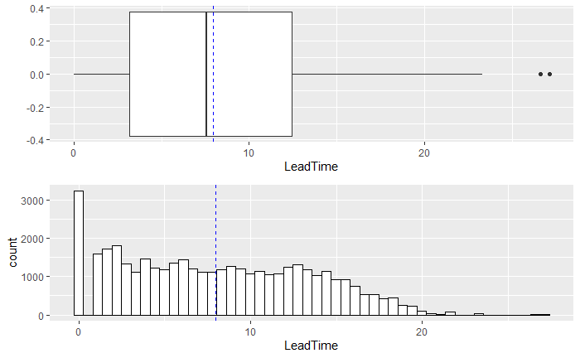
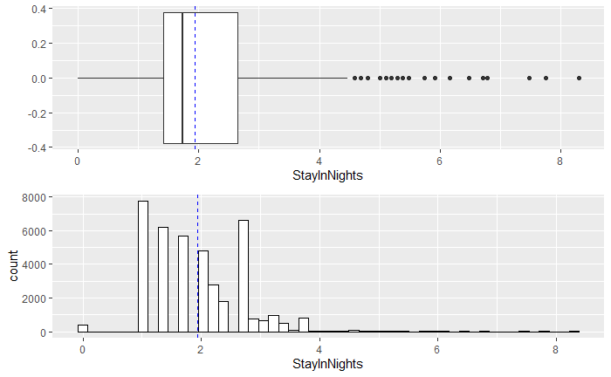
Univariate Analysis
Notes:
We will be discussing the 4 most important variables to determine Cancellation variable - LeadTime, StayInNights, MarketSegment and TotalSpecialRequests.
Looking at all the variables, all the numerical variables went through sqrt transformation, the graphs shown above are the associated Boxplot with the histogram of the associated variable.
Both variables after transformation has some outliers.

Slide 9
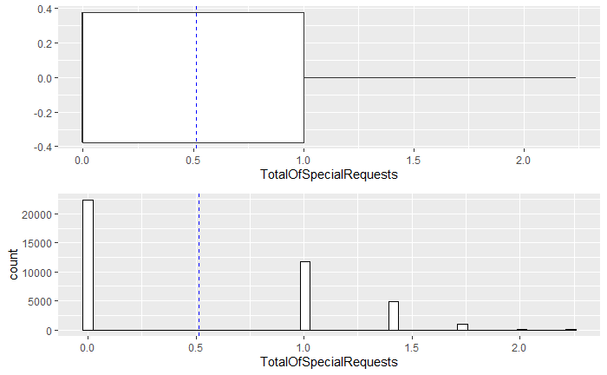
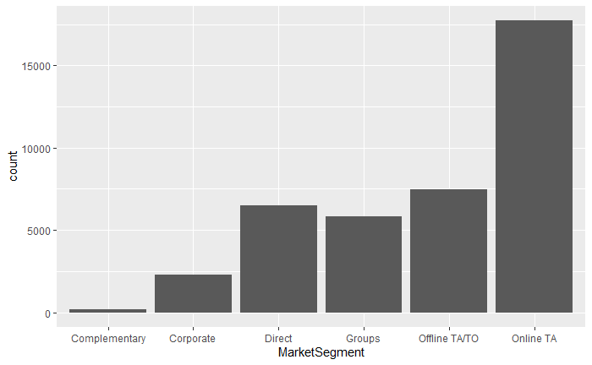
Univariate
Notes:
Looking at TotalSpecial Requests, there seem to be no outliers. However, as we can see most of the special requests are either 0, 1, 2 or 3. Limited amount of numbers with high frequency.
For Market segment Online TA has the highest frequency, followed by Offline TA and Direct, the least active MarketSegment is Complementary

Slide 10
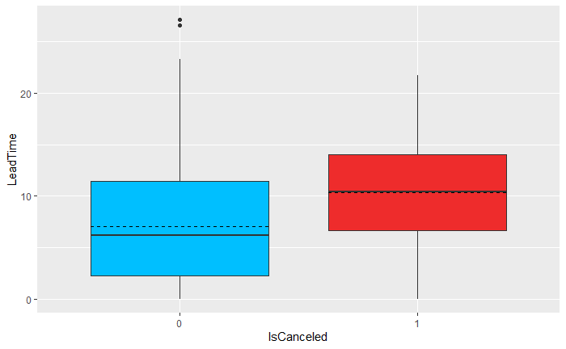
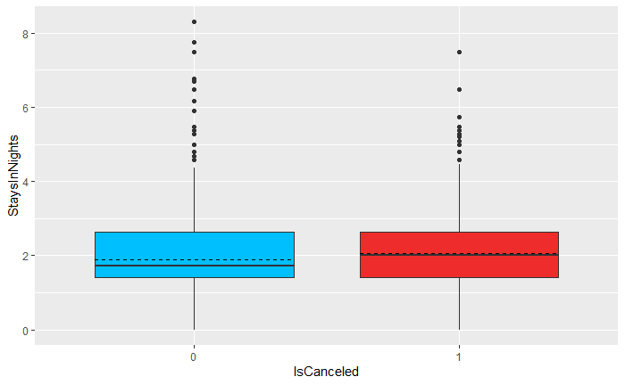
Bivariate Analysis
Notes:
The graph represents the numerical variables on the y-axis and Cancellation (Dependent variable) on the X-axis.
The Dark line represents the median and the dotted lines represent the mean.
For the cancellations, on average it can be seen that both LeadTime and StayInNights is higher, than with non-cancellations.
Again many outliers are visible for StayInNights

Slide 11
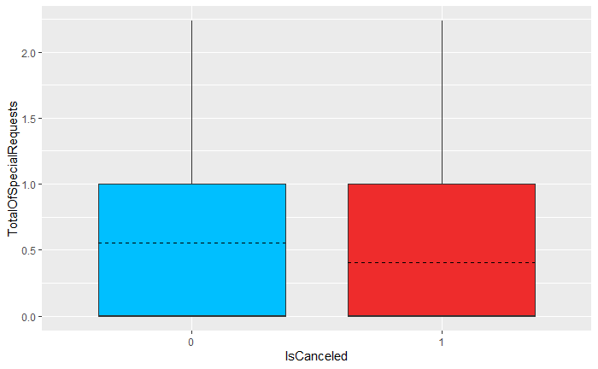
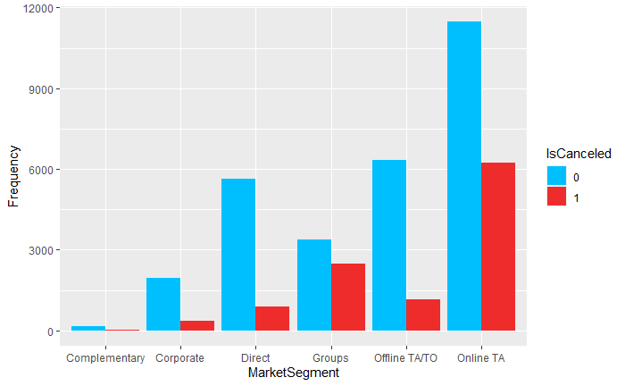
Bivariate Analysis
Notes:
For TotalSpecialRequests, on average there are many requests for non-cancelled bookings than for cancelled bookings.
For the Cancellation variable, we can see that for the there is more data for the non-cancellations than the cancellations.
Online TA has the highest non-cancellations followed by offline TA and Direct.
For cancellations, a similar trend shows where Online TA is the highest followed by Groups.

Slide 12
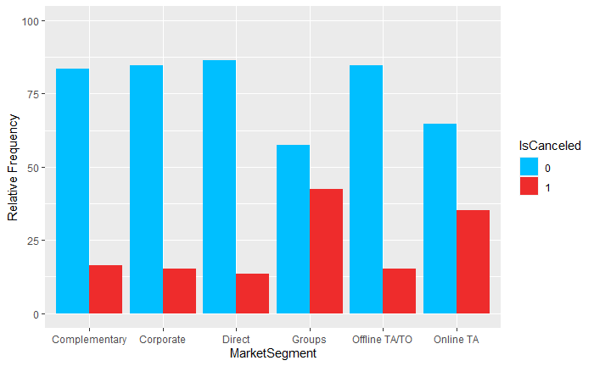
Bivariate Analysis

Slide 13
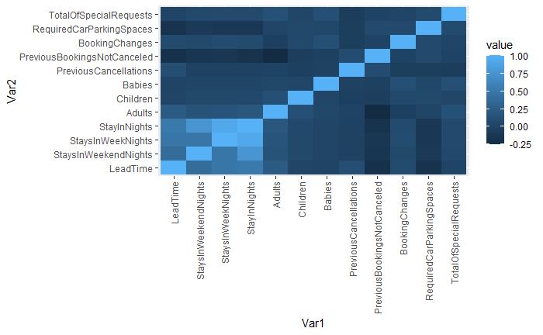
Bivariate Analysis
Notes:
We took all the correlation data among each of the numerical variables and plotted them on a heatmap. Wherever the color is the lightest it shows the most correlation, and wherever it is the darkest it shows the least correlation.
Looking at the heatmap, we can see that WeekendNights, WeekNights and Nights are all correlated which makes sense as these variables are dependent on each other.
Other than that we couldn’t find variables that showed significance prominence.

Slide 14
Maps

Slide 15
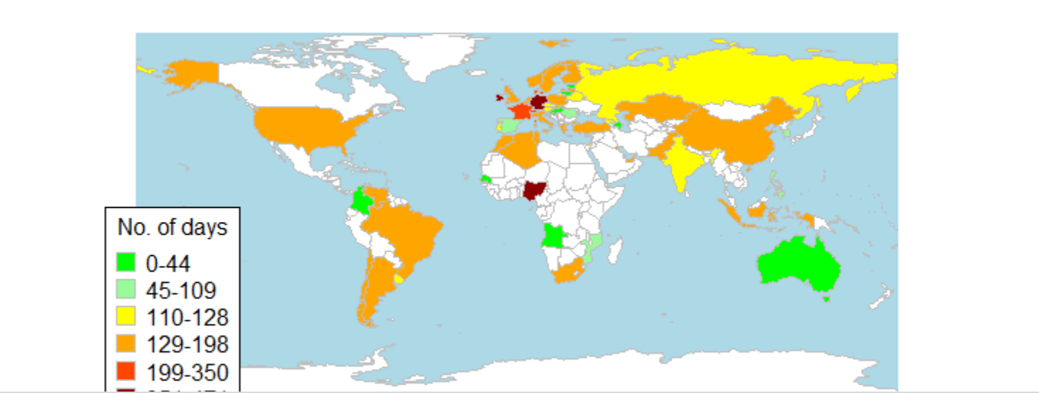
Map showing lead time for cancellations

Slide 16
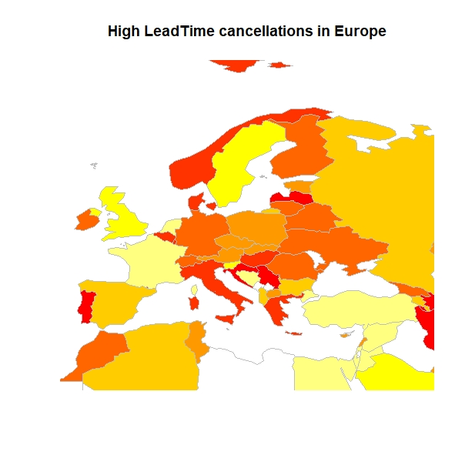

Slide 17
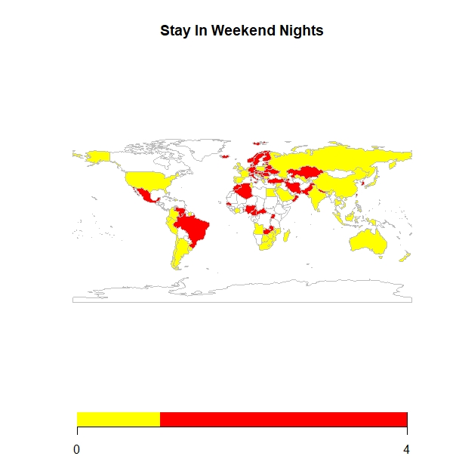
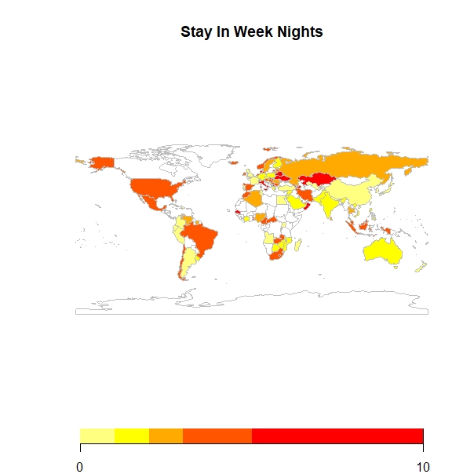

Slide 19
Machine Learning:
Logistic Regression

Slide 20
Logistic Regression
Lead Time
Overall Stays in Nights
Total # of Special Requests
Market Segment

Slide 21
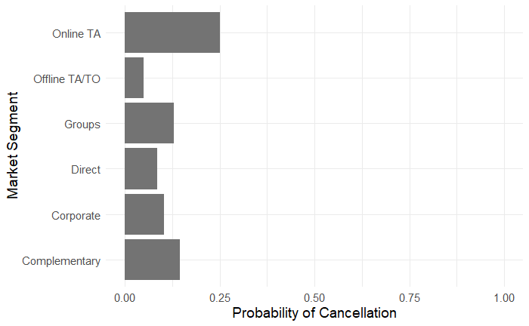
Market Segment
Cancellation is 6.5x more likely when booked through online platforms rather than through offline platforms.
Notes:
Online Travel Agents have ~25% chance of cancellation,
Groups have ~13% chance of cancellation,
Complementaries have ~15% chance of cancellation
Corporates have ~10% chance of cancellation;
whereas Direct bookings have only ~9% and Offline Travel Agents/Tour Operators have only ~5% chance of cancellation.
#Overall, looking at the predictions above, we expect higher chance of cancellation when the reservation is made through Online than through Offline platforms, for example. Specifically, it’s 6.5x more likely to cancel if you booked through online platforms rather than through offline platforms.

Slide 22
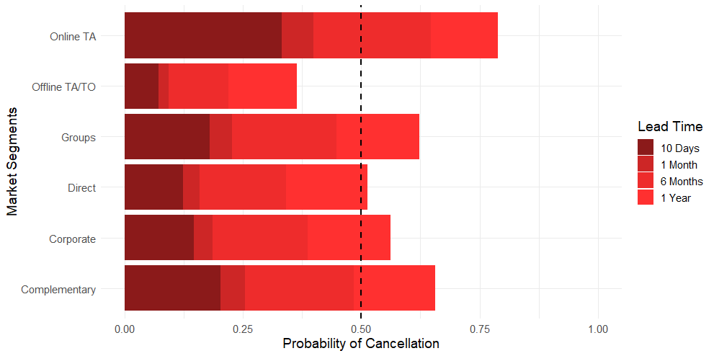
Lead Time
Notes:
After a year lead time, people will be more likely to cancel their hotel reservations except if they did it through offline platforms.

Slide 23
Number of Nights Stayed
Every one more night booked to stay in a hotel (regardless of week day or weekend) increases the odds for cancellation by around 7%.

Slide 24
Total Number of Special Requests
Every additional special request by customers decreases the odds for cancellation by around 58%.
Notes:
Every additional special request by customers decreases the odds of cancellation by ~58%.

Slide 25
When Lead Time is on average;
Stays in Night is on average.
Notes:
Lead Time = ~3 months
Stays in Nights = ~4 days

Slide 26
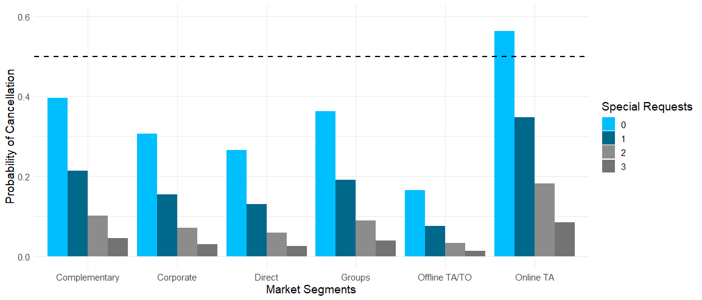
Total Number of Special Requests
Notes:
When lead time is average lead time (~3 months); when stays in nights is average nights (for ~4 days):

Slide 27
When Lead Time is a year;
Stays in Night is on average.
Notes:
Lead Time = 1 year
Stays in Nights = ~4 days

Slide 28
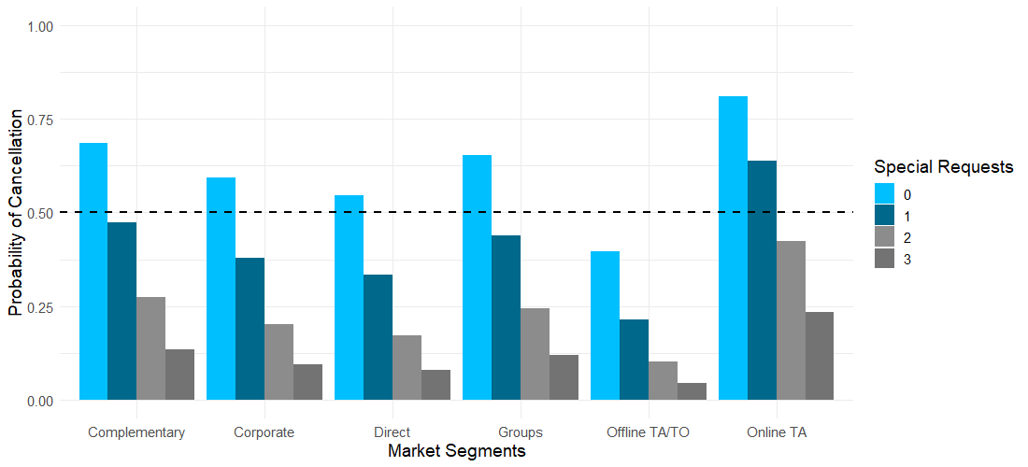
Total Number of Special Requests
Notes:
When lead time is 1 year; when stays in nights is average nights (for ~4 days):

Slide 29
Conclusions

Slide 30
Cancellations are expected MORE:
When a hotel reservation is made through online platforms.
When a year has passed since the booking.

Slide 31
Cancellations are expected LESS:
With each special request made by customer.

Slide 32
Thank you!

