Slide 1
NGS – variant analysis Introduction to variant analysis

Slide 2
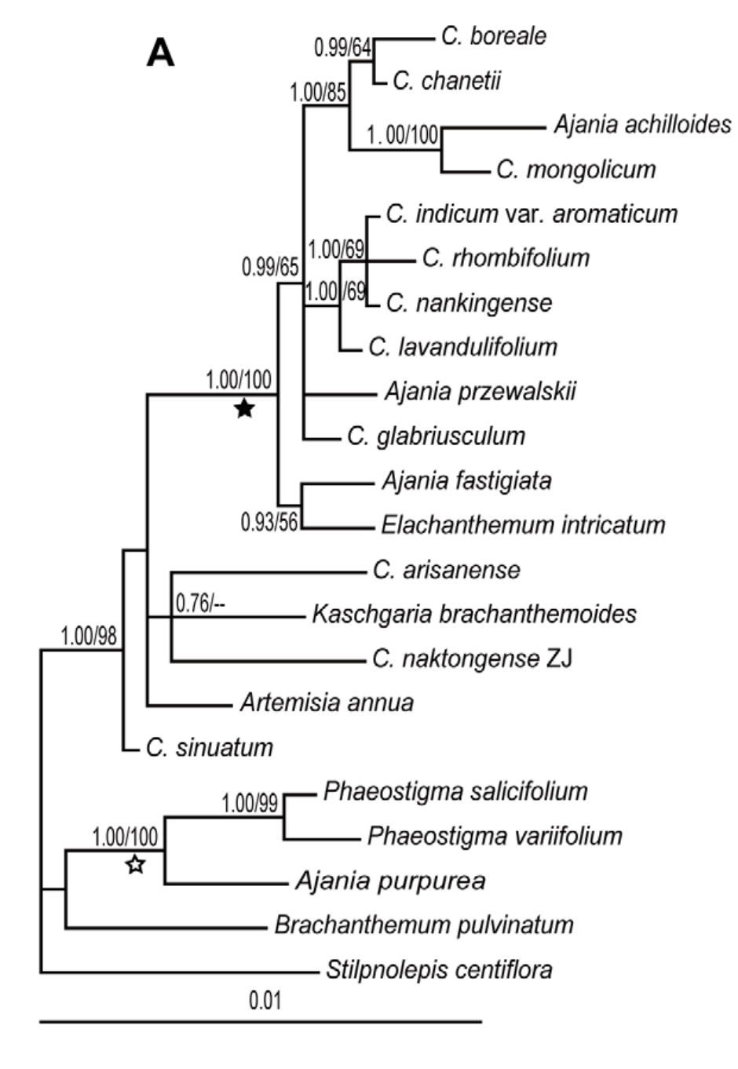
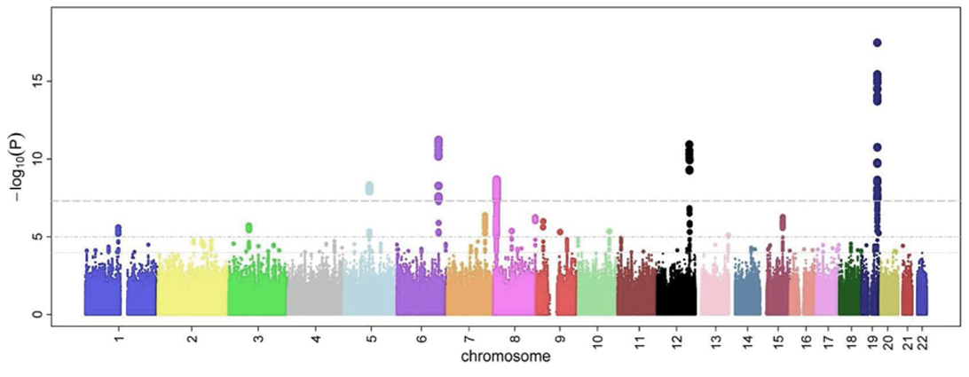
Why study variants?
Find causes for phenotypic variation
Understand relatedness
https://en.wikipedia.org/wiki/Genome-wide_association_study
Liu PL et al. PLoS One (2012) 7:e48970

Slide 3

Mutation
Causes variation
Change in DNA sequence
CCD4a
Carotenoids
Apocarotenoids

Slide 4

Mutations - causes
Repair mistakes
Unbalanced cell division
Transposable elements
https://nl.wikipedia.org/wiki/Springend_gen

Slide 5

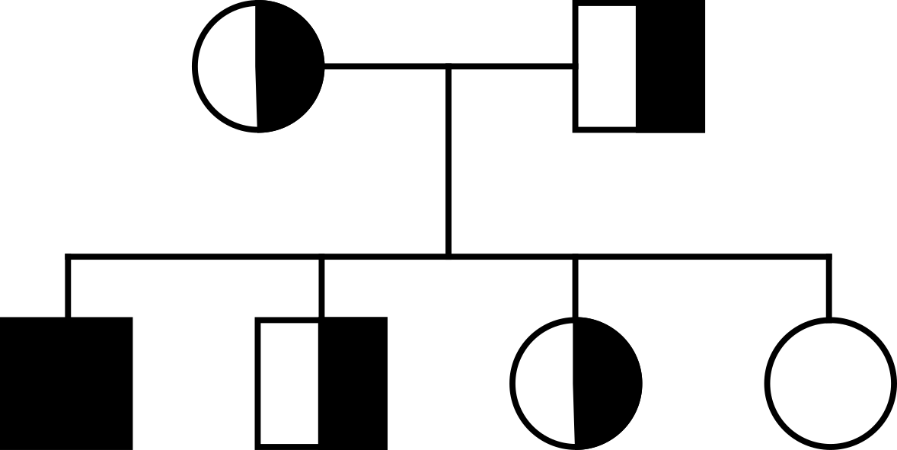
Mutations - types
inherited – germline variant
cells – caused by somatic mutation

Slide 6
Question 4

Slide 7
Some definitions..
Mutation: a change in DNA
Variant: any difference that exists between any DNA
Polymorphism: variation that is common in a population (often AF > 1%)
Variant vs polymorphism can be problematic: depends on the population

Slide 8
nucleus
Allele
repulsion
Haplotype
Heterozygous Variant
coupling
Homozygous variant
homolog A
homolog B
homolog A
homolog B
chromosome 1
chromsome 2

Slide 9
Question 5

Slide 10
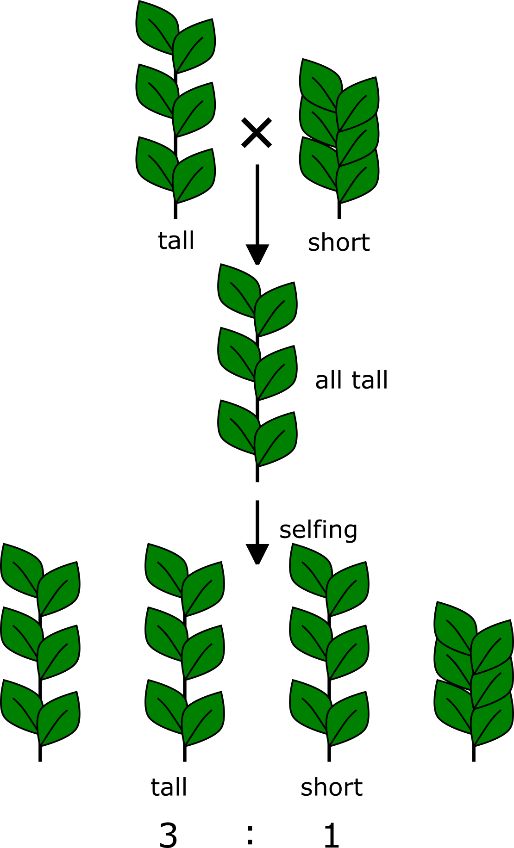
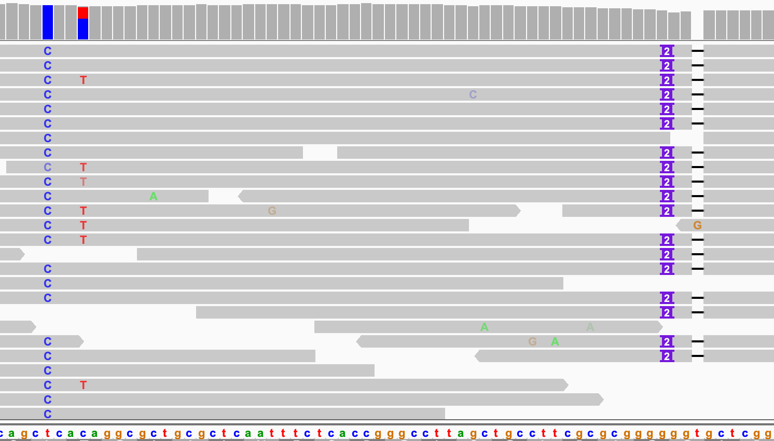
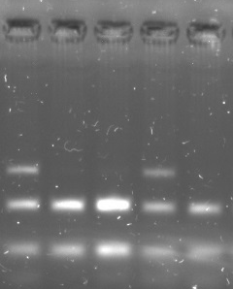
Detecting variants
Phenotypic analysis
Molecular analysis
Sequencing

Slide 11
Small variants
Single nucleotide variant (SNV)
Insertion/deletion (INDEL)
ATCATGACCGTCA
ATCATGTCCGTCA
ATCATGACCGTCA
ATCATG---GTCA

Slide 12
Haplotypes
Major symptoms
NGS variants: mostly SNP
Most SNPs are bi-allelic e.g. [A/T], [G/C]
Genetic variation is often multi-allelic
A
G
Minor symptoms
A
C
T
G
T
C

Slide 13
Question 6
A/T
G/T
T/C

Slide 14
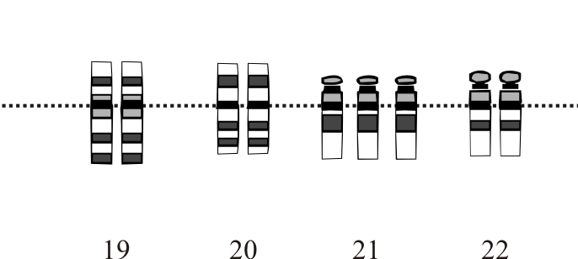
Large variants
Structural variation (> 1,000 base pairs)
Copy number variation
Translocations
Inversions
Deletions/insertions
Chromosomal aberration
https://en.wikipedia.org/wiki/Aneuploidy

Slide 15
This course
Inherited (germline) small variants
Detection by next generation sequencing (NGS)

Slide 17
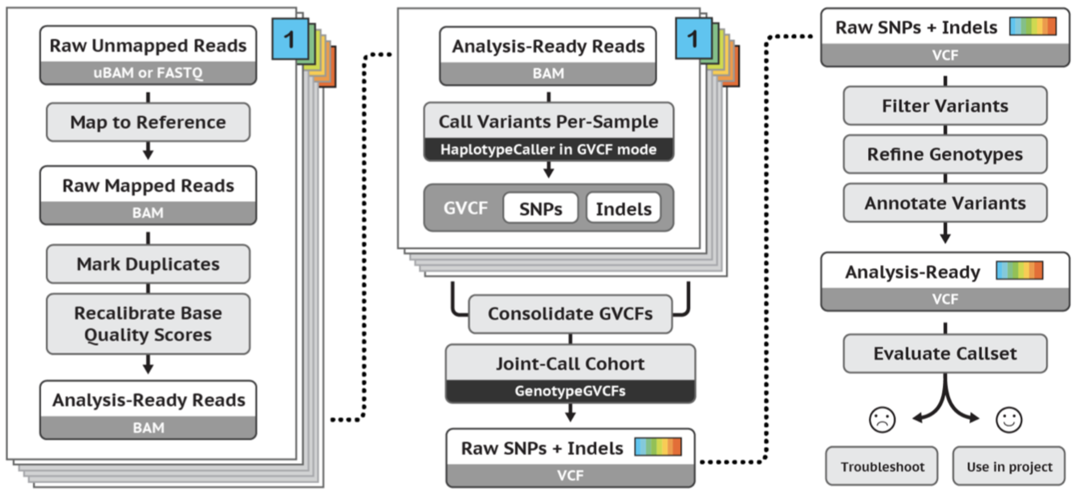
GATK
Today
https://gatk.broadinstitute.org/hc/en-us/articles/360035535932-Germline-short-variant-discovery-SNPs-Indels-

