Slide 1
NGS – variant analysis Sequencing and alignment

Slide 2
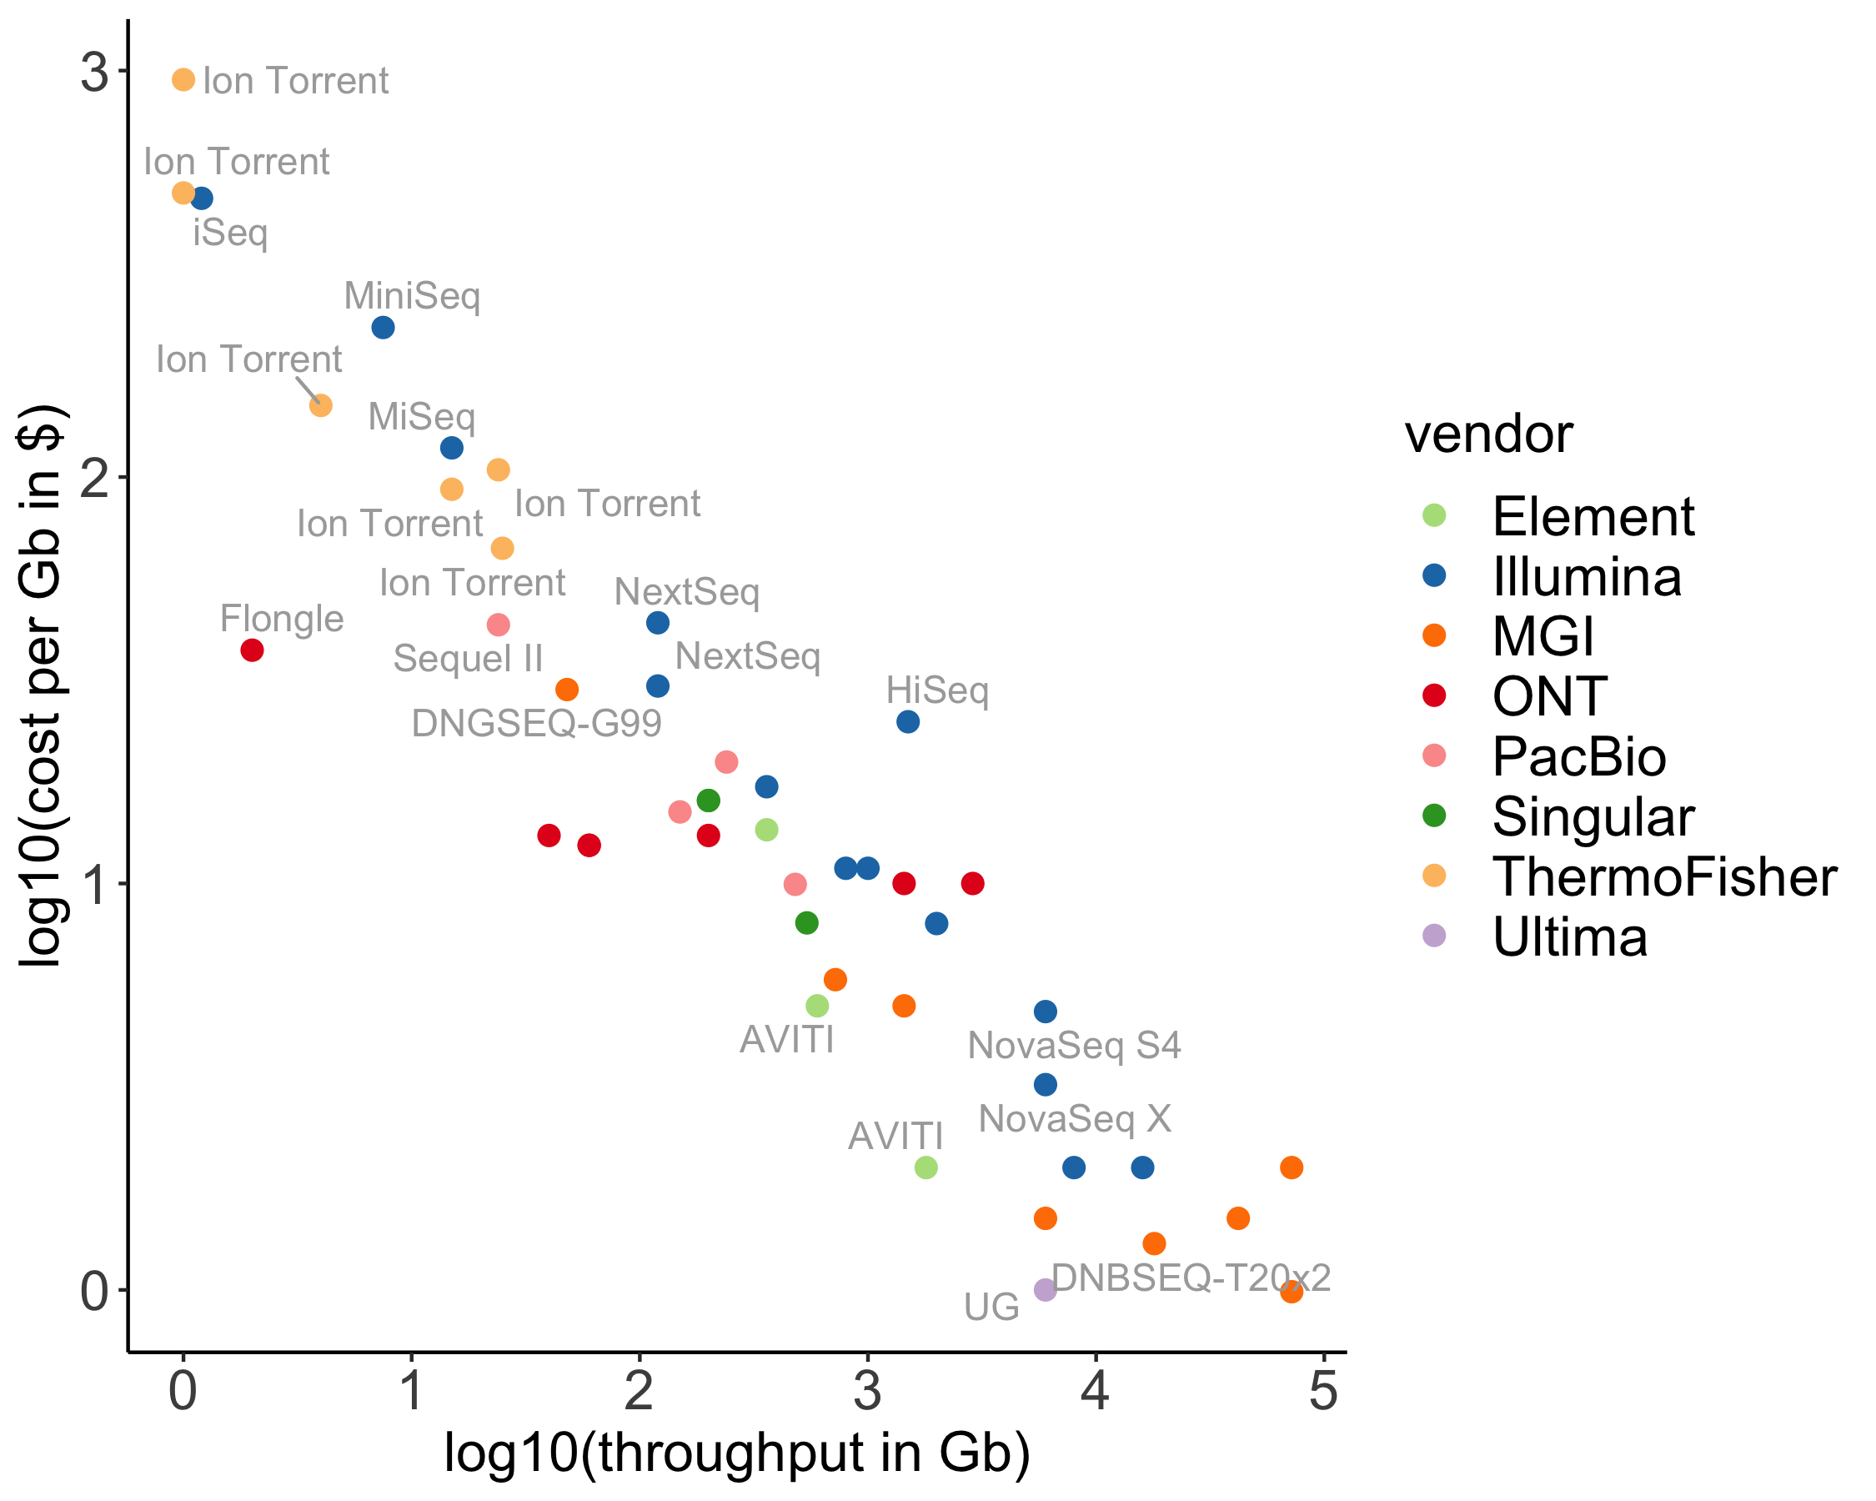
drawn from: https://docs.google.com/spreadsheets/d/1GMMfhyLK0-q8XkIo3YxlWaZA5vVMuhU1kg41g4xLkXc/ Albert Vilella

Slide 3



Sequencing-by-synthesis
2nd generation sequencing
Massive throughput: up to 500x10⁹ bases/run
Illumina still most used platform today

Slide 4

Sequencing-by-synthesis
50 – 300 bp
Paired-end (or single-end)
paired-end

Slide 5
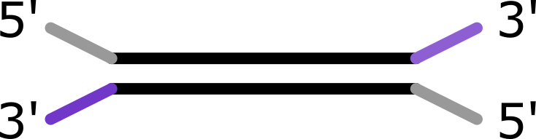
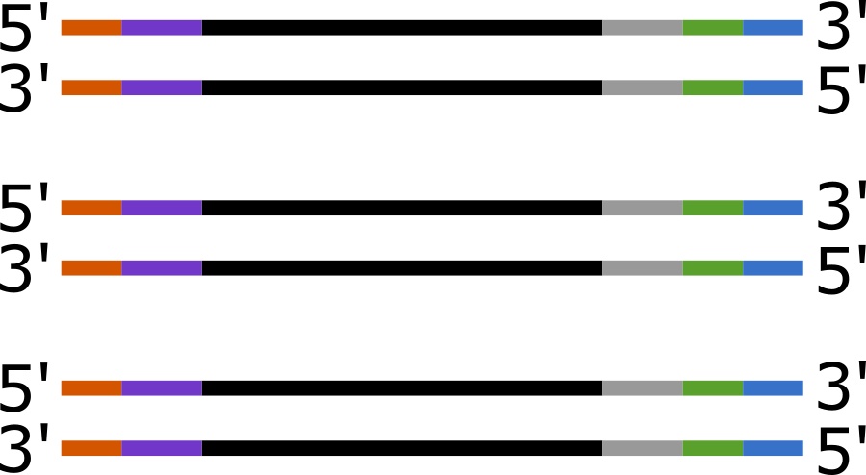
Illumina libray prep
shear DNA
Ligate adapters
Barcode + p5/p7 sites
PCR: 8-16 cycles
Sequencing

Slide 6
Some definitions
p5
adapter
read 1
read 2
adapter
barcode
p7
Fragment
Insert size | Fragment
Inner distance

Slide 7
Some more definitions..
Library: fragments from one (c)DNA sample that share a barcode
Sequencing run: complete cycle of generating reads on a machine
Flow cell: physical platform where sequencing reactions take place. Used once in a sequencing run.
Lane: compartment within the flow cell. An Illumina flow cell often has multiple lanes (2 or 4)

Slide 8
lib1
lib2
lib3
lib4
Libraries
Pooling
lane1
lane2
Demultiplexing
lib1_S1_L001_R1.fastq
lib2_S2_L001_R1.fastq
lib3_S3_L001_R1.fastq
lib4_S4_L001_R1.fastq
lib1_S1_L002_R1.fastq
lib2_S2_L002_R1.fastq
lib3_S3_L002_R1.fastq
lib4_S4_L002_R1.fastq

Slide 9
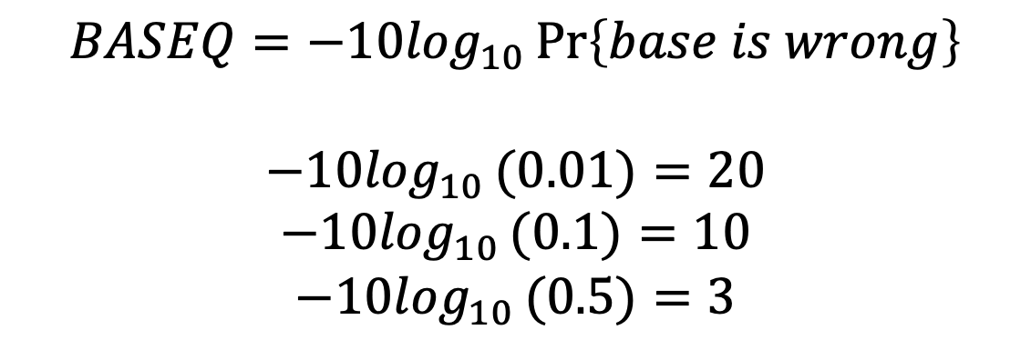
fastq
fasta + basequality (fasta + q = fastq)
$$BASEQ=−{10log}_{10}\operatorname{Pr}\left\{base is wrong\right\}$$
$$−10\log_{10}(0.01){=20}$$
$$−10\log_{10}(0.1){=10}$$
$$−10\log_{10}(0.5){=3}$$

Slide 10
Question 7

Slide 11
fastq files
reads.fastq
title, starts with @
@D00283R:66:CC611ANXX:4:2311:2596:2330 1:N:0:TCCGGAG
ACTCTACGCTCAATAAAGATTTCTGATACGGCTCCTGAAATGCAGAATGAGT
+
B/<<<B<FFFFFFFFFFBBFFFBFFFFBFFFF/FFFFFFFF/BFFFFFBFFF
nucleotide sequence
optional description
base quality
!"#$%&'()*+,-./0123456789:;<=>?@ABCDEFGHI
| | | |
0.2......................26...31........41

Slide 12
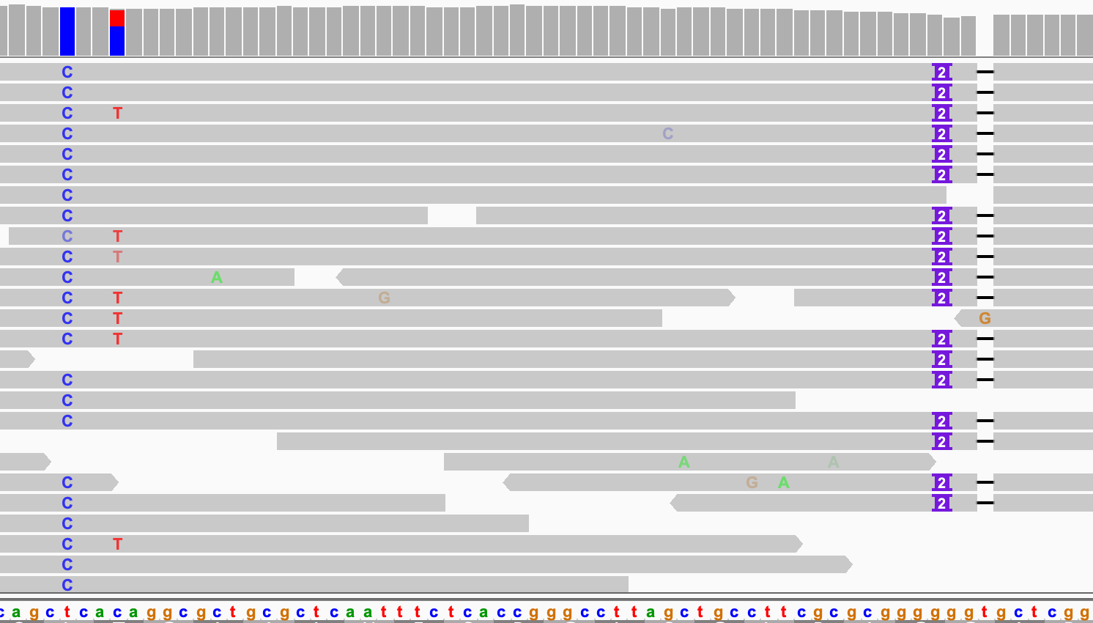

Slide 13
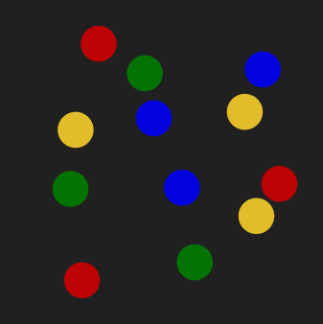
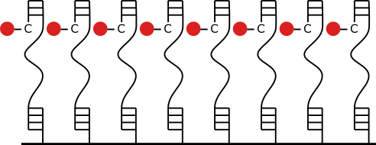
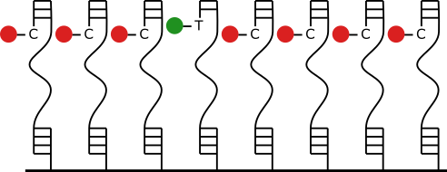
in phase
out of phase

Slide 14
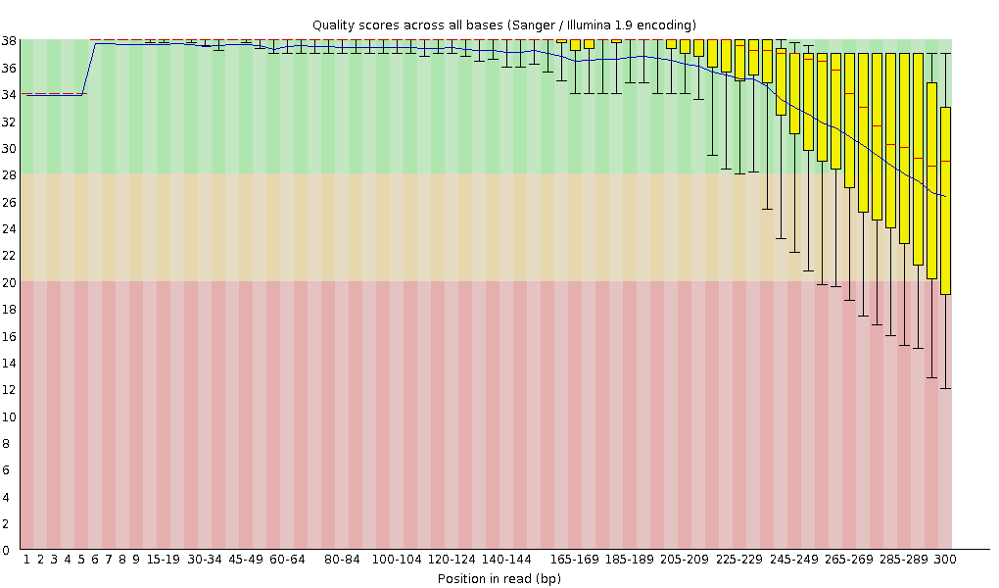
Illumina - limitations
Bridge amplification
Lengths are limited by out-of-phase of signal

Slide 15
Long reads (3rd generation)
Crux: maximizing signal from a single-molecule base read-out
Single molecule, so no out-of-phase signal
Two frequently used platforms:
PacBio SMRT sequencing
Oxford Nanopore Technology

Slide 16
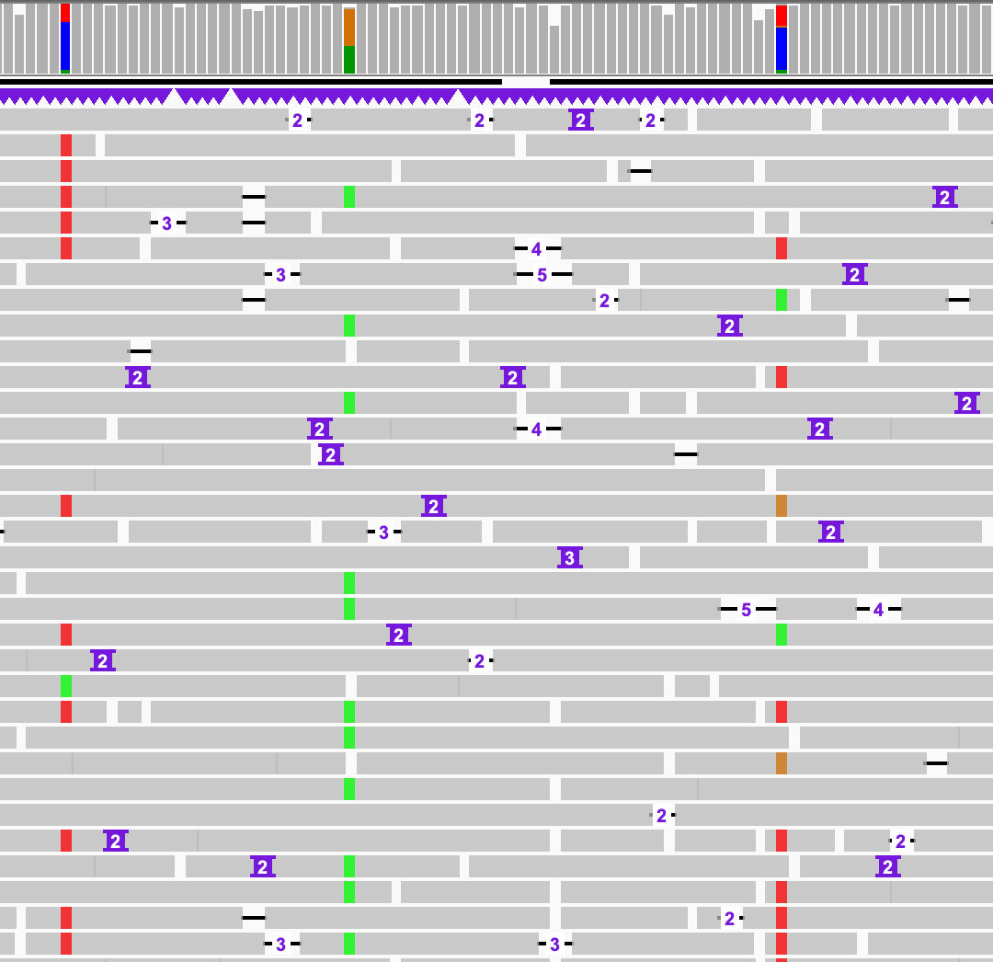

Slide 17
Long reads
More error -> difficulties for variant analysis
But:
PacBio HiFi: high baseQ + no bias
Long reads can have higher mapping qualities
Long reads improve haplotyping

Slide 18
What to sequence?
Whole genome/metagenome
Reduced representation:
Bait capture/whole exome sequencing
Restriction Enzyme based (e.g. RAD seq)
Amplicon sequencing
RNA-seq

Slide 19
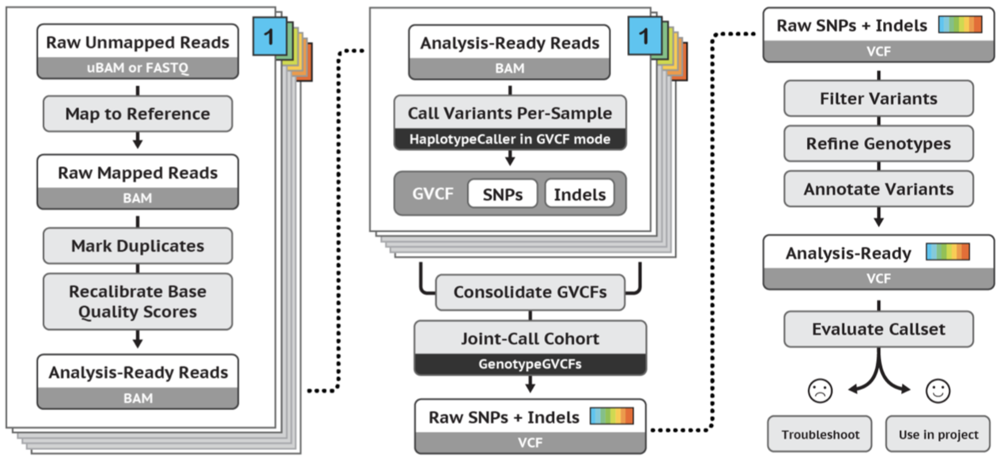
GATK
Today
https://gatk.broadinstitute.org/hc/en-us/articles/360035535932-Germline-short-variant-discovery-SNPs-Indels-

Slide 20
What we don't do today
Looking at reads QC (fastQC, multiQC)
https://sequencing.qcfail.com/
SIB NGS intro course: Quality Control
SIB bulk RNAseq course: Quality Control
Removing adapter sequences, trimming (cutadapt, trimmomatic, fastp ,...)
SIB NGS intro course: trimming
SIB bulk RNAseq course: trimming

Slide 21
Read alignment (phred)
fastq
aligner
sam
fasta

Slide 22
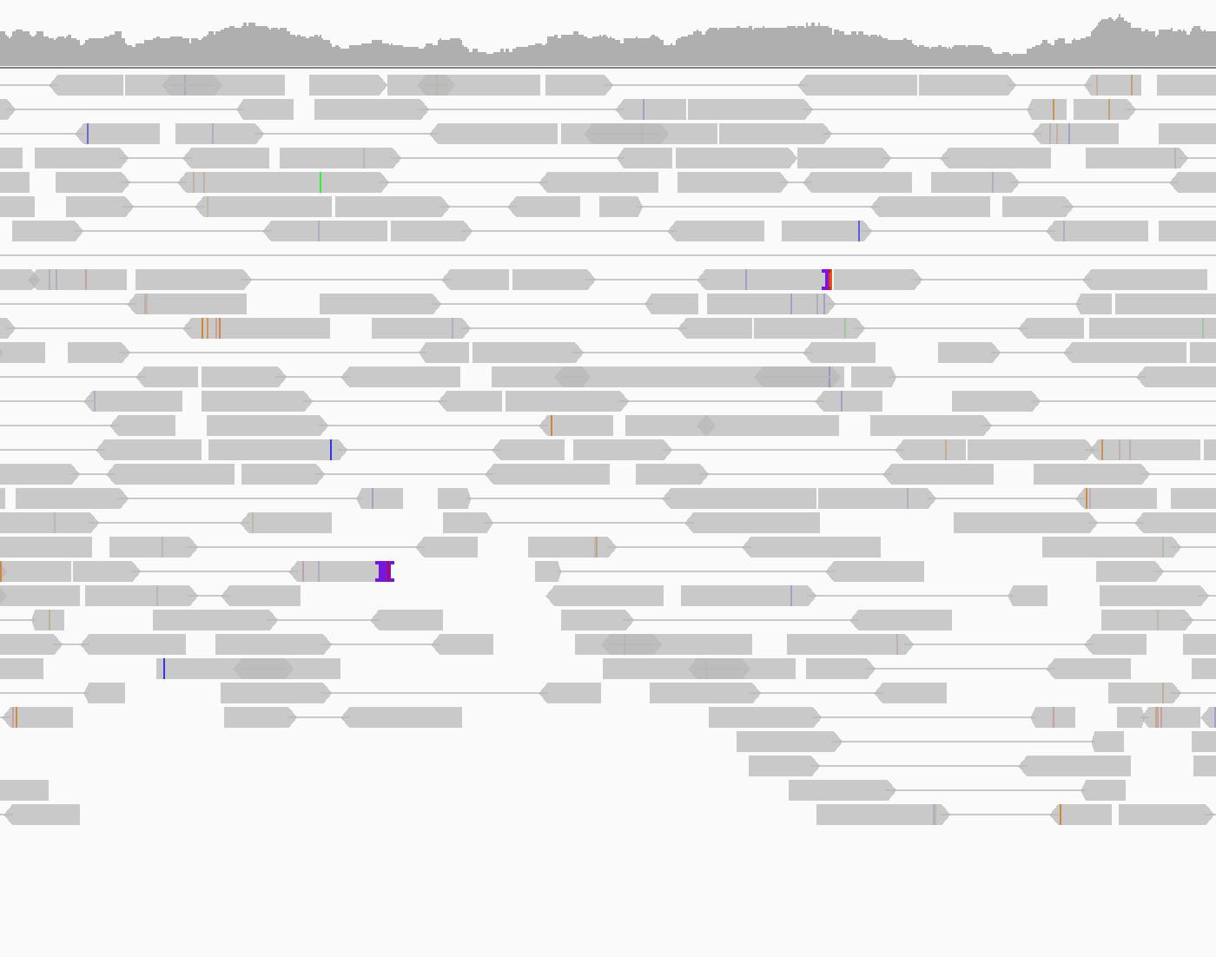

Slide 23
Software
Basic alignment:
bowtie2
bwa-mem
dragen
Long reads:
minimap2
SIB NGS long reads course

Slide 24
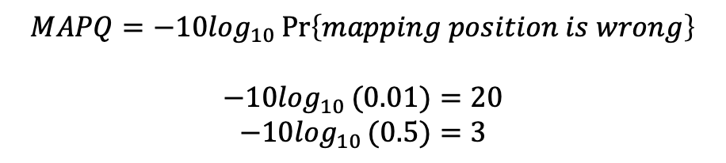
Mapping quality
$$MAPQ=−{10log}_{10}\operatorname{Pr}\left\{mapping position is wrong\right\}$$
$$−10\log_{10}(0.01){=20}$$
$$−10\log_{10}(0.5){=3}$$

Slide 25
Question 8

Slide 26
sam
sequence alignment format
sam
fasta

Slide 27
sam header
@HD VN:1.0 SO:coordinate
@SQ SN:U00096.3 LN:4641652
@PG ID:bowtie2 PN:bowtie2 VN:2.4.1 CL: bowtie2-align-s --wrapper basic-0 -x ref.fasta -1 reads_1.fastq -2 reads_2.fastq"

Slide 28
SAM column | example
read name | SRR519926.5
flag | 89
reference | chr20
start position | 61
mapping quality | 42
CIGAR string | 150M
reference name mate is mapped | =
start position mate | 476
fragment length | 515
sequence | CATCACCATTCCCAC
base quality | @>4:4C@89+&9CC@
optional | AS:i:-2
optional | RG:Z:rg1

Slide 29
Question 9

Slide 30
Read groups
Have multiple groups of reads in a bam file
Add metadata to alignments:
Samples
Libraries
Lanes
..

Slide 31
Read groups
@RG ID:rg1 LB:lib1 SM:sampleA
@RG ID:rg2 LB:lib2 SM:sampleA
read1 456345 chr20 RG:Z:rg1
read2 456348 chr20 RG:Z:rg2
read3 456357 chr20 RG:Z:rg2
read4 456359 chr20 RG:Z:rg1

Slide 32
Marking duplicates
duplicates
sam
fasta

Slide 33
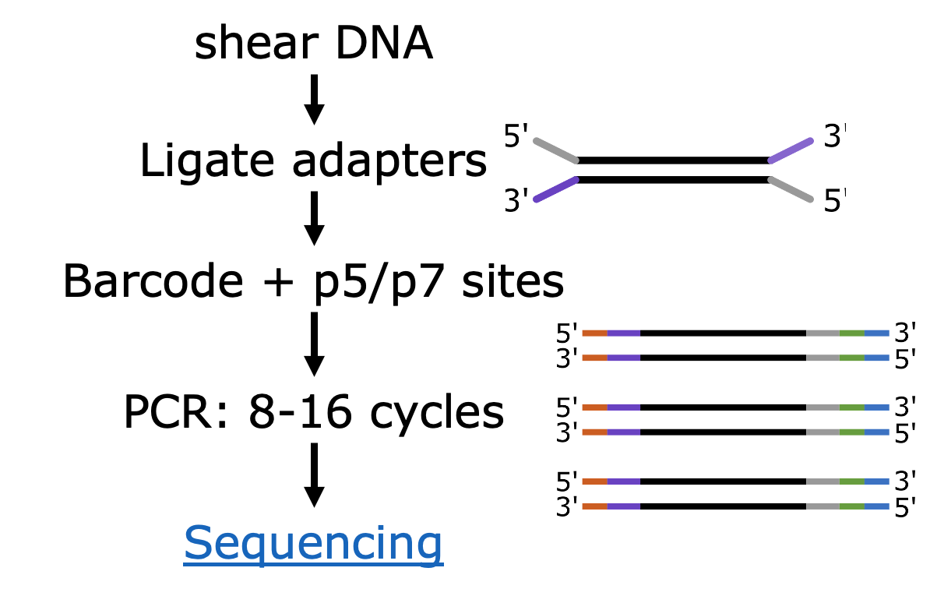
Marking duplicates
‘Regular’ duplicate: originates from PCR during library prep
Optical duplicate: originates from bridge amplification
Optical duplicates
‘Regular’ duplicates

Slide 34
Marking duplicates
Variant calling: each read is an independent observation of the genome
Duplicates (can) have the same molecular origin -> not independent
In a high-quality library, removing duplicates probably doesn’t have a big effect on variant analysis
Ebbert MTW et al. (2016) Evaluating the necessity of PCR duplicate removal from next-generation sequencing data and a comparison of approaches. BMC Bioinformatics.

Slide 35
Unique Molecular Identifiers
UMI added before PCR reaction
Detect PCR duplicates and PCR errors
duplicates
sam
fasta

Slide 36
Unique Molecular Identifiers
UmiAwareMarkDuplicatesWithMateCigar
UMI-tools
duplicates
sam
fasta

