Slide 1
NGS – variant analysis Variant calling

Slide 2
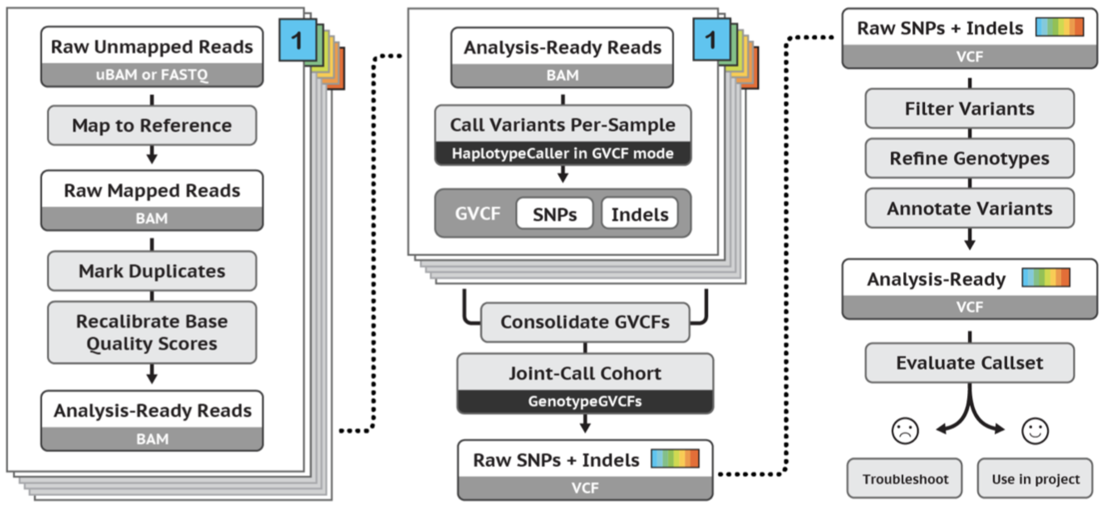
GATK workflow
Yesterday
image source: https://gatk.broadinstitute.org

Slide 3
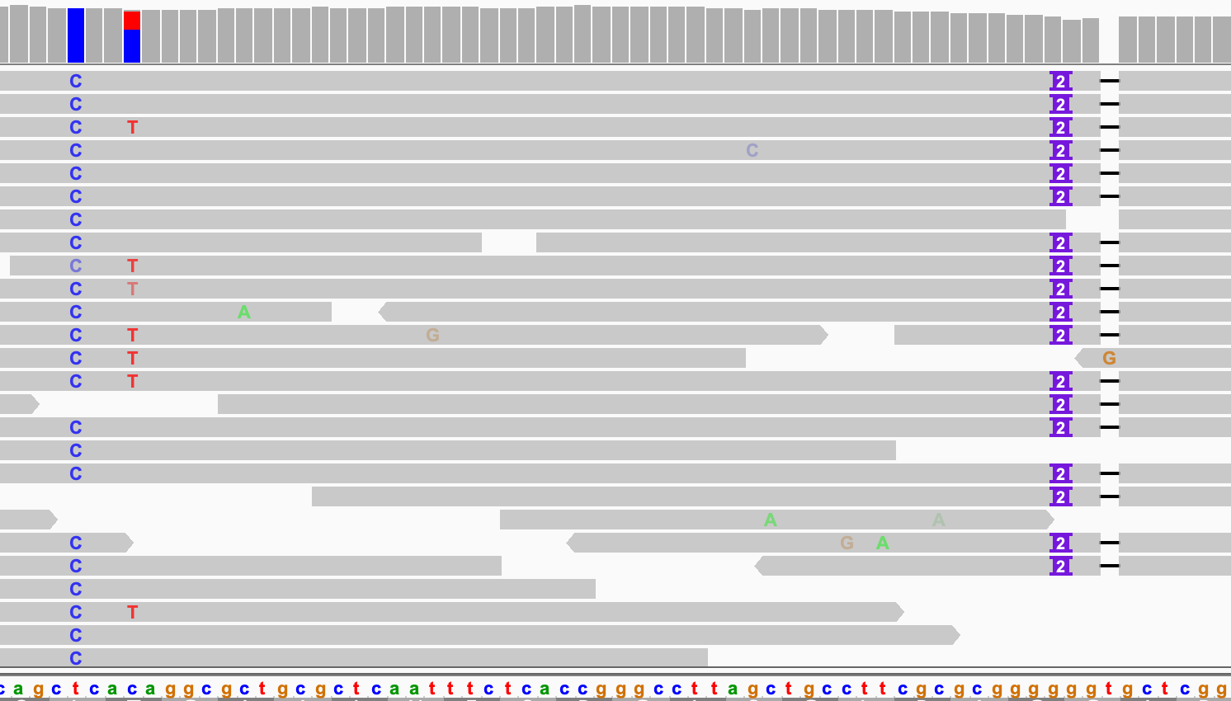

Slide 4
Three important questions
Is there a variant at location X?
Deviation from REF in the alignments
What are the alleles?
The variation in sequence in these deviations
What is the genotype (HomRef, Heterozygote or HomAlt)?
Estimating the allele counts in the sample

Slide 5
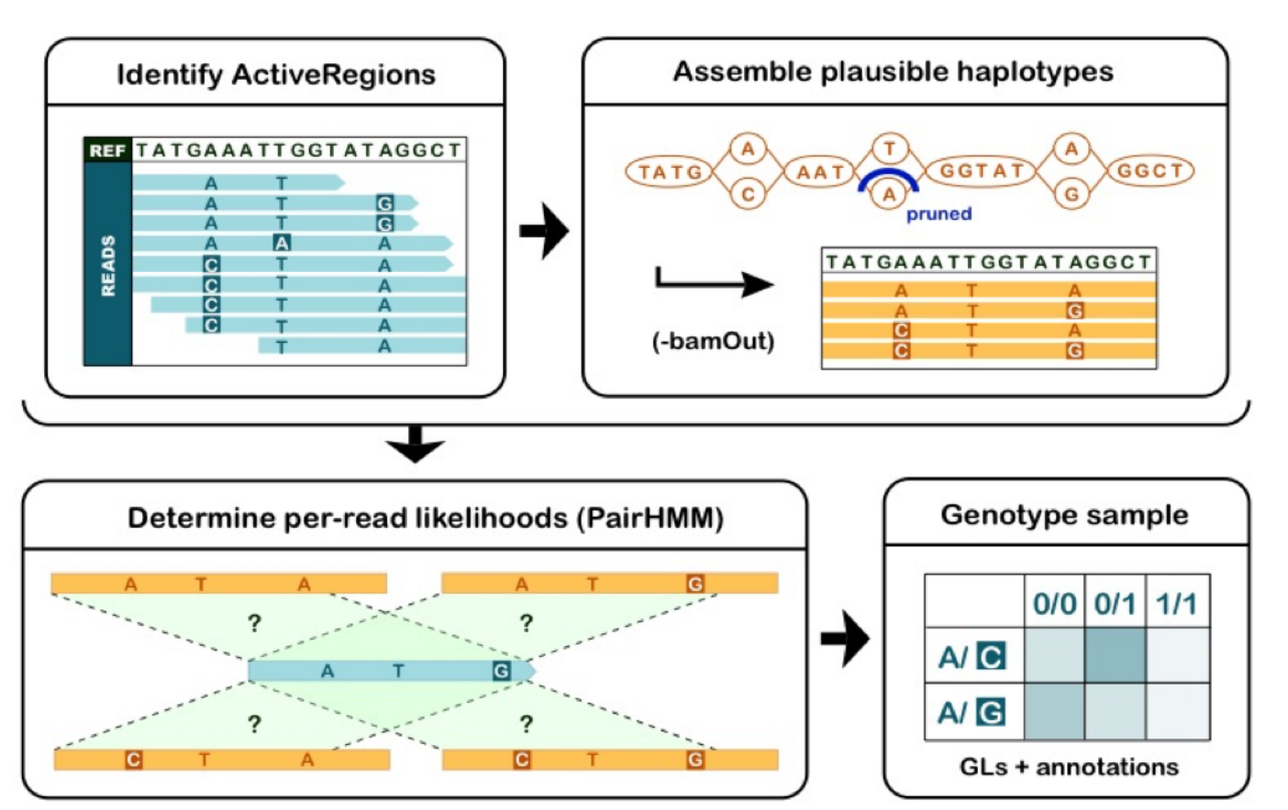
HaplotypeCaller
Poplin R et al. Scaling accurate genetic variant discovery to tens of thousands of samples. bioRxiv. 2017;1–22.

Slide 6
What are the alleles?
W
X
Y
Z
genotype (unknown)

Slide 7
What are the alleles?
W
X
Y
Z
genotype (unknown)
reads
5
5
5
4
4
4
5

Slide 8
What are the alleles?
W
X
Y
Z
genotype (unknown)
reads
5
5
5
4
4
4
5
1
1

Slide 9
What are the alleles?
W
X
Y
Z
genotype (unknown)
reads
5
5
5
4
4
4
5
pruning
1
1

Slide 10
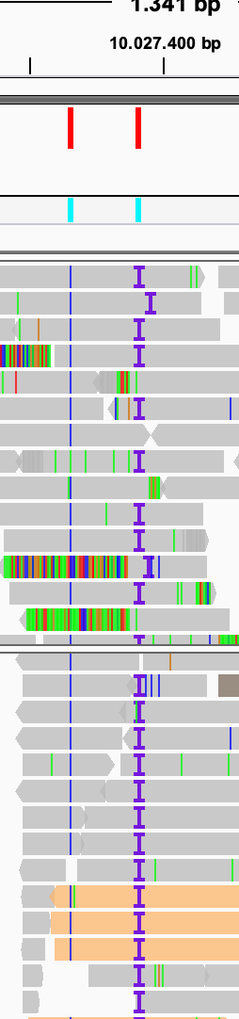
What are the alleles?
Indel realignment
Expensive process, but only on ‘active’ regions
bwa alignment
re-aligned

Slide 11
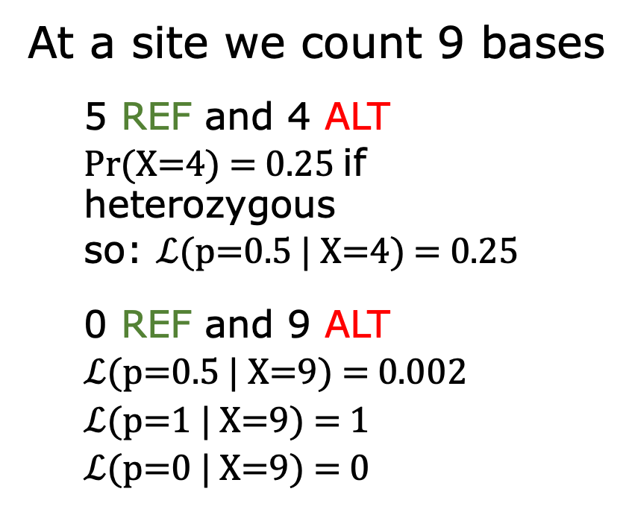
What is the genotype?
p=0
At a site we count 9 bases
5 REF and 4 ALT
Pr(X=4) = 0.25 if heterozygous
so: $ℒ$(p=0.5 | X=4) = 0.25
0 REF and 9 ALT
$ℒ$(p=0.5 | X=9) = 0.002
$ℒ$(p=1 | X=9) = 1
$ℒ$(p=0 | X=9) = 0
X=4
C
A
A
C
C
A
p=0.5
A
C
A
X=9
C
C
C
C
C
C
p=1
C
C
C

Slide 12
Question 10

Slide 13
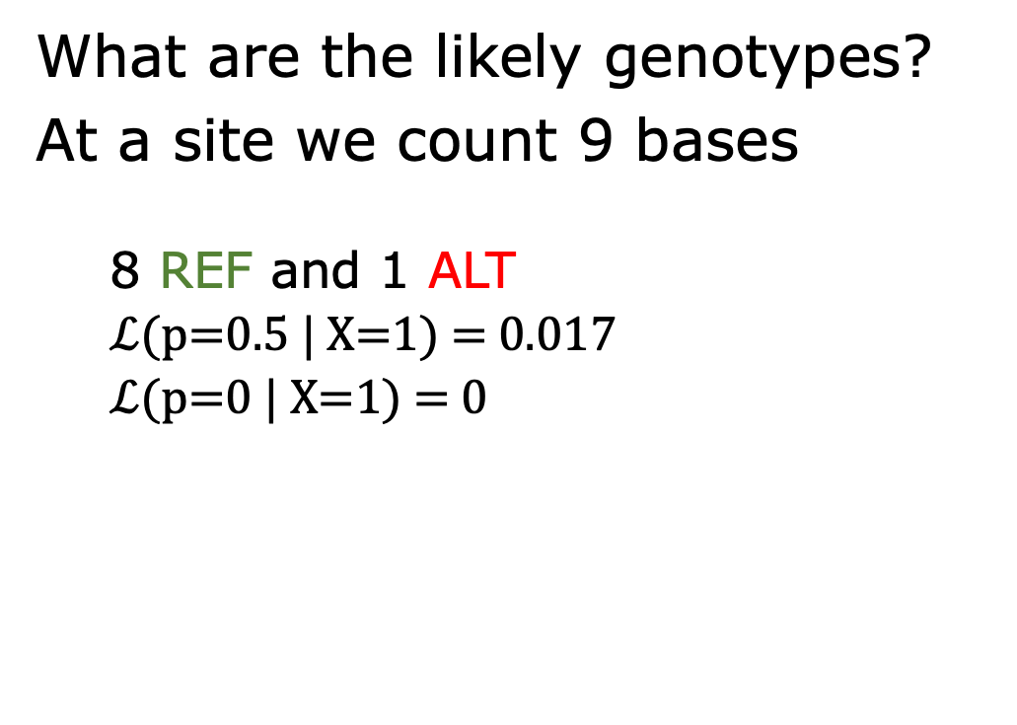
Estimating genotype
What are the likely genotypes?
At a site we count 9 bases
8 REF and 1 ALT
$ℒ$(p=0.5 | X=1) = 0.017
$ℒ$(p=0 | X=1) = 0
p=0
X=1
A
A
p=0.5
A
A
A
A
C
A
A
p=1
Strict binomial distribution would only work with error-free data

Slide 14
Base quality and error
Base quality: 20 = error probability 0.01
100 samples with 40x coverage
In total 40 errors expected

Slide 15
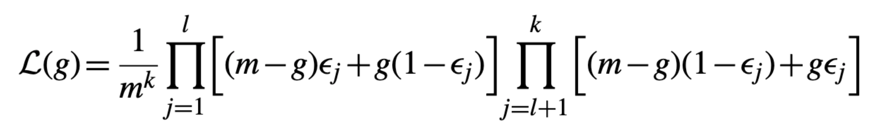
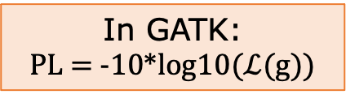
Estimating the genotype
Genotype likelihood (simplified):
g: genotype (i.e. 0, 1 or 2)
m: ploidy (2 for human)
∈: base error
k: number of bases at the site
l: number of bases that equal reference
In GATK:
PL = -10*log10($ℒ$(g))
Li H. Bioinformatics. 2011;27:2987–93.

Slide 16
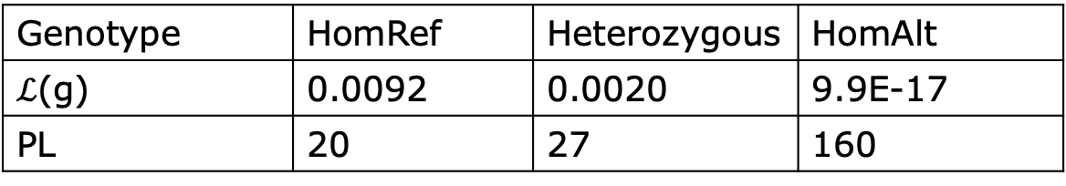
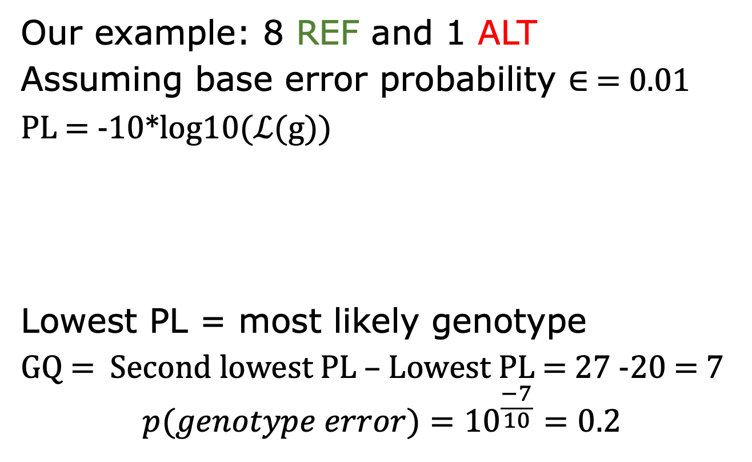
PL and GQ
Our example: 8 REF and 1 ALT
Assuming base error probability ∈ = 0.01
PL = -10*log10($ℒ$(g))
Lowest PL = most likely genotype
GQ = Second lowest PL – Lowest PL = 27 -20 = 7
$${p(genotype error)=10}^{\frac{−7}{10}}=0.2$$
Genotype | HomRef | Heterozygous | HomAlt
$ℒ$(g) | 0.0092 | 0.0020 | 9.9E-17
PL | 20 | 27 | 160

Slide 17
Question 11

Slide 18
Estimating the genotype
g = 0,1 or 2
m = 2
∈ = 0.01 (BQ=20)
k = 9

Slide 19
Base quality correction
Essential for estimating genotype likelihood
Context can affect base quality, e.g.:
homopolymers
cycle
estimated error rate ≠ ‘real’ error rate
Base quality score recalibration (BQSR) takes this context into account

Slide 20
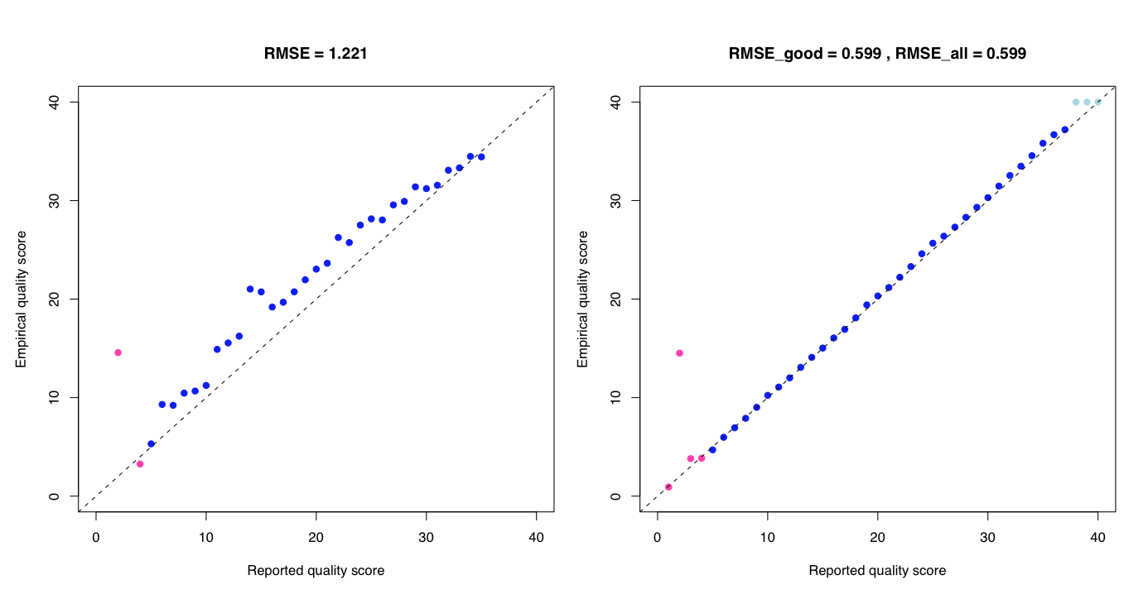
BQSR
Before BQSR
After BQSR
https://gatk.broadinstitute.org/hc/en-us/articles/360035890531-Base-Quality-Score-Recalibration-BQSR-

Slide 21
vcf
##fileformat=VCFv4.2
##FILTER=<ID=LowQual,Description="Low quality">
##FILTER=<ID=PASS,Description="All filters passed">
##FORMAT=<ID=AD,Number=R,Type=Integer,Description="Allelic depths for the ref and alt alleles in the order listed">
##FORMAT=<ID=DP,Number=1,Type=Integer,Description="Approximate read depth (reads with MQ=255 or with bad mates are filtered)">
##FORMAT=<ID=GQ,Number=1,Type=Integer,Description="Genotype Quality">
##FORMAT=<ID=GT,Number=1,Type=String,Description="Genotype">
##FORMAT=<ID=PL,Number=G,Type=Integer,Description="Normalized, Phred-scaled likelihoods for genotypes as defined in the VCF specs">
##GATKCommandLine=<ID=GenotypeGVCFs,CommandLine="GenotypeGVCFs --output
##GATKCommandLine=<ID=HaplotypeCaller,CommandLine="HaplotypeCaller --bam-output
##INFO=<ID=AC,Number=A,Type=Integer,Description="Allele count in genotypes, for each ALT allele, in the same order as listed">
##INFO=<ID=AF,Number=A,Type=Float,Description="Allele Frequency, for each ALT allele, in the same order as listed">
##INFO=<ID=AN,Number=1,Type=Integer,Description="Total number of alleles in called genotypes">
##INFO=<ID=DP,Number=1,Type=Integer,Description="Approximate read depth; some reads may have been filtered">
##contig=<ID=chr20,length=64444167>
#CHROM POS ID REF ALT QUAL FILTER INFO FORMAT father mother
chr20 10019252 . G C 134.68 . AC=1;AF=0.167;AN=6;DP=15 GT:AD:DP:GQ:PL 0/1:3,5:8:58:143,0,58 0/0:2,0:2:6:0,6,48
chr20 10019348 . A ACT 1587.89 . AC=5;AF=0.833;AN=6;DP=45 GT:AD:DP:GQ:PL 0/1:7,6:13:99:231,0,256 1/1:0,13:13:39:573,39,0
chr20 10019469 . C T 1792.98 . AC=4;AF=0.667;AN=6;DP=89 GT:AD:DP:GQ:PL 0/1:17,15:32:99:465,0,503 0/1:11,12:23:99:289,0,289

Slide 22
vcf
##fileformat=VCFv4.2
##FILTER=<ID=LowQual,Description="Low quality">
##FILTER=<ID=PASS,Description="All filters passed">
##FORMAT=<ID=AD,Number=R,Type=Integer,Description="Allelic depths for the ref and alt alleles in the order listed">
##FORMAT=<ID=DP,Number=1,Type=Integer,Description="Approximate read depth (reads with MQ=255 or with bad mates are filtered)">
##FORMAT=<ID=GQ,Number=1,Type=Integer,Description="Genotype Quality">
##FORMAT=<ID=GT,Number=1,Type=String,Description="Genotype">
##FORMAT=<ID=PL,Number=G,Type=Integer,Description="Normalized, Phred-scaled likelihoods for genotypes as defined in the VCF specs">
##GATKCommandLine=<ID=GenotypeGVCFs,CommandLine="GenotypeGVCFs --output
##GATKCommandLine=<ID=HaplotypeCaller,CommandLine="HaplotypeCaller --bam-output
##INFO=<ID=AC,Number=A,Type=Integer,Description="Allele count in genotypes, for each ALT allele, in the same order as listed">
##INFO=<ID=AF,Number=A,Type=Float,Description="Allele Frequency, for each ALT allele, in the same order as listed">
##INFO=<ID=AN,Number=1,Type=Integer,Description="Total number of alleles in called genotypes">
##INFO=<ID=DP,Number=1,Type=Integer,Description="Approximate read depth; some reads may have been filtered">
##contig=<ID=chr20,length=64444167>
#CHROM POS ID REF ALT QUAL FILTER INFO FORMAT father mother
chr20 10019252 . G C 134.68 . AC=1;AF=0.167;AN=6;DP=15 GT:AD:DP:GQ:PL 0/1:3,5:8:58:143,0,58 0/0:2,0:2:6:0,6,48
chr20 10019348 . A ACT 1587.89 . AC=5;AF=0.833;AN=6;DP=45 GT:AD:DP:GQ:PL 0/1:7,6:13:99:231,0,256 1/1:0,13:13:39:573,39,0
chr20 10019469 . C T 1792.98 . AC=4;AF=0.667;AN=6;DP=89 GT:AD:DP:GQ:PL 0/1:17,15:32:99:465,0,503 0/1:11,12:23:99:289,0,289

Slide 23
vcf
#CHROM POS ID REF ALT
20 14370 . G A
20 17330 . T A
20 1110696 . A G,T
20 1230237 . T .
20 1234567 . GTC G,GTCT
FORMAT NA00001 NA00002
GT:GQ 0|0:48 1|0:48
GT:GQ 0|0:49 0|1:99
GT:GQ 1|2:21 2|1:27
GT:GQ 0|0:54 0|0:48
GT:GQ 0/1:35 0/2:17
0
1
2

Slide 24
Question 12

Slide 25
sample 1
sample 2
X
Y
Z
X
Y
Z
sample1.vcf
sample2.vcf
CHROM POS ID SAMP1
20 1101 SNPX 1|1
20 1203 SNPY 0|1
CHROM POS ID SAMP2
20 1101 SNPX 1|0
20 1203 SNPY 0|1
20 1253 SNPZ 1|1
combined.vcf
CHROM POS ID SAMP1 SAMP2
20 1101 SNPX 1|1 1|0
20 1203 SNPY 0|1 0|1
20 1253 SNPZ ? 1|1

Slide 26
Question 13

Slide 27
Missing genotype problem
Most variant callers genotype all samples in one go. But:
variant calling process can become very computationally intensive
new sample? Redo entire variant call
GATK uses GVCF:
Store information on non-variant regions

Slide 28
Other software
freebayes: haplotype-aware variant calling -> good alternative to gatk
bcftools: working with vcfs (part of samtools)
vcftools: working with vcfs
whatshap: haplotyping
DeepVariant: variant calling in short and long reads

Slide 29
GATK workflow
Yesterday
image source: https://gatk.broadinstitute.org

