Slide 1
NGS – variant analysis Filtering and evaluation

Slide 2
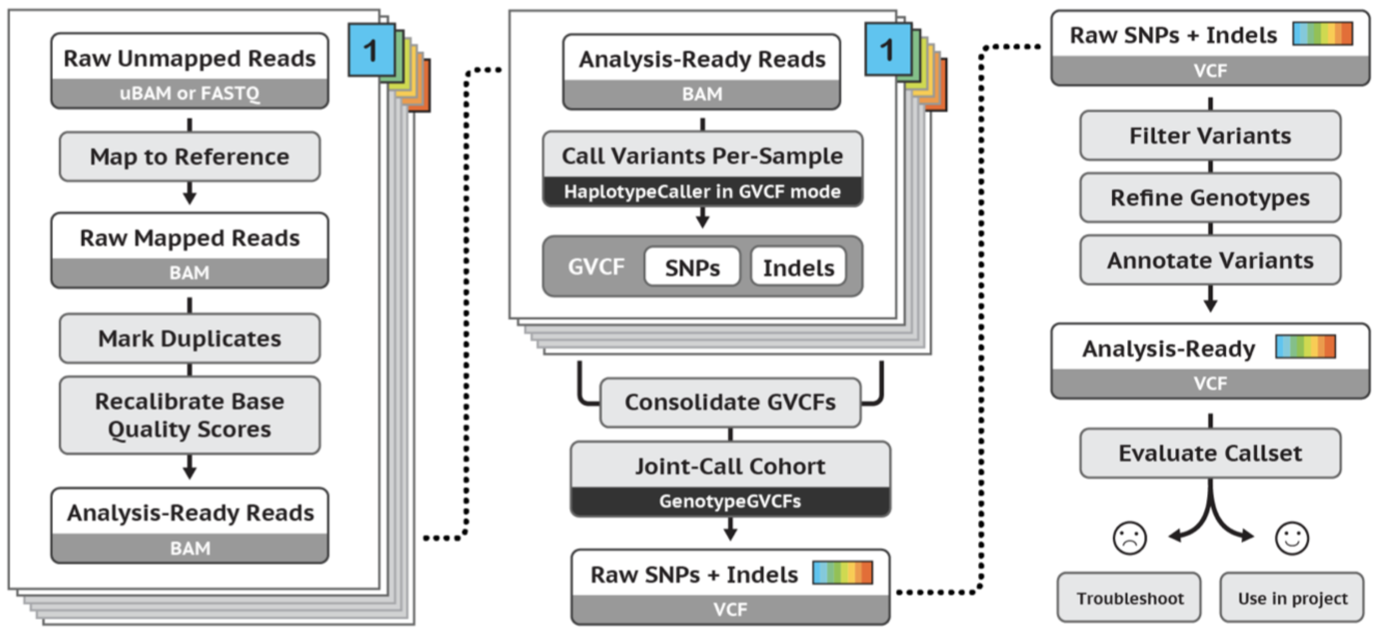
GATK workflow
Yesterday
image source: https://gatk.broadinstitute.org

Slide 3
Important QC info
Mapping quality
Depth
Strand-bias
..

Slide 4
Filtering
Hard filtering: take thresholds of each measure
Machine-learning-based: VQSR

Slide 5
Filtering
Hard filtering: take thresholds of each measure
Machine-learning-based: VQSR

Slide 6
VQSR
Better performance compared to hard filtering, but you will need:
Truth-set
‘Large’ dataset (whole genome or 30 whole exomes)

Slide 7
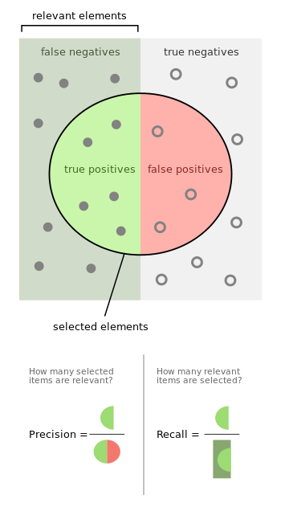
Evaluation
Precision: how many of the selected variants were true variants?
Recall: how many of the true variants were selected?
By Walber - Own work, CC BY-SA 4.0, https://commons.wikimedia.org/w/index.php?curid=36926283

Slide 8
Question 14

Slide 9
Evaluation
Precision: how many of the selected variants were true variants?
Recall: how many of the true variants were selected?
By Walber - Own work, CC BY-SA 4.0, https://commons.wikimedia.org/w/index.php?curid=36926283

