Slide 1
NGS – variant analysis Variant annotation

Slide 2
Variant annotation
Functional annotation: relative to genomic features (often genes)
Coding regions
Promoter regions
Promoter
Coding
Intronic
UTR
Intergenic

Slide 3
Coding variants
GCA AGA GAT AAT TGT TGG CAA
Ala Arg Asp Asn Cys Trp Gln
synonymous
missense
frameshift
stop gained
GCA AGG GAT AAA TGA TG-C AA
Ala Arg Asp Lys * Cys
http://pcingola.github.io/SnpEff/se_inputoutput/#effect-prediction-details
http://www.sequenceontology.org/browser/current_svn/term/SO:0001580

Slide 4
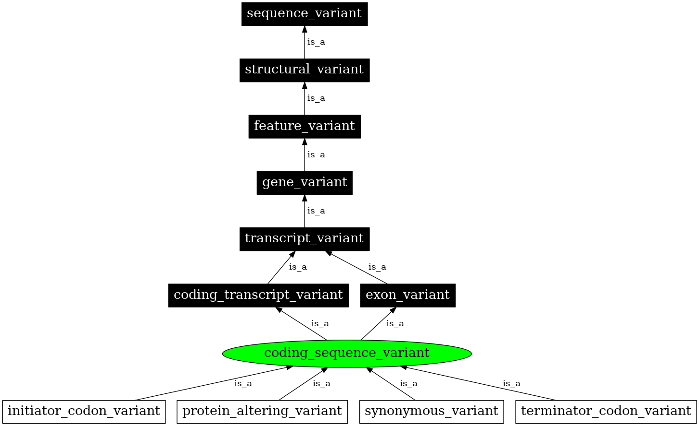
Sequence ontology
Initiated by GO consortium
Term definitions + relationships
http://www.sequenceontology.org/browser/current_svn/term/SO:0001580

Slide 5
Isoforms
Transcript A
Coding
Transcript B
Intronic
Most genes have multiple isoforms
Annotation for all isoforms?
Single annotation/variant:
Effect with most impact
Most relevant transcript, e.g. based on ensembl transcript tags

Slide 6
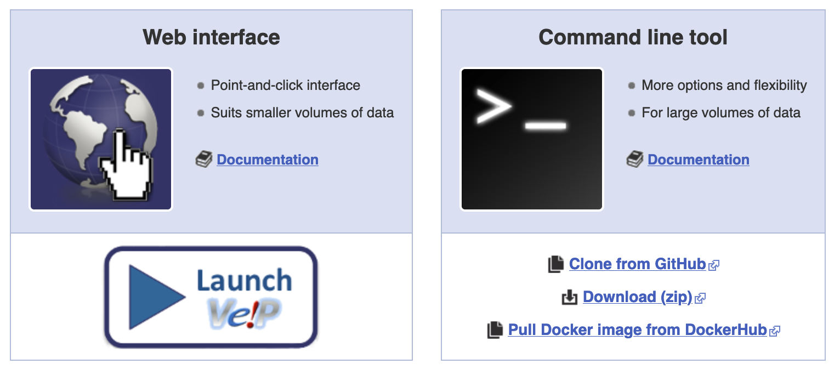

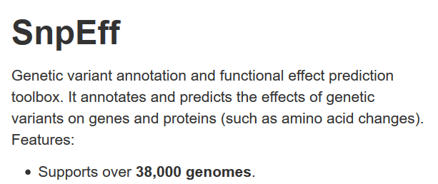
Functional annotation tools
Command line: https://annovar.openbioinformatics.org/
Web-based:
https://wannovar.wglab.org/
VEP

Slide 7
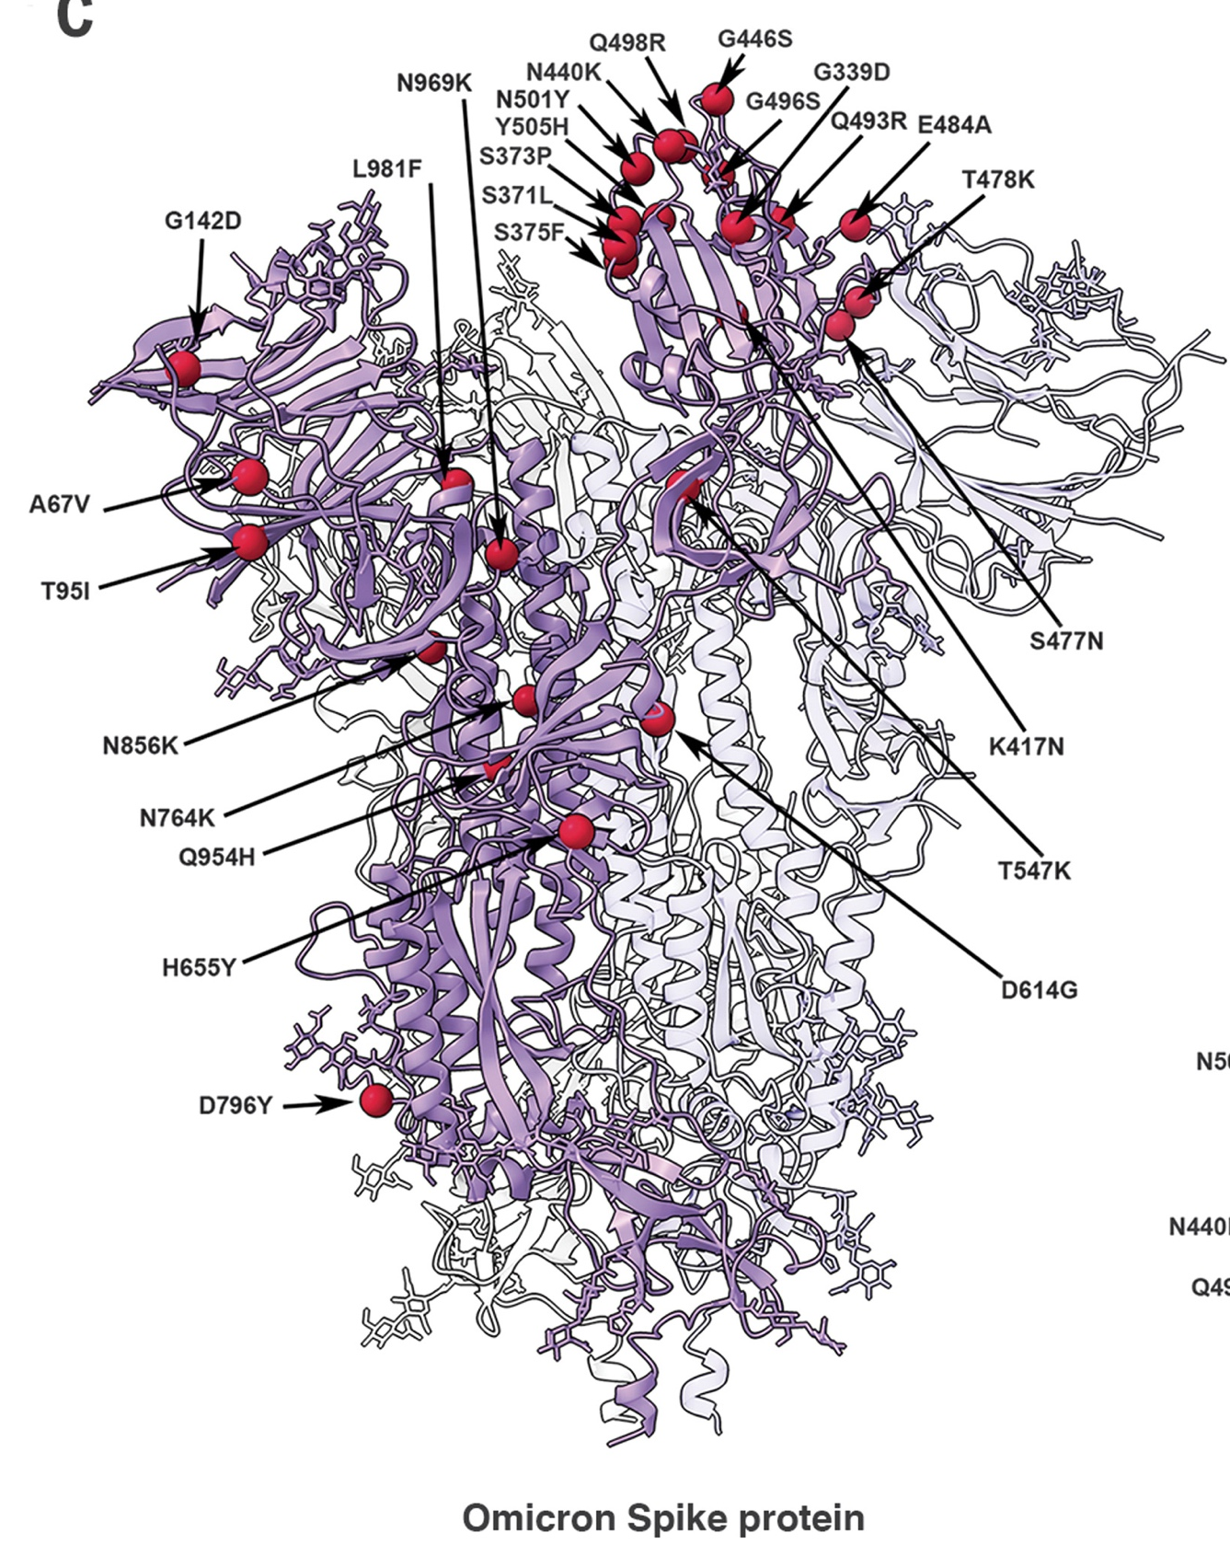
Effect prediction scores
One “high impact” mutation is not the other
Prediction of effect based on e.g.:
Comparative genomics (conserved regions)
Protein structure/biochemistry
Experimental function (e.g. eQTL)
For human genome many databases available, e.g.:
dbNSFP
MutationTaster

