Slide 1


Introduction to RNA-Seq – Quality Control
Wandrille Duchemin

Slide 2

”Raw data”: FASTQ format
FASTQ format stores sequences and “Phred” quality score in a single file
Sequence header starts with @
Quality header usually starts with +
Paired data: two separate files for forward and reverse with same ordering
@HWI-ST143:498:D0T4GACXX:7:1101:1474:2111 1:N:0:TGACCA
TCTCNAGATAAAATCAAAACCAACAGAGAGTCTAGAATAAAAGTGAATAG
+
@@BF#2ADHHHHHJJJJIJJJJJJIJGJIJHIIGIHIIIIIJJHIHIJJJ
@HWI-ST143:498:D0T4GACXX:7:1101:1424:2149 1:N:0:TGACCA
CAGATGTTTTGGTAAGAAGAATGCCATTAGCAATTGGTGGAGGAGCAGGA
+
BBCFFFEFHHHHHJIJIJJHIIJIIJJJJJJJJJJIJHIJIJJIJIGIIG

Slide 4
FASTQ Header
Depends on sequencing technology used, changed several times by Illumina and others
Chastity filter switched (now N is good)
Representation of paired reads modified
@HWI-ST143:498:D0T4GACXX:7:1101:1474:2111 2:N:0:TGACCA
@HWI-ST143:498:D0T4GACXX:7:1101:1474:2111#TGACCA/2

Slide 5
Phred Quality Scores
ASCII encoded
Represents probability (p) that base call is incorrect
Quality (Q) = -10 log₁₀(p)
P-value | Phred | Probability of incorrect base call | Base call accuracy
1E-01 | 10 | 1 in 10 | 90%
1E-02 | 20 | 1 in 100 | 99%
1E-03 | 30 | 1 in 1000 | 99.9%
1E-04 | 40 | 1 in 10,000 | 99.99%

Slide 6
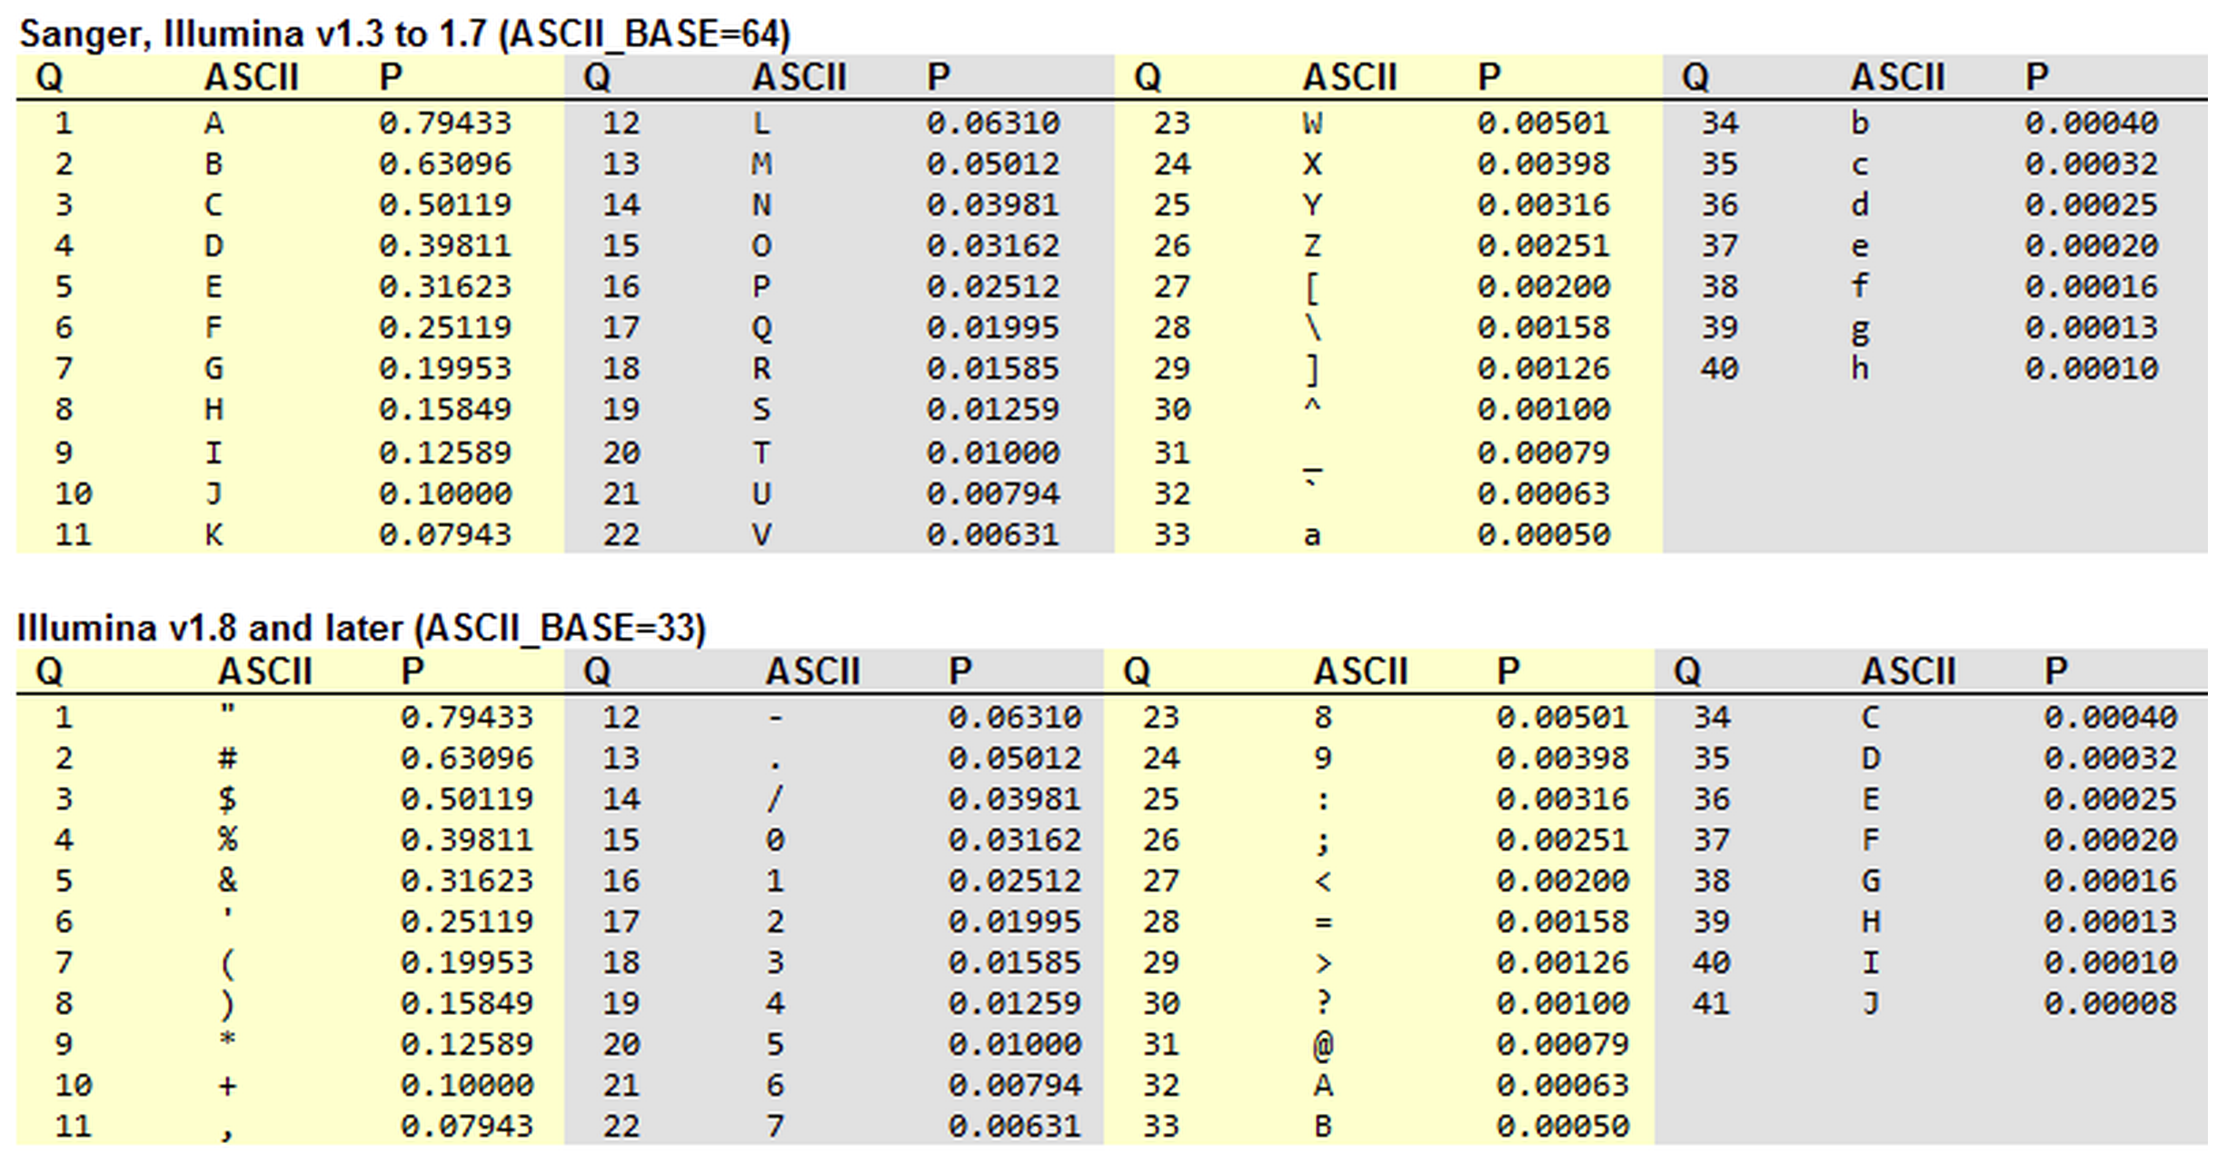
Phred Quality Scores

Slide 7
Quality Control using FastQC
FastQC aims to provide a QC report which can spot problems which originate either in the sequencer or in the starting library material
Generates an HTML report with various metrics
Supported file formats:
FASTQ (can be gzip compressed), SAM, BAM

Slide 8
PRACTICAL
Go to the website and do the fastQC practical

Slide 9
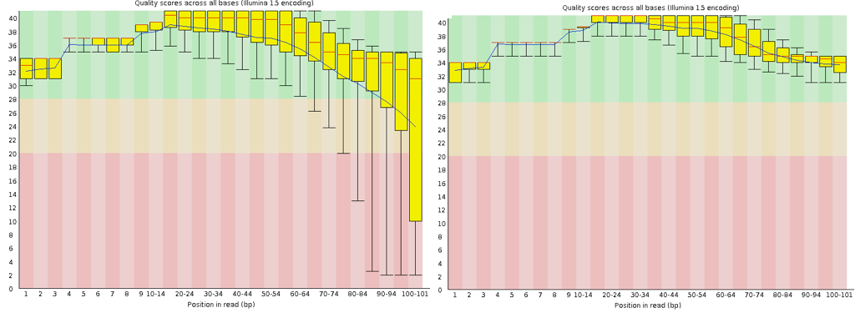
Per Base Sequence Quality

Slide 10
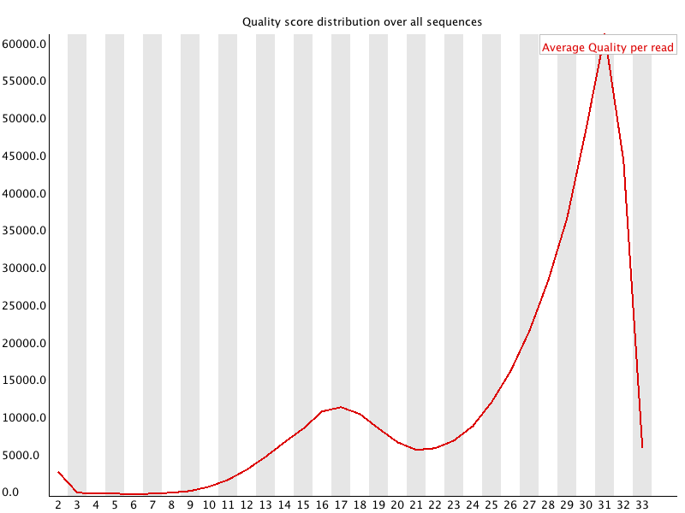
Per Sequence Quality Scores

Slide 11
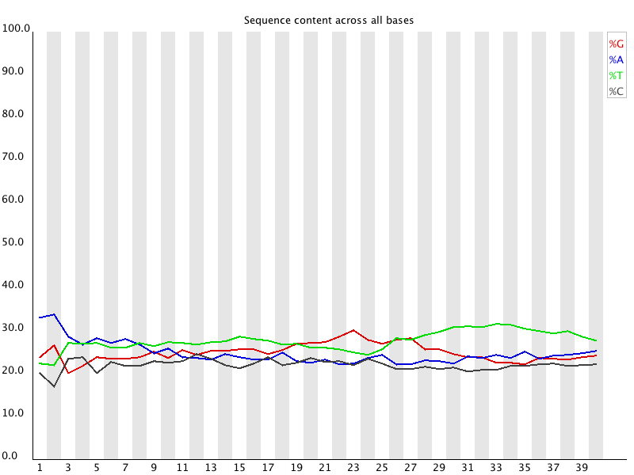
Per Base Sequence Content

Slide 12
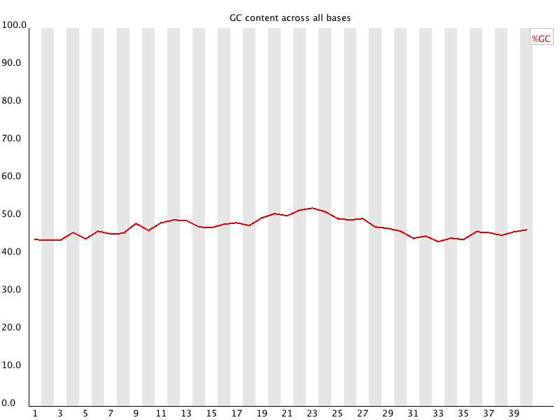
Per Base GC Content

Slide 13
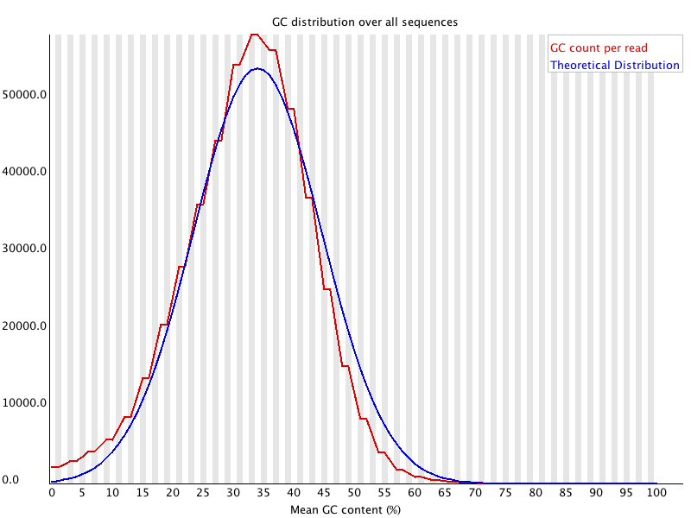
Per Sequence GC Content

Slide 14
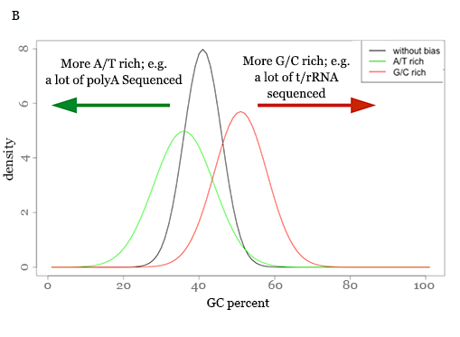
Per Sequence GC Content

Slide 15
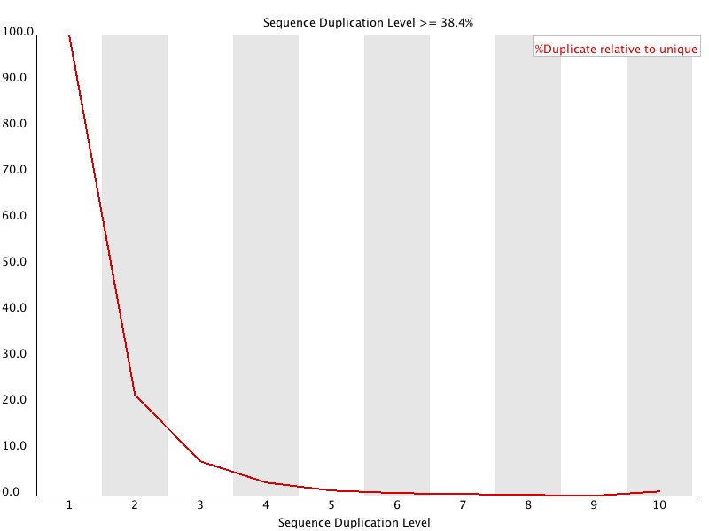
Duplicate Sequences

Slide 16
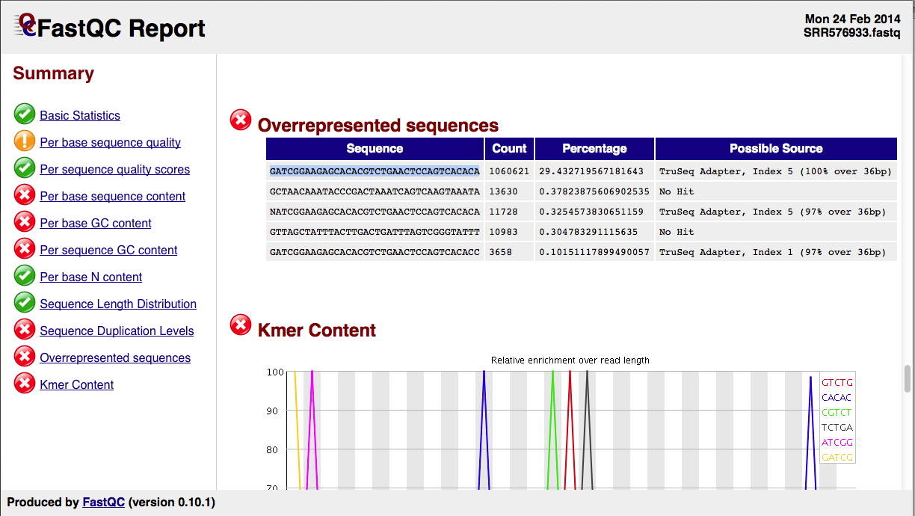
Overrepresented Sequences

Slide 17
MultiQC Reports
Generally, you will be interested in how the QC metrics of all your samples compare with each other
The software MultiQC will combine your per sample FastQC reports into a single report

Slide 18
PRACTICAL
Go to the website and do the multiQC practical

Slide 19
FASTQ QC – Modifying with Trimmomatic
Some datasets require modification prior to alignment, eg trimming low quality base calls
The decision to modify the dataset depends on the nature of the dataset and the question(s) asked
Trimming increases the rate of mapped reads BUT diminish the absolute numbers of reads
Aggressive trimming (high quality threshold, low length filtering) can have negative impacts on expression quantification (see William et al. (2016) Trimming of sequence reads alters RNA-Seq gene expression estimates. BMC bioinfo )

Slide 20
Trimmomatic – Clipping Adapter Sequences
Generally, your sequencing facility will send you FASTQ files where all sequencing adapter sequences have been removed
In practice, there can sometimes be unclipped adapter sequences. Why ?
Trimmomatic option:
ILLUMINACLIP:<fastaWithAdaptersEtc>:<seed mismatches>:<palindrome clip threshold>:<simple clip threshold>
ILLUMINACLIP:fastafilePATH:2:30:10
Notes:
These values are (very roughly speaking) log-10 probabilities of getting a match at random. Each perfectly matching base scores just over 0.6, so 15 requires a perfect 25 base match. Each mismatching base reduces the score by the Q/10 value of that base. So it takes 5 or even 6 additional matching bases to overcome one high quality mismatch, but maybe only 1 or 2 additional bases if the mismatching base is low quality.

Slide 21
Trimmomatic Options
ILLUMINACLIP: Cut adapter and other illumina-specific sequences from the read.
SLIDINGWINDOW: Performs a sliding window trimming approach. It starts scanning at the 5‟ end and clips the read once the average quality within the window falls below a threshold.
MAXINFO: An adaptive quality trimmer which balances read length and error rate to maximise the value of each read
LEADING: Cut bases off the start of a read, if below a threshold quality
TRAILING: Cut bases off the end of a read, if below a threshold quality
CROP: Cut the read to a specified length by removing bases from the end
HEADCROP: Cut the specified number of bases from the start of the read
MINLEN: Drop the read if it is below a specified length
AVGQUAL: Drop the read if the average quality is below the specified level
TOPHRED33: Convert quality scores to Phred-33
TOPHRED64: Convert quality scores to Phred-64

Slide 22
Trimmomatic
eg Trim a paired-end dataset
trimmomatic PE \
reads_1.fq reads_2.fq \
./trimmed_data/paired_trimmed_1.fq. /trimmed_data/unpaired_trimmed_1.fq \
./trimmed_data/paired_trimmed_2.fq. /trimmed_data/unpaired_trimmed_2.fq \
SLIDINGWINDOW:4:10
Read the manual for more information. This is good practice, as software is constantly evolving and you can’t always rely on recipes provided by courses ;-)
http://www.usadellab.org/cms/?page=trimmomatic

Slide 23
Practical Exercises
For this course, you have access to a dedicated computer cluster
This matches the reality of most NGS workflows, which cannot be realized on a single machine
The software you will need has been built inside a “container” environment (specifically, Singularity)
Enables portability and reproducibility of workflows
You will login to a head node, and distribute your computational tasks to the cluster using a job scheduler called Slurm

Slide 24
Computer Cluster Overview
Compute Cluster
user1
user2
Slurm Scheduler
Singularity Container
Shared File System
ssh
Head
Node
userN

Slide 25
Working Interactively with Singularity Containers
apart from exploring help documentation…
DO NOT RUN INTERACTIVE JOBS ON THE HEAD NODE
2 strikes, you’re out

Slide 26
Practical 1
Connect to the course cluster
Mac : Xterm
Windows : mobaXterm
Linux : terminal
ssh <login>@<cluster_adress>
Use the singularity container
singularity exec /shared/home/SHARED/DATA/RNASEQ20.img fastqc --help
NB : copy paste from a .pdf sometimes gives errors
Create and edit a file (live demo)
nano test.txt

Slide 27
Working Interactively with Singularity Containers
Recipe to simplify working the container:
singularity_container=/home/data/SWcontainer.img
singularity_exec="singularity exec $singularity_container"
$singularity_exec ls /easybuild/apps/
$singularity_exec fastqc –-help
REMINDER :
DO NOT OTHERWISE RUN INTERACTIVE JOBS
ON THE HEAD NODE

Slide 28
Submitting Jobs via Slurm
You will use simple scripts to describe what you are trying to compute
How much computational resource do I need?
Which software do I need?
Which commands do I want to run, using which files?
These scripts are interpreted by Slurm, which then manages where and how to run your jobs

Slide 29
Basic Slurm Script
#!/usr/bin/bash
#SBATCH --job-name=fastqc
#SBATCH --time=00:30:00
#SBATCH --cpus-per-task=1
#SBATCH --mem=1G
#SBATCH -o fastqc.o
#SBATCH -e fastqc.e
singularity_container=/home/data/SWcontainer.img
singularity_exec="singularity exec -B /home/data/ $singularity_container”
dataDir=/home/data/Liu2015
$singularity_exec fastqc -o FASTQC/ $dataDir/SRR1272187_NFLV_1.fastq.gz

Slide 30
Submitting Jobs via Slurm – Resource Limits
Per job, you are limited to a maximum of:
8 cores
30 G of RAM

Slide 31
Submitting Your Slurm Script
To submit your Slurm script (aka “submit script”):
sbatch myslurmscript.sh
To check the status of all your jobs:
squeue –u <username>
To check the status of a specific job:
sstat -j <jobid>.batch -a -o AveCPU,MaxRSS
To check the resources used by a completed job:
sacct –j <jobid>
sacct -j <jobid> -o State,ExitCode,NCPUS,CPUTime,Elapsed,MaxRSS

Slide 32
Datasets
We will be working with two datasets from the following studies:
Liu et al (2015) “RNA-Seq identifies novel myocardial gene expression signatures of heart failure” Genomics 105(2):83-89 https://doi.org/10.1016/j.ygeno.2014.12.002
Ruhland et al (2016) “Stromal senescence establishes an immunosuppressive microenvironment that drives tumorigenesis” Nature Communications 7:11762 https://dx.doi.org/10.1038/ncomms11762

Slide 33
Practical 2
Copy the script fastqc_Liu2015_SRR1272187_1.sh from /shared/home/SHARED/Solutions/Liu2015 into your home directory
Launch the script using sbatch. Check if it is running with squeue
Check the results of your job once it is finished running
Continued next slide ...
Notes:
These values are (very roughly speaking) log-10 probabilities of getting a match at random. Each perfectly matching base scores just over 0.6, so 15 requires a perfect 25 base match. Each mismatching base reduces the score by the Q/10 value of that base. So it takes 5 or even 6 additional matching bases to overcome one high quality mismatch, but maybe only 1 or 2 additional bases if the mismatching base is low quality.

Slide 34
Practical 2 - continued
Conduct a QC analysis on the two datasets at:
/shared/home/SHARED/DATA/Liu2015/
/shared/home/SHARED/DATA/Ruhland2016/
1. Create a sensible directory structure to house your results in your home folder
2. Create FastQC reports, compile these to MultiQC reports, and interpret the results
3. Decide if you should trim the data. If yes, trim the data with Trimmomatic (NB : Trim a single fastq file. Trimmomatic needs ~4Gb)
hints :
- copy and adapt fastqc_Liu2015_SRR1272187_1.sh
- look up the help of the software you want to use (eg. multiqc --help)
- All of these steps will work with 1 core and 1 G RAM

Slide 35
A note on retrieving published datasets
Most NGS data is deposited at the Short Read Archive (SRA) hosted by the NCBI, with links from the Gene Expression Omnibus (GEO)
The structure of the SRA database is somewhat obscure, as is the compressed SRA format itself
Several steps are required to retrieve data from a published study
Step 1 – find GEO or SRA identifier from publication
Step 2 – find the “run” files for each sample (SRR)
Step 3 – use SRA Toolkit to dump SRR to FASTQ

Slide 36
A note on retrieving published datasets
Example, from the Liu 2015 dataset which reports the GEO accession GSE57345
Use the NCBI search engine, and click on the BioProject link in the Genomes section corresponding to the GEO accession
In the Project Data table, you will see a number of links to SRA Experiments
These links point to each of the samples from the BioProject, and contain links to the SRR files
Find the SRR identifier in the Run field for each sample

Slide 37
A note on retrieving published datasets
If you have properly installed the SRA Toolkit, you can retrieve the data in FASTQ format using the fastq-dump utility:
fastq-dump --gzip --skip-technical --readids --dumpbase --split-files --clip SRR1272191
You’ll need to know the nature of the dataset before attempting to (library type, paired vs single end, etc)
fastq-dump takes a very long time
More information about fastq-dump:
https://edwards.sdsu.edu/research/fastq-dump/

Slide 38
REFERENCES
https://www.bioinformatics.babraham.ac.uk/projects/fastqc/
P. Ewels, et al. MultiQC: Summarize analysis results for multiple tools and samples in a single report. Bioinformatics (2016). doi: 10.1093/bioinformatics/btw354
http://multiqc.info

Slide 39
Contributors: Wandrille Duchemin Geoffrey Fucile Walid Gharib Pablo Escobar Lopez Mihaela Zavolan

