Slide 1
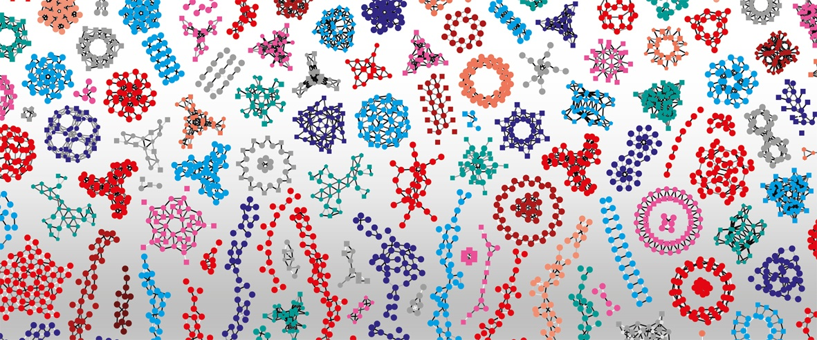

Introduction to RNA-Seq – Sequence trimming
Wandrille Duchemin

Slide 2
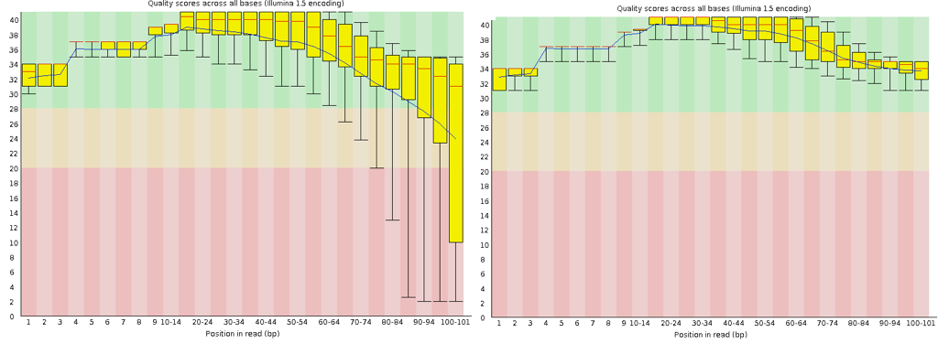
Per Base Sequence Quality

Slide 3
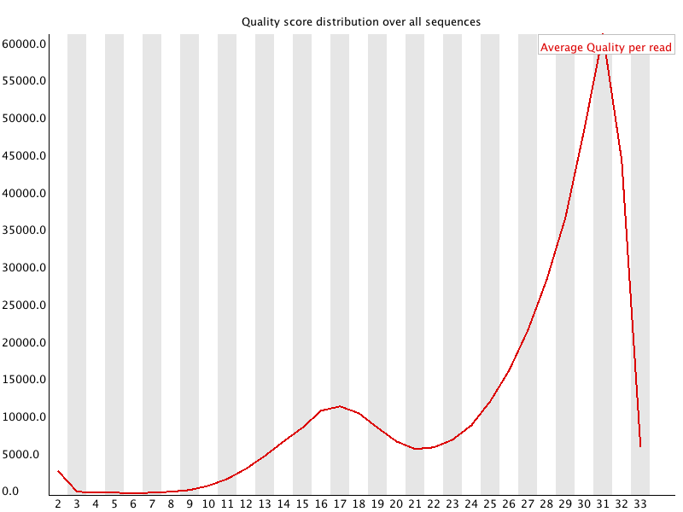
Per Sequence Quality Scores

Slide 4
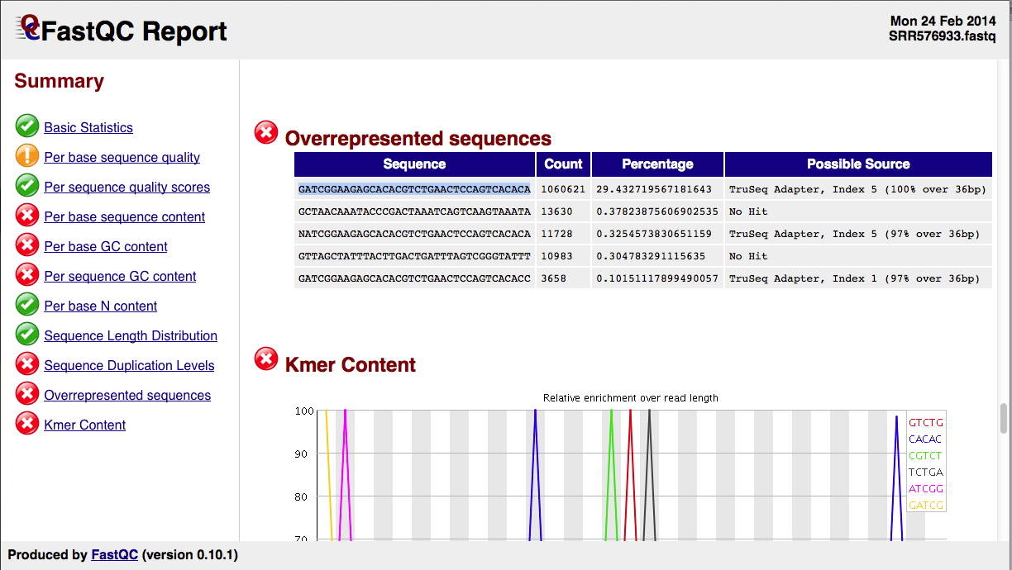
Overrepresented Sequences

Slide 5

Trimming – Modifying with Trimmomatic
Some dataset require modification prior to alignment, eg. trimming low quality base calls
The decision to modify the dataset depends on the nature of the dataset and the question(s) asked
Transcriptome assembly, variant analysis, genome annotation → DO TRIMMING
Counting (eg. differential expression) : most software can handle no trimming but still recommend some light trim. (continued)

Slide 6
Trimming – Modifying with Trimmomatic
Some dataset require modification prior to alignment, eg. trimming low quality base calls
The decision to modify the dataset depends on the nature of the dataset and the question(s) asked
Trimming increases the rate of mapped reads BUT diminish the absolute numbers of reads
Aggressive trimming (high quality threshold, low length filtering) can have negative impacts on expression quantification
see : William et al. (2016) Trimming of sequence reads alters RNA-Seq gene expression estimates. BMC bioinfo

Slide 7
Trimmomatic – Clipping Adapter Sequences
Generally, your sequencing facility will send you FASTQ files where all sequencing adapter sequences have been removed
In practice, there can sometimes be unclipped adapter sequences. Why ?
Trimmomatic option:
ILLUMINACLIP:<fastaWithAdaptersEtc>:<seed mismatches>:<palindrome clip threshold>:<simple clip threshold>
ILLUMINACLIP:fastafilePATH:2:30:10
Notes:
These values are (very roughly speaking) log-10 probabilities of getting a match at random. Each perfectly matching base scores just over 0.6, so 15 requires a perfect 25 base match. Each mismatching base reduces the score by the Q/10 value of that base. So it takes 5 or even 6 additional matching bases to overcome one high quality mismatch, but maybe only 1 or 2 additional bases if the mismatching base is low quality.

Slide 8
Trimmomatic Options
ILLUMINACLIP: Cut adapter and other illumina-specific sequences from the read.
SLIDINGWINDOW: Performs a sliding window trimming approach. It starts scanning at the 5‟ end and clips the read once the average quality within the window falls below a threshold.
MAXINFO: An adaptive quality trimmer which balances read length and error rate to maximise the value of each read
LEADING: Cut bases off the start of a read, if below a threshold quality
TRAILING: Cut bases off the end of a read, if below a threshold quality
CROP: Cut the read to a specified length by removing bases from the end
HEADCROP: Cut the specified number of bases from the start of the read
MINLEN: Drop the read if it is below a specified length
AVGQUAL: Drop the read if the average quality is below the specified level
TOPHRED33: Convert quality scores to Phred-33
TOPHRED64: Convert quality scores to Phred-64

Slide 9
Trimmomatic
eg Trim a paired-end dataset
trimmomatic PE \
reads_1.fq reads_2.fq \
./trimmed_data/paired_trimmed_1.fq. /trimmed_data/unpaired_trimmed_1.fq \
./trimmed_data/paired_trimmed_2.fq. /trimmed_data/unpaired_trimmed_2.fq \
SLIDINGWINDOW:4:10
Read the manual for more information. This is good practice, as software is constantly evolving and you can’t always rely on recipes provided by courses ;-)
http://www.usadellab.org/cms/?page=trimmomatic

Slide 10
REFERENCES
http://www.usadellab.org/cms/?page=trimmomatic
Bolger et al (2014) “Trimmomatic: A flexible trimmer for Illumina sequence data” Bioinformatics 30(15): 2114-2120.

Slide 11
Practical
Go to the website and do the trimming practical

Slide 12
Contributors: Wandrille Duchemin Geoffrey Fucile Walid Gharib Pablo Escobar Lopez Mihaela Zavolan

