Slide 1
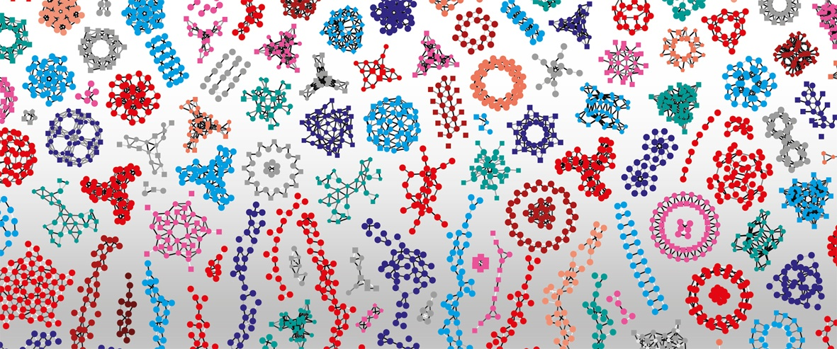

Introduction to RNA-Seq – Mapping & Aligning
Wandrille Duchemin

Slide 2

“Aligning” & “Mapping” Sequencing Reads
Whole genome re-sequencing
Transcriptome sequencing (RNA-seq)
BWA¹
Bowtie²
Tophat³
STAR⁴
Aligner
Aligner
1. Li and Durbin 2009
2. Langemead et al. 2009
3. Trapenell et al. 2009; Kim et al. 2013
4. Dobin et al. 2013

Slide 3
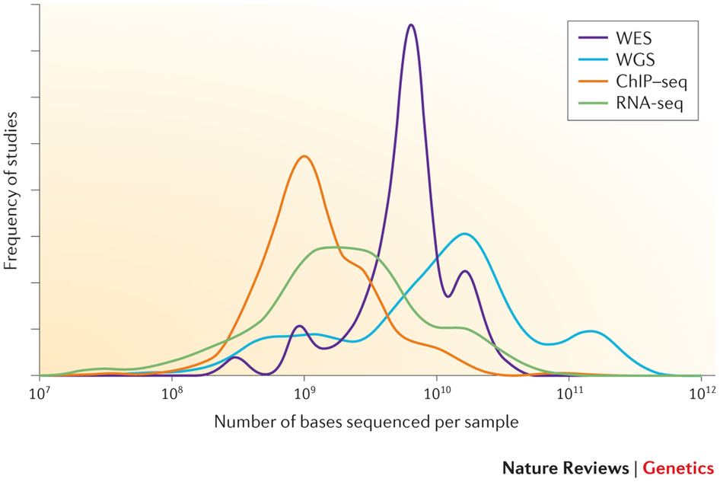
Why not use BLAST?
The elapsed (wallclock) time needed to align 20 million Illlumina reads from a human transcriptome sample against a human genome (hg19). Adapted from Borozan et al 2013
~200 million reads on average per WGS study
20e¹⁰ bases = 20e⁸ reads (100 bp)
Sims et al 2013
~ 94 Hours using Blast = ~4 Days
~ 6.4 Hours using BWA or Bowtie2
reads from 2012 to June 2013 for the Illumina platform in the European Nucleotide Archive

Slide 4

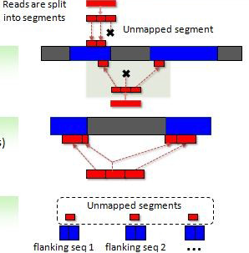


Alignment using TopHat2
Phase 1 – mapping complete reads using Bowtie2 (Burrows-Wheeler algorithm)
Phase 2 – “remapping”
Phase 3 – “stitching”
Kim et al 2013
Notes:
Using unmapped reads from step 1, TopHat2 tries to
find novel splice sites that are based on known junction
signals (GT-AG, GC-AG, and AT-AC)
segments (25 bp each by default)
Tophat2 examines
any cases in which the left and right segments of the same
read are mapped within a user-defined maximum intron size (usually between 50 and 100,000 bp)
The genomic sequences flanking these splice sites are
concatenated, and the resulting spliced sequences are
collected as a set of potential transcript fragments. Any
reads not mapped in the previous stages (or mapped
very poorly) are then re-aligned with Bowtie2

Slide 5
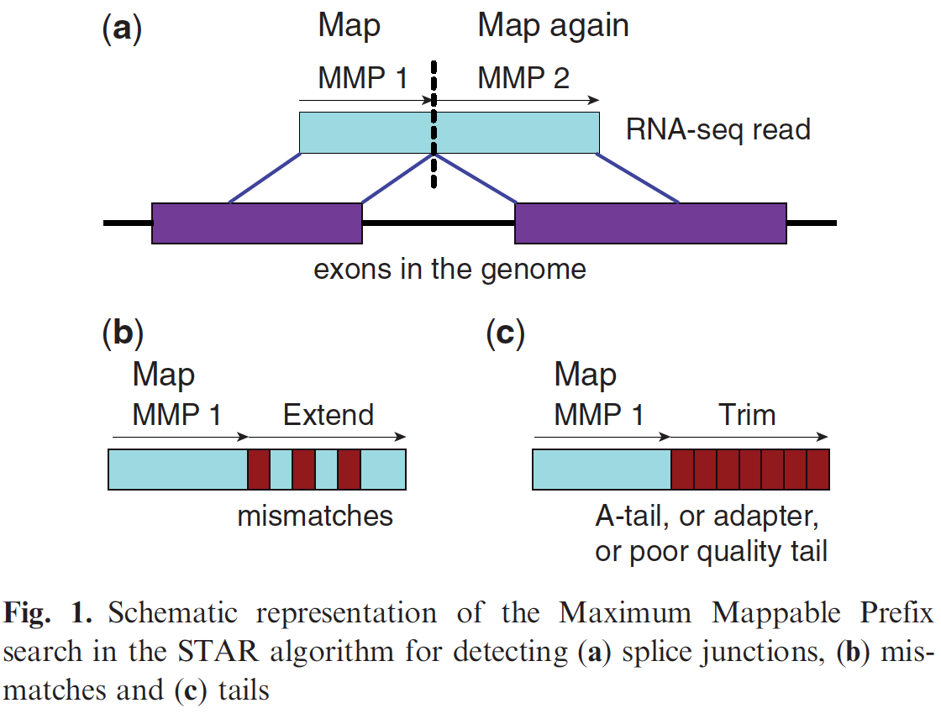
Alignment using STAR
Phase 1 – Mapping using “Maximum Mappable Prefix”
Phase 2 – “Stitching”
Dobin et al 2013
Notes:
MMp1 is also a seed

Slide 6
“Pseudo-aligners”
The basic idea is to determine the compatibility of reads with targets (genomic features) without the need for computationally expensive alignment
The reference is split into k-mers to construct a De Bruijn graph representation of the transcriptome
“Redundant” k-mers, eg the common region of multiple transcripts, are assigned to the same k-mer compatibility class. This substantially reduces the search space when reads are split into k-mers
Primary advantage -> speed
Primary disadvantage -> no alignment information

Slide 7
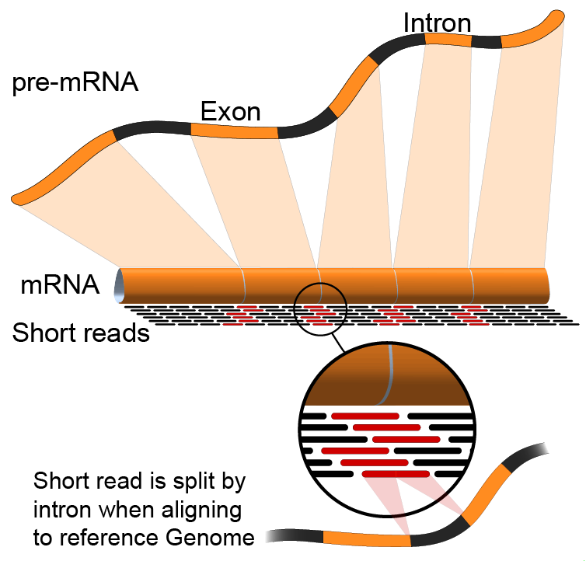
Alignment vs. Pseudoalignment
https://en.wikipedia.org/wiki/RNA-Seq
sailfish (Patro et al. 2014), see also “Kallisto” (Bray et al.2016)

Slide 8
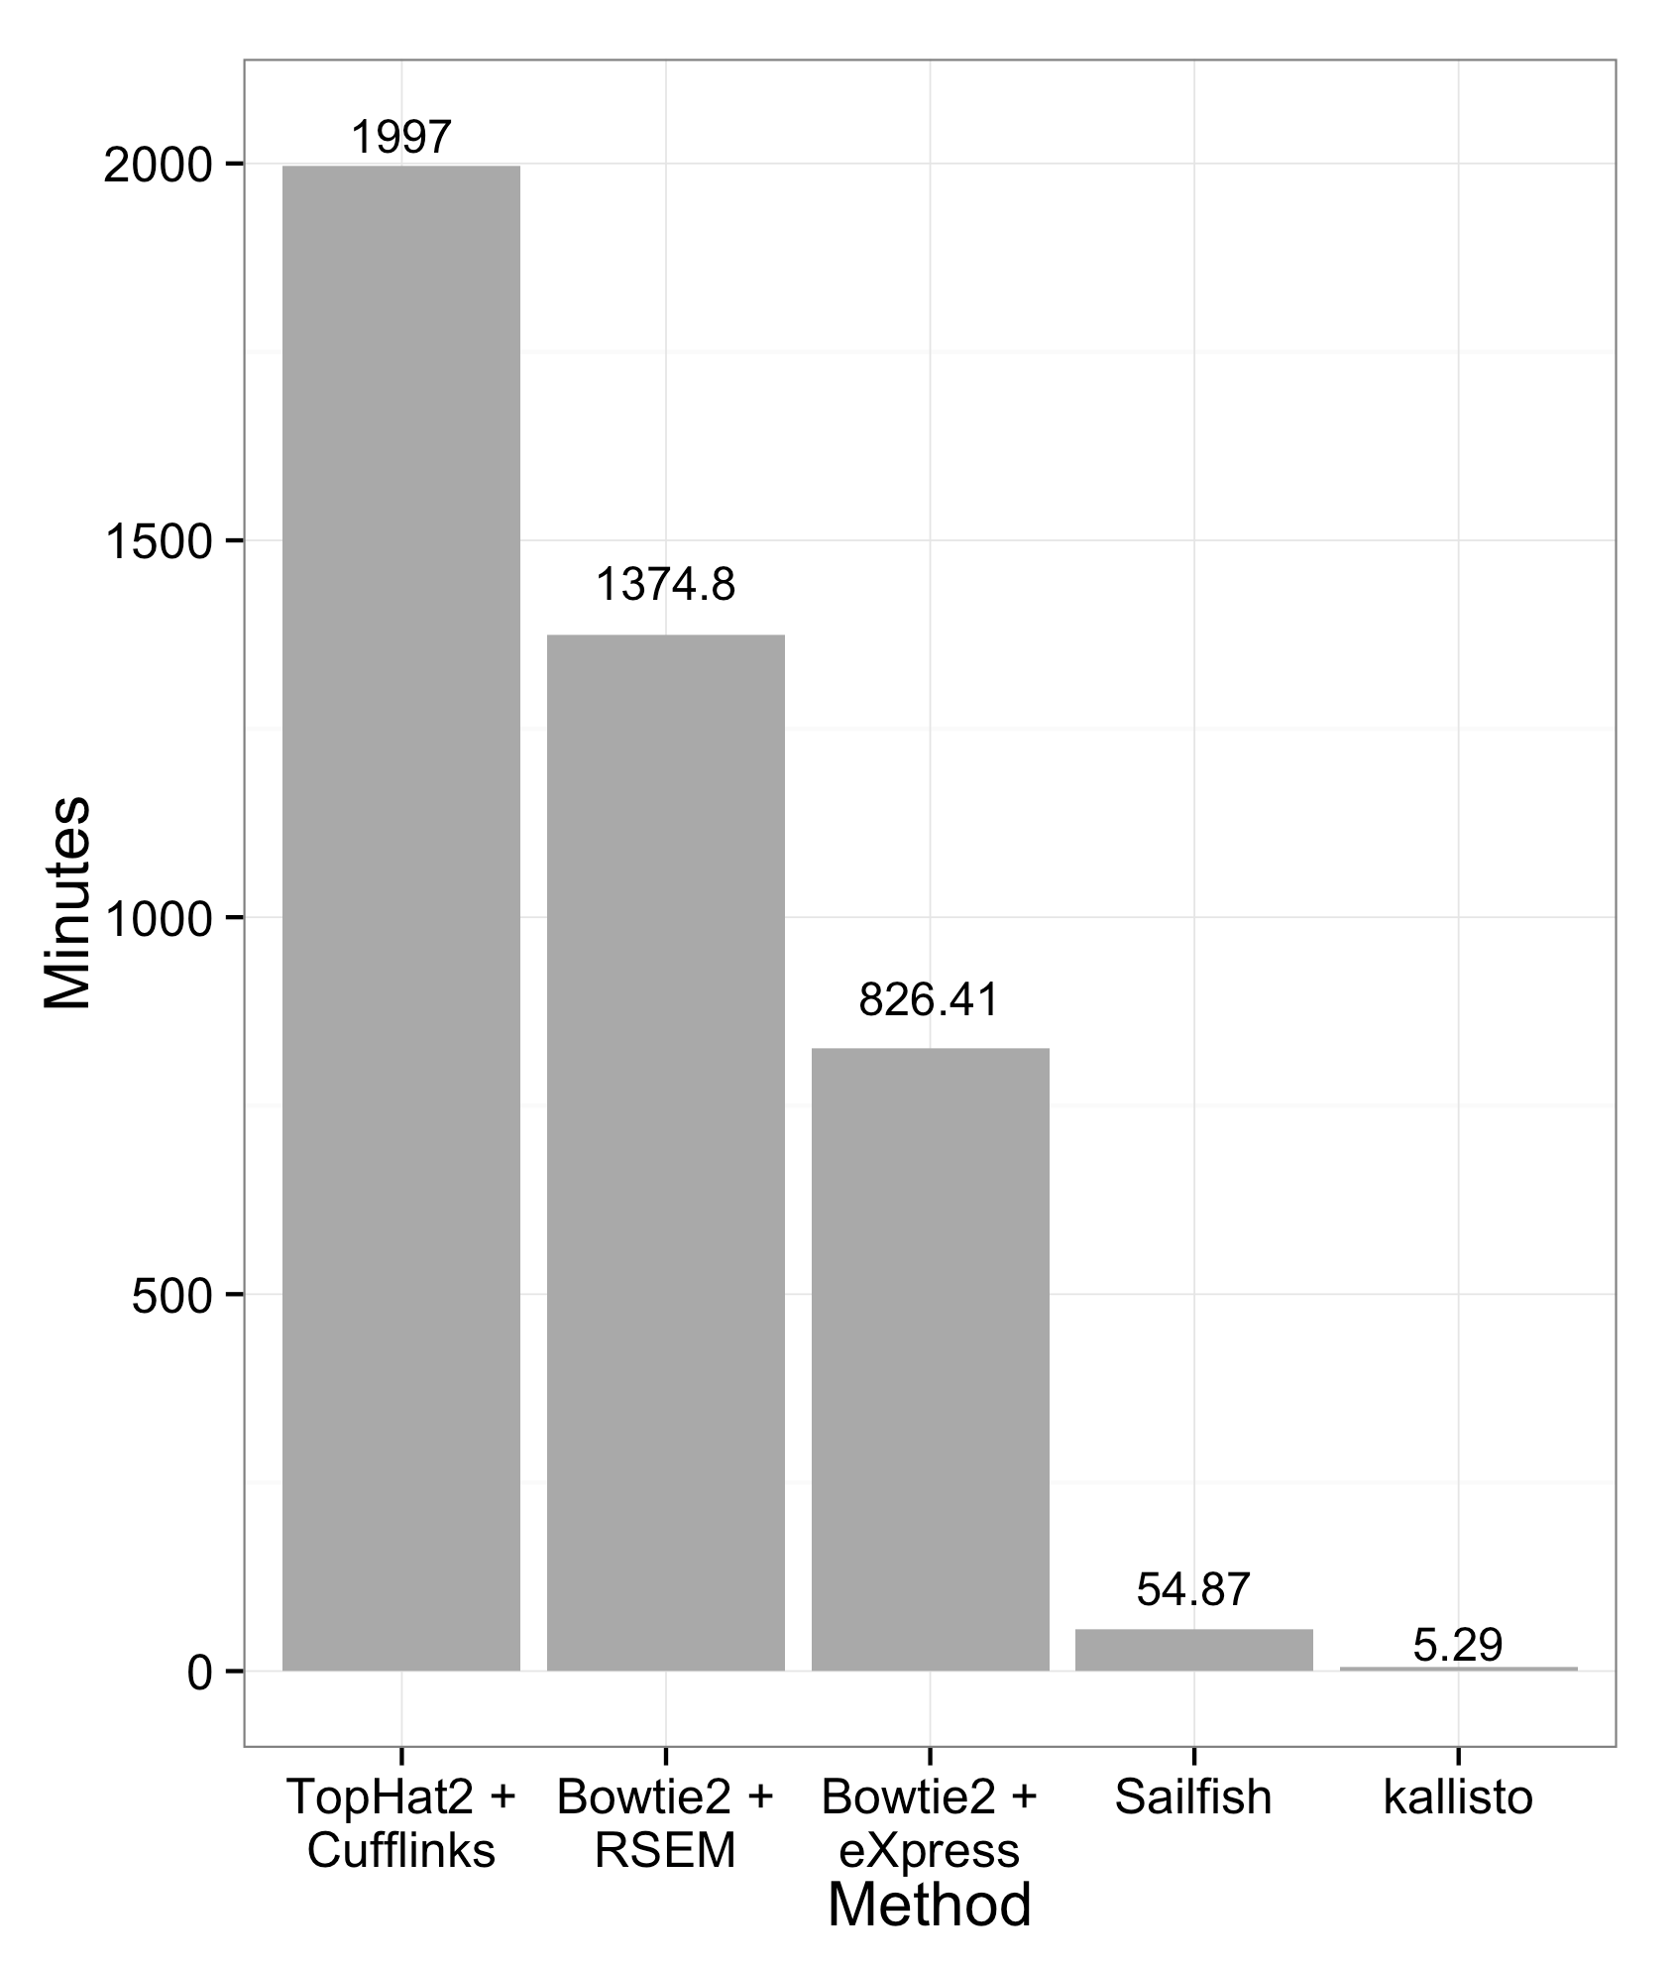
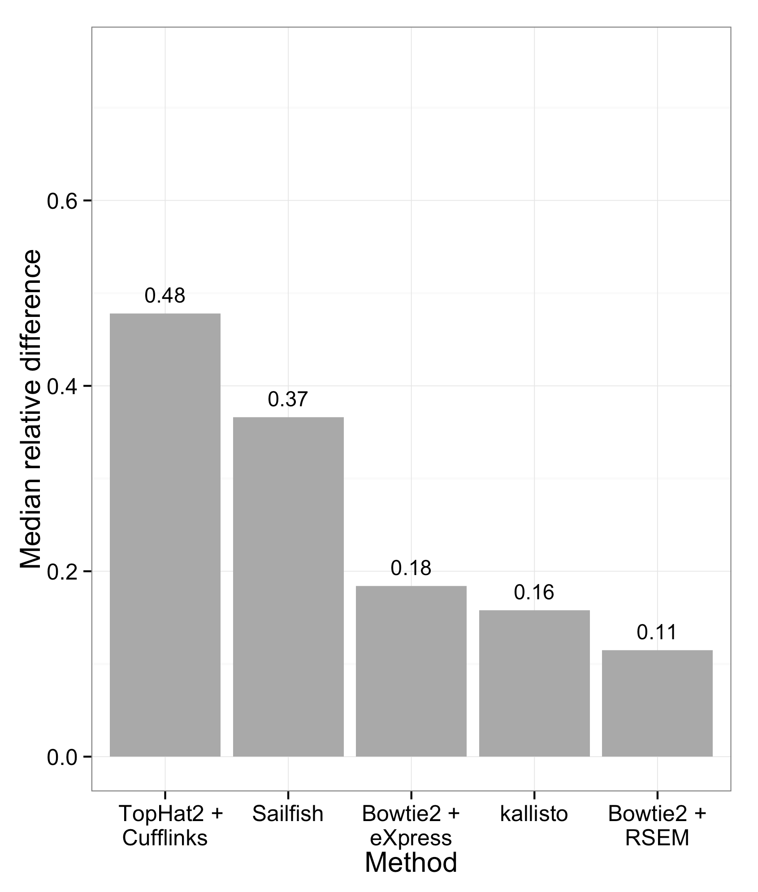
Kallisto Pseudoalignment
From the kallisto paper : https://arxiv.org/pdf/1505.02710.pdf
Also, kallisto or salmon ? https://github.com/mikelove/salmon_kallisto_diffs

Slide 9
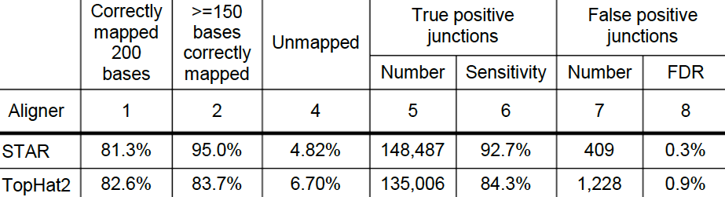
Benchmarking the Aligners (simulated dataset)
Star is at least x20 faster than Tophat2 for similar parameters
Tophat2 is at least x6 more memory efficient (can be run on recent laptops)
Dobin & Gingeras 2013
Essentially, if you have access to a cluster you should be using STAR

Slide 10
Reference Genome Preparation
Regardless of which aligner you choose to use, you must choose a suitable reference genome
Consider the accompanying annotations
Consider which alternative scaffolds to use
The reference genome must be indexed in a manner specific to the algorithm of the chosen aligner
STAR index != Bowtie2 index
Generally requires annotation file for RNA-Seq

Slide 11
Genome Annotation Files
Typically, these are column-based and tab-delimited text files describing genomic features
Gene, CDS, exon, intron, miRNA, etc
Chromosome, start, end, strand, attributes, etc
The most common formats include:
GFF (General Feature Format, latest is GFF3)
GTF (General Transfer Format, ~= GFF2)
We will be working with GTF files
Relatively simple, and bundled with iGenomes
https://support.illumina.com/sequencing/sequencing_software/igenome.html

Slide 12
GTF (GFF2) Annotation Format
http://www.ensembl.org/info/website/upload/gff.html
Tab-delimited, empty columns denoted with “.”
Column order:
seqname – chromosome, scaffold, etc
source – origin of the annotation, db/project
feature – gene, transcript, exon, etc
start – feature start coordinate (1-based)
end – feature end coordinate (1-based)
score – floating point, eg quality score
strand – + (forward) or – (reverse)
frame – reading frame, 0, 1, or 2
attribute – semicolon-delimited feature descriptions

Slide 13
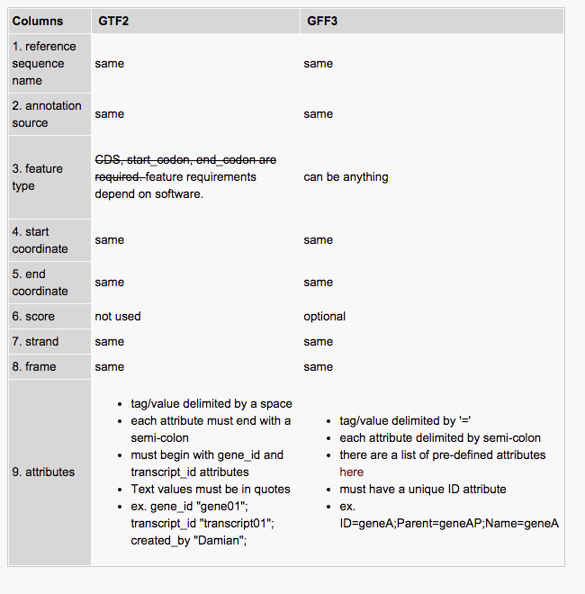
GTF vs GFF3
http://blog.nextgenetics.net/?e=27

Slide 14
Practical
Go to the website and do the reference genome index building practical

Slide 15
SAM Alignment Format - Header
@SQ SN:1 LN:30427671
@SQ SN:2 LN:19698289
@SQ SN:3 LN:23459830
@SQ SN:4 LN:18585056
@SQ SN:5 LN:26975502
@SQ SN:M LN:366924
@SQ SN:C LN:154478
@RG ID:Col0_R1 PL:Illumina LB:1342 SM:Col0_R1
@SQ Reference Sequence: SN name, LN length
@RG Read Group: e.g. grouping samples
https://samtools.github.io/hts-specs/SAMv1.pdf

Slide 16
SAM Alignment Format
Notes:
segments are mapped to the same reference, the
unsigned observed template length equals the number of bases from the leftmost mapped base to the
rightmost mapped base. The leftmost segment has a plus sign and the rightmost has a minus sign.
The sign of segments in the middle is undefined. It is set as 0 for single-segment template or when the
information is unavailable.

Slide 17
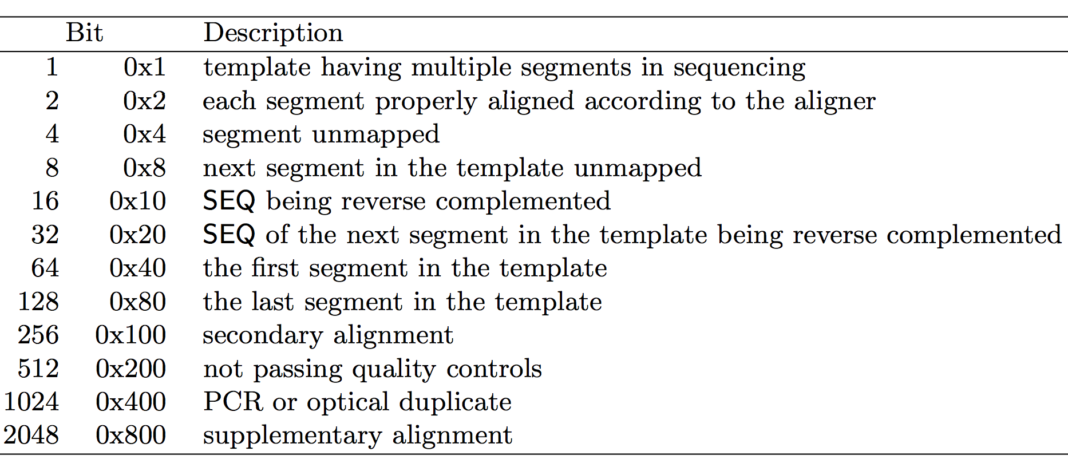
SAM Alignment Format: Flags
Example, flag 83 = 64+16+2+1 means it's first read (0x40) of pair-end reads (0x1) and it's mapped on minus strand (0x10) and both reads mapped (0x2).
https://broadinstitute.github.io/picard/explain-flags.html
https://samtools.github.io/hts-specs/SAMv1.pdf
Notes:
0x is a prefix indicating the number is in hex

Slide 18
SAM format: CIGAR string
Summary of alignment to the reference
eg, 101M, 1S92M, 15M87N70M90N16M
Code | Description
M | Alignment match | Base-level match + mismatch
I | Insertion
D | Deletion
N | Skipped | eg intron
S | Soft clipping | Kept in SAM
H | Hard clipping | Not in SAM
Notes:
CIGAR: 3M1I3M1D5M
The POS indicates that the read aligns starting at position 5 on the reference. The CIGAR says that the first 3 bases in the read sequence align with the reference. The next base in the read does not exist in the reference. Then 3 bases align with the reference. The next reference base does not exist in the read sequence, then 5 more bases align with the reference. Note that at position 14, the base in the read is different than the reference, but it still counts as an M since it aligns to that position.
Clipping: means part of the reads that could not be aligned, hard and soft means present or not present in the alignment seq files, anyways these will never be used in the downstream analysis
Both of these maskings are different from deletions. Masking simply means the part of the read can not be aligned to the genome (simplified, but a reasonable assumption for most cases, I think). A deletion means that a stretch of genome is not present in the sample and therefore not in the reads.

Slide 19
SAM format: optional fields
Used by some aligners to encode additional information for downstream analyses
Can cause incompatibilities among workflows
Code | Description
RG | Read Group e.g. sample or lane
MD | String for mismatching positions
NH | Number of reported alignments that contains the query in the current record
HI | Query hit index, indicating the alignment record is the i-th one stored in SAM

Slide 20
BAM format
Binary SAM format
Lossless compression of SAM format
~4-fold smaller file size
Genome viewers and many downstream applications require the BAM file to be sorted and have an index (typically .bai extension)

Slide 21
Practical
Go to the website and do the mapping and QC practicals

Slide 22
REFERENCES
Li H & Durbin R (2009) “Fast and accurate short read alignment with Burrows-Wheeler transform” Bioinformatics 25(14):1754-60
Langmead et al (2009) “Ultrafast and memory-efficient alignment of short DNA sequences to the human genome” Genome Biology 10(3):R25.
Trapnell et al (2009) “TopHat: discovering splice junctions with RNA-Seq” Bioinformatics 25(9):1105-11.
Kim et al (2013) “TopHat2: accurate alignment of transcriptomes in the presence of insertions, deletions and gene fusions” Genome Biology 14(4):R36.
Dobin et al (2013) “STAR: ultrafast universal RNA-seq aligner” Bioinformatics 29(1):15-21.
Patro et al (2014) “Sailfish enables alignment-free isoform quantification from RNA-seq reads using lightweight algorithms” Nature Biotechnology 32(5):462-4.
Patro et al (2017) “Salmon provides fast and bias-aware quantification of transcript expression” Nature Methods 14(4):417-419.
Bray et al (2016) “Near-optimal probabilistic RNA-seq quantification (Kallisto)” Nature Biotechnology 34(5):525-7.

Slide 23
Contributors: Wandrille Duchemin Geoffrey Fucile Walid Gharib Pablo Escobar Lopez

Slide 24
Annex : Assessing read coverage for biases
The RSeQC package includes a function for evaluating “gene body coverage”
This can be used to assess 5’ or 3’ bias, which might happen if your RNA is degraded or otherwise biased
Requirements:
Genome annotations in the 12-column BED format
Index (.bai) for sorted BAM file, which can be generated using the SAMtools package
samtools index sample1_sorted.bam
geneBody_coverage.py -r /data/GRCm38/Mus_musculus.GRCm38.89.bed12 \
-i sample1_sorted.bam \
-f pdf \
-o output_prefix

Slide 25
Annex - CRAM format
Binary SAM format, significantly improved over BAM lossless compression
Compatible with BAM files
Both lossless and lossy compression possible
https://samtools.github.io/hts-specs/CRAMv3.pdf

Slide 26
Annex - Other relevant formats: BED
Tab-delimited text file used to describe intervals
Minimally:
Sequence ID
Start
End
Optional:
Name
Score
Strand
For large files, use binary index format bigBED
BEDtools (http://code.google.com/p/bedtools)

Slide 27
Annex - Other relevant formats: VCF (Variant Call Format)
Tab-delimited text to describe SNPs, structural variants, indels etc
Contains:
Chromosome
Position
Reference allele, alternative allele(s)
Various statistical metrics
BCF: indexed binary format
https://samtools.github.io/hts-specs/VCFv4.2.pdf

