Slide 1


Introduction to RNA-Seq – Sequence trimming
Wandrille Duchemin

Slide 2
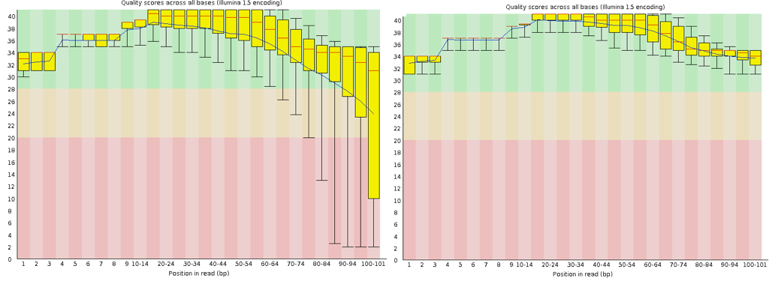
Per Base Sequence Quality

Slide 3
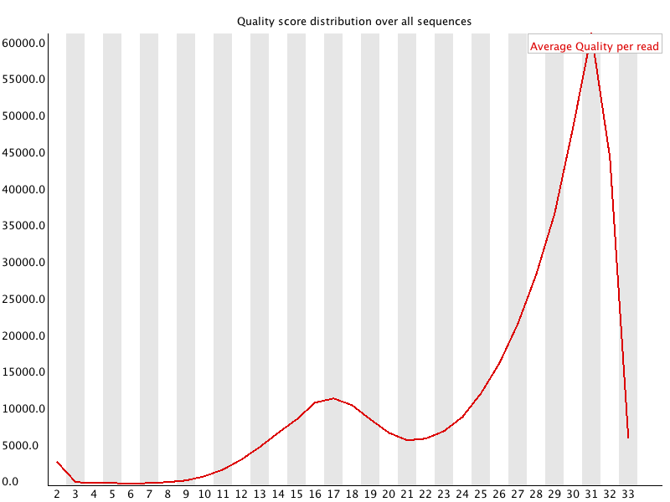
Per Sequence Quality Scores

Slide 4
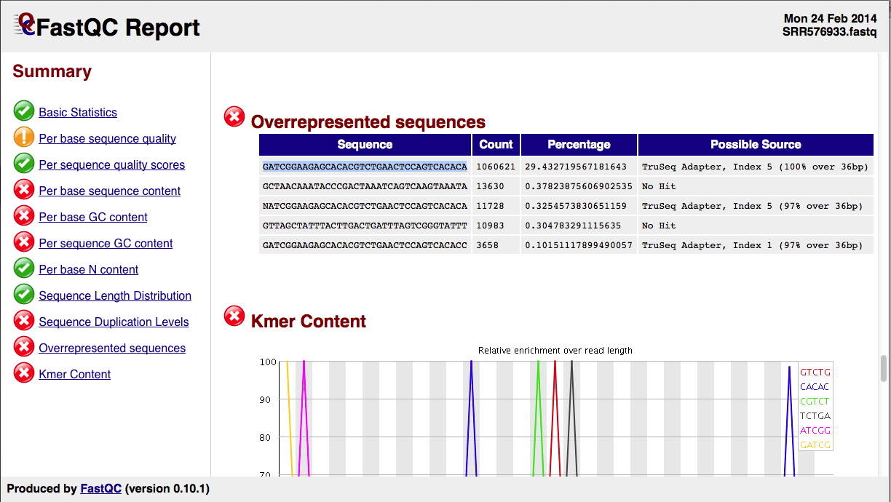
Overrepresented Sequences

Slide 5

RNA-seq data analysis
Raw reads
trimming/filtering
Trimmed/filtered
reads
QC
QC
Sequencing
facility
mapping
assembly
QC
Mapped reads
Assembled
transcriptome
QC
normalization
across libraries
Expression
matrix
expression
quantification
variant
calling
QC
isoform
description
Normalized
counts
...
Pathway enrichment
analysis
...
Differential
Expression analysis
Table of DE genes/transcript
...

Slide 6

Trimming – doing it or not?
Depends on your use case
Transcriptome assembly, variant analysis, genome annotation → DO TRIMMING
Counting (eg. differential expression) : most software can handle no trimming but still recommend some light trim. (continued)

Slide 7
Trimming – doing it or not?
Raw reads
trimming/filtering
Trimmed/filtered
reads
Sequencing
facility
assembly
Transcriptome assembly:
DO trimming
Assembled
transcriptome
expression
quantification
variant
calling
isoform
description
...

Slide 8
Trimming – doing it or not?
Raw reads
trimming/filtering
Trimmed/filtered
reads
Sequencing
facility
mapping
Variant analysis,
genome annotation:
DO trimming
Mapped reads
variant
calling
...

Slide 9
Trimming – doing it or not?
Raw reads
trimming/filtering
Trimmed/filtered
reads
Sequencing
facility
mapping
Counting
(eg, differential expression):
NO trimming or light trim
Mapped reads
expression
quantification

Slide 10
Trimming – doing it or not?
Raw reads
trimming/filtering
Trimmed/filtered
reads
Sequencing
facility
mapping
Counting
(eg, differential expression):
NO trimming or light trim
Mapped reads
expression
quantification
Aggressive trimming (high quality threshold, low length filtering)
can have negative impacts on expression quantification
see : William et al. (2016) Trimming of sequence reads alters RNA-Seq gene expression estimates. BMC bioinfo

Slide 11
Trimming – doing it or not?
Raw reads
trimming/filtering
Trimmed/filtered
reads
Sequencing
facility
mapping
Counting
(eg, differential expression):
NO trimming or light trim
% mapped reads
Mapped reads
# mapped reads
QC
expression
quantification
Aggressive trimming (high quality threshold, low length filtering)
can have negative impacts on expression quantification
see : William et al. (2016) Trimming of sequence reads alters RNA-Seq gene expression estimates. BMC bioinfo

Slide 12
Trimmomatic – main options
ILLUMINACLIP: Cut adapter and other illumina-specific sequences from the read.
SLIDINGWINDOW: Performs a sliding window trimming approach. It starts scanning at the 5‟ end and clips the read once the average quality within the window falls below a threshold.
MAXINFO: An adaptive quality trimmer which balances read length and error rate to maximise the value of each read
LEADING: Cut bases off the start of a read, if below a threshold quality
TRAILING: Cut bases off the end of a read, if below a threshold quality
CROP: Cut the read to a specified length by removing bases from the end
HEADCROP: Cut the specified number of bases from the start of the read
MINLEN: Drop the read if it is below a specified length
AVGQUAL: Drop the read if the average quality is below the specified level

Slide 13
Trimmomatic – main options
ILLUMINACLIP: Cut adapter and other illumina-specific sequences from the read.
SLIDINGWINDOW: Performs a sliding window trimming approach. It starts scanning at the 5‟ end and clips the read once the average quality within the window falls below a threshold.
LEADING: Cut bases off the start of a read, if below a threshold quality
TRAILING: Cut bases off the end of a read, if below a threshold quality
CROP: Cut the read to a specified length by removing bases from the end
HEADCROP: Cut the specified number of bases from the start of the read
MINLEN: Drop the read if it is below a specified length
AVGQUAL: Drop the read if the average quality is below the specified level
http://www.usadellab.org/cms/?page=trimmomatic

Slide 14
Practical
Go to the website and do the trimming practical

Slide 15
Contributors: Wandrille Duchemin Geoffrey Fucile Walid Gharib Pablo Escobar Lopez Mihaela Zavolan

