Slide 1
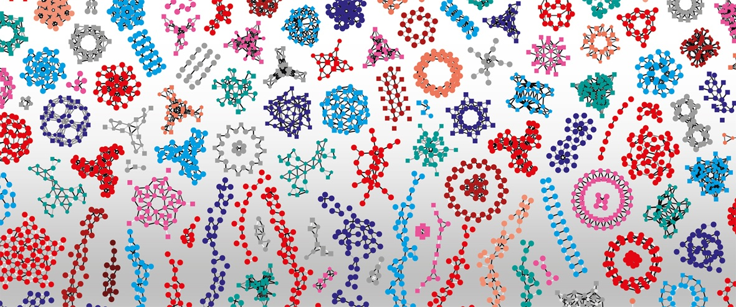

Introduction to RNA-Seq – Enrichment analysis
Wandrille Duchemin
Notes:
1

Slide 2

Enrichment analysis
What to do with your list of differentially expressed gene ?
Interpretation can be difficult, especially when many genes are DE

Slide 3
Enrichment analysis
What to do with your list of differentially expressed gene ?
Interpretation can be difficult, especially when many genes are DE
ENRICHED
Biological function
Pathway
TF
...
DE genes

Slide 4
Enrichment analysis
What to do with your list of differentially expressed gene ?
Interpretation can be difficult, especially when many genes are DE
ENRICHED
Biological function
Pathway
TF
...
DE genes
mapping

Slide 5
Enrichment analysis
What to do with your list of differentially expressed gene ?
Interpretation can be difficult, especially when many genes are DE
ENRICHED
Biological function
Pathway
TF
...
DE genes

Slide 6
Enrichment analysis - mapping
The goal is to regroup certain genes together in meaningful sets
Genes involved in the same pathway (eg. DNA repair)
Genes located in the same biological compartment
Genes with a similar molecular function
Genes regulated by the same transcription factor
…

Slide 7
Enrichment analysis - mapping
A few of the possibilities :
Gene Ontology
Reactome
KEGG
MSigDB
Custom set
…

Slide 8
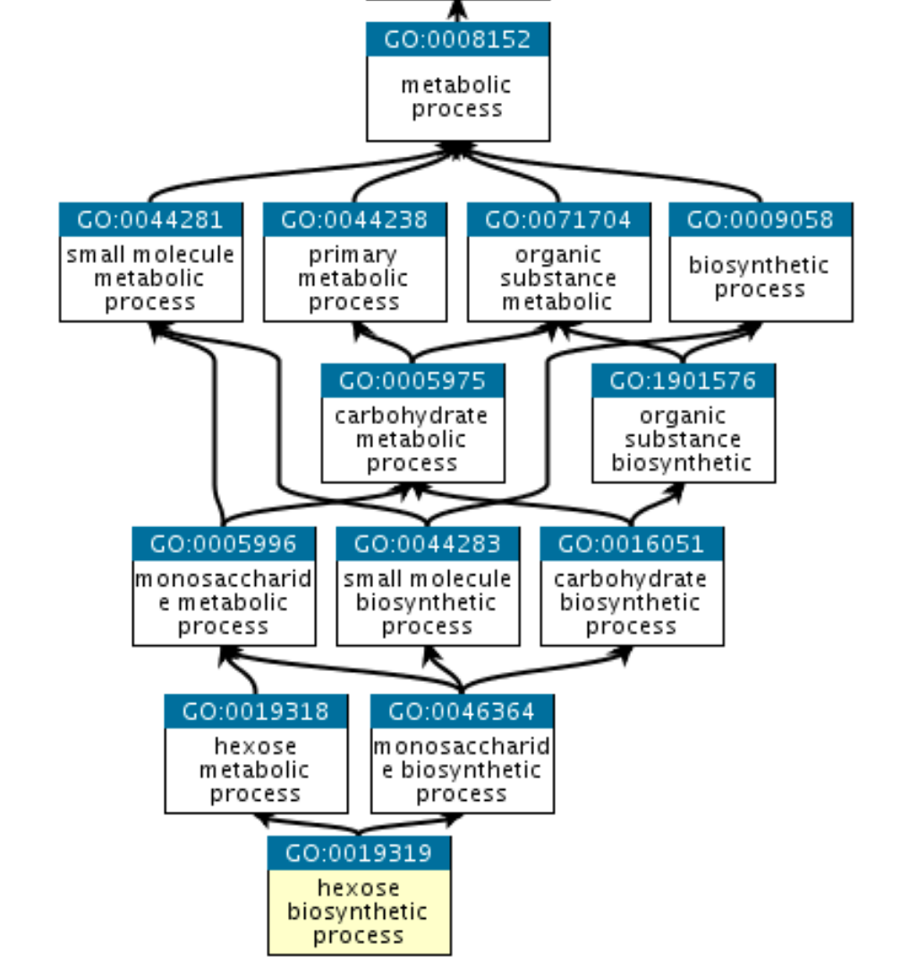
Enrichment analysis - mapping
Gene ontology : http://geneontology.org
3 domains of nested terms:
Molecular Function
Cellular Component
Biological Process

Slide 9
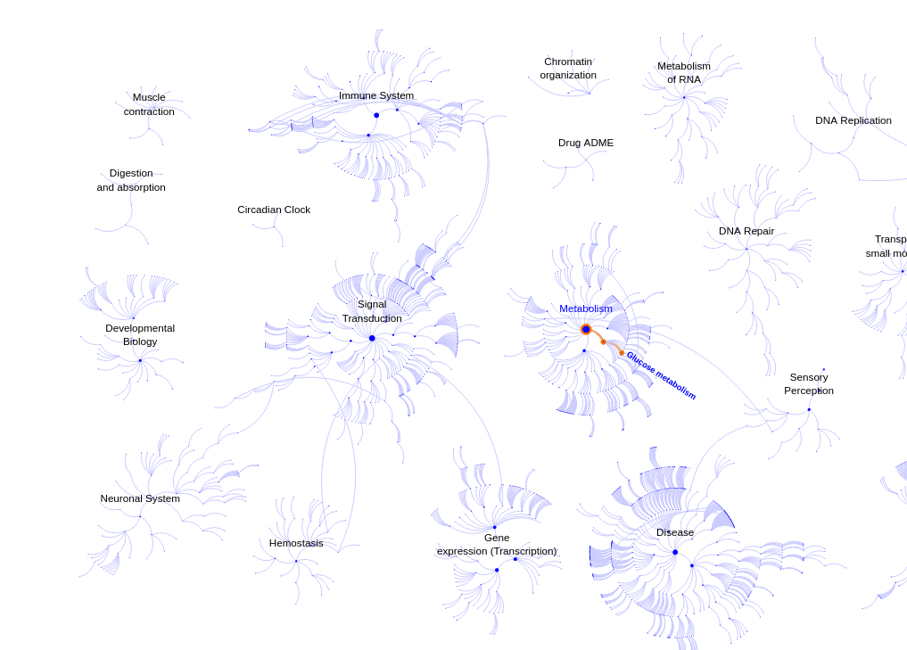
Enrichment analysis - mapping
Reactome : https://reactome.org

Slide 10
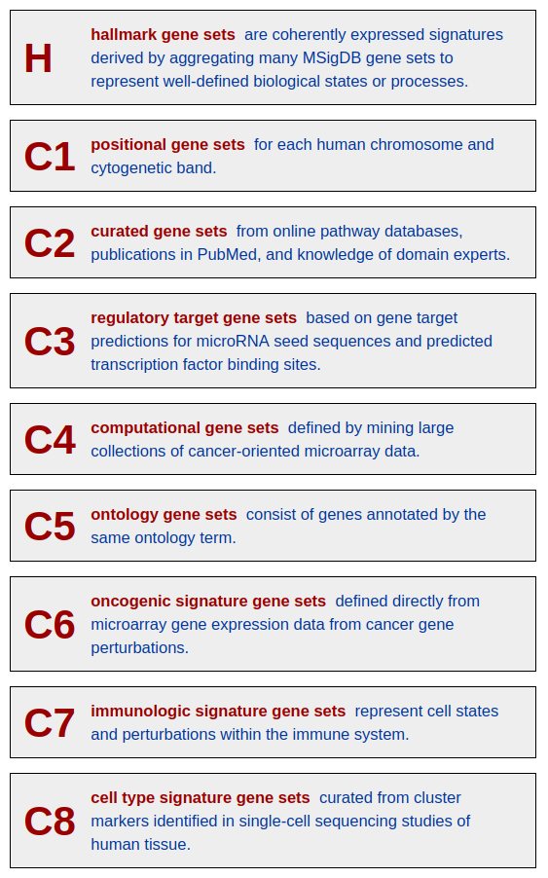
Enrichment analysis - mapping
MSigDB : http://www.gsea-msigdb.org/gsea/msigdb/index.jsp
Human mouse and rat only

Slide 11
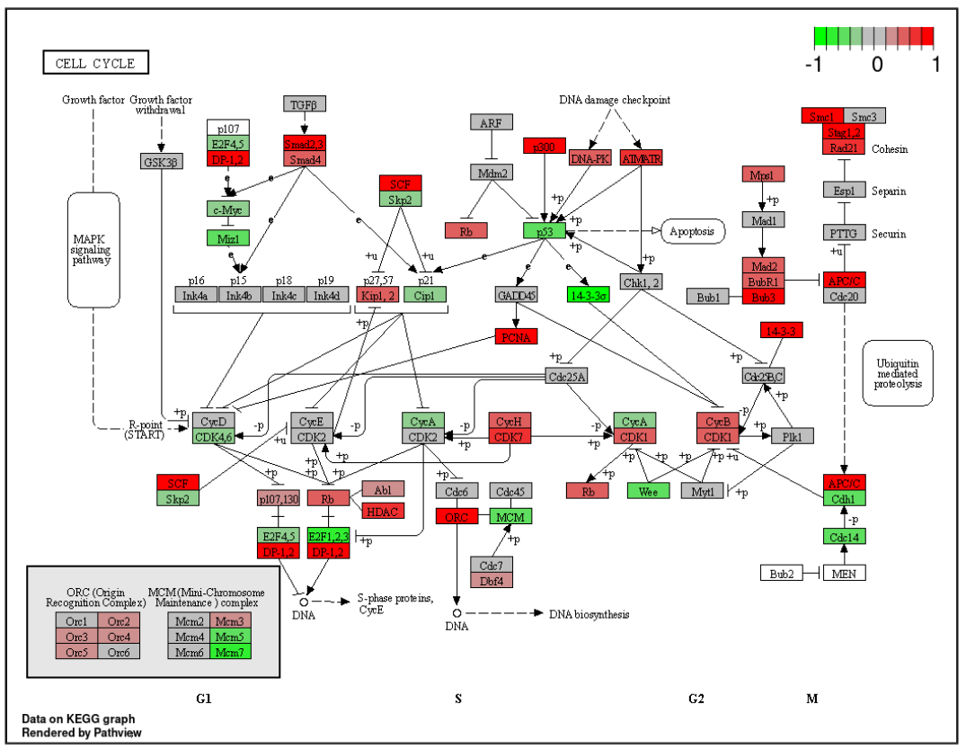
Enrichment analysis - mapping
KEGG : https://www.genome.jp/kegg/ - KEGG PATHWAY
Projection of DE data
onto a KEGG pathway map
With R package pathview
https://bioconductor.org/packages/release/bioc/html/pathview.html

Slide 12
Enrichment analysis - mapping
Custom gene sets :
Derived from specialized litterature
Tentative annotation
Understudied organisms
...

Slide 13
Enrichment analysis – computing enrichment
2 possible approaches (among many!)
Over-representation analysis
Gene Set Enrichment Analysis

Slide 14
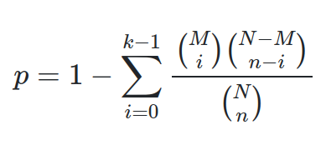
Enrichment analysis – computing enrichment
2 possible approaches (among many!)
Over-representation analysis
Fisher’s exact test (with p-val correction)
 | DE | Not DE
in gene set | A | B
not in gene set | C | D
N = A+B+C+D # total genes
M = A+B # genes in set
n = A+C # DE genes
k = A # DE genes in set

Slide 15
Enrichment analysis – computing enrichment
2 possible approaches (among many!)
Gene Set Enrichment Analysis
Do not rely on 0/1 DE status, but on a continuous measurement (eg. log2FC)
Computes Enrichment Score from list of ranked genes
Estimates significance using permutations

Slide 16
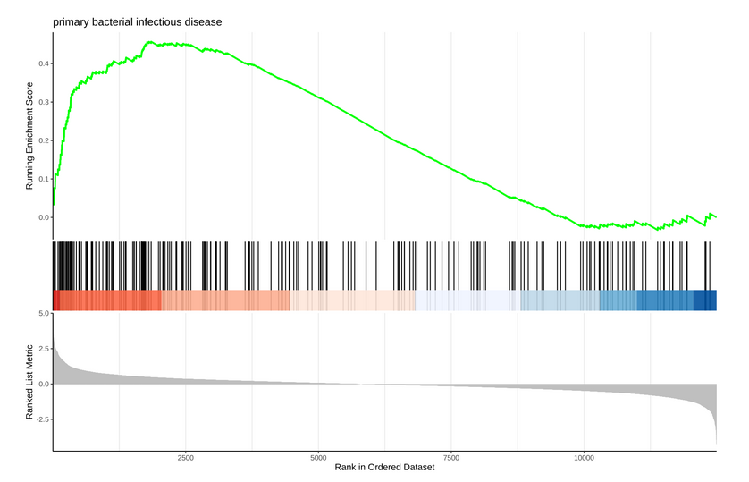
Enrichment analysis – GSEA

Slide 17
Enrichment analysis – ES
Going through the list of ranked genes
Gene :
* in set → Move curve away from 0
* not in set → Move curve to 0

Slide 18
Enrichment analysis – ES
Enrichment Score (ES) : curve maximum
Leading
Edge
genes

Slide 19
Enrichment analysis – NES
ES
Subramanian et al. 2005 : normalization
by comparison with gene-label permuted sets
Korotkevich et al. 2021 : fGSEA: normalization
With parallel evaluation + score heuristic +
Refinement of low-p-values

Slide 20
Enrichment analysis – (f)GSEA
ES
Subramanian et al. 2005 : normalization
by comparison with gene-label permuted sets
Korotkevich et al. 2021 : fGSEA: normalization
With parallel evaluation + score heuristic +
Refinement of low p-values
~100x faster
Default in clusterProfiler

Slide 21
Enrichment analysis – GSEA
Enrichment Score visualized using functions from the R package enrichplot
http://www.bioconductor.org/packages/release/bioc/html/enrichplot.html

Slide 22
Enrichment analysis – computing enrichment
Many more methods or implementations:
Signaling Pathway Impact Analysis
https://bioconductor.org/packages/release/bioc/html/SPIA.html
ISMARA
https://ismara.unibas.ch/mara/
...

Slide 23
Practical
Go to the website and follow the Enrichment practical

Slide 24
Contributors: Geoffrey Fucile Walid Gharib Irene Keller Pablo Escobar Lopez Charlotte Soneson

