Slide 1

First Steps with R in Life Sciences: Statistics
With slides from: Diana Marek, Geoffrey Fucile, Alex Smith, Linda Dib, Leonore Wigger, Wandrille Duchemin
Notes:
Welcome back. This afternoon we use what you learned about R to answer real questions with data.
Plan: (1) the idea of a statistical test and the p-value, (2) the t-test to compare two groups, (3) correlation, (4) a first linear regression with lm().
Reassure the group: no maths background needed. The goal is to know which function to use, how to read its output, and how to say the result in a sentence.

Slide 2
Statistical hypothesis testing
Why do we need a statistical test?
Biological measurements are noisy: two groups never have exactly the same mean, even when nothing really differs between them. A test helps us decide whether a difference is real or could simply be due to chance.
Two hypotheses in competition
H0, the null hypothesis: "nothing is going on" (e.g. no difference between groups)
H1, the alternative hypothesis: what we actually want to show
Example
H0: KO and WT mice have, on average, the same body weight
H1: the average body weight of KO mice is different from that of WT mice
Notes:
Start with the intuition: if you weigh 10 KO and 10 WT mice, the two averages will never be exactly equal, even if the KO has no effect at all. Biological variability alone creates differences.
A test asks: is the difference we see bigger than what chance alone would usually produce?
H0 is the "boring" hypothesis: nothing is going on. H1 is what the researcher usually hopes to show.
Key point: we never prove H1 directly. We look at whether the data are surprising enough to reject H0.
Possible question: "Why not test H1 directly?" Answer: H0 gives a precise situation (difference = 0) that we can compute probabilities for; H1 ("some difference") does not.

Slide 3
The p-value in plain words
Imagine that H0 is true (e.g. KO and WT mice really have the same weight).
The p-value answers: "how surprising would our data be in that case?"
Small p-value (e.g. 0.001): a difference this big would rarely happen by chance alone → we reject H0
Large p-value (e.g. 0.4): a difference like this could easily happen by chance → we cannot reject H0 (this does not prove that H0 is true!)
The usual recipe
Before looking at the data, choose a significance level, usually 0.05
Run the test in R: it gives you a test statistic and a p-value
p-value < 0.05 → the difference is called "statistically significant"
A significant result means the difference is probably not due to chance. It does not tell you that the difference is large or biologically important.
Notes:
This is the most important concept of the afternoon, take your time.
Analogy: a courtroom. H0 = "the defendant is innocent". The p-value measures how surprising the evidence would be if they were innocent. Very surprising evidence: we convict (reject H0). Weak evidence: we acquit, but that does not prove innocence.
0.05 is a convention, not a law of nature. Choose it before looking at the data.
Common misconceptions to address:
- the p-value is NOT the probability that H0 is true;
- p = 0.06 is not "almost significant proof of nothing", it is just weaker evidence;
- a tiny p-value with a huge sample can come from a biologically irrelevant difference. Always look at the size of the effect too.

Slide 4
t-test
Goal
Compare the mean of a continuous measurement between two groups
Is the difference between the two means larger than what we would expect by chance?
Life-science examples
Body weight of KO vs WT mice
Expression of a gene in treated vs untreated cells
Cholesterol level of patients on diet A vs diet B
Assumptions
Observations are independent (e.g. each mouse is measured only once)
In each group, the values roughly follow a normal ("bell-shaped") distribution
R uses Welch's t-test by default, so the two groups do not need to have the same variance.
Notes:
The t-test is the workhorse for comparing two group means. Ask the audience for an example from their own work.
Independence: each value comes from a different individual. If the same mouse is measured twice, that is paired data (later in the session).
Normality: we only need it roughly, and we will check it with plots.
Welch: older textbooks mention an "equal variance" assumption. R's default (Welch's t-test) does not need it, so they don't have to worry about it.

Slide 5
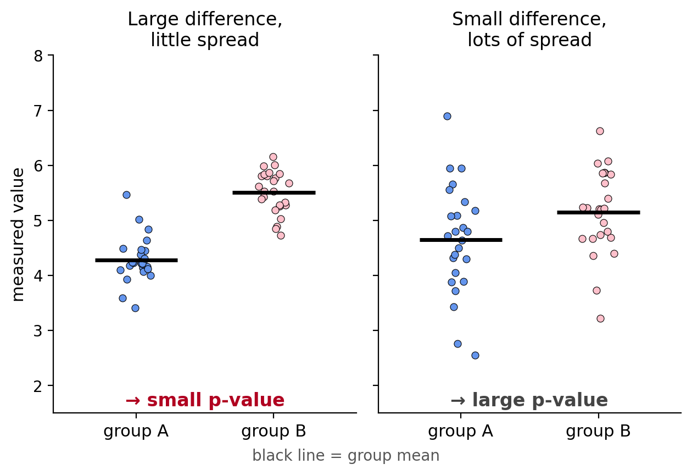
How does the t-test work?
The t-test compares two things:
the difference between the group means (the signal)
the spread of the values within each group (the noise)
Both are combined into one number, the t statistic:
t ≈ difference of means / its uncertainty
Large difference, little spread → large t → small p-value
Small difference or lots of spread → small t → large p-value
More samples per group = less uncertainty = easier to detect a real difference.
Notes:
No formula needed, only the intuition: signal vs noise.
Left panel: the means are far apart and each group is tight, so it is easy to believe the groups differ: small p-value.
Right panel: the means are closer and the points overlap a lot, so the difference could easily be chance: large p-value.
Sample size: with more points, the mean of each group is estimated more precisely, so even a modest difference can become significant.
The figure is illustrative; the p-values are not computed on these points.

Slide 6
Example data set: iris
Let's compare Iris virginica and Iris versicolor petal lengths.
data(iris)
# we limit the data to 2 species
iris_f = iris[ iris$Species %in% c('versicolor','virginica') , ]
iris_f$Species = factor(iris_f$Species)
tapply( iris_f$Petal.Length, iris_f$Species, mean )
versicolor virginica
4.260 5.552
plen_versicolor = iris_f$Petal.Length[iris_f$Species=='versicolor']
plen_virginica = iris_f$Petal.Length[iris_f$Species=='virginica']
Notes:
Our running example: iris, a dataset built into R (measurements in cm). We keep only two species and compare petal length.
Walk through the code slowly:
- %in% keeps the rows whose species is in the list;
- factor() is re-applied to drop the now-empty "setosa" level (otherwise plots and tests can show an empty group);
- tapply() computes the mean per species: 4.26 vs 5.55 cm.
The question for the next slides: is this 1.3 cm difference real or could it be chance?
We also store each group in its own vector, which we need for the normality checks.

Slide 7
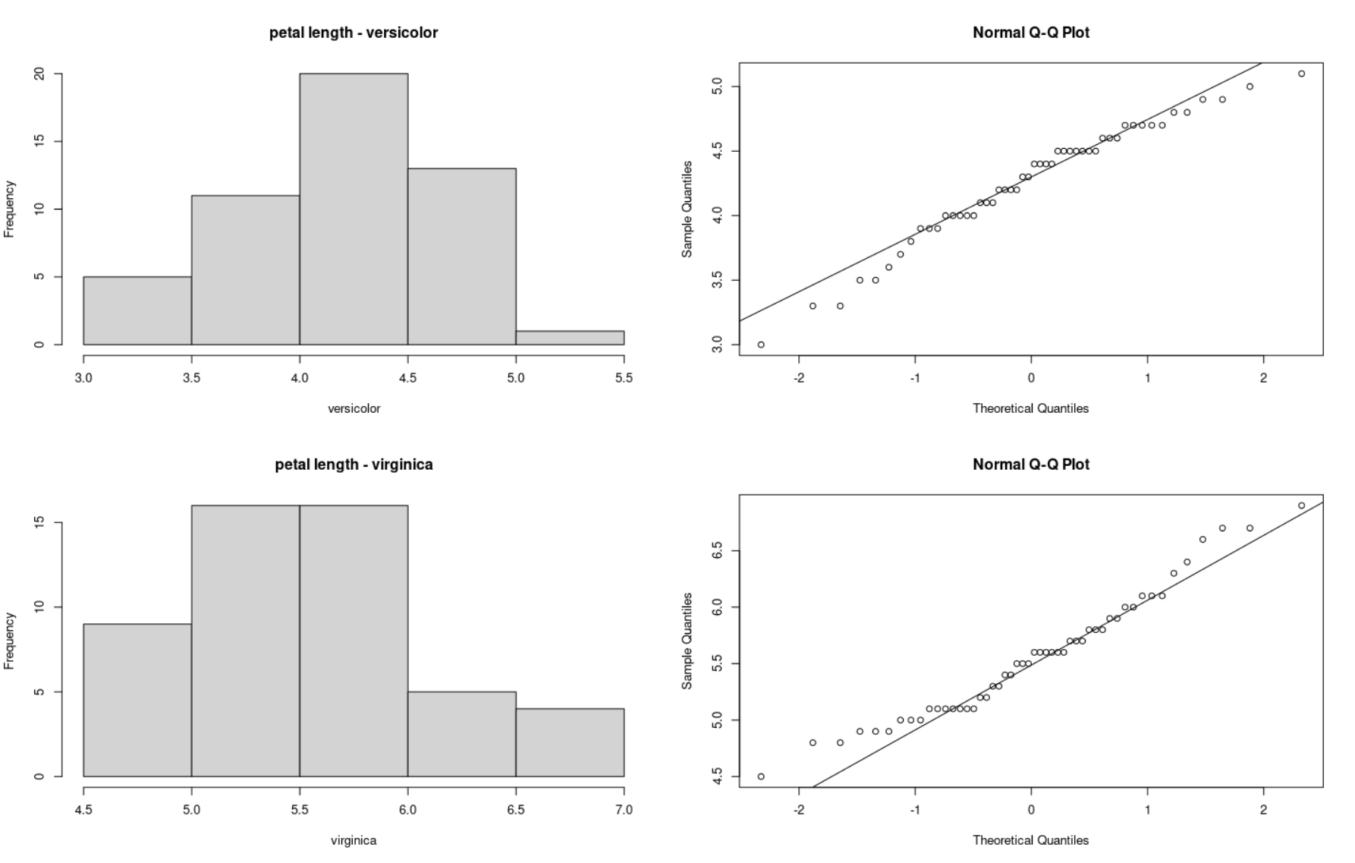
Check normality of the data with plots
We use histograms and QQplot to visually assess normality
par(mfrow=c(2,2))
hist(plen_versicolor,
xlab="versicolor",
main="petal length - versicolor")
qqnorm(plen_versicolor)
qqline(plen_versicolor)
hist(plen_virginica,
xlab="virginica",
main="petal length - virginica")
qqnorm(plen_virginica)
qqline(plen_virginica)
dev.off()
Notes:
Before testing, look at the data.
Histogram: we hope for a roughly symmetric, single-peaked shape.
Q-Q plot: if the data are normal, the points lie close to the straight line. Small wiggles at the ends are normal.
Here both species look reasonably normal.
par(mfrow=c(2,2)) splits the plot window into 2 x 2 panels; dev.off() resets it.

Slide 8
Check normality of the data with tests
The Shapiro-Wilk test checks normality.
Here H0 = "the data are normal", so:
p-value > 0.05: no evidence against normality
p-value < 0.05: the data are probably not normal
shapiro.test(plen_versicolor)
W = 0.966, p-value = 0.1585
shapiro.test(plen_virginica)
W = 0.96219, p-value = 0.1098
The t-test still works well when data are only roughly normal: no need to be too strict. Always look at the plots, not only at the test!
Notes:
The Shapiro-Wilk test is a quick numerical check. Careful with the logic: here H0 is "normal", so a LARGE p-value is what we hope for.
Both p-values are above 0.05: no evidence against normality.
Caveats to mention briefly: with very few points this test almost never rejects, and with thousands of points it rejects tiny, unimportant deviations. That is why the plots matter more than the test.
The t-test is robust: roughly normal is good enough, especially with 20+ observations per group.

Slide 9
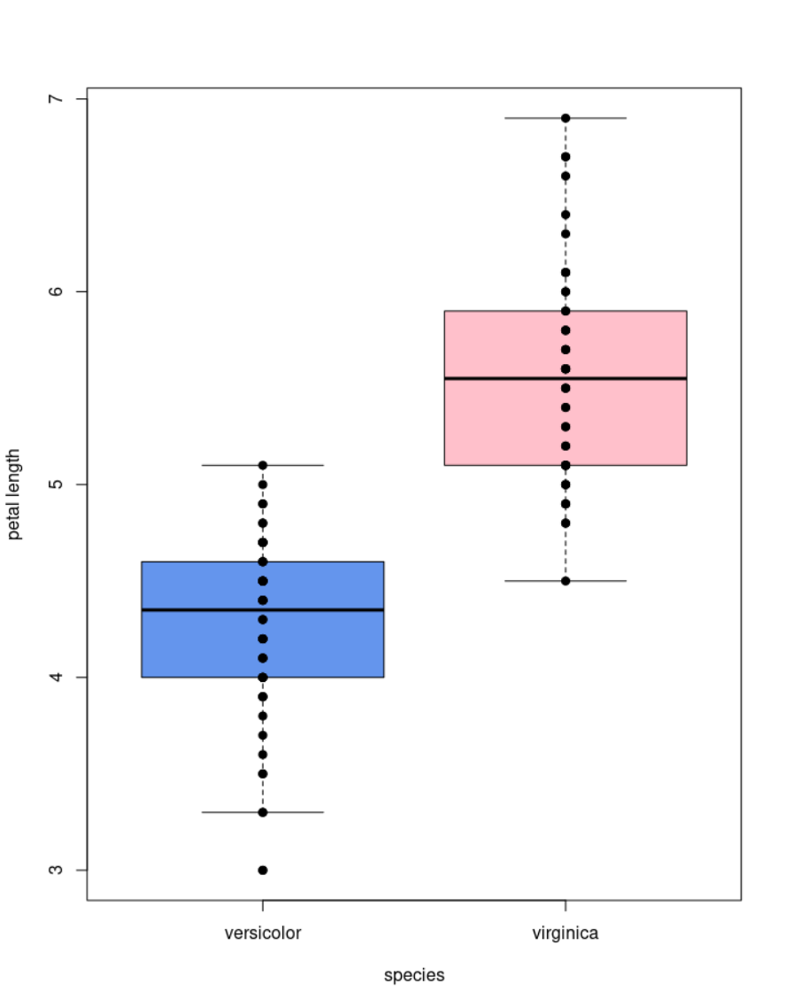
Visualize group differences
boxplot(Petal.Length ~ Species,
data=iris_f,
col=c("cornflowerblue", "pink"),
ylab="petal length",
xlab="species")
points( Petal.Length ~ Species,
data=iris_f,
col="black",
pch = 19)
Notes:
Always plot before you test. The boxplot shows the median, the quartiles and the spread; adding the points shows every observation.
The formula Petal.Length ~ Species reads "petal length as a function of species". We will reuse this ~ notation in t.test() and in lm().
Ask: from the plot alone, do you expect a significant difference? (Yes, the boxes barely overlap.)

Slide 10
Function t.test()
t.test(plen_versicolor, plen_virginica)
t.test(Petal.Length ~ Species, data=iris_f) #equivalent to the above
Welch Two Sample t-test
data: Petal.Length by Species
t = -12.604, df = 95.57, p-value < 2.2e-16
alternative hypothesis: true difference in means between group versicolor and group virginica is not equal to 0
95 percent confidence interval:
-1.49549 -1.08851
sample estimates:
mean in group versicolor mean in group virginica
4.260 5.552
Notes:
Two equivalent ways to call t.test(): with two vectors, or with a formula and a data frame. The formula version is usually more convenient with data frames.
Don't explain the whole output here; the next slide goes through it line by line.
Notice the title "Welch Two Sample t-test": this is R's default.

Slide 11
Reading the t.test() output
t = -12.604, df = 95.57, p-value < 2.2e-16
t: size of the difference compared to the noise (the sign only says which group is larger)
df (degrees of freedom): linked to the number of observations, you can ignore it for now
p-value: < 2.2e-16 is the smallest value R displays, so extremely small → we reject H0
95 percent confidence interval: -1.49549 -1.08851
Plausible range for the true difference of means (versicolor − virginica). It does not contain 0, which agrees with the small p-value.
mean in group versicolor mean in group virginica
4.260 5.552
The two group means
How to report it: "On average, I. virginica petals are 1.3 cm longer than I. versicolor petals (Welch t-test, p < 0.001)."
Notes:
Go through the output line by line.
t: the difference expressed in "units of noise". Negative only because versicolor comes first (alphabetical order of the factor levels).
df: they can ignore it; it is related to sample size.
p-value < 2.2e-16: this is not exactly zero, it is simply the smallest number R prints. Report it as p < 0.001.
Confidence interval: the true difference is plausibly between -1.50 and -1.09 cm. Because 0 is not in the interval, it is consistent with p < 0.05. This is often more informative than the p-value because it shows the size of the effect.
End with the reporting sentence: always state the direction, the size of the difference, the test and the p-value.

Slide 12
t.test object
t.test() and other tests return a list that can be assigned to a variable.
View the names of the list’s slots using names().
Access the elements of a list using the $ or the [[ ]] operators.
test_res = t.test(Petal.Length ~ Species, data=iris_f)
names(test_res)
[1] "statistic" "parameter" "p.value" "conf.int" "estimate"
[6] "null.value" "stderr" "alternative" "method" "data.name"
test_res[['p.value']]
[1] 4.900288e-22
Notes:
Programming tip rather than statistics: the result of a test is a list, so you can store it and extract parts of it.
This is useful to put p-values in a table, or to run many tests in a loop later.
test_res$p.value and test_res[["p.value"]] give the same thing.

Slide 13
Paired data
Sometimes both measurements come from the same individuals (or from matched pairs). The two groups are then not independent → use the paired t-test.
Life-science examples
Blood pressure of the same patients before and after a treatment
Tumour vs adjacent normal tissue from the same patient
The same mice weighed at the start and at the end of a diet
How it works
Compute the difference within each pair (e.g. after − before)
Test whether the mean of these differences is different from 0
Assumption
The differences are roughly normally distributed
Notes:
Paired designs are very common in life sciences. Ask for examples from the audience.
Why it matters: people differ a lot from each other, but each person is compared to themselves. Removing the between-individual variability makes the test much more powerful.
Using an unpaired t-test on paired data is a frequent mistake; it usually gives a larger p-value than it should.
The paired t-test is just a one-sample t-test on the differences: is their mean different from 0?

Slide 14
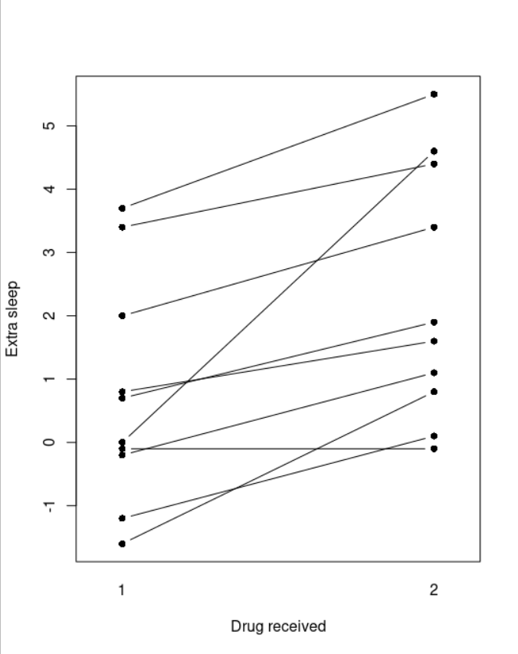
Paired data representation
data(sleep)
head(sleep, n=3)
extra group ID
1 0.7 1 1
2 -1.6 1 2
3 -0.2 1 3
interaction.plot(response=sleep$extra,
x.factor=sleep$group,
trace.factor=sleep$ID,
legend=FALSE, type="b",
lty=1, pch=16,
xlab="Drug received",
ylab="Extra sleep")
Notes:
The sleep dataset (built into R): extra hours of sleep for 10 patients, each of whom took both drugs (group 1 and group 2). ID identifies the patient.
In the plot, each line is one patient. Most lines go up: almost every patient slept more with drug 2.
This plot shows the pairing, which a simple boxplot would hide.

Slide 15
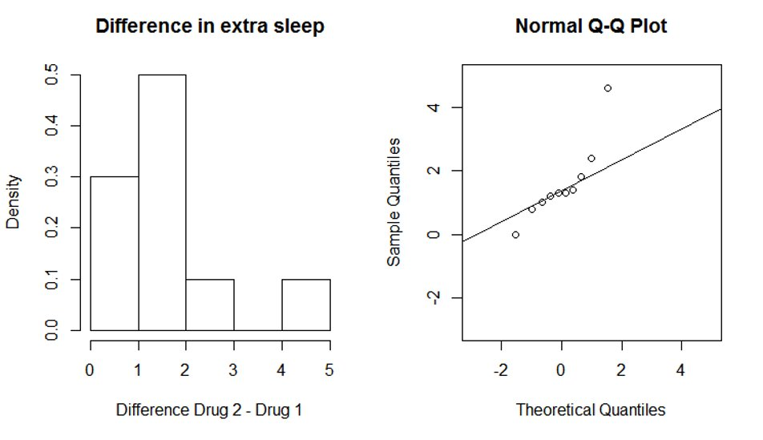
Check normality of the differences between pairs
difference = sleep$extra[sleep$group==2]-sleep$extra[sleep$group==1]
hist(difference, freq=FALSE, xlab="Difference Drug 2 - Drug 1",
main="Difference in extra sleep", col="white")
qqnorm(difference)
qqline(difference)
Notes:
For the paired test, the assumption is on the differences, not on each group separately.
We compute one difference per patient and check its histogram and Q-Q plot, exactly as before.
With 10 points it is hard to judge; we just look for strong skewness or extreme outliers. Nothing alarming here.

Slide 16
Paired t-test
# using a paired t-test:
t.test(sleep$extra[sleep$group==1],
sleep$extra[sleep$group==2], paired=TRUE)
# paired values must be at the same position in the two vectors
# do not use formula notation (extra~sleep) for paired t-test
Paired t-test
data: sleep$extra[sleep$group == 1] and sleep$extra[sleep$group == 2]
t = -4.0621, df = 9, p-value = 0.002833
alternative hypothesis: true difference in means is not equal to 0
95 percent confidence interval:
-2.4598858 -0.7001142
sample estimates:
mean of the differences
-1.58
Notes:
paired=TRUE is the only change.
Important: the values must be in the same order in both vectors (patient 1 in position 1 in both, etc.). In the sleep data, the rows are already sorted by ID.
Recent versions of R no longer accept the formula notation with paired=TRUE, hence the comment.
Reading: mean difference = -1.58 h (group 1 minus group 2), so drug 2 gives on average about 1.6 h more sleep. p = 0.0028: significant at 0.05. The confidence interval (-2.46 to -0.70) does not contain 0.

Slide 17
Choosing a t-test, and alternatives
Which t-test should I use?
Two independent groups (e.g. KO vs WT mice):
t.test(x, y)
The same individuals measured twice (e.g. before / after treatment):
t.test(x, y, paired=TRUE)
What if the data are far from normal?
Small deviations are fine: the t-test is quite robust
For data that are clearly not normal (very skewed, strong outliers), alternative tests exist. They are called non-parametric tests and do not assume any particular distribution.
They are not covered in this course. If you need them, look at the resources at the end of the course or ask a statistician.
Notes:
Summary slide: the decision is mainly about the design (independent vs paired groups).
About non-normal data: tell them alternatives exist (non-parametric, rank-based tests) so they know the word if they read it in a paper, but we deliberately don't cover them.
A log-transformation is also often used for skewed biological data (e.g. concentrations, expression values) if someone asks.

Slide 18
Let's practice - 10
Come back to the mice data-set stored in the "mice_data" data frame.
Considering WT mice weight and KO mice weight separately, check the assumption of normality graphically.
Make an appropriate plot to visualize the mouse weights grouped by genotype.
Perform a test to see whether the mouse weight is different between the two genotypes.
Repeat steps 1 to 3 for the diet variable.
EXTRA TASKS:
Test if the two groups have equal variance with var.test(). If they do, look in ?t.test which option you can change, and try it.
Notes:
Exercise, about 20-25 minutes.
Remind them of the steps: plots for normality per group, boxplot by group, then t.test() with the formula notation.
Diet: same procedure, same functions, just a different grouping variable.
Extra task: var.test() compares the variances. The option to look for in ?t.test is var.equal=TRUE. Point out that the default (Welch) is usually fine anyway.
Common problems: forgetting data=, misspelled column names, a grouping variable with more than two levels (t.test() needs exactly two groups).

Slide 19
Bivariate linear correlation
Goal: measure how strongly two continuous variables are linearly related
Examples: expression of two genes across samples; BMI and blood pressure of patients
The correlation coefficient goes from -1 (perfect negative) through 0 (none) to +1 (perfect positive)
cor() computes the correlation between two variables
Default: method="pearson" (linear correlation)
Other options: method="spearman", method="kendall" (rank-based correlations)
cor.test() computes the correlation and tests whether it is different from 0 (p-value)
Correlation does not mean causation!
Notes:
Change of topic: two continuous variables measured on the same individuals.
The coefficient r goes from -1 to +1; the sign gives the direction, the absolute value the strength.
Pearson measures linear relationships. Spearman uses ranks: more robust to outliers and works for any monotonic relationship.
cor() only gives the number; cor.test() also gives a p-value and a confidence interval.
Correlation does not mean causation: e.g. ice-cream sales and drowning both increase in summer.

Slide 20
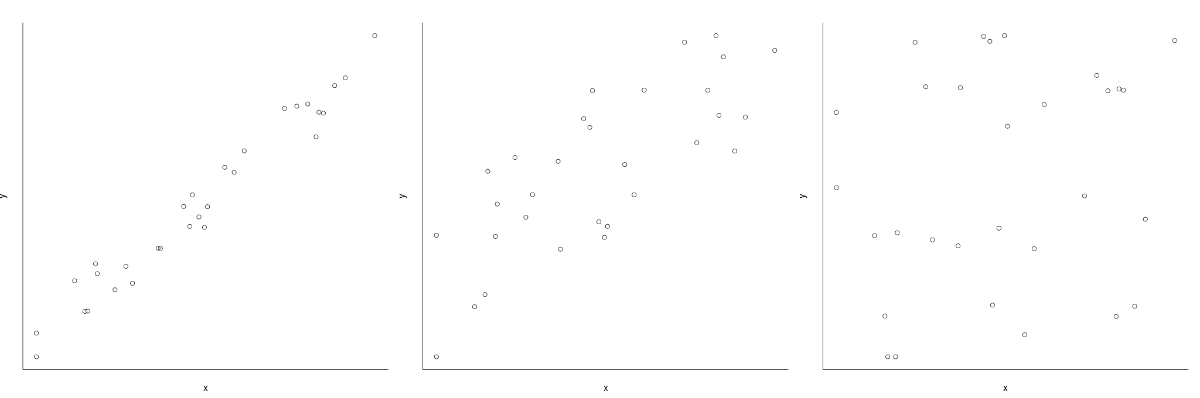

Visualization of linear correlation
Strong linear correlation
Medium-strong linear correlation
No correlation
Notes:
Show what different values of r look like. Ask the audience to guess r for each panel before revealing the labels.
Even a "medium" correlation leaves a lot of scatter around the trend.

Slide 21
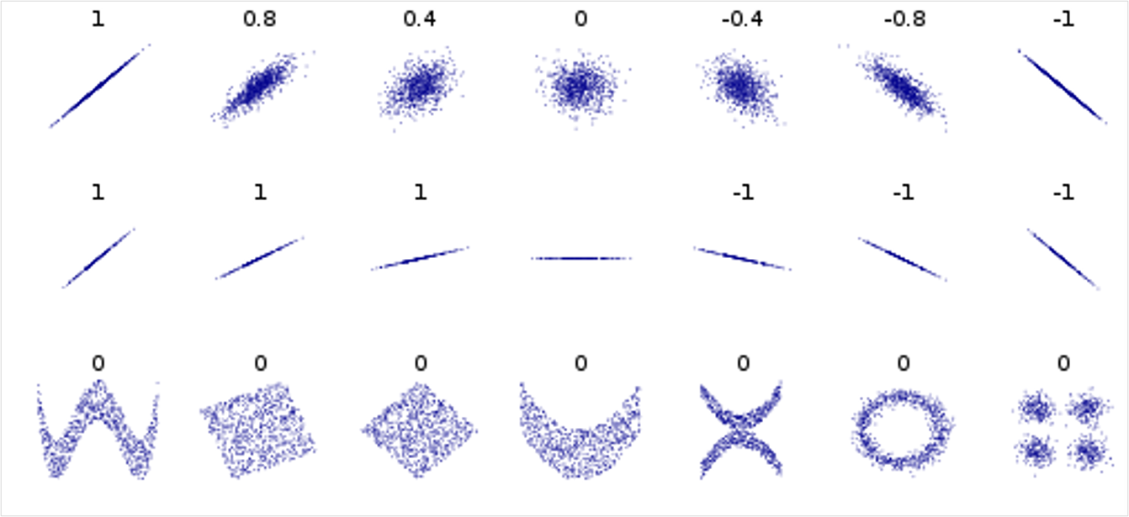
More visualization of linear correlation
correlation reflects the noisiness and direction of a linear relationship (top row)
but not the slope of that relationship (middle)
nor many aspects of nonlinear relationships (bottom).
Image credit:
wikipedia user DenisBoigelot,
under the CC0 1.0 license
Notes:
The classic Wikipedia figure.
Top row: r reflects how tightly the points follow a line, and its direction.
Middle row: all have r = 1 or -1 whatever the slope (except the flat line, where r is undefined). So r does not tell you how steep the relationship is; that is what regression will do.
Bottom row: strong non-linear patterns can have r = 0. Lesson: always plot your data before computing a correlation.

Slide 22
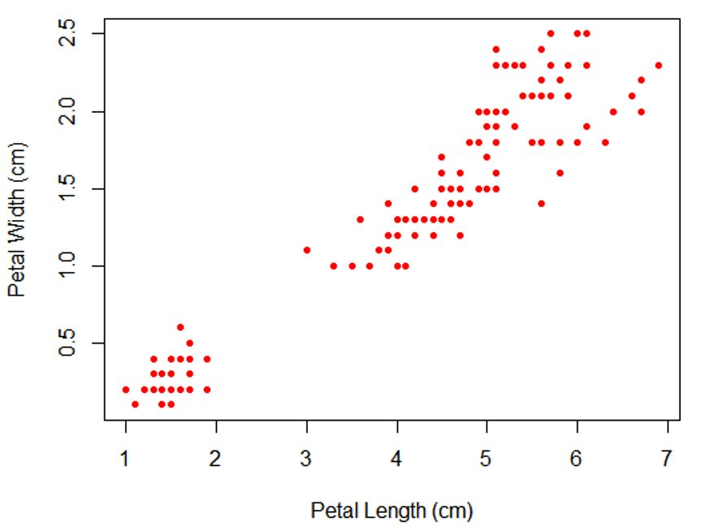
Scatter plot
plot(iris$Petal.Length, iris$Petal.Width,
col="red", pch=20,
xlab="Petal Length", ylab="Petal Width")
Notes:
Basic scatter plot with plot(x, y). Ask: what correlation do you expect? (Strong, positive.)
Note the cluster at the bottom left: that is the setosa species. Groups in the data can create or inflate correlations; worth mentioning briefly.

Slide 23
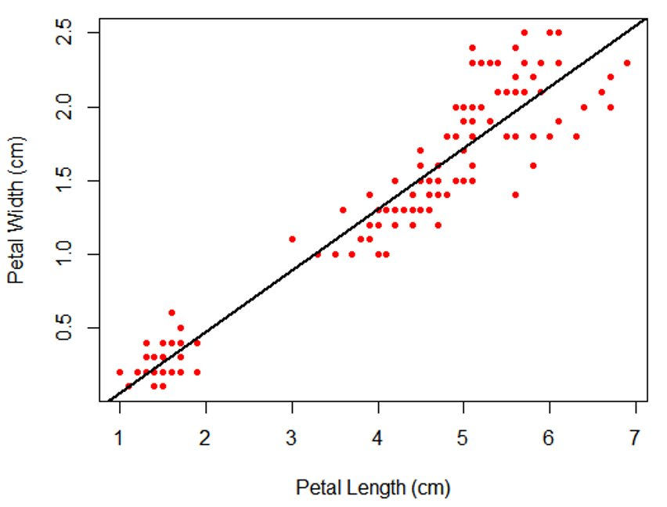
Scatter plot
plot(iris$Petal.Length, iris$Petal.Width,
col="red", pch=20,
xlab="Petal Length", ylab="Petal Width")
abline(lm(iris$Petal.Width~iris$Petal.Length),
col="black", lwd=2)
Notes:
We add a trend line with abline(lm(...)). This is a preview of the linear regression we will see right after.
Note the formula order: y ~ x, so Petal.Width ~ Petal.Length.

Slide 24
Linear correlation
cor(iris$Petal.Length, iris$Petal.Width, method="pearson")
[1] 0.9628654
cor.test(iris$Petal.Length, iris$Petal.Width, method="pearson")
Pearson's product-moment correlation
data: iris$Petal.Length and iris$Petal.Width
t = 43.387, df = 148, p-value < 2.2e-16
alternative hypothesis: true correlation is not equal to 0
95 percent confidence interval:
0.9490525 0.9729853
sample estimates:
cor
0.9628654
Notes:
r = 0.96: very strong positive linear correlation.
cor.test() output: focus on the p-value (here tiny, so the correlation is significantly different from 0), the confidence interval for r, and the estimate.
Point out the similarity with the t.test() output: same structure, same way to read it.
A significant correlation is not necessarily a strong one: with many points, even r = 0.2 can be significant.

Slide 25
Linear regression
Goal
Describe how an outcome variable changes with an explanatory variable, using a straight line. The line can also be used to make predictions.
Life-science examples
How does blood glucose change with BMI?
How does the response to a drug change with the dose?
How does height change with age in children? (our example)
In R, the model is written as a formula
outcome ~ explanatory variable
Height ~ Age # "Height explained by Age"
Correlation: how strongly are X and Y related? Regression: how much does Y change when X increases?
Notes:
Correlation answers "how strongly are X and Y related?". Regression answers "how much does Y change when X changes?" and lets us predict Y from X.
In regression the roles are not symmetric: one outcome, one (or more) explanatory variables.
The formula notation is the same ~ as in t.test() and boxplot(): outcome on the left, explanatory on the right.

Slide 26
Simple linear regression
R finds the straight line that best fits the points:
y = a + b × x
x: explanatory variable (e.g. Age) y: outcome (e.g. Height)
a, the intercept: value of y when x = 0
b, the slope: how much y changes on average when x increases by 1 (e.g. cm per year)
Residuals: vertical distance between each point and the line (what the line does not explain)
Assumptions (checked with plots)
The relationship looks roughly like a straight line
Observations are independent
Residuals have a similar spread all along the line
Residuals are roughly normally distributed
Notes:
Only two numbers describe a line: the intercept (where the line crosses x = 0) and the slope (how steep it is).
R chooses the line that makes the residuals as small as possible overall (least squares). No need to go further than that.
The assumptions are close to those of the t-test: independence and roughly normal residuals, plus a straight-line relationship and a constant spread. We check them with plots a few slides later.

Slide 27
Summary of the data
CLASS dataset, from the program SAS
(names removed and units have been modified from imperial to metric)
class_data <- read.csv("course_dataset/class.csv")
class_data$Gender=as.factor(class_data$Gender)
summary(class_data)
Gender Age Height Weight
F: 9 Min. :11.00 Min. :130.3 Min. :22.91
M:10 1st Qu.:12.00 1st Qu.:148.0 1st Qu.:38.22
Median :13.00 Median :159.5 Median :45.13
Mean :13.32 Mean :158.3 Mean :45.37
3rd Qu.:14.50 3rd Qu.:167.4 3rd Qu.:50.92
Max. :16.00 Max. :182.9 Max. :68.04
Notes:
The CLASS dataset: 19 school children, with gender, age (years), height (cm) and weight (kg).
read.csv() then as.factor() so that Gender is treated as a category.
summary() is always a good first look: ranges, medians, and the number of F and M.

Slide 28
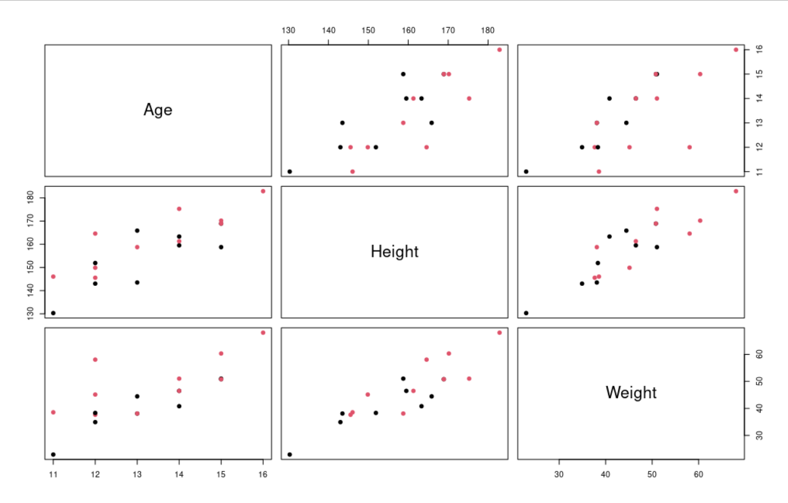
Visual summary of the data
pairs(class_data[2:4] , col = class_data$Gender,
pch=19 )
Notes:
pairs() makes all scatter plots between the selected columns at once. Colours show gender.
The circled panel is height vs age: clearly increasing, roughly linear. That is the relationship we model next.

Slide 29
The lm() function
lm() fits a linear model and returns an object containing the result:
my_model <- lm(outcome ~ explanatory, data = my_data)
Useful functions to apply to the model
my_model (just print it): the intercept and the slope
plot(my_model): plots to check the assumptions
summary(my_model): p-values and R-squared
coef(my_model), residuals(my_model): extract the coefficients or the residuals
Notes:
The general pattern for modelling in R: fit the model, store it in an object, then apply functions to that object.
Same idea as storing the t.test() result earlier.
Only summary() and plot() really matter for today; coef() and residuals() are convenient extras.

Slide 30
Simple linear regression code
model_height_age <- lm(Height~Age, data=class_data)
model_height_age
Call:
lm(formula = Height ~ Age, data = class_data)
Coefficients:
(Intercept) Age
64.069 7.079
→ Height ≈ 64.1 + 7.1 × Age (in cm, age in years)
Notes:
Printing the model only shows the two coefficients.
Write the equation on the board: Height = 64.1 + 7.1 x Age.
Ask the audience to predict the height of a 12-year-old: 64.1 + 7.1 x 12 = about 149 cm. Compare with the data.

Slide 31
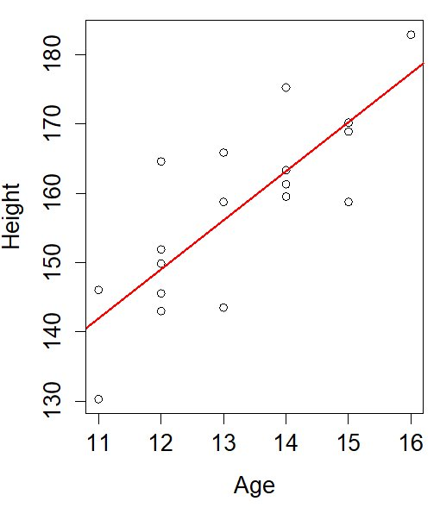
Representation of the fit (II)
plot(Height~Age,data=class_data)
abline(model_height_age, col="red", lwd=2)
Coefficients = intercept and slope of the red line
coef(model_height_age)
(Intercept) Age
64.068667 7.079333
Slope: each extra year of age adds on average about 7 cm of height
Intercept: predicted height at age 0 (64 cm). Not meaningful here: there is no child younger than 11 in the data!
Notes:
abline() can take the model object directly and draws the fitted line.
Slope: on average, children are about 7 cm taller per extra year in this age range.
Intercept: mathematically the height at age 0, but we have no data near 0, so don't interpret it. Never extrapolate far outside the range of your data.

Slide 32
Representation of the fit (III)
Residuals: vertical distance between each point and the line (observed − predicted)
residuals(model_height_age)[1:4]
1 2 3 4
-11.639333 4.108667 -3.478667 2.871333
Positive residual: the point is above the line
Negative residual: the point is below the line
A good model has small residuals with no visible pattern
Notes:
Residual = observed value minus predicted value. Show the two blue arrows: one point above the line (positive residual), one below (negative).
A model with smaller residuals fits the data better.
Residuals are what we inspect to check the assumptions on the next slide.

Slide 33
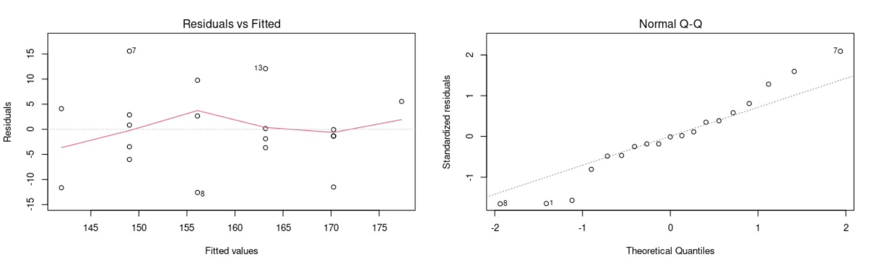
Check model assumptions
par(mfrow=c(1,2))
plot(model_height_age, which=1:2)
# only the 2 most useful plots
More details on these plots:
https://library.virginia.edu/data/articles/diagnostic-plots
Residuals vs Fitted: are the residuals centred on 0?
Good: points scattered randomly around the dotted line at 0, no clear shape
Problem: a curve (the relation is not a straight line) or a funnel (spread increases)
Normal Q-Q: are the residuals normally distributed?
Good: points lie roughly on the dashed line
Here: OK, small deviations at the ends are normal with only 19 children
Notes:
We look at only two plots to keep it simple (plot(model) without which= gives four; the other two are for more advanced use).
Residuals vs Fitted: the red line should stay roughly flat around 0, and the points should not form a curve or a funnel. Here: no strong pattern, OK.
Normal Q-Q: points roughly on the dashed line. Here: OK. The numbered points (7, 8, 1) are just the most extreme observations, not necessarily errors.
With 19 points, these plots will never look perfect. We only worry about strong, obvious patterns.

Slide 34
Model summary
summary(model_height_age)
Call:
lm(formula = Height ~ Age, data = class_data)
Residuals:
Min 1Q Median 3Q Max
-12.5900 -3.5730 -0.0787 3.4900 15.5713
Coefficients:
Estimate Std. Error t value Pr(>|t|)
(Intercept) 64.069 16.565 3.868 0.00124 **
Age 7.079 1.237 5.724 2.48e-05 ***
---
Signif. codes: 0 '***' 0.001 '**' 0.01 '*' 0.05 '.' 0.1 ' ' 1
Residual standard error: 7.832 on 17 degrees of freedom
Multiple R-squared: 0.6584, Adjusted R-squared: 0.6383
F-statistic: 32.77 on 1 and 17 DF, p-value: 2.48e-05
What to look at
Age, Estimate = 7.079: the slope, height increases by about 7 cm per year
Age, Pr(>|t|) = 2.48e-05: p-value testing whether the slope is different from 0. Very small → height is significantly associated with age
R-squared = 0.66: age explains about 66% of the variation in height
You can ignore the rest of the output for now.
Notes:
Don't try to explain every number. Focus on the three highlighted elements.
Age Estimate (7.079): the slope, same as before.
Age Pr(>|t|): tests H0 "slope = 0", i.e. no relationship between age and height. Very small, so we reject it.
R-squared 0.66: 66% of the differences in height between children are explained by age; the remaining 34% is due to other factors (genetics, gender, ...).
The stars are just a visual shortcut for the p-value thresholds.
Reporting sentence: "Height increased by 7.1 cm per year of age (95% CI available with confint(), p < 0.001, R-squared = 0.66)."

Slide 35
Let's practice - 11
The data set "Pima" comes from a study on diabetes in women of Pima Indian heritage.
We are using a subset (Pima.tr).
Load the package MASS using library(). Load the dataset Pima.tr using data(Pima.tr). Use ? to get an idea which variables it contains.
Hypothesis: Blood glucose level (glu) is associated with diastolic blood pressure (bp). Run a linear model to test the hypothesis.
Visualize the fit with a scatter plot and a trend line.
Check the assumptions of the model graphically with plot().
EXTRA TASKS:
Try another explanatory variable, e.g. body mass index (bmi). Which of the two models explains more of the variation in glucose (R-squared)?
Notes:
Exercise, about 20-25 minutes. Pima.tr: 200 women from a diabetes study; glu = plasma glucose, bp = diastolic blood pressure, bmi = body mass index.
Steps: library(MASS); data(Pima.tr); ?Pima.tr; model <- lm(glu ~ bp, data=Pima.tr); summary(model); plot(glu ~ bp, data=Pima.tr); abline(model); plot(model, which=1:2).
Remind them: the outcome (glucose) is on the left of the ~.
For the extra task, compare the R-squared values of glu ~ bp and glu ~ bmi.
Debrief: a significant p-value with a low R-squared is common in biology: a real but weak association.

Slide 36
The next steps
R manuals: http://cran.r-project.org/manuals.html
free course material: https://glittr.org
STHDA (Statistical Tools for High Throughput Data Analysis) free tutorials: http://www.sthda.com/english/
Stackoverflow documentation, resources and user forum: http://stackoverflow.com/tags/r/info
Rseek - search engine on numerous online R resources: http://www.rseek.org
Notes:
Point to these resources for further learning, especially if they want to go further on topics we skipped (non-parametric tests, multiple regression).
Encourage them to practise on their own data soon after the course.

Slide 37
Credits and Acknowledgments
Content and slides developed by:
Diana Marek, Geoffrey Fucile, Alex Smith, Linda Dib, Leonore Wigger, Wandrille Duchemin
Content inspired by material from:
  Owen L. PETCHEY and “Getting started with R” book
  Daniel WEGMANN and Frédéric SCHÜTZ
  Robert STOJNIĆ and Ian ROBERTS
  Jenny DRNEVICH
http://www.sib.swiss/training
Any questions? Contact training@sib.swiss
Notes:
Credits to the authors of the original material.

Slide 38

Thank you
sib.swiss
Notes:
Thank participants, remind them of the feedback form if there is one, and of the contact address for questions.

