Slide 1

First Steps with R in Life Sciences: Graphics
With slides from: Diana Marek, Geoffrey Fucile, Alex Smith, Linda Dib, Leonore Wigger, Wandrille Duchemin

Slide 2
Exam – 0.5 ECTS
Take-home exam: data analysis tasks, available on course page.
Exam is graded as "pass" or "fail".
  Submit analysis to your teacher in one week (ask for their e-mail).
  If you pass, you will receive a certificate of achievement from the SIB Training Team, which you can submit to your educational institution.
  If you don't take the exam, you will receive a certificate of attendance.

Slide 3
Building graphics in R

Slide 4
R graphics
R is powerful for plotting graphs and figures. It provides several plotting systems:
base (widely used, comes with basic R installation)
ggplot2 (widely used, implements the Grammar of Graphics (Wilkinson, Springer (2005)))
lattice (mainly used for specialized needs, e.g. 3D plots)
They have very different syntaxes, cannot be mixed, and need to be learned separately. This course introduces the R base plotting system.

Slide 5
R base plotting system
Plots are built up step by step with multiple function calls.
High-level graphics functions:
draw a new plot.
Tailor its appearance with optional arguments.
  Low-level graphics functions: add graphical elements to an existing plot, piece by piece.

Slide 6
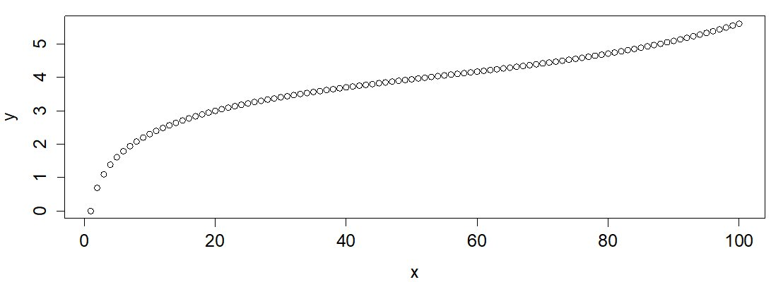
Plotting – the basics
Generic function plot():
plots a variable y against a variable x.
argument type : type of plot ("l" for lines, "p" for points, "b" for both, etc.). The default is points.
x <- 1:100
y <- log(x) + (x/100)^5
plot(x,y) # equivalent to plot(x, y, type="p")

Slide 7
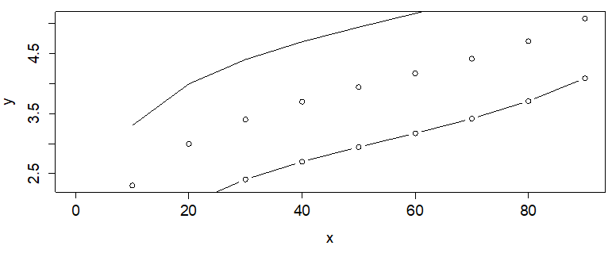
Adding elements to a plot
a new plot is created every time the plot() function is called .
low-level plotting commands: add graphical elements to an existing plot
points() to add points to an existing plot
  lines() to add a line to an existing plot
  These function also have the type argument (e.g., "l" for lines, "p" for points and "b" for both).
x <- seq(0,100, by=10)
y <- log(x) + (x/100)^5
plot(x,y)
lines(x,y+1)
points(x,y-1, type="b")

Slide 8
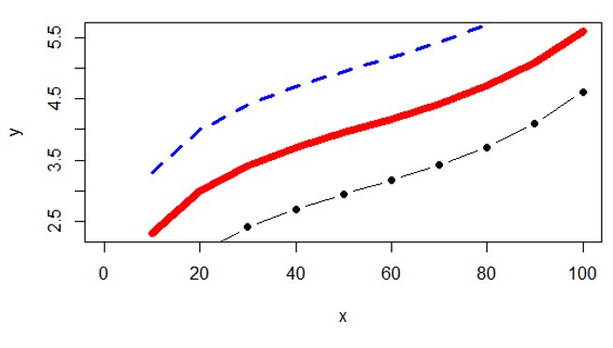
Customizing plots (I)
plot(), points() and lines() all take customizing arguments, including:
  col indicating the colour
  lwd indicating the line width
  lty indicating the line type
  pch indicating the plotting character (symbol)
plot(x, y, type="l", col="red",
lwd=7)
lines(x, y+1, col="blue",
lty="dashed")
points(x, y-1, type="b",
pch=19)

Slide 9
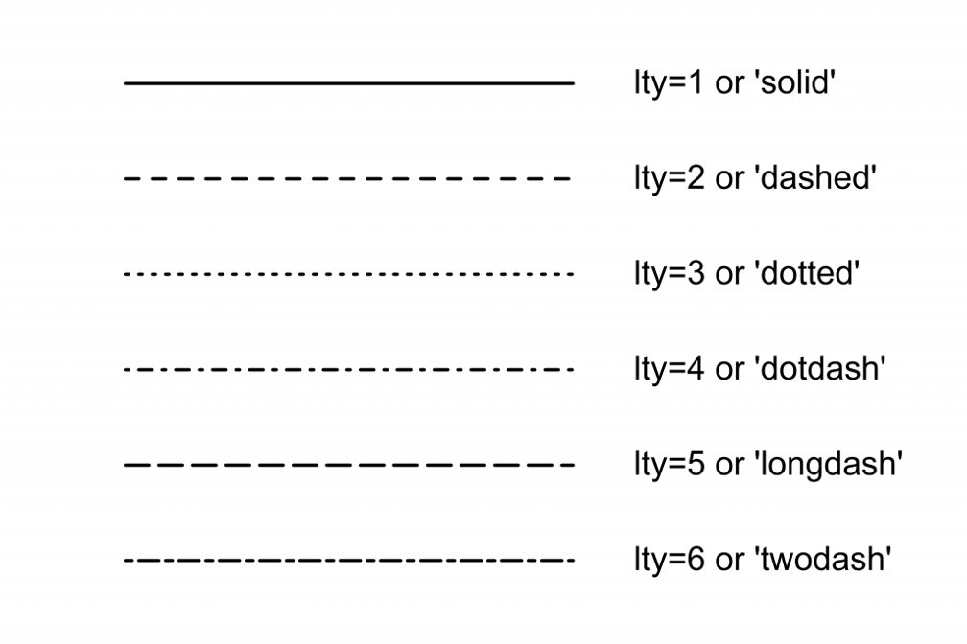
R line types, to use with lty

Slide 10
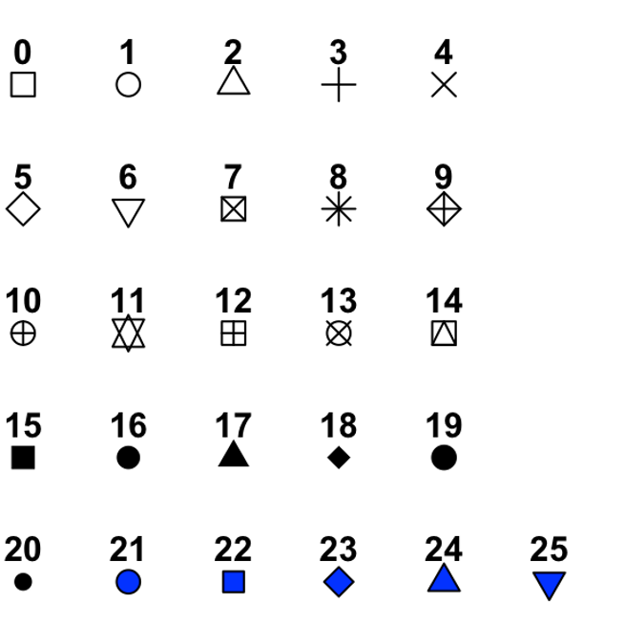
R plotting characters, to use with pch

Slide 11
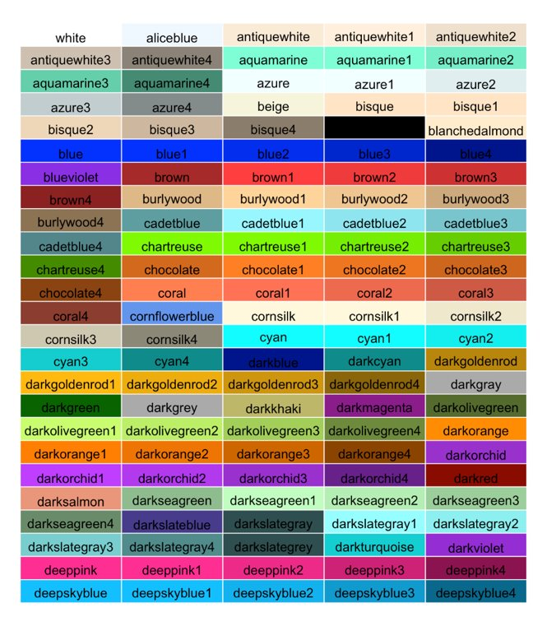
R color names
657 built-in color names
colors() to get a full list
Here is a subset -->
also possible to define colors:
Hex codes
RGB numbers
Numbers 1 to 8
www.nceas.ucsb.edu/~frazier/RSpatialGuides/colorPaletteCheatsheet.pdf

Slide 12
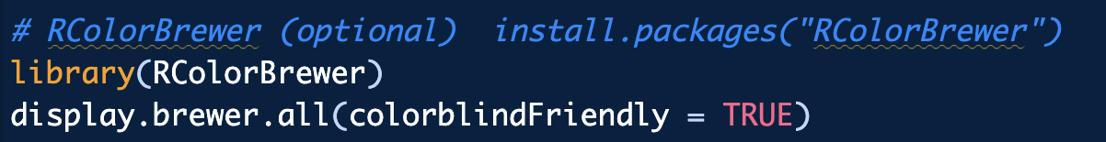
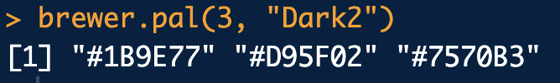
Color blind palette
returns the first 3 colours from the "Dark2" palette
Notes:
A hex code is a way to write a colour as a mix of red, green and blue light, which is how screens make colours.

Slide 13
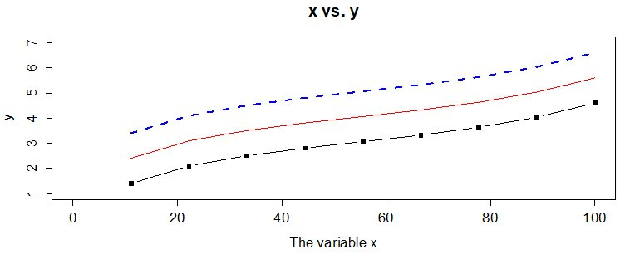
Customizing plots (II)
The plot() command takes further arguments to customize the plotting area:
  xlim and ylim to set the limits on the x- and y-axis, respectively
  xlab and ylab to set the labels for the x- and y-axis, respectively
  main to set a title
x <- seq(0, 100, length.out=10)
y <- log(x) + (x/100)^5
plot(x,y, type="l", col="red",
ylim=c(1,7),
xlab="The variable x",
main ="x vs. y" )
lines(x, y+1, lwd=3,
lty="dashed", col="blue")
points(x, y-1, type="b", pch=15)

Slide 14
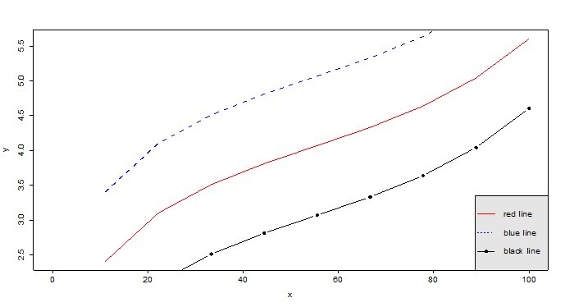
Customizing plots (III)
The legend() command adds a legend to plots:
  x , y to set the numeric coordinates for positioning the legend.
    OR x can be used by itself with a keyword for legend position: "bottomright", "bottom", "bottomleft", "left", "topleft", "top", "topright", "right", "center"
  legend to set the text to appear in the legend
  col to set the colours of points or lines
  lty and lwd to set the line types and widths for lines appearing in the legend
  pch to set the plotting symbols appearing in the legend
  bty for box type around the legend ("o" for box, "n" for no box)
  bg for background color
legend(x="bottomright",
legend=c("red line",
"blue line", "black line"),
lty=c(1,2,1),
pch=c(NA,NA,19),
col=c("red", "blue", "black"),
bg="gray90")

Slide 15
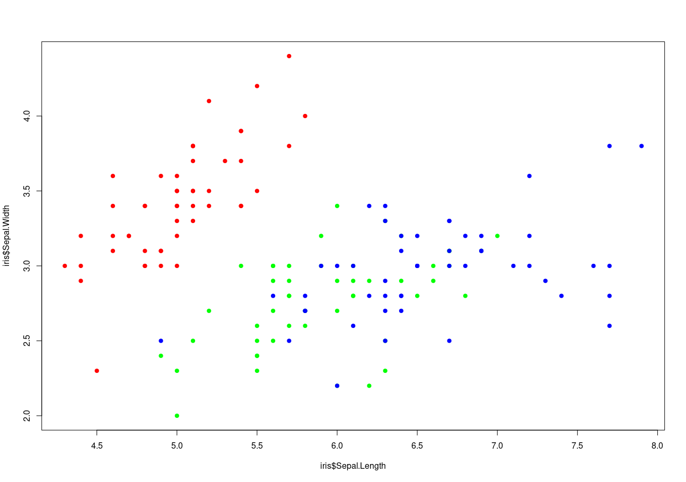
Customizing plots (IV)
When doing a scatterplot, it is common to color the points according to a categorical variable
data(iris)
colormap = c( "setosa" = "red" , 'versicolor' = 'green' ,
'virginica' = 'blue' )
plot(iris$Sepal.Length,
iris$Sepal.Width ,
col = colormap[ iris$Species ],
pch=19)

Slide 16
Digression: why does the previous trick work?
colormap = c( "setosa" = "red" , 'versicolor' = 'green' , 'virginica' = 'blue' )
# named vector: associate a label to some value (here a color)
colormap
setosa versicolor virginica
"red" "green" "blue"
# selecting 1 elements in a named vector,
colormap["setosa"]
setosa
"red"
# nothing prevents you from repeating an index
colormap[c("setosa","virginica","setosa","setosa")]
setosa virginica setosa setosa
"red" "blue" "red" "red"
# factor are auto-coerced to numeric in this case:
c('red','green','blue')[iris$Species]
[1] "red" "green" "blue" "red" ...

Slide 17
Continuous colors
seq_cols <- rev(hcl.colors(7, "Blues")) # rev(): light = small, dark = large
seq_cols # (by default hcl.colors goes dark -> light)
# Base R has no automatic colour scale: we cut the numbers into 7 bins
width_bins <- cut(iris$Petal.Width, breaks = 7, dig.lab = 2)
table(width_bins) # how many flowers per bin
plot(iris$Sepal.Length, iris$Petal.Length,
pch = 21, bg = seq_cols[width_bins], col = "grey30", # pch 21 = circle with an outline
cex = 1.3, # so light colours stay visible
xlab = "Sepal length (cm)", ylab = "Petal length (cm)",
main = "Sequential colors: Blues")
legend("topleft", legend = levels(width_bins),
pt.bg = seq_cols, pch = 21, pt.cex = 1.3, col = "grey30", bty = "n",
title = "Petal width (cm)", cex = 0.8)

Slide 18
abline() (I)
abline() adds one or more straight lines through the current plot – vertical, horizontal or sloped.
Useful for
  showing boundaries and cutoffs
  fitting straight trend lines through the data (cf. lm())
Arguments:
  abline(v=c(…) ): add vertical line(s) at the given x value(s)
  abline(h=c(…) ): add horizontal line(s) at the given y value(s)
  abline(a= ,b= ): add an affine line with intercept a and slope b
  abline(reg=lm(…) ): add a trend line from a linear regression equivalent to abline(lm(…))

Slide 19
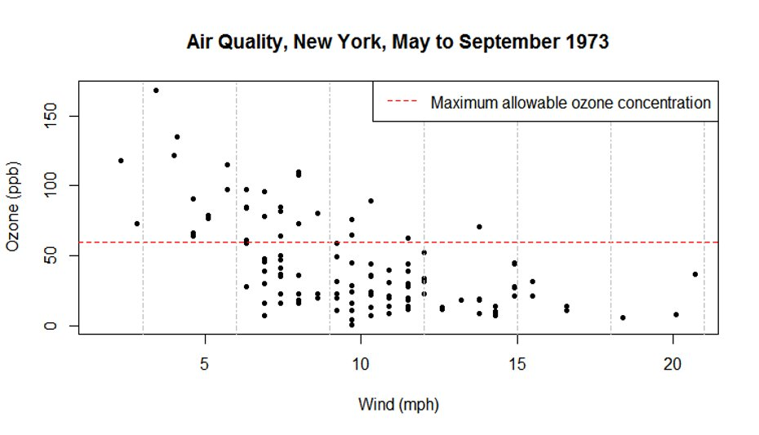
abline() (II) - horizontal and vertical lines
data(airquality) # Daily measurements, New York, May-Sept. 1973
plot(airquality$Wind, airquality$Ozone, pch=20,
xlab= "Wind (mph)", ylab="Ozone (ppb)")
abline(h=60, col="red", lty="dashed")
abline(v=seq(3,21,3), col="grey", lty="dotdash")
legend("topright",
"Maximum allowable
ozone concentration",
col="red",
lty="dashed")

Slide 20
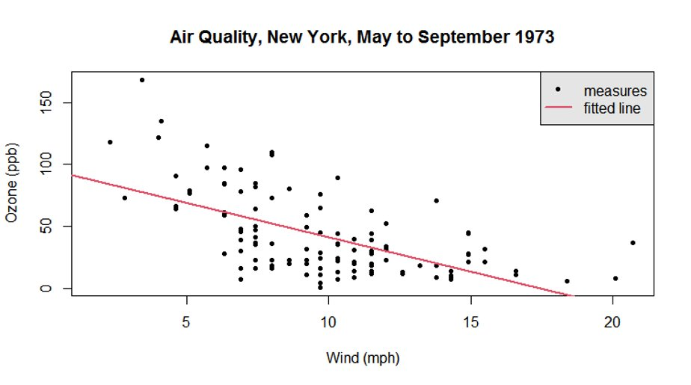
abline() (III) - trend line
plot(airquality$Wind, airquality$Ozone, pch=20,
xlab= "Wind (mph)", ylab="Ozone (ppb)")
abline(lm(airquality$Ozone ~ airquality$Wind), col=2, lwd=2)
legend("topright",
legend= c("measures",
"fitted line"),
pch= c(20, NA),
lty = c(0, 1),
lwd=c(NA, 2),
col = c(1, 2),
bg = "gray90")

Slide 21
Let's practice - 7
Import the mouse data from the file course_datasets/mice_data_mod.csv.
This file contains the same data as mice_data.csv and in addition, two more columns.
Run str() to check your data frame: did it load correctly?
Convert genotype and diet to factor variables.
Make a scatter plot of respiratory rate against mouse weights using the function plot().
  use solid circles as plotting symbol
  add a title
  customize the axis labels (“Weight [g]”, “Respiratory Rate [bpm]”)
  color the points by genotype.
Fit a trend line using the function abline()
Add a legend for the genotype
  EXTRA TASKS:
  use the command data(airquality) to load the airquality dataset
  Plot the relationship between wind speed (Wind) and temperature (Temp)
    Color by Month
    Add nice labels and a legend

Slide 22
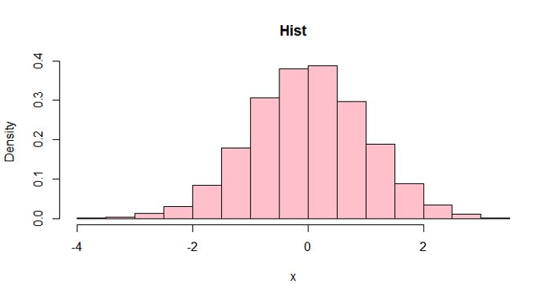
Histograms
hist() creates a histogram in a new plot (like plot). Main parameters:
breaks: guides the number of bins. Number or vector of breakpoints
freq:
  TRUE : y-axis represents counts per bin
  FALSE: y-axis represents density
x<- rnorm(10000) # 10000 random draw in a normal distribution
hist(x, freq=FALSE,
main="Hist",
col="pink")

Slide 23
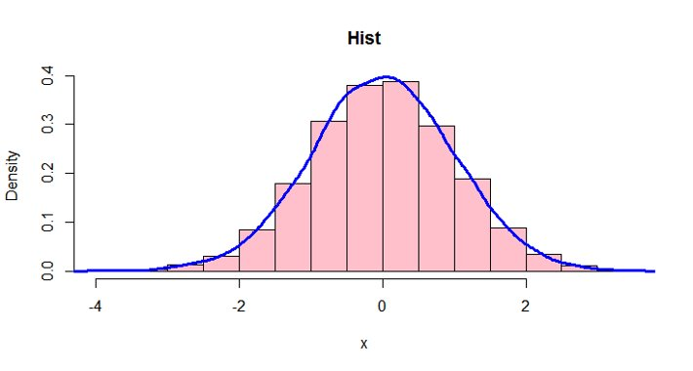
Histograms and density line
density() estimates the probability density of the data (kernel density estimates).
The output of density() can be given to the lines() function.
x<- rnorm(10000) # 10000 random draw in a normal distribution
hist(x, freq=FALSE,
main="Hist",
col="pink")
lines(density(x),
Col="blue",
lwd=3)

Slide 24
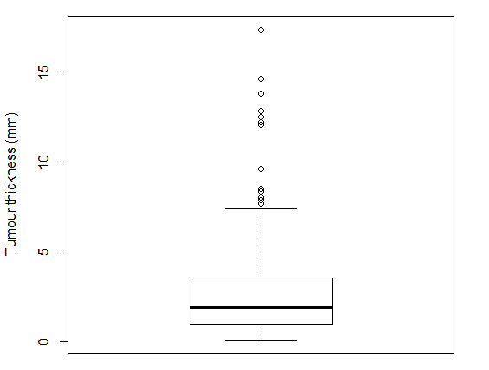
Boxplots (I) - anatomy
Example: melanoma thickness in 205 patients
Outliers
Median

Slide 25
Boxplots (II) - anatomy
Example: melanoma thickness in 205 patients
Outliers
Whisker: covers all points < Q3 + 1.5 * IQR
Median
Box: Interquartile range (Q1 to Q3)
Whisker: covers all points > Q1 - 1.5 * IQR

Slide 26
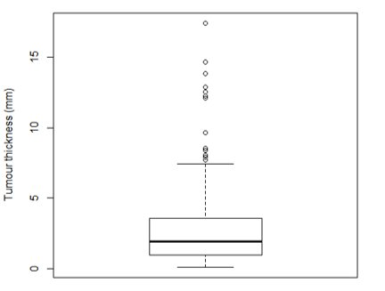
Boxplot (III) - plotting code
library(MASS)
data(Melanoma) # 205 patients with malignant melanoma
head(Melanoma)
time status sex age year thickness ulcer
1 10 3 1 76 1972 6.76 1
2 30 3 1 56 1968 0.65 0
3 35 2 1 41 1977 1.34 0
4 99 3 0 71 1968 2.90 0
5 185 1 1 52 1965 12.08 1
6 204 1 1 28 1971 4.84 1
boxplot(Melanoma$thickness,
ylab='Tumour thickness (mm)',
col='white')

Slide 27
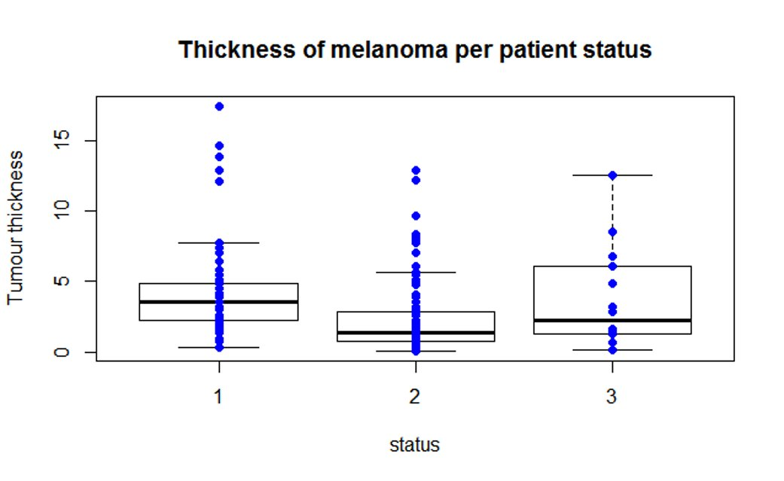
Boxplot (IV) - more boxplots
We want
separate boxplots for subgroups
individual points overlaid
status:
died from melanoma
alive
dead from other causes

Slide 28
Boxplot (V) - data preparation
# check if the grouping variable is a factor (it is not!)
str(Melanoma)
'data.frame': 205 obs. of 10 variables:
$ time : int 10 30 35 99 185 204 210 232 232 279 ...
$ status : int 3 3 2 3 1 1 1 3 1 1 ...
$ sex : int 1 1 1 0 1 1 1 0 1 0 ...
$ age : int 76 56 41 71 52 28 77 60 49 68 ...
$ year : int 1972 1968 1977 1968 1965 1971 1972 1974
$ thickness: num 6.76 0.65 1.34 2.9 12.08 ...
$ ulcer : int 1 0 0 0 1 1 1 1 1 1
# coerce the grouping variable to factor
Melanoma$status <- factor(Melanoma$status)

Slide 29
Boxplot (VI) - plotting code
Method 1: data subsets
boxplot(Melanoma$thickness[Melanoma$status=="1"],
Melanoma$thickness[Melanoma$status=="2"],
Melanoma$thickness[Melanoma$status=="3"],
main="Thickness of melanoma per patient status",
xlab="status", ylab="Tumour thickness",
names=c("1","2","3"))
points(Melanoma$status, Melanoma$thickness,
col="blue",pch=19) #adds the actual data points to the plot
Method 2: Formulas
boxplot(thickness ~ status, data=Melanoma,
main="Thickness of melanoma per patient status",
xlab="status", ylab="Tumour thickness")
points(thickness ~ status, data=Melanoma,
col="blue", pch=19) #adds the actual data points to the plot

Slide 30
Boxplot (VII) - result
Both methods give the same result:

Slide 31
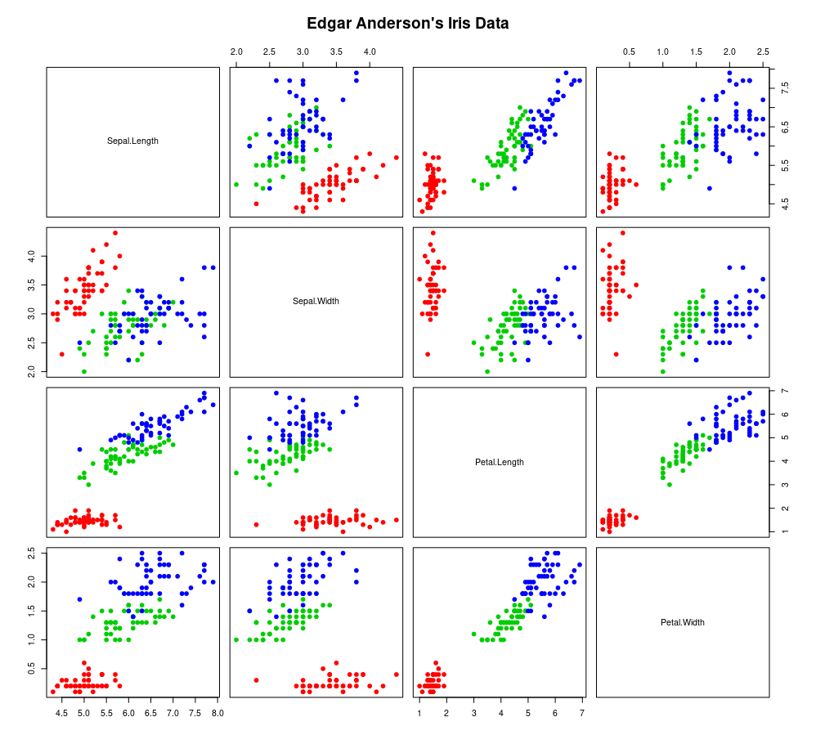
Pairs scatter plot - pairs()
If x is a matrix or a data frame, pairs() draws
all possible bivariate plots between the
columns of x.
data(iris)
pairs(iris[,1:4], pch=19,
col=colormap[ iris$Species ])

Slide 32
Let's practice - 8
This is a continuation of the previous practice: we will continue to plot the mice data
Plot a histogram of mouse weight and customize it with title, labels, colors.
Represent the density line on top.
Make boxplots of weights from WT and KO mice. Customize with title, labels, colors.
Optional: Repeat 2 with diet instead of genotype.
EXTRA TASKS
Come back to the airquality dataset
Make boxplot of temperatures per month
Make boxplot of wind speed per month
for each of these plots, add labels as well as overlay the actual points onto the boxplots

Slide 33
Permanent graphic changes (I)
The function par() allows to change the default values of many plotting parameters.
All future calls to graphics functions will be affected.
Example 1: set plotting colors and symbols
par(col="red", pch=15)
Example 2: set margin widths for subsequent plots
  mar sets plot margins in number of lines
  mai sets plot margins in inches
  use vectors of 4 values (c(0,1,1,2)) for the bottom, left, top, and right margins
  par(mar=c(5.1,4.1,4.1,2.1)) #set margins in lines
  par(mai=c(1.02,0.82,0.82,0.42)) #set margins in inches

Slide 34
Saving figures to files
Programmatic method: surround the plotting code with
Before format function: pdf(), png(), jpeg(),…
After: dev.off()
pdf(file="quadratic_cubic.pdf", width=7, height=4, paper="a4")
plot(-90:90,(-90:90)**2)
dev.off()
Alternatively, you may use Rstudio interface:
Plots > Export > Save as Image (PNG,JPEG,TIGG,BMP)
Plots > Save as PDF

Slide 35
Choosing an image file format
Raster graphics (png, tiff, jpeg):
  file sizes depend on the image size (number of pixels)
  once created, stretching the image leads to poor quality
Vector graphics (pdf, ps, eps, svg):
  file sizes depend on the number of drawing actions (e.g. number of points, lines,...)
  all elements can be scaled as desired
  Embedding image files in MS Office documents (Word, PowerPoint):
  In Windows, png and tiff work best, pdf can get blurry.
  In macOS, pdf works well.
  Can also export plot from RStudio to clipboard, then paste.
  Publication-quality figures:
  Vector graphics (pdf, eps) tend to be easier to adapt as they can be resized
  File size tip: when many points are plotted, pdfs can become large in file size and slow to display. When this is an issue, consider png.

Slide 36
Plots are initiated with: plot(), hist(), boxplot(), ...
Further modification with: points(), lines(), abline(), … examples: https://r-graph-gallery.com/index.html

Slide 37

R markdown for reporting your results
-Notebook interface and a file format
-Build reproducible results combining text, scripts and plots
Composed of three elements:
YAML header
Text (sections, headers, titles)
Code chunks

Slide 38
Let's practice - 9
This is a continuation of the previous practice: we will continue to plot the mice data, only that in R markdown!
Make a multi-panel figure with the four graphics (from the previous exercises) on one page
Change the code to export the figure to a pdf file with paper size A4. Set width and height arguments in the call to pdf() to make it look nice.
EXTRA TASKS
Choose 1 and try to tweak the different elements color. For example, try to change the background color, the color of the title, the thickness and color of axis labels, …
Change the parameters in the chunk header to have different plot dimension or position

Slide 39

Thank you
sib.swiss

