Slide 1

First Steps with R in Life Sciences: Introduction
With slides from: Diana Marek, Geoffrey Fucile, Alex Smith, Linda Dib, Leonore Wigger, Wandrille Duchemin

Slide 2


ELIXIR Code of conduct
Notes:
What ELIXIR is: ELIXIR is the European infrastructure for life-science data, bringing together national nodes. SIB runs the Swiss node (ELIXIR Switzerland), which is why this course is listed in the ELIXIR training portfolio and follows its Code of Conduct.
Why show this slide: the Code of Conduct applies to every ELIXIR event, including this course: the classroom, breaks, the online chat and any exchanges with trainers or other participants. Say it once at the start so the rules are explicit for everyone, not just implied.
1. Diversity: everyone is welcome, whatever their background, career stage, field or level in programming. In this course: there are no stupid questions; beginners and experienced users learn side by side.
2. Act ethically and with integrity: be honest about your work and respect others' work. In this course: cite the code and data you reuse, respect data confidentiality, and do not share course material or participants' data outside the agreed scope.
3. Foster trust and collaboration: help each other, share knowledge openly, and give credit. In this course: it is fine (encouraged!) to help your neighbour during exercises, but explain rather than just type the answer for them.
4. Respect and show courtesy to each other: be kind and constructive; no harassment or discriminatory remarks, in person or online. In this course: let people finish their questions, keep criticism about the code, never about the person.
If something goes wrong: anyone who experiences or witnesses unacceptable behaviour can speak to one of the trainers, privately and in confidence. Concerns can also be raised directly with ELIXIR via the Code of Conduct page on the ELIXIR website (elixir-europe.org).
Tip: keep this short (about 1 minute), make eye contact, and then move on to practical information. The tone should be welcoming, not disciplinary.

Slide 3

General Information
Course page: https://github.com/sib-swiss/first-steps-with-R-training
  Slides
  Data sets
  Exercises
  Solutions
Optional exam, 0.5 ECTS value

Slide 4



Asking questions - Communication
Raise your hand anytime
Done with an exercise?

Slide 5



Introducing ourselves
Who are you?
Your name, and where you work or study
What do you work on?
Your field, and the kind of data you handle
Why R?
What you would like to be able to do after this course
About 30 seconds each, no slides required :)

Slide 6



What type of computer OS are you using?
Windows
macOS
Unix / Linux
Ubuntu, CentOS, ...
Why we ask: R is the same everywhere, but shortcuts (Ctrl vs Cmd) and file paths (C:/Users/... vs /Users/...) differ a little.

Slide 7






Do you code in other languages?
None
R will be your first one, great place to start
Yes, but only notions
you have seen a loop or two
Yes, and I am proficient
you will mostly learn R's quirks
For example: Python, bash, MATLAB, Java, C, SQL, Perl...

Slide 8




What is your experience with R?
Never tried
I have never used R
A few commands
I ran some commands or did a few exercises
A bit for real
I used R a little for work or a personal project
Extensively
...wait, why am I even here?
Every level is welcome: the exercises have extra tasks for the fast ones.

Slide 9
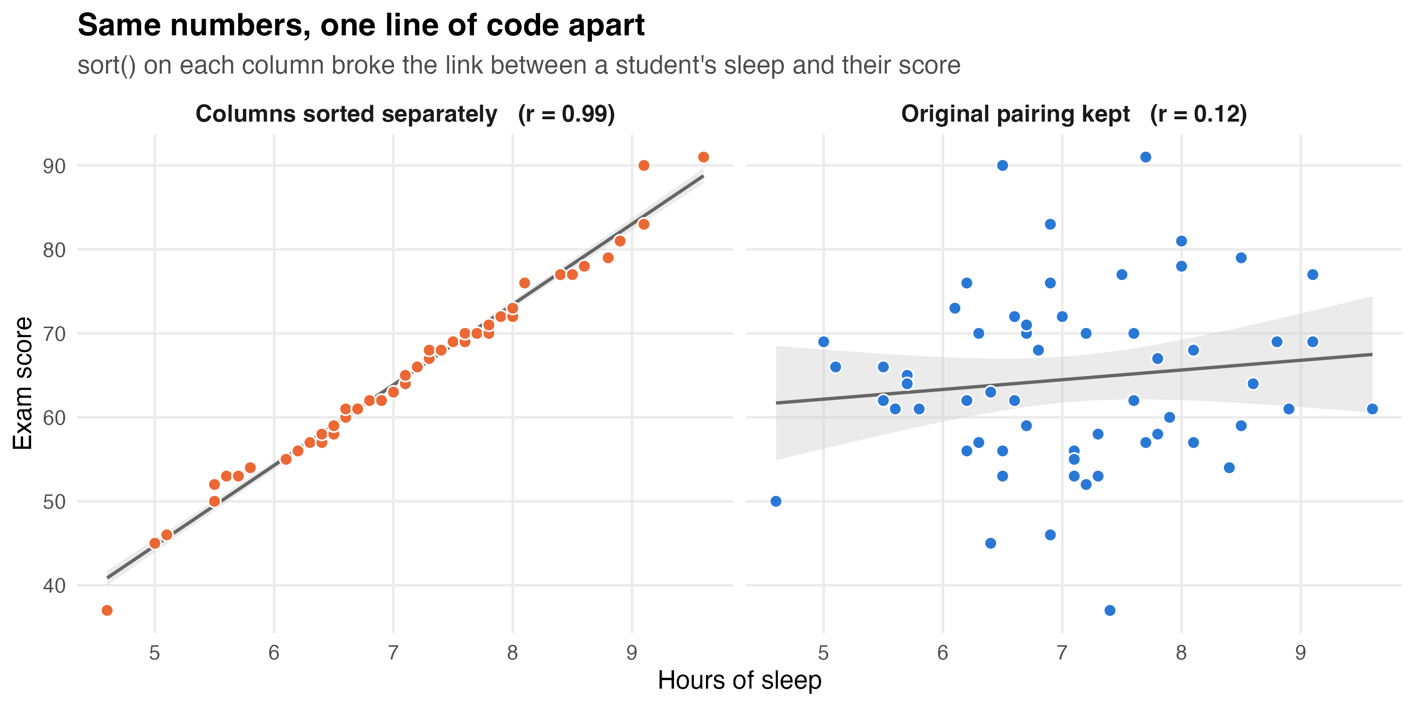
Why learn R?
Suppose you have made some nice plots to show your collaborators
A tip found online: as a first step, tidy up the columns of your data frame with the sort() function

Slide 10
Why learn R?
Suppose you have made some nice plots to show your collaborators
A tip found online: as a first step, tidy up the columns of your data frame with the sort() function
tidy <- students
tidy$sleep <- sort(tidy$sleep) # <- looks harmless...
tidy$score <- sort(tidy$score) # <- ...but is it?

Slide 11
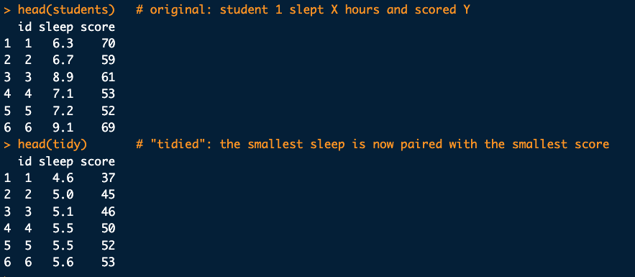
Why learn R?
Suppose you have made some nice plots to show your collaborators

Slide 12
Why learn R?
Better make sure you know what your script is doing!

Slide 13

Course Content:
R is vast, it can't be learned overnight.
This course will give a basic understanding and concepts of R.
This course is the first step in your journey

Slide 14
Course Outline
  Day 1
  Getting Familiar with R and Rstudio
  Getting started with the R syntax and Objects
  Packages and versioning
  R environnement
  Formatting your data
  Importing/exporting data with R (working with files)
  Day 2
  Building Graphics in R (basic plotting)
  R functions
  Data analysis in R
  Introduction to R maekdown
  High-definition figures export

Slide 15
Getting Familiar with R and Rstudio

Slide 16

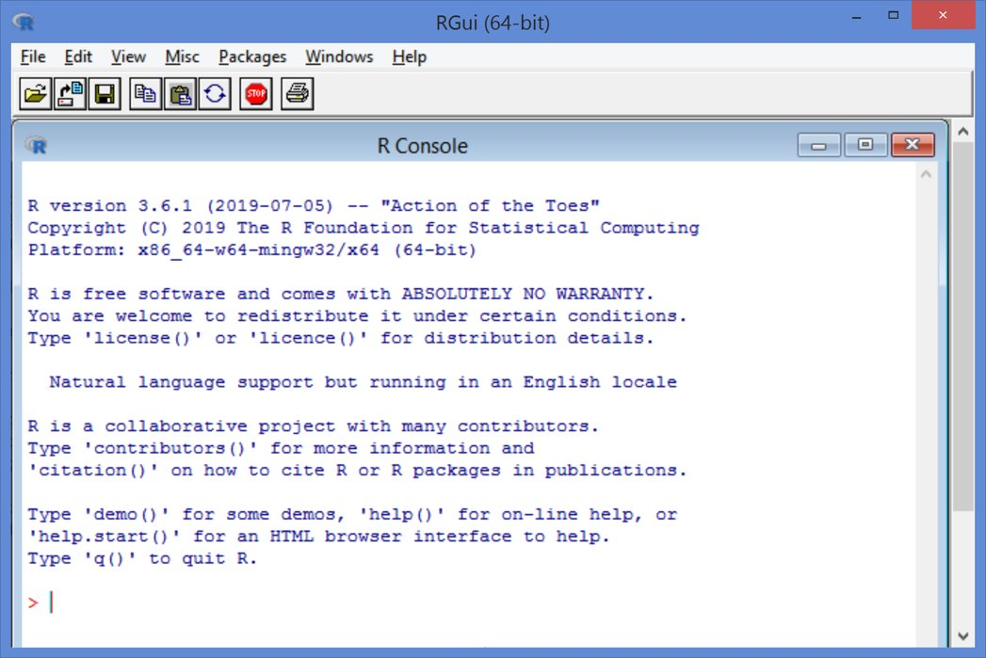
RGui (R Graphical user interface)
Installed at the same time as the programming language
Current version
R 4.6.1
June 2026
This screenshot runs R 3.6.1 from 2019. In R years, that is roughly the Jurassic. Yours will look the same, just younger.

Slide 17
R combined with Rstudio
www.rstudio.com
Integrated Development Enviroment (IDE) designed to help with R
It includes:
A console
A syntax highlighting editor
Tools for viewing the workspace and history
A file explorer, package explorer, plot and help display areas
We suggest Rstudio as the preferred option when working with R

Slide 18
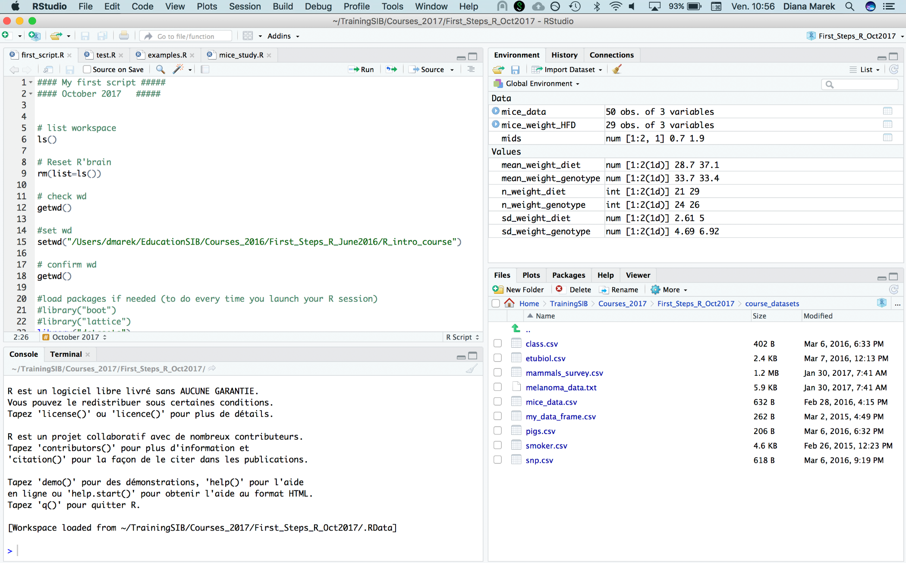
Rstudio Interface
Workspace, history
Editor
Console, terminal
File explorer, plots, packages, help

Slide 19
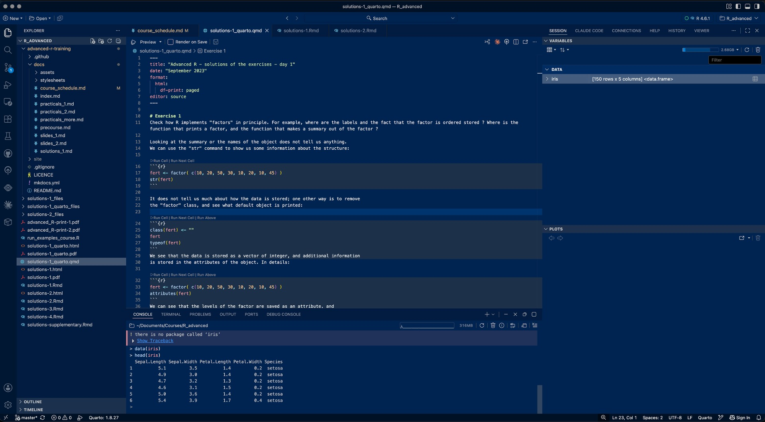
Positron interface
R version in use
Variables (workspace)
Editor
Plots
Files
Console, terminal
Same building blocks as RStudio, arranged a bit differently. Help, History and Viewer sit in tabs next to Session.

Slide 20
Positron: an alternative to RStudio
A free, next-generation IDE released by Posit (the company behind RStudio). Stable since summer 2025.
RStudio
Positron
Languages
Built for R (Python possible)
R and Python treated as equals
Based on
Its own interface, 14+ years old
Code OSS, the open-source core of VS Code
Interface
4 panes: editor, console, environment, files/plots/help
Very similar panes, plus a data explorer and extensions
Robustness
A crash in R can freeze the whole IDE
R runs separately: a crash does not kill the IDE
Projects
.Rproj files
Plain folders (workspaces)
In this course we use RStudio. Everything you learn here (console, scripts, working directory, packages) transfers directly to Positron. Feel free to use Positron though.

Slide 21
Creating an R project
Rstudio allows the organization of your work in projects
File > New Project or click on "Project" in the upper-right corner
Choose New directory, then New Project, give an appropriate name and location
OR choose Existing Directory
This creates an .Rproj file in the directory
The project directory automatically becomes the "working directory"

Slide 22
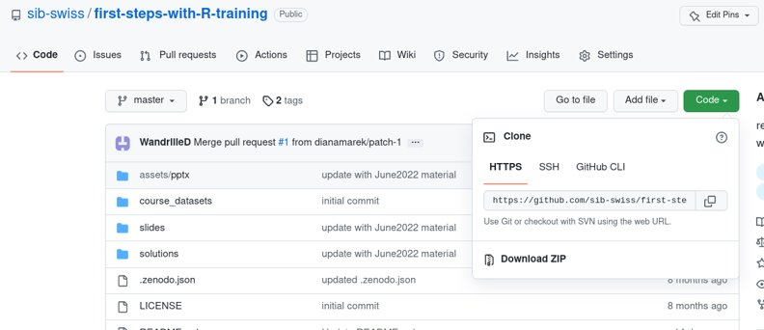

Let's practice - 1
Outside Rstudio : prepare the course data for the exercises
  Download the course material from :
  https://github.com/sib-swiss/first-steps-with-R-training
  Either use git clone OR click Download ZIP
  and UNZIP and then move the folder where you want it
Inside Rstudio: project setup
  In Rstudio, create a new project set in the folder of the course material you just recovered.

Slide 23
Console: the command line
The ">" indicates R is ready for a new command

Slide 24
Try it out:
Type the following at the command prompt:
Simple calculation:
1+1
Pre-defined function:
abs(-11)
Assigning a value to a variable
x <- 128.5
Displaying a variable's content
x
After each command,
Hit the return key to execute it

Slide 25
What is a programming language?
complex
A programming language is a set of words and rules to give precise, unambiguous instructions to a computer.
R is an interpreted language: each command is read and executed right away by the R interpreter.
The computer does exactly what you write, not what you meant.
How do we write complex programs? By stacking simple building blocks: each level reuses the ones below it, so you never have to think about everything at once.
Projects & packages
share and reuse whole toolboxes
Scripts
analysis.R: a recorded, re-runnable sequence
Functions
mean(x), log2(x)
Control flow
if / else, for: decide, repeat
Variables & operators
x <- 2 * y
Values & types
42, "WT", TRUE
simple
Today we climb the first steps of this ladder.

Slide 26
R key concepts: a first glimpse
You just met four building blocks of R. A first glimpse only: we come back to each of them in detail later.
1 + 1
Operator
does arithmetic or comparisons
+ - * / ^
abs(-11)
Function
ready-made code: name + parentheses
returns 11
x <- 128.5
Variable
stores a value under a name
x now contains 128.5
# my note
Comment
ignored by R, written for humans
explain your code!

Slide 27
R key concepts: the working directory
The working directory is the folder where R reads and writes files by default.
In an RStudio project, it is automatically the project folder, so you rarely need to change it.
Your computer
C:/Users/Leo/
├─ Documents/
└─ Rcourse/
├─ Rcourse.Rproj
├─ course_datasets/
│ └─ mice_data.csv
└─ ex1.R
← you are here
Where am I?
getwd()
[1] "C:/Users/Leo/Rcourse"
Move elsewhere (rarely needed)
So R finds "course_datasets/mice_data.csv" without the full path.
setwd("D:/cool_R_project/")

Slide 28
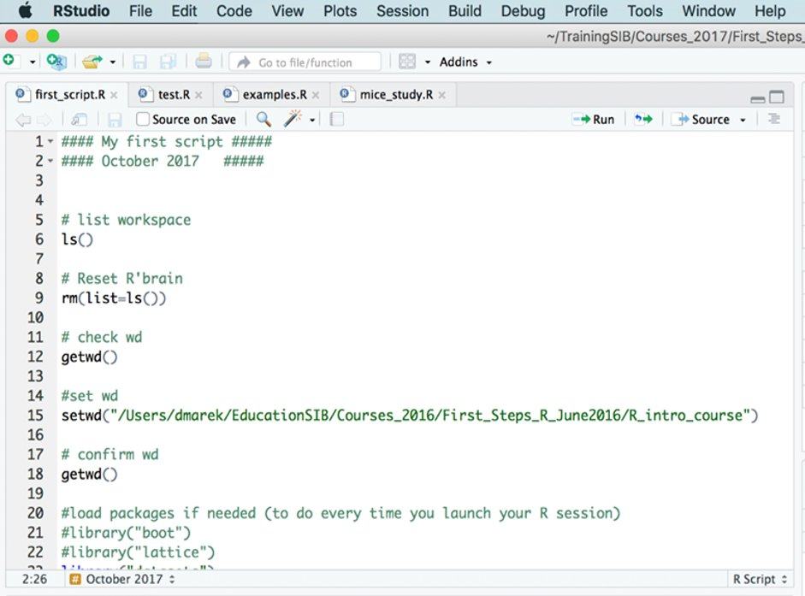
Editor: writing code in a file

Slide 29
R scripts
A script is a normal text file which contains commands meant to be executed one after the other.
Write your code into a script and save it
to document your analysis as you do it
to be able to re-use that code later and create variations
for easy execution
In Rstudio : File > New File > Rscript or Ctrl+Shift+N
Save often! (File > Save or Ctrl+S)

Slide 30
Console or script: what is the difference?
R console
in a terminal or RGui
Console in RStudio
bottom-left pane
Script + console
editor pane, .R file
How: Type a command, press Enter: it runs immediately. Tab completion works; plots and help open in separate windows.
Code saved? No, only a command history.
Best for: Quick checks; working on a remote server (HPC).
How: Same R, same behaviour, but everything in one window: richer autocompletion, plus Environment, Plots and Help panes.
Code saved? No, only the History pane.
Best for: Trying things out; inspecting objects.
How: Write code in a text file, then send it to the console with Ctrl+Enter or Run.
Code saved? Yes: the file is your record.
Best for: Your real analysis: reproducible, commented, shareable.
Script (.R file)
where code is kept
Ctrl+Enter
Console
where code runs
Results
output, objects, plots
There is only one R: the console is where code runs, the script is where your work is kept.

Slide 31
Sending code from the editor to the console
Ctrl+Enter (Windows and Linux)
Cmd+return (Mac)
click the "Run" button
By default, the current line is executed,
if something is selected, then this is executed (e.g., part of a line, or multiple lines)

Slide 32
Most of your code should be in scripts
Code in scripts is "just text", it gets executed when you send it to the console
It is possible to run an individual code line, a block of code or an entire script at once

Slide 33
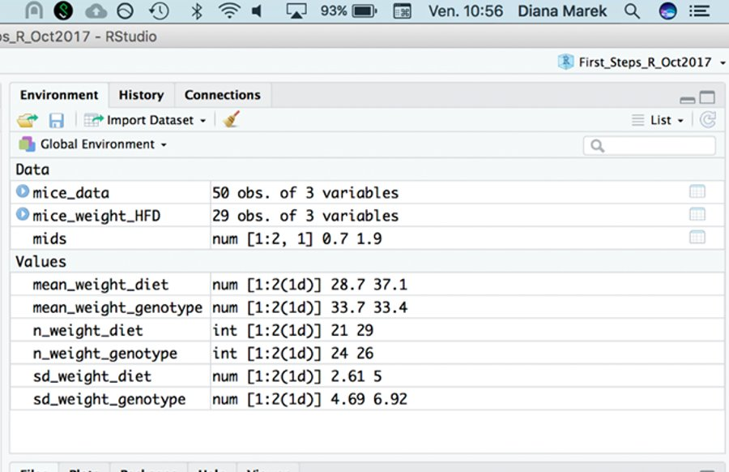



Workspace: R's short-term memory
The workspace (or global environment) is R's short-term memory: every object you create during the session lives there.
It disappears when R closes, unless you save it.
List what is in memory
ls()
Remove one object
rm(x)
In RStudio: the Environment pane shows the same objects as ls(). The broom icon clears the workspace.
Clear everything
rm(list = ls())

Slide 34
Let's practice - 2
Prepare your first script
  Open a script file and save it.
  Type or paste the following code
  # First steps with R, ex1
  w <- 3
  h<- 0.5
  area <- w*h
  area
Look at the script (before running it) can you understand each line? What do you expect it to print to the console?
Run the script and explore Rstudio's feature:
    Run the script line-by-line or Run all lines at once by selecting them

Slide 35
Closing or Switching Projects
Closing a project: File > Close
Switch to another project: File > Open Projects...
Open another project but leave the current one open: File > Open Project in New Session
In your computer's file explorer, double-clicking a .Rproj file with open a project
When closing or switching project, the workspace and history are cleared
  (Tools > Global Options > General to change this behavior)

Slide 36
Closing or Switching Projects
Closing a project: File > Close
Switch to another project: File > Open Projects...
Open another project but leave the current one open: File > Open Project in New Session
In your computer's file explorer, double-clicking a .Rproj file with open a project
When closing or switching project, the workspace and history are cleared
  (Tools > Global Options > General to change this behavior)
history and workspace can be saved in an .Rhistory and .Rdata file

Slide 37
Projects in Positron: just folders
Positron has no .Rproj file: a project is simply a folder (called a workspace). The folder you open becomes the working directory.
RStudio
Positron
One folder, both IDEs
Create
File > New Project
File > New Folder (from a template)
Rcourse/
├─ data/
├─ scripts/
│ └─ ex1.R
├─ Rcourse.Rproj RStudio
└─ .vscode/ Positron
└─ settings.json
Open
File > Open Project, or double-click the .Rproj file
File > Open Folder, or right-click a folder > Open with Positron (Windows)
Switch
File > Open Projects...
File > Open Recent
Two at once
Open Project in New Session
Open the other folder in a new window
Positron ignores the .Rproj file, so both IDEs can open the same folder.
Settings
stored in the .Rproj file
stored in .vscode/settings.json
Same rule as in RStudio: one folder per analysis, open the folder, and use relative paths inside it.

Slide 38
Let's practice - 2bis
Look at your project option (Tools > Project Options). If needed, modify them to save your workspace and history and to restore them at startup.
Check that it works:
  Close Rstudio
  Double-click the .Rproj file
  Does the project open? Is your workspace empty?
Check other behaviours:
  Close your project
  Open your project again from Rstudio

Slide 39
Saving the Workspace (.Rdata file)
You have the option of saving one or several variable to a file for later use
save.image("my_workspace.RData") # saves the entire workspace
save(x,y,file="precious_objects.RData") # saves specific objects
You can use load() to read the objects in any R session:
load("precious_objects.RData")
This is useful to save intermediate results files
Or to pass a bunch of R objects to someone else

Slide 40
Packages
A package is a bundle of R code that someone wrote, documented and shared, so that others can reuse it.
Installing a package adds new functions (and sometimes datasets) to R.
Base R comes with only a small set of packages; thousands more are developed by the community.
Analogy: R is a smartphone, packages are its apps. You install an app once, and open it each time you want to use it.
Two main repositories for life sciences
CRAN (cran.r-project.org): the main R repository
Bioconductor (bioconductor.org): bioinformatics, -omics analysis. Installed with BiocManager::install(), not install.packages()
Inside a package, e.g. readxl
Functions
read_excel(), excel_sheets()
Documentation
?read_excel, examples, tutorials
Example data
small files to try the functions
Dependencies
other packages it needs to work
Repository
CRAN / Bioconductor
install.packages()
BiocManager::install()
Your computer
package library folder
library()
Your R session
functions ready to use
once
every session

Slide 41
Installing / loading packages
install.packages("stringi") # looks for and installs the package named stringi
Installation is done only once per computer (or if you reinstall/upgrade R version)
Library(stringi) # loads library stringi
# -> makes its content available in the R session
Loading is done at each session, usually at the beginning of a script

Slide 42
Session information
Getting precise information about your session can be useful for debugging
This information is usually required to get help online
R.version.string : prints the curretnly used R version
sessionInfo() : prints version information about R and loaded libraries

Slide 43
Reproducible environnements with Renv
The Problem
The Solution
"It works on my machine…"
renv records the exact version of every
package your project uses.
Initialise a new project
R packages update constantly.
The same code can give different results
depending on
when and where you run it.
Package versions change → analyses break
→ results differ between collaborators
renv::init()
Freeze current package versions
renv::snapshot()
Restore environment on any machine
renv::restore()
All versions saved in renv.lock — commit it with your project
For this course → run renv::restore() to install the exact package versions used here

Slide 44
  Getting started with the R syntax and Objects

Slide 45
What is a data type, and why do we need it?
Inside the computer, everything is stored as 0s and 1s.
A data type tells R how to interpret those bits, and therefore which operations make sense.
Why it matters
Arithmetic only works on numbers
Text needs other tools (pasting, searching, alphabetical sorting)
TRUE / FALSE values drive decisions and counting
A wrong type is a classic bug: a column of numbers read as text because one cell says "n/a"
Check the type of any object with class(x)
Same digits, different type
> 12 + 1
[1] 13
> "12" + 1
Error: non-numeric argument
to binary operator
> sort(c(2, 10, 9))
[1] 2 9 10
> sort(c("2", "10", "9"))
[1] "10" "2" "9"
> class("12")
[1] "character"
As text, "10" comes before "2" (compared character by character)

Slide 46
Basic data types
Numeric:
  Number, stored with decimal point
  Examples: 0, 1, 55.2, -11.1111
  In some context, this type is labelled "double"
  Integers, stored without the decimal points, exist but are rarely used
Character:
  Text sequence. Must be enclosed in quotes : " " or ' ' (either work)
  Examples: "1a++", 'Hello World, "s" , "99"
Logical:
  TRUE or FALSE (all upper case)

Slide 47
R syntax
Case sensitive: R differentiate lower and upper case letters
Commands can be separated by a newline or a semicolon ; (but newline are preferred for readability)
Long statements can be written on several lines
R has no strict rules about the number of spaces around elements. Use your best judgment and be consistent.
The # character stands for comments

Slide 48
R objects
An object is a storage space in memory that contains a value, a data structure, or some code.
Almost everything in R is an object!
Variables are objects containing data
Functions are objects containing code
Think of a labelled box: the name is the label you use to find it, the object is what is stored inside.
name
object in memory
kind
temp
-5.5
a value
fruits
"apple"
"banana"
"cherry"
a vector
sqrt
{ code }
a function
ls() lists the names of all objects in your workspace

Slide 49
Object name rules
Letters, numbers, dots . , and underscores _
Cannot start with a number
Cannot contain operators
Best to start with a letter
Examples:
X
mydata1
mydata.normalized
N_times

Slide 50
The assignment operator
Assigning means storing a value in memory and giving it a name, so you can reuse it later.
R first computes the right-hand side, then stores the result under the name on the left.
Assignment prints nothing: type the name to see the value.
Either <- or = works. Pick one and stick to it (<- is the R convention).
x <- 10
x
10
goes into
10
named box
value
x <- 10 # create x, store 10 in it
x <- 25 # replace the value of x by 25
myNumber <- 15
x <- myNumber # both now contain 15
x <- x + sqrt(16) # add sqrt(16) to x
x <- x + sqrt(16)
① right side first: x is still 10, so
10 + 4 → 14
② then store: 14 goes into x
the old value 10 is replaced
So this is not an equation, it is an action.

Slide 51
What is a function?
Input
81
argument(s)
sqrt( )
pre-written code you do not need to see
Output
9
return value
A function is a named, reusable piece of code: it takes inputs, performs a task, and returns a result.
Same idea as in maths: f(x) = √x, so f(81) = 9
Why use functions?
Write once, reuse many times, instead of copy-pasting
Hide complexity: you can use mean() without knowing how it is computed
Already tested by thousands of users: fewer errors
Anatomy of a function call
round(3.14159, digits = 2)
function name
1st argument
named argument
[1] 3.14 ← the returned value
On day 2 you will write your own functions.

Slide 52
Using functions (I)
Functions are called with parentheses () after the function name
Arguments are the inputs to functions, passed inside the ()
  ls() # no arguments
  sqrt(81) # one argument
  rep(1, 2) # two arguments, separated by a comma ,
Arguments have names which can be used when calling a function
rep(x=1, times=5) # named args. Equivalent to rep(1,5)
rep(1, times=5) # mixed unnamed/named
Use ?function_name to check R's help and see which arguments
a function expects

Slide 53
Using functions (II)
Many functions take more than one argument
If unnamed, arguments must be listed in the correct order (association by position)
If named, arguments can be passed in arbitrary order (association by name)
  write.table(object, "outfile.txt" , TRUE)
  write.table(object, append=TRUE, file="outfile.txt")

Slide 54
Using functions (III)
Some functions have arguments with default values
Example: round()
Usage (from R help): round(x, digits = 0)
Arguments with default values can be omitted in the function call.
Arguments without default values cannot be omitted.
  round(2.011) # rounding to 0 digits, the default
  [1] 2
  round(2.011, 2) # rounding to 2 digits after the decimal point
  [1] 2.01

Slide 55
What is a loop, and why do we need it?
Without a loop: copy, paste, repeat
start
print(1^2)
print(2^2)
print(3^2)
# ... and 997 more lines?
elements
left in 1:1000?
no
With a loop: write the action once
yes
for (i in 1:1000) {
print(i^2)
}
i takes the next value
repeat
run the body
print(i^2)
A loop repeats the same block of code once for each element of a collection.
Why? Process many samples, files or genes with the same code: less typing, no copy-paste errors, and it scales from 3 to 3000.
end

Slide 56
Control flow (I): for loops
Looping through elements
for (variable in collection) { body }
variable takes each value in turn collection is what we go through body is the code repeated each time
Example 1: over numbers
Example 2: over a vector of text
for (i in 1:5) {
print(i^2)
}
fruits <- c("apple", "banana", "cherry")
for (f in fruits) {
cat("I like", f, "\n")
}
Console output
Console output
[1] 1
[1] 4
[1] 9
[1] 16
[1] 25
I like apple
I like banana
I like cherry

Slide 57
Control flow (II): making a decision with if
if lets your code make a decision: run a block of code only when a condition is TRUE, and optionally another block (else) when it is FALSE.
temp <- 25
temp > 20 ?
TRUE
FALSE
if (condition) {
code if TRUE
} else {
code if FALSE
}
print("warm")
print("cold")
Example
temp <- 25
if (temp > 20) {
print("warm")
} else {
print("cold")
}
the script continues
temp > 20 is a comparison: it returns one TRUE or FALSE. else is optional.
[1] "warm"

Slide 58
Control flow (III): if / else vs ifelse()
x <- c(-2, 5, 0) one condition, or one per element?
if / else
one decision: which code should run?
ifelse()
vectorised: one answer per element
if (condition) { ... }
else { ... }
ifelse(x > 0, "positive",
"not positive")
x x > 0
if (x[1] > 0) "positive" else
"not positive"
-2
FALSE
"not positive"
✔ works: x[1] > 0 is a single FALSE
5
TRUE
"positive"
if (x > 0) "positive"
Error: the condition has length > 1
0
FALSE
"not positive"
✘ x > 0 gives 3 values (error since R 4.2)
Rule of thumb: if / else decides what code runs; ifelse() computes a value for each element.

Slide 59
Control flow (IV): loops + conditions
Combine for and if / else: label each temperature and keep the result
temps <- c(12, 25, 31, 8)
labels <- character(length(temps)) # empty box
for (i in seq_along(temps)) { # i = 1, 2, 3, 4
if (temps[i] > 30) {
labels[i] <- "hot"
} else if (temps[i] > 15) {
labels[i] <- "mild"
} else {
labels[i] <- "cold"
}
}
labels
What happens at each turn of the loop
i
temps[i]
condition met
labels[i]
1
12
none
"cold"
2
25
> 15
"mild"
3
31
> 30
"hot"
4
8
none
"cold"
Same result without a loop
ifelse() works on the whole vector at once:
ifelse(temps > 30, "hot",
ifelse(temps > 15, "mild", "cold"))
Question: which label does 30 °C get? And 15 °C?
[1] "cold" "mild" "hot" "cold"

Slide 60
Using functions (IV): getting help
Using and understand the help/documentation is 50% of what makes a programmer
?paste
?round
?sqrt
Also, internet is your friend:
Google "R how to compute square root"
  https://stackoverflow.com/questions/tagged/r

Slide 61
Let's practice - 3
Open a new script and save it
  Assign the values 6.7 and 56.3 to variable a and b, respectively
  Calculate (2*a)/b+(a*b) and assign the result to variable x. Display the content of
  Find out how to compute the square root of variables. Compute the square root of a, of b, and of a/b
  Calculate:
    the logarithm of x
    the logarithm in base 2 of x
  Print the result of the function of your choice, applied to a and b (hint: use a loop)
  Extra task: print a different result for a and b (hint: use the if and else commands)
  Extra task: look into while(). How is it different from for() ?

Slide 62
Common Object Classes
vector: a series of data, all of the same type
matrix: multiple columns of the same length and data type
data frame: multiple columns of the same length, but each with their data type
list: collection of objects; can be of different classes and sizes
function: a command to perform a specific task

Slide 63
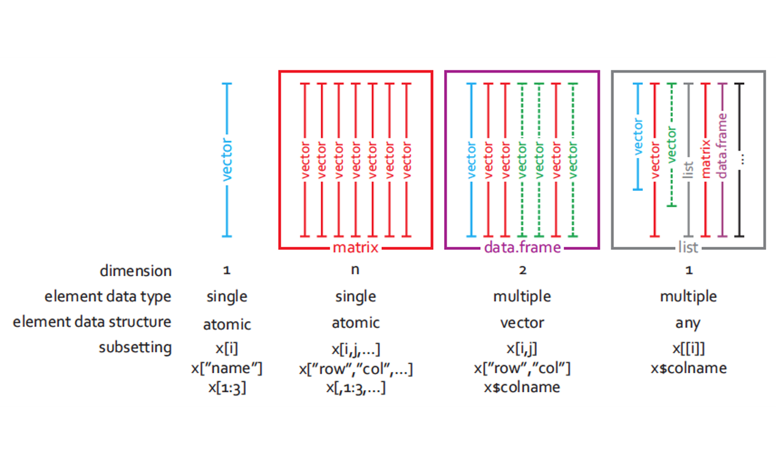
Common Object Classes

Slide 64
Vectors: simple usage
Create a vector using c() :
height <- c(180, 167, 199) # c() is for concatenate
Create a named vector:
height <- c(Mia=180, Paul=167, Ed=199)
Access elements with []:
height[1] # get the first element
height["Paul"] # get the element named Paul
height[ c(1,3) ] # get the 1st and 3rd element

Slide 65
Vectors: more creation recipes
a <- 1:10 # the : operator
1 2 3 4 5 6 7 8 9 10
s <- seq(0,2,0.5) # seq: from 0 to 2 by increment of 0.5
0.0 0.5 1.0 1.5 2.0
genotypes <- rep( c('WT','KO') , 3 ) # rep to repeat
"WT" "KO" "WT" "KO" "WT" "KO"
c(a,s) # c() can be used to concatenate 2 vectors
1.0 2.0 3.0 4.0 5.0 6.0 7.0 8.0 9.0 10.0 0.0 0.5 1.0 1.5 2.0

Slide 66
Vectors: manipulation (I)
a <- 1:4
a
[1] 1 2 3 4
a*2 # multiply each element of a by 2
[1] 2 4 6 8
a + c(12,10,12,10) # add the elements of 2 vectors
[1] 13 12 15 14

Slide 67
Vectors: manipulation (II)
Many functions take a vector as argument.
Some perform an element-wise operation. Example:
log2(a) # compute the logarithm in base 2 of each element
[1] 0.000000 1.000000 1.584963 2.000000
Some return a single value. Example:
mean(a) # compute the mean of the elements of a
[1] 2.5

Slide 68
Coercion (I)
All elements of a vector must be the same type
When combining different types, they are coerced to the most flexible type
Flexibility scale: logical < numeric < character
vec <- c(12,"twelve",TRUE) # combine 3 data type
vec # coerced to character
[1] "12" "twelve" "TRUE"
class(vec) # class() returns the type of a vector
[1] "character"

Slide 69
Coercion (II)
We can coerce a vector to any type with: as.logical() , as.numeric(), as.character()
Example: coerce a logical vector to numeric
FALSE becomes 0, TRUE becomes 1
mathematical functions automatically coerce to numeric
x <- c(FALSE,FALSE,TRUE)
as.numeric(x)[1] 0 0 1
sum(x) # number of TRUE
mean(x) # proportion of TRUE

Slide 70
Let's practice - 4
Create two vectors:
  vector_a, containing the values from −5 to 5
  vector_b, from 0 to 1 by increment of 0.1
Calculate the (element-wise) sum, difference and product between the elements of vector_a and vector_b. ​
Calculate the sum of elements in vector_a. ​
Calculate the overall sum of elements in both vector_a and vector_b.​
Identify the smallest and the largest value in vector_a​
Identify the smallest and the largest value among both vector_a and vector_b.​
Compute the overall mean of the values among both vector_a and vector_b.​
Hint: Each task in exercises 1-7 can be performed in a single statement per vector
(the minimum and maximum count as 2 separate tasks)​
EXTRA TASKS:
- use the seq() function to create a vector x containing 100 values equally spread between 0 and 5
- compute a vector y corresponding to the exponential of x
- compute and compare the means and standard deviations of x and y

Slide 71
Operators (most common ones)
Arithmetic: + , - , * , / , ^
Comparison: < , > , <= , >= , == (equal to),
!= (different from)
Logical: ! (negation), & (and), | (or)
Other: %in%
Comparison, logical operators, and %in% always return logical values (TRUE/FALSE)

Slide 72
Operators returning logical values
c(1,3,2) == 2
[1] FALSE FALSE TRUE
c(1,3,2) < 2
[1] TRUE FALSE FALSE
!(c(1,3,2) < 2) # ! Reverses TRUE and FALSE
[1] FALSE TRUE TRUE
c("Fred", "Marc", "Dan", "Ali") %in% c("Dan", "Geoff", "Ali")
[1] FALSE FALSE TRUE TRUE

Slide 73
Using logical vectors to subset
The [] operator can also accept a logical vector
a <- 1:4
a
[1] 1 2 3 4
a[ c(FALSE,FALSE,TRUE,TRUE) ] # select the elements where there is TRUE
[1] 3 4
a[ a>2 ] # the logical vector is provided by a logical expression
[1] 3 4
This sort of operation is extremely common
to subset some data

Slide 74
Missing values (I)
Missing values are usually represented by NA:
y <- c(1,2,3,4,5,NA,NA)
NA's interfer with many functions:
mean(y)
[1] NA
Arguments often exist to remove NA's before calculation
mean(y, na.rm=TRUE)
[1] 3
Alternatively, use na.omit() to remove NAs from the data
y_cleaned <- na.omit(y)
mean(y_cleaned)
[1] 3

Slide 75
Missing values (II)
x <- c(1, NA, 0/0) # 0/0 gives NaN = Not a Number
x
x [1] 1 NA NaN
is.na(x) #detects NAs and NaNs from x
[1] FALSE TRUE TRUE
is.nan(x) # detects only NaNs from x
[1] FALSE FALSE TRUE
x > 2 # what if we try to compare NA and NaN to a number?
[1] FALSE NA NA
x[!is.na(x)] # removes NAs and NaNs from x
[1] 1

Slide 76
Data frame: creation
We can create a dataframe from its individual column (each one is a vector)
  name <- c("Joyce", "Chaucer", "Homer")
  status <- c("dead", "deader", "deadest")
  reader_rating <- c(55, 22, 100)
  poets <- data.frame(name, status, reader_rating)
  poets
  name status reader_rating
  1 Joyce dead 55
  2 Chaucer deader 22
  3 Homer deadest 100

Slide 77
Data frame: manipulation
poets[ 2 , 2 ] # gets the element on row 2 in column 2
  poets[ , c(1,3) ] # gets columns 1 and 3
  poets[ , c("name", "reader_rating") ] # gets columns "name" and
  # "reader_rating"
  poets$name # gets column "name"
  rownames(poets) # gets the row names
  colnames(poets) # gets the column names
  rownames(poets) <- c("J", "C", "H") # overwrites row names

Slide 78
Let's practice - 5
Open a new script and save it as "Ex5.R".
In your script, write and execute the commands
  library(MASS) # loads the library MASS
  data(bacteria) # loads the bacteria data set (from MASS)
  Check: You should have a variable named "bacteria" in your Environment.
What are the names of the columns of the bacteria data.frame ?
Use [] to select rows 100 to 119 of the column ap .
Use $ to get the column week and check how many 0 values it has.
EXTRA TASKS
using a comparison operator and [], select the rows which correspond to a “placebo” treatment (in the trt column).
Compute the fraction of "y" in columns y (hint: the function mean() can help).
Compute the same fraction but only among the rows corresponding to a "placebo" treatment. Same with a "drug" treatment, and with a "drug+" treatment.

Slide 79
Lists: creation
Lists are collections of object which may be of different classes and sizes
  Create a few objects:
  vec <- c(0.4, 0.9, 0.6)
  mat <- cbind(c(1,1), c(2,1))
  df <- data.frame(name=c("Ed", "Lisa"), age=c(61, 71))
  Unnamed list - collect these objects in a list, using the function list():
  l <- list(vec, mat, df)
  Named list - collect these objects in a list with named elements:
  l_with_names <- list(myvector=vec, mymatrix=mat, mydata=df)

Slide 80
Lists: manipulation
  l[[1]] # gets the first object
  l_with_names[["myvec"]] # gets the object named "myvec"
  l_with_names$myvec # gets the object named "myvec"
  names(l_with_names) # gets the list elements' names
  names(l_with_names) <- c("A", "B", "C") # overwrites names
Lists can be used to collect a diverse sets of objects related to the same analysis

Slide 81
Everything in R is an object
Using R is all about creating and manipulating data objects using functions
Objects have a class (vector, data frame, list,…)
Data in objects have a type (numeric, character, logical)

Slide 82
  Formatting your Data

Slide 83
Prepare your Data outside of R
To make importation of your data in R easy, you have to format it properly beforehand.
Excel or OpenOffice can be used for that task.
Three main precepts of tidy data:
Each variable forms a column
Each observation forms a row
Each type of observational unit forms a table
http://www.ucd.ie/ecomodel/pdf/TidyData.pdf

Slide 84
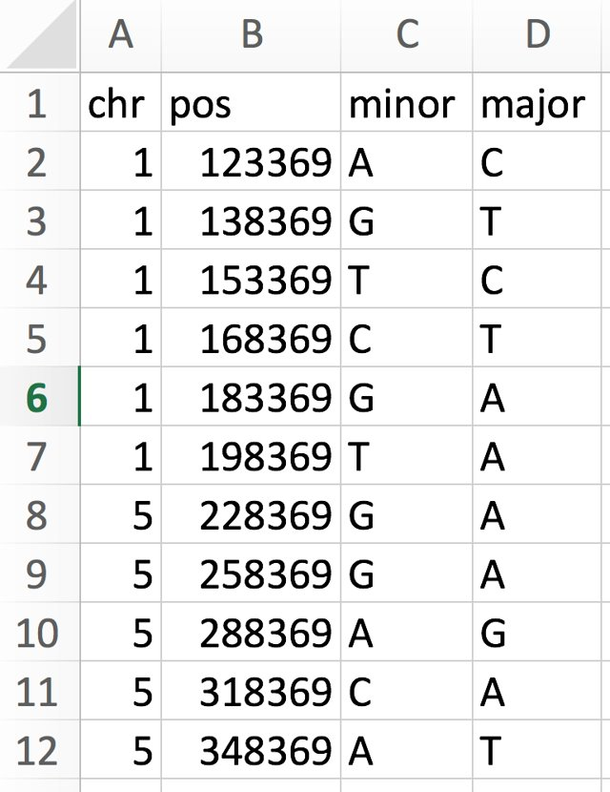
Example of a well-formatted dataset
A header line with variable names
4 variables, 1 in each column
One observation per row

Slide 85
Example of a well-formatted dataset - metadata
Glossary for the snp data
snp single nucleotide polymorphism
chr chromosome
pos position
minor minor allele (a minority of individuals
have this letter at this position)
major major allele ( a majority of individuals
have this letter at this position)
+ data source, date of collection,...
Data is often useless without the accompanying metadata

Slide 86
But the reality is not awlways as simple…
Two exercice: A) metabolites_table and optional: B) Cell_lines_table
Difficult to use with any
Statistical program
Courtesy of Frederic Schuetz

Slide 87
Importing data
Most flexible function to read tabular data: read.table()
Reads a formatted text file
Imports it as a data frame
Many options, to accommodate most text files
Two main elements to give to read.table():
What/where is the file to read
What are the formatting options

Slide 88
Specifying the file to read (I)
Where is the file I want to import?
    Look for your file in the file system.
    Note its path: the succession of folders to access it
File paths can be specified as a string with '/' as separator:
"C:/Users/Leo/courses/data/snp.csv"
Or with a little help from the function file.path():
file.path("C:","Users", "Leo", "courses", "data", "snp.csv")

Slide 89
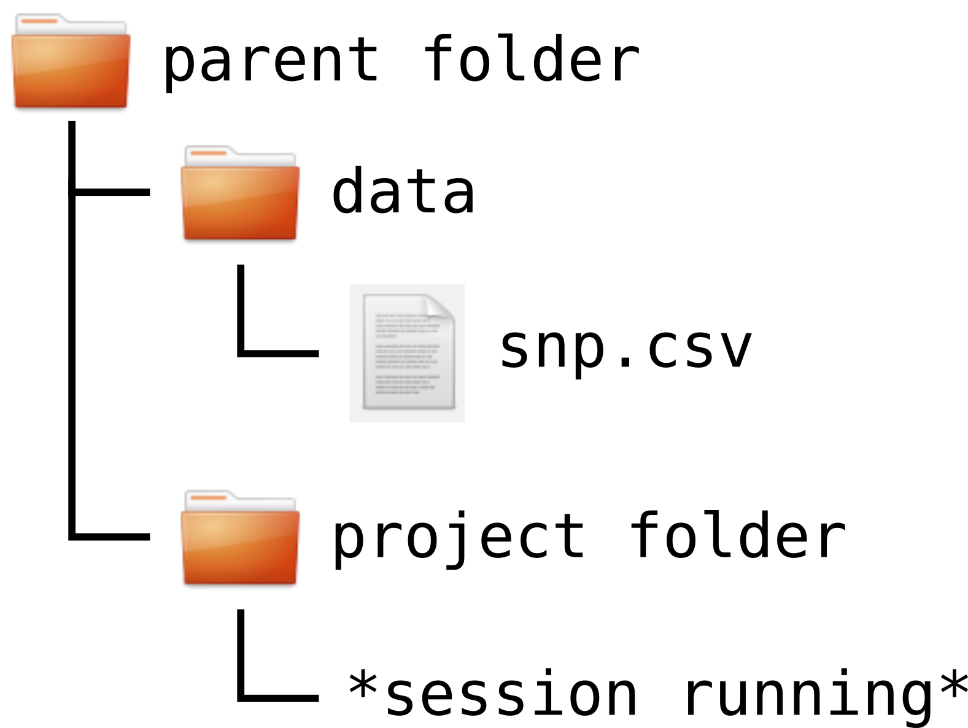
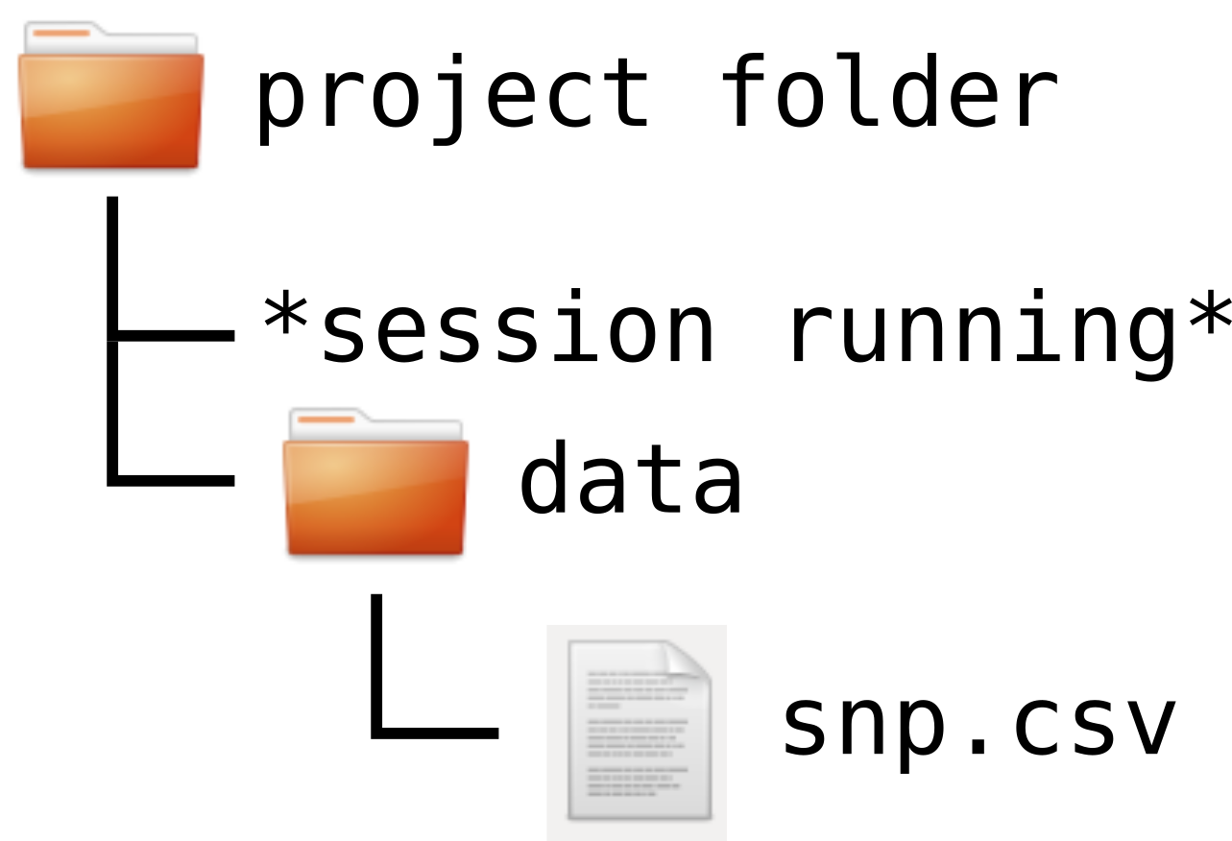
Specifying the file to read (II)
Files path can be absolute
"C:/Users/Leo/courses/data/snp.csv"
Or relative (to the working directory)
"data/snp.csv" "../data/snp.csv"

Slide 90
Format options
Most important optional arguments of read.table(), read.csv(), read.delim()
header (TRUE/FALSE): specifies whether the first line contains column names
  Default in read.table() is FALSE.
  Default in read.csv() and read.delim() is TRUE.
sep: specifies the field separator character (e.g. "," or tab "\t").
  Default in read.table() is any white space characters (space, tab, newline and carriage return).
  Default in read.csv() is comma.
  Default in read.delim() is tab.
When in doubt, use help(read.table)

Slide 91
Importing data
Most flexible function to read tabular data: read.table()
Reads a formatted text file
Imports it as a data frame
Many options, to accommodate most text files
Two main elements to give to read.table():
What/where is the file to read
What are the formatting options

Slide 92
Specifying the file to read (I)
Where is the file I want to import?
    Look for your file in the file system.
    Note its path: the succession of folders to access it
File paths can be specified as a string with '/' as separator:
"C:/Users/Leo/courses/data/snp.csv"
Or with a little help from the function file.path():
file.path("C:","Users", "Leo", "courses", "data", "snp.csv")

Slide 93
Specifying the file to read (II)
Files path can be absolute
"C:/Users/Leo/courses/data/snp.csv"
Or relative (to the working directory)
"data/snp.csv" "../data/snp.csv"

Slide 94
Format options
Most important optional arguments of read.table(), read.csv(), read.delim()
header (TRUE/FALSE): specifies whether the first line contains column names
  Default in read.table() is FALSE.
  Default in read.csv() and read.delim() is TRUE.
sep: specifies the field separator character (e.g. "," or tab "\t").
  Default in read.table() is any white space characters (space, tab, newline and carriage return).
  Default in read.csv() is comma.
  Default in read.delim() is tab.
When in doubt, use help(read.table)

Slide 95
Reading Excel files
Although it is recommended to export your data files to a non-proprietary text format, it is still possible to read directly from an excel file.
install.packages("readxl")
# Loading
library(readxl)
# reading the sheet named 'my data' from an excel file
my_data <- read_excel("my_file.xls",sheet='my data')

Slide 96
Metabolites dataset (from Bosnjakovic et al., BioRxiv, 2025)
doi:https://doi.org/10.1101/2025.07.10.663939
Bosnjakovic2025_metabolites_dataset.xlsx
Try to read this into R. Remember we talked about read.delim, read.table, read.xlsx…
What do you observe?

Slide 97
Metabolites dataset
Bosnjakovic2025_metabolites_dataset.xlsx
Row 1 : treatment → None None None None None "VC, BaP" "VC, BaP" "BaP" …
Row 2 : condition → None None None None None "0.2% DMSO" "0.2% DMSO" "20µM BaP" …
Row 3 : real names → "Precursor Name" "Prec. Form." … "24h" "24h" "24h" …

Slide 98
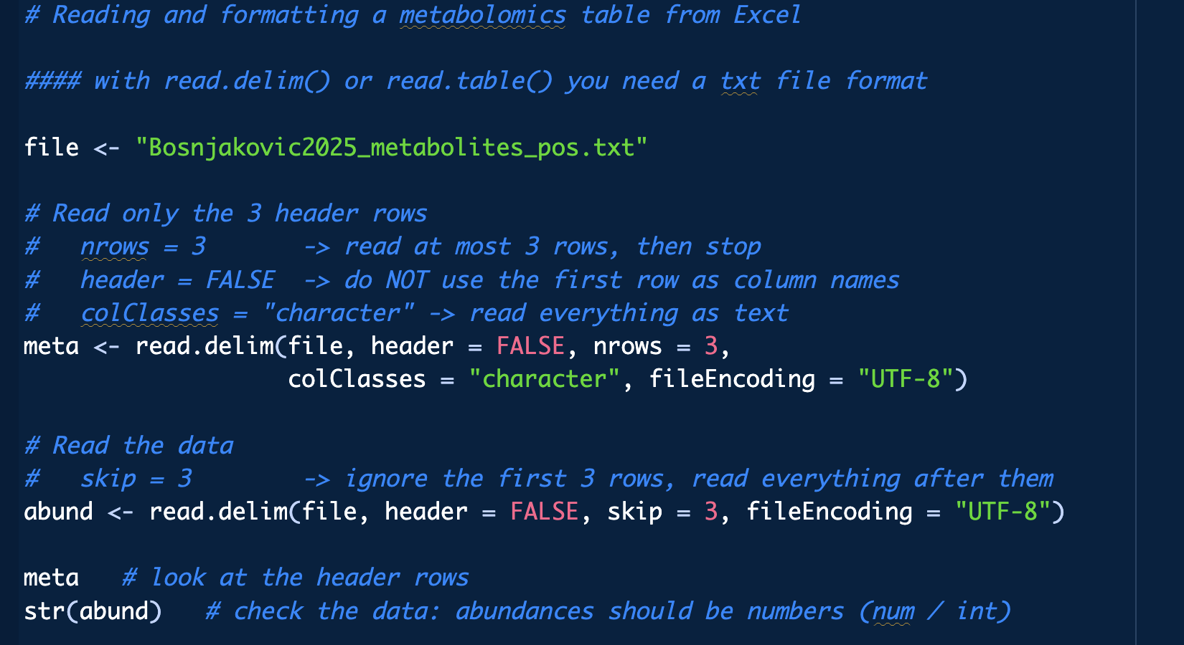

Step-by-step
If you want to use base R read.delim or read.table, you need to:
Open the excel file
Save the sheet you are interested in as tab delimited txt file
Read it in R

Slide 99
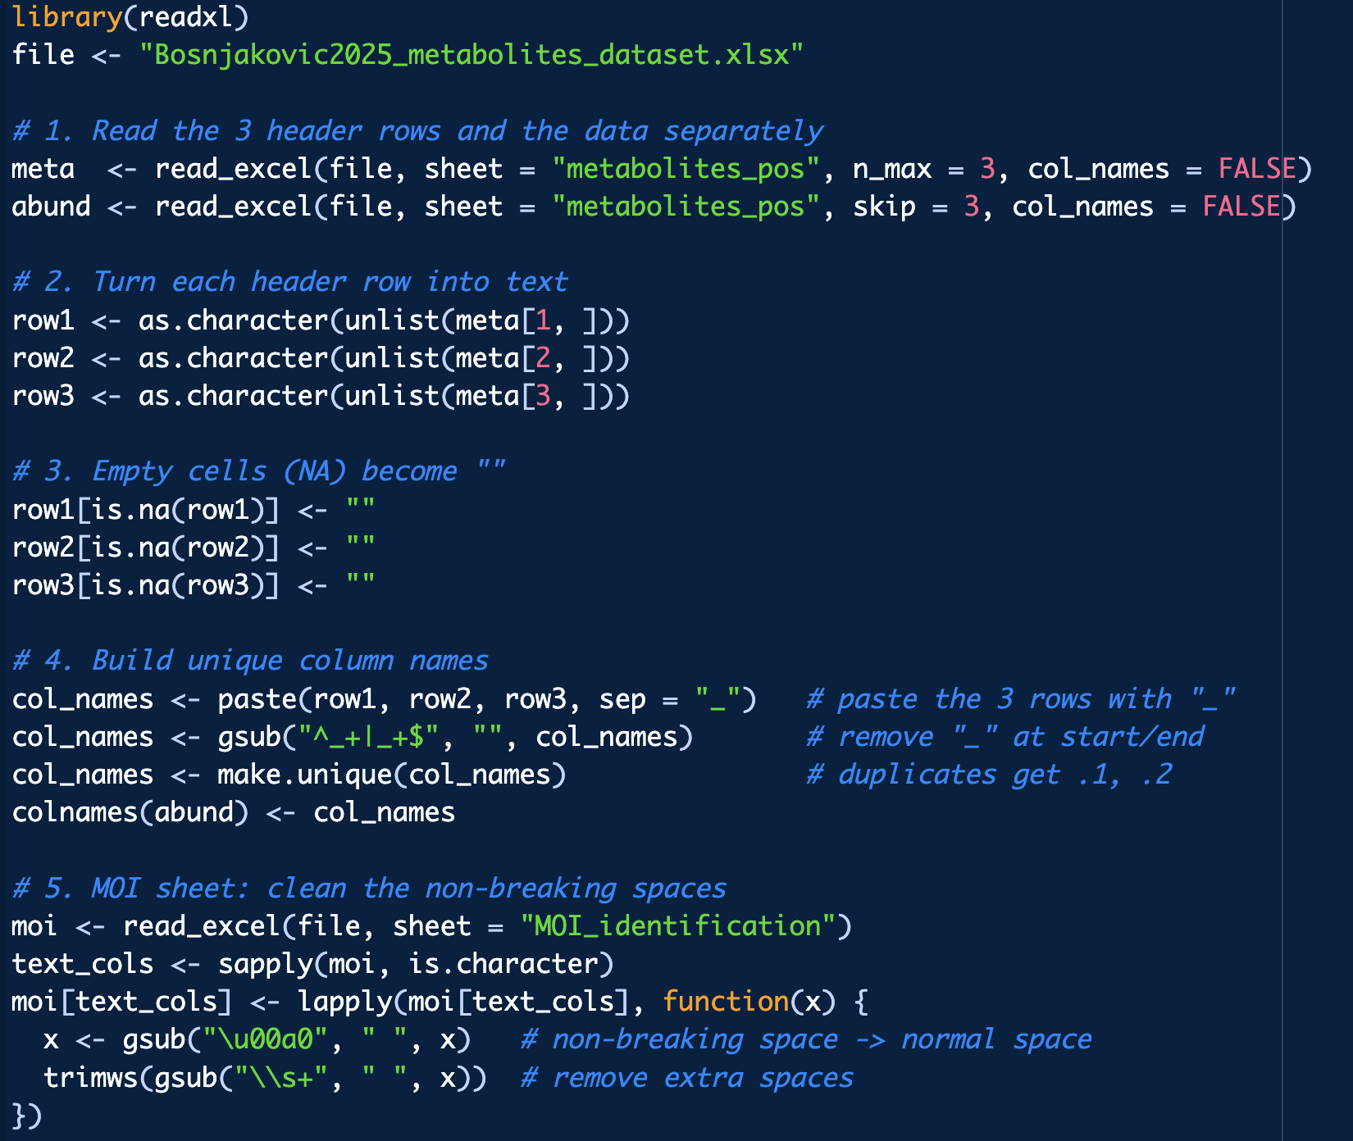
Step-by-step

Slide 100
Cell lines dataset (from Ujiie, Sakyo, Oya, et al., Cancer Medicine, 2025)
Doi: https://doi.org/10.1002/cam4.71373
Ujiie2025_Supplementary Table S3.xlsx
Again, try to read this into R
What do you observe in this case?

Slide 101
Cell lines dataset (from Ujiie, Sakyo, Oya, et al., Cancer Medicine, 2025)
Doi: https://doi.org/10.1002/cam4.71373
The problem: line 1 table title, real column names on line 2, NA in PRISM_IC50 for the excluded cells, column name in CamelCase.

Slide 102
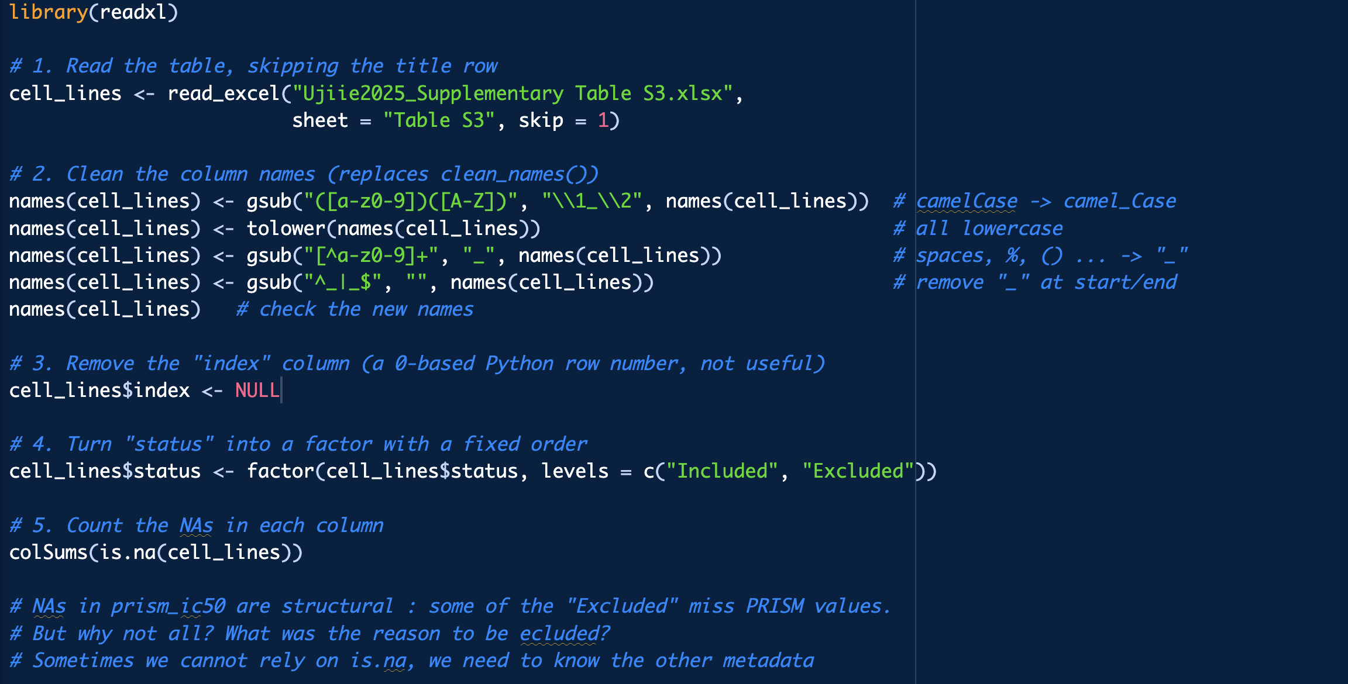
Step-by-step

Slide 103
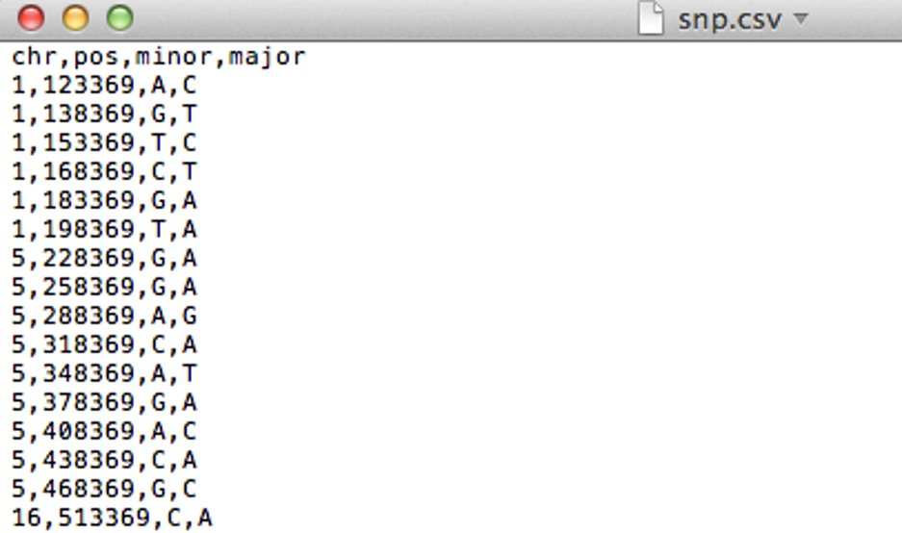
Saving your data
Export the spreadsheet to a text file format
csv (comma separated values), file extension .csv OR
tsv (tab separated values), file extension .txt or .tsv
Now you are ready to import this dataset in R

Slide 104
Formatting checklist/recommendations
First row is a header (column names)
First column contain row IDs
No blank spaces in column names (use _ instead)
Column names do not contain symbols other than _
Short column names are better
Remove all comments or other content around the data table
  --> put them in a metadata file
Indicate missing values with NA (spelled exactly like that)
Have data backups!

Slide 105
Let's practice – 6a
A dataset from mouse experiments at 18 weeks is available in the file mice_data.csv in the course_datasets folder (courtesy of F. Schutz and F. Preitner). Let's explore the dataset to see what it contains.
Open a new script file in R studio, comment it and save it.
Have look at the csv file in R studio's file explorer. What do you need to check in order to be able to read in the file correctly?
Read the file into R, assign its content to object "mice_data". Examine the object.
How many observations and variables does the dataset have?
What is the structure of the dataset? What are the names and classes of the variables?

Slide 106
Digression: factors (I)
Factors is a datatype used to represent categorical data.
Some functions require factors (and not character) to work properly.
genotype <- factor(c("WT", "WT", "Mut2", "Mut1", "Mut2"))
[1] WT WT Mut2 Mut1 Mut2
Levels: Mut1 Mut2 WT
The available values in a factor are called levels.
levels(genotype)
[1] "Mut1" "Mut2" "WT"

Slide 107
Digression: factors (II)
By default factor levels are sorted alphabetically.
We can specify them manually (sometimes useful to set reference level in some stat applications)
genotype <- factor(c("WT", "WT", "Mut2", "Mut1", "Mut2"),
levels=c("WT","Mut1","Mut2"))
[1] WT WT Mut2 Mut1 Mut2
Levels: WT Mut1 Mut2

Slide 108
Setting factor variables
Convert categorical variables to factors as needed.
snps$chr <- factor(snps$chr, levels=c("1","5","16","22"))
snps$minor <- factor(snps$minor)
snps$major <- factor(snps$major)
str(snps) # structure of the data frame
'data.frame': 40 obs. of 4 variables:
$ chr : Factor w/ 4 levels "1","5","16","22": 1 1 1 ...
$ pos : int 123369 138369 153369 168369 183369 ...
$ minor: Factor w/ 4 levels "A","C","G","T": 1 3 4 2 3 ...
$ major: Factor w/ 4 levels "A","C","G","T": 2 4 2 4 1 ...

Slide 109
Getting a summary
summary(snps)
chr pos minor major
1 : 6 Min. : 123369 A: 9 A:17
5 : 9 1st Qu.: 340869 C:10 C:10
16: 9 Median : 715869 G:15 G: 4
22:16 Mean : 777869 T: 6 T: 9
3rd Qu.:1185869
Max. :1673369

Slide 110
Reminder – accessing parts of the dataframe (I)
snps[2,] # 2nd row
chr pos minor major
2 1 138369 A T
snps[, "minor"] # column named "minor"
[1] A A T C G T G G A C A G A C G C A G G C G A C A G T C G C C T A G G T G T C G A
Levels: A C G T
snps[1:3, c(1,3)] # 3 first rows, 1st and 3rd column
chr minor
1 1 A
2 1 G
3 1 T

Slide 111
Reminder – accessing parts of the dataframe (II)
snps$chr # equivalent to snps[, 1]
[1] 1 1 1 1 1 1 5 5 5 5 5 5 5 5 5 16 16 16 16 16 16 16 16 16 22 22 22
[28] 22 22 22 22 22 22 22 22 22 22 22 22 22
Levels: 1 5 16 22
snps$chr[40] # chromosome of the last row
[1] 22

Slide 112
table()
The table() function is useful to get a summary of one or several categorical columns.
table(snps$chr)
1 5 16 22
6 9 9 16
table(snps$minor, snps$major)
# rows are minor, columns are major
A C G T
A 0 4 2 3
C 3 0 2 5
G 10 4 0 1
T 4 2 0 0

Slide 113
table()
The table() function is useful to get a summary of one or several categorical columns.
table(snps$chr)
1 5 16 22
6 9 9 16
table(snps$minor, snps$major , dnn = c("minor","major"))
# rows are minor, columns are major
major
minor A C G T
A 0 4 2 3
C 3 0 2 5
G 10 4 0 1
T 4 2 0 0

Slide 114
Let's practice – 6b
Continue from the mouse dataset used previously.
Use the following code if you do not have the dataframe already loaded
mice_data = read.csv("course_datasets/mice_data.csv")
Which variables appear to be categorical? Convert them to factors.
Get the summary statistics of "mice_data"
Use the function table() to compute the number of observations in different mouse groups.
  How many mice are included of each genotype (WT, KO)?
  How many mice are included per diet (HFD, CHOW)?
  Make a 2x2 table by genotype and diet crossed.
  EXTRA TASKS:
  Come to the bacteria dataset and explore the relationship between the categorical columns using what you learned

Slide 115
Subsetting (I)
subset() allows you to subset your data by specific columns and values in those columns. Logical operators can be used within the subset.
subset(snps, chr==1)# keeps only the snps where chr is 1
chr pos minor major
1 1 123369 A C
2 1 138369 G T
3 1 153369 T C
4 1 168369 C T
5 1 183369 G A
6 1 198369 T A

Slide 116
Subsetting (II)
# keeps only the snps in chr 1 with an "A" as major allele
subset(snps, chr==1 & major=="A")
chr pos minor major
5 1 183369 G A
6 1 198369 T A
# keeps only the snps in chr 1 with an "A" or "T" as major allele
subset(snps, chr==1 & (major=="A" | major=="T"))
chr pos minor major
2 1 138369 G T
4 1 168369 C T
5 1 183369 G A
6 1 198369 T A

Slide 117
Customizing summaries of data (I)
apply() generates custom summaries of your data using :
X: a column you want to aggregate (of any data type)
INDEX: a factor column, or list of factor columns, for grouping
FUN: a function to be applied to X (mean, sd, min, max, length, median, range, quantiles…), separately for each grouping indicated by INDEX

Slide 118
Customizing summaries of data (II)
# loading a dataset with hours of extra sleep in two groups
data(sleep)
head(sleep, n=3)
extra group ID
1 0.7 1 1
2 -1.6 1 2
3 -0.2 1 3
tapply(X=sleep$extra, INDEX=sleep$group, FUN=mean)
1 2
0.75 2.33
For each group, compute the mean extra sleep

Slide 119
Adding a row or column
Add a row to the snp data: rbind()
snps_updated <- rbind(snps,
data.frame(chr=22,
pos=1723369,
minor="A",
major="T"))
Add a column to the snp data: cbind()
majorGC <- snps$major %in% c("G","C")
snps_mod <- cbind(snps, majorGC)
OR
snps$majorGC <- snps$major %in% c("G","C")

Slide 120
Removing a row or column
Exclusion (-):
snps_orig <- snps_mod[,-1] # remove the first column
head(snps_orig) # check resulting data
Extraction:
# extract all columns that you want to keep
# (from the 2nd to the last)
snps_orig <- snps_mod[,2:ncol(snps_mod)]
head(snps_orig) # check resulting data

Slide 121
Exporting data to a file
write.table() or write.csv()
Example:
write.table(snps_updated, file="snps_updated.csv",
quote=FALSE, sep=",", row.names=FALSE)
Some important arguments (check ?write.table for more):
  file: file path and name for the output file
  append: allows to append to an existing file (default is FALSE).
  quote: whether the elements of character or factor columns should be surrounded by double quotes in the printed output (default is TRUE).
  sep: field separator to be used, e.g., comma (",") or tab ("\t").
  row.names: whether the row names are written (default is TRUE)
  col.names: whether the column names are written (default is TRUE).

Slide 122
Let's practice – 6c
Continue from the mouse dataset used previously.
Use the following code if you do not have the dataframe already loaded
mice_data = read.csv("course_datasets/mice_data.csv")
Subsets
  Isolate the observations for the mice on high fat diet (HFD) using subset().
  Compute the average weights of the subset.
  Do the same for the mice on regular chow diet (CHOW).
  Export the data of each subgroup to a csv file.
Look at the results from the two previous exercises. What does this initial exploration of the data suggest about mouse weights?
Optional: Compute the means and standard deviations for WT and KO mouse weights using tapply(). Then do the same for CHOW and HFD groups.
EXTRA TASK: next slide

Slide 123
Let's practice – 6c – extra tasks
Come back to the bacteria dataset. We will try to explore how the fraction of infection of H.influenzae in otitis changes with respect to both week of observation and treatment
add a new column y_yes to the dataframe which contains TRUE when column y is "y" and FALSE otherwise. This column will be useful for our tapply after.
Use tapply to compute the fraction of otitis with H.influenzae (column y_yes) for each week
for each level of the trt column
  Generate a subset of the dataframe with only the observations with this treatment level
  Use tapply to compute the fraction of otitis with H.influenzae for each week for this treatment level

Slide 124
Thank you

Slide 125
Annexes

Slide 126
Reading Excel files
Although it is recommended to export your data files to a non-proprietary text format, it is still possible to read directly from an excel file.
install.packages("readxl")
# Loading
library(readxl)
# reading the sheet named 'my data' from an excel file
my_data <- read_excel("my_file.xls",sheet='my data')

Slide 127
Coding style
Different authorities have different style recommendations for naming things, spacing, operator symbols, layout, commenting etc.
Example: https://web.stanford.edu/class/cs109l/unrestricted/resources/google-style.html
File names: Use meaningful names, ending with file extension .R (predict_ad_revenue.R)
Identifiers: Variable names should have all lower case letters, words separated with dots (avg.clicks)
Line length: maximum 80 characters
Indentation: two spaces, no tabs
Assignment: use <-, not =
Semicolon: don’t use them
Spaces:
Place spaces around all binary operators (=, +, -, <, etc.)
Do not place a space before a comma, but always place one after a comma.
Otherwise, do not place spaces around code in parentheses or square brackets

