Slide 1
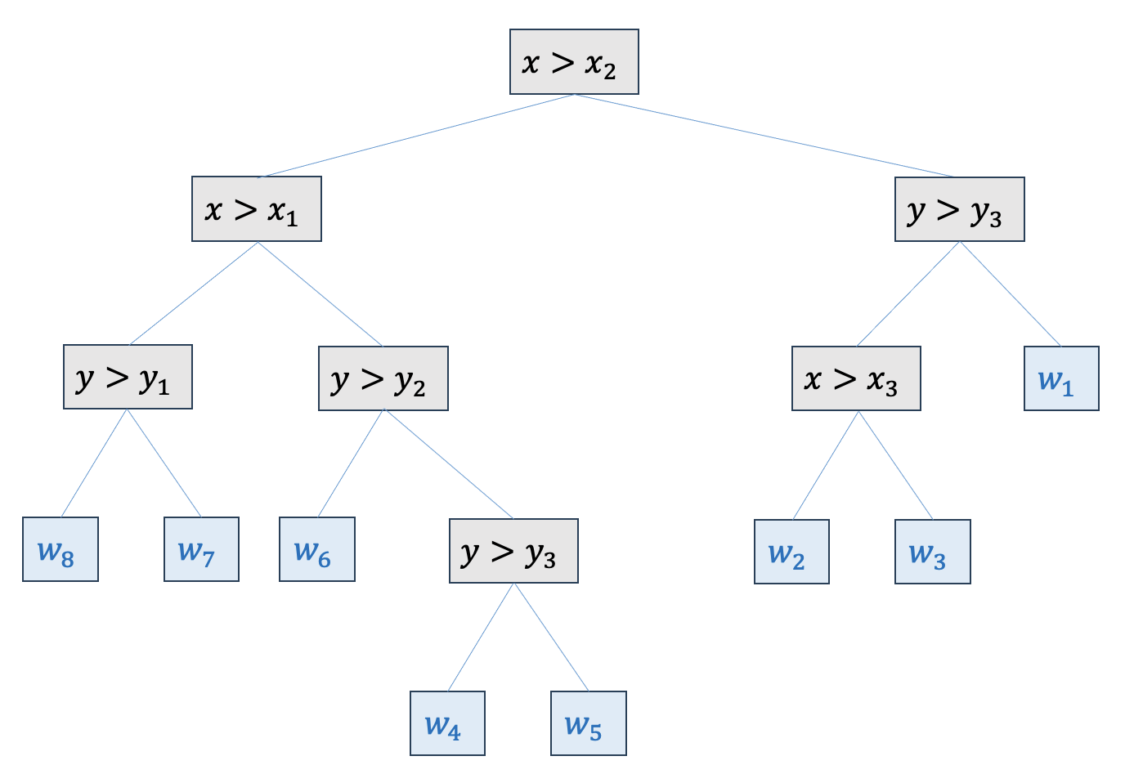
















Trees
$𝒟=\left\{\left(x_{i},y_{i}\right)\right\}, 1≤i≤n, x_{i}∈ℝ^{m},y_{i}∈ℝ$
${\hat{y}}_{i}=f\left(x_{i}\right),$
$f∈𝒯=\left\{f\left(x\right)=w_{q\left(x\right)}\right\}, \left(q:ℝ^{m}→\left\{1..T\right\}, w∈ℝ^{T}\right), T \text{number} \text{of} \text{leafes}$
$$w_{4}$$
$$y_{4}$$
$$w_{1}$$
$$y_{3}$$
$$w_{7}$$
$$w_{5}$$
$$y_{2}$$
$$w_{2}$$
$$w_{3}$$
$$y_{1}$$
$$w_{8}$$
$$w_{6}$$
$$x_{1}$$
$$x_{2}$$
$$x_{3}$$

Slide 2















$$x>x_{2}$$
$$x>x_{1}$$
$$y>y_{3}$$
$$y>y_{1}$$
$$y>y_{2}$$
$$x>x_{3}$$
$$w_{1}$$
$$w_{8}$$
$$w_{7}$$
$$w_{6}$$
$$y>y_{3}$$
$$w_{2}$$
$$w_{3}$$
$$w_{4}$$
$$w_{5}$$

Slide 3
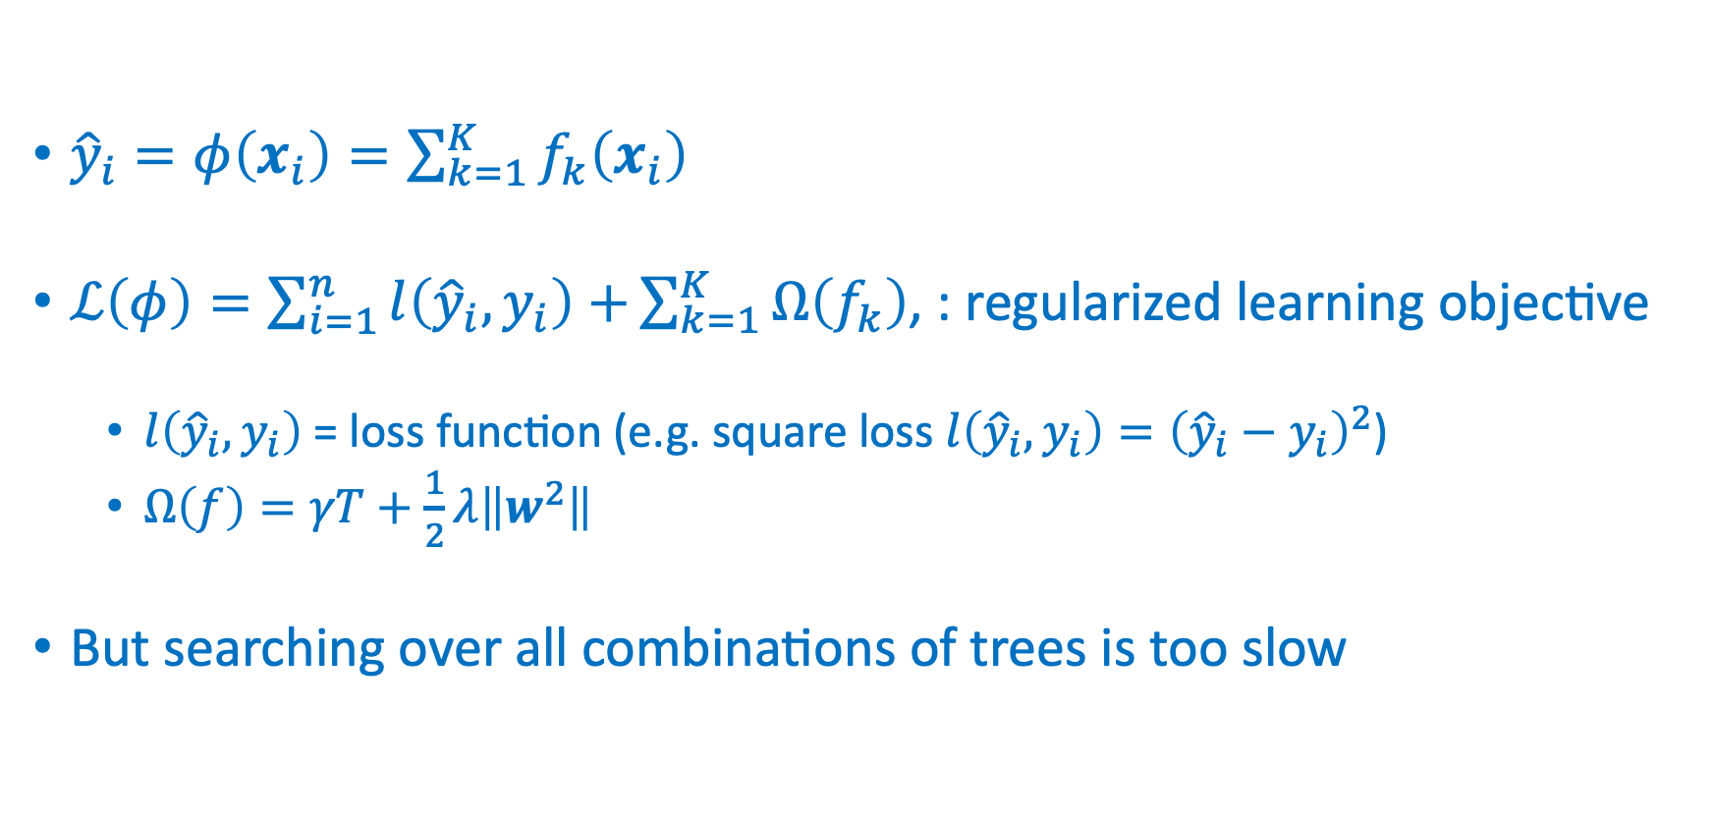
Additive tree regression
${\hat{y}}_{i}=φ\left(x_{i}\right)=\sum_{k=1}^{K}{f_{k}\left(x_{i}\right)}$
$ℒ\left(φ\right)=\sum_{i=1}^{n}{l\left({\hat{y}}_{i},y_{i}\right)+}\sum_{k=1}^{K}{Ω\left(f_{k}\right)}$, : regularized learning objective
$l\left({\hat{y}}_{i},y_{i}\right)$ = loss function (e.g. square loss $l\left({\hat{y}}_{i},y_{i}\right)={\left({\hat{y}}_{i}−y_{i}\right)}^{2}$)
$Ω\left(f\right)=γT+\frac{1}{2}λ\left\|w^{2}\right\|$
But searching over all combinations of trees is too slow

Slide 4
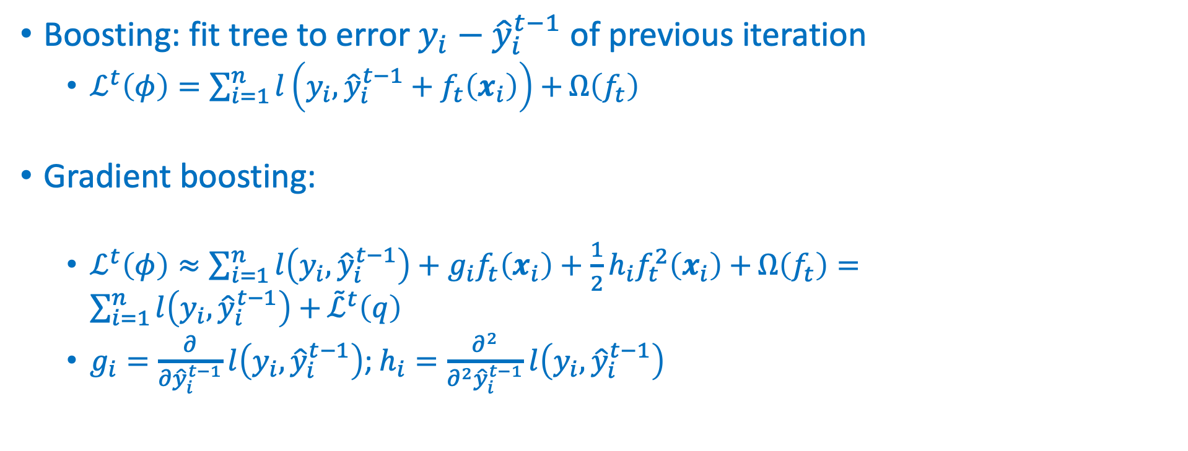
Gradient boosting
Boosting: fit tree to error $y_{i}−{\hat{y}}_{i}^{t−1}$of previous iteration
$ℒ^{t}\left(φ\right)=\sum_{i=1}^{n}{l\left(y_{i},{\hat{y}}_{i}^{t−1}+f_{t}\left(x_{i}\right)\right)+}Ω\left(f_{t}\right)$
Gradient boosting:
$ℒ^{t}\left(φ\right)≈\sum_{i=1}^{n}{l\left(y_{i},{\hat{y}}_{i}^{t−1}\right)+g_{i}f_{t}\left(x_{i}\right)+\frac{1}{2}h_{i}f_{t}^{2}\left(x_{i}\right)+}Ω\left(f_{t}\right)=\sum_{i=1}^{n}{l\left(y_{i},{\hat{y}}_{i}^{t−1}\right)+}{\tilde{ℒ}}^{t}\left(q\right)$
$g_{i}=\frac{∂}{∂{\hat{y}}_{i}^{t−1}}l\left(y_{i},{\hat{y}}_{i}^{t−1}\right)$; $h_{i}=\frac{∂^{2}}{∂^{2}{\hat{y}}_{i}^{t−1}}l\left(y_{i},{\hat{y}}_{i}^{t−1}\right)$

Slide 5
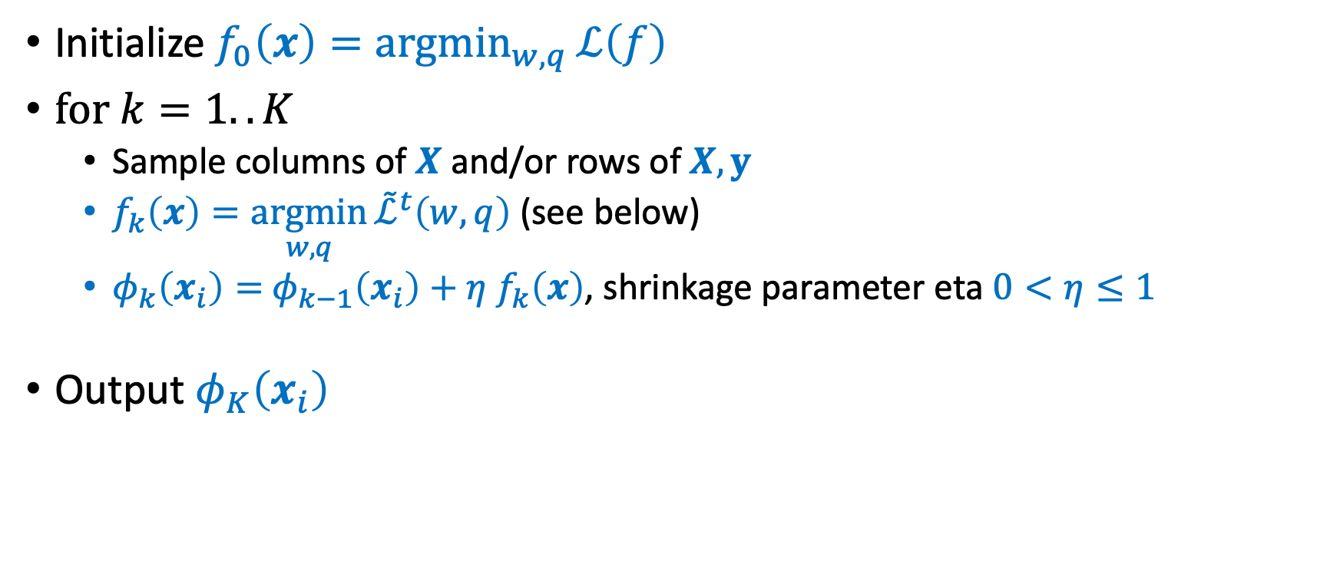
Gradient boosting
Initialize $f_{0}\left(x\right)=\underset{w,q}{argmin}{ℒ\left(f\right)}$
$\text{for} k=1..K$
Sample columns of $X$ and/or rows of $X, y$
$f_{k}\left(x\right)=\underset{w,q}{argmin}{{\tilde{ℒ}}^{t}\left(w,q\right)}$ (see below)
$φ_{k}\left(x_{i}\right)=$ $φ_{k−1}\left(x_{i}\right)+η$ $f_{k}\left(x\right)$, shrinkage parameter eta $0<η≤1$
Output $φ_{K}\left(x_{i}\right)$

Slide 6
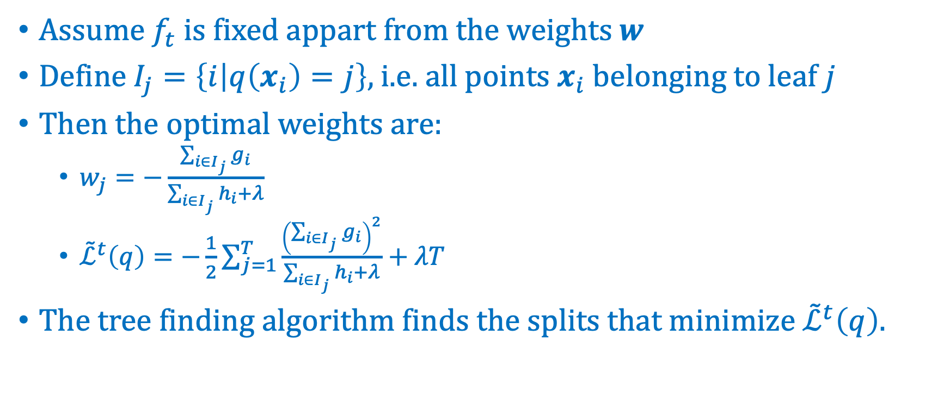
Gradient boosting
Assume $f_{t}$ is fixed appart from the weights $w$
Define $I_{j}=\left\{i | q\left(x_{i}\right)=j\right\}$, i.e. all points $x_{i}$ belonging to leaf $j$
Then the optimal weights are:
$w_{j}=−\frac{\sum_{i∈I_{j}}{g_{i}}}{\sum_{i∈I_{j}}{h_{i}+λ}}$
${\tilde{ℒ}}^{t}\left(q\right)=−\frac{1}{2}\sum_{j=1}^{T}{\frac{{\left(\sum_{i∈I_{j}}{g_{i}}\right)}^{2}}{\sum_{i∈I_{j}}{h_{i}+λ}}}+λT$
The tree finding algorithm finds the splits that minimize ${\tilde{ℒ}}^{t}\left(q\right).$

Slide 7
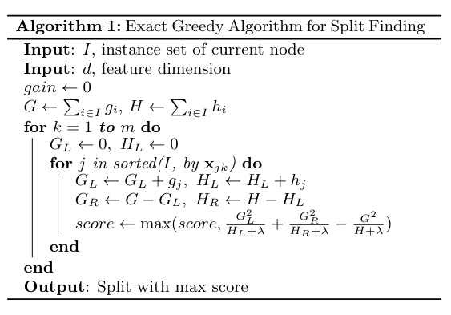
Gradient boosting

Slide 8
XGBoost
XGBoost is a scalable gradient boosting system
It is open source (https://github.com/dmlc/xgboost) and well documented (https://xgboost.readthedocs.io/en/stable/)
It performs very well on tabular data and won several competitions (eg. KDDCup 2015) beating neural networks (NN).
Unlike neural nets it relies on feature selection and engineering.

Slide 9
XGBoost
Chen & Guestrin, KDD 16, 2016
Exact greedy (slower) and approximate (faster) algorithms
Deal with missing values (sparsity aware)
Include feature interaction constraints
Include monotonicity constraints
Include regularization (shrinkage, sampling, penalties)
Callbacks, early stopping
Parallel on multiple CPUs, support for Spark distributed computing
GPU support
Out-of-core computing (data larger than memory)
Since 2.0: optimize histo size, learning to rank, quantile regression, federated learning

Slide 10

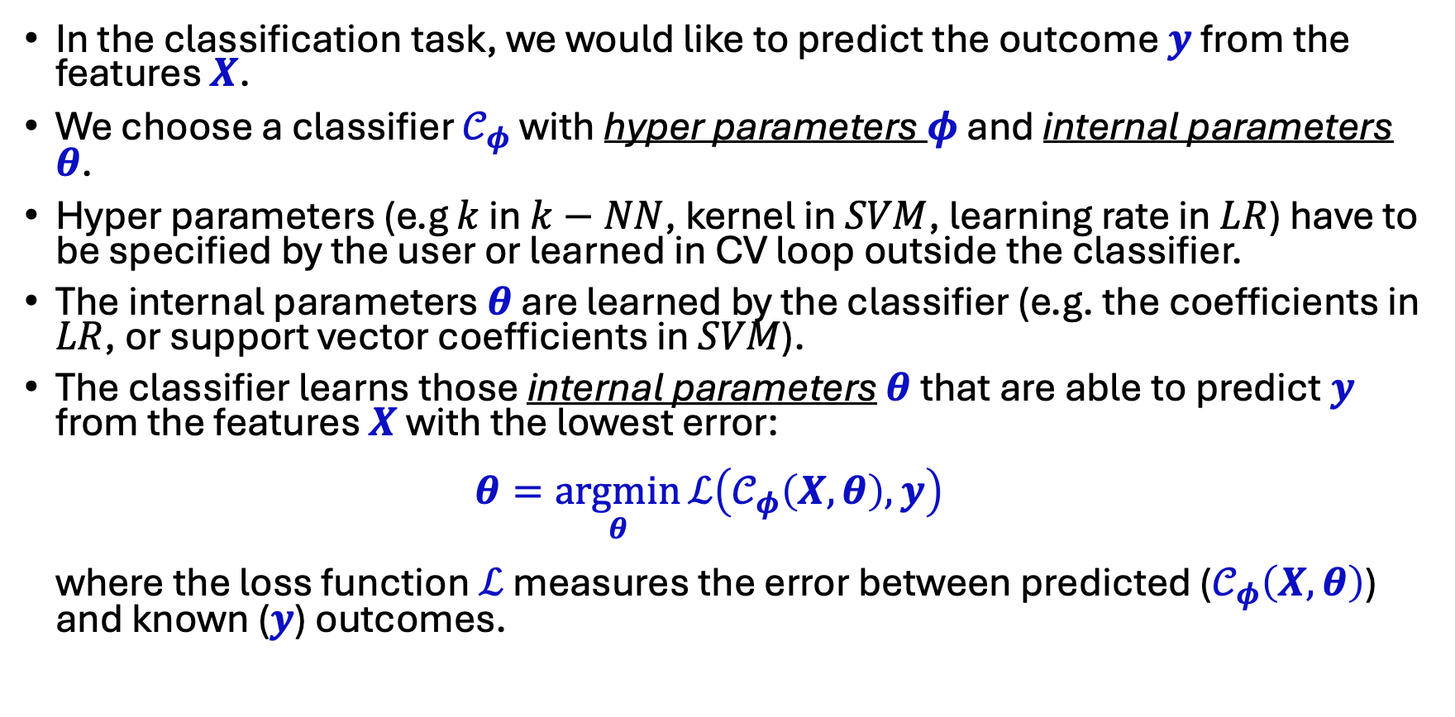
Some More Notations:
In the classification task, we would like to predict the outcome $y$ from the features $X$.
We choose a classifier $𝒞_{φ}$ with hyper parameters $φ$ and internal parameters $θ$.
Hyper parameters (e.g $k$ in $k−NN$, kernel in $SVM$, learning rate in $LR$) have to be specified by the user or learned in CV loop outside the classifier.
The internal parameters $θ$ are learned by the classifier (e.g. the coefficients in $LR$, or support vector coefficients in $SVM$).
The classifier learns those internal parameters $θ$ that are able to predict $y$ from the features $X$ with the lowest error: $θ=\underset{θ}{argmin}{ℒ\left(𝒞_{φ}\left(X,θ\right),y\right)}$ where the loss function $ℒ$ measures the error between predicted ($𝒞_{φ}\left(X,θ\right)$) and known ($y$) outcomes.

Slide 11
Hyperparameter optimization
ML models have internal parameters, which are learned by the training algorithm, and hyperparameters, which have to be set before training.
Both internal - and hyperparameters have a strong impact on the performance of the ML model.
There is a tradeoff between CPU/GPU cycles spent on hyperparameter optimization and training. Recent results show that allocating more cycles for hyperparameter optimization can be more rewarding.
Hyperparameter optimization is implemented as an outer loop over the CV loop

Slide 12
Hyperparameter optimization
Hyperparameters have tree-structured configuration spaces of discrete, ordinal, and continuous variables.
Hyperparameter optimization can be based on complete tree searches, random searches, or clever algorithms that suggest which parameter combination to test in the next step based on previous results.
Hyperopt (Bergstra et al. Neurips 2011) implements the latter two strategies. It implements sophisticated algorithms to suggest new parameter combinations (see below). It is open-source and available on https://github.com/hyperopt/hyperopt.
Other tools are Hypermax (tree parzen estimator), Scikit-Optimizer (skopt) (Bayesian), Spearmint (Bayesian), Hyperband (fast random armed bandit), Optuna (dynamic search space, pruning, easy API)

Slide 13
Hyperopt
Random algorithms find optimal solutions faster and more accurately than grid searches (Bergstra & Bengio, J. Mach. Learn. Res., 2012)
Therefore Hyperopt implements a random search algorithm.
Hyperopt also offers three model-based search algorithms:
Gaussian process approach (GP)
Tree-structured Parzen window approach (TPE)
Random

Slide 14
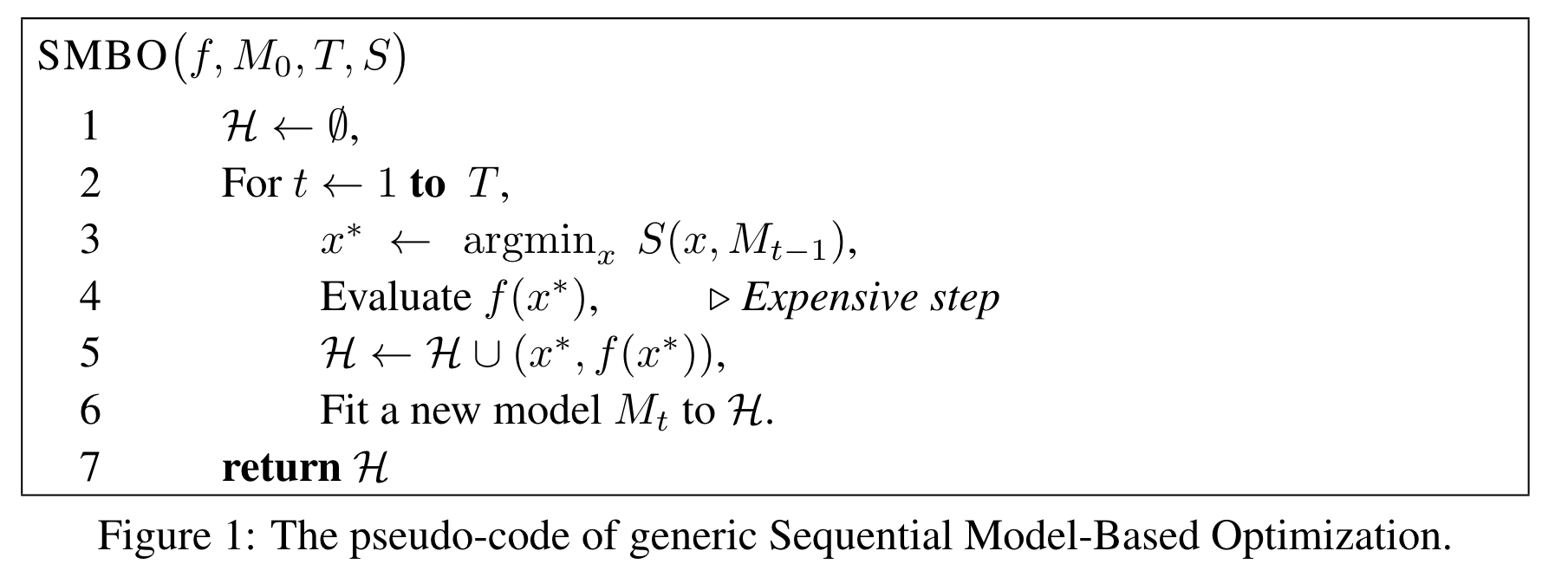
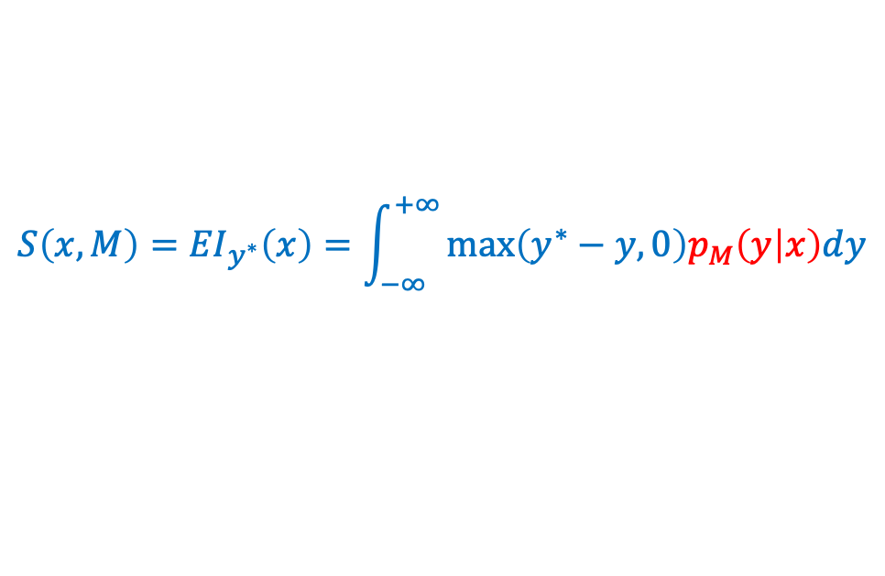
Hyperopt’s model-based algorithm
$$S\left(x, M\right)={EI}_{y^{∗}}\left(x\right)=\int_{−∞}^{+∞}{\max_{ }\left(y^{∗}−y,0\right)p_{M}\left(y | x\right)dy}$$
$$EI: \text{Expected} \text{improvement} \text{of} \text{hyperscore} \text{values} x$$

Slide 15
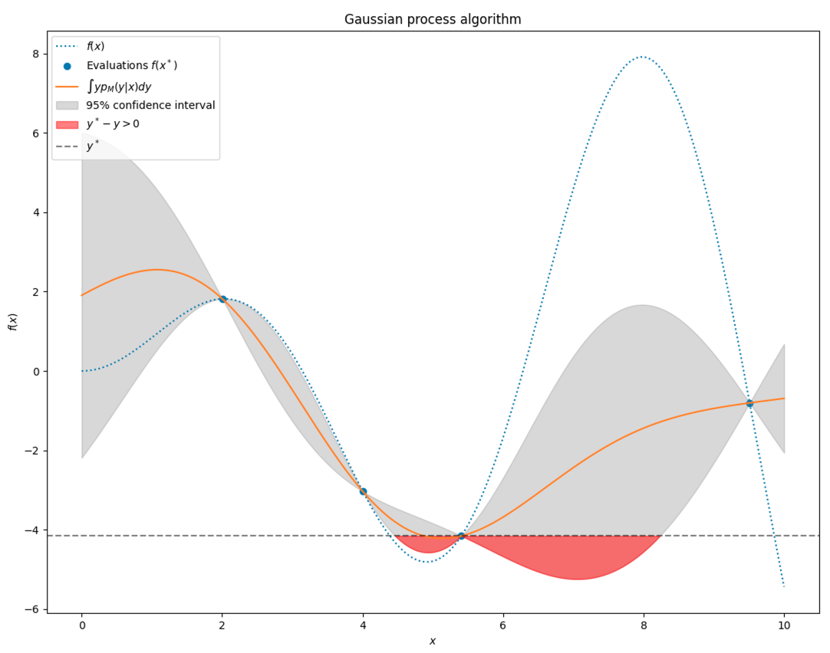
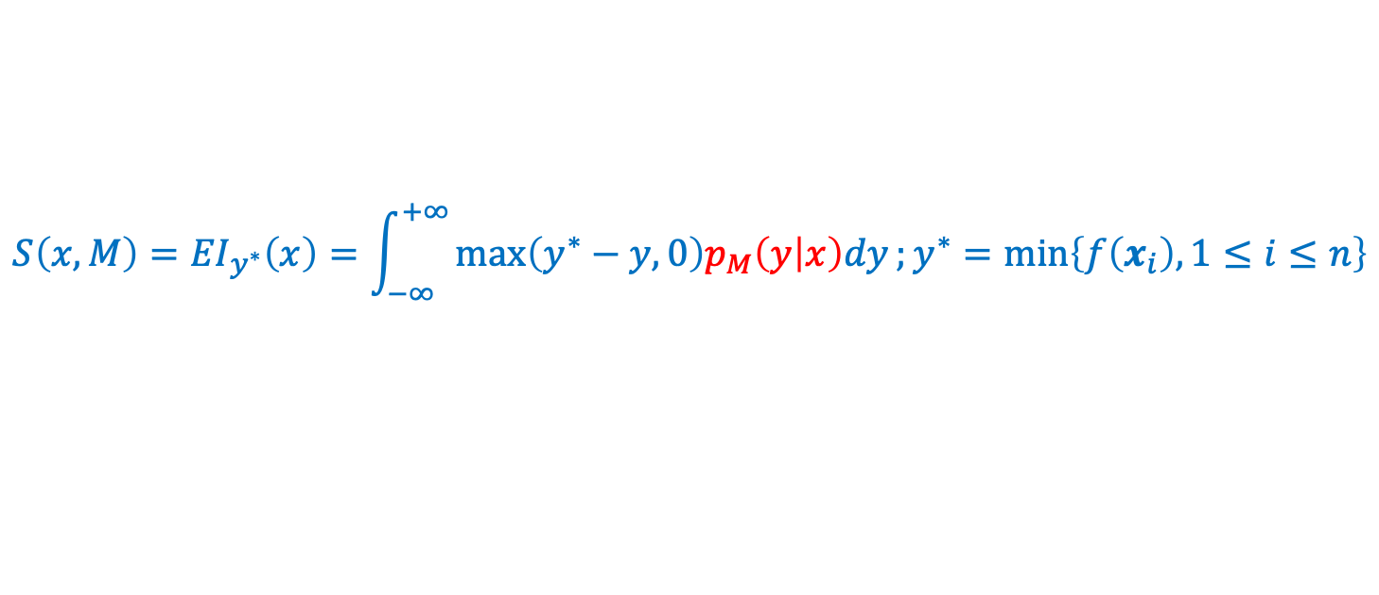
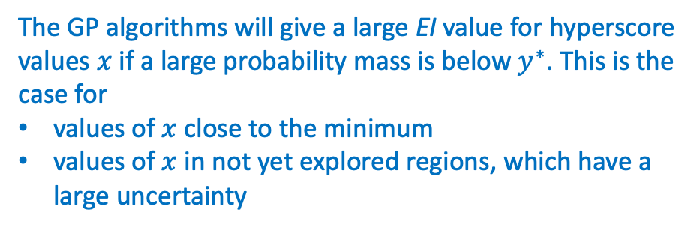


Hyperopt’s GP algorithm
$$S\left(x, M\right)={EI}_{y^{∗}}\left(x\right)=\int_{−∞}^{+∞}{\max_{ }\left(y^{∗}−y,0\right)p_{M}\left(y | x\right)dy};y^{∗}=\min_{ }\left\{f\left(x_{i}\right), 1≤i≤n\right\}$$
$p_{M}\left(y | x\right)$: estimated by gaussian process (GP)
The GP algorithms will give a large EI value for hyperscore
values $x$ if a large probability mass is below $y^{∗}$. This is the
case for
values of $x$ close to the minimum
values of $x$ in not yet explored regions, which have a large uncertainty
$$y^{∗}$$

Slide 16
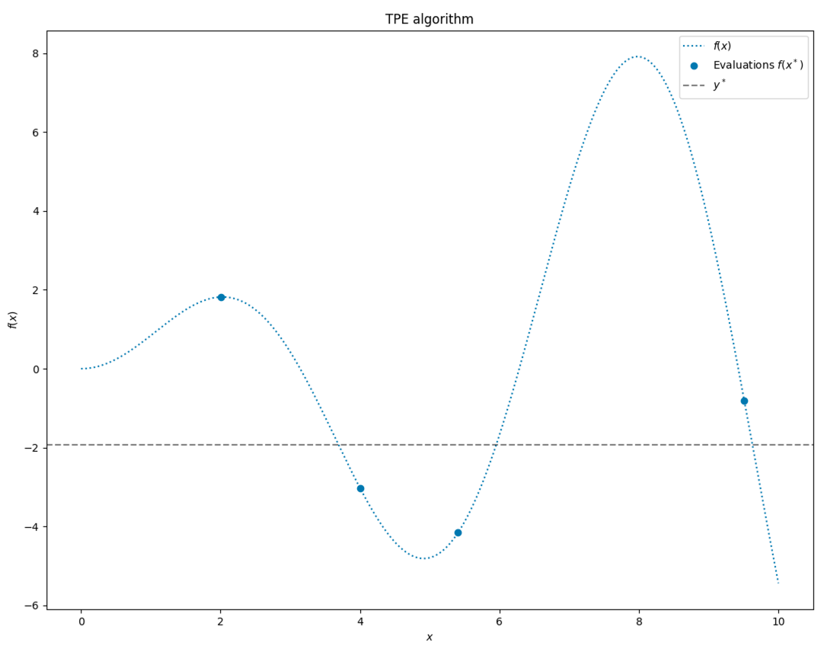
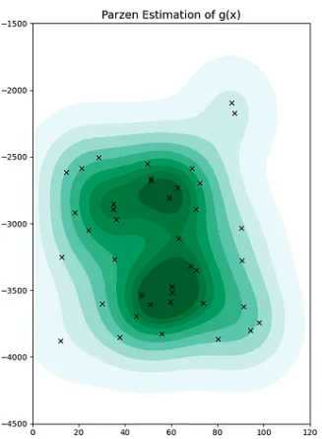
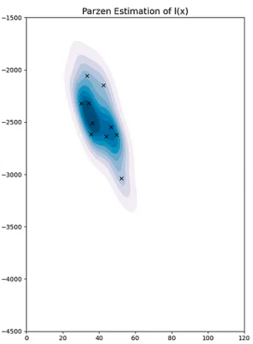

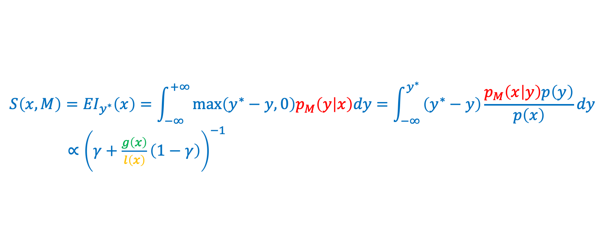

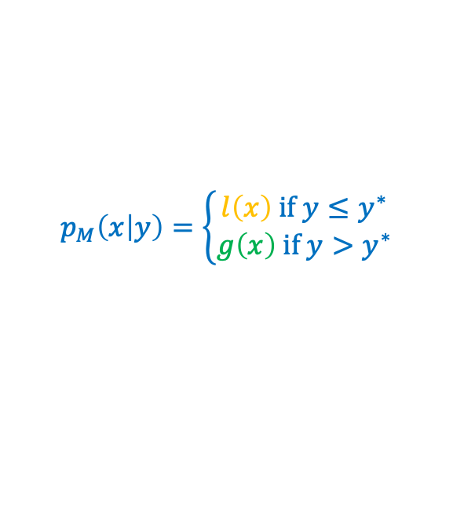
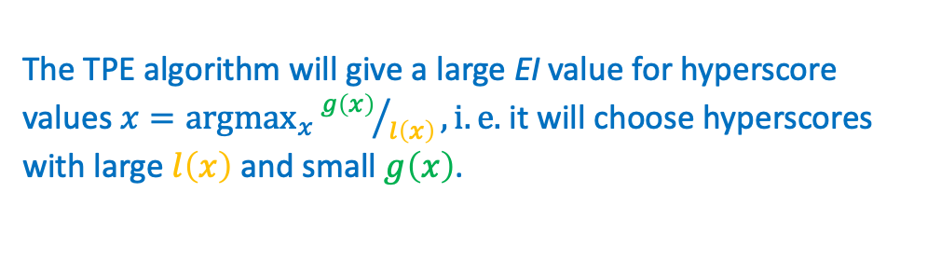


Hyperopt’s TPE algorithm
$$S\left(x, M\right)={EI}_{y^{∗}}\left(x\right)=\int_{−∞}^{+∞}{\max_{ }\left(y^{∗}−y,0\right)p_{M}\left(y | x\right)dy}=\int_{−∞}^{y^{∗}}{\underset{ }{\left(y^{∗}−y\right)}\frac{p_{M}\left(x | y\right)p\left(y\right)}{p\left(x\right)}{dy}}$$
$∝{\left(γ+\frac{g\left(x\right)}{l\left(x\right)}\left(1−γ\right)\right)}^{−1}$
$$y^{∗}=γ−\text{quantile}:p\left(y<y^{∗}\right)=γ$$
$$p_{M}\left(x | y\right)=\left\{\begin{aligned}l\left(x\right) \text{if} y≤y^{∗} \\ g\left(x\right) \text{if} y>y^{∗}\end{aligned}\right.$$
g$\left(x\right)$
The TPE algorithm will give a large EI value for hyperscore
values $x=\underset{x}{argmax}{{g\left(x\right)}/{l\left(x\right)}}, i.e.$it will choose hyperscores with large $l\left(x\right)$ and small $g\left(x\right)$.
$$y^{∗}$$
$$l\left(x\right)$$
TPE: Tree structured Parzen estimator

