Slide 1
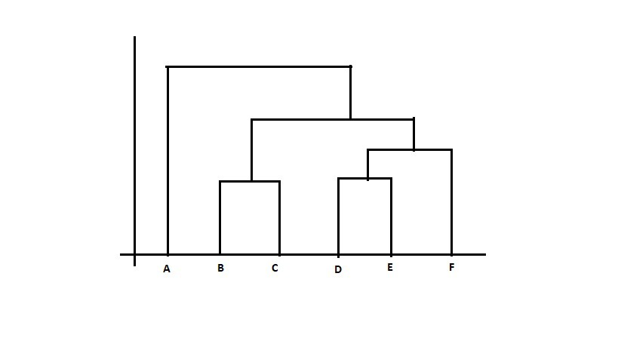
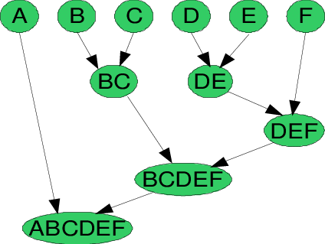
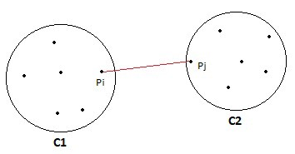
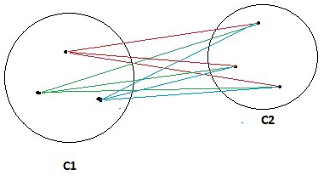
Linkage distance
Min linkage
Similarity between clusters (choice of linkage)
Min
Max
Group Average
Distance Between Centroids
Ward’s Method (similar to Group Average)
Group average linkage

