Slide 1
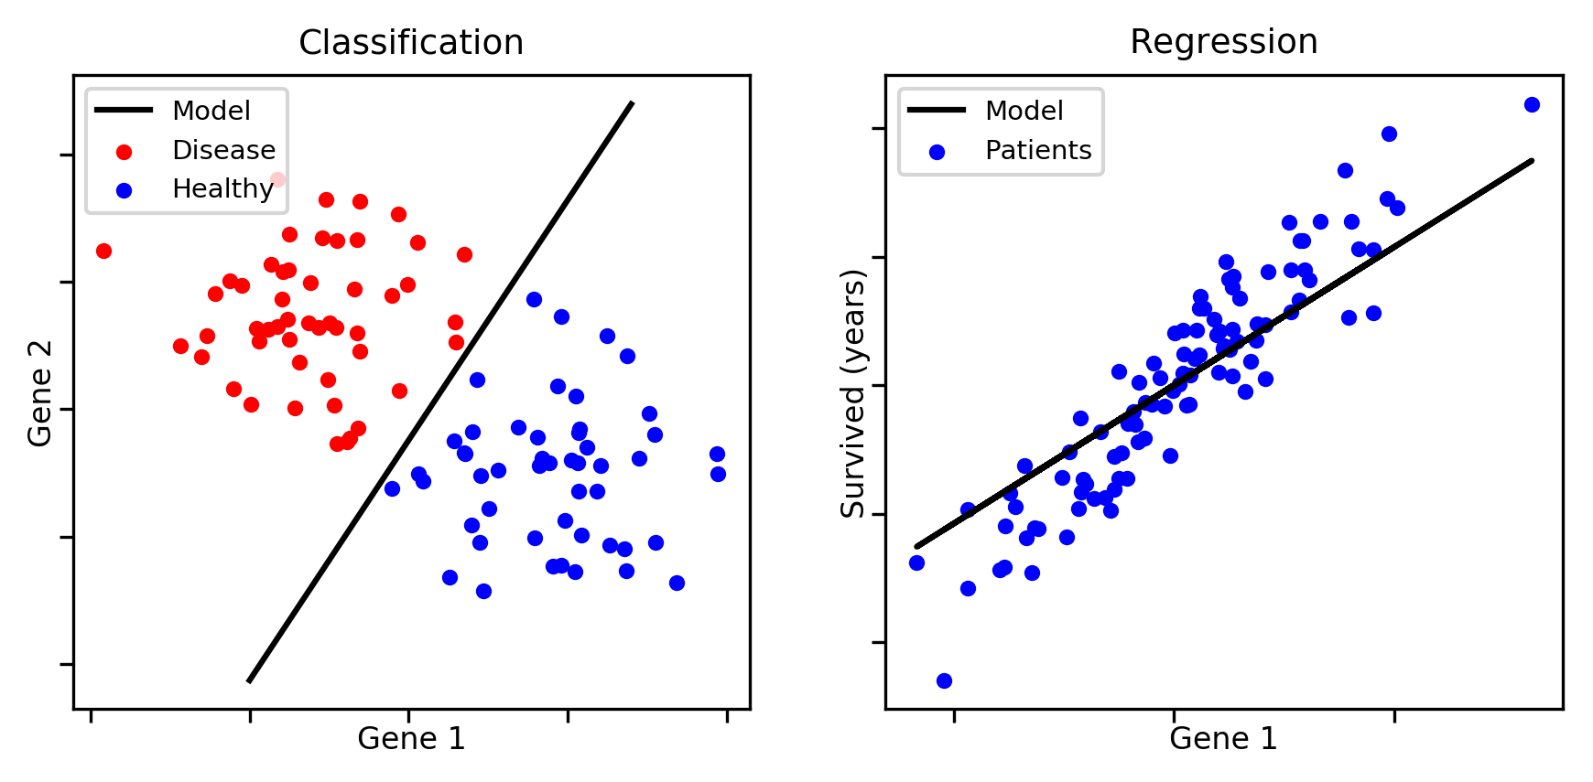
Data is labeled :
- categorical label → classification
- label is a quantity → regression

