Slide 1
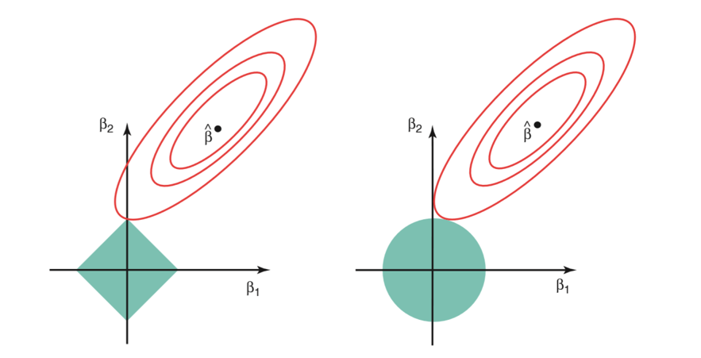
Usual loss landscape
ω2
ω2
ω
ω
L1
L2
ω1
ω1
Constrains imposed by the regularization on parameter space

