Slide 1
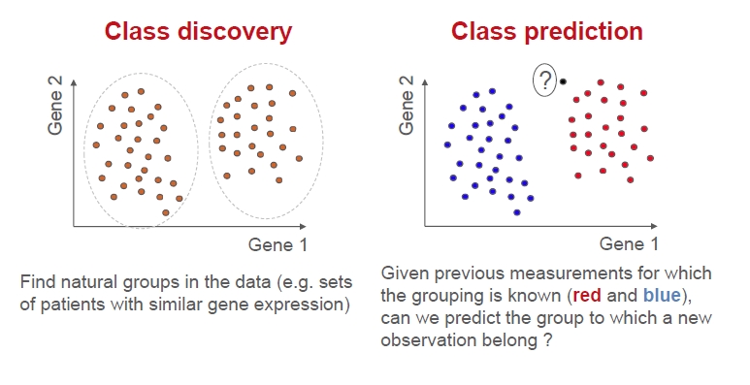
Unsupervised learning :
- no labels
- aims at discovering structure
Supervised learning :
- labels
- aims at discovering the laws that generates those labels

