Slide 1
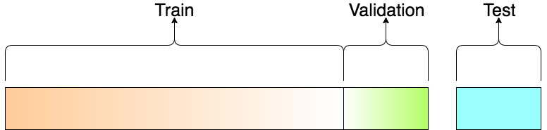
Finding the data related parameters
of a particular model
Checking the value of this model on unseen data
Fitting
Evaluating
Train set
Test set
Data

