Slide 1
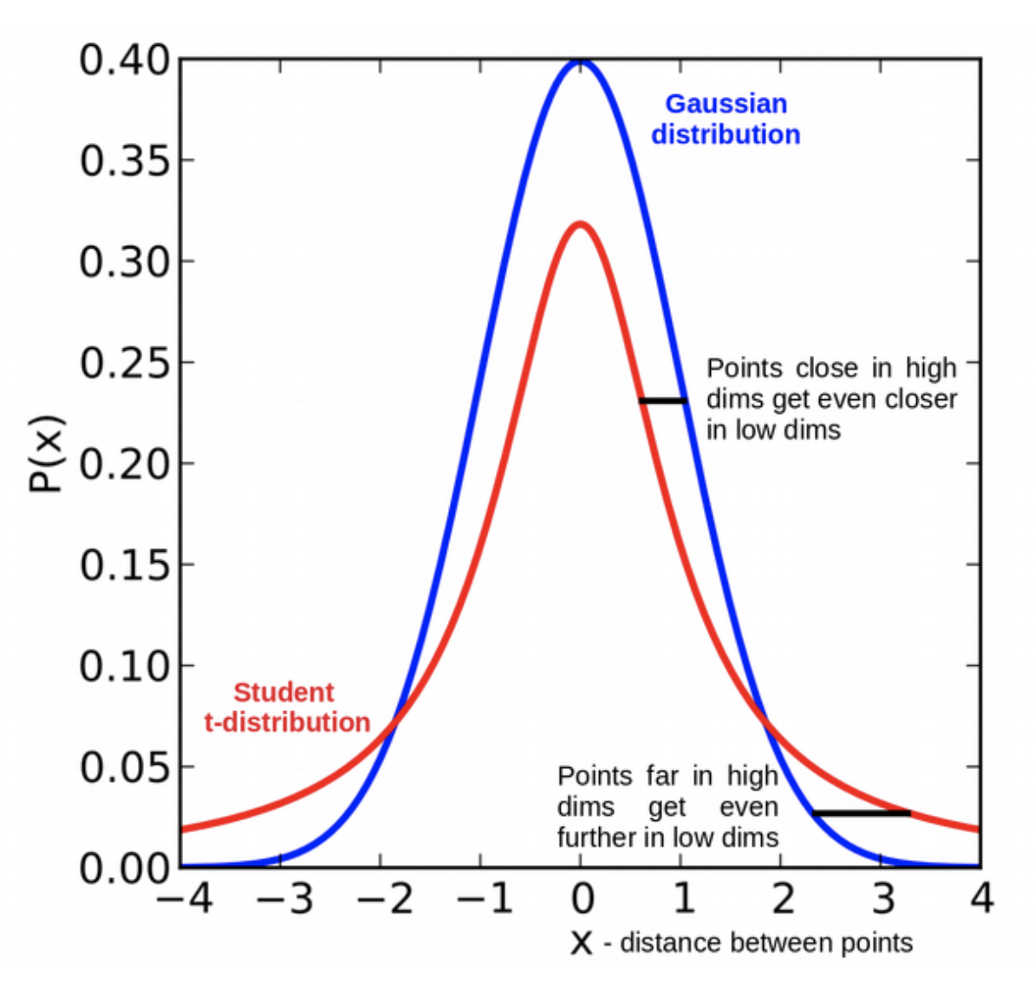
t-distributed Stochastic Neighborhood Embedding (t-SNE)
Choose to have equal
perplexity
t-SNE
optimize

