Slide 1
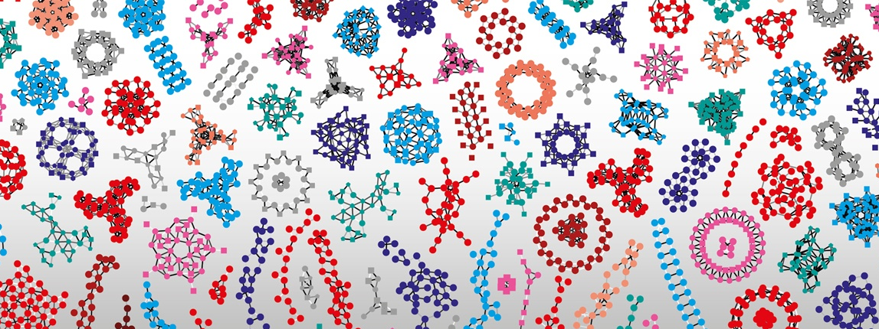

Deep learning techniques in Life sciences
Van Du Tran, Markus Müller, Wandrille Duchemin
SIB Swiss Institute of Bioinformatics
November 2024

Slide 2
Outline
Autoencoders
Convolutional neural networks
Recurrent neural networks
Attention mechanism and transformers
Deep reinforcement learning
Generative adversarial networks

Slide 3







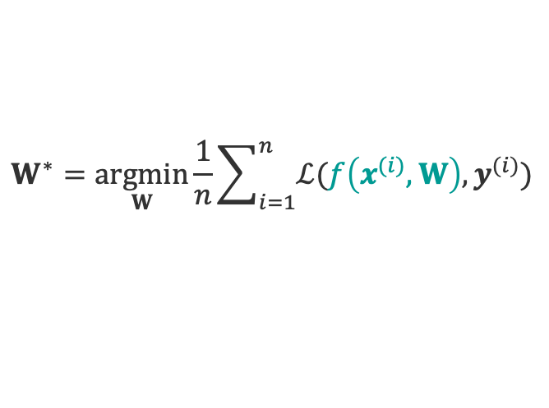





Neural Network revisited
Input
Hidden layer 1
Hidden layer 2
Output
$$x^{(i)}$$
$${\hat{y}}^{(i)}$$
$$x1$$
$$\hat{y}1$$
$$x2$$
$$\hat{y}2$$
$$\hat{y}q$$
$$xp$$
$$W$$
$$W^{(0)}$$
$$W^{(1)}$$
$$W^{(2)}$$
Activation functions on linear regressions
Loss optimization
$$W^{∗}=\underset{W}{argmin}{\frac{1}{n}\sum_{i=1}^{n}{ℒ(f\left(x^{(i)},W\right), y^{(i)})}}$$

Slide 4
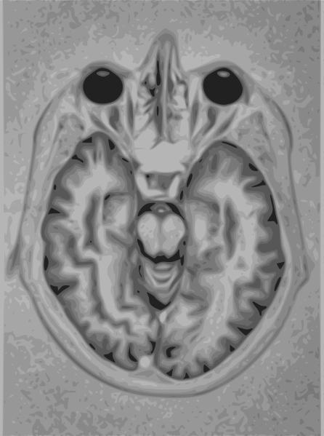
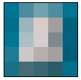
Dimensionality issue
5x5 pixels
1524 x 2048 pixels
Sparsity
Closeness
Full connectivity => curse of dimensionality!
https://commons.wikimedia.org/w/index.php?curid=1078380
https://commons.wikimedia.org/wiki/File:Brain_Mri_nevit.svg

Slide 5
Outline
Autoencoders
Convolutional neural networks
Recurrent neural networks
Attention mechanism and transformers
Deep reinforcement learning
Generative adversarial networks

Slide 6
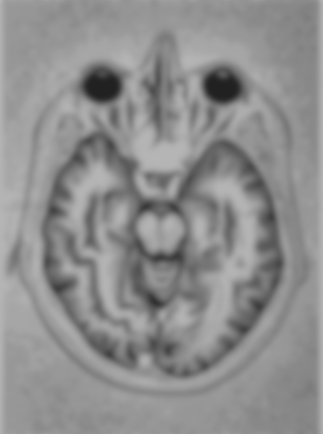




Autoencoder
Learning a lower-dimensional feature representation (compression) from unlabeled training data and a reconstruction back
Encode
Decode
Bottleneck layer
Reconstructed input
Input
Output
$$z$$
Latent space
deterministic
$$x$$
$$\hat{x}$$
$$ℒ\left(x,\hat{x}\right)={\left\|x−\hat{x}\right\|}^{2}$$
tensorflow.keras.Model(name=’autoencoder’)

Slide 7
Autoencoder
Generalization of PCA: non-linear
Challenges: models that learn a meaningful and generalizable latent space representation

Slide 8
Variational autoencoder
Probabilistic twist on autoencoder: map the input into a distribution instead of a fixed vector => two vectors of means and standard deviations
Encode
standard
deviation
Decode
mean
Reconstructed input
Input
Output
$$z$$
Latent space
stochastic
$$x$$
$$\hat{x}$$
$$ℒ\left(x,\hat{x}\right)={\left\|x−\hat{x}\right\|}^{2}$$
tensorflow.keras.Model(name=’vae’)

Slide 9
Autoencoders: When?
Image compression, denoising and generation, recommendation system, anomaly detection, feature extraction
Life sciences
dimensionality reduction (clustering) in sequencing data
multi-omics and biomedical data integration

Slide 10
Outline
Autoencoders
Convolutional neural networks
Recurrent neural networks
Attention mechanism and transformers
Deep reinforcement learning
Generative adversarial networks

Slide 11
Neural Network revisited
Input
Hidden layer 1
Hidden layer 2
Output
$$x^{(i)}$$
$${\hat{y}}^{(i)}$$
$$x1$$
$$\hat{y}1$$
$$x2$$
$$\hat{y}2$$
$$\hat{y}q$$
$$xp$$
$$W$$
$$W^{(0)}$$
$$W^{(1)}$$
$$W^{(2)}$$
Activation functions on linear regressions
Loss optimization
$$W^{∗}=\underset{W}{argmin}{\frac{1}{n}\sum_{i=1}^{n}{ℒ(f\left(x^{(i)},W\right), y^{(i)})}}$$

Slide 12
Convolutional Neural Network (CNN, ConvNet)
Inspired by the organization of the visual cortex
Image processing: take in image input => assign importance to features/objects => differentiate
Each neuron receives connections only from a subset of neurons in the previous layer
Spatial and temporal dependency

Slide 13
CNN: How? Convolutional layer

Slide 14
CNN: How? Convolutional layer
Input image
Filter
Feature map
1 | 0 | 0 | 0 | 1
0 | 1 | 0 | 1 | 0
0 | 0 | 1 | 0 | 0
0 | 1 | 0 | 1 | 0
1 | 0 | 0 | 0 | 1
1 | 0 | 1
0 | 1 | 0
1 | 0 | 1
Convolution operation: sum of element-wise products

Slide 15
CNN: How? Convolutional layer
Input image
Filter
Feature map
1 | 0 | 0 | 0 | 1
0 | 1 | 0 | 1 | 0
0 | 0 | 1 | 0 | 0
0 | 1 | 0 | 1 | 0
1 | 0 | 0 | 0 | 1
1 | 0 | 1
0 | 1 | 0
1 | 0 | 1
3
Convolution operation: sum of element-wise products

Slide 16
CNN: How? Convolutional layer
Input image
Filter
Feature map
1 | 0 | 0 | 0 | 1
0 | 1 | 0 | 1 | 0
0 | 0 | 1 | 0 | 0
0 | 1 | 0 | 1 | 0
1 | 0 | 0 | 0 | 1
3
1 | 0 | 1
0 | 1 | 0
1 | 0 | 1
3 | 0
Convolution operation: sum of element-wise products

Slide 17
CNN: How? Convolutional layer
Input image
Filter
Feature map
1 | 0 | 0 | 0 | 1
0 | 1 | 0 | 1 | 0
0 | 0 | 1 | 0 | 0
0 | 1 | 0 | 1 | 0
1 | 0 | 0 | 0 | 1
3 | 0 | 3
1 | 0 | 1
0 | 1 | 0
1 | 0 | 1
3 | 0
Convolution operation: sum of element-wise products

Slide 18
CNN: How? Convolutional layer
Input image
Filter
Feature map
1 | 0 | 0 | 0 | 1
0 | 1 | 0 | 1 | 0
0 | 0 | 1 | 0 | 0
0 | 1 | 0 | 1 | 0
1 | 0 | 0 | 0 | 1
3 | 0 | 3
0
1 | 0 | 1
0 | 1 | 0
1 | 0 | 1
3 | 0 | 3
Convolution operation: sum of element-wise products

Slide 19
CNN: How? Convolutional layer
Input image
Filter
Feature map
1 | 0 | 0 | 0 | 1
0 | 1 | 0 | 1 | 0
0 | 0 | 1 | 0 | 0
0 | 1 | 0 | 1 | 0
1 | 0 | 0 | 0 | 1
3 | 0 | 3
0
1 | 0 | 1
0 | 1 | 0
1 | 0 | 1
3 | 0 | 3
0 | 5
Convolution operation: sum of element-wise products

Slide 20
CNN: How? Convolutional layer
Input image
Filter
Feature map
1 | 0 | 0 | 0 | 1
0 | 1 | 0 | 1 | 0
0 | 0 | 1 | 0 | 0
0 | 1 | 0 | 1 | 0
1 | 0 | 0 | 0 | 1
3 | 0 | 3
0 | 5 | 0
1 | 0 | 1
0 | 1 | 0
1 | 0 | 1
3 | 0 | 3
0 | 5
Convolution operation: sum of element-wise products

Slide 21
CNN: How? Convolutional layer
Input image
Filter
Feature map
1 | 0 | 0 | 0 | 1
0 | 1 | 0 | 1 | 0
0 | 0 | 1 | 0 | 0
0 | 1 | 0 | 1 | 0
1 | 0 | 0 | 0 | 1
3 | 0 | 3
0 | 5 | 0
3
1 | 0 | 1
0 | 1 | 0
1 | 0 | 1
3 | 0 | 3
0 | 5 | 0
Convolution operation: sum of element-wise products

Slide 22
CNN: How? Convolutional layer
Input image
Filter
Feature map
1 | 0 | 0 | 0 | 1
0 | 1 | 0 | 1 | 0
0 | 0 | 1 | 0 | 0
0 | 1 | 0 | 1 | 0
1 | 0 | 0 | 0 | 1
3 | 0 | 3
0 | 5 | 0
3 | 0
1 | 0 | 1
0 | 1 | 0
1 | 0 | 1
3 | 0 | 3
0 | 5 | 0
3
Convolution operation: sum of element-wise products

Slide 23
CNN: How? Convolutional layer
Input image
Filter
Feature map
1 | 0 | 0 | 0 | 1
0 | 1 | 0 | 1 | 0
0 | 0 | 1 | 0 | 0
0 | 1 | 0 | 1 | 0
1 | 0 | 0 | 0 | 1
3 | 0 | 3
0 | 5 | 0
3 | 0
1 | 0 | 1
0 | 1 | 0
1 | 0 | 1
3 | 0 | 3
0 | 5 | 0
3 | 0 | 3
Convolution operation: sum of element-wise products

Slide 24
CNN: How? Convolutional layer
Input image
Filter
Feature map
1 | 0 | 0 | 0 | 1
0 | 1 | 0 | 1 | 0
0 | 0 | 1 | 0 | 0
0 | 1 | 0 | 1 | 0
1 | 0 | 0 | 0 | 1
3 | 0 | 3
0 | 5 | 0
3 | 0
1 | 0 | 1
0 | 1 | 0
1 | 0 | 1
3 | 0 | 3
0 | 5 | 0
3 | 0 | 3
1 | 0 | 0
0 | 1 | 0
0 | 0 | 1
0 | 0 | 1
0 | 1 | 0
1 | 0 | 0
Convolutional layers:
Extract low to high-level features
Reduce spatial size
Limitation: sensitive to position of features
tensorflow.keras.layers.Conv2D

Slide 25
CNN: How? Pooling layer
Down sampling: lower resolution + important features
After Convolutional layer + Nonlinearity (ReLU) for each feature map
Usually 2x2 pixels with stride of 2 pixels => reduce to ¼ feature map
Max or average pooling
Invariance to local translation
4 | 2
5 | 4
1 | 3 | 1 | 0
0 | 4 | 2 | 1
5 | 3 | 0 | 2
0 | 0 | 4 | 2
max
2 | 1
2 | 2
average
tensorflow.keras.layers.MaxPool2D

Slide 26
CNN: How? Fully connected layer
Input
Pooling
Convolution
Fully connected
Convolution
Flatten
.
.
.
.
.
.
Pooling
Output

Slide 27
CNN: When?
Image recognition, video analysis, natural language processing
Life sciences:
sequence analysis (DNA, RNA sequence data),
structure prediction (imaging data),
biomedical image processing and diagnosis (imaging data),
biomolecular function prediction (microarray, sequencing data, structure properties), protein variant impact prediction
biomolecule interaction prediction and system biology (microarray, interaction data)

Slide 28
Outline
Autoencoders
Convolutional neural networks
Recurrent neural networks
Attention mechanism and transformers
Deep reinforcement learning
Generative adversarial networks

Slide 29
Neural Network revisited
Input
Hidden layer 1
Hidden layer 2
Output
$$x^{(i)}$$
$${\hat{y}}^{(i)}$$
$$x1$$
$$\hat{y}1$$
$$x2$$
$$\hat{y}2$$
$$\hat{y}q$$
$$xp$$
$$W$$
$$W^{(0)}$$
$$W^{(1)}$$
$$W^{(2)}$$
Activation functions on linear regressions
Loss optimization
$$W^{∗}=\underset{W}{argmin}{\frac{1}{n}\sum_{i=1}^{n}{ℒ(f\left(x^{(i)},W\right), y^{(i)})}}$$

Slide 30
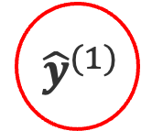

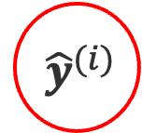
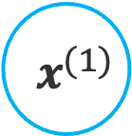

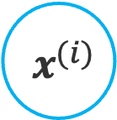
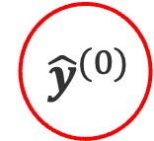

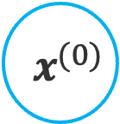


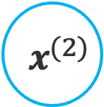
Neural Network with recurrence
$$x^{(i)}$$
$$x^{(0)}$$
$$x^{(1)}$$
$$x^{(2)}$$
Input
$$h^{(0)}$$
$$h^{(1)}$$
:
$${ \hat{y}}^{(i)}$$
$${ \hat{y}}^{(0)}$$
$${ \hat{y}}^{(1)}$$
$${ \hat{y}}^{(2)}$$
Output
$${ \hat{y}}^{\left(i\right)}=f(x^{(i)})$$
$${ \hat{y}}^{\left(i\right)}=f(x^{\left(i\right)},h_{i−1})$$
past memory

Slide 31
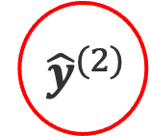


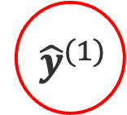


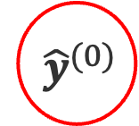

Recurrent Neural Network (RNN)
Sequential or time series data: data points depend upon previous data points
Memory: store historical information to forecast future values
$$x^{(0)}$$
$$x^{(1)}$$
$$x^{(2)}$$
$$h^{(0)}$$
$$h^{(1)}$$
$${ \hat{y}}^{(0)}$$
$${ \hat{y}}^{(1)}$$
$${ \hat{y}}^{(2)}$$

Slide 32
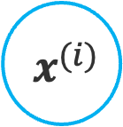

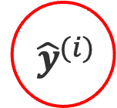
Recurrent Neural Network (RNN)
Sequential or time series data: data points depend upon previous data points
Memory: store historical information to forecast future values
$$x^{(i)}$$
Input
RNN
$$h^{(i)}$$
$${ \hat{y}}^{(i)}$$
Output

Slide 33

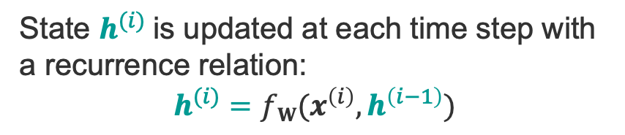


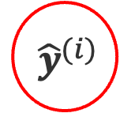
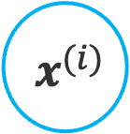
RNN: How?
$$x^{(i)}$$
Input
State $h^{(i)}$is updated at each time step with
a recurrence relation:
$$h^{(i)}=fW(x^{\left(i\right)},h^{\left(i−1\right)})$$
RNN
$$h^{(i)}$$
Same function (sigmoid, tanh, ReLU) and parameters
at every time step!
$${ \hat{y}}^{(i)}$$
Output
$$h^{(i)}=f({W_{x}^{T}x}^{\left(i\right)}+W_{h}^{T}h^{\left(i−1\right)}+b_{h})$$
$${ \hat{y}}^{(i)}={f(W}_{y}^{T}h^{\left(i\right)}+by)$$
tensorflow.keras.layers.SimpleRNN
Notes:
Siri, voice search, google translate

Slide 34
Types of RNNs
One to One
One to Many
Many to One
Many to Many

Slide 35
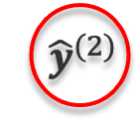


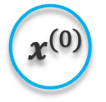

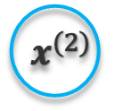




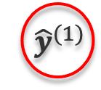

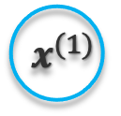

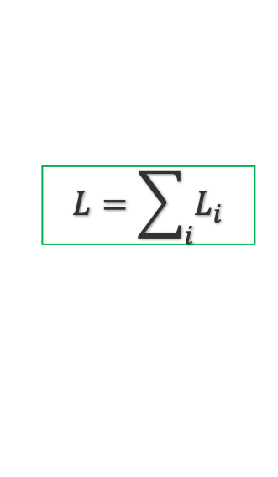


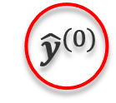



Back propagation through time
Calculate gradient of the loss function w.r.t. each parameter backward through the network
Adapt parameter to minimize loss
$$x^{(0)}$$
$$x^{(1)}$$
$$x^{(2)}$$
$$W_{x}$$
$$W_{x}$$
$$W_{x}$$
$$h^{(0)}$$
$$W_{h}$$
$$h^{(1)}$$
$$W_{h}$$
$$h^{(2)}$$
$$W_{y}$$
$$W_{y}$$
$$W_{y}$$
$${ \hat{y}}^{(0)}$$
$${ \hat{y}}^{(1)}$$
$${ \hat{y}}^{(2)}$$
$$L_{0}$$
$$L_{1}$$
$$L_{2}$$
$$L=\sum_{i}{L_{i}}$$

Slide 36
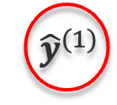




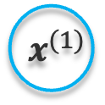


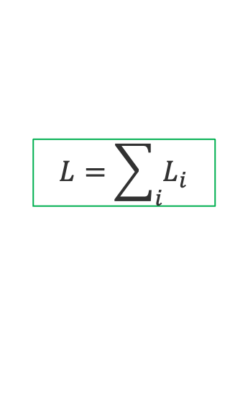


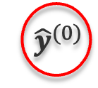


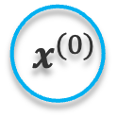


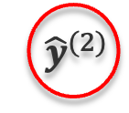

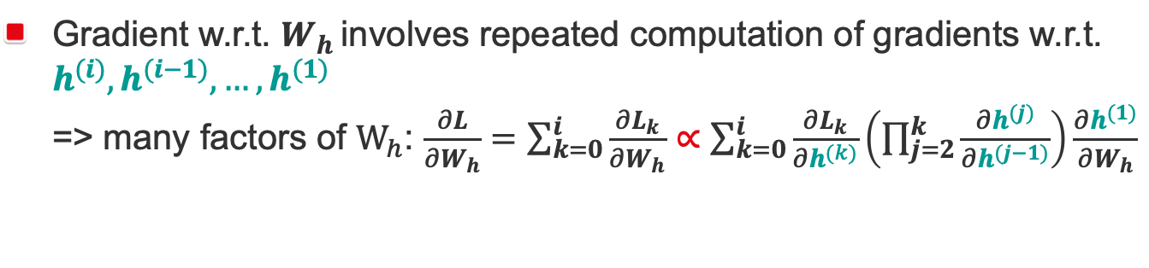
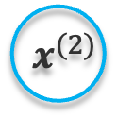


Gradient issues
Gradient w.r.t. $W_{h}$ involves repeated computation of gradients w.r.t. $h^{(i)},h^{(i−1)}, …,h^{(1)}$
=> many factors of $W_{h}$: $\frac{∂L}{∂W_{h}}=\sum_{k=0}^{i}{\frac{∂L_{k}}{∂W_{h}}}∝\sum_{k=0}^{i}{\frac{∂L_{k}}{∂h^{(k)}}\left(\prod_{j=2}^{k}{\frac{∂h^{(j)}}{∂h^{(j−1)}}}\right)\frac{∂h^{(1)}}{∂W_{h}}}$
$$x^{(0)}$$
$$x^{(1)}$$
$$x^{(2)}$$
1.1¹⁰⁰ ~ 1e+5
Exploding gradient:
when many values > 1
Quickly reach infinity
Gradient clipping to scale large gradients
$$W_{x}$$
$$W_{x}$$
$$W_{x}$$
$$h^{(0)}$$
$$W_{h}$$
$$h^{(1)}$$
$$W_{h}$$
$$h^{(2)}$$
$$W_{y}$$
$$W_{y}$$
$$W_{y}$$
0.9¹⁰⁰ ~ 2e-5
$${ \hat{y}}^{(0)}$$
$${ \hat{y}}^{(1)}$$
$${ \hat{y}}^{(2)}$$
Vanishing gradient:
when many values < 1
Difficult to learn long period dependencies
Activation function, weight initialization, network structure
$$L_{0}$$
$$L_{1}$$
$$L_{2}$$
$$L=\sum_{i}{L_{i}}$$

Slide 37
Adapted network structure
“I grew up in France… I speak fluently (?)”
Long Short-Term Memory Network: track information throughout many timesteps => memorize long-term dependencies
Memory cell: store information
Forget gate: what information to ignore
Input gate: which values from input to update memory state
Output gate: what to output based on input and memory state
Gate ~ neuron: activation of a weighted sum
tensorflow.keras.layers.LSTM

Slide 38
RNN: When?
Language translation, speech recognition, natural language processing
Life sciences:
sequence analysis, genomic sequence evolution,
biomolecular function prediction
human-virus protein-protein interaction prediction,
biomedical ontologies,
forecast the spread of virus,
pharmaceutical development

Slide 39
Outline
Autoencoders
Convolutional neural networks
Recurrent neural networks
Attention mechanism and transformers
Deep reinforcement learning
Generative adversarial networks

Slide 40
Attention
Machine translation
Fixed-length
vector
Input Sentence
Encoder
Decoder
Output Sentence
RNN/LSTM
RNN/LSTM
I do deep learning
I often find myself daydreaming about what I could do with deep pockets full of knowledge, learning from the depths of experience.
Generated by ChatGPT

Slide 41
Attention
Mimic cognitive attention
Improve RNN drawbacks: favor recent elements, fail to handle long sequences
Model dependency without regard to the distance between elements in the sequences

Slide 42


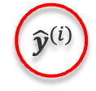

Attention
Machine translation
Input Sentence
Encoder
Decoder
Output Sentence
RNN/LSTM
RNN/LSTM
$$x^{(i)}$$
Encoder hidden states
Input
RNN
RNN
$$h^{(i)}$$
$$h^{(i)}$$
$${ \hat{y}}^{(i)}$$
Output
Global attention: all hidden states
Local attention: a few hidden states
Hierarchical-nested attention: both word and sentence levels

Slide 43
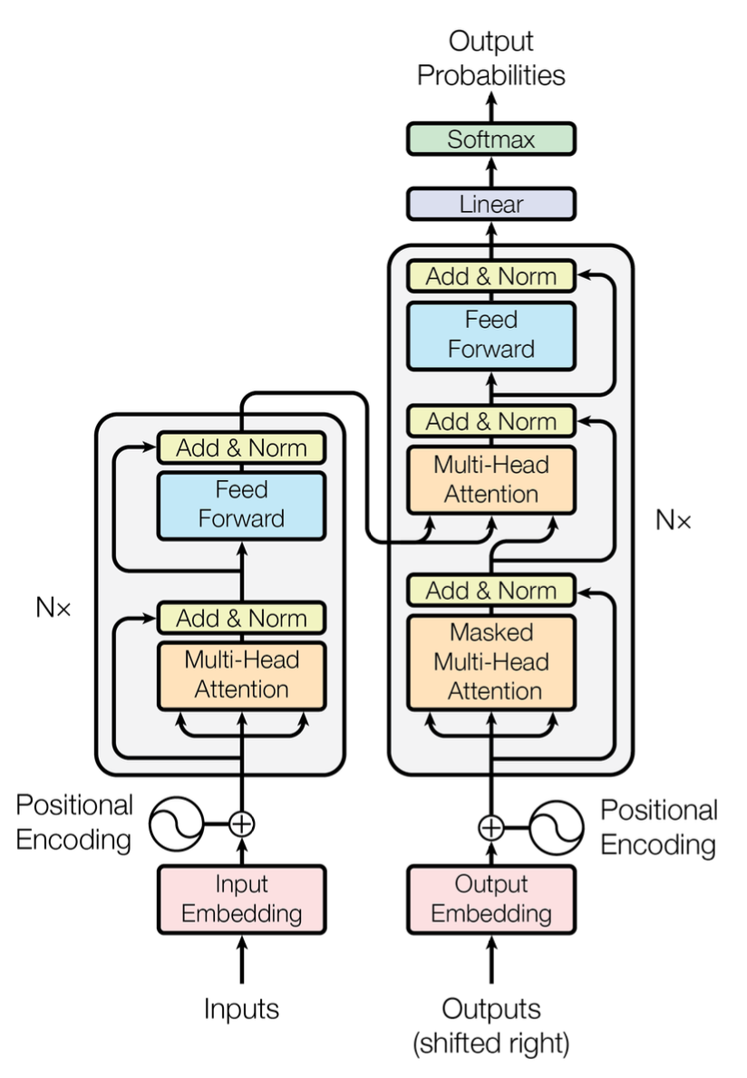
Transformer
Encoder-Decoder using only Attention mechanism for global dependencies between input and output
Self-attention
Parallelized processing
No recurrence or convolution
Large Language Model
Pre-trained autoencoding models: BERT (Bidirectional Encoder Representations from Transformers)
Autoregressive models: GPT (Generative Pretrained Transformer)
Vaswani et al. Attention Is All You Need. NIPS 2017

Slide 44
Application in life sciences
Sequence analysis, genome analysis
Multi-omics, spatial transcriptomics
Biomedical informatics
Drug discovery
Protein structure prediction
Foundation model for human single-cell transcriptomics, human genomics

Slide 45
Outline
Autoencoders
Convolutional neural networks
Recurrent neural networks
Attention mechanism and transformers
Generative adversarial networks
Deep reinforcement learning

Slide 46
Generative Adversarial Network (GAN)
Deep-learning-based generative model
Data augmentation
Generator: generate new plausible examples from the problem domain.
Discriminator: classify examples as real (from the domain) or fake (generated).

Slide 47
GAN: How?
Random Input
Generator Model
Generated Sample
Real Sample
Discriminator Model
Update
Update
Binary Classification Real/Fake

Slide 48
GAN: When?
Digital image processing
Life sciences:
Medical imaging processing
Medical informatics: generating discrete data based on real medical data, addressing imbalanced samples problem
Generating scRNA-seq data, genomic sequences, compound and protein designs

Slide 49
Outline
Autoencoders
Convolutional neural networks
Recurrent neural networks
Attention mechanism and transformers
Generative adversarial networks
Deep reinforcement learning

Slide 50
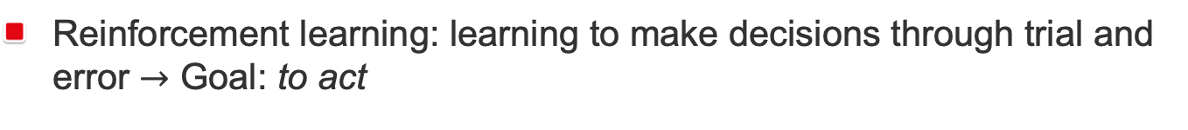


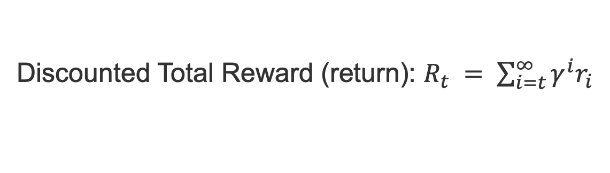
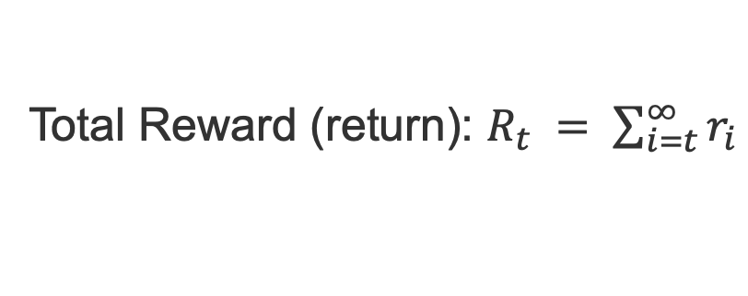
Reinforcement Learning
Reinforcement learning: learning to make decisions through trial and error $→$ Goal: to act
Action: a_{t}
Environment
Policy: $π$
Agent
$$Q\left(st,at\right)=𝔼(R_{t}|st,at)$$
State changes: s_{t+1}
Reward: r_{t}
Situation in which the agent find itself
Measure of the success or failure of the action
Total Reward (return): $R_{t} = \sum_{i=t}^{∞}{r_{i}}$
Discounted Total Reward (return): $R_{t} = \sum_{i=t}^{∞}{{γ^{i}r}_{i}}$

Slide 51






Deep Reinforcement Learning
Large state and action spaces
Map states and actions to Q values
State
s
Neural Network
Neural Network
$$Q\left(s,a1\right)$$
$$Q\left(s,a2\right)$$
$$Q\left(s,a\right)$$
State
s
Action a
decision tree,
SVM
decision tree,
SVM
$$Q\left(s,an\right)$$
Agent
Agent
Action + State $→$ Expected Return
State $→$ Expected Return for each action
Use neural networks to learn Q, then infer the optimal policy $π(s)$

Slide 52
Deep Reinforcement Learning: When?
Recommendation systems, robotics, energy smart grids
Life sciences
biological sequence annotation,
biological data mining,
prediction of bacterial genomes,
protein-protein interaction,
segmentation in medical imaging,
brain machine interface

Slide 53
Thank you!

