Slide 2
Questions :
Check the description at the SRA sample page. What kind of sample is this?
How does the quality of the reads look? Anything special about the overrepresented sequences? (Hint: blast some overrepresented sequences, and see what they are)
Did trimming improve the QC results? What could be the cause of the warnings/errors in the fastqc reports?
What are the alignment rates?
How are spliced alignments stored in the SAM file?
Are there any differences between the treatments in the percentage of assigned alignments by featureCounts? What is the cause of this?
Can you find any genes that seem to be differentially expressed?
What is the effect of setting the option -Q in featureCounts?

Slide 3
Type of samples
Blood and lung samples from mouses
6 infectious and inflammatory diseases
Here we have 3 cases infected against 3 control (non infected)

Slide 4
General statistics
Sample Name | % Duplication | Reads After Filtering | GC content | % PF | % Adapter | Dups | GC | Seqs
Case1_R1 | 17.4% | 1.0M | 49.2% | 99.6% | 1.0%
Case2_R1 | 14.3% | 1.2M | 49.1% | 99.6% | 0.7%
Case3_R1 | 13.2% | 1.1M | 49.3% | 100.0% | 0.3%
Control1_R1 | 19.0% | 0.9M | 51.1% | 99.8% | 0.3%
Control2_R1 | 22.8% | 0.9M | 53.8% | 100.0% | 0.1%
Control3_R1 | 18.4% | 1.0M | 50.8% | 99.8% | 0.4%
trimmed_Case1_R1 |  |  |  |  |  | 64.5% | 49.0% | 0.5M
trimmed_Case1_R2 |  |  |  |  |  | 57.7% | 49.0% | 0.5M
trimmed_Case2_R1 |  |  |  |  |  | 62.7% | 49.0% | 0.6M
trimmed_Case2_R2 |  |  |  |  |  | 56.0% | 49.0% | 0.6M
trimmed_Case3_R1 |  |  |  |  |  | 61.3% | 49.0% | 0.5M
trimmed_Case3_R2 |  |  |  |  |  | 54.6% | 49.0% | 0.5M
trimmed_Control1_R1 |  |  |  |  |  | 57.2% | 50.0% | 0.4M
trimmed_Control1_R2 |  |  |  |  |  | 51.3% | 51.0% | 0.4M
trimmed_Control2_R1 |  |  |  |  |  | 60.8% | 53.0% | 0.5M
trimmed_Control2_R2 |  |  |  |  |  | 53.8% | 54.0% | 0.5M
trimmed_Control3_R1 |  |  |  |  |  | 57.5% | 50.0% | 0.5M
trimmed_Control3_R2 |  |  |  |  |  | 52.2% | 50.0% | 0.5M

Slide 5
Overrepresented sequences
Overrepresented sequence | Reports | Occurrences | % of all reads
CCCGAATCTCAGTGAGGTCCTCCTTGGTGAACACGAAGCCCACGTTCCCC | 4 | 2522 | 0.0415%
CCTCGTTGGAGTGACATCGTCTTTAAACCCCGCGTGGCAATCCCTGACGC | 3 | 1571 | 0.0259%
CTCCGACTCTTCCTTTGCTTCAGCTTTGGCAGGGGCTGCAGCAGCCGCAG | 1 | 516 | 0.0085%
CCCGGATGTGAGGCAGCAGTTTCTCCAGAGCTGGGTTGTTCTCCAGGTGG | 1 | 507 | 0.0084%
CTCAACCCCAGACCACAGGACCGGTTCTGCCCAACCCTTTTGAACTACTT | 1 | 920 | 0.0152%

Slide 6
QC results before/after trimming
Notes:
Did trimming improve the QC results? What could be the cause of the warnings/errors in the fastqc reports?

Slide 7
Alignments rates
Reads | Alignement rates | Properly paired
case 1 | 87.14% | 66.58%
case 2 | 87.60% | 67.01%
case 3 | 87.78% | 67.53%
control 1 | 88.02% | 67.37%
control 2 | 87.18% | 64.40%
control 3 | 87.86% | 67.18%
Notes:
What are the alignment rates?
How are spliced alignments stored in the SAM file?

Slide 8
Assigned alignments by featureCounts

Slide 9
Differential expression

Slide 10
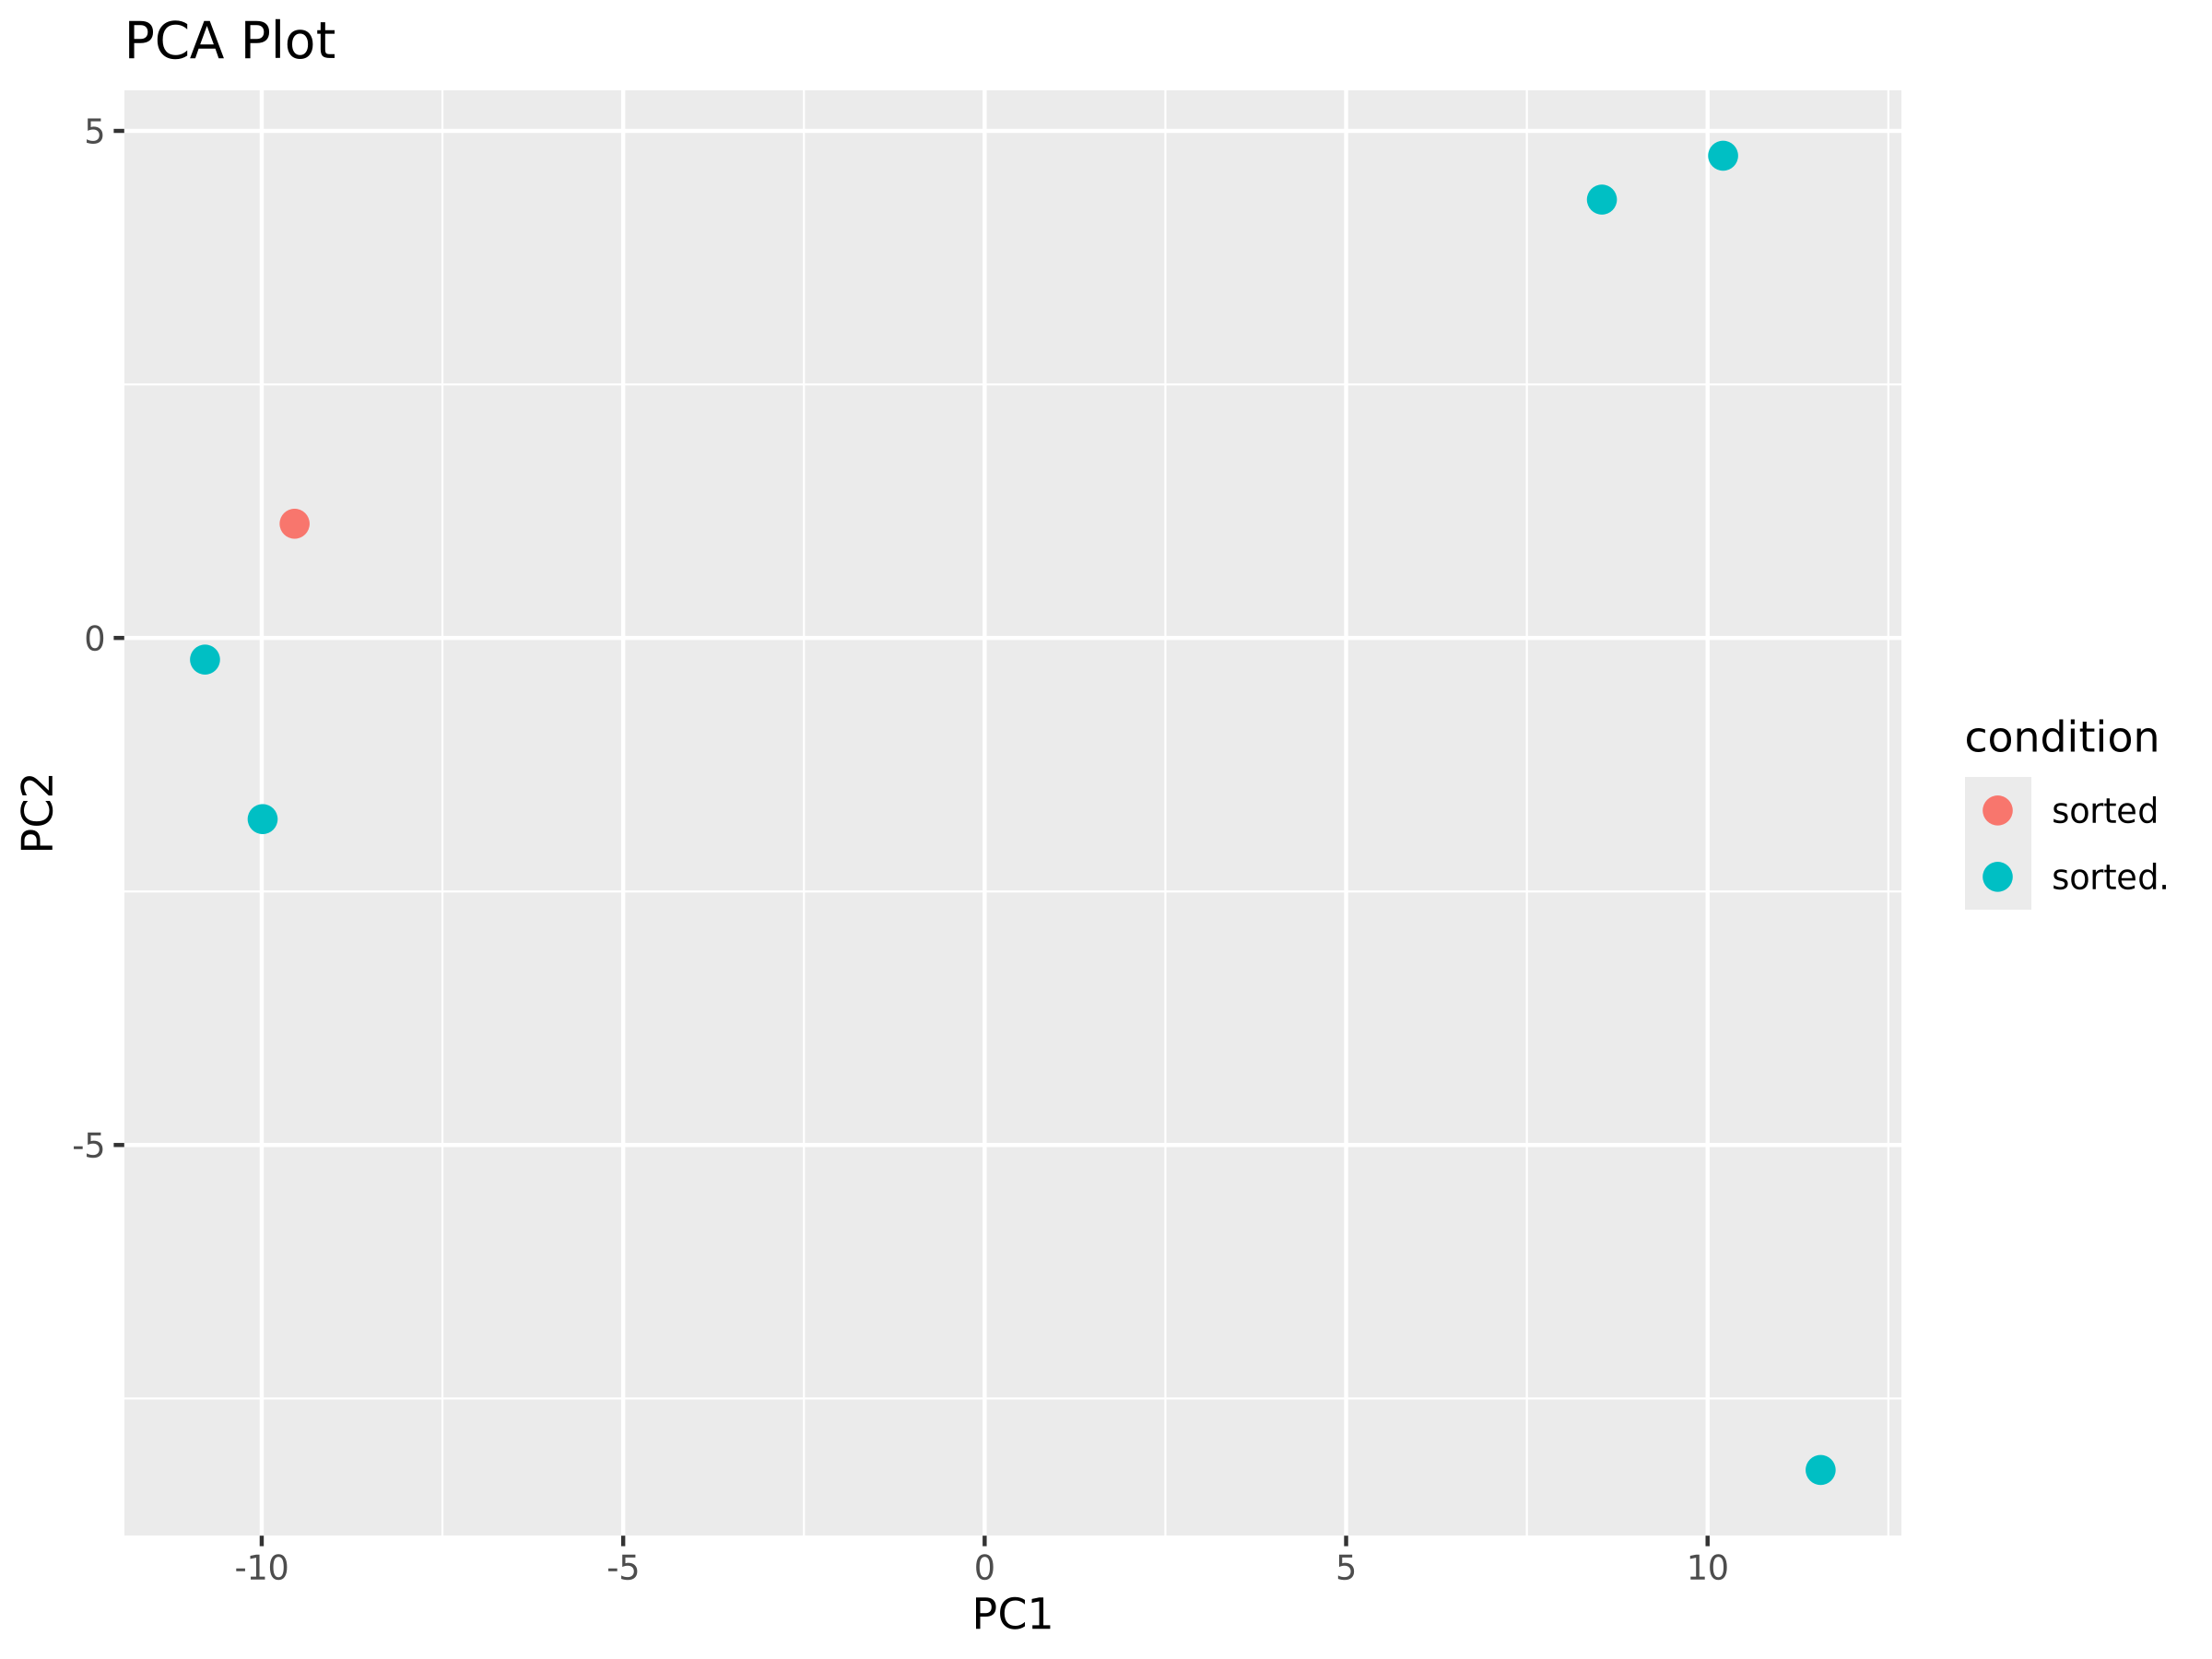

Slide 11
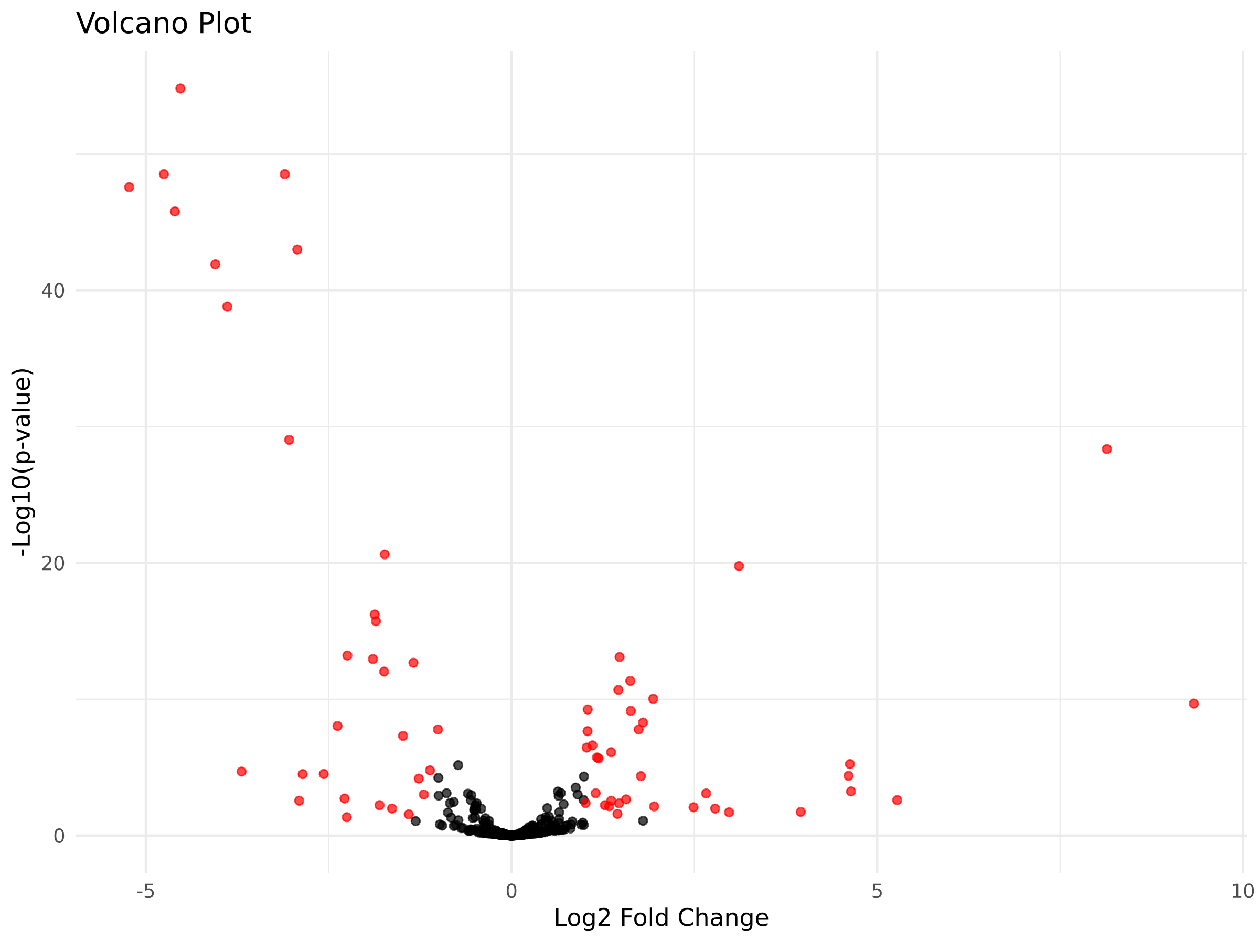
Notes:
In black, non significative results

