Slide 1
Data
Type of sample: RNA-seq, from RNA isolated from lung and blood
Species: Mus musculus
N = 6, 3 replicates per condition → 3 cases (infected with different pathogens) + 3 controls (non-infected)

Slide 2
Most common quality issues of the reads
Per tile sequence quality
Per base sequence quality
Sequence duplication levels

Slide 3
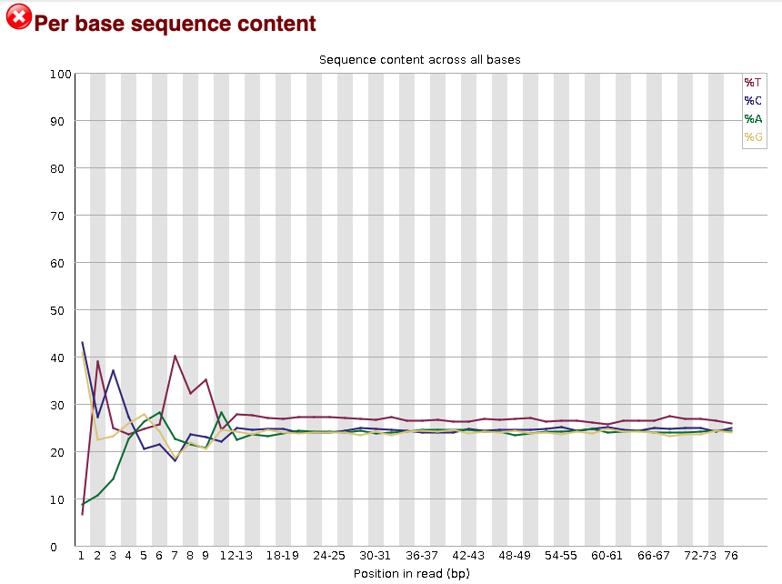
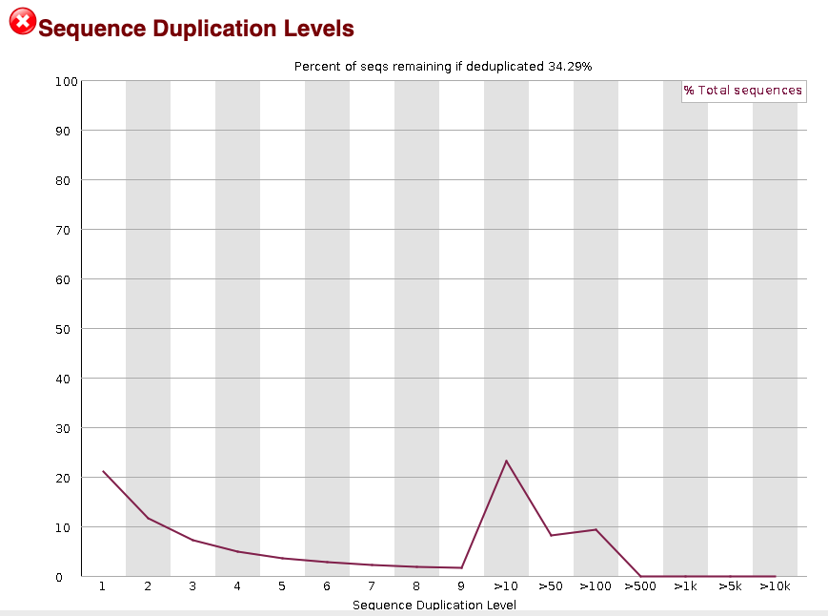
Some quality issues before and after trimming
Case 1 R1 (before and after trimming)

Slide 4
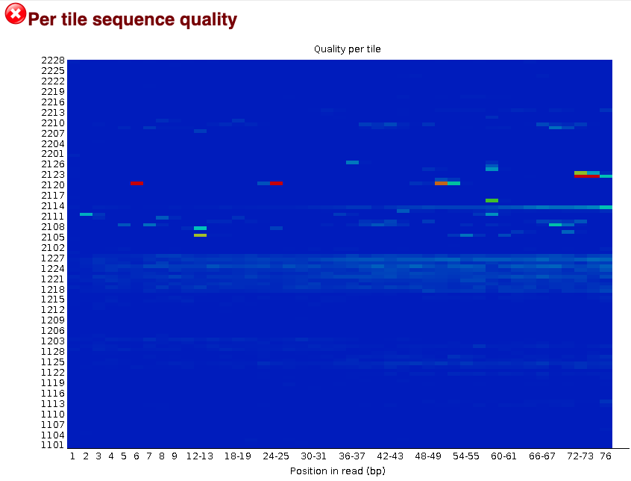
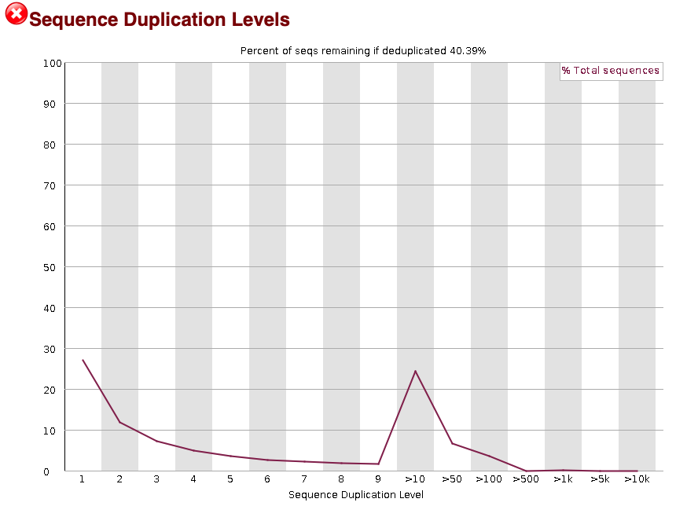
Quality of reads (FASTQC)
Case 1 R2 (before and after trimming)

Slide 5
Quality of reads (FASTQC)
Case 1 R2 (before and after trimming)

Slide 6
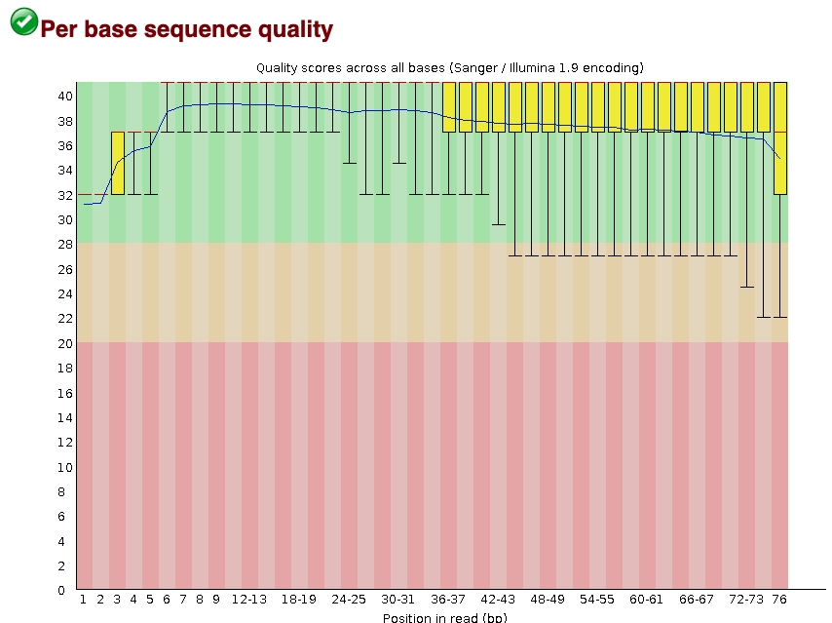
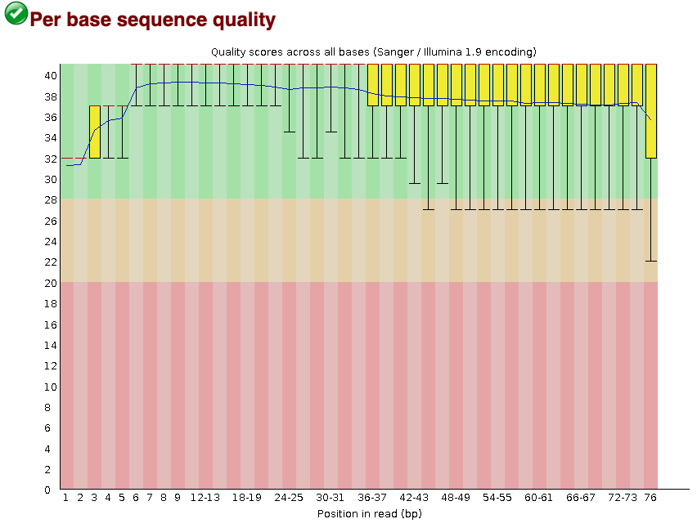
In some cases trimming only slightly improved per base sequence quality
Case 2 R1 (before and after trimming)
Before
After

Slide 7

Trimming removed overrepresented sequences
Before
After

Slide 8
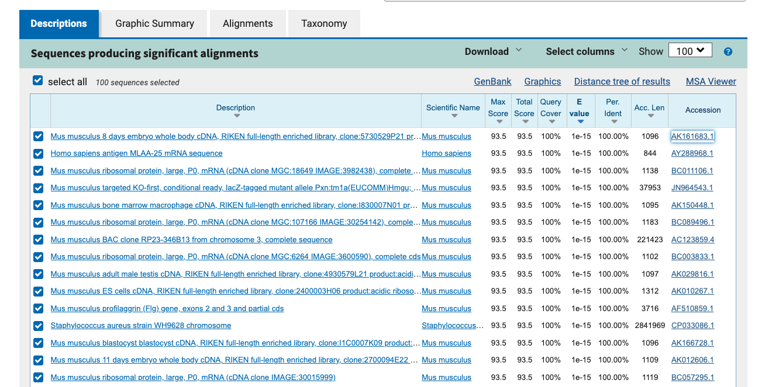
Overrepresented sequences

Slide 9
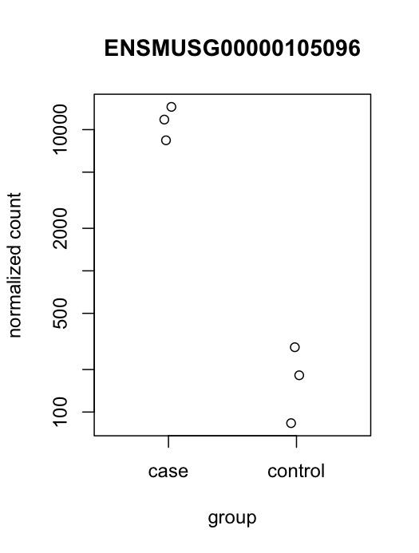
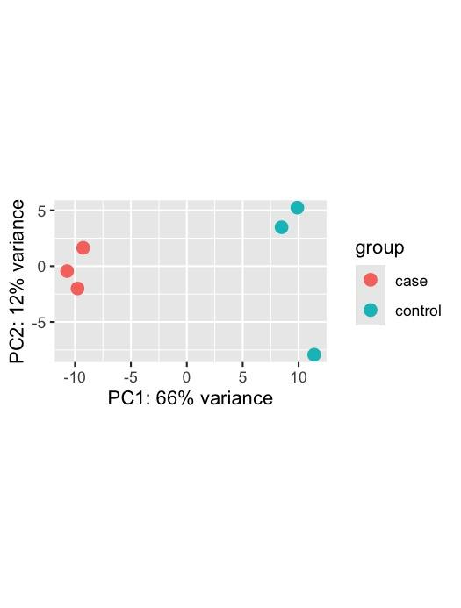

Slide 10
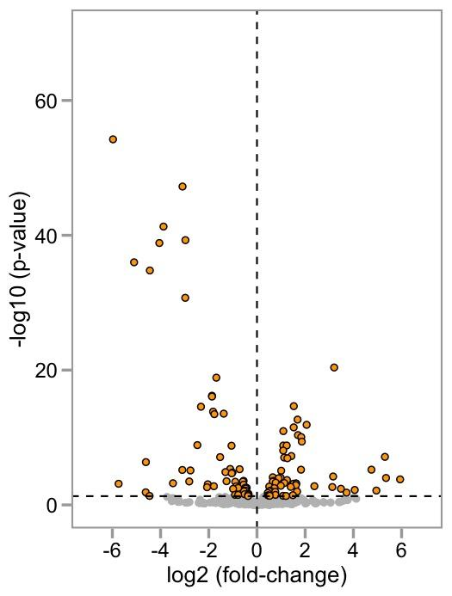
Volcano plot of differentially expressed genes

