Slide 1
DataFest 2023 American Bar Association (ABA) Pro Bono Legal Services
The unDATAbles
Avinash Achhra
Daniela Batres
Sarthak Rokade
Anushka Sancheti
Siba Siddique

Slide 2
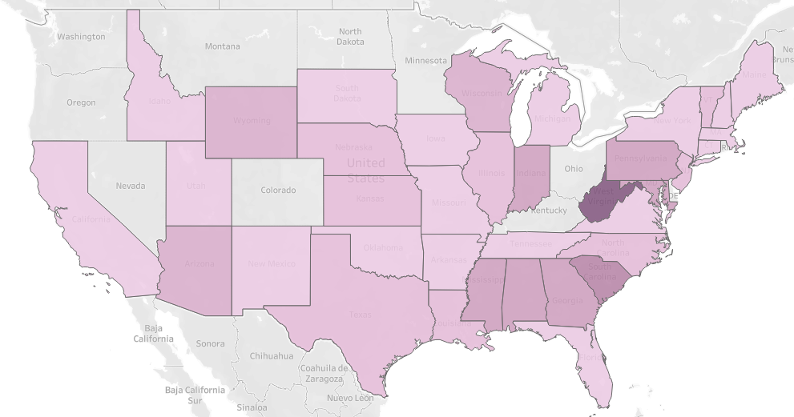
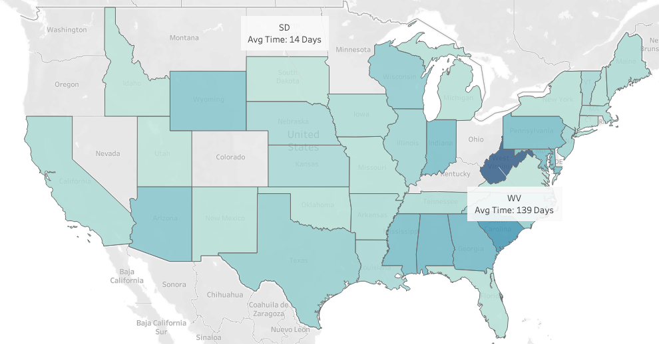

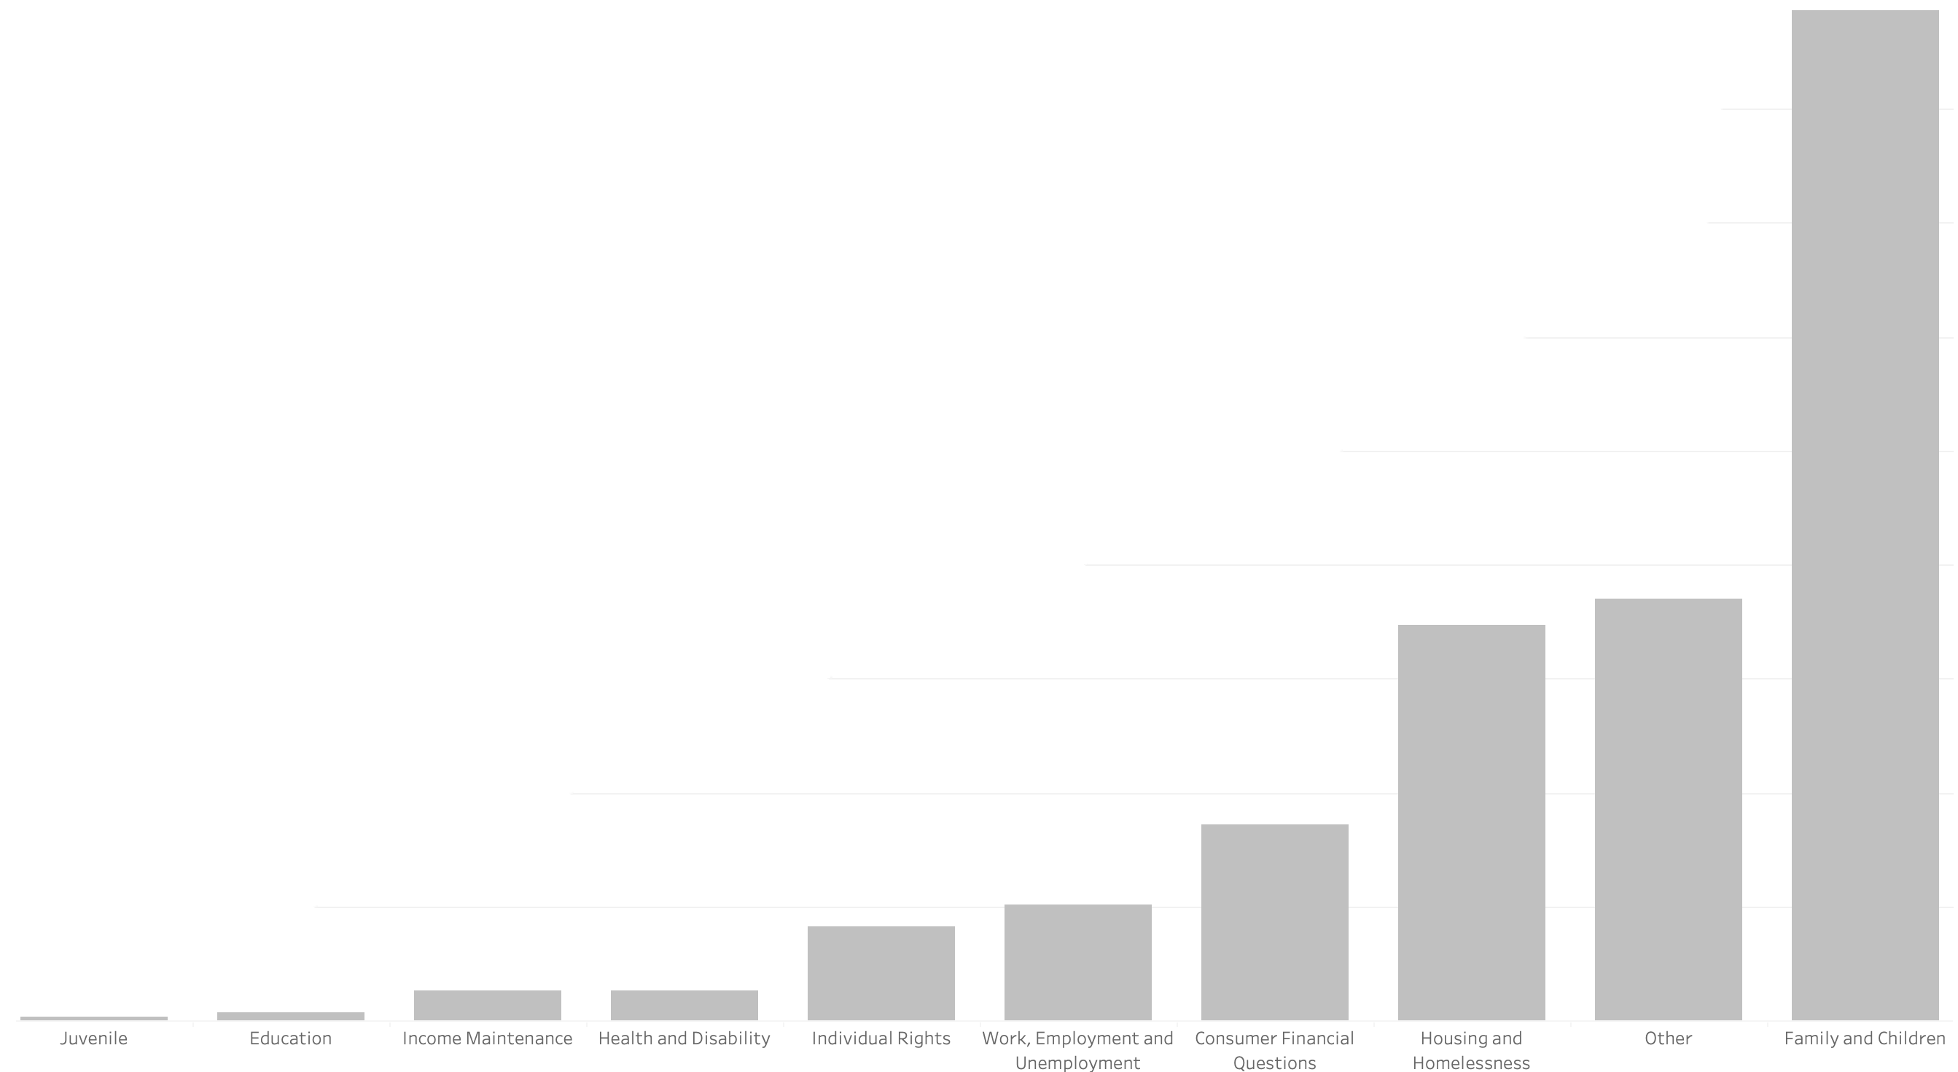


On Average, How Long Does it Take to Close Cases in Each State?
Days:
14
The Category of Questions with Most Cases: Family and Children
139

Slide 3




We Expected West Virginia to be Understaffed,
We Decided to Zoom into the Problem…
SD
WV
Average Time (days) to Assign Case
1
11
Average Time (days) to Work the Case
8
129
But the data told a different story.
Avg Cases per Attorney
43
19

Slide 4






Recommendations
We Decided to Zoom FURTHER into the Problem…
40
Avg Age
Female to Male Ratio
3:1
2:1
SD WV
$19,000
Avg Income
~
Avg Household
3.1
3
Exploration
Sentiment Analysis & Customer Satisfaction
Admin/Attorney Data
FAQ & Chatbot
Attorney/Case Database for Matching

Slide 5
Thank You!
Questions?

