Slide 1

Ejabberd Server
PRESENTED BY : SIBAJI KHATAI

Slide 2
Content
Introduction
Key Features
Additional Features
Architecture of an ejabberd service
Installing ejabberd
Starting ejabberd
Configuring ejabberd
Ejabberd Rest API
Multi User Chat
Screen shot

Slide 3
Introduction
ejabberd is a free and open source instant messaging server written in Erlang/OTP.
ejabberd is cross-platform, distributed, fault-tolerant, and based on open standards to achieve real-time communication.
ejabberd is designed to be a rock-solid and feature rich XMPP server.
ejabberd is suitable for small deployments, whether they need to be scalable or not, as well as extremely large deployments.
Ejabberd can be used in different ways. The most common one is to use ejabberd Community Edition. This is the standard Open Source version that everyone loves: highly scalable and flexible.
Fortunately, if you need more than just the ejabberd platform software, ProcessOne can help you with a commercial offering. Commercial offering come in two type of packaging:

Slide 4
Introduction
ejabberd Business Edition, including features for large companies (enhanced geodistributed companies and mobile support to develop own, rich clients) and world-class support, that can please even the most demanding businesses, with 24/7 options.
ejabberd SaaS being a way to access and benefit of all the features of ejabberd Business Edition at an attractive and scalable price. ejabberd SaaS allows you to keep control of your data thanks to integration API you can implement on your backend to become a data provider for ejabberd SaaS.
Whatever approach you choose, you can hardly make the wrong choice with ejabberd! In every case you can easily integrate ejabberd with your existing application using:
REST API and ejabberdctl command-line tool
Mobile libraries for iOS: XMPPFramework, Jayme REST API
Mobile libraries for Android: Smack, Retrofit
Web library with WebSocket support and fallback to BOSH: Strophe

Slide 5
Key Features
Ejabberd is:
Cross-platform: ejabberd runs under Microsoft Windows and Unix derived systems such as Linux, FreeBSD and NetBSD.
Distributed: You can run ejabberd on a cluster of machines and all of them will serve the same Jabber domain(s). When you need more capacity you can simply add a new cheap node to your cluster. Accordingly, you do not need to buy an expensive high-end machine to support tens of thousands concurrent users.
Fault-tolerant: You can deploy an ejabberd cluster so that all the information required for a properly working service will be replicated permanently on all nodes. This means that if one of the nodes crashes, the others will continue working without disruption. In addition, nodes also can be added or replaced ‘on the fly’.
Administrator Friendly: ejabberd is built on top of the Erlang programming language. As a result, if you wish, you can perform self-contained deployments. You are not required to install an external database, an external web server, amongst others because everything is already included, and ready to run out of the box. Other administrator benefits include:
  Comprehensive documentation.
  Straightforward installers for Linux, Mac OS X, and Windows.
  Web Administration.
  Shared Roster Groups.
  Command line administration tool.
  Can integrate with existing authentication mechanisms.
  Capability to send announce messages.

Slide 6
Key Features
Internationalized: ejabberd leads in internationalization. Hence it is very well suited to build service available across the world. Related features are:
  Translated to 25 languages.
  Support for IDNA.
Open Standards: ejabberd is the first Open Source Jabber server claiming to fully comply to the XMPP standard.
  Fully XMPP compliant.
  XML-based protocol.
  Many protocols supported.

Slide 7
Additional Features
Moreover, ejabberd comes with a wide range of other state-of-the-art features:
Modular
  Load only the modules you want.
  Extend ejabberd with your own custom modules.
Security
  SASL and STARTTLS for c2s and s2s connections.
  STARTTLS and Dialback s2s connections.
  Web Admin accessible via HTTPS secure access.
Databases
  Internal database for fast deployment (Mnesia).
  Native MySQL support.
  Native PostgreSQL support.
  ODBC data storage support.
  Microsoft SQL Server support.
  SQLite support.

Slide 8
Additional Features
Authentication
  Internal Authentication.
  PAM, LDAP and SQL.
  External Authentication script.
Others
  Support for virtual hosting.
  Compressing XML streams with Stream Compression (XEP-0138).
  Statistics via Statistics Gathering (XEP-0039).
  IPv6 support both for c2s and s2s connections.
  Multi-User Chat module with support for clustering and HTML logging.
  Users Directory based on users vCards.
  Publish-Subscribe component with support for Personal Eventing via Pubsub.
  Support for web clients: Support for XMPP subprotocol for Websocket and HTTP Binding (BOSH) services.
  IRC transport.
  SIP support.
  Component support: interface with networks such as AIM, ICQ and MSN installing special transports.

Slide 9
Architecture of an ejabberd service
ejabberd brings configurability, scalability and fault-tolerance to the core feature of XMPP – routing messages.
Its architecture is based on a set of pluggable modules that enable different features, including:
One-to-one messaging
Store-and-forward (offline messages)
Contact list (roster) and presence
Groupchat: MUC (Multi-User Chat)
Messaging archiving with Message Archive Management (MAM)
User presence extension: Personal Event Protocol (PEP) and typing indicator
Privacy settings, through privacy list and simple blocking extensions
User profile with vCards
Full feature web support, with BOSH and websockets
Stream management for message reliability on mobile (aka XEP-0198)
Message Delivery Receipts (aka XEP-184)
Last activity
Metrics and full command-line administration

Slide 10
Installing Ejabberd on Windows
Go to ejabberd official download page (https://www.processone.net/en/ejabberd/downloads/) on ProcessOne website.
Download the "Windows 64-bits Installer".
Double-click the ejabberd-YY.MM-windows-installer.exe to start the installer.
On the Windows Security dialog, Allow this application to install.
Select the installer language you prefer, then click "Next" to go through necessary installation steps:
  accepting the license agreement,
  selecting the installation directory,
  defining the XMPP domain: by default, it's set to the name of your computer on the local network. if unsure, type localhost here,
  setting the administrator username,
  setting the administrator password,
  selecting if this ejabberd instance will be part of a cluster: for simple local install, just select "No",
  start the installation,
  when asked by the Windows Firewall prompt, you can both times click "Cancel",
After successful install, you should see on your Desktop two new shortcuts: "Start ejabberd" and "Stop ejabberd". To start or stop ejabberd, right-click on each shortcut and select "Run as Administrator", then confirm the Windows dialog by clicking "Yes".

Slide 11
Starting Ejabberd
Ejabberd can be started manually at any time, or automatically by the operating system at system boot time.
To start and stop ejabberd manually, use the desktop shortcuts created by the installer. If the machine doesn't have a graphical system, use the scripts ’start’ and ’stop’ in the ’bin’ directory where ejabberd is installed.
You can also use the ejabberdctl command line administration script to start and stop ejabberd. If you provided the configure option –enable-user=USER (see compile), you can execute ejabberdctl with either that system account or root.
Usage example:
prompt> ejabberdctl start
prompt> ejabberdctl status
The node ejabberd@localhost is started with status: started
ejabberd is running in that node
prompt> ejabberdctl stop

Slide 12
Configuring ejabberd
Here are the main entry points to learn more about ejabberd configuration. ejabberd is extremely powerful and can be configured in many ways with many options.
Sections:
File Format
Basic Configuration: hosts, acl, logging...
Authentication: auth_method
Database and LDAP
Listen Modules: c2s, s2s, http, sip, stun, xmlrpc...
Listen Options

Slide 13
1. File Format
The configuration file will be loaded the first time you start ejabberd. The configuration file name MUST have “.yml” or “.yaml” extension. This helps ejabberd to differentiate between the new and legacy file formats (see section Legacy Configuration File).
The configuration file is written in YAML.
Note that ejabberd never edits the configuration file. If you are changing parameter from web admin interface, you will need to apply them to configuration file manually. This is to prevent messing up with your config file comments, syntax, etc.
Please, consult ejabberd.log for configuration errors. ejabberd will report syntax related errors, as well as complains about unknown options and invalid values. Make sure you respect indentation (YAML is sensitive to this) or you will get pretty cryptic errors.
The option include_config_file in a configuration file instructs ejabberd to include other configuration files immediately.
This is a basic example:
include_config_file: /etc/ejabberd/additional.yml

Slide 14
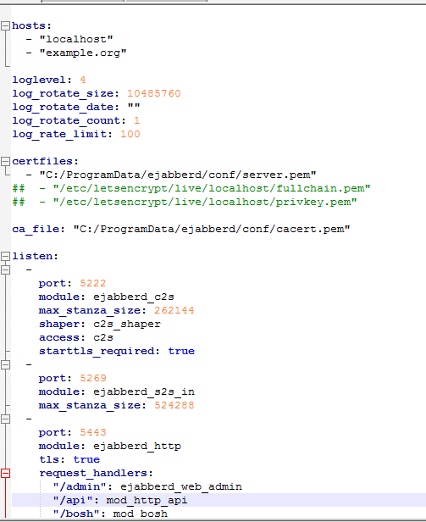
1.File Format(ejabberd.yml)

Slide 15
2.Basic Configuration(XMPP Domains)
ejabberd supports managing several independent XMPP domains on a single ejabberd instance, using a feature called virtual hosting.
The option hosts defines a list containing one or more domains that ejabberd will serve.
Of course, the hosts list can contain just one domain if you do not want to host multiple XMPP domains on the same instance.
Examples:
Serving one domain:
hosts: [example.org]
Serving three domains:
hosts:
- example.net
- example.com
- sibajitech.org

Slide 16
2.Basic Configuration(Logging)
ejabberd configuration can help a lot by having the right amount of logging set up.
There are several toplevel options to configure logging:
loglevel: Verbosity of log files generated by ejabberd.
hide_sensitive_log_data Privacy option to disable logging of IP address or sensitive data.
log_rotate_size
log_rotate_count: Setting count to N keeps N rotated logs. Setting count to 0 does not disable rotation, it instead rotates the file and keeps no previous versions around. Setting size to X rotate log when it reaches X bytes. To disable rotation set the size to 0 and the date to "" Date syntax is taken from the syntax newsyslog uses in newsyslog.conf.
Here are some examples:
$D0 rotate every night at midnight
$D23 rotate every day at 23:00 hr
The values in default configuration file are:
log_rotate_size: 0
log_rotate_date: "$D0“
log_rotate_count: 1

Slide 17
3.Authentication(Internal)
ejabberd uses its internal Mnesia database as the default authentication method. The value internal will enable the internal authentication method.
It is possible to use the option auth_password_format to store the password in SCRAM format.
For details about the client-server communication when using SCRAM-SHA-1, refer to SASL and SCRAM-SHA-1.
When you enable SCRAM password format for internal storage, if you try to authenticate a user that had their password already stored in plain text, their password will be automatically converted to SCRAM format. It means database is converted as you use it.
If you want to convert your Mnesia database all at once, you can look into the Erlang function: ejabberd_auth_internal:maybe_scram_passwords/0.
Examples:
To use internal authentication on example.org and LDAP authentication on example.net:
host_config:
example.org:
auth_method: [internal]
To use internal authentication with hashed passwords on all virtual hosts:
auth_method: internal
auth_password_format: scram

Slide 18
3.Authentication(JWT )
ejabberd supports authentication using JSON Web Token (JWT). When enabled, clients send signed tokens instead of passwords, which are checked using a private key specified in the jwt_key option. JWT payload must look like this:
  {
  "jid": "test@example.org",
  "exp": 1564436511
  }
Options:
jwt_key
jwt_auth_only_rule
jwt_jid_field
Example:
  auth_method: jwt
  jwt_key: /path/to/jwt/key

Slide 19
4.Database and LDAP
ejabberd uses its internal Mnesia database by default. However, it is possible to use a relational database, key-value storage or an LDAP server to store persistent, long-living data. ejabberd is very flexible: you can configure different authentication methods for different virtual hosts, you can configure different authentication mechanisms for the same virtual host (fallback), you can set different storage systems for modules, and so forth.
The following databases are supported by ejabberd:
Mnesia
MySQL. Check the tutorial Using ejabberd with MySQL
Any ODBC compatible database
PostgreSQL
MS SQL Server/SQL Azure
SQLite
Redis(only for transient data)
The following LDAP servers are tested with ejabberd:
Active Directory(see section Active Directory)
OpenLDAP
CommuniGate Pro
Normally any LDAP compatible server should work; inform us about your success with a not-listed server so that we can list it here

Slide 20
4.Database and LDAP
For example Database:
host_config:
public.example.org:
sql_type: pgsql
sql_server: localhost
sql_database: database-public-example-org
sql_username: ejabberd
sql_password: password
auth_method: [sql]
For example LDAP
  auth_method: [ldap]
  ldap_servers: [ldap.example.org]
  ldap_rootdn: "cn=Manager,dc=example,dc=org“
  ldap_password: secret
  ldap_encrypt: tls
  ldap_port: 6123
  ldap_base: "ou=Users,dc=example,dc=org“
  ldap_filter: "(objectClass=shadowAccount)"

Slide 21
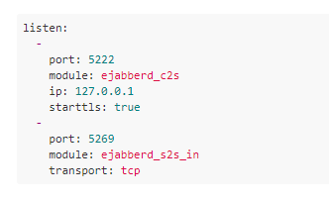
5.Listen Modules
The listen option defines for which ports, addresses and network protocols ejabberd will listen and what services will be run on them. Each element of the list is an associative array with the following elements:
Port number. Optionally also the IP address and/or a transport protocol.
Listening module that serves this port.
Options for the TCP socket and for the listening module.
For example:
The available modules are
ejabberd_c2s
ejabberd_c2s
ejabberd_http etc…

Slide 22
6.Listen Options
These are the options allowed by the listening modules :
access
backlog
custom_headers
default_host
hosts
password
request_handlers
tag
timeout
tls

Slide 23
Ejabberd Rest API
In ejabberd Rest API we will go through following items.
Introduction
Understanding ejabberd "commands"
The role of ejabberd API
Simple Configuration

Slide 24
1. Ejabberd Rest API (Introduction)
ejabberd comes with a powerful API that serve two goals:
It is primarily used to manage the XMPP service and integrate the platform with back-end platforms and script tools.
It also can be used from user clients to perform tasks on behalf of the users. This allows write simple basic clients that do not have to use XMPP protocol. This can be handy, for example to send a message from your smart watch, or show the number of offline messages.
The system is powerful and very versatile and you can configure it very finely, but it can be quite daunting to set up.
This section is write to demystify ejabberd API configuration and help you integrate ejabberd with your other back-ends or script through an HTTP / HTTPS Rest API.

Slide 25
2. Understanding ejabberd Command
ejabberd operations are organised around the concept of commands. ejabberd standard modules already provide many commands, but the mechanism is generic and any module can provide its own set of commands. This exposition of commands for third-party modules make it very powerful.
All commands can be exposed through interfaces. Available interfaces are:
ejabberdctl command-line tool,
ejabberd ReST API and ejabberd XML-RPC API,
to some extend, XMPP protocol itself through discovery and adhoc commands.
ejabberd commands are universal, extensible and widely available through various configurable entrypoints.
Note: The XML-RPC API still works but is deprecated in favor of the ReST API. You should migrate to ReST if you are using it.

Slide 26
3.The role of ejabberd API
As we have seen, ejabberd API role is to provide and control access to ejabberd commands over HTTP/HTTPS.
Thus, ejabberd API primary goal is to grant access to some or all ejabberd "commands".
An admin ejabberd ReST API requires:
At least one admin user, if you plan to check credentials for command access (You can alternatively rely on originating IP addresses).
HTTP/HTTPS handlers configured to expose the desired commands.
The selection of authentication mechanisms that can be used to access the API. Two mechanisms are available to access the HTTP API:
  Basic authentication. This mechanism is enabled by default.
  OAuth 2.0 token based authentication. It has to be explicitly added to the config file.

Slide 27
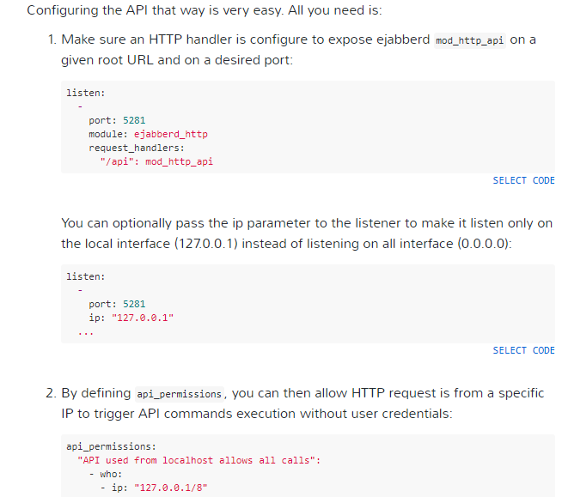
4. Simple Configuration
If you are planning to use ejabberd API for admin purpose, it is often enough to configure it to be available local commands. Access is thus generally limited by IP addresses, either restricted to localhost only, or restricted to one of your platform back-end.

Slide 28
Multi User Chat
Most of the command to manage MUC service depends on the activation of mod_muc_admin module in ejabberd.
To enable mod_muc_admin-dependant ejabberdctl commands, you just need to add mod_muc_admin in modules section of ejabberd config file.
For example, in ejabberd.yml format:
modules:
mod_muc_admin: {}
Commands
1. Online Rooms
List existing rooms ('global' to get all vhosts).
ejabberdctl muc_online_rooms [global]
2. Create MUC room
Create a MUC room name@service in host.
ejabberdctl create_room room_name muc_service xmpp_domain

Slide 29
Multi User Chat
3. Destroy MUC room
Destroy a MUC chat room
ejabberdctl destroy_room room_name muc_service
4. Invite several users to a MUC room
Send a direct invitation to several JIDs. Password and Message can also be: none. Users JIDs are separated with ':'.
ejabberdctl send_direct_invitation room_name muc_service password reason jid1[:jid2]
5. How to remove an user from MUC.
ejabberdctl set_room_affiliation room_name muc_service user_jid outcast

Slide 30

Administrator Login Screen

Slide 31
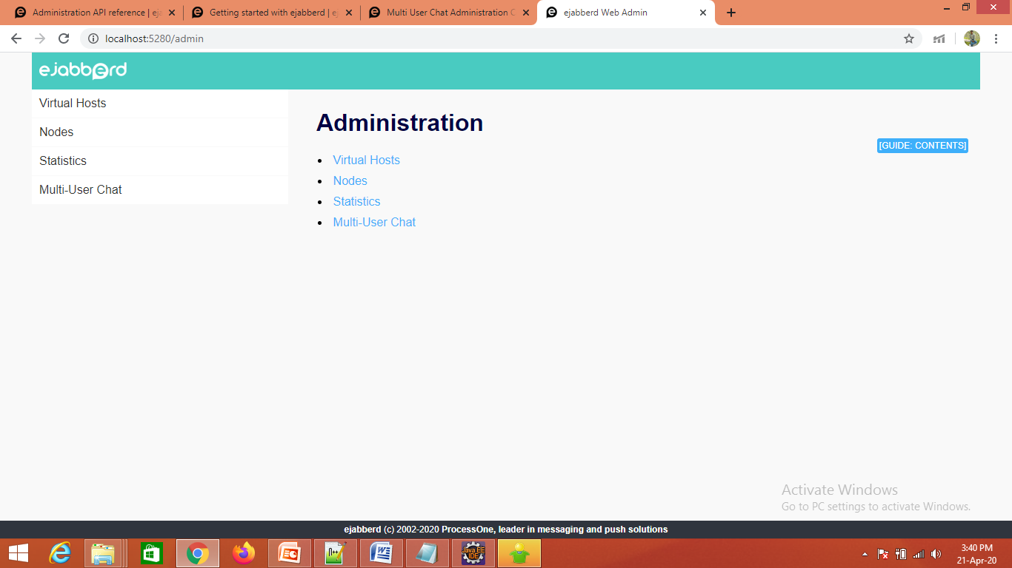
Home Screen

Slide 32
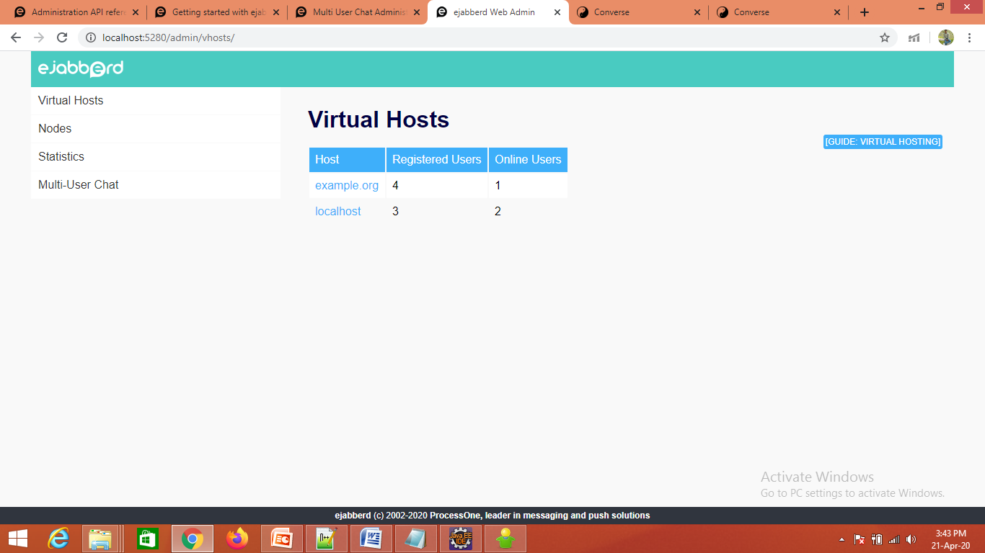
Virtual Host Screen

Slide 33

Online users Screen

Slide 34
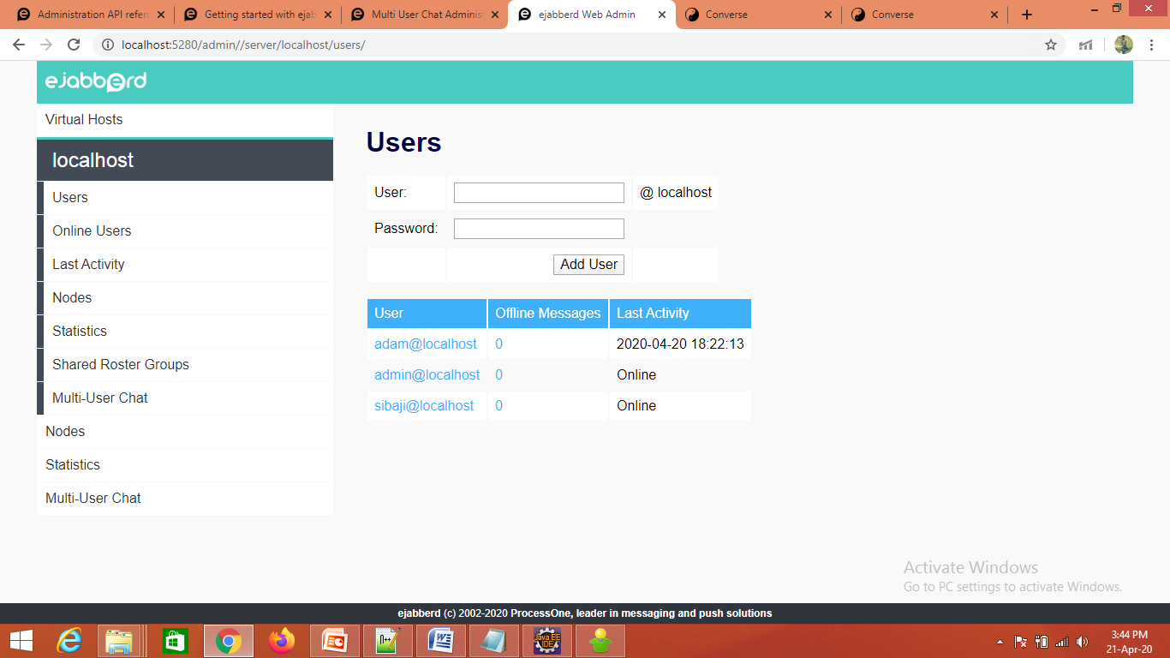
Adding user Screen

Slide 35
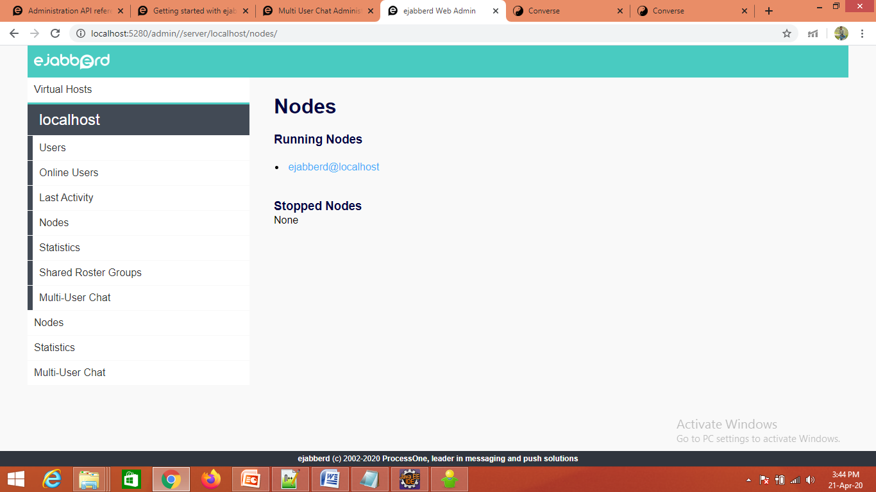
Nodes Screen

Slide 36

Statistics Screen

Slide 37
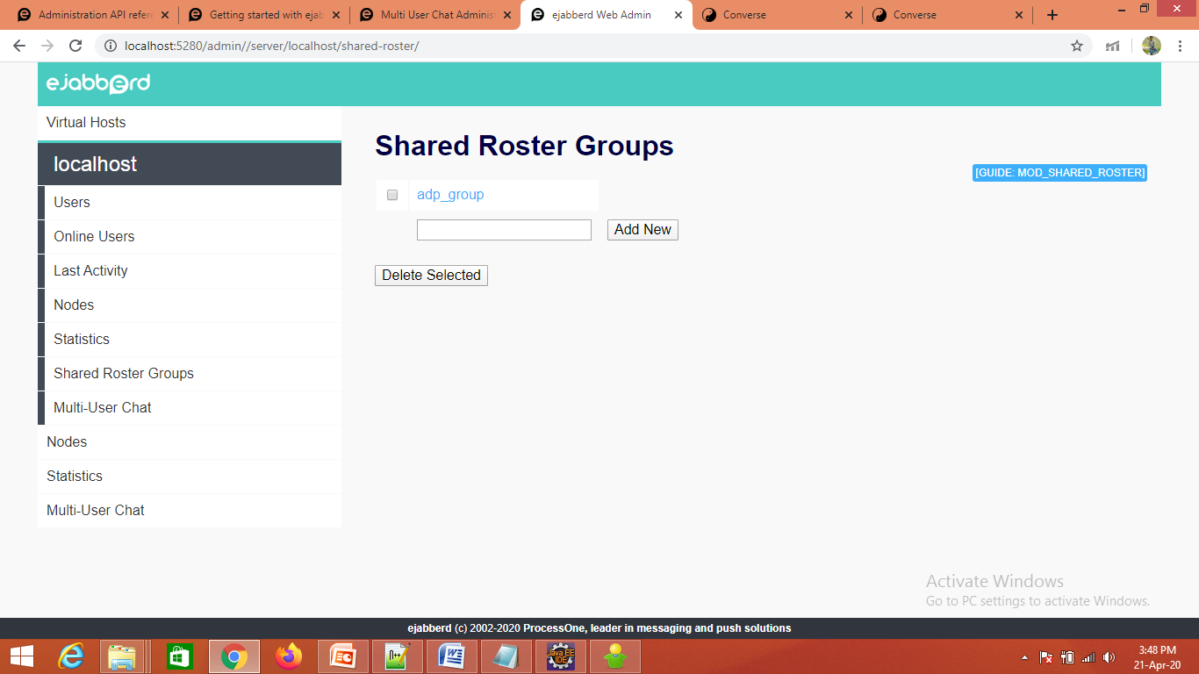
Shared Roster Groups Screen

Slide 38
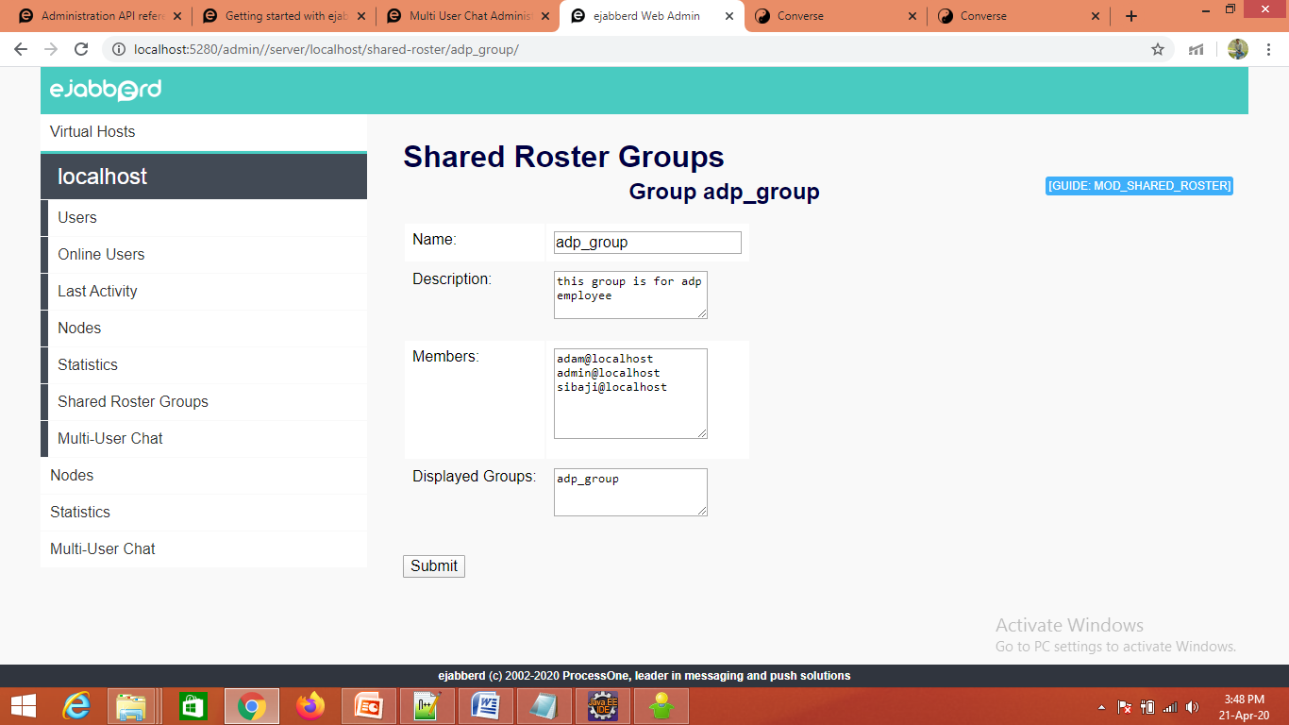
Adding details to Roster Screen

Slide 39
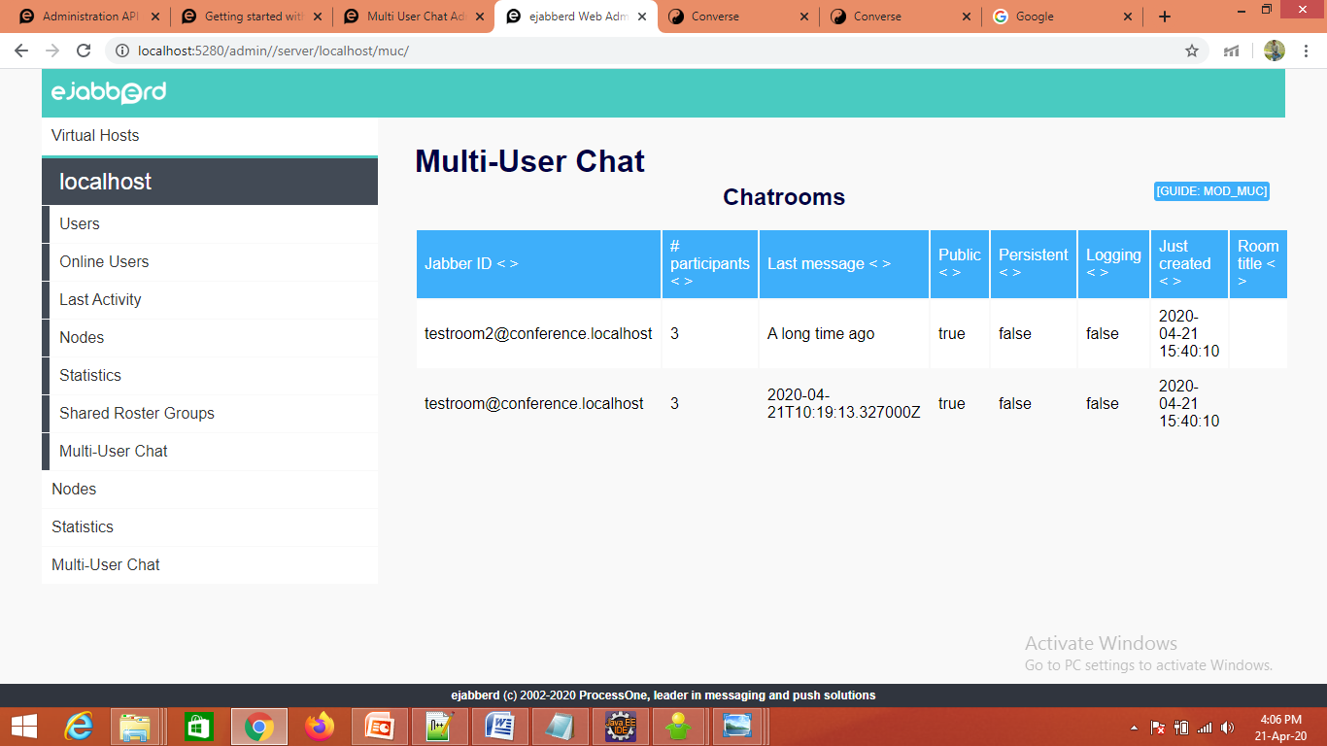
Multi user Chat Room Screen

Slide 40
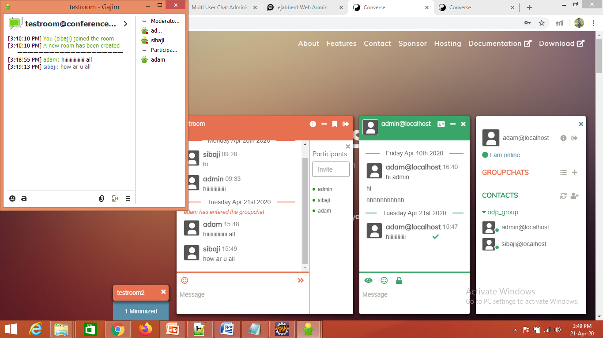
Multi user chat Client Screen

Slide 41


