Slide 1
Project Methodologies

Slide 2
Introduction
Traditional Methodologies
Agile Methodology
Scrum
Scrum Framework: Roles
Scrum Framework: Ceremonies
Scrum Framework: Artifacts
Resources and online Scrum Tools

Slide 3
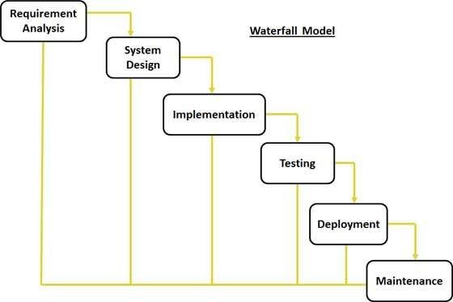
Traditional Methodologies: Waterfall Model
You complete one phase (e.g. design) before moving on to the next phase(e.g. development)
You rarely aim to re-visit a ‘phase’ once it’s completed. That means, you better get whatever you’re doing right the first time!

Slide 4
Traditional Methodologies: Waterfall Model
Changes
You don’t realize any value until the end of the project
You leave the testing until the end
You don’t seek approval from the stakeholders until late in the process
Takes too long…
Takes too long
Skipped
This approach is highly risky, often more costly and generally less efficient than Agile approaches

Slide 5
Agile Methodology
Agile meaning ability to move quick and easy
Not a process, it's a philosophy or set of values…
Rapid
Adaptive
Agile
Quality-Driven
Cooperative
Iterative

Slide 6
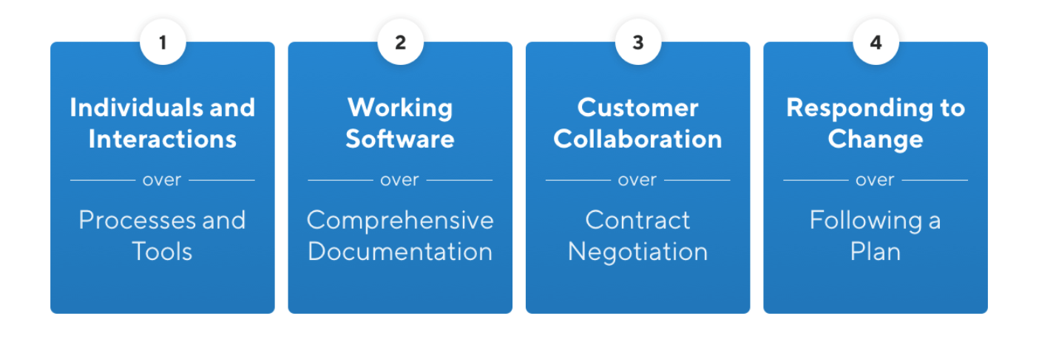
The 4 values of the Agile Manifesto

Slide 7
The 12 Agile principles
₁
Our highest priority is to satisfy the customer through early and continuous delivery of valuable software.
ROI

Slide 8
The 12 Agile principles
₂
Welcome changing requirements, even late in development. Agile processes harness change for the customer's competitive advantage.
CHANGEABILITY

Slide 9
The 12 Agile principles
₃
Deliver working software frequently, from a couple of weeks to a couple of months, with a preference to the shorter timescale.
GETTING REAL

Slide 10
The 12 Agile principles
₄
Business people and developers must work together daily throughout the project
ALIGNMENT

Slide 11
The 12 Agile principles
₅
Build projects around motivated individuals. Give them the environment and support they need, and trust them to get the job done.
SELF-
ORGANIZATION

Slide 12
The 12 Agile principles
₆
The most efficient and effective method of conveying information to and within a development team is face-to-face conversation.
BANDWIDTH

Slide 13
The 12 Agile principles
₇
Working software is the primary measure of progress.
DONE

Slide 14
The 12 Agile principles
₈
Agile processes promote sustainable development. The sponsors, developers, and users should be able to maintain a constant pace indefinitely.
SUSTAINABILITY

Slide 15
The 12 Agile principles
₉
Continuous attention to technical excellence and good design enhances agility.
IMPROVEMENT

Slide 16
The 12 Agile principles
₁₀
Simplicity — the art of maximizing the amount of work not done — is essential.
KEEP IT SIMPLE STUPID (KISS)

Slide 17
The 12 Agile principles
₁₁
The best architectures, requirements, and designs emerge from self-organizing teams.
EMERGE

Slide 18
The 12 Agile principles
₁₂
At regular intervals, the team reflects on how to become more effective, then tunes and adjusts its behavior accordingly.
INSPECT & ADJUST

Slide 19
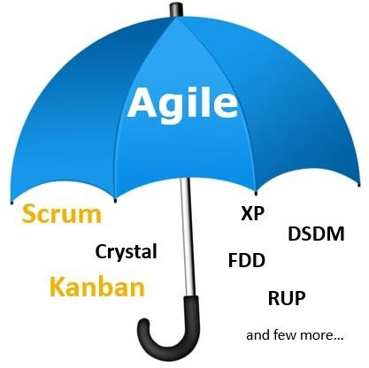
Various Agile Methodologies

Slide 20
What is Scrum
Scrum is an agile lightweight framework that allows us to focus on delivering the highest business value in the shortest time.
It allows us to rapidly and repeatedly inspect actual working software (every two weeks to one month).
The business sets the priorities. Teams self-organize to determine the best way to deliver the highest priority features.
Every two weeks to a month anyone can see real working software and decide to release it as is or continue to enhance it for another sprint.
The Scrum framework is purposefully incomplete, only defining the parts required to implement Scrum theory. Various processes, techniques and methods can be employed within the framework.

Slide 21




Scrum Origins
Some professionals believe that Jeff Sutherland, John Scumniotales and Jeff McKenna invented Scrum in 1993.
Others, who vouch for HirotakaTakeuchi and IkujiroNonakaas inventing Scrum in 1986.
Controversies

Slide 22
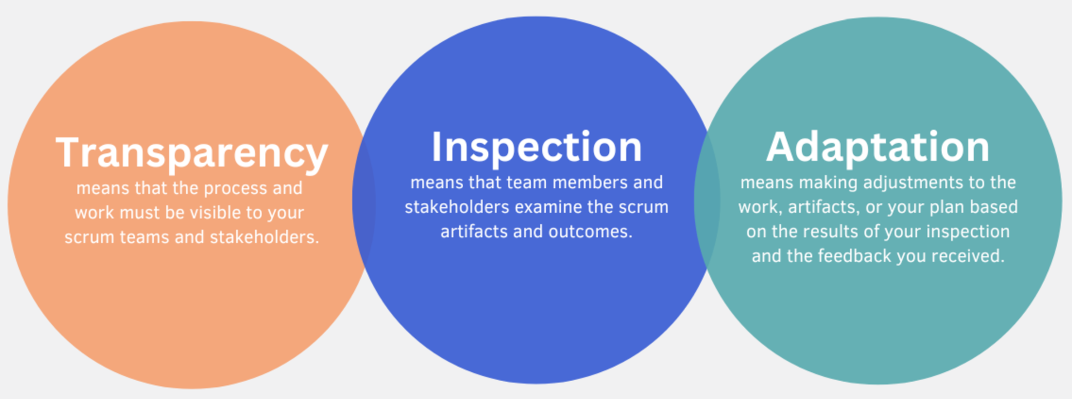
3 Empirical Scrum Pillars

Slide 23

5 Scrum Values

Slide 24
Scrum framework
Roles
Product owner
Scrum Master
Team/Developers
Ceremonies/Events
The sprint
Sprint planning
Daily scrum
Sprint review
Sprint retrospective
Artifacts
Product backlog
Sprint backlog
Increment/Done work

Slide 25
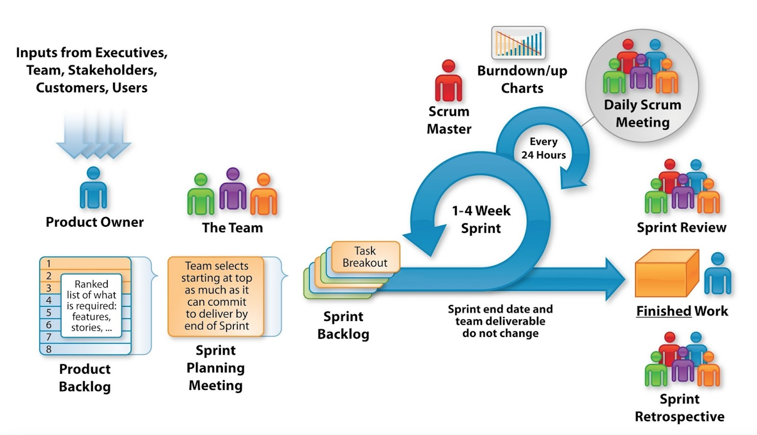
Scrum framework

Slide 26
Scrum framework
Roles
Product Owner
Scrum Master
The Team
Events
The sprint
Sprint planning
Daily scrum
Sprint review
Sprint retrospective
Artifacts
Product backlog
Sprint backlog
Increment/Done work

Slide 27
Role: Product Owner
Collect input from parties such as executives, stakeholders, customers etc, and based on the collected information define the features of the product
Prioritize features according to value
Adjust features and priority every iteration, as needed
Ensuring that the Product Backlog is transparent, visible and understood.

Slide 28
Role: Scrum Master
Represents management to the project
Responsible for enacting Scrum values and practices
Removes impediments
Ensure that the team is fully functional and productive
Enable close cooperation across all roles and functions
Shield the team from external interferences

Slide 29
Role: The Team
Typically 5-9 people
Cross-functional
  Programmers, testers, user experience designers, etc.
Members should be full-time
  May be exceptions (e.g., database administrator)
Teams are self-organizing
  Ideally, no titles but rarely a possibility
Membership should change only between sprints.

Slide 30
Scrum framework
Roles
Product Owner
Scrum Master
The Team
Events
The sprint
Sprint planning
Daily scrum
Sprint review
Sprint retrospective
Artifacts
Product backlog
Sprint backlog
Increment/Done work

Slide 31
Event: The Sprint
No changes are made that would endanger the Sprint Goal
Quality does not decrease
The Product Backlog is refined as needed
Scope may be clarified and renegotiated with the Product Owner as more is learned
All the work necessary to achieve the Product Goal, including Sprint Planning, Daily Scrums, Sprint Review, and Sprint Retrospective, happen within Sprints.

Slide 32
Event: Sprint Planning
Purpose: At every sprint start, sprint backlog is created out of product backlog.
Participants: Product owner, scrum master, team
Duration: This is a time-boxed meeting, duration depends on the duration of sprint and complexity of the items.
Highlights:
  The Product Owner ensures that attendees are prepared to discuss the most important Product Backlog items and how they map to the Product Goal.
  Tasks are identified and refined, and each gets a time estimation
  For each selected Product Backlog item, the team plan the work necessary to create an Increment that meets the Definition of Done.
  Sometimes a larger item gets decomposed into smaller work items. How this is done is at the sole discretion of the Developers.

Slide 33
Event: Daily Scrum
Parameters
  Daily
  15min
  stand-up, face-to-face
Anyone can participate,
Only Team, Scrum master and Product owner may speak
Usually Team members brings up the following 3 things
  What was done yesterday
  What is planned to be done today
  Mention if there are any impediments preventing progress. The Team might be able to help.

Slide 34
Event: Sprint Review
The Scrum Team presents the results of their work to Product Owner, Scrum master and interested stakeholders.
During the event, the Scrum Team and stakeholders review what was accomplished in the Sprint and what has changed in their environment
The Product Backlog may also be adjusted to meet new opportunities. The Sprint Review is a working session and the Scrum Team should avoid limiting it to a presentation.
Invite the world

Slide 35
Event: Sprint Retrospective
Purpose: This meeting is held at the end of each sprint (after the sprint review), it facilitates team to inspect and adapt its process to optimize efficiency.
  In this meeting following points would be discussed.
    What went well in the sprint.
    What did not went well in the sprint.
    How can we enhance.
  The output of this meeting becomes the input for next sprint for enhancing the practice.
Participants: Product owner, scrum master, team

Slide 36
Scrum framework
Roles
Product Owner
Scrum Master
The Team
Events
The sprint
Sprint planning
Daily scrum
Sprint review
Sprint retrospective
Artifacts
Product backlog
Sprint backlog
Increment/Done work

Slide 37
Artifact: Product backlog
The requirements
A list of all desired work on the project
Ideally expressed such that each item has value to the users or customers of the product
Prioritized by the product owner
Reprioritized before the start of each sprint

Slide 38
Artifact: Sprint backlog
The sprint backlog is a list of tasks identified by the Scrum team to be
completed during the Scrum “Sprint”.
During the sprint planning meeting, the team selects some number of product backlog items

Slide 39
Artifact: Increment
An Increment is a concrete stepping stone toward the Product Goal.
The list of increments show how much work has been completed
The moment a Product Backlog item meets the Definition of Done, an Increment is born.
Definition of Done is a formal description of the state of the Increment when it meets the quality measures required for the product.

Slide 40
Resources and online Scrum Tools
Reading instructions for project methods:
https://www.agilealliance.org/agile-essentials/
https://scrumguides.org/scrum-guide.html
https://www.atlassian.com/software/jira/guides/getting-started/introduction#what-is-jira-software
JIRA tool will be used as the online Scrum management tool. Get started with JIRA at:
https://www.atlassian.com/software/jira

