Slide 1
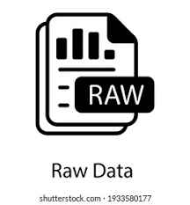
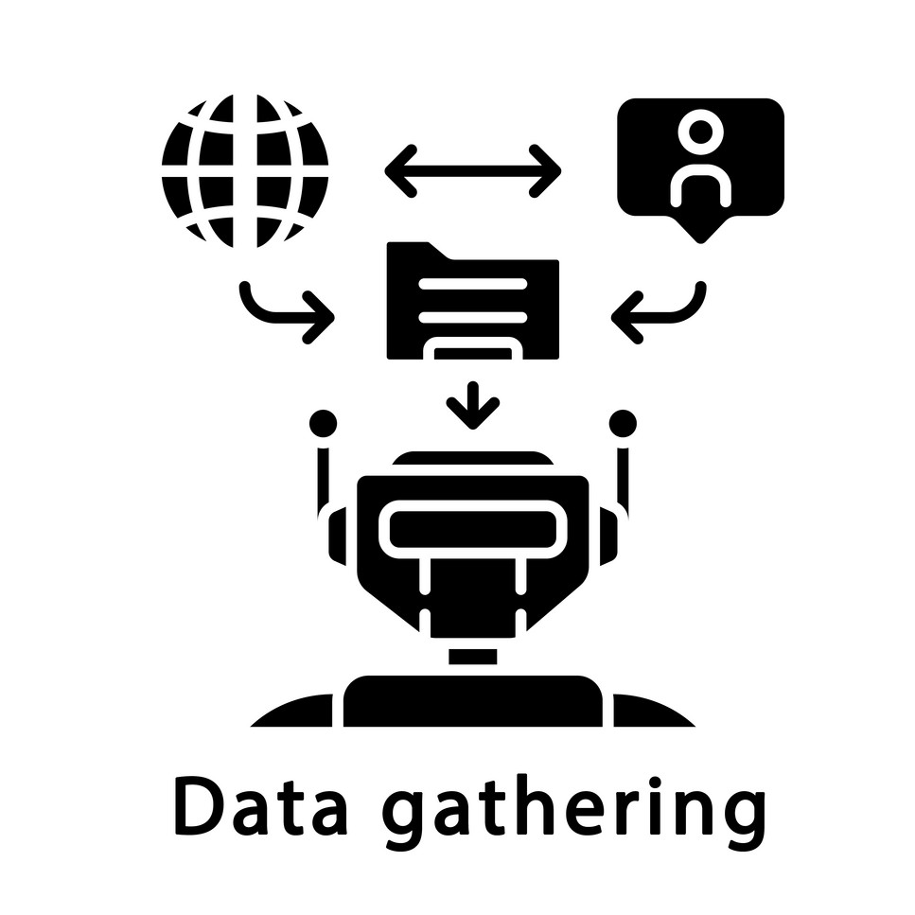
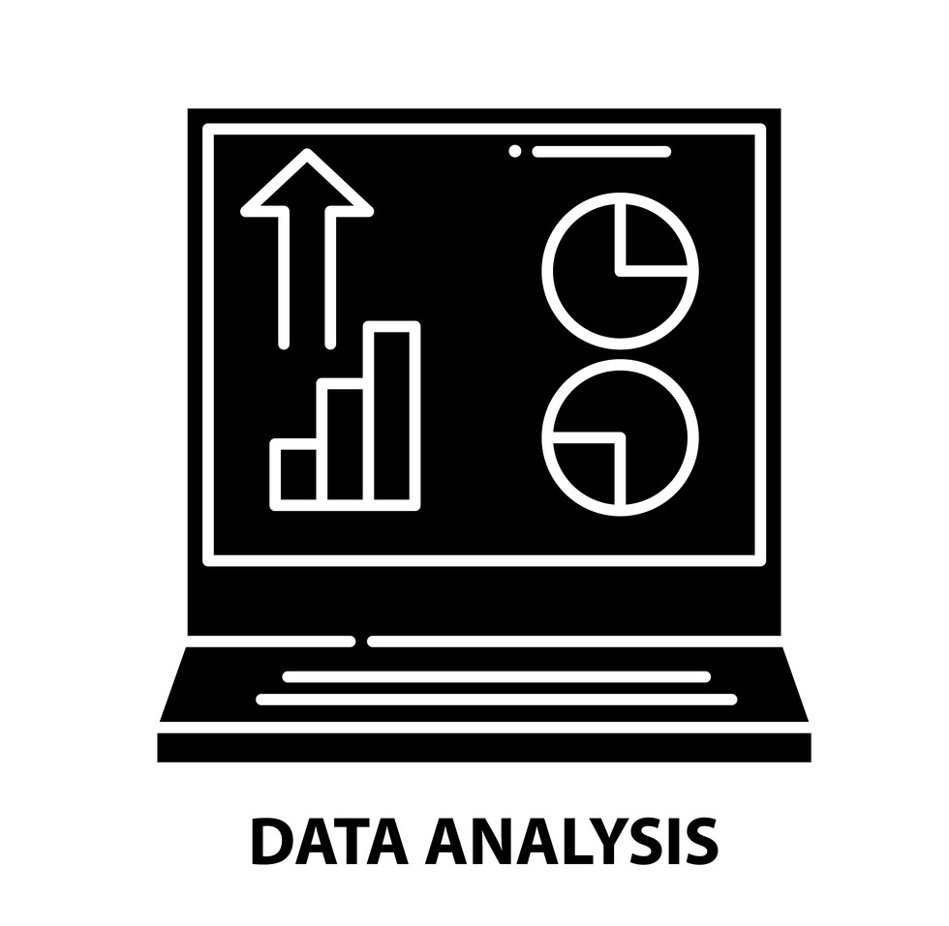
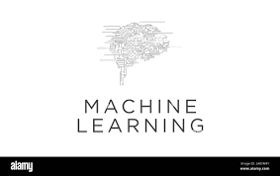
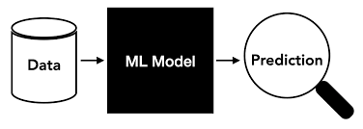
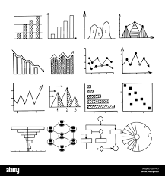

Predictive Machine Learning Project This is a Landscaping of a predictive model focusing on using EGAD
Understand Raw Data
Define problem statement
Reduce losses and increase revenue
Define the objective of the project
Fraud detection ML
data that was sourced from different insurance providers. Available on GitHub
Gather Data
Data collection
Data is converted into structured form for analysis
Creating new features
Analyse Data
Exploratory Data Analysis (EDA)
Data processing
Splitting data and creating models
Machine Learning
Training Model
V
Predict and train models
Predictive Modelling
Power BI Dashboard
Build Data Insights and Visualization
Pipelines
Deploy ML

