Slide 1
Kafka

Slide 2
What is Kafka?
Apache Kafka is a distributed publish-subscribe messaging system and a robust queue that can handle a high volume of data and enables you to pass messages from one end-point to another. Kafka is suitable for both offline and online message consumption.
Kafka messages are persisted on the disk and replicated within the cluster to prevent data loss. Kafka is built on top of the ZooKeeper synchronization service. It integrates very well with Apache Storm and Spark for real-time streaming data analysis.

Slide 3
Benefits of Kafka
Reliability − Kafka is distributed, partitioned, replicated and fault tolerance.
Scalability − Kafka messaging system scales easily without down time..
Durability − Kafka uses Distributed commit log which means messages persists on disk as fast as possible, hence it is durable.
Performance − Kafka has high throughput for both publishing and subscribing messages. It maintains stable performance even many TB of messages are stored.

Slide 4
Kafka Componets
Broker
Producer
Consumer
Zookeeper

Slide 5
Producer & Consumer
Producer:Producers push data to brokers. When the new broker is started, all the producers search it and automatically sends a message to that new broker. Kafka producer doesn’t wait for acknowledgements from the broker and sends messages as fast as the broker can handle.
Consumer: Since Kafka brokers are stateless, which means that the consumer has to maintain how many messages have been consumed by using partition offset. If the consumer acknowledges a particular message offset, it implies that the consumer has consumed all prior messages. The consumer issues an asynchronous pull request to the broker to have a buffer of bytes ready to consume. The consumers can rewind or skip to any point in a partition simply by supplying an offset value. Consumer offset value is notified by ZooKeeper.

Slide 6
Zookeeper & Broker
Broker: Kafka cluster typically consists of multiple brokers to maintain load balance. Kafka brokers are stateless, so they use ZooKeeper for maintaining their cluster state. One Kafka broker instance can handle hundreds of thousands of reads and writes per second and each bro-ker can handle TB of messages without performance impact. Kafka broker leader election can be done by ZooKeeper.
ZooKeeper: ZooKeeper is used for managing and coordinating Kafka broker.
ZooKeeper service is mainly used to notify producer and consumer about the presence of any new broker in the Kafka system or failure of the broker in the Kafka system. As per the notification received by the Zookeeper regarding presence or failure of the broker then producer and consumer takes decision and starts coordinating their task with some other broker.

Slide 7
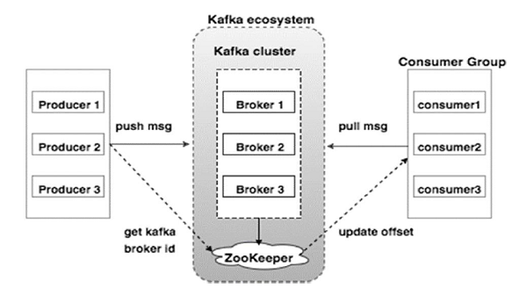
Kafka Architecture

Slide 8
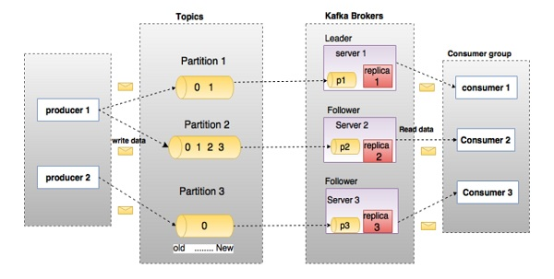
Kafka WorkFlow

Slide 9
Kafka Installation
Java:
$ java -version
Download JDK
http://www.oracle.com/technetwork/java/javase/downloads/index.html
Now the latest version is JDK 8u 60 and the file is “jdk-8u60-linux-x64.tar.gz”. Please download the file on your machine.
$ cd /go/to/download/path
$ tar -zxf jdk-8u60-linux-x64.gz
Set path
To set path and JAVA_HOME variables, add the following commands to ~/.bashrc file.
export JAVA_HOME =/usr/jdk/jdk-1.8.0_60
export PATH=$PATH:$JAVA_HOME/bin
Now apply all the changes into current running system.
$ source ~/.bashrc

Slide 10
Kafka Installation
ZooKeeper :
Download ZooKeeper
To install ZooKeeper framework on your machine, visit the following link and download the latest version of ZooKeeper.
http://zookeeper.apache.org/releases.html
As of now, latest version of ZooKeeper is 3.4.6 (ZooKeeper-3.4.6.tar.gz).
Extract tar file
Extract tar file using the following command
$ cd opt/
$ tar -zxf zookeeper-3.4.6.tar.gz
$ cd zookeeper-3.4.6
$ mkdir data

Slide 11
Kafka Installation
Create Configuration File
Open Configuration File named conf/zoo.cfg using the command vi “conf/zoo.cfg” and all the following parameters to set as starting point.
$ vi conf/zoo.cfg
tickTime=2000
dataDir=/path/to/zookeeper/data
clientPort=2181
initLimit=5
syncLimit=2
Once the configuration file has been saved successfully and return to terminal again, you can start the zookeeper server.
Start ZooKeeper Server
$ bin/zkServer.sh start
Starting zookeeper ... STARTED

Slide 12
Kafka Installation
Download and install scala-2.12
http://https://kafka.apache.org/downloads
rpm -ivh scala-2.12.rpm
2. Download and extract Kafka
http://https://kafka.apache.org/downloads
tar -xzf kafka_2.12-2.3.0.tgz
3. Move the extracted directory to /opt/mapr/kafka.
4. Modify /opt/kafka/config/server.properties to set log.dirs and also reflect zookeeper quorum settings.
log.dirs=/opt/kafka/logs
Zookeeper connection string can be found using “maprcli node list zookeepers”, then set :
zookeeper.connect=<zookeeper-server>:5181

Slide 13
Startup Kafka server
Go to
/opt/mapr/kafka/kafka_2.12-2.3.0/bin
Start Zookeeper:
./zookeeper-server-start.sh /opt/mapr/kafka/kafka_2.12-2.3.0/config/ zookeeper.properties
[2013-04-22 15:01:37,495] INFO Reading configuration from: config/zookeeper.properties (org.apache.zookeeper.server.quorum.QuorumPeerConfig)...
./kafka-server-start.sh /opt/mapr/kafka/kafka_2.12-2.3.0/config/server.properties
[2013-04-22 15:01:47,028] INFO Verifying properties (kafka.utils.VerifiableProperties)
[2013-04-22 15:01:47,051] INFO Property socket.send.buffer.bytes is overridden to 1048576 (kafka.utils.VerifiableProperties)...

Slide 14
Kafka Topics
Create a topic
Let's create a topic named "test" with a single partition and only one replica:
> bin/kafka-topics.sh --create --bootstrap-server <kafka-server>:9092 --replication-factor 1 --partitions 1 --topic test
“test” topic is created
We can now see that topic if we run the list topic command:
> bin/kafka-topics.sh --list --bootstrap-server <kafka-server>:9092
test
Alternatively, instead of manually creating topics you can also configure your brokers to auto-create topics when a non-existent topic is published to.

Slide 15
Publish-Subscribe messages
Producer service will start & produce messages/records.
./kafka-console-producer.sh --broker-list esekilx5568.rnd.ki.sw.ericsson.se:9092 --topic test
Consumer service will start & Consume the messages/records.
./kafka-console-consumer.sh --bootstrap-server esekilx5568.rnd.ki.sw.ericsson.se:9092 --topic test --from-beginning

Slide 16
Publish files to kafka
Producer service will start & publish the file data.
./kafka-console-producer.sh --broker-list esekilx5568.rnd.ki.sw.ericsson.se:9092 --topic test < /opt/mapr/kafka/employee.txt

Slide 17
Multi Broker/Multiple kafka servers
First we make a config file for each of the brokers.
cp config/server.properties config/server-1.properties
cp config/server.properties config/server-2.properties
Now edit these new files and set the following properties:
config/server-1.properties:
broker.id=1
listeners=9093
log.dirs=/opt/mapr/kafka/kafka-logs-1
config/server-2.properties:
broker.id=2
listeners=9094
log.dirs=/opt/mapr/kafka/kafka-logs-2

Slide 18
Multi Broker/Multiple kafka servers
> bin/kafka-server-start.sh config/server-1.properties &
> bin/kafka-server-start.sh config/server-2.properties &

