Slide 1



EV Vehicle/Charging Demand Prediction
NAME:- SIBANGA KUMAR SAHU
AICTE Student ID: STU6656c17d386901716961661
AICTE Internship ID: INTERNSHIP_1748923002683e727a876ea

Slide 2

Learning Objectives
Learn how electric vehicle adoption is growing over time and across different regions, using real-world registration data.
Practice cleaning datasets, handling missing values, and extracting meaningful features.
Learn how to use machine learning algorithms like Random Forest Regressor to forecast EV demand based on historical trends.
Create graphs (line plots, bar charts, heatmaps) to show trends in EV growth and charging demand visually.
Forecast future EV population by region.
GOAL
Source :
www.freepik.com/

Slide 3
Tools and Technology used
Python was used for programming due to its simplicity and strong ML libraries.
Pandas and NumPy helped with data loading, cleaning, and numerical operations.
Matplotlib and Seaborn were used to visualize EV trends and predictions.
Scikit-learn provided tools for training the Random Forest model and evaluating its accuracy.
Jupyter Notebook served as the coding and analysis environment.

Slide 4
Methodology
Loaded the EV population dataset using Pandas and explored its structure.
Cleaned the data by converting date formats, handling missing values, and capping outliers using the IQR method.
Performed feature selection and extracted relevant columns like state, county, year, and EV totals.
Used Random Forest Regressor to model the EV adoption/charging demand.
Split the data into training and test sets using train_test_split.
Applied RandomizedSearchCV for hyperparameter tuning to improve model performance.
Evaluated model accuracy using R² Score, MAE, and RMSE metrics.
Visualized prediction results and trends using Seaborn and Matplotlib.

Slide 5
Problem Statement:
The rapid rise in electric vehicle (EV) adoption creates a growing need to predict future EV demand and plan for adequate charging infrastructure. However, there’s a lack of predictive insight into where and when EV demand will rise across different regions. This project aims to analyze historical EV registration data and use machine learning to forecast EV adoption trends. The goal is to support government bodies, city planners, and utility providers in making data-driven decisions. Accurate predictions will help optimize charging station placement, reduce grid stress, and improve resource allocation.

Slide 6
Solution:
Developed a Machine Learning model (Random Forest Regressor) to forecast EV adoption and charging demand.
Used historical EV population data to identify trends and generate predictive insights.
Applied data cleaning, preprocessing, and feature engineering for accurate modeling.
Implemented hyperparameter tuning using RandomizedSearchCV to optimize model performance.
Generated region-wise EV adoption predictions to aid in charging station planning.
The solution offers a data-driven tool to support infrastructure development and policy decisions.
GitHub repo: https://github.com/sibanga/AICTE_Internship_Week1.git

Slide 7
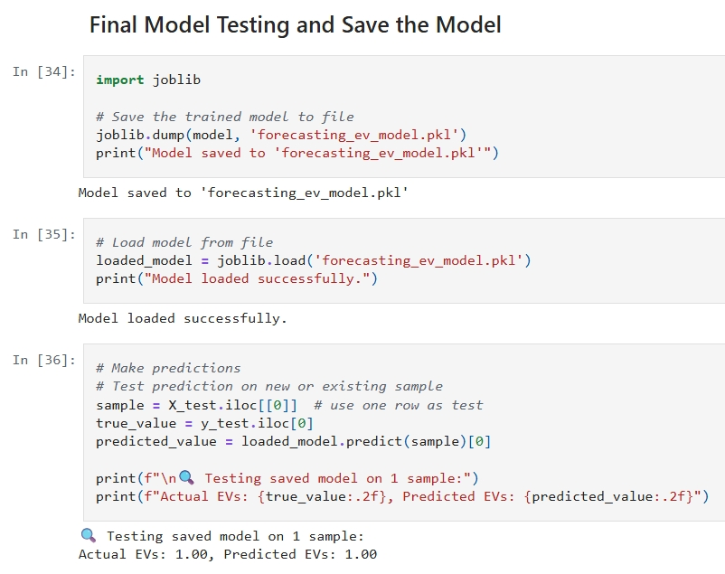
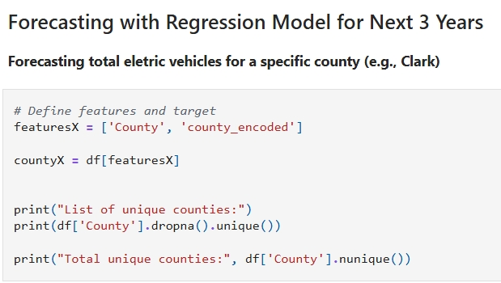
Screenshot of Output:

Slide 8
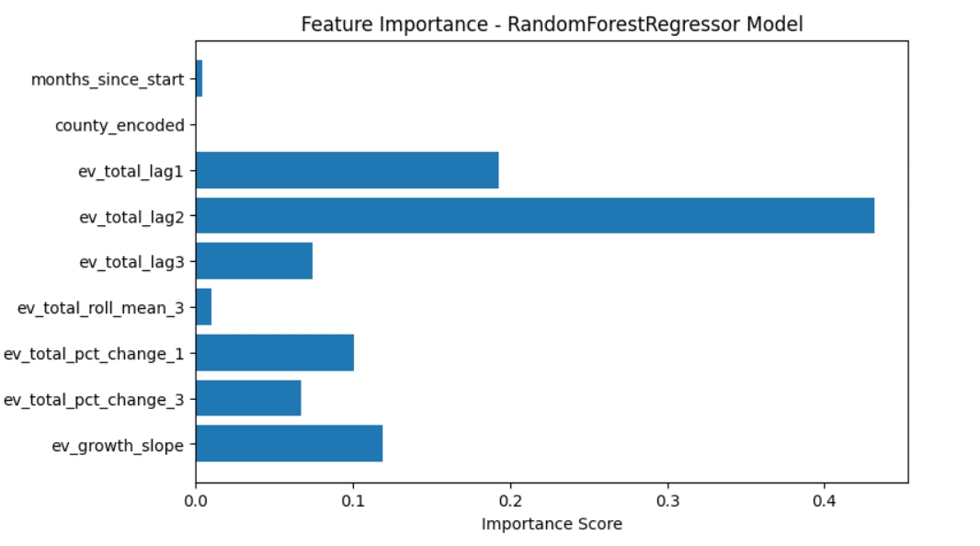
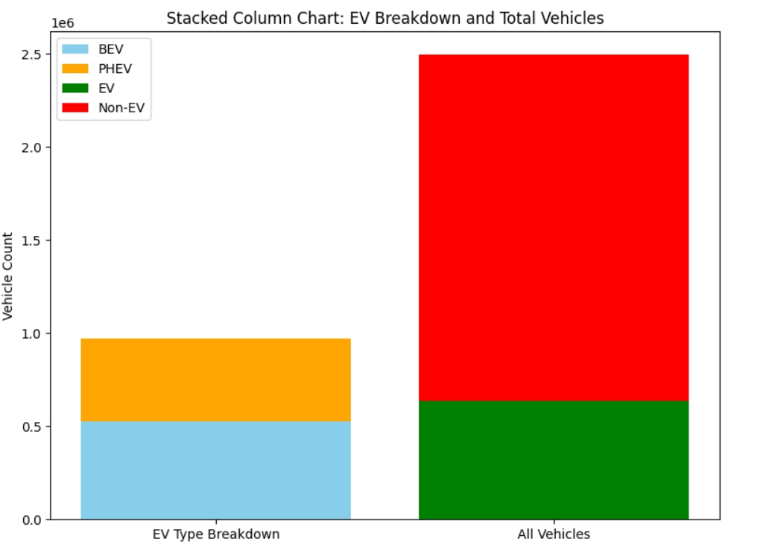
Visual presentation:

Slide 9
Conclusion:
Successfully built a machine learning model to predict EV adoption and charging demand.
Used historical data to uncover trends in electric vehicle growth across different regions.
The Random Forest Regressor showed high accuracy in predicting future EV adoption.
Visualization of results confirmed strong alignment between actual and predicted values.
The model supports planning for charging infrastructure and energy distribution.
Enables government and city planners to make informed, data-driven decisions.
Offers a scalable approach to forecast and manage future EV demands efficiently.

