Slide 1
Computer Networks COL 334 / COL 672
Course Instructor: Dr. Abhijnan Chakraborty
Slot E: Tuesday, Wednesday and Friday 10-11 AM
Room: Lecture Hall 111

Slide 2
Introductory course on computer networks
This course provides an introduction to computer networks, with a special focus on the Internet architecture and protocols.
The course will cover protocols at the Application, Transport, Network and Data Link layers (won’t go into physical layer).
We will cover network security and wireless networks.
Topics include layered network architectures, addressing, naming, forwarding, routing, communication reliability, the client-server model, web and email protocols.
Besides the theoretical foundations, students will acquire practical experience through the programming assignments.

Slide 3
Textbooks
Primary: Computer Networking: A Top-Down Approach by Jim Kurose and Keith Ross.
Computer Networks: A Systems Approach by Larry Peterson and Bruce Davie.

Slide 4
Evaluation
Minor Exam (35%)
Major Exam (40%)
Programming Assignments (25%)
Audit criteria: 40% marks overall AND at least 30% in each of the components

Slide 5
Programming Assignments
Assignment is to be done and submitted individually.
Needs to be submitted within the deadline.
There will be penalties on late submission.
No marks for mere submission.
There will be separate evaluations for each of the assignments.

Slide 6
Attendance
At least 70% to be eligible to sit in the major exam.

Slide 7
No Cheating
Fine to talk with other students about assignments
But only general concepts, not specifics
General rule: no copying of specifics
If you’re unsure, then ask.
Will use similarity detection software
Any cheating (in assignments/exams) – Fail (F Grade)
Don’t come with excuses later
Notes:
WE will do everything to help you get through this course.

Slide 8
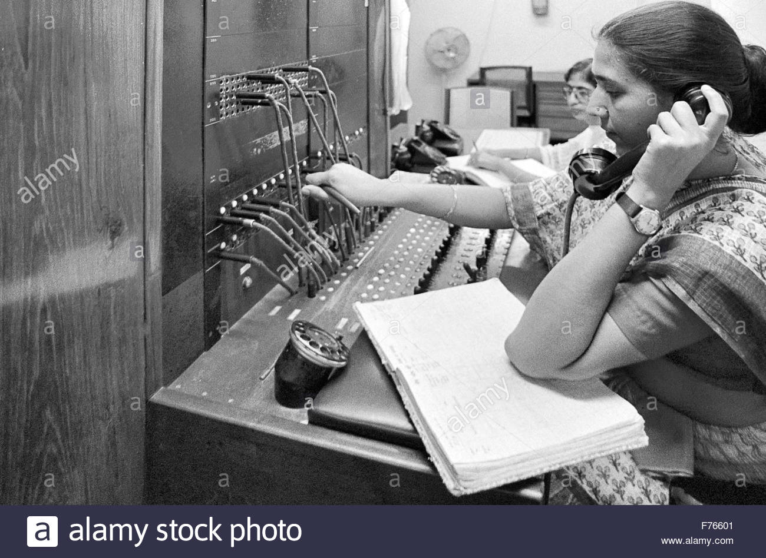
What is this course about?
Networks
Road Network – traffic
Telephone Network – traditionally build a circuit
Internet is a Packet data network
This course is about the Internet

Slide 9
Goals for the Internet
Ability to connect many different networks
Ability to scale to the entire world
Ability to recover from failures
Basic network technology goals
Speed
Cost
Port-density
Reliability
Other “features”: quality of service, security, etc..
These are harder and more interesting goals!
(more architectural than engineering)

Slide 10
Architecture vs Engineering
Architecture:
The allocation of functionality and definition of interfaces among elements
The Internet “architecture” is the decision about what tasks get done, and where:
In the network, or in the hosts
Engineering is more about how tasks get done
These architectural decisions play a crucial role in scaling, heterogeneity, robustness, etc…

Slide 11
What topics will this course cover?
The core of the Internet “architecture”:
IP, DNS, BGP
Other technologies crucial to the Internet
Higher-level protocols: TCP, HTTP.…
Crucial lower-level technologies: Ethernet, wireless…
These are the two network technologies we will study because they raise interesting questions about shared media
Won’t cover network topics not crucial to Internet
But that doesn’t mean they aren’t interesting
E.g., sensornets, low-level encoding, radio technology

Slide 12
Various perspectives on the Internet
Different levels of abstraction
Basic concepts versus actual protocols
Different geographic scales:
LAN vs Enterprise vs WAN vs Interdomain
Different conceptual approaches:
Architecture vs Protocol vs Algorithm
Different aspects of functionality:
Different “layers” focus on different tasks
Notes:
What are layers???

Slide 13
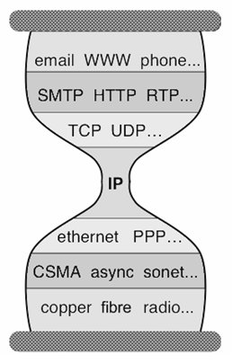
The Internet: an hourglass with layers
Application
Application
Protocol
Reliable
Delivery
Unreliable
Packet Delivery
Lower-level
Network
Physical
Layers

Slide 14
Fundamental conceptual questions
How can you deliver packets from source to destination?
How do you build reliable transport on top of an unreliable network?
How can you federate a set of competing ISPs?
….

Slide 15
Internet has had tremendous impact
Internet changed the way we gather information
Web, Search engines
Internet changed the way we relate to each other
Email, Facebook, twitter
Which one would you choose?
Computers without the Internet (standalone PCs)
Internet without modern computers

Slide 16
The Internet introduced new paradigm
Completely different from the phone network
Inventors had to overcome strong technical and commercial resistance to realize their dreams
Motivation not for personal gain, but societal benefit!
A true success story of “thinking differently”
Their strong vision kept the design on track
Brilliant in conception, sometimes weak in execution
Read internet history: https://www.scienceandmediamuseum.org.uk/objects-and-stories/short-history-internet

Slide 17
Let’s start the journey!

