Slide 1
User Datagram
Protocol
(UDP)

Slide 2
CONTENTS
PROCESS-TO-PROCESS COMMUNICATION
USER DATAGRAM
CHECKSUM
UDP OPERATION
USE OF UDP

Slide 3
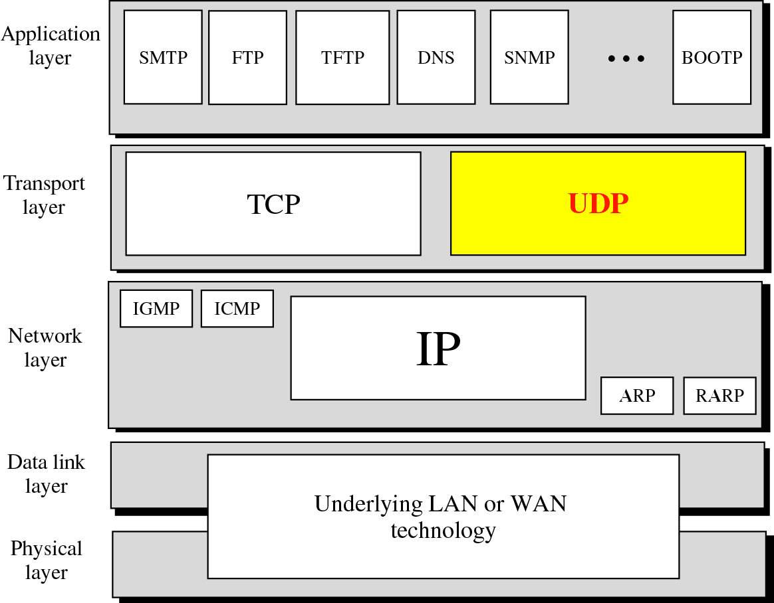
Position of UDP in the TCP/IP protocol suite

Slide 4
PROCESS
TO
PROCESS
COMMUNICATION

Slide 5
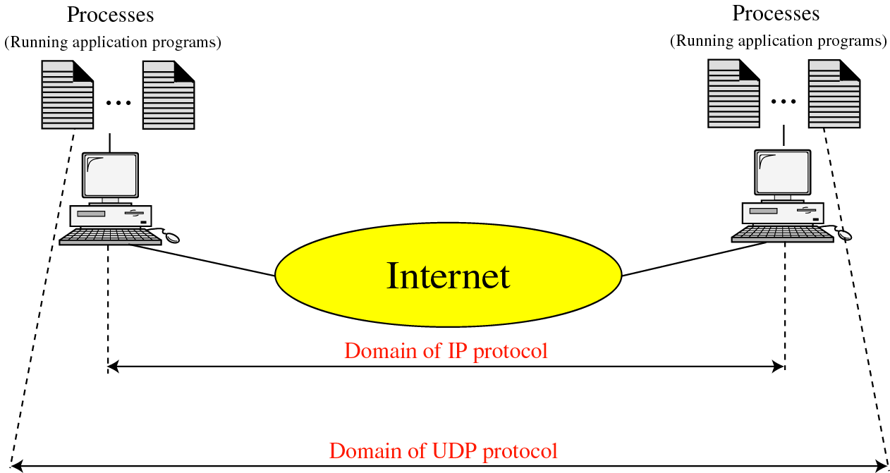
UDP versus IP

Slide 6
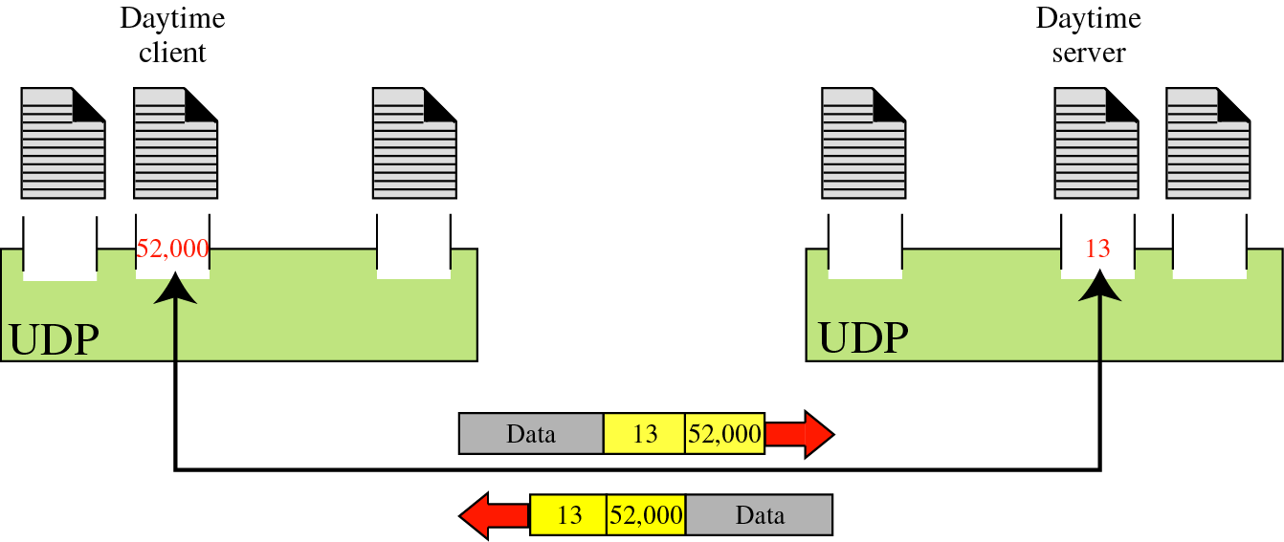
Port numbers

Slide 7
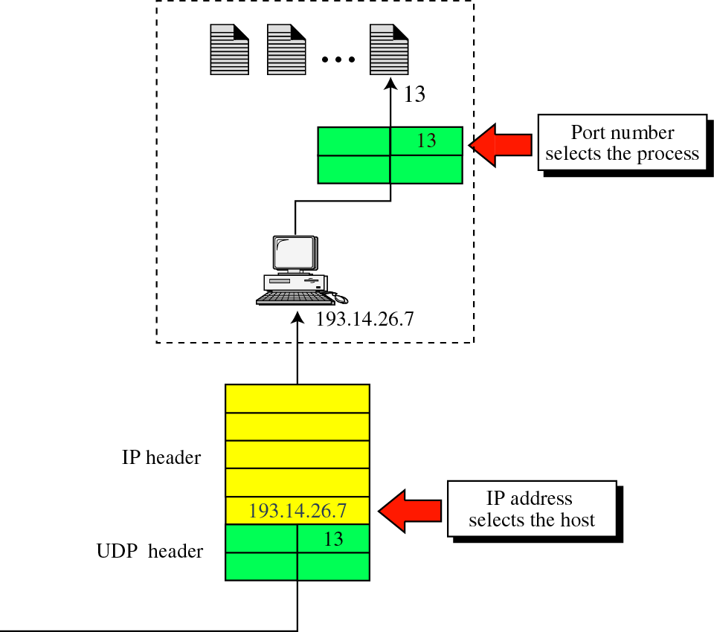
IP addresses versus port numbers

Slide 8
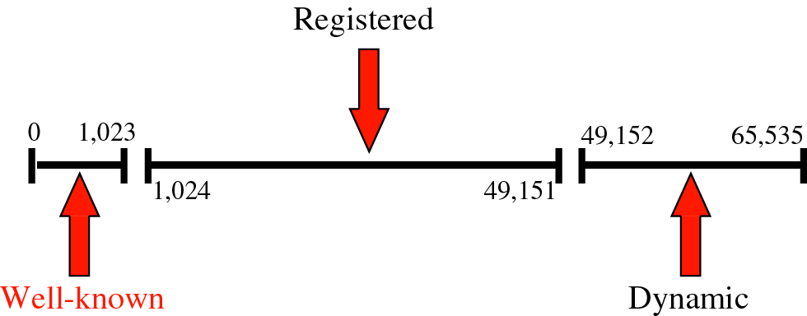
IANA ranges

Slide 9
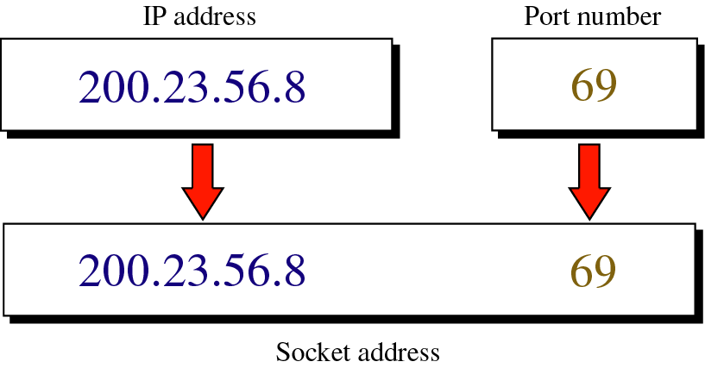
Socket addresses

Slide 10
USER
DATAGRAM

Slide 11
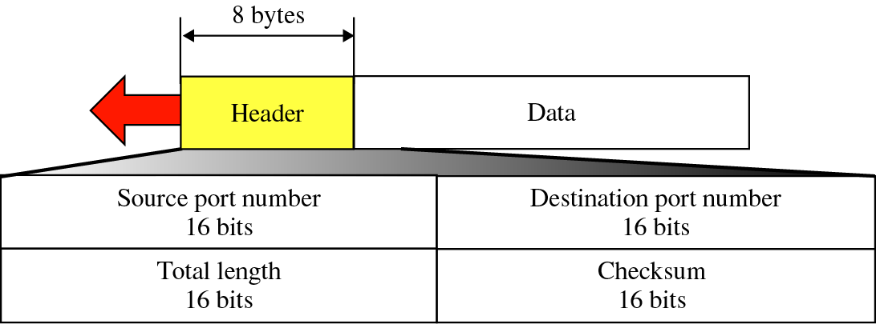
User datagram format

Slide 12

UDP length =
IP length − IP header’s length

Slide 13
CHECKSUM

Slide 14
UDP
OPERATION

Slide 15
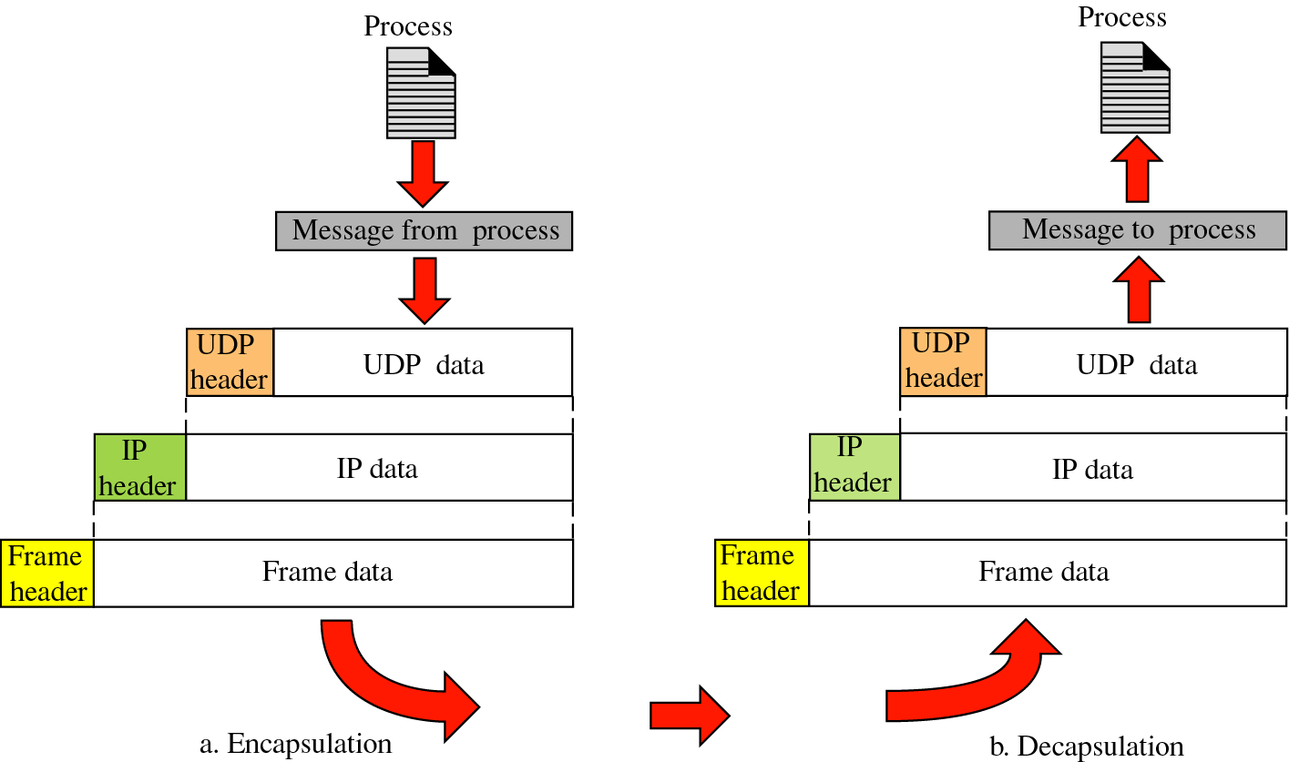
Encapsulation and decapsulation

Slide 16
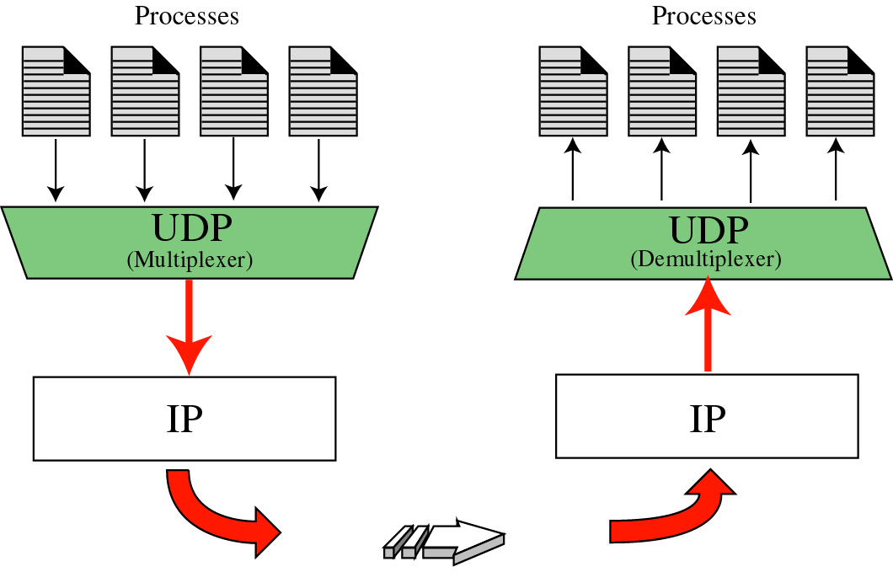
Multiplexing and demultiplexing

Slide 17
USE
OF UDP

