Slide 1










Network analysis of
Microorganisms

Slide 2
WHAT IS A NETWORK ANALYSIS?

Slide 3
WHAT IS A NETWORK ANALYSIS?
A way to study relationships

Slide 4
WHAT IS A NETWORK ANALYSIS?
A way to study relationships
Nodes
The “end points” of a relationship
Edges
Connection between nodes

Slide 5
WHAT IS A NETWORK ANALYSIS?
A way to study relationships
Nodes
The “end points” of a relationship
Edges
Connection between nodes

Slide 6
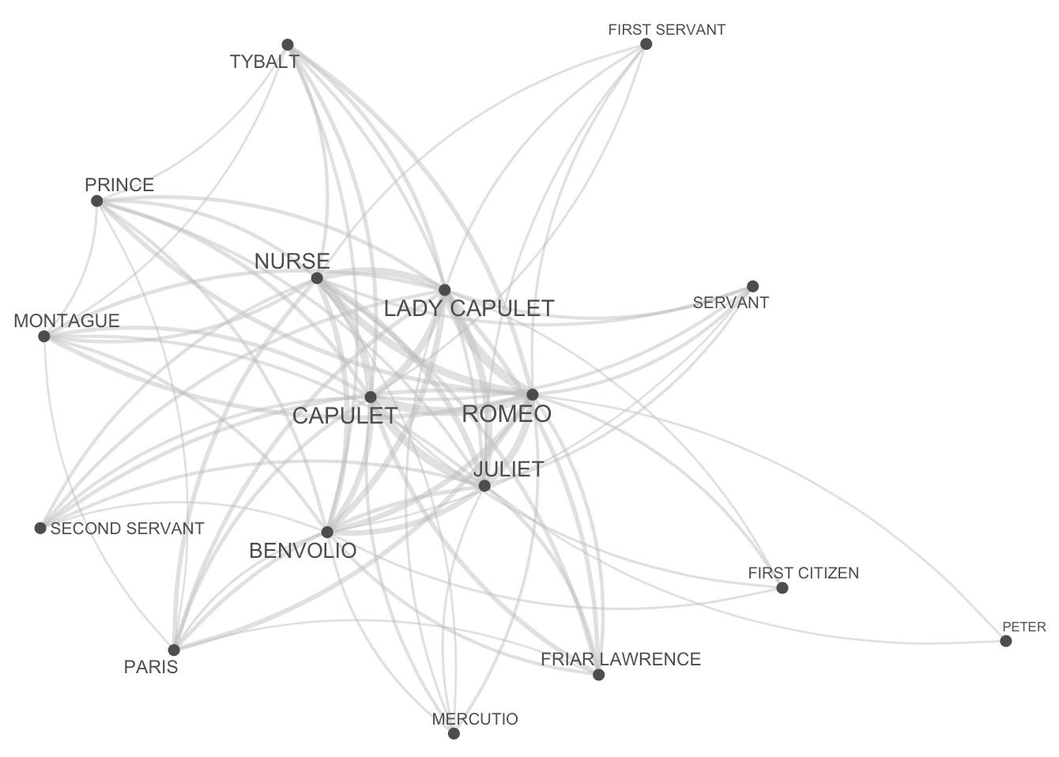
Frequency of characters in Romeo and Juliet appearing in the same scene

Slide 7
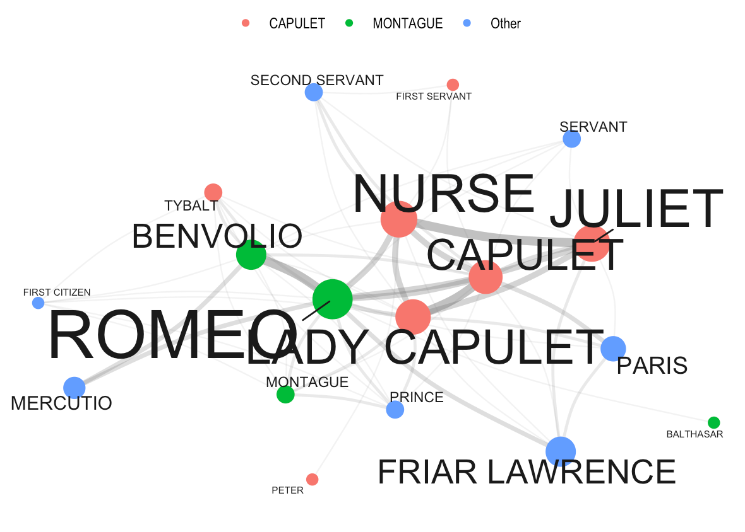
Frequency of characters in Romeo and Juliet appearing in the same scene
Notes:
Modules are groups of nodes more densely connected overall, not necessarily with the strongest individual links.
- You can have a best friend outside of your main friend group (large edge) but you know everyone within your group collectively more
- A node may stay in a module where it has more connections overall, even if its strongest individual connection is to a node in another module.

Slide 8
WHAT IS A MICROBIAL NETWORK ANALYSIS?
Relationships between microbes
Nodes
Microbes (OTUs,ASVs,Species)
Edges
Connection between nodes
Notes:
Operational Taxonomic Unit
Amplicon sequence variant
- Unlike Operational Taxonomic Units (OTUs), which group sequences based on similarity, ASVs distinguish sequences based on single nucleotide differences

Slide 9
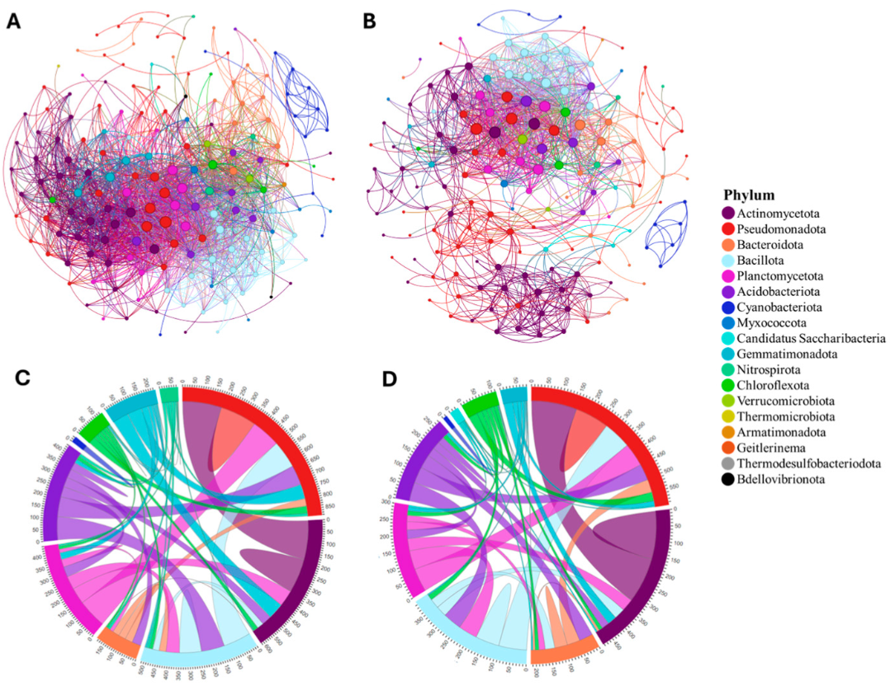
Rhizosphere Microbiome Co-Occurrence Network Analysis across a Tomato Domestication Gradient
Dixon et al. 2024
(A) Co-occurrence network diagram in unfertilized soil. (B). Co-occurrence network diagram in fertilized soil. (C) Chord diagram in unfertilized soil. (D) Chord diagram in fertilized soil

Slide 10




Microbial network analyses tools in R
Package | Strength | Functionality | Ideal For
cooccur |  | Binary co-occurrence only | Presence / absence only No visuals
NetCoMi |  | Microbial networks | Network construction and analysis
microeco |  | Full pipeline | Full microbiome data pipeline Data clean up and visualization
SpiecEasi |  | Sparse networks | Stats pros and model masters only Can build sparse association networks (only the most statistically significant connections are kept

Slide 11
Microbial network analyses tools in R
Package | Strength | Functionality | Ideal For
cooccur |  | Binary co-occurrence only | Presence / absence only No visuals
NetCoMi |  | Microbial networks | Network construction and analysis
microeco |  | Full pipeline | Full microbiome data pipeline Data clean up and visualization
SpiecEasi |  | Sparse networks | Stats pros and model masters only Can build sparse association networks (only the most statistically significant connections are kept
https://chiliubio.github.io/microeco_tutorial/intro.html

