Slide 1
Web Technologies Lab
Sibi Chakkaravarthy Sethuraman
Computer Science and Engineering
VIT-AP, Amaravati, India

Slide 2
Points to Ponder
Don’t use laptop
Keep your bag outside

Slide 3
Launch your own (first) github.io page

Slide 4
Launch your first static page in any (web) server
Signup → https://in.000webhost.com/ or hostinger or infinityfree
Signup → http://www.dot.tk/en/index.html?lang=en or Dottk or freenom

Slide 5
Registering Domain and Configuring Nameserver

Slide 6
Basic HTML Tags and Exercises
Create a webpage that prints your name to the screen.
Create a webpage and set its title to “Welcome to VIT-AP".
Create a webpage that prints your name in Sky blue to the screen.
Print the numbers 1 - 10, each number being a different color.
Create a web page to print your name in a Calibri font.
Solution in https://github.com/sibichakkaravarthy/sibichakkaravarthy.github.io

Slide 7
Basic HTML Tags and Exercises – Cont’d..
Print a paragraph with 4 - 5 sentences. Each sentence should be a different font.
Print a paragraph that is a description of a book, include the title of the book as well as its author. Names and titles should be underlined, adjectives should be italicized and bolded.
Print your name to the screen with every letter being a different heading size.
Solution in https://github.com/sibichakkaravarthy/sibichakkaravarthy.github.io

Slide 8
Basic HTML Tags and Exercises – Cont’d..
Print the squares of the numbers 1 - 20. Each number should be on a separate line, next to it the number 2 superscripted, an equal sign and the result. Example: 10⁴ = 10000
Print two paragraphs that are both indented (Use &nbsp)
(nbsp - Non Breaking Space Publishing)
Solution in https://github.com/sibichakkaravarthy/sibichakkaravarthy.github.io

Slide 9
Basic HTML Tags and Exercises – Cont’d..
Print two lists with any information you want. One list should be an ordered list, the other list should be an unordered list.
Change the ordered list and represent the ordering in number, alphabets and Roman numerals
Prints an h1 level heading followed by a horizontal line whose width is 100%. Below the horizontal line print a paragraph relating to the text in the heading.
Use delete and insert tag to print the following
HTML is a programming language → Strike this
HTML is not a programming language → Insert this
Solution in https://github.com/sibichakkaravarthy/sibichakkaravarthy.github.io

Slide 10
Basic HTML Tags and Exercises – Cont’d..
Print a long quote and a short quote. Use tags <blockquote></blockquote> and <q></q>.
Definition and Usage Tags (DL/DT/DD)
Usage <dl><dt><dd></dd></dt></dl>
There is Address tag also
Usage <address> </address>
Solution in https://github.com/sibichakkaravarthy/sibichakkaravarthy.github.io

Slide 11
Basic HTML Tags and Exercises – Cont’d..
Create a link to Google search engine
Create a page with a link at the top of it that when clicked will jump all the way to the bottom of the page.
Create a page with a link at the bottom of it that when clicked will jump all the way to the top of the page.
Create a page with a link at the top of it that when clicked will jump all the way to the bottom of the page. At the bottom of the page there should be a link to jump back to the top of the page.
Solution in https://github.com/sibichakkaravarthy/sibichakkaravarthy.github.io

Slide 12
Basic HTML Tags and Exercises – Cont’d..
Display different images. Skip two lines between each image. Each image should have a title.
Display an image that has a border of size 2, a width of 200, and a height of 200.
Display an image that when clicked will link to a VITAP home page
Display an image that when clicked will link to itself and will display the image in the browser by itself
TO comment HTML tags use
Syntax: <!– your code goes here -->
Solution in https://github.com/sibichakkaravarthy/CSE4004-*

Slide 13
Basic HTML Tags and Exercises – Cont’d..
Defining HTML table
Align attribute (right, left, top, bottom)
Classwork – Design your own resume
Solution in https://github.com/sibichakkaravarthy/sibichakkaravarthy.github.io

Slide 14
HTML and CSS
Create a web page with basic tags such as paragraph, heading, anchor, hyperlink
Add inline style to all the tags
Add an external and embedded styles

Slide 15
Stylesheets - font
Create a web page with basic tags such as paragraph, heading
Create an external stylesheets and add the following styles
Change font
Change font style
Set font size with pixels, pica, point, em and percentage
Add strokes to the font
Change the letters inside <p> to all caps
Align all the paragraph to center
Change the font color
Note: 1em is equal to the current font size. The default text size in browsers is 16px. So, the default size of 1em is 16px

Slide 16
Stylesheets - text
Adding shadow to the text using text-shadow property
Transforming text to all caps, small using text-transform property

Slide 17
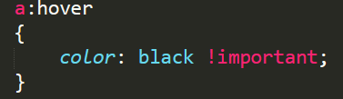

Playing with HTML and CSS – Exercise 1
Body
Pick a nice background color, font family/color/size and line-height for the <body>
Setting font properties at the body-level will apply it on all basic texts (<p><li> ..etc.,)
Headers
Choose a nice color and font-family for headers (<h1…h6>
Choose font size and line-height for headers
Resize image with width
Links
Change links colors & text decoration
Add some hover effects on links using the hover property
Add some hover effects using background-image property

Slide 18
Playing with HTML and CSS – Exercise 2
Create a web page with basic tags such as paragraph, heading, anchor, hyperlink
Add inline styles to each tag
Add an embedded styles on the same web page and try to override the styles of paragraph

Slide 19
Embedding JS into HTML page
Use <script> tag to specify your JavaScript
<head
<script>
// your JS code
</script>
</head>

Slide 20
Types of JavaScript
Inline JavaScript
Drawback: JS code will not be cached.
(The browser will not be able to store it in cache, thus requiring it to fetch the full HTML file each time).
Embedded or Internal JavaScript
External JavaScript

Slide 21
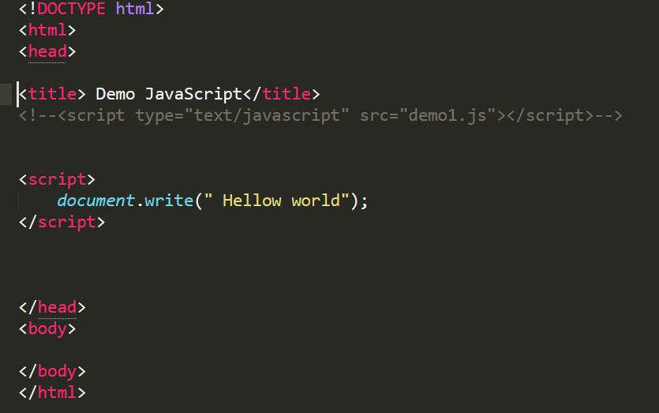
Hello world in JS

Slide 22
JavaScript Variable: Declare, Assign a Value
use the keyword var to declare a variable
Example:
Var name = “sibi”;
or
Var name;
Name = “sibi”;

Slide 23
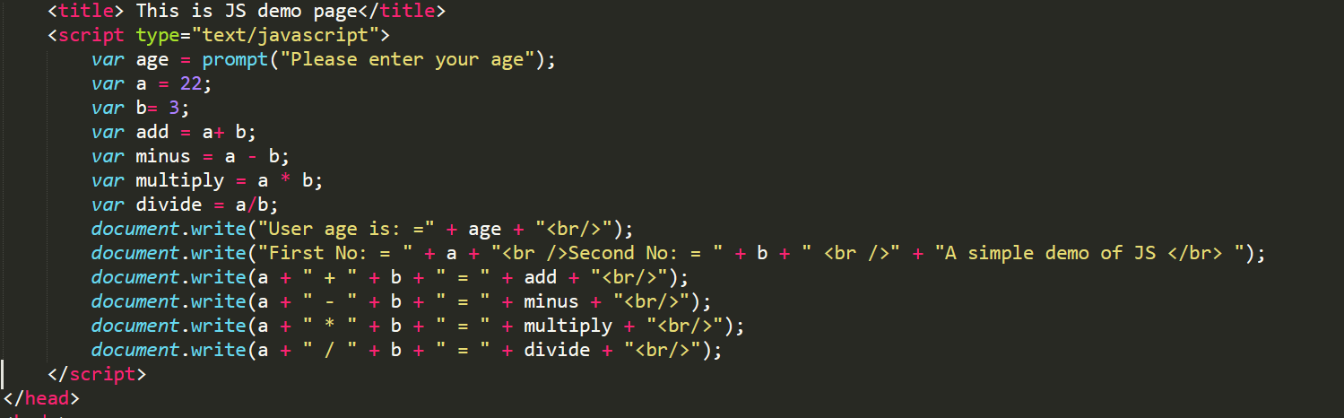
JS – Example code

Slide 24
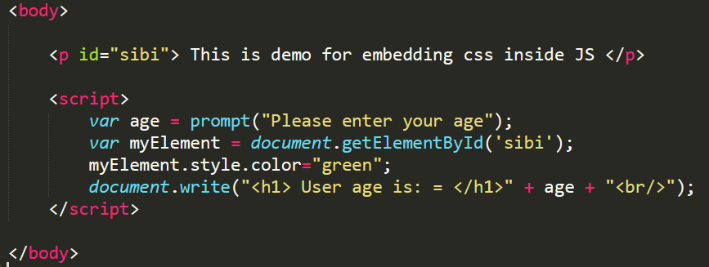
Embedding html tags and CSS in JavaScript

Slide 25
HTML Events and JS Event Handling
HTML events are "things" that happen to HTML elements.
or
HTML events are the characteristics of the HTML elements
Example: An HTML button was clicked
When JavaScript is used in HTML pages, JavaScript can "react" on these events.

Slide 26
Event1 – Text event handling
<!DOCTYPE html>
<html>
<body>
<h1 onclick="this.innerHTML=‘Text Changed!’">Click on this text!</h1>
</body>
</html>

Slide 27
Event 2 – Button event
<!DOCTYPE html>
<html>
<body>
<button onclick="this.innerHTML=Date()">The time is?</button>
</body>
</html>

Slide 28
Event 3 – Button + HTML element event
<!DOCTYPE html>
<html>
<body>
<button onclick="document.getElementById('demo').innerHTML=Date()">The Date and time is?</button>
<p id="demo">Now in this place Date and Time will be displayed</p>
</body>
</html>

Slide 29
HTML elements
Finding HTML elements by id
Example: var myElement = document.getElementById(“sibi");
Finding HTML elements by tag name
Example: var x = document.getElementsByTagName("p");
Finding HTML elements by class name
Example: var x = document.getElementsByClassName("intro");

Slide 30
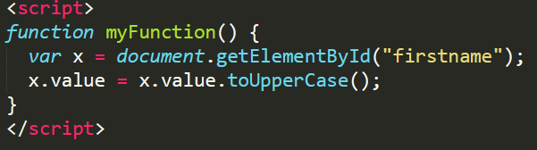
Event 4 - Function

Slide 31
Event 5 – Mouse Event
Onmouseover() and onmouseout()
Onmousedown() and onmouseup()
or
Onclick()

Slide 32
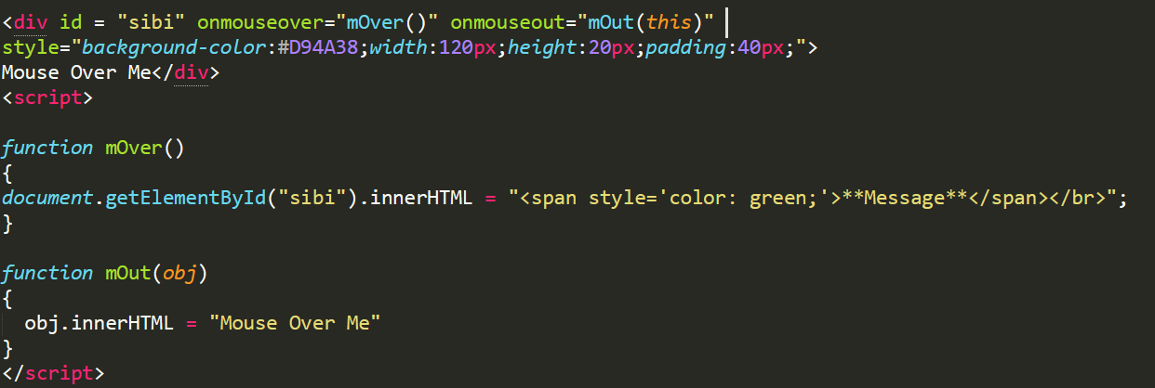
onmouseover() and onmouseout()

Slide 33
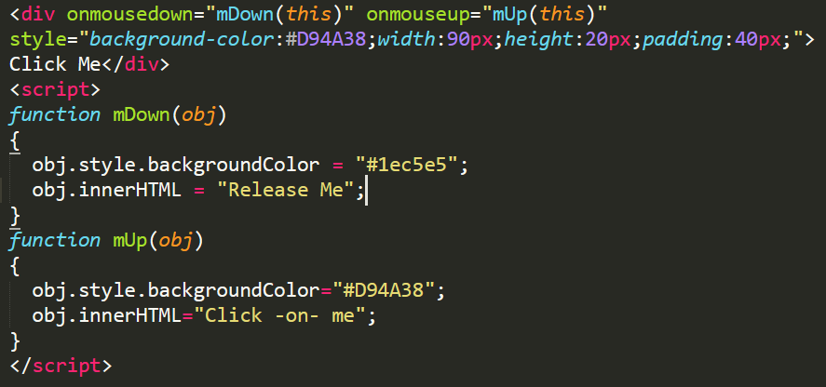
Onmousedown() and onmouseup()

Slide 34
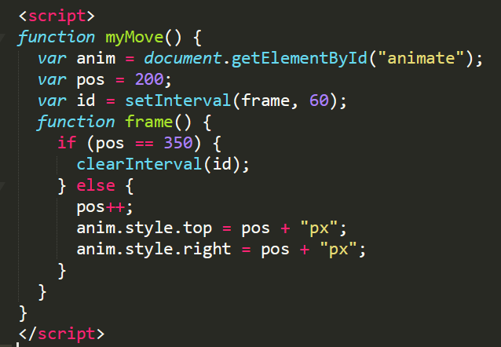
Event 6 – A simple graphics using JS
What is this pos denotes?
You can control framerate also
Why navigation till 350px
Clears the frame on the current rendered frame

Slide 35
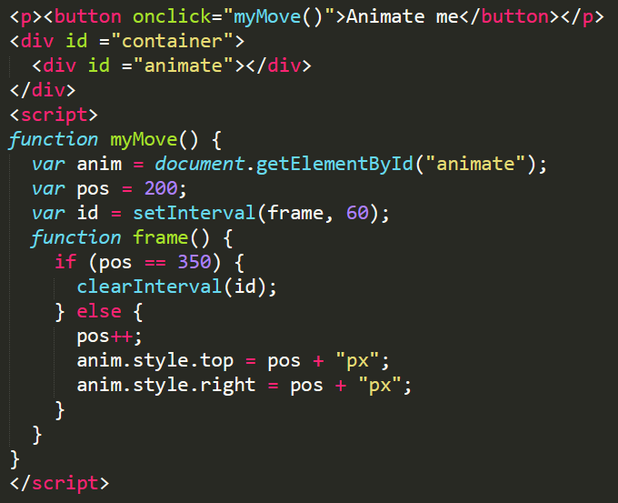
A simple graphics using JS

Slide 36
JavaScript – Classwork Lab Practice – 30.07.2019
Create a web page with basic tags such as paragraph, heading, anchor, hyperlink
Add inline styles to each tag
Create a div container at the top left and bottom right corner to display date and time.
Create a button which changes the inner html text when clicked.
Create a div container and load the image.
Perform mouse over operation to change the image.
Perform alert message “ Mouse near me” when the mouse is hover the image.
Perform alert message “ Mouse near me” when the mouse is clicked on the image.
When mouse is clicked change the position of the div container to the top right.
Solution -> https://github.com/sibichakkaravarthy/CSE4004-*

Slide 37
Create your own web server to handle and serve client request
Create a web socket
Bind the socket connection using IP and Port
Listen for the connection
Accept the connection using connection IP and Port
Receive the request
Process the request and acknowledge

Slide 38
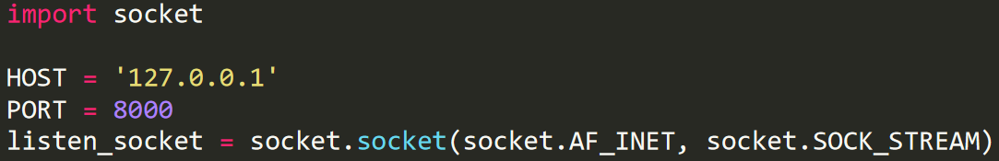
Create your own web server to handle and serve client request
Create a socket
(WebSockets provide a persistent connection between a client and server that both parties can use to start sending data at any time. The client establishes a WebSocket connection through a process known as the WebSocket handshake. This process starts with the client sending a regular HTTP request to the server).

Slide 39

Binding and Listening for the connection
Binding the socket connection using IP and Port and listening for the connection

Slide 40
Accepting the request from the client
Accept the connection using connection IP and Port

Slide 41
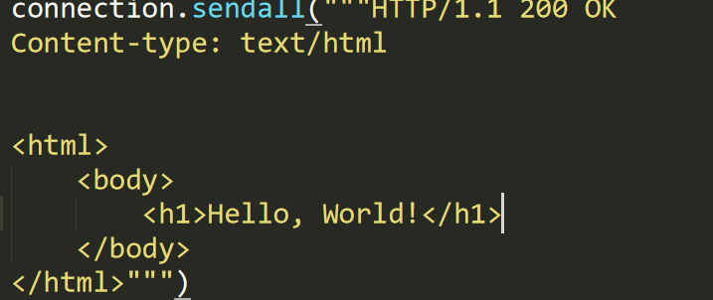
Serving the clients with static web page

Slide 42

Closing the socket
Terminating the communication between the client and server

Slide 43
Create your own web server to listen continuously and handle all the client request

Slide 44
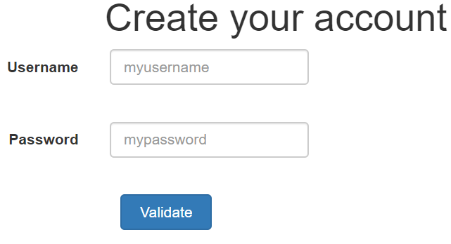
JS,HTML,CSS – Classwork Lab Practice – 06.08.2019
Design a form as given
(With proper margin)
On clicked the input text box should be highlighted
On button click validate for bad username and password and highlight the same.
Create another button on the middle of view port (use box model for button positioning)
On button click retrieve the location

Slide 45
Data representation – Classwork lab practice – 27.08.2019
Design a web application to retrieve the weather data from https://openweathermap.org
Task 1:
Draw a vertical line to split the web page into two verticals.
Retrieve the city name and coordinates (use forecast id)
Create a table and display Vijayawada & Mumbai weather (use current weather data and forecast id)
Note: Use json formatters to format json data for better visualization.

Slide 46
Data representation – Classwork lab practice – 03.09.2019
Design a web application to retrieve the weather data from https://openweathermap.org
Task 2:
Integrate google map api.
Retrieve the city name and coordinates (use forecast id)
Retrieve the icon img from openweathermap and plot the weather conditions (use icons from openweathermap)

Slide 47
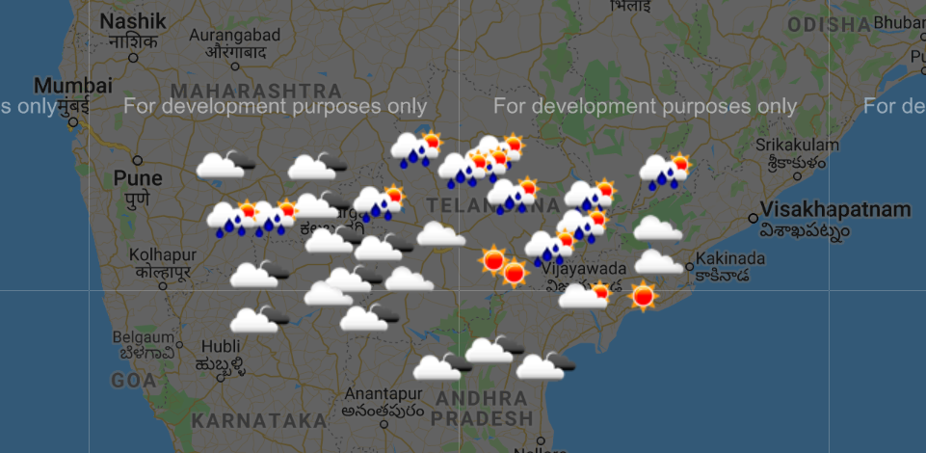
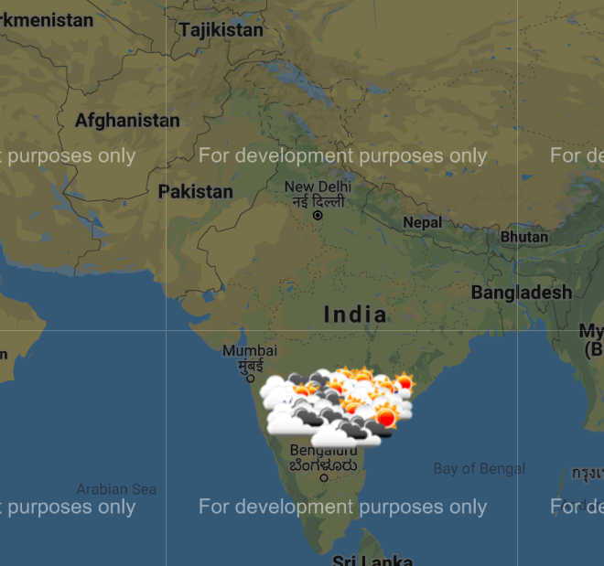
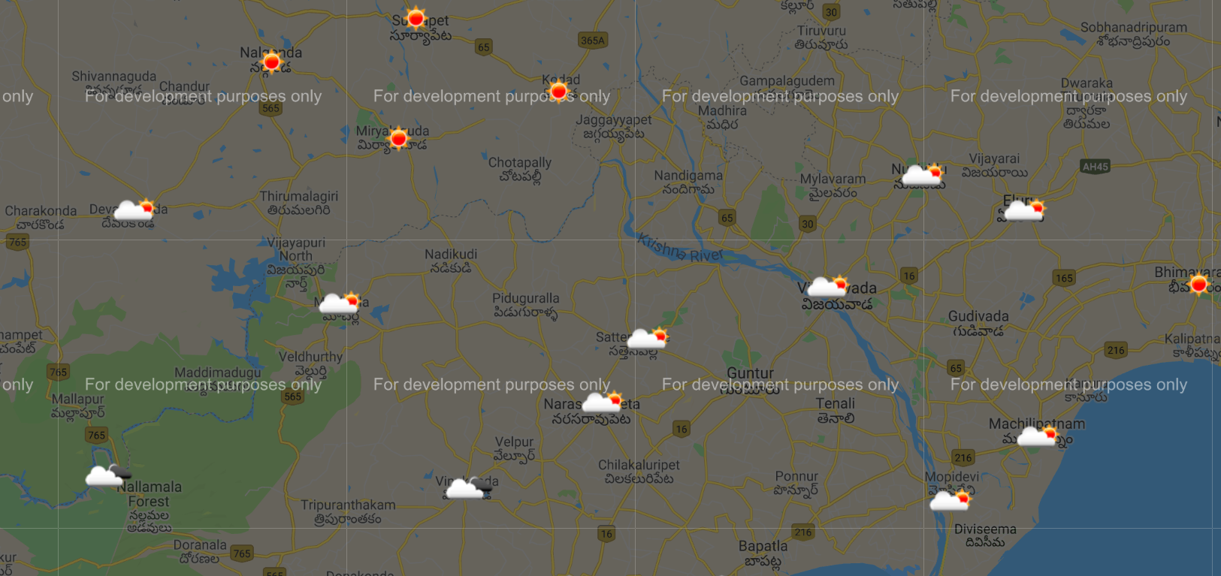
Sample output

Slide 48
Working with Servlets
Create a simple servlet to print basic <h> tags.
Create a simple button and invoke a servlet on button click.

Slide 49
Life Cycle of Servlet
servlet
GenericServlet
HttpServlet
init(ServletConfig);
doGet(HttpServletRequest,
HttpServletResponse);
service(ServletRequest,
ServletResponse);
doPost(HttpServletRequest,
HttpServletResponse);
…….
destroy();

Slide 50
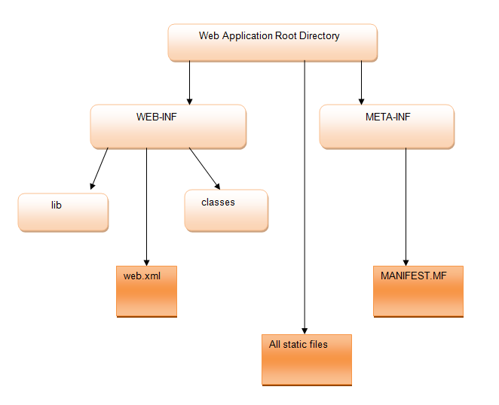
Servlet container folder structure

Slide 51
Servlets – How multiple request, response gets handled
Inside the web (servlet) container, we have a special file called deployment descriptor (web.xml)
Inside web.xml, we define, for which request which servlet should be called.

Slide 52
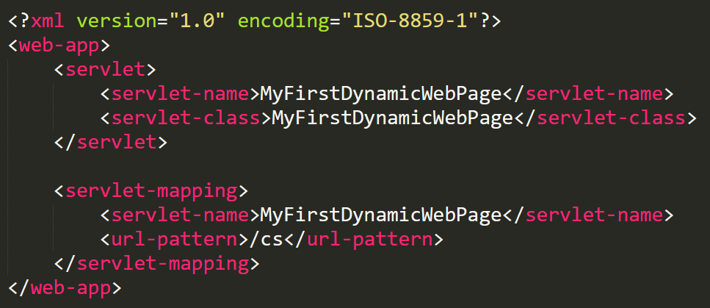
Web.xml

Slide 53
HttpServlet
Base class for web-based servlets
Overrides method void service ()
Request methods:
GET
POST
Methods doGet and doPost respond to GET and POST
Called by service
Receive HttpServletRequest and HttpServletResponse objects
GET and POST method is used to transfer data from client to server in HTTP protocol but Main difference between POST and GET method is that GET carries request parameter appended in URL string while POST carries request parameter in message body which makes it more secure way of transferring data from client to server

Slide 54
HttpServletRequest
HttpServletRequest interface
Object passed to doGet and doPost
Extends ServletRequest
Methods
String getParameter( String name )
Returns value of parameter name (part of GET or POST)
Enumeration getParameterNames()
Returns names of parameters (POST)
String[] getParameterValues( String name )
Returns array of strings containing values of a parameter
Cookie[] getCookies()
Returns array of Cookie objects, can be used to identify client

Slide 55
HttpServletResponse
HttpServletResponse
Object passed to doGet and doPost
Extends ServletResponse
Methods
void addCookie( Cookie cookie )
Add Cookie to header of response to client
ServletOutputStream getOutputStream()
Gets byte-based output stream, send binary data to client
PrintWriter getWriter()
Gets character-based output stream, send text to client
void setContentType( String type )
Specify MIME type of the response (Multipurpose Internet Mail Extensions)
MIME type “text/html” indicates that response is HTML document.
Helps display data

