Slide 1
Sales_Analysis_USA
File created on: 11/29/2024 10:49:53 AM

Slide 2
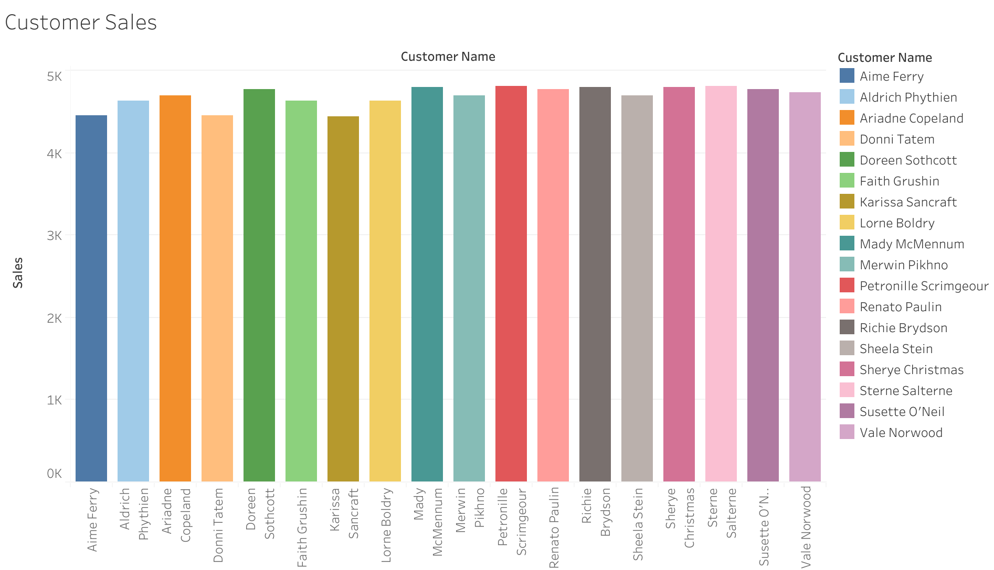

Slide 3
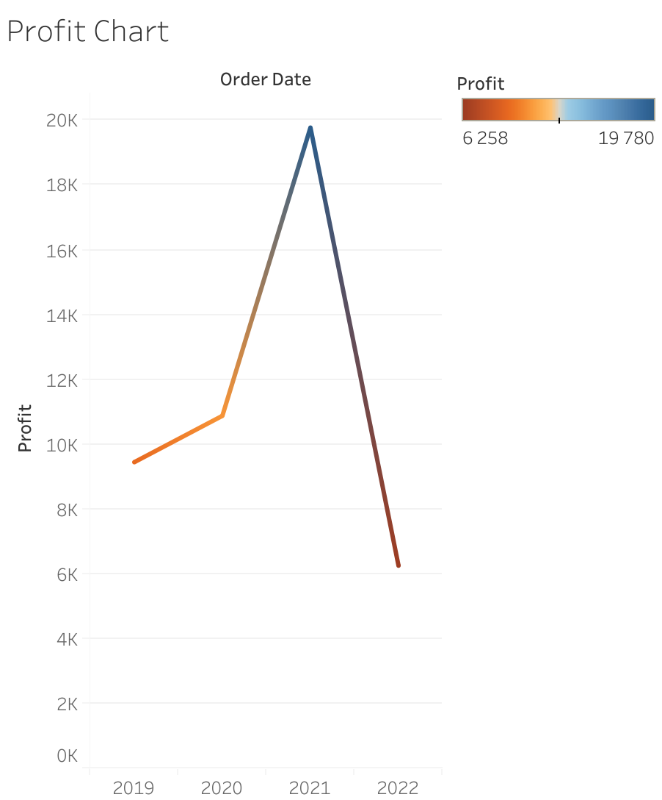

Slide 4
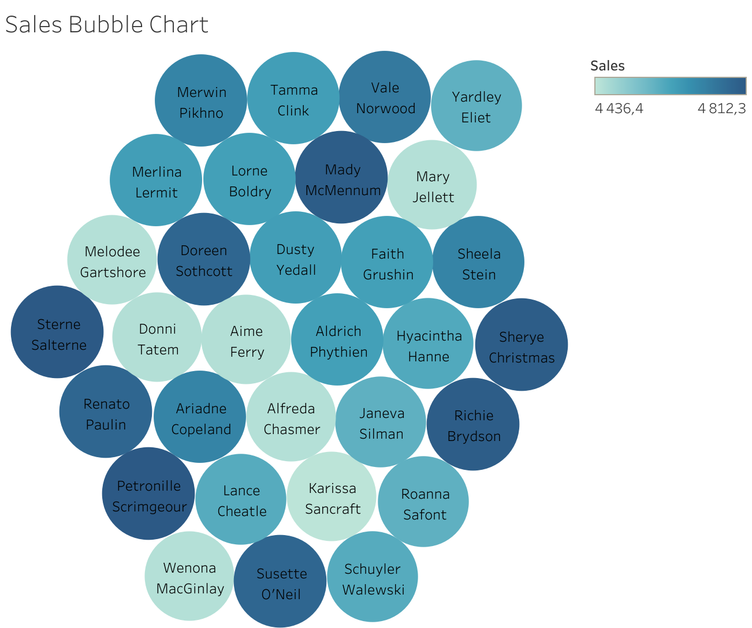

Slide 5
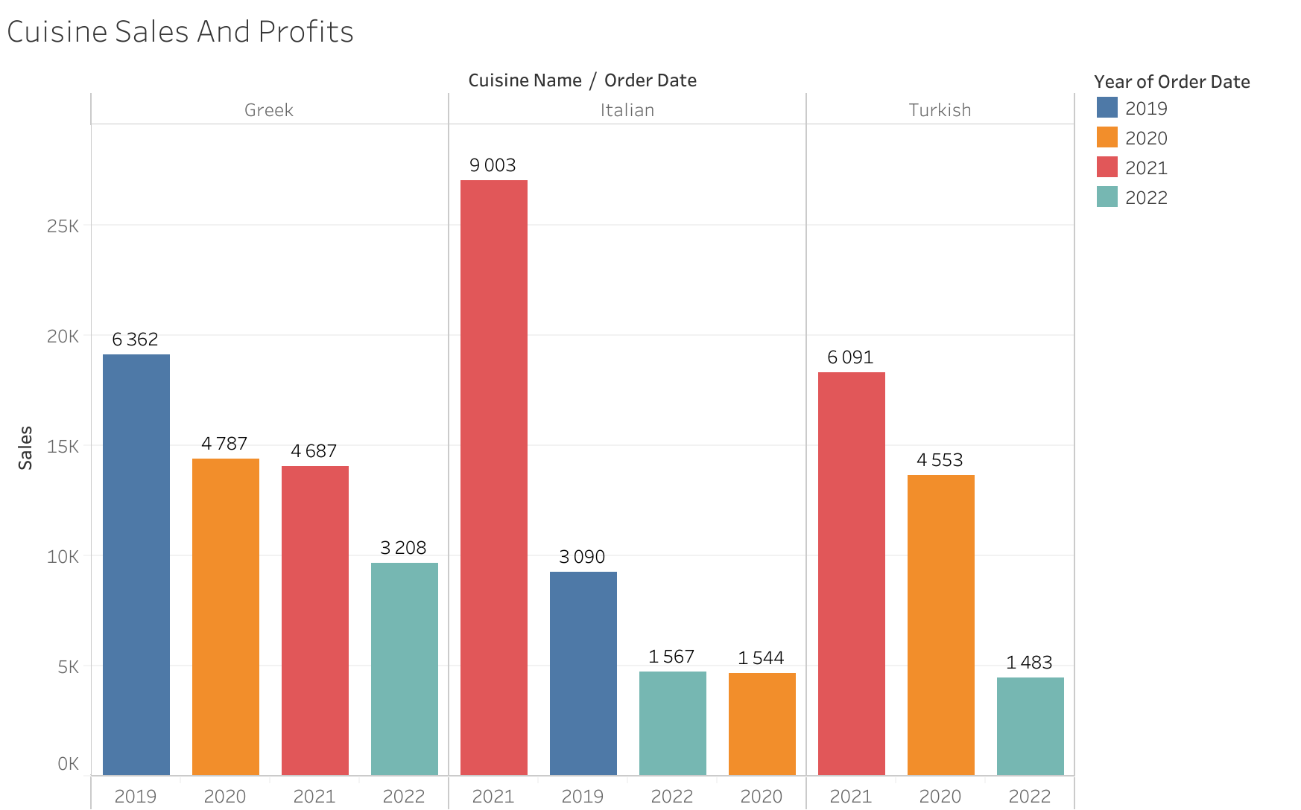

Slide 6
