Slide 1
Week 4
https://github.com/sibrassch/stage/blob/main/week4.R

Slide 2
Na meeting:
GOAL 1: alpha en beta estimation
GOAL 2: correlatie tussen estimated vs real values plotten
GOAL 3: model fitten met echte data
GOAL 3.5: alpha en beta estimation echte data
GOAL 4: eigen model laten switchen van p_reward om vast aantal trials
GOAL 5: model laten switchen obv feedback

Slide 3
GOAL 1 & 2
alpha en beta estimation
correlatie tussen estimated vs real values plotten
N = 100
N = 1000

Slide 4
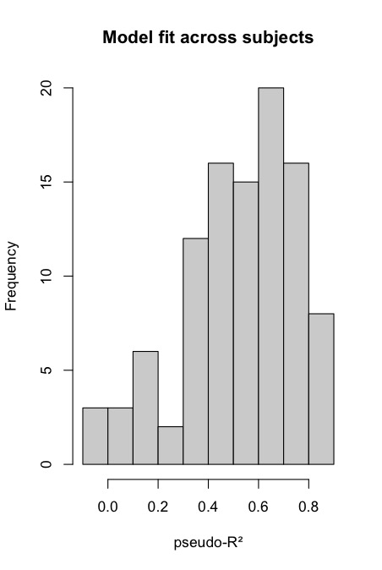

GOAL 3
model fitten met echte data
McFadden’s pseudo-R²
R² = 1 – ( logLfull / logLnull )

Slide 5
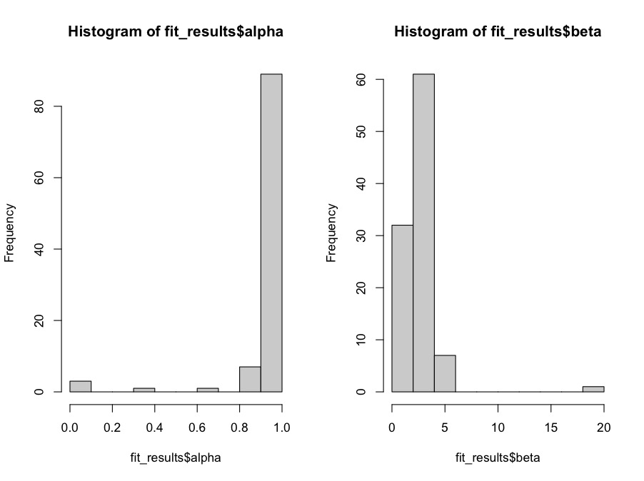
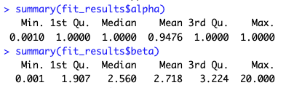
GOAL 3.5
alpha en beta estimation echte data

Slide 6
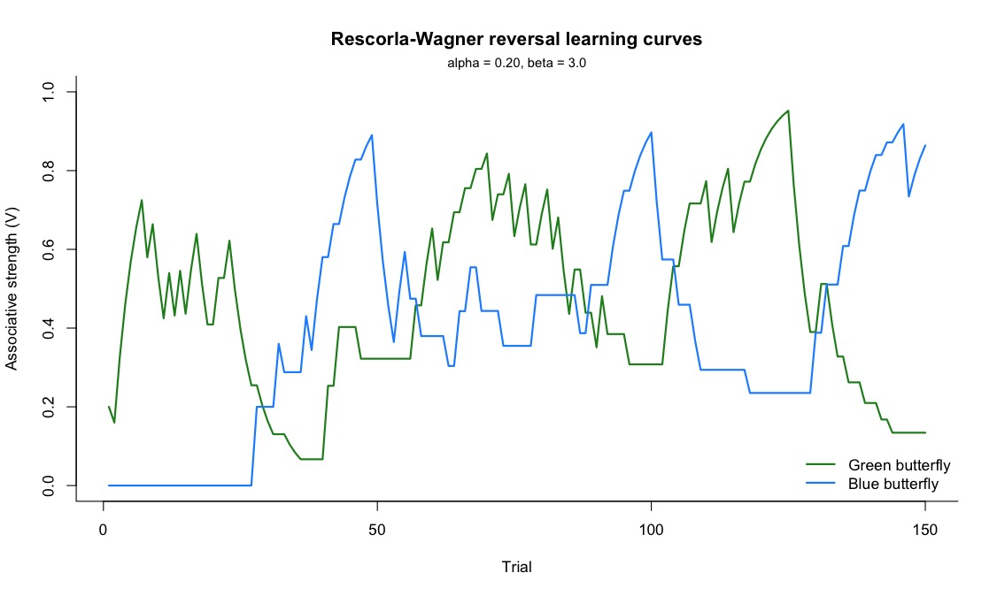
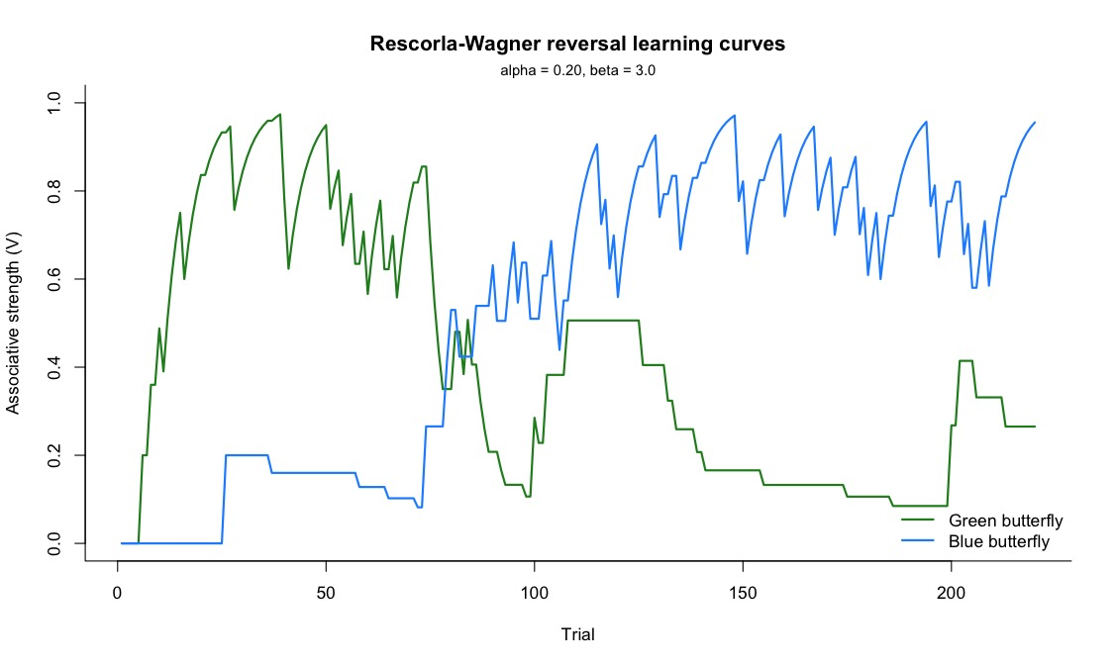
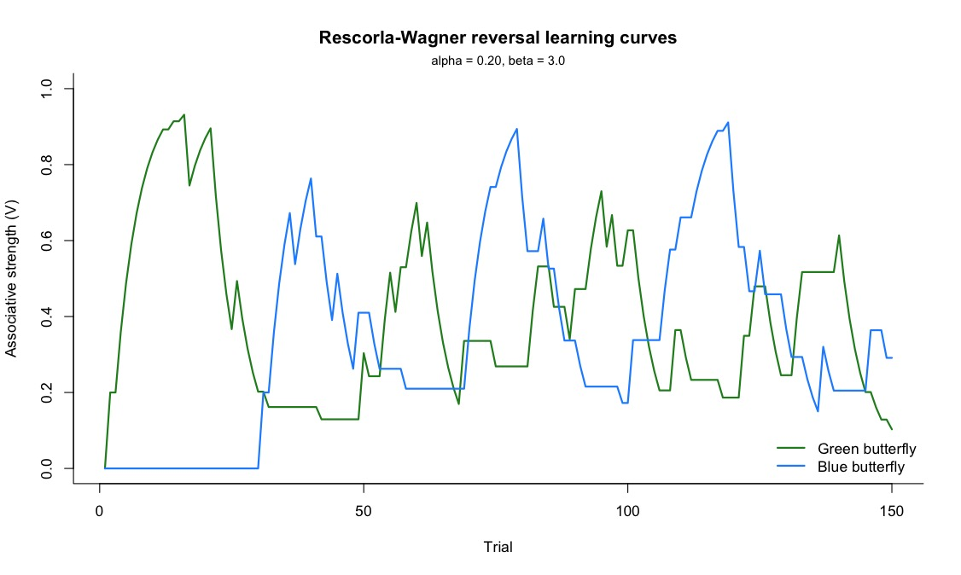
GOAL 4
eigen model laten switchen van p_reward om vast aantal trials
75, 25, 20

Slide 7

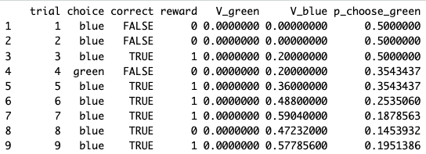
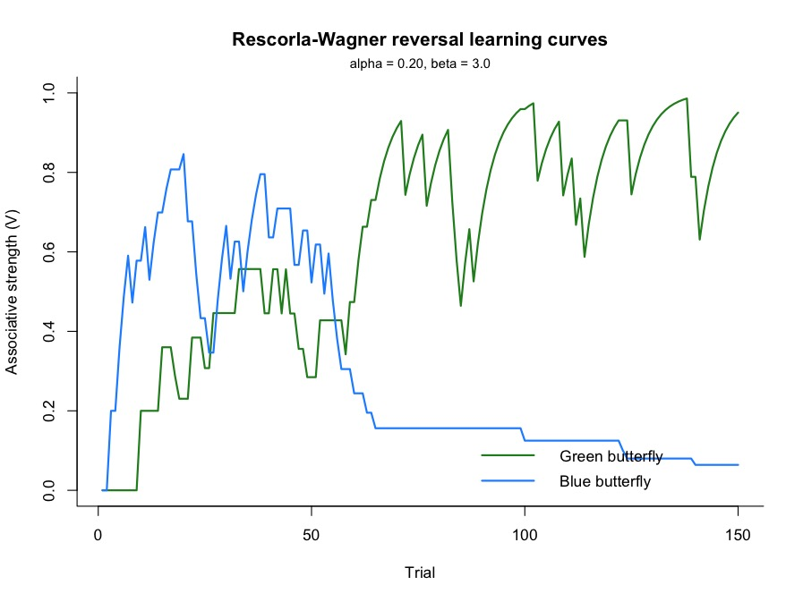
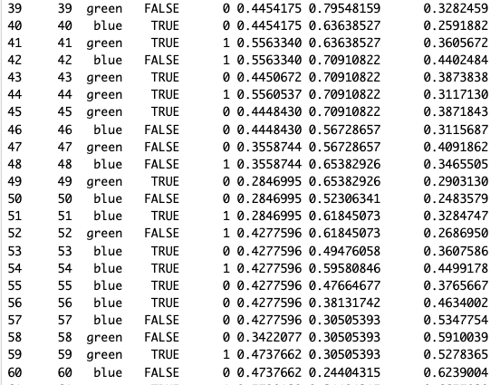
GOAL 5
model laten switchen obv feedback

Slide 8

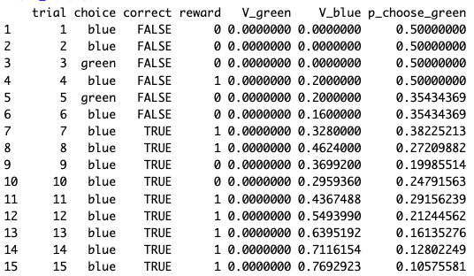
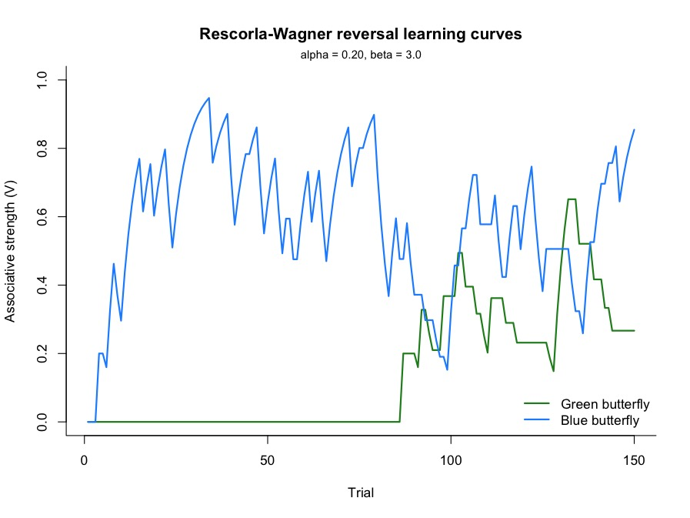
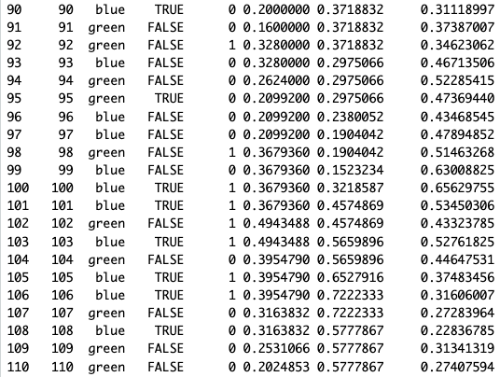
GOAL 5 pt.2
Switchen na 2x FALSE

Slide 9
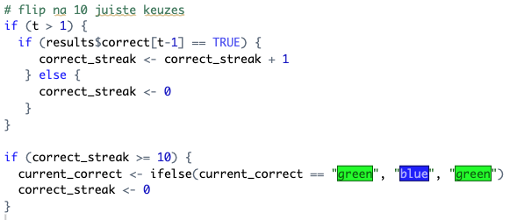
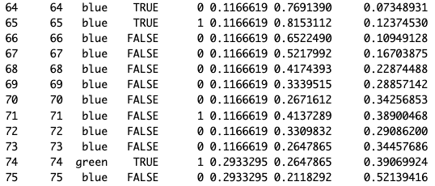
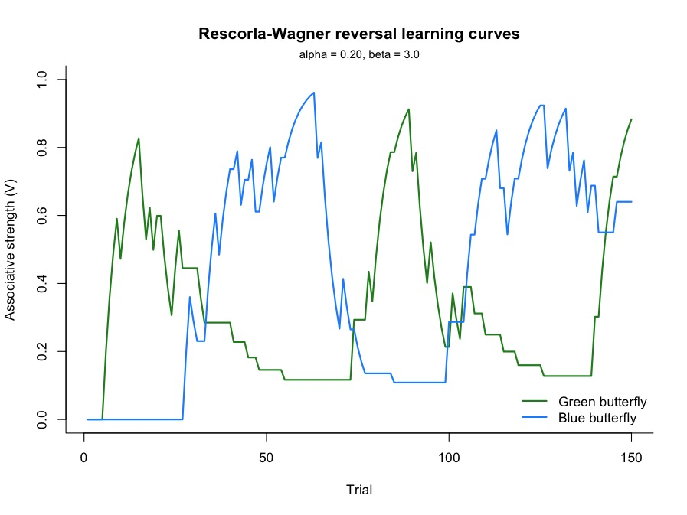
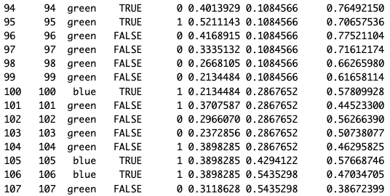
GOAL 5 pt.3
Switchen na 10x TRUE (10 juiste antwoorden)

Slide 10
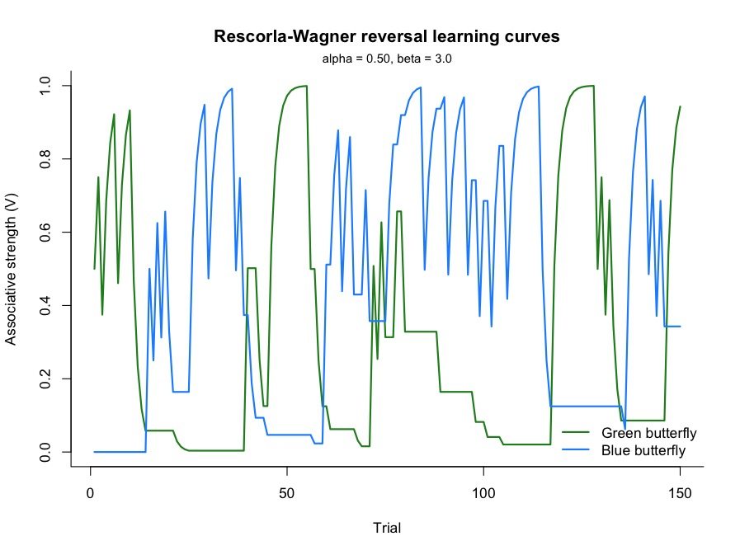
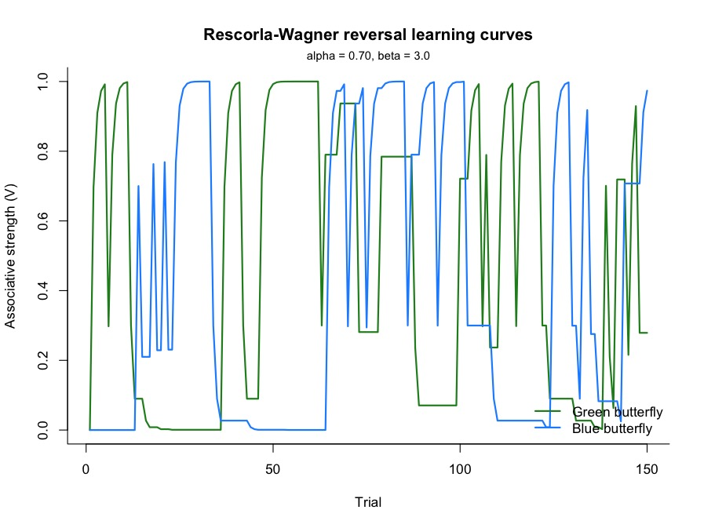

Slide 11
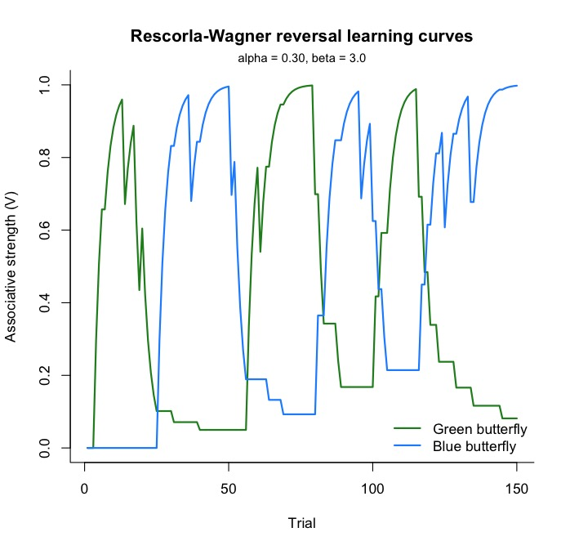
P1 = 0.95
P2 = 0.05

Slide 12
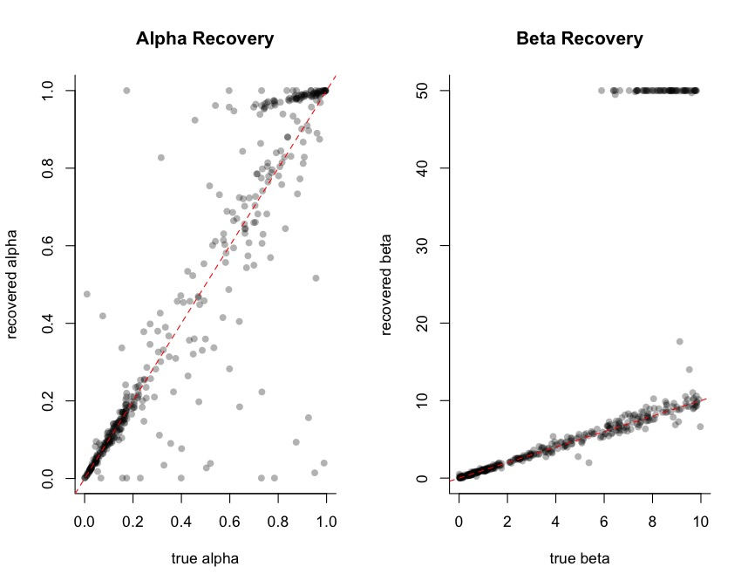
Parameter recovery Nieuw model
Reversal na 10 juiste antwoorden

Slide 13
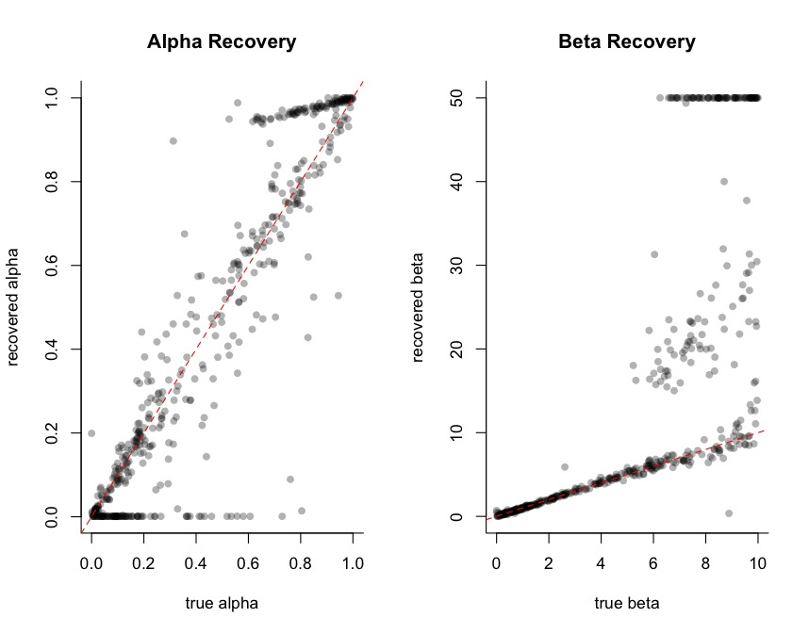
Parameter recovery Nieuw model
Reversal na 20 trials

