Slide 1
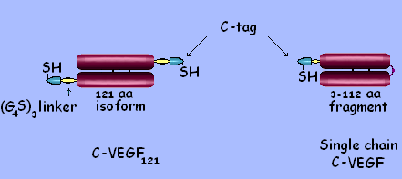
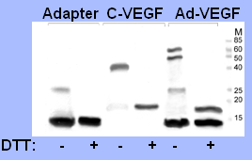
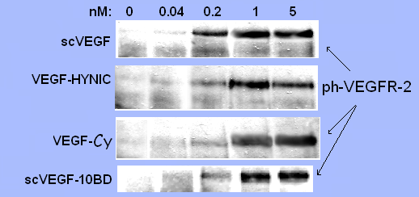
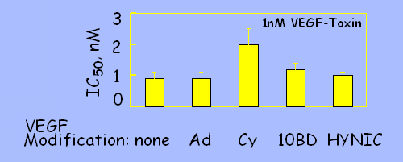
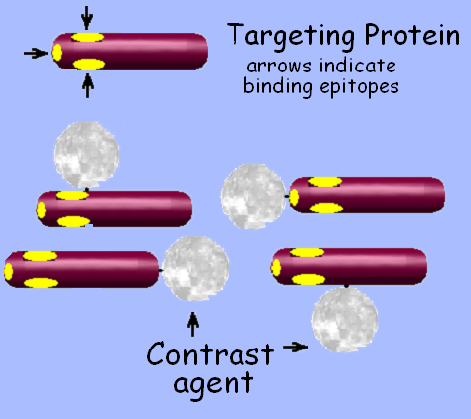
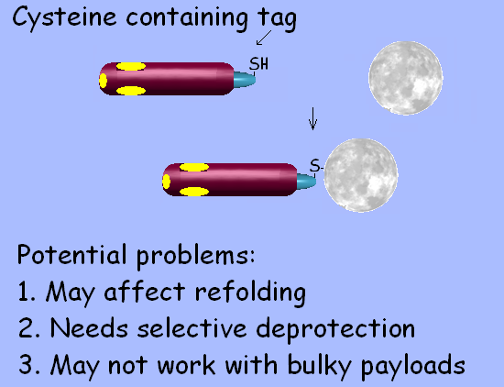
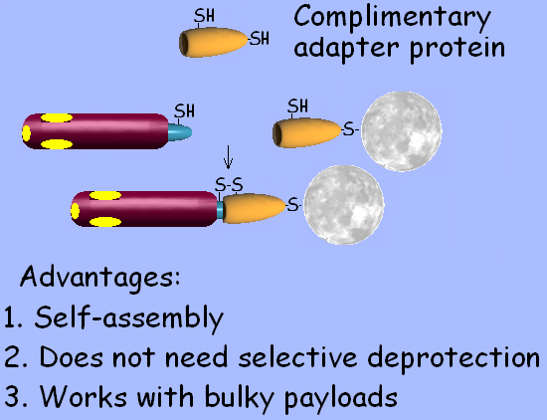
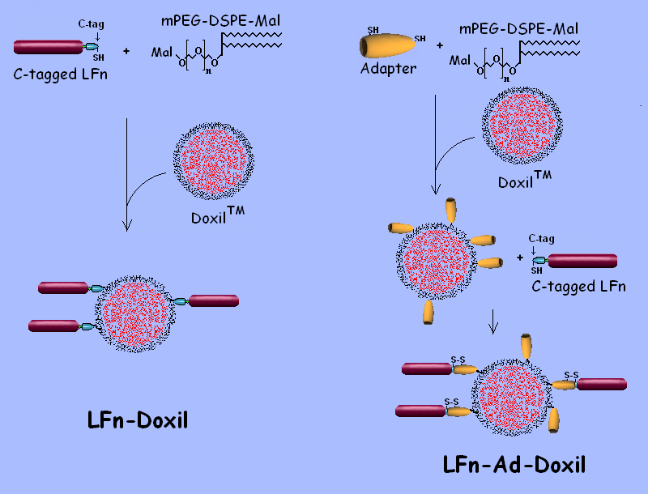
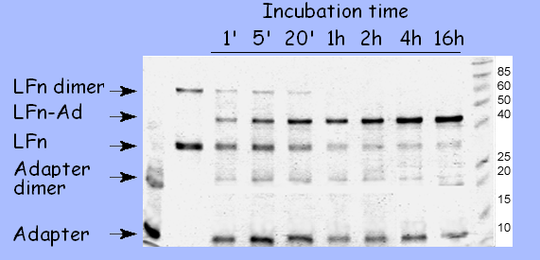
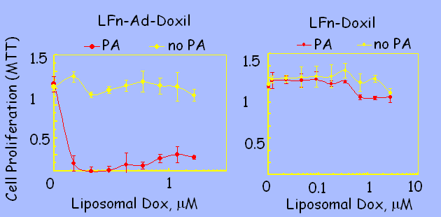
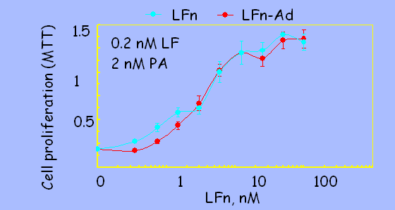
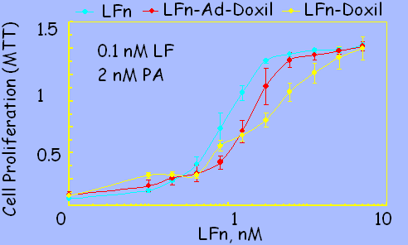
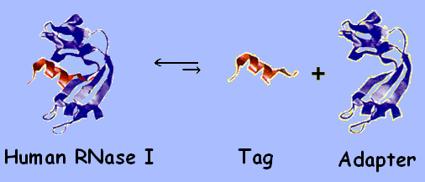
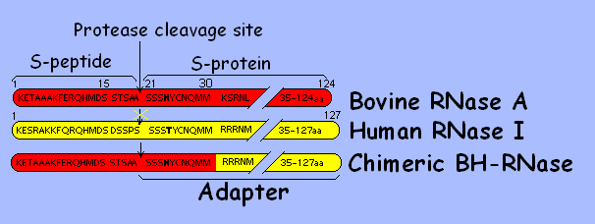
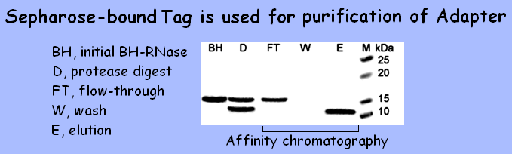
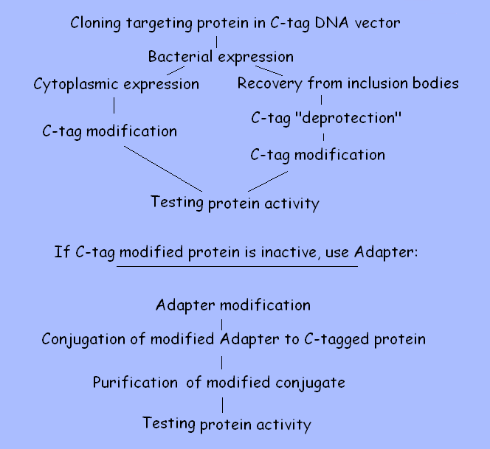
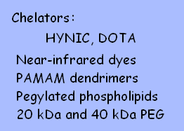
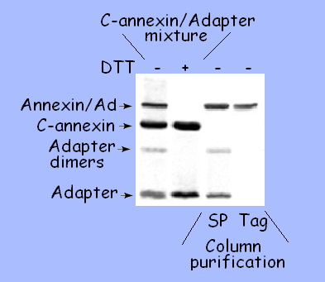
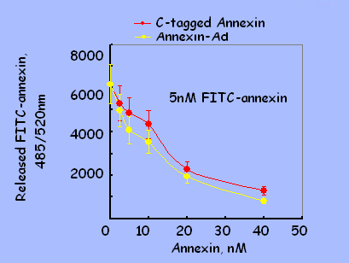
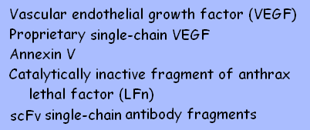
A Cysteine-containing Tag and Complimentary Adapter Protein for Loading Contrast Agents Onto Targeting Proteins
Marina V. Backer, Vimal Patel, Brian T. Jehning and Joseph M. Backer
SibTech, Inc., Newington, CT 06111
Abstract
6. C-tagged VEGF for Imaging Tumor Neovasculature
Targeted imaging of disease-associated cell surface markers can lead to development of personalized treatment regiments. The lack of a reliable technology for “loading” contrast agents onto targeting proteins inhibits the advances in this area. Currently, loading is achieved by random chemical cross-linking of cargo to targeting proteins, which damages proteins, requires expensive customized development, and yields heterogeneous products.
We have developed a new platform technology for loading contrast agents onto targeting proteins that circumvents these problems. The strategy is based on expression of a targeting protein with a 15-aa humanized tag containing cysteine in position 4 (C-tag). The tag is fused to a targeting protein via a short G₄S linker.
In our experience, C-tagged recombinant proteins produced in bacteria and refolded in typical red-ox buffers contain varying numbers of free thiol group (5-40%), while the majority of the C4 thiol groups requires “deprotection” under mild reducing conditions. After deprotection, C4 thiol group can be conjugated either directly to contrast agents (e.g. near-infrared dyes) or to contrast agent carriers (e.g. chelators for radionuclides, liposomes).
Alternatively, contrast agents or their carriers can be conjugated to a ~10 kDa humanized adapter protein that can bind to C4-tag. To avoid dissociation of the complex, adapter protein is engineered to form an intermolecular disulfide bond with C4 thiol group upon the complex formation. Importantly, formation of this disulfide bond does not require prior “deprotection” of C4 thiol group. We expect that these facile procedures for loading contrast agents onto proteins will provide new opportunities for targeted imaging.
Engineering C-tagged dimeric and single chain VEGF
C-VEGF binds Adapter
via S-S bond
Various VEGF conjugates bind and activate VEGFR-2
Various VEGF conjugates rescue cells from VEGF-Toxin
C- VEGF₁₂₁ : human VEGF₁₂₁ was cloned into C-tag vector for bacterial expression.
Single chain C-VEGF (scVEGF): two 3-112aa fragments of human VEGF₁₂₁ were cloned head-to-tail into C-tag vector for bacterial expression
After a 16-hrs incubation at 4 ºC, samples of Adapter protein, C-VEGF₁₂₁ and their mixture at molar ratio of 5:1 were analyzed by SDS-PAGE under reducing or non-reducing conditions.
C-tagged VEGF (C-VEGF or scVEGF) was modified either directly on C-tag or via Adapter (Ad) conjugated to C-tag. Purified conjugates were analyzed in tissue culture using 293/KDR cells that express 2x10⁶ VEGFR-2 per cell. VEGFR-2 phosphorylation (left) is a short-term assay that reflects the ability of VEGF to bind and activate VEGFR-2 within 10 min. VEGF-Toxin competition assay (right) demonstrates the ability of VEGF to protect cells from VEGFR-2 mediated toxicity of VEGF-Toxin fusion protein during a 96-h incubation.
C-tagged VEGF driven in vivo fluorescent and SPECT imaging of 4T1 tumors is presented on posters # 303 and 585
1. Site-specific Cross-linking of Contrast Agents
Random crosslinking Fusion Tag for site- specific Complimentary Adapter protein
damages proteins modification
7. Conjugation of Liposomes to Targeting Proteins: Directly on C-tag or via Adapter. The story of C-tagged LFn.
Doxil liposomes can be bound directly to C-tag or via Adapter
LFn-Adapter conjugate forms within minutes of incubation
Only LFn-Ad-Doxil effectively kills RAW cells in the presence of PA (72-hr assay)
Aliquots of LFn/Adapter mixture were analyzed by non-reducing SDS-PAGE
C-tagged LFn and LFn-Adapter are functionally active in protection of RAW cells from PA-mediated LF toxicity
LFn-Doxil and LFn-Ad-Doxil are functionally active (2-hr assay)
RAW cells were plated on 96-well plates (10,000 cell/well). Twenty hrs later, targeted Doxil was serially diluted in complete culture medium with or without PA and added to cells in triplicate wells. After a 5-hr incubation at 37ºC, Doxil-containing media were aspirated and cells were shifted to complete culture medium. Cells were quantitated after 72 hrs of total time by an MTT-based assay.
2. Fusion Tag and Adapter Protein Are Parts of Human RNase I
Human RNase I can be reconstituted from two fragments: a 15-aa Tag and a 107-aa Adapter
Adapter protein is released by limited protease digestion of chimeric BH-Rnase
High affinity interaction of Tag and Adapter is used for purification of Adapter from protease digestion mixture
RAW cells were plated on 96-well plates (10,000 cell/well). Twenty hrs later, free or modified LFn was serially diluted in complete culture medium with indicated amounts of LF and PA, and added to cells in triplicate wells. After a 2-hr incubation at 37ºC, cells were quantitated.
3. Site-specific Modification of 4. Payloads Used for Cross-linking
C-tagged Targeting Proteins
8. C-tagged Annexin V for Imaging Apoptosis
C-tagged annexin binds Adapter protein Annexin-Ad conjugate displays unaffected functional activity
Annexin-Adapter protein conjugate was detected in annexin/Adapter protein mixture after a 16-h incubation at 4ºC. The conjugate was purified from unreacted components by ion-exchange chromatography (SP column) followed by affinity chromatography (Tag-bound column).
Functional activity of annexin-Adapter was estimated by its ability to compete with FITC-annexin for binding to phosphatidylserine-displaying erythrocytes of stabilized human blood. Annexin binds to erythrocytes in the presence of Ca²⁺ and is released in the presence of EDTA. Both annexin-Adapter conjugate and C-tagged annexin displaced FITC-annexin in a dose-dependent manner with IC₅₀ of 11+3 nM. Correct size recombinant human annexin V displays similar activity in this assay with IC₅₀ of 9+4 nM
5. C-tagged Targeting Proteins
Conclusions
A platform technology for standardized loading of imaging and therapeutic agents onto targeting protein is developed.
The technology is based on a 15-aa cysteine-containing tag and a complimentary adapter protein and offers two strategies for conjugating payloads to targeting proteins.
The technology works with different recombinant proteins that are expressed with the cysteine-containing tag.
The technology works with various contrast agents and their carriers such as chelators, dendrimers, liposomes.

