Slide 1
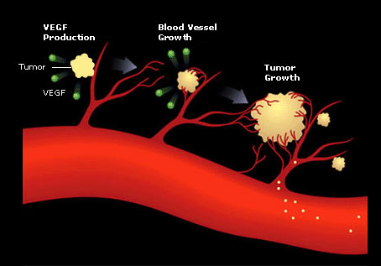
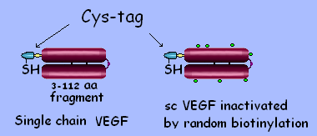
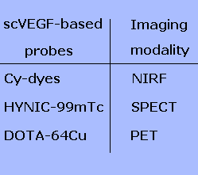
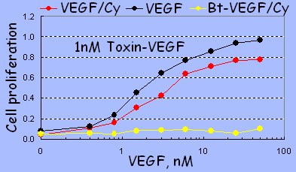
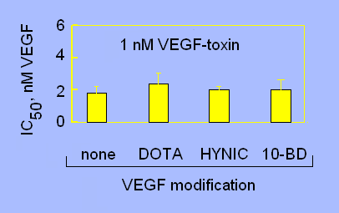
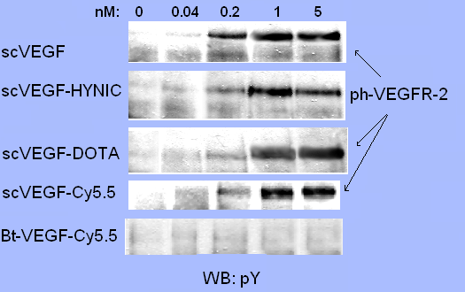
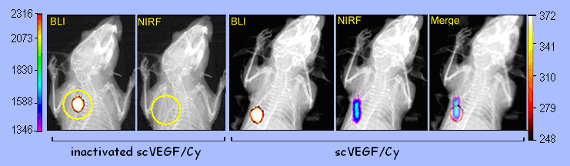
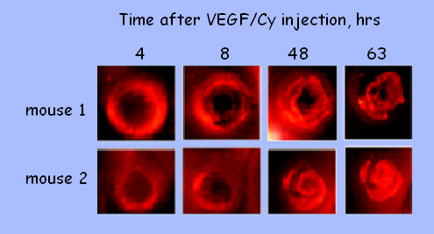
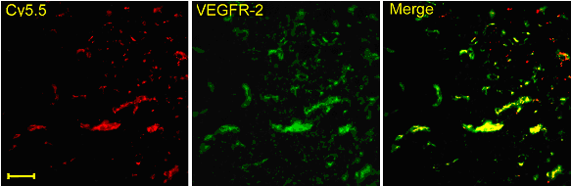
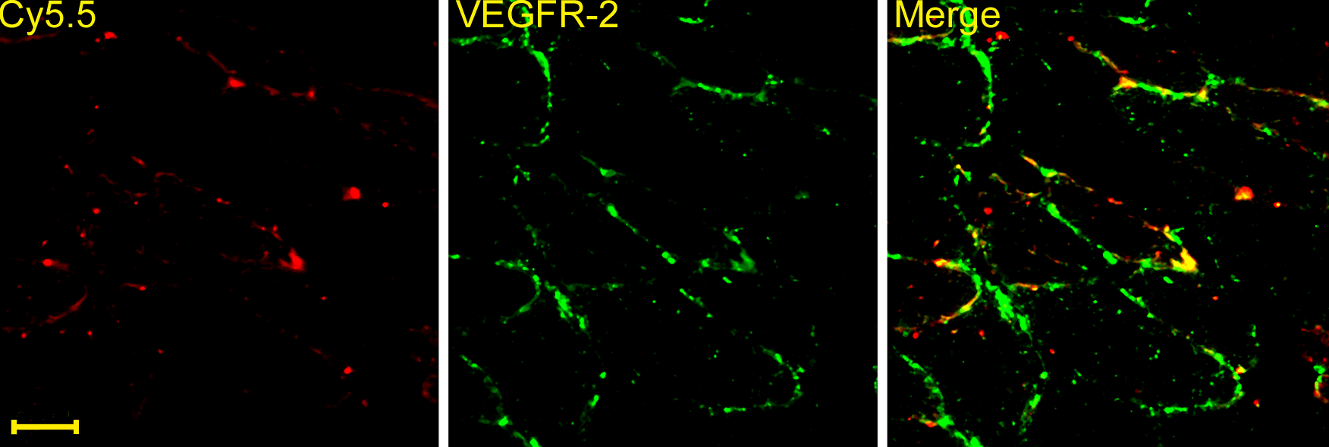
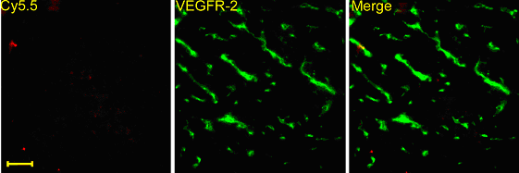
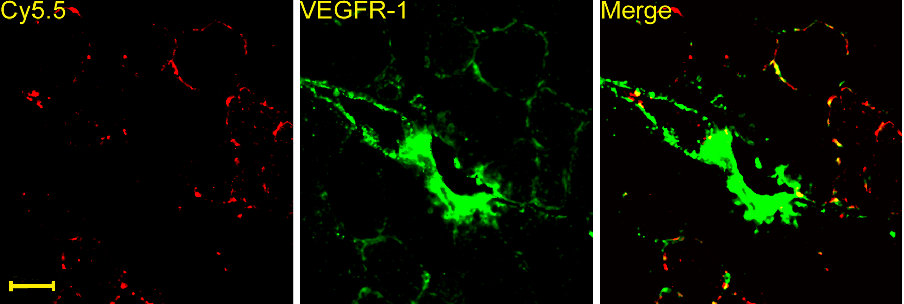
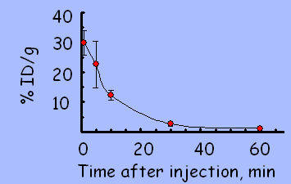
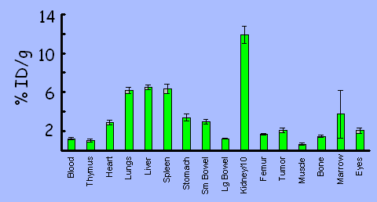
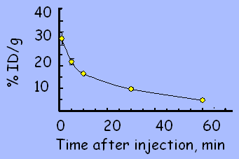
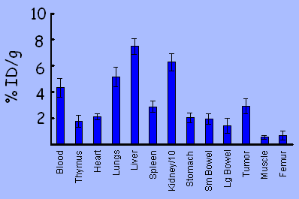
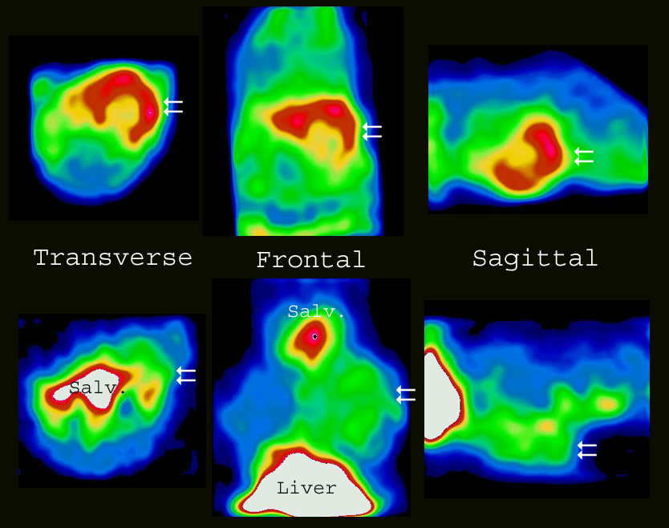
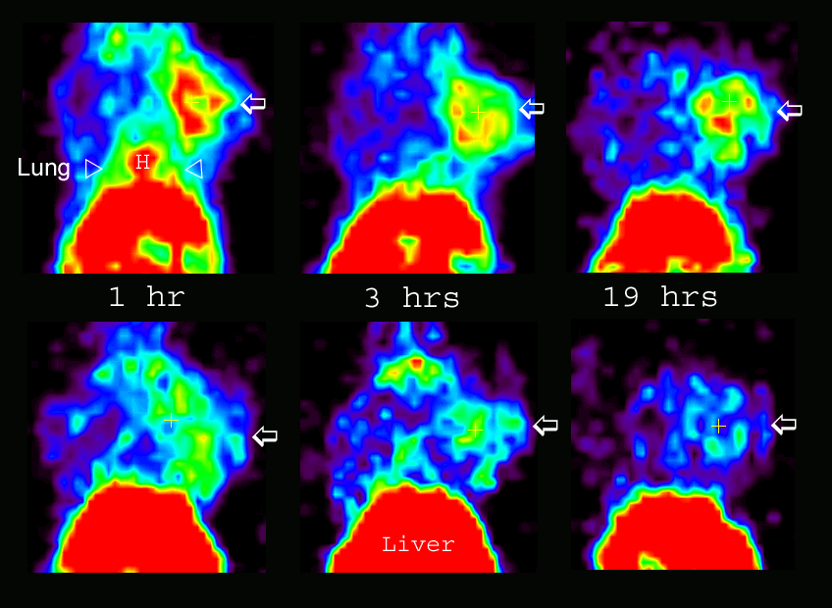
Molecular Imaging of VEGF Receptors in Angiogenic Vasculature with Single-chain VEGF Driven Probes
Marina V. Backer¹, Zoya Levashova², Vimal Patel¹, Brian T. Jehning¹, Francis G. Blankenberg², Joseph M. Backer ¹
¹SibTech, Inc., Newington, Connecticut 06111, USA
²Department of Pediatrics & Division of Nuclear Medicine/Department of Radiology & MIPS Stanford University, Stanford, California 94304, USA
Abstract
VEGF signal transduction pathway is the crucial regulator of angiogenesis and therefore, VEGF and VEGF receptors are the major therapeutic targets, particularly for anti-angiogenic cancer therapies. However, little is known about patterns of expression of VEGF receptors at various stages of tumor development or therapeutic treatments. In part, it is due to the paucity of targeted contrast agents that selectively image VEGF receptors on tumor endothelial cells. We describe here a family of VEGF-driven probes developed for in vivo near-infrared fluorescent (NIRF), single photon emission computed tomography (SPECT) and positron emission tomography (PET) imaging. The probes are based on an engineered single-chain VEGF expressed with a novel 15-aa cysteine-containing tag (Cys-tag) for facile site-specific labeling with various contrast agents. Conjugation of Cy5.5, HYNIC, or DOTA-PEG to C4 thiol group in Cys-tagged scVEGF did not significantly affect VEGF activities in two in vitro assays. In contrast, randomly biotinylated probes were completely inactive in the same assays, providing authentic controls for in vivo imaging. Judging by NIRF, SPECT, and PET imaging of Balb/c mice with orthotopic 4T1luc tumors, scVEGF/Cy5.5, scVEGF/HYNIC-⁹⁹mTc, and scVEGF/PEG-DOTA-⁶⁴Cu selectively and heterogeneously accumulated in the tumor area.
VEGF Drives Single chain (sc) VEGF
Angiogenesis for in vivo Molecular Targeting
Testing Activity of VEGF-based Probes in Tissue Culture
Protection from toxin-VEGF induced death
VEGFR-2 autophosphorylation
Single chain VEGF (scVEGF): two 3-112aa fragments of human VEGF₁₂₁ were cloned head-to-tail into Cys-tag vector for bacterial expression
scVEGF conjugates serially diluted in toxin-VEGF containing culture medium were added to 293/KDR cells to a final toxin-VEGF concentration of 1 nM. Cell proliferation was determined 96h later
293/KDR cells were stimulated with scVEGF conjugates for 10’ at 37ºC and analyzed by Western blotting
VEGF Targeted Imaging in Animal Models of Breast Cancer
Fluorescent imaging with VEGF/Cy
Female 5-6 weeks old mice were injected with luciferase expressing breast carcinoma cells in the region of mouse fatpad. BALB/c mice received 5x10³ 4T1luc cells. SCID/Chr (BALB/c background) mice received 5x10⁶ MDA-231luc cells. Seven to ten days after tumor cell inmplantation, mice were tail vein injected with 10 μg/mouse of Cy-probe, 5 min later injected intraperitoneally with luciferin (0.5 mg/mouse), anesthetized and imaged.
Left, sequential BLI and NIRF imaging of the same 4T1luc tumor-bearing Balb/c mouse injected intravenously with inactive control inVEGF/Cy or scVEGF/Cy, followed by intraperitoneal luciferin injection.
Right, serial imaging after a single VEGF/Cy injection
VEGF-based Probes Co-localize with VEGFR-2 in Tumor Neovasculature
Mice were sacrificed 2-4 hrs after NIRF imaging. Tissue cryosections (7-µm thickness) were fixed with 1% formaldehyde blocked with avidin-biotin blocking kit (Molecular Probes) followed by blocking with 5% normal rabbit serum, and probed with first rat anti-mouse antibody and biotinylated rabbit-anti rat antibody (Vector Labs). Steptavidin-peroxidase conjugate was used for coupling with peroxidase, which was visualized by Alexa-488 using tyramine amplification technique (Molecular Probes). Slides were observed and digitized on a Zeiss LSM 510 confocal microscope using 40X oil objective. Red, Cy5.5 fluorescence, green, immunofluorescent staining. Scale bar, 20 μm.
Left, Cy5.5 fluorescence and immunofluorescent staining of VEGFR-2 on 4T1luc tumor cryosections. High (top) and low (bottom) intensity fields of Cy5.5 fluorescence were analyzed.
Right, Co-localization of Cy5.5 and VEGFR-2 or VEGFR-1 in muscle tissue contiguous to MDA-231luc tumor.
SPECT imaging with ^{99m}Tc loaded scVEGF
PET imaging with ⁶⁴Cu loaded scVEGF
Blood clearance of radioactivity in Balb/c mice (n=4) intravenously injected with scVEGF/Tc
Biodistribution of radioactivity in 4T1luc tumor bearing Balb/c mice (n=4) 1 hr after intravenous injection of scVEGF/Tc.
Blood clearance of radioactivity in 4T1luc tumor bearing Balb/c mice (n=5) injected with scVEGF/Cu.
Biodistribution of radioactivity in 4T1luc tumor bearing Balb/c mice (n=6) 2 hours after intravenous injection of scVEGF/Cu.
Representative transverse, frontal and sagittal SPECT images of two separate left axillary fat pad tumor bearing mice 1 hr after intravenous injection of either 1.2 mCi of scVEGF/Tc (top row) or inVEGF/Tc (bottom row). Note the peripheral rim uptake of scVEGF/Tc of tumor (double arrows) as compared with inVEGF/Tc. Salv, uptake of trace free ^{99m}Tc in the salivary/neck region. Liver uptake was markedly higher (white is highest activity in false color images) than tumor uptake of inVEGF/Tc. In order to satisfactory display both tumor and liver uptake in the same field of view, it was necessary to narrow the intensity window to a very low range resulting in a near white out of the salivary and liver regions.
4T1lluc tumor bearing mice received 100 µCi probe per mouse via the tail vein. PET was performed on a microPET R4 rodent model scanner (Concorde Microsystems Inc.), in the prone position in the microPET scanner.
Serial frontal images of two separate left axillary fat pad tumor bearing mice taken at 1, 3, and 19 hours after injection of either scVEGF/Cu (top row) or equal amounts of inVEGF/Cu (bottom row). White arrows mark the location of left mammary fat pad tumor in each image. H = heart or blood pool activity observed at one hour in the longer circulating scVEGF/Cu. Also note the significant blood pool activity within the lung (arrow heads) at one hour.
Conclusions
Functionally active VEGF-based probes for different imaging modalities are prepared and validated in vivo.
We expect that in vivo imaging of accessible VEGF receptors will advance understanding and treatment of angiogenesis-dependent diseases.

