Slide 1
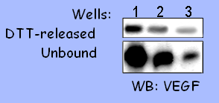
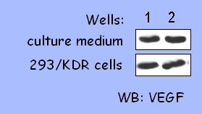
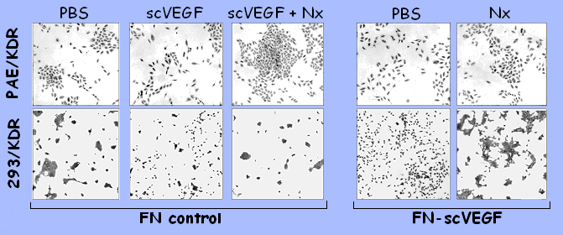
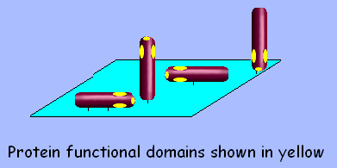
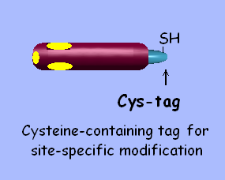

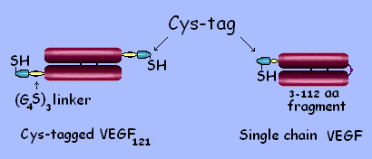
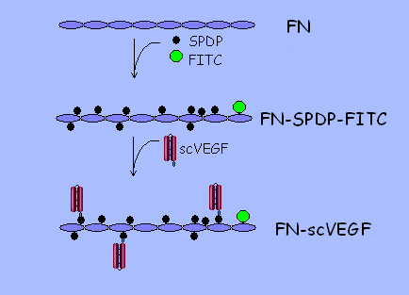
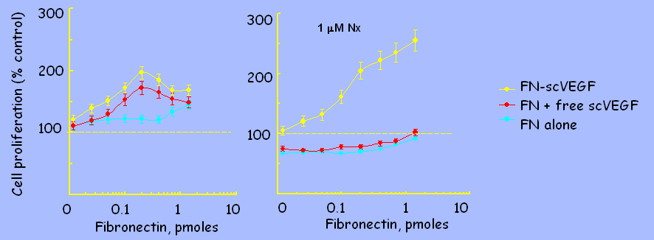
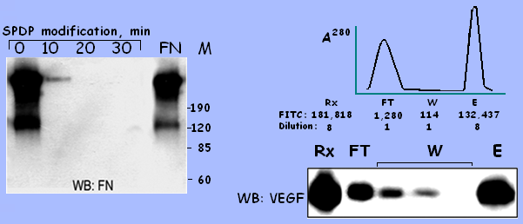
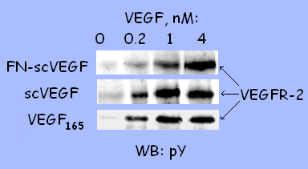
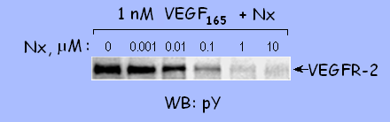
A New Technology for Site-Specific Conjugation of Cytokines to Surfaces.
Effects of Signaling by Fibronectin-Conjugated Single-Chain VEGF on VEGFR-2 Positive Cells.
Marina V. Backer, Vimal Patel, Brian T. Jehning and Joseph M. Backer
SibTech, Inc., Newington, CT 06111
Abstract
4. Immobilization of scVEGF on Tissue Culture Plastic
before cell growth after cell growth
Derivatization of biomedical surfaces with functionally active proteins opens multiple opportunities in device and tissue engineering. We hypothesized that covalently immobilized cytokines can continuously activate cell receptors without being internalized. This, in turn, might induce profound changes in cell behavior, providing new opportunities for tissue and device engineering. Since random conjugation tends to inactivate cytokines and generate highly heterogeneous products, an effective technology for covalent immobilization should rely on site-specific conjugation. We propose to express cytokines with a recently described 15-aa cysteine-containing tag (Cys-tag) designed for site-specific conjugation and use this tag for covalent immobilization. We describe here construction of a fibronectin (FN) scaffold derivatized with Cys-tagged single-chain VEGF. Site-specific cross-linking of scVEGF to FN yielded FN-scVEGF conjugates containing ~3-6 molecules of scVEGF per FN. VEGF activity of FN-scVEGF was similar to that of free scVEGF in VEGFR-2 tyrosine autophosphorylation assay, indicating that site-specific conjugation did not interfere with VEGF/VEGFR-2 interactions. VEGFR-2 expressing cells seeded onto FN-scVEGF coated wells grew significantly faster than cells seeded on FN alone, or on FN in the presence of free scVEGF. Growth pattern of VEGFR-2 positive cells seeded on FN-scVEGF reflected the presence of functionally active VEGF: cells did not form typical tight cobblestone colonies but moved away from each other, preventing cell-cell contacts. Selective inhibitor of VEGFR-2 tyrosine autophosphorylation blocked this behavior, indicating that it was due to activation of VEGFR-2 by immobilized scVEGF.
Serial 1:2 dilutions of FN-scVEGF in PBS were added to wells of a 96-well plate, 100 μl/well. After an 18-h incubation at 4 ºC, unbound FN-scVEGF was removed, wells were extensively washed with PBS and treated with 0.1 M DTT at 37 ºC for 10 min. DTT-released scVEGF from 3 consecutive wells, and unbound FN-scVEGF collected from the same wells, were separated on 17.5% gels and analyzed by Western blotting using anti-VEGF antibody
Complete culture medium (100 μl/well) or 293/KDR cells (1,000 cells/100 μl/well) were added to duplicate FN-scVEGF coated wells and incubated under normal culture conditions for 96 hrs. Then medium was aspirated, wells were treated with 4% SDS and 0.1 M DTT at 37ºC for 10 min and analyzed by Western blotting.
5. Immobilized scVEGF Induces Scattering of Cells Overexpressing VEGFR-2
1. New Technology for Site-Specific Protein Immobilization
Random immobilization Expression with Cys-tag Site-specific uniform immobilization
2. Cross-linking of scVEGF to Fibronectin (FN)
Engineering single chain (sc)VEGF Site-specific immobilization of scVEGF
VEGFR-2 overexpressing cells (PAE/KDR or 293/KDR) were plated on 24-well plates coated with FN-scVEGF or equivalent amounts of FN-c. Free scVEGF or Nx were added to control wells 3 hrs later to final concentrations of 10 nM and 1 μM, respectively. After 48 hrs of growth under normal culture conditions, cells were washed with PBS, fixed and stained with Giemsa stain.
6. Immobilized scVEGF Stimulates Growth of VEGFR-2 Overexpressing Cells
Single chain VEGF (scVEGF): two 3-112aa fragments of human VEGF₁₂₁ were cloned head-to-tail into Cys-tag vector for bacterial expression
3. FN-scVEGF Conjugate Retains VEGF Functional Activity
Left, 293/KDR cells were plated on duplicate FN-scVEGF- or FN-c coated wells, 1,000 cells/well. Free scVEGF was serially diluted and added to FN-c coated wells 3 hrs later, at a range matching bound scVEGF in FN-scVEGF coated wells. Cells were quantitated after 96-h growth under normal culture conditions. Control cell growth on un-coated wells was taken as 100%.
Right, the same experiment was done in the presence of Nx added to wells 3 hrs after cell plating to a final concentration of 1 μM
Modification of FN: Modified FN is not detected by WB. To quantify modified FN, it was labeled with FITC (one FITC per FN molecule)
Purification of FN-scVEGF
affinity purification on Gelatine-Agarose. FN was quantitated by FITC fluorscence, scVEGF was quantitated by WB
Functional activity of FN-scVEGF: induction of VEGFR-2 tyrosine phosphorylation in 293/KDR cells expressing 2.5x10⁶ VEGFR-2 per cell.
Conclusions
Cys-tagged proteins can be site-specifically conjugated to the surfaces, while retaining functional activity.
Immobilized scVEGF induces VEGFR-2 tyrosine autophosphorylation, enhances growth and induces cell scattering.
We expect that immobilized scVEGF will be useful for expansion of endothelial progenitor cells and for stimulation of re-endothelialization.
Tyrosine kinase inhibitor NVP-AAD777-NX (Nx, Novartis) specifically inhibits VEGFR-2 tyrosine autophosphorylation induced by VEGF
Cys-tagged Recombinant Proteins Under Development
Cys-tag positioning Bacterial expression Functional activity
Nx was used in tissue culture experiments to confirm VEGFR-2-mediated mechanism of the effects induced by FN-scVEGF.
VEGF, Vascular Endothelial Growth Factor N-terminal Insoluble ~ 95 %
scVEGF, proprietary single-chain VEGF N-terminal Insoluble 100 %
FLex, extracellular domain of Flt-3 ligand N-terminal Insoluble > 95%
EGF, epidermal growth factor N-terminal Insoluble 100 %
Annexin V N-terminal Soluble > 90%
LFn, a fragment of anthrax Lethal Factor C -terminal Soluble 100%
Firefly luciferase N-terminal In progress ND

