Slide 1
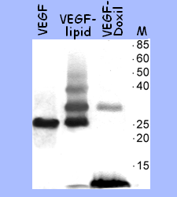
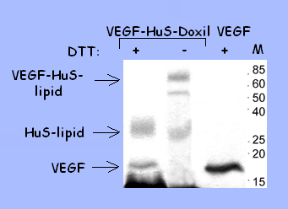
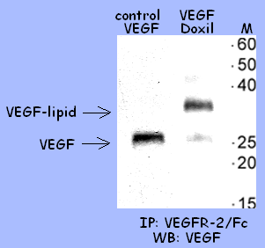
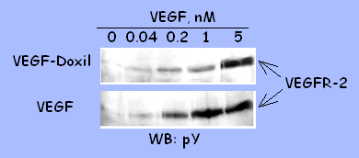
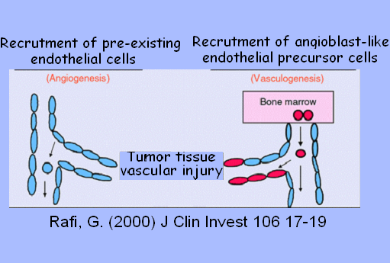
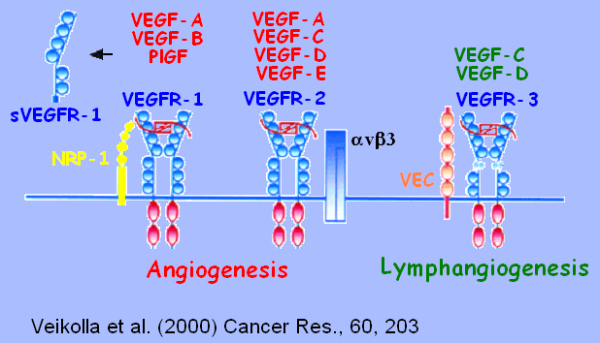
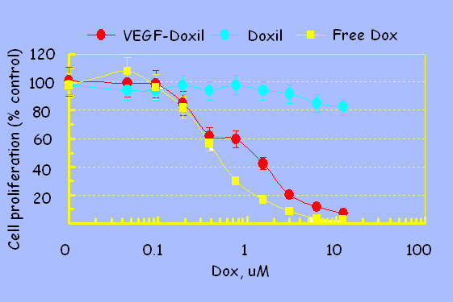
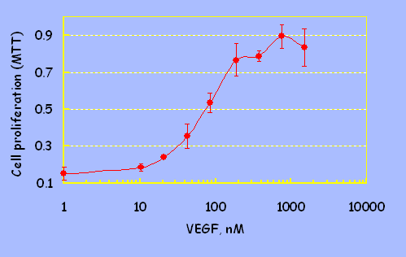
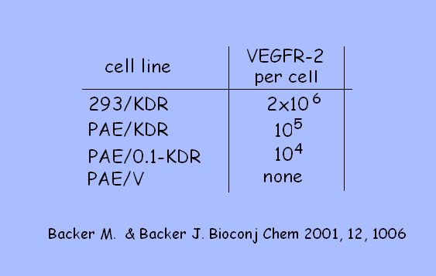
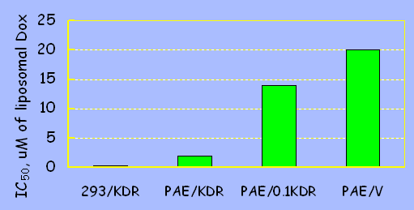
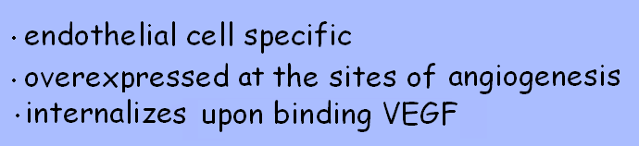

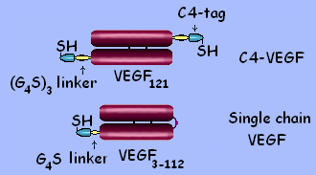
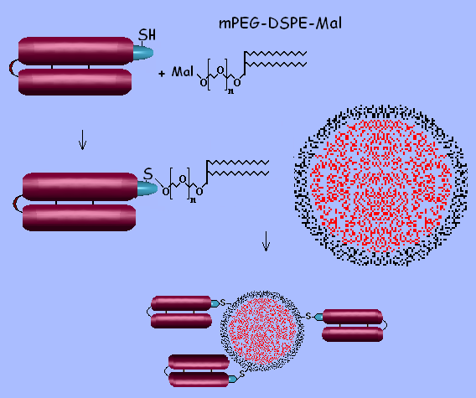
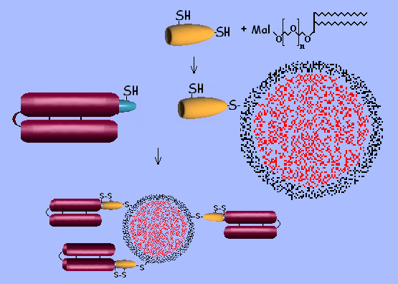
Using VEGF for Targeting Doxorubicin-loaded Liposomes to Tumor Vasculature
Marina V. Backer, Vimal Patel, Brian T. Jehning and Joseph M. Backer
SibTech, Inc., Newington, CT 06111
Abstract
The VEGF/VEGFR-2 pathway is the crucial regulator of tumor angiogenesis, and therefore it is a primary target for potential anti-cancer therapeutics. One strategy for development of such therapeutics is to use VEGFR-2 for intracellular delivery of cytotoxic agents. This strategy implies that only cells expressing VEGFR-2 above a certain threshold level would accumulate a lethal dose of cytotoxic agents via receptor-mediated uptake. Since VEGFR-2 is overexpressed at sites of angiogenesis, it is anticipated that such a strategy will inhibit tumor growth via destruction of tumor vasculature. In addition, it is possible that gradual release of cytotoxic agents from dying endothelial cells will lead to death of surrounding tumor cells providing a significant bystander effect. To deliver large doses of cytotoxic agent to tumor endothelial cells, we have decorated commercially available doxorubicin-loaded liposomes, DoxilTM, with VEGF and characterized their efficacy in tissue culture experiments. A facile technology for decoration of liposomes with targeting proteins was developed. VEGF-decorated liposomes, VEGF/Lip, were prepared using “dock-and-lock” technology for modification of targeting proteins. Briefly, VEGF was expressed as a fusion protein with a cysteine-containing 15-aa tag. A complimentary adapter protein was designed to have a free cysteine capable of forming a disulfide bond with a cysteine in the tag upon VEGF-adapter complex formation. Adapter protein was modified with DSPE-PEG-Mal-3400 lipid (Nektar Therapeutics) and inserted into doxorubicin-loaded liposomes, DoxilTM (OrthoBiothech). Tagged VEGF was “docked” to the liposome-associated adapter and the complex was “locked” by a tag-adapter disulfide bond. Both untargeted DoxilTM and VEGF/Lip were separated from free doxorubicin via two rounds of gel-filtration on Sepharose 4B. Average concentration of doxorubicin in liposome solutions was determined by HPLC.Functional activity of VEGF/Lip was tested in induction of VEGFR-2 tyrosine autophosphorylation in 293/KDR cells. Recombinant VEGF was used as a control. Cytotoxicity of VEGF/Lip, untargeted liposomes and free doxorubicin was tested with cells expressing various levels of VEGFR-2, from none to 2.5x10⁶ per cell. VEGF-driven rescue from VEGF/Lip toxicity was performed with 293/KDR cells expressing 2.5x10⁶ VEGFR-2/cell. Direct lipidation of VEGF yielded conjugates that did not display functional activities of VEGF. To avoid VEGF damaging, we conjugated lipid to a specialized adapter protein that can be linked via a disulfide bond to a cysteine-containing tag fused to VEGF. Lipidated adapter protein was inserted into liposomes, creating a standardized reagent for conjugation to targeting proteins armed with the cysteine-containing tag. VEGF/Lip retains functional activities comparable to that of parental VEGF, indicating non-destructive nature of “dock-and-lock” mediated liposome decorating. After a 2-hour exposure, doxorubicin was cytotoxic to 293/KDR cells with IC₅₀ of 0.1 μM, while untargeted DoxilTM liposomes were not cytotoxic to these cells up to 12 μM of doxorubicin. In contrast, VEGF-targeted DoxilTM liposomes were cytotoxic to 293/KDR with IC₅₀ of 0.2 μM doxorubicin. Even after a 5-min exposure VEGF/Lip were selectively cytotoxic for 293/KDR cells with IC₅₀ of 0.7 uM doxorubicin Cytotoxicity of VEGF/Lip was lower for cells with lower levels of VEGFR-2 expression and was inhibited in a dose-dependent manner by free VEGF, indicating receptor-mediated mechanism of VEGF/Lip uptake.
8. Insertion VEGF into Doxil (Doxorubicin Loaded Liposomes)
Single chain VEGF (28kDa) was lipidated site-specifically via C4-tag and inserted into Doxil. Liposomes were purified by gel-filtration on Sepharose 4B and analyzed by reducing SDS-PAGE
Complimentary adapter protein (HuS) was lipidated and inserted into Doxil. Purified HuS-liposomes were incubated o/n with C4-tagged VEGF (18 kDa), and purified by gel-filtration. Covalent binding of VEGF was confirmed by non-reducing SDS-PAGE (no DTT lane). After DTT treatment, VEGF-HuS-lipid conjugate migrated as two bands corresponding to HuS-lipid and VEGF (plus DTT lane)
9. VEGF-Doxil Displays VEGF Functional Activity
VEGF-Doxil was collected on soluble VEGFR-2 (extracelular VEGFR-2 domain fused to Fc) pre-adsorbed on Protein A agarose and analyzed by Western blotting with Ab for VEGF. To estimate efficiency of VEGF-Doxil/VEGFR-2 binding, equimolar free VEGF was used in parallel throughout the procedure.
Near confluent 293/KDR cells expressing 2x10⁶ VEGFR-2 per cell were stimulated then with VEGF-Doxil or free VEGF for 10 min at 37oC. Cell lysates were analyzed by Western blotting using anti-phosphotyrosine RC20:HRPO conjugate
1. Angiogenesis in Human Diseases 2. Molecular Markers of Angiogenesis
10. VEGF-Doxil Is Selectively Cytotoxic for VEGFR-2 Expressing Cells
293/KDR cells were exposed to VEGF-Doxil, Doxil or free Dox for 5 min at 37 ºC, and then shifted to fresh culture medium. Cell proliferation was measured after 96h of incubation using an MTT-based assay
VEGF was serially diluted in complete culture medium containing VEGF-Doxil and added to cells in triplicate wells to final Dox concentration of 5 uM, for 5 min at 37oC. Cell quantitation was done after 96-h incubation under normal culture conditions
11. VEGF-Doxil Cytotoxicity Is Dependent on VEGFR-2 Expression
3. Why Image VEGF Receptors 4. VEGF₁₂₁ as a Targeting Protein
Cells were exposed to VEGF-Doxil for 5 min at 37 ºC, shifted to fresh culture medium and allowed to grow for 72-96 hrs. IC₅₀ values reflect Dox concentrations sufficient to inhibit cell growth to 50%
5. VEGF for Molecular Targeting 6. Site-Specific Modification 7. Complimentary Adapter Protein
Conclusions
VEGF₁₂₁ and single-chain VEGF₁₁₀ expressed with cysteine containing C4-tag can be site-specifically lipidated using maleimide chemistry
C4-tagged VEGF can be covalently “locked” to complimentary adapter protein HuS inserted into liposomes.
VEGF-Doxil retains functional activity comparable to free recombinant VEGF
VEGF-Doxil efficiently kills cells overexpressing VEGFR-2
VEGF-Doxil is marginally toxic for endothelial cells expressing VEGFR-2 at the level of quiescent vasculature

