Slide 1
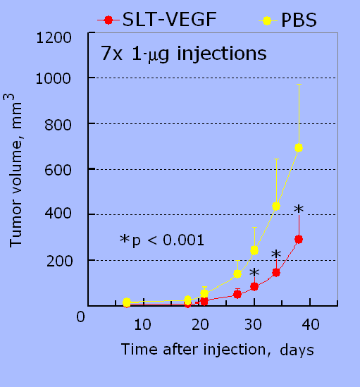
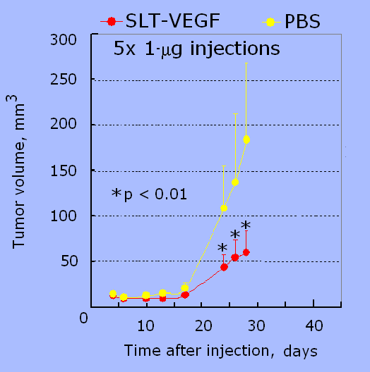
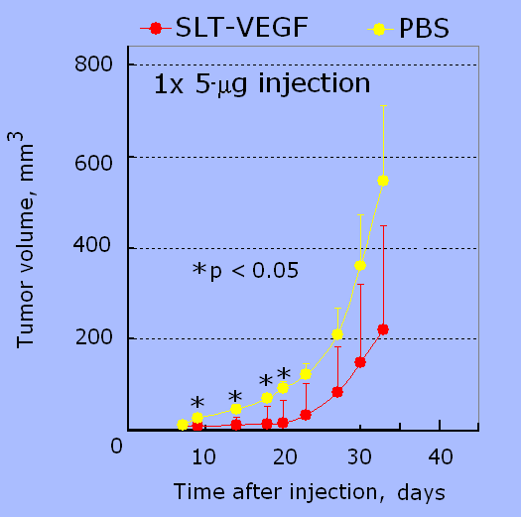
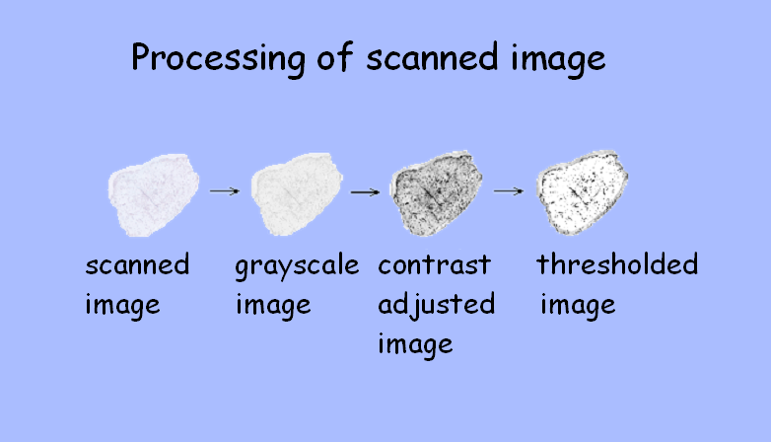
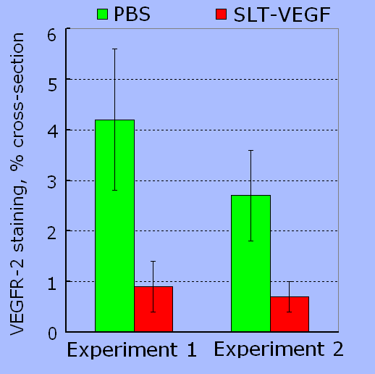
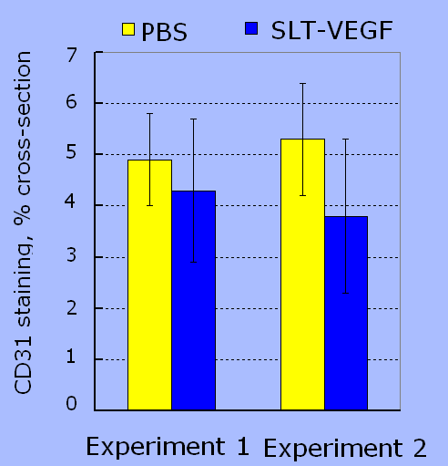
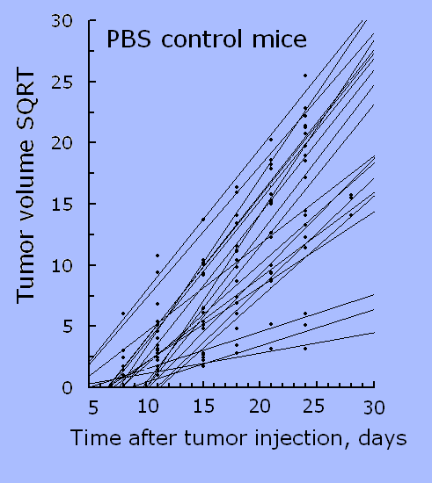
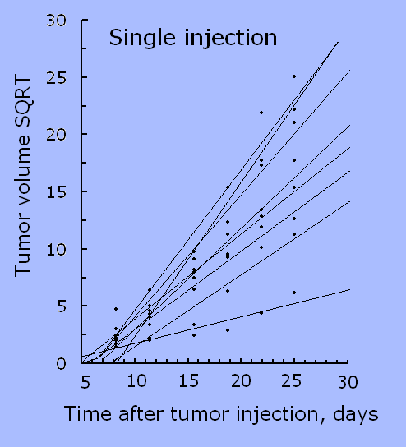
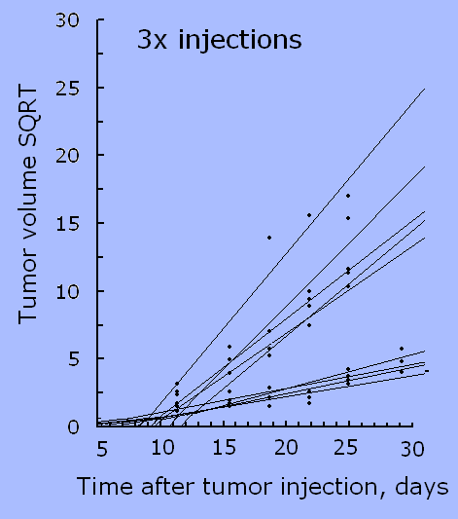
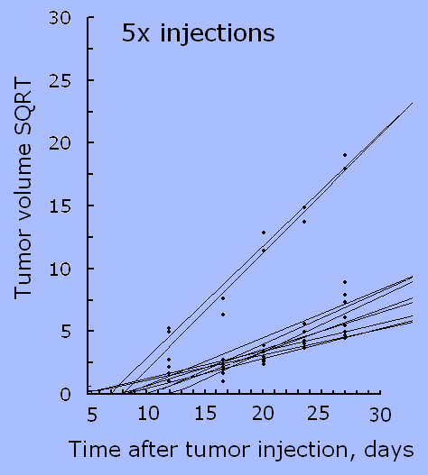
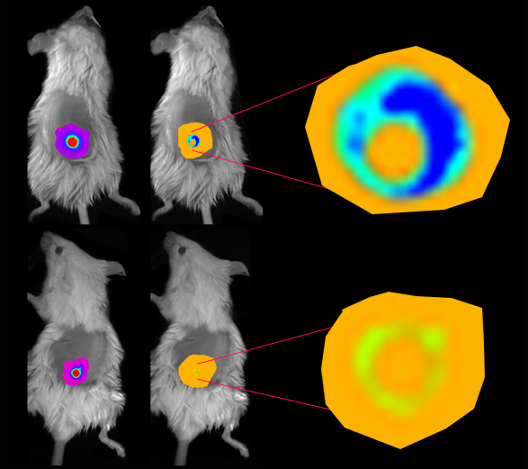
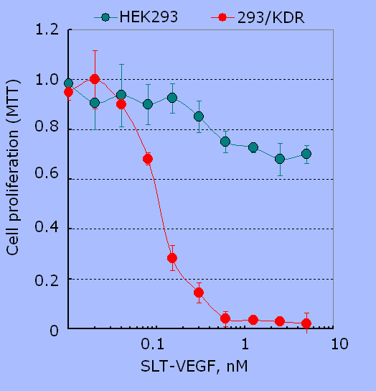
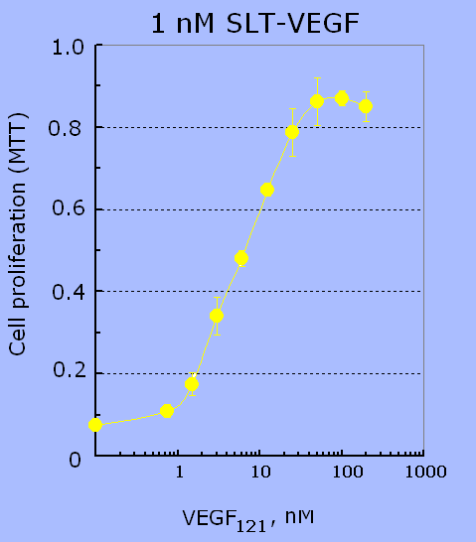
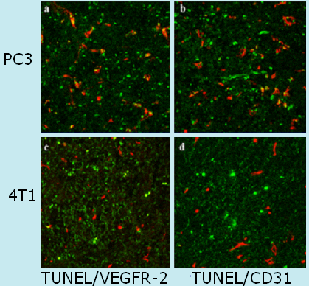
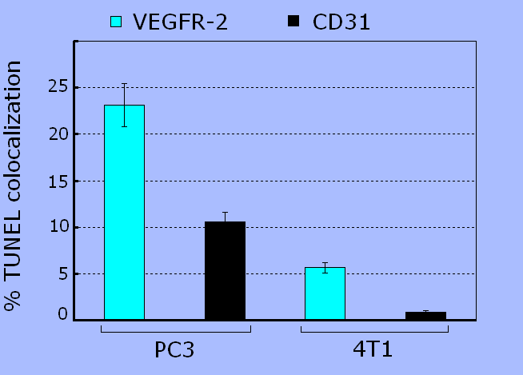
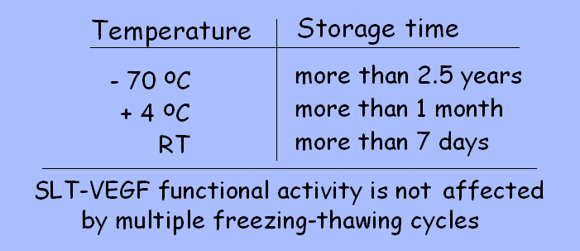
Toxin-VEGF fusion protein inhibits tumor growth
Tao Hu, Carl V. Hamby*, Joseph M. Backer and Marina V. Backer
SibTech, Inc., Newington, CT 06111, USA; *New York Medical College, Valhalla, NY 10595, USA.
Abstract
SLT-VEGF inhibits growth of human prostate PC3 tumor
Systemic SLT-VEGF treatment decreases VEGFR-2 but not CD31 staining. Quantitative Analysis of Scanned Immunostained Sections (QASIS)
Growth of primary tumor and metastatic lesions beyond few millimeters requires neovascularization that combines angiogenesis and vasculogenesis. The critical question in attacking neovascularization is how to target tumor-associated vasculature while sparing the normal quiescent vasculature. Endothelial cells in tumor vasculature overexpress VEGFR-2, a major receptor for vascular endothelial growth factor (VEGF), which is expressed only at low levels in quiescent vasculature. To target only those endothelial cells that overexpress VEGFR-2, we have constructed a novel toxin-VEGF fusion, named SLT-VEGF by fusing the catalytic subunit A of Shiga-like toxin I (SLT) to the 121 amino acid-long splice variant of VEGF.
To obtain an “FDA-friendly” protein, the SLT-VEGF coding sequence was cloned into the pET29a(+) bacterial expression vector carrying a kanamycin resistance gene. The resulting protein contains 293 aa of the full-length SLT subunit A fused to 121 aa of the human VEGF₁₂₁ via a 7-aa linker GTDDDDK. SLT-VEGF is purified from inclusion bodies to >95% purity with a yield of ~5 mg/L. SLT-VEGF selectively kills (IC₅₀ ~0.07 nM) growing endothelial cells overexpressing VEGFR-2, but not quiescent endothelial cells, or cells expressing low levels of VEGFR-2. SLT-VEGF retains full activity after storage for more than 2.5 years at –70 ⁰C, one month at +4 ºC, or seven days at room temperature.
SLT-VEGF activity in vivo was tested using PC3 human prostate tumors in Ncr nu/nu mice and 4T1 mouse mammary carcinoma tumors in Balb/c mice. Mice received 5 or 7 bi-weekly injections of SLT-VEGF, 0.05 mg/kg/injection (1 mg/mouse/injection). This SLT-VEGF treatment significantly inhibited tumor growth in both models while inducing only transient discomfort in mice and a low-titer anti-SLT antibody response. Mice bearing 4T1 tumors were also treated with different SLT-VEGF treatment regimens and tumor growth for every individual mouse was analyzed. By plotting tumor growth rates for individual mice as linear regression curves, responder and non-responder mice could be clearly distinguished in each group. We found that the proportion of mice whose tumors respond to SLT-VEGF treatment increases with an increasing cumulative dose of SLT-VEGF.
To establish the mechanism of SLT-VEGF action, the protein was injected into 4T1 and PC3 tumors that were excised 24 h later, sectioned and stained for apoptotic cells with a TUNEL kit and for markers of endothelial cells, such as VEGFR-2 and CD31. Judging by co-localization of apoptotic and endothelial markers, SLT-VEGF induces apoptosis preferentially in endothelial cells overexpressing VEGFR-2.
We expect that combination of highly potent and selective cytotoxicity in vivo, convenience of “FDA-friendly” production, and excellent stability would make SLT-VEGF a valuable candidate for clinical development.
PC3 human prostate tumors were established by inoculating 5 x10⁶ cells/animal s.c. in the backs of Ncr nu/nu mice. Starting on day 7, mice received s.c. SLT-VEGF injections as indicated. A single 5 µg/mouse s.c. injection inhibited only early tumor growth.
n=15
n=5
n=5
4T1 tumor bearing mice received 5 s.c. injections of 1 μg SLT-VEGF. In each experiment a tumor of a control (PBS injected) mouse and a 2-2.5 fold smaller tumor of SLT-VEGF treated mouse were removed, cut vertically and sagittally, and snap-frozen. Frozen sections of 7 μm were cut serially through ~450 μm of the tumor tissue. Alternative sections were stained for either CD31 or VEGFR-2. Immunostaining was quantitated with QASIS procedure (Quantitative Analysis of Scanned Immunostained Sections) and presented as percentage of the stained pixels in 75-80% of the whole cross-section. The data are average +/- STD for 15-20 sections.
SLT-VEGF inhibits growth of mouse mammary 4T1 tumor
The growth rates of s.c. 4T1 tumors in individual mice (Balb/c) given different treatment regimens are represented by linear regression on the square root of tumor volumes as a function of time. A regression slope of 0.5 was chosen to classify mice in each treatment group as non-responders (slope>0.5) or responders (slope<0.5). By this classification, 3/23 mice receiving only PBS were responders, 1/8 mice receiving a single s.c. injection of 1 µg of SLT-VEGF responded, 4/9 mice receiving 3 s.c. weekly injections of 1 µg SLT-VEGF responded, and 8/10 mice receiving 3 s.c. 1 µg and 2 additional 0.33 µg injections of SLT-VEGF spaced 1 week apart responded.
SLT-VEGF inhibits uptake of VEGF/Cy5.5 by tumor vasculature
SLT-VEGF is selectively toxic for cells over-expressing VEGFR-2
4T1-Luc s.c. tumors were established by inoculating 5 x10³ cells/animal. Starting on day 4 post inoculation mice received two bi-weekly s.c. SLT-VEGF injections, 1 µg/mouse. Control mice were injected with PBS. A proprietary VEGF/Cy5.5 probe was injected i.v. in the tail vein, 7.5 ug/mouse. Five min post VEGF-Cy5.5 injection mice were anesthetized for planar whole-body bioluminescent imaging (BLI) or near-infrared imaging (NIR, 625/700 nm).
For cytotoxicity assay, 293/KDR cells expressing 2.6x10⁶ VEGFR-2 per cell and parental HEK293 cells were plated on 96-well plates, 1000 cells/well. SLT-VEGF was added in triplicate wells 20 hrs later. For competition assay, SLT-VEGF was mixed with varying amounts of VEGF₁₂₁ in complete culture medium and added to 293/KDR cells in triplicate wells to a final SLT-VEGF concentration of 1 nM. Viable cells were determined 96 hrs later by MTT-based assay.
BLI NIR
PBS
injections
2x1µg
SLT-VEGF injections
Intratumoral SLT-VEGF injection induces apoptosis in VEGFR-2 positive cells
Double immunohistostaining. Twenty-four hrs after intratimoral injection of 10 μg SLT-VEGF, PC3 and 4T1 tumors were snap-frozen, cryosectioned and stained for apoptosis (TUNEL-based FITC labeling, green) and for either VEGFR-2 or CD31 followed by visualization with a secondary Alexa-594 coupled antibody (red). The percentages of apoptotic endothelial cells were calculated by dividing the number of cells with colocalized TUNEL/VEGFR-2 or TUNEL/CD31 staining (yellow) by the total number of VEGFR-2 or CD31 positive cells. Five random fields per section were analyzed.
SLT-VEGF is a very robust protein
Conclusions
SLT-VEGF is selectively cytotoxic for VEGFR-2 overexpressing cells.
SLT-VEGF is a very robust protein.
SLT-VEGF inhibits tumor growth in two xenograft mouse models.
SLT-VEGF selectively targets endothelial cells overexpressing VEGFR-2 in tumors
Selective effects of SLT-VEGF on VEGFR-2 positive tumor endothelial cells are established by analyzing multiple histological sections with a novel procedure for quantitative analysis of scanned immunostained sections (QASIS).
Inhibitory effects of SLT-VEGF on tumor angiogenesis are visualized by in vivo optical imaging with a novel VEGF/Cy5.5 probe.
SLT-VEGF is expressed in E.coli at the level of ~5 mg/L with endotoxin varying from 30 to 300 EU/mg. SLT-VEGF retains complete functional activity after prolonged storage under various conditions.

