Slide 1
Glasgow ‘FMD’ model
Spatial stochastic individual-based simulation model of disease transmission and control
SEIR holding-level model using real contact data
Initial outbreak, prior to detection of disease
Movement records are used to locate (potentially) infected premises
Consider both: initial spread and control
Scotland and GB
Mohr et al. (2018, PVM)

Slide 2
Main features
Disease transmission between agricultural premises via
Movements of animals and local spread
Control measures (examination of dangerous contacts, culling of animals on confirmed premises)
Movement restrictions (standstills ->’staying at home’)
Stochastic simulations can be run with various sets of parameters (user-defined, GUI)
Tested for FMD-like parameters and Scottish sheep and cattle movement data

Slide 3
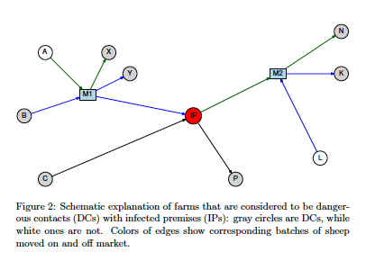
Control strategies
Detection of infectious premises after a certain number of days with clinical signs and
Contact tracing of on- and off-movements to target serological examinations at farms that could have received infected animals.
Notes:
The model assumes that after 7 days of clinical signs a farm would be reported to be infectious, which then would lead to diagnosis and removal (i.e. culled or put under restrictions that will allow for no further spread of infection.
Contact tracing was implemented iteratively, starting with the first confirmed case. Once a farm was confirmed to be an IP, all animals kept on the farm would be culled within 24 hours. Subsequently dangerous contacts (DC) have to be identified and farms that are at risk of infection need to be examined. It was assumed that there would be no pre-emptive culling, only diagnosed farms would be removed. Confirmed IPs were transferred to the (R) compartment and could not infect other farms. To obtain farms that traded livestock with an IP, the contact tracing window was set to 21 days, which is in agreement with current policies in the UK. During the simulations we obtained all on- and off-movements for the IP that occurred within 21 days preceding the identification and: (i) direct contacts were transferred to the investigation queue and examined after 1 day (to simulate latency in contact tracing) (ii) for movements through markets, dangerous markets (i.e. those receiving or sending animals to or from the IP) were identified and all recipients of animals on those days were transferred to the investigation queue and examined after 4 days. Contact tracing procedures were performed iteratively, starting with farms that were diagnosed by clinical signs first. Once the examined farm was confirmed to be infectious, it acquired IP-status and the same procedures were performed for its contacts. For farms that were not infectious, no further contact tracing was triggered.

Slide 4
How to use it
Contact-tracing apps: Individuals / households??
Implemented in Java 7
Graphic user interface (GUI)
Compiled java libraries
Input files (.csv files):
Farms data (i.e. census data including spatial information)
Markets data
Individual contact data (direct movements, transitional movements)
Distance kernels (Green et al., Tildesley et al., Ster et al.)
Output
Epidemic size, (both: locally and through movements)
Epidemic duration
Daily statistics
Adjacency matrix

Slide 5
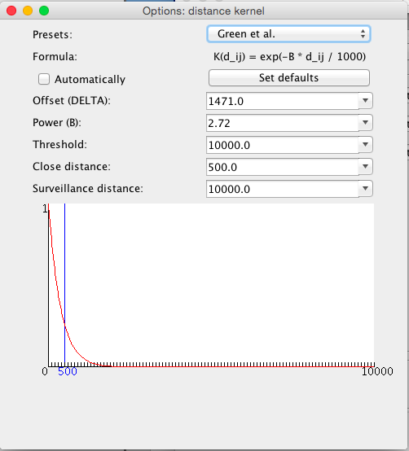
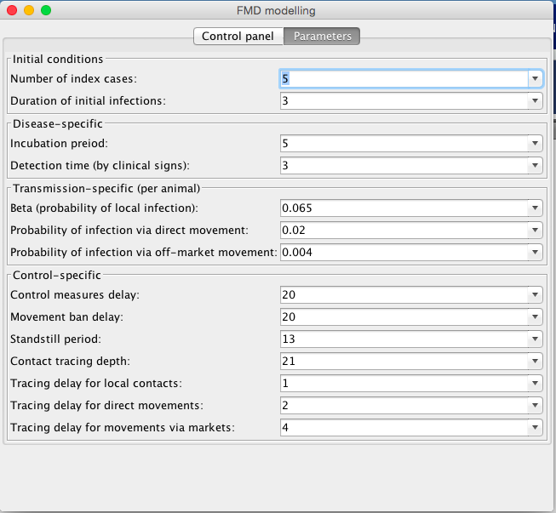
Parameter settings
(b) Dialog window to setup a
specific distance kernel
(a) Main window
Notes:
the total number of infected farms

Slide 6
Strengths & limitations
Advantages:
Cross-platform: Windows, Mac OSX
Parameters can be adapted for COVID-19
Explicitly includes contact tracing / standstills
Limitations of the model:
No vaccination
Fixed values instead of distributions for e.g. incubation period, detection by clinical signs, reporting delays …
Quite slow…
GUI for now
“Reverse” contact tracing

Slide 7
Questions model could address
Efficacy of contact tracing using mobile phone technologies
Uptake and complicance with outputs
Optimal usage of technology, epidemiologically and for compliance eg
Ask alertees to self-isolate for 14 days?
Provide rapid testing of alertees?
Short isolation and test/multiple testing
Practical implications
Whole schools/offices closed at moments notice
Testing infrastructure needed to test all alertees
Is use only practical in conjunction with social distancing?
Might app encourage social distancing to avoid being alerted?

