Slide 1
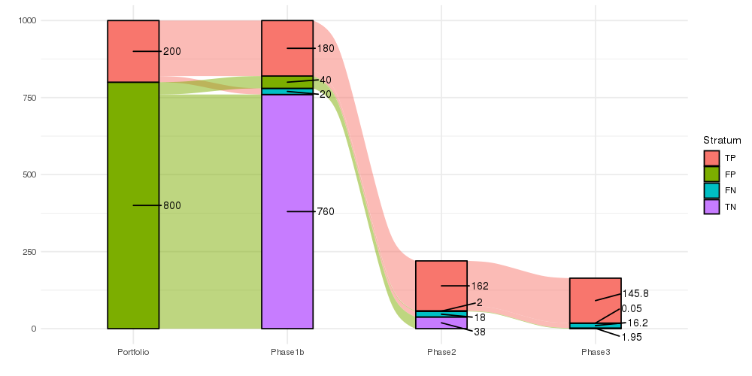
Option 1: ggalluvial
Can add extra annotations
Change colors
Change order of stratum
Add titles

Slide 2
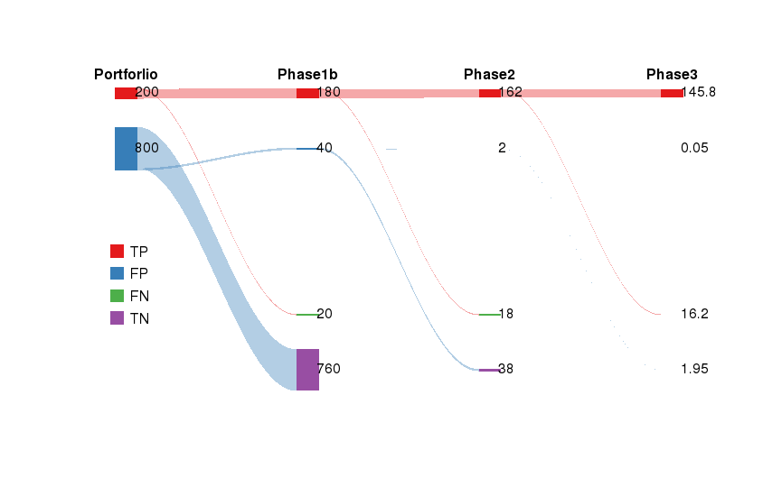
Option 2: riverplot
Can change colors
Can stagger phases
Can add text annotations
Might be able to do a better job scaling

Slide 3
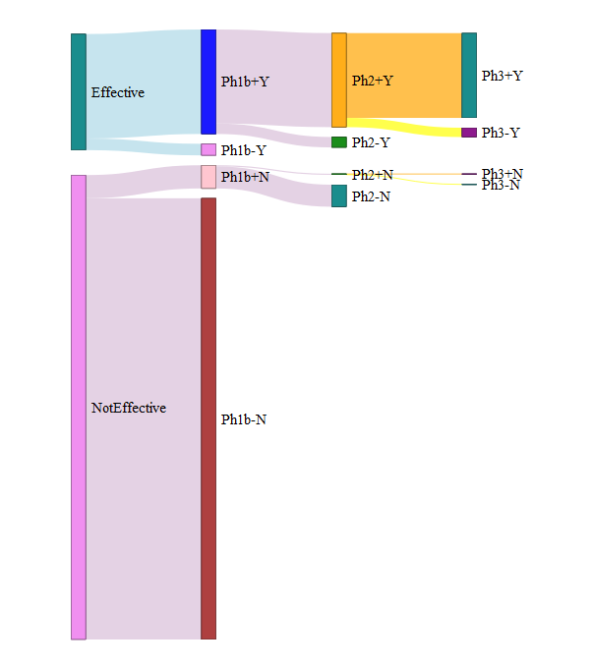
Option 3: networkD3

Slide 4
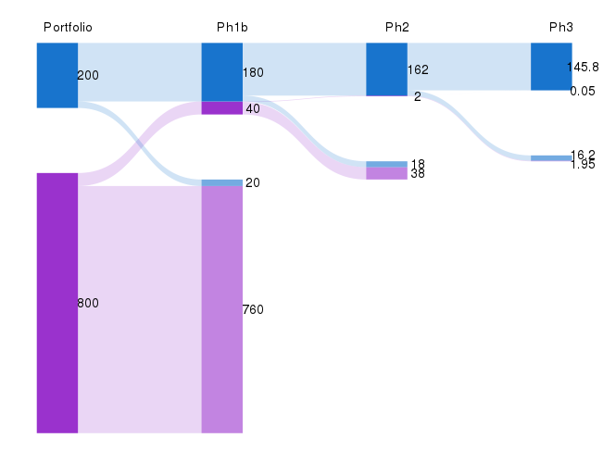
Option 4: ggforce
Can change colors, transparency, position of columns and bars, white spaces
Can add text annotations
(Basically rectangles and stream shapes drawn with coordinates defined by the counts)

Slide 5
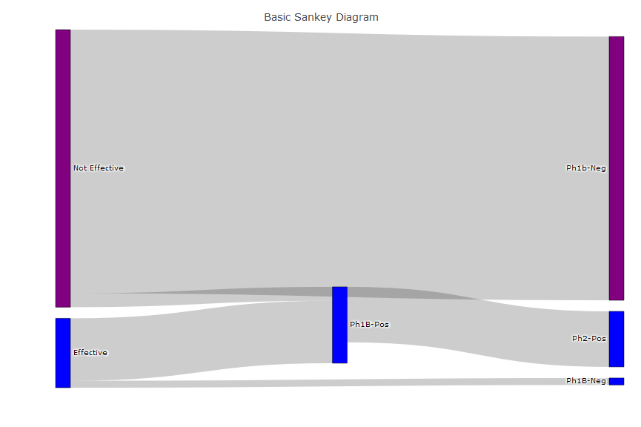
Option 5: plotly
Options 5 and 6 are the best at creating interactive Sankey plots (not shown here,
here they are basically screen shots). So it’s harder to pin the nodes to a fixed location
on the plot.

Slide 6
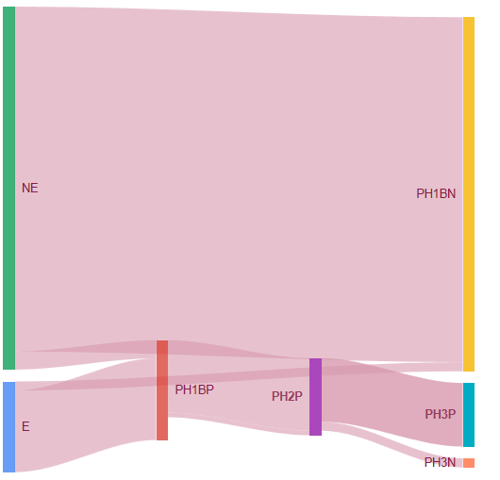
Option 6: googleVis

