Slide 1
Hardware Accelerated Genetic Optimization for PCB Layer Assignment
Heather Berlin & Zachary Zumbo

Slide 2

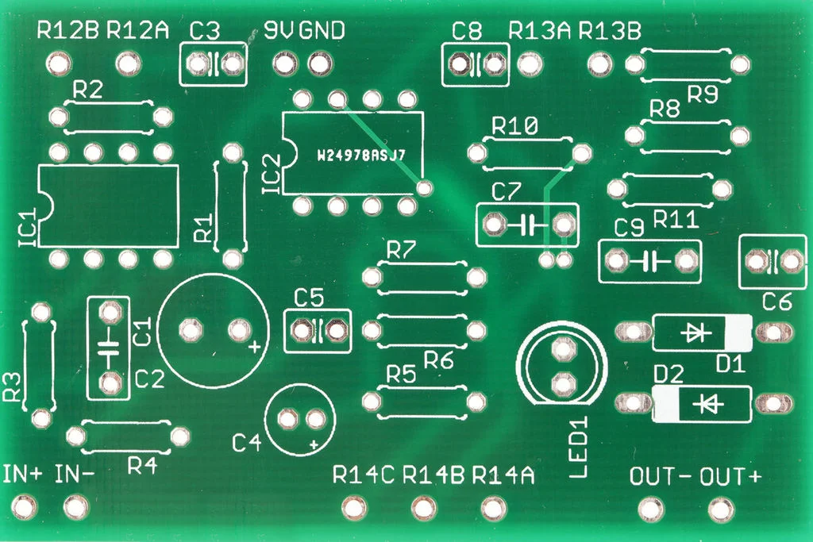

Background
Notes:
Cadence AI/ML for PCB / Package / Chip Synthesis
Goal: E2E automation of the PCB design process
Thesis work -> Evaluate layer assignment techniques

Slide 3
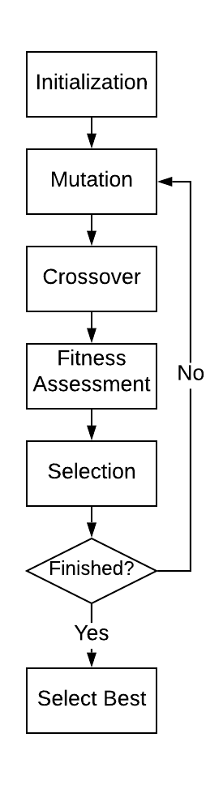
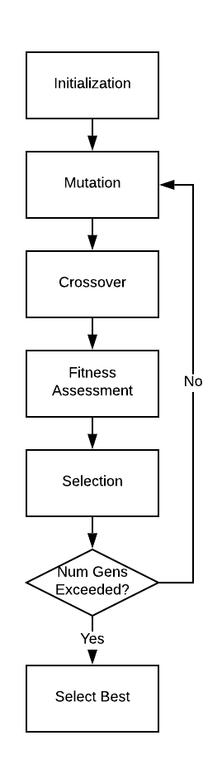
Genetic Optimization Overview
Basic Loop:
Initialize Population (randomly assign gene data)
Mutate the population
Crossover / mate the individuals
Assign a fitness score to each individual
Run tournament selection to determine who lives
If we haven’t finished, repeat 2-5
Else, select the best individual and return it
Notes:
1 generation of genetic optimization

Slide 4
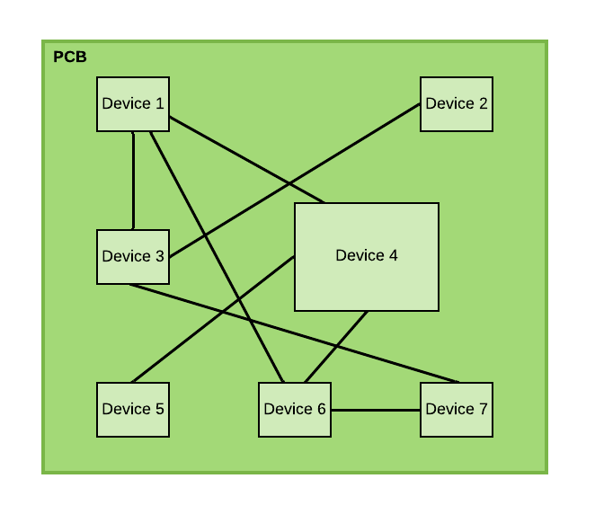
Problem Statement
P&R is hard
Precompute layer assignments
Need routability metric
Metric: # of intersections per layer
How do we best assign layers?
Use Genetic Optimization
Post-placement -- Pre-routing
Connections are logical not physical
Notes:
Placing & routing PCBs is hard
Simplify by precomputing layers for traces (before route)
Routability metric is number of intersections
Fewer intersections per layer the better
Use genetic optimization to precompute

Slide 5
Problem Solution
Modularize GenOpt process in HW
Micro-parallelize for higher performance (RNG)
Intersecting pairs optimization + fitness function implementation:
If two connections intersect assuming they are on same layer, add them to intersecting pairs. Check per-layer intersections for these pairs.
For each intersecting pair <i,j>
if chrom[i] == chrom[j] : fitness += 1
Notes:
How do we actually implement this? Key insights, talk abt int pairs and chrms on next slide

Slide 6
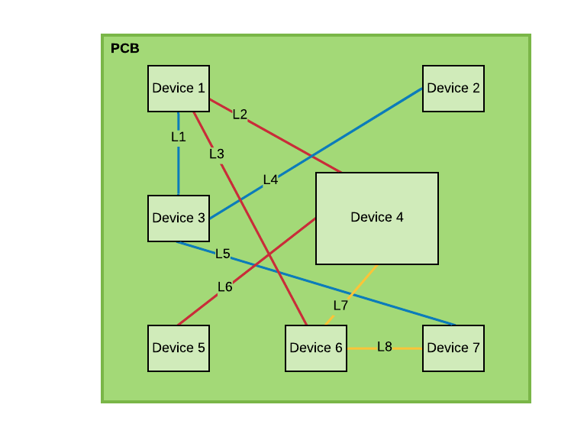
GenOpt Representation + Example
Each gene represents a line segment (connection)
Value of the gene represents its layer on the board
There are 8 lines (L1-L8) and 3 layers (RYB)
Intersecting Pairs
<L2,L4> | <L3,L4> | <L3,L5> | <L3,L6> | <L5,L6> | <L5,L7>
Chromosome
Line: | L1 | L2 | L3 | L4 | L5 | L6 | L7 | L8
Layer: | B | R | R | B | B | R | Y | Y

Slide 7
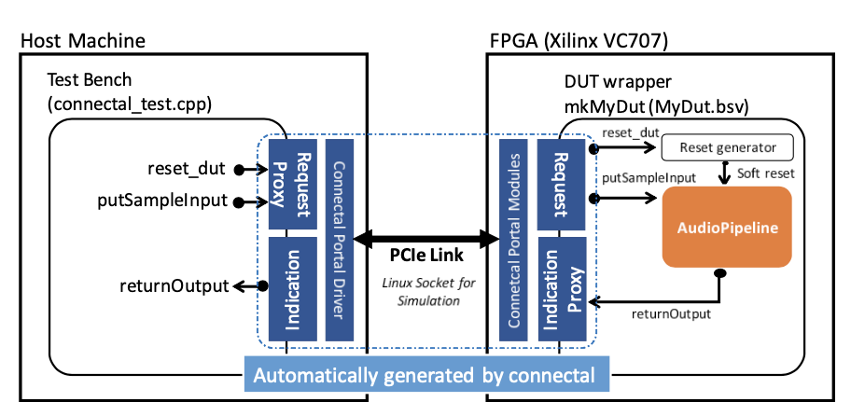
High Level Design
GenOptPipeline

Slide 8
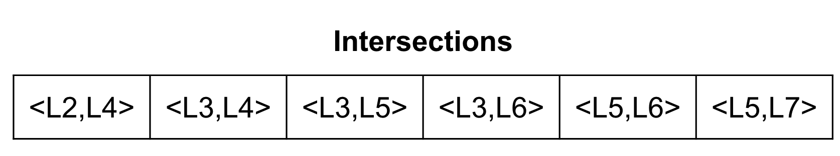
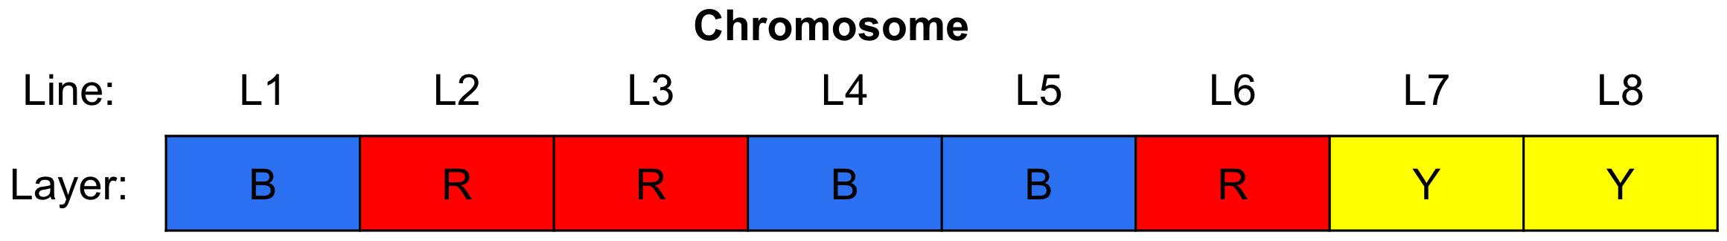
System Overview
POPULATION_SIZE
N_GENERATIONS
TOURNAMENT_SIZE
CROSSOVER_PROB
INDIVIDUAL_MUTATION_PROB
GENE_MUTATION_PROB
IntersectingPairs.bin
Genetic optimization pipeline
Out.positions
Notes:
Intersections are stored in a binary file, which is connectal opens and passes to Bluespec
The arguments on the upper right are user-specified parameters to customize the genetic optimization process

Slide 9
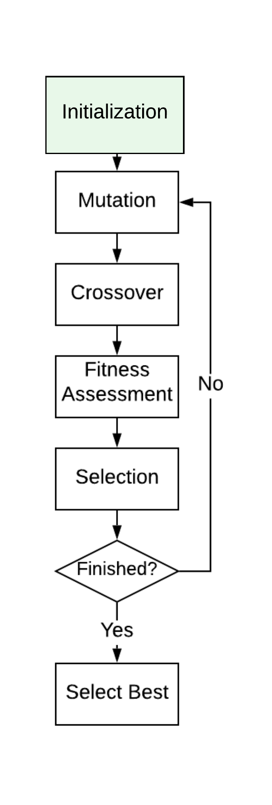
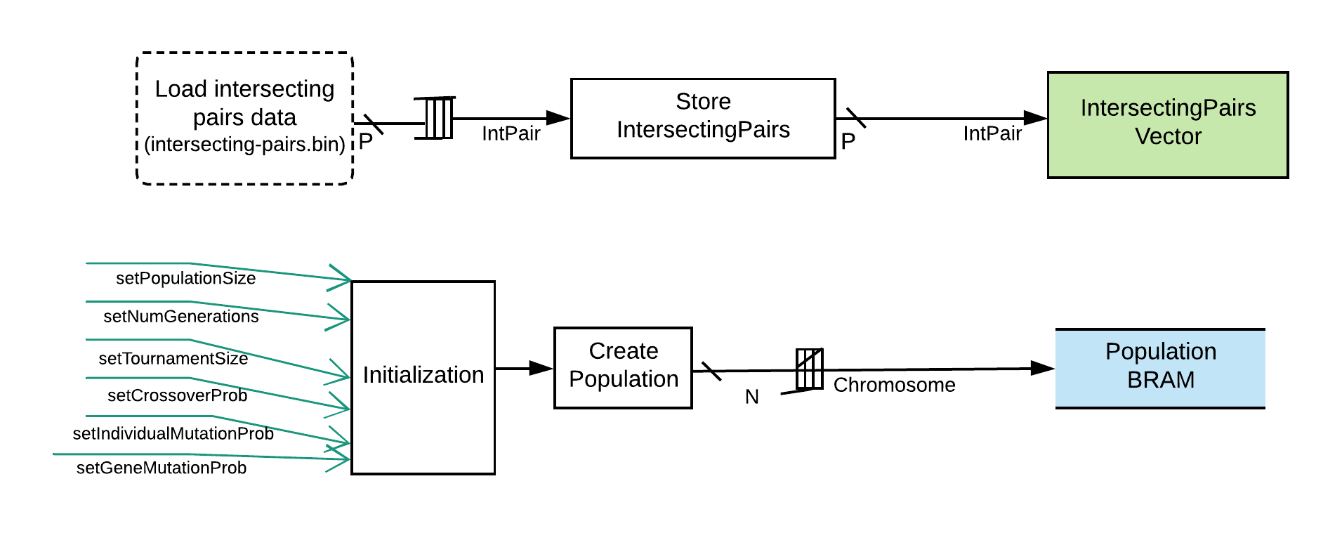
Initialization
connectal$ NGENS=10 POPSIZE=50 TOURNSIZE=10 CXPB=0.7 INDPB=0.4 MUTPB=0.2 make run_simulation
Notes:
pairs of line segments that overlap if placed on the same layer in the PCB board

Slide 10

The population is stored in BRAM
Recall: each chromosome in the population specifies placements for the line segments on the PCB board
N = population size (e.g. 50)
L = number of layers on the PCB (e.g. 8)
M = number of line segments (e.g. 100)
Size of populationBRAM
1 word in BRAM = 1 chromosome
Bits:
Entire population in BRAM:
Bits:
For a population of size N=50, M=100 lines, and L=8 levels,
populationBRAM uses 1.875kb
Notes:
With a population size of 50, our population consists of 50 chromosomes
1 chromosome corresponds to 1 word in BRAM
In this

Slide 11
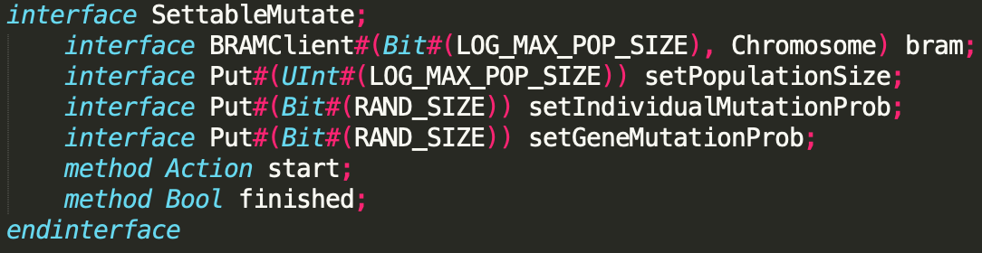
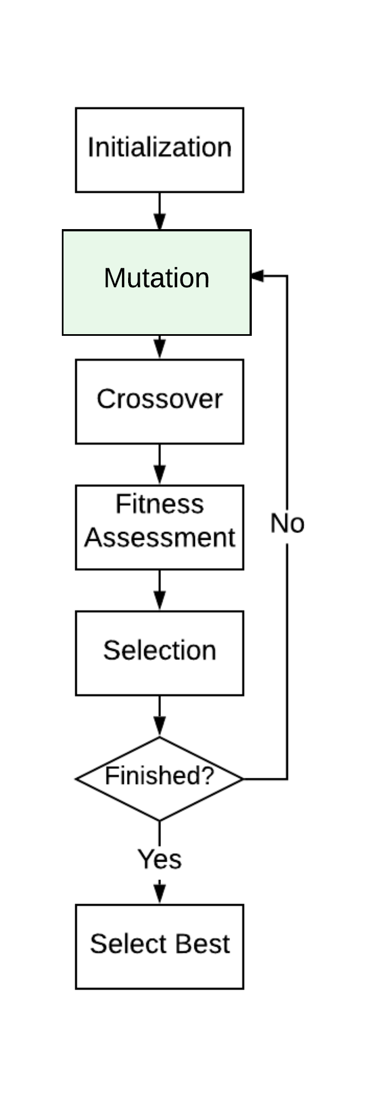
Mutation
We randomly mutate chromosomes in the population with probability mutpb.
For chromosomes to mutate, we mutate each gene with probability indpb

Slide 12
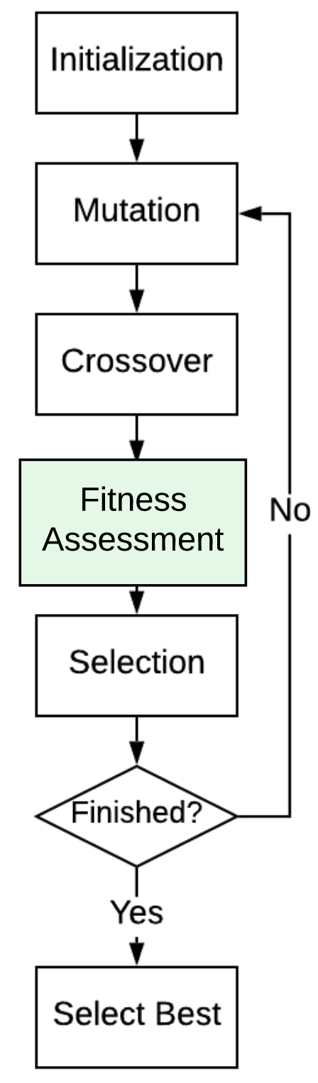
Fitness
Fitness is defined as the number of overlapping line segments in the line segment placement specified by a chromosome
The fitness of this chromosome is 1, because lines L3 and L6 overlap in this line segment placement.

Slide 13
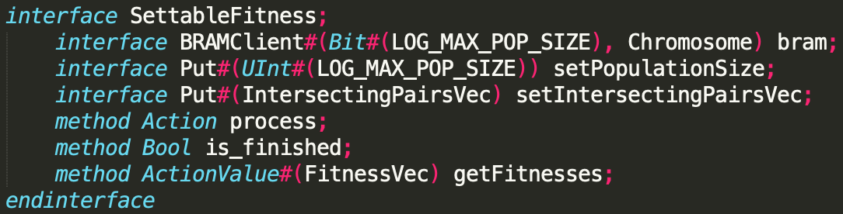
Fitness
Fitness is defined as the number of overlapping line segments in the line segment placement specified by a chromosome
The fitness of this chromosome is 1, because lines L3 and L6 overlap in this line segment placement.

Slide 14
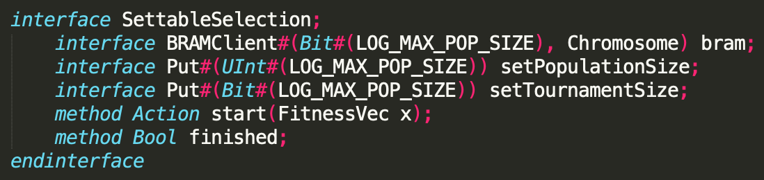
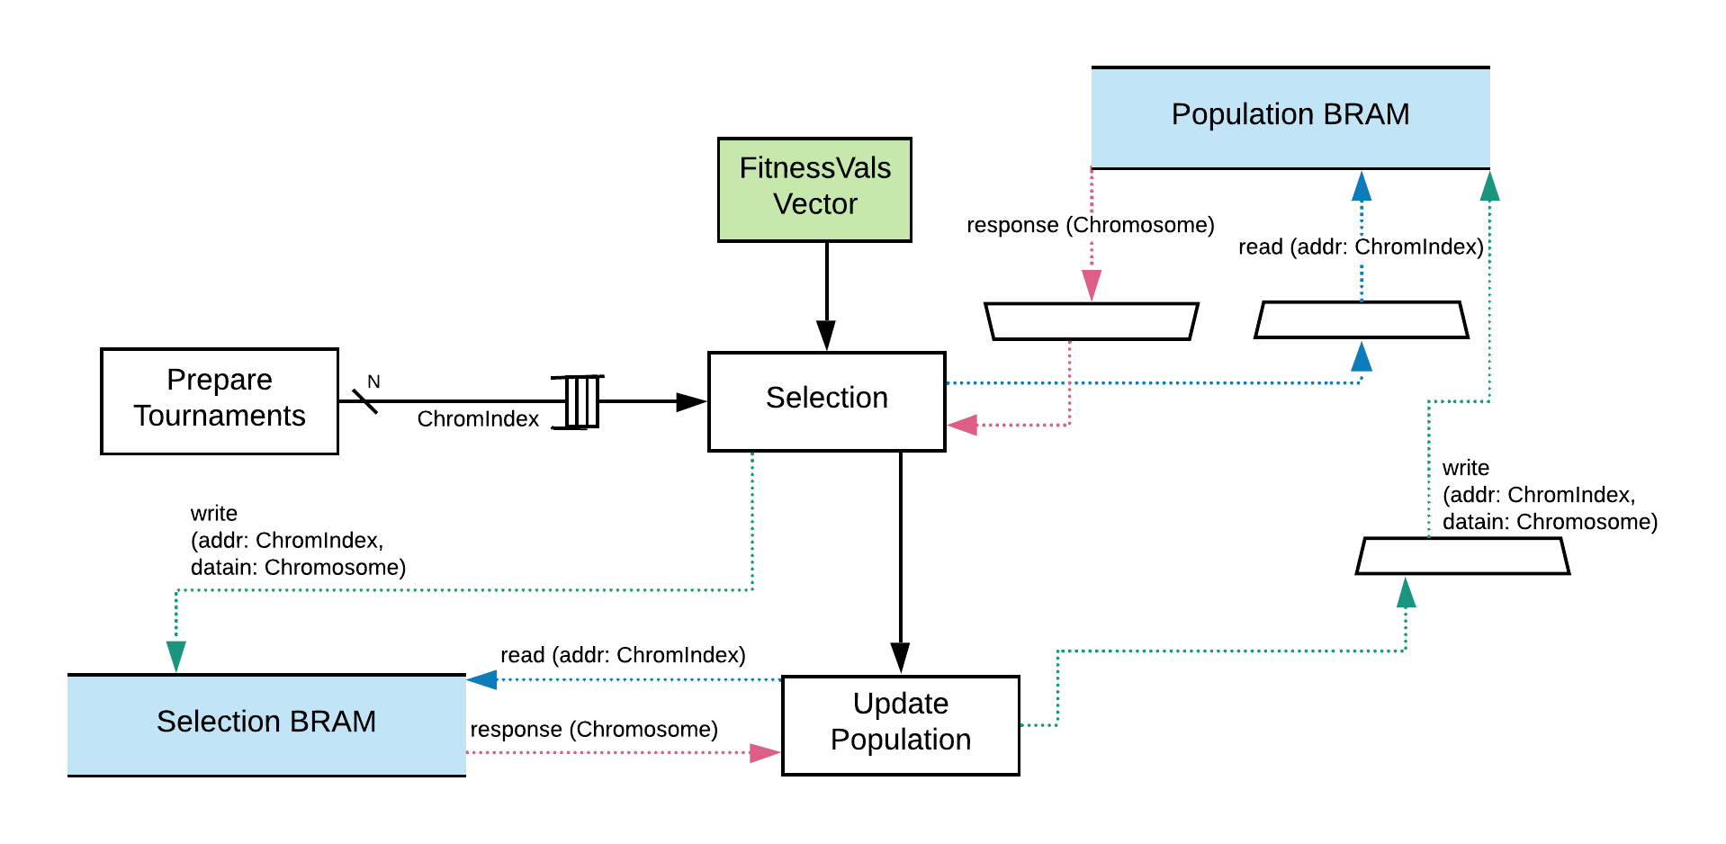
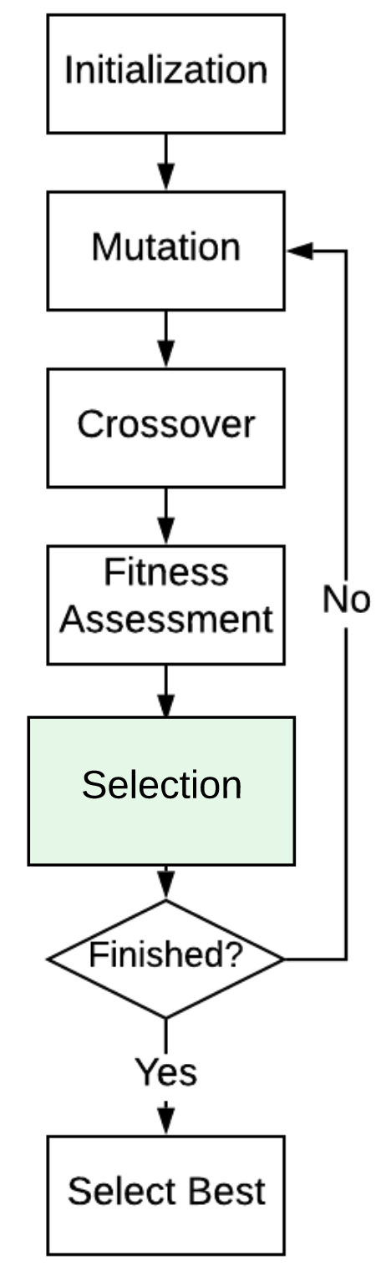
Selection
We select chromosomes with the best (i.e. lowest) fitness values
Notes:
N total tournaments each of size T: each tournament contains T ChromIndex values as entries (each ChromIndex uses log2(N) bits).

Slide 15
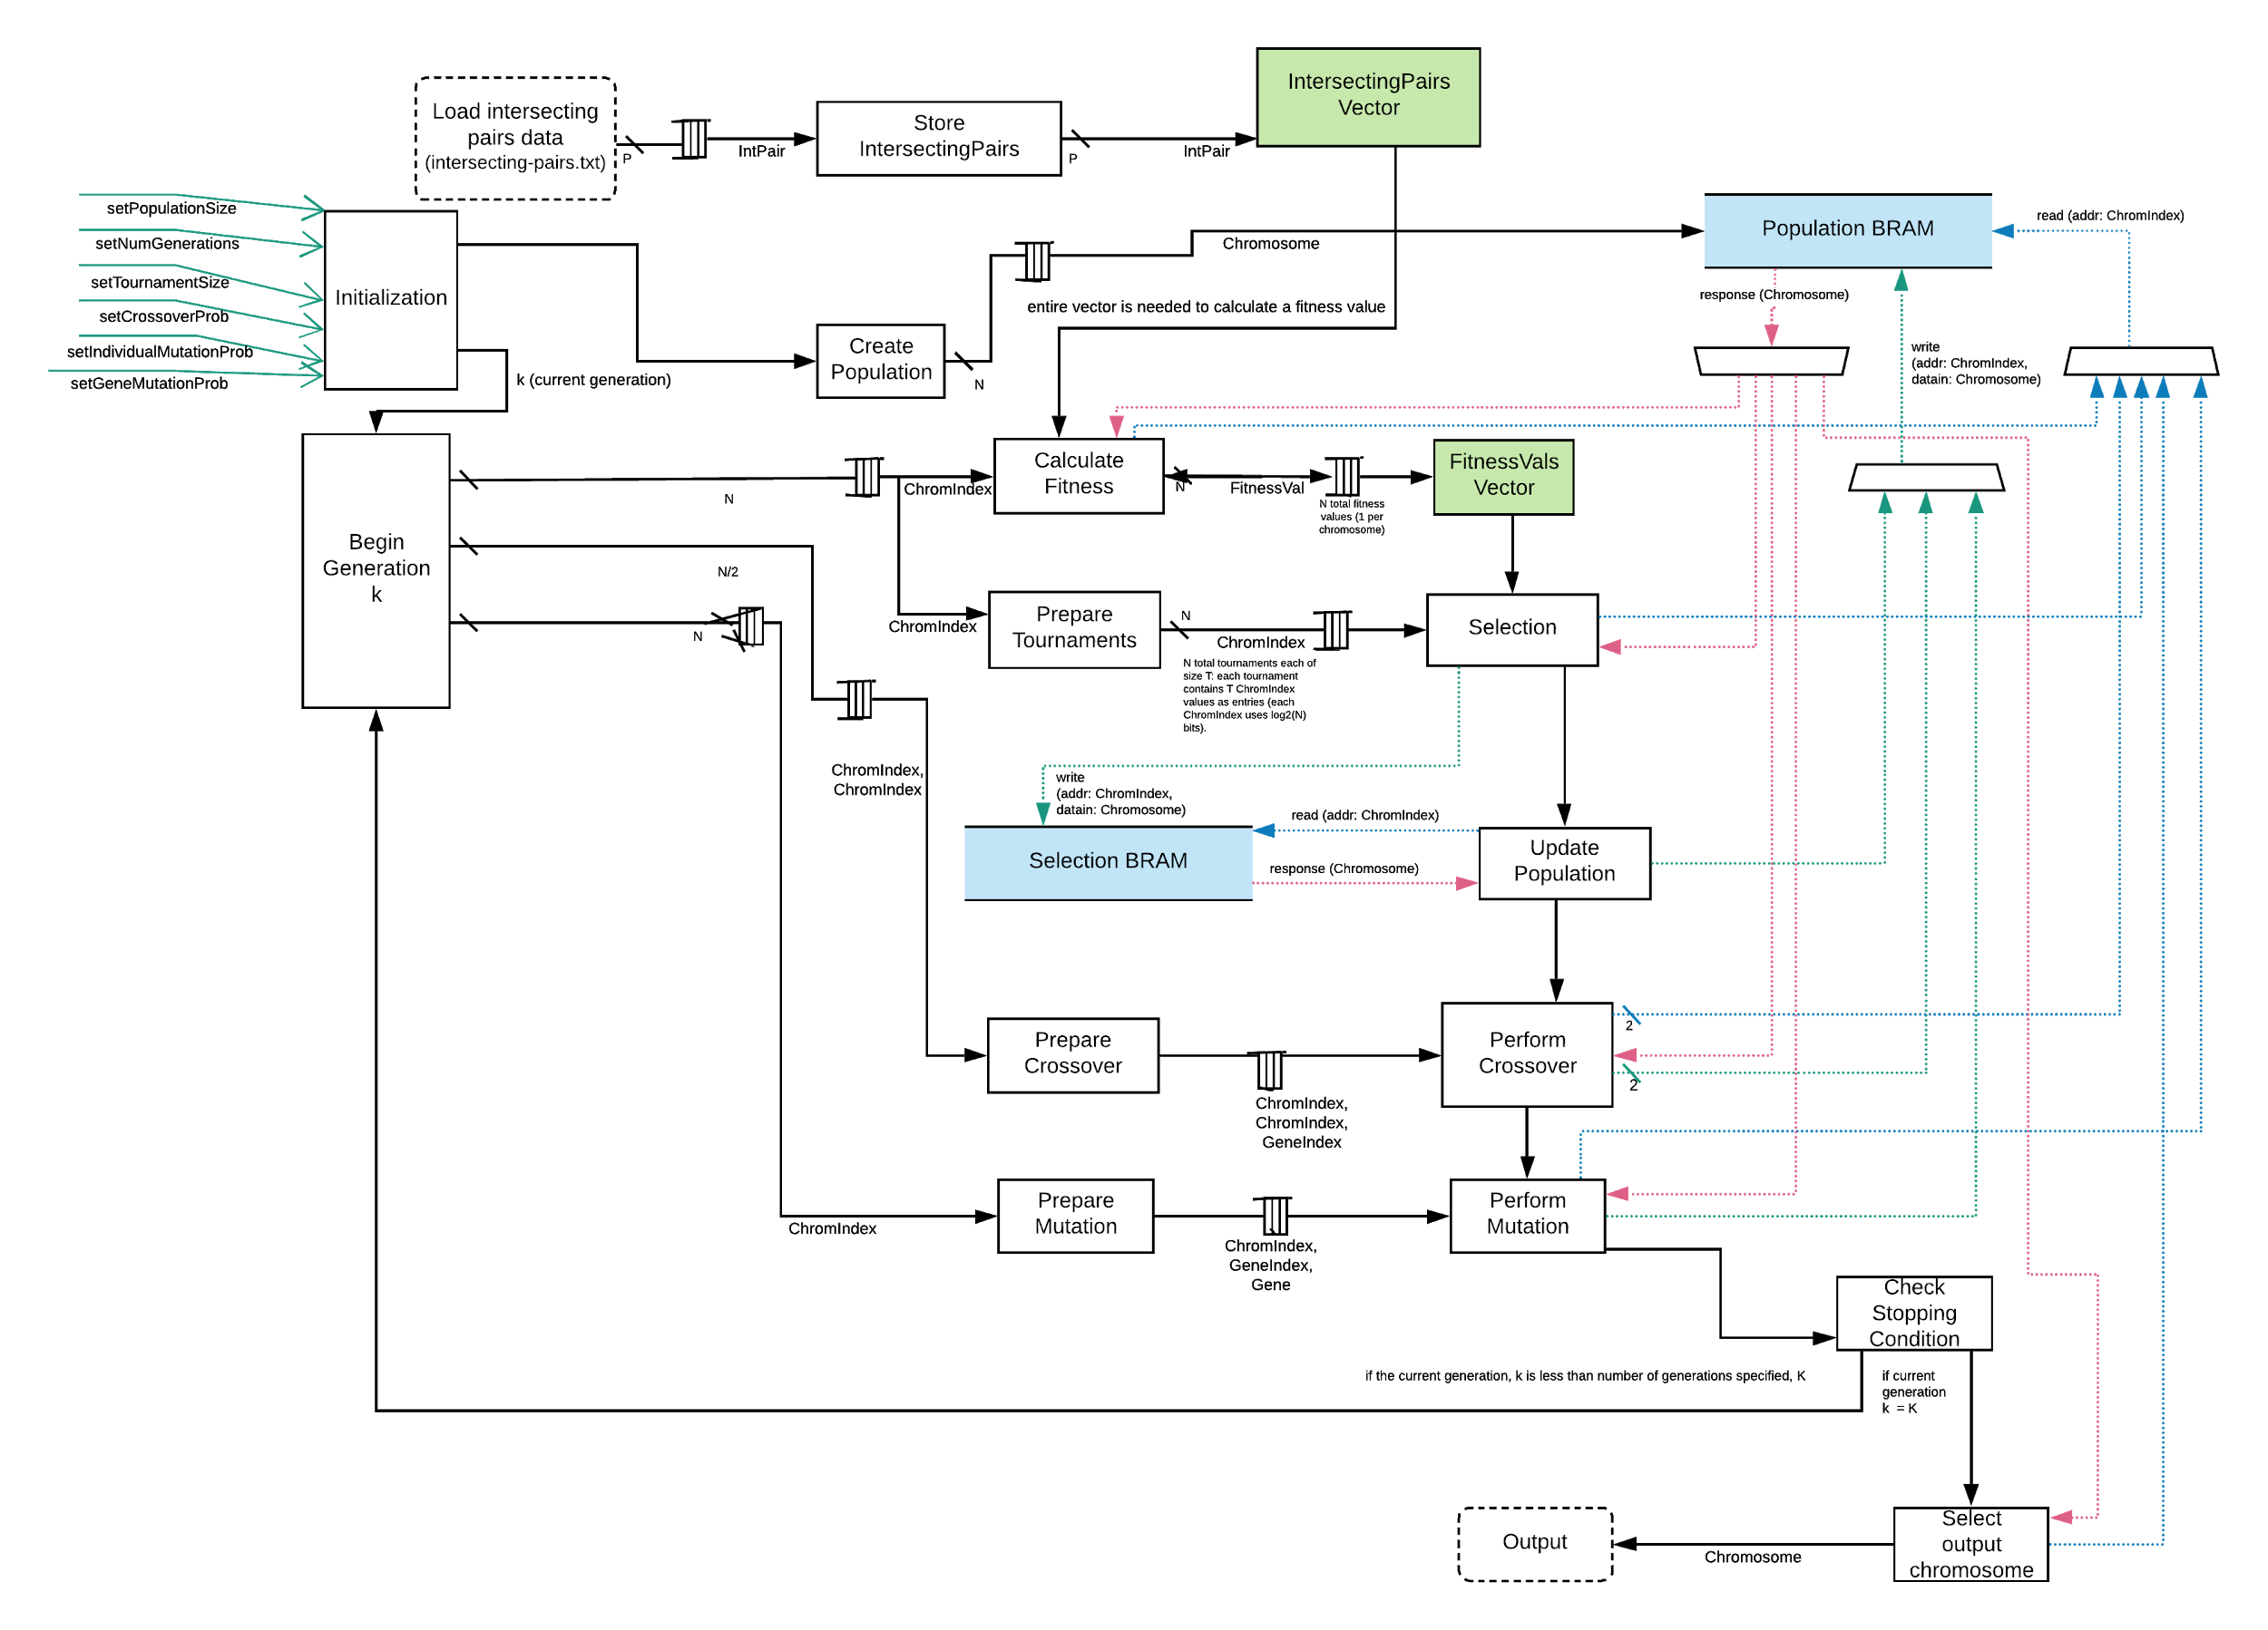

Slide 16
Challenges Faced
Sharing BRAM between modules
Loading intersecting pairs
Transferring information between module-specific BRAM and shared BRAM
Communicating with connectal
Deadlocks
Random number generators

Slide 17
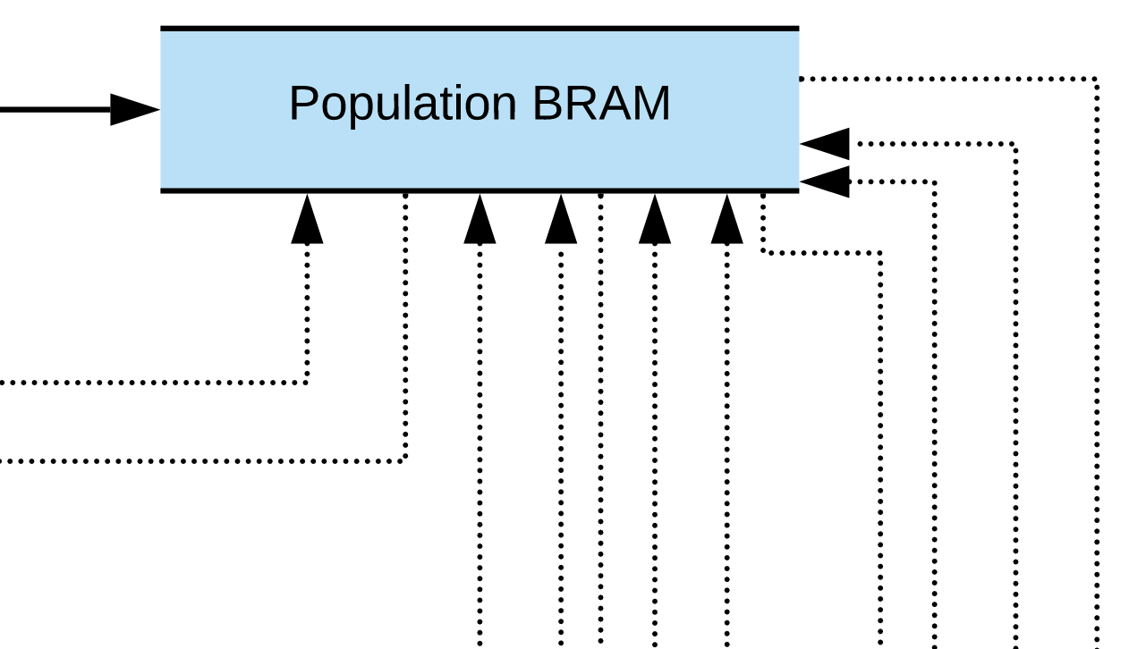
Challenge: sharing BRAM between modules
Notes:
Solution:
Population BRAM needed to be shared between F
Use a vector of BRAMClients for modules to send/receive information from the shared BRAM.
Multiple modules need to send and receive information from the population BRAM, but BRAM needs to know which module to send the responses to

Slide 18
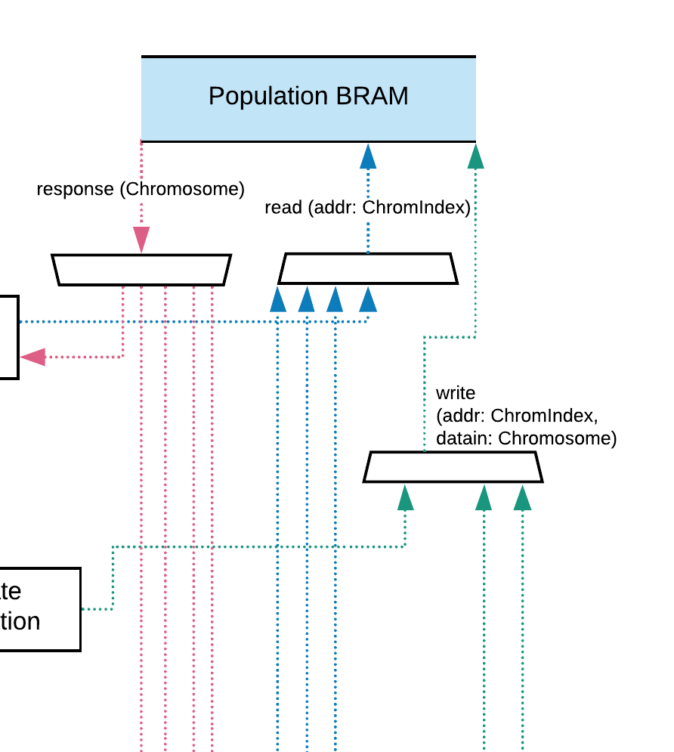
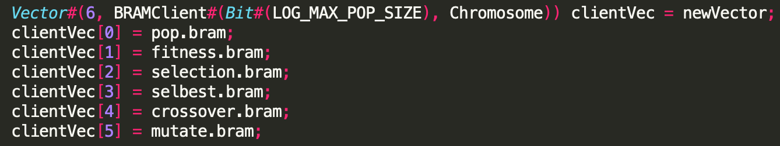
Challenge: sharing BRAM between modules
Approach:
use a BRAMClient Vector
Notes:
Use a vector of BRAMClients for modules to send/receive information from the shared BRAM.

Slide 19
Challenge: BRAM deadlock
Approach:
Only add the BRAMClient id (0,1,2,3,4 or 5) to the BRAM’s response FIFO if the BRAM request isn’t a write
Notes:
…. But why are responses stalling?
Solution: Only add the BRAMClient id the response FIFO if the BRAM request is not a write!!!!

Slide 20
Project Results
For 100 connections, 50 intersecting pairs, a population size of 100 and 100 generations:
FPGA: 28009 cycles * (17 ns / cycle) = 4.8*10⁻⁴ sec
CPU (Single Core): 1.99 sec
Roughly 4000x speed improvement

Slide 21
Potential Future Work
Fully Parallelize Fitness Function
Add support for larger populations + board designs

Slide 22
Thank you!
Q & A

